Slide 1




FUTURE and REALITY of GAMING [FR0G] VIENNA 2021
Doris C. Rusch, Ph.D.
Professor of Game Design, Uppsala University
Deputy Head of Department of Game Design
Uppsala University, Gotland, Sweden
Andrew M. Phelps
Professor of Human Interface Technology, College of Engineering, University of Canterbury, NZ
Professor of Media Arts & Sciences, School of Communication, American University, USA
Professor of Computer Science, College of Arts & Sciences, American University, USA
Visiting Professor, Department of Game Design, Uppsala University, Gotland, Sweden
Director, American University Game Center
President, Higher Education Video Game Alliance

Slide 2
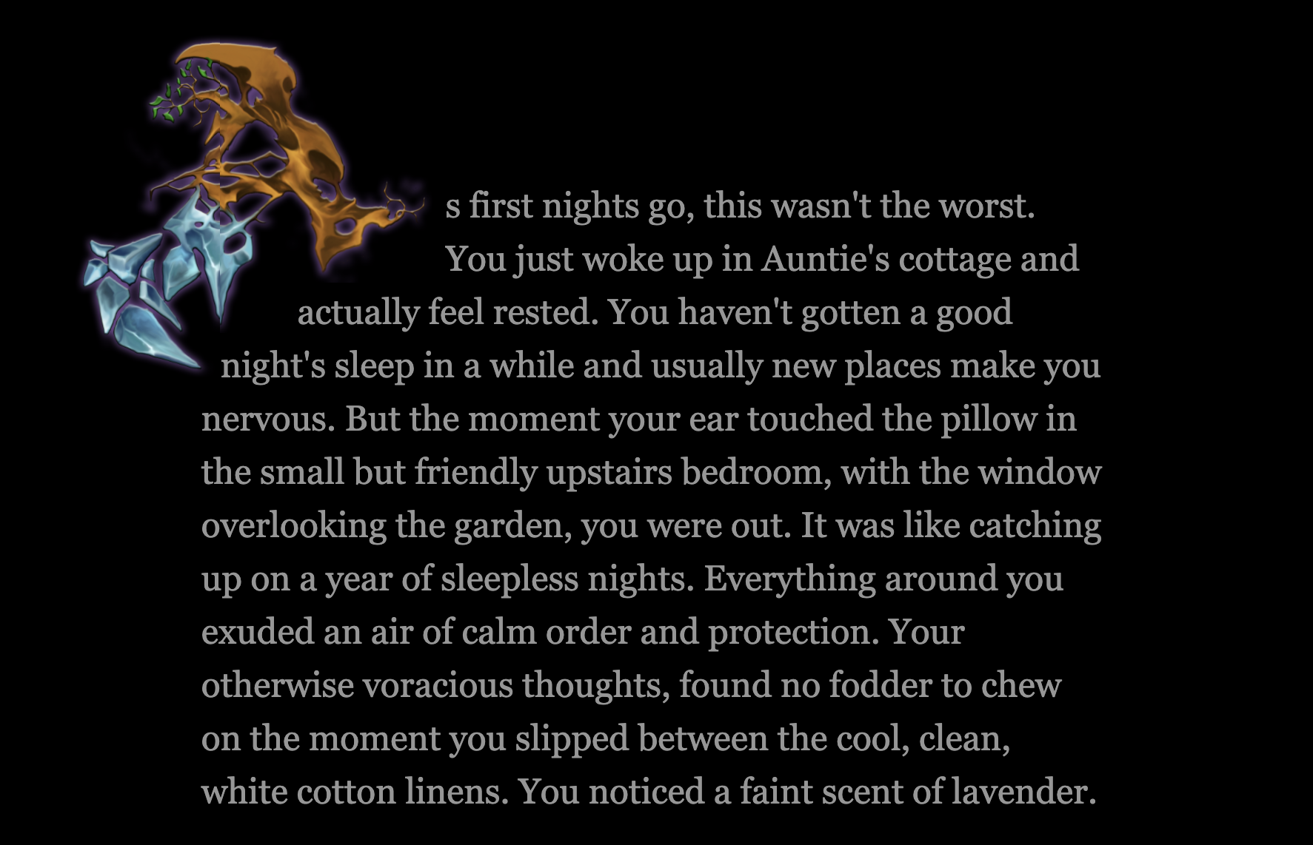

Slide 3
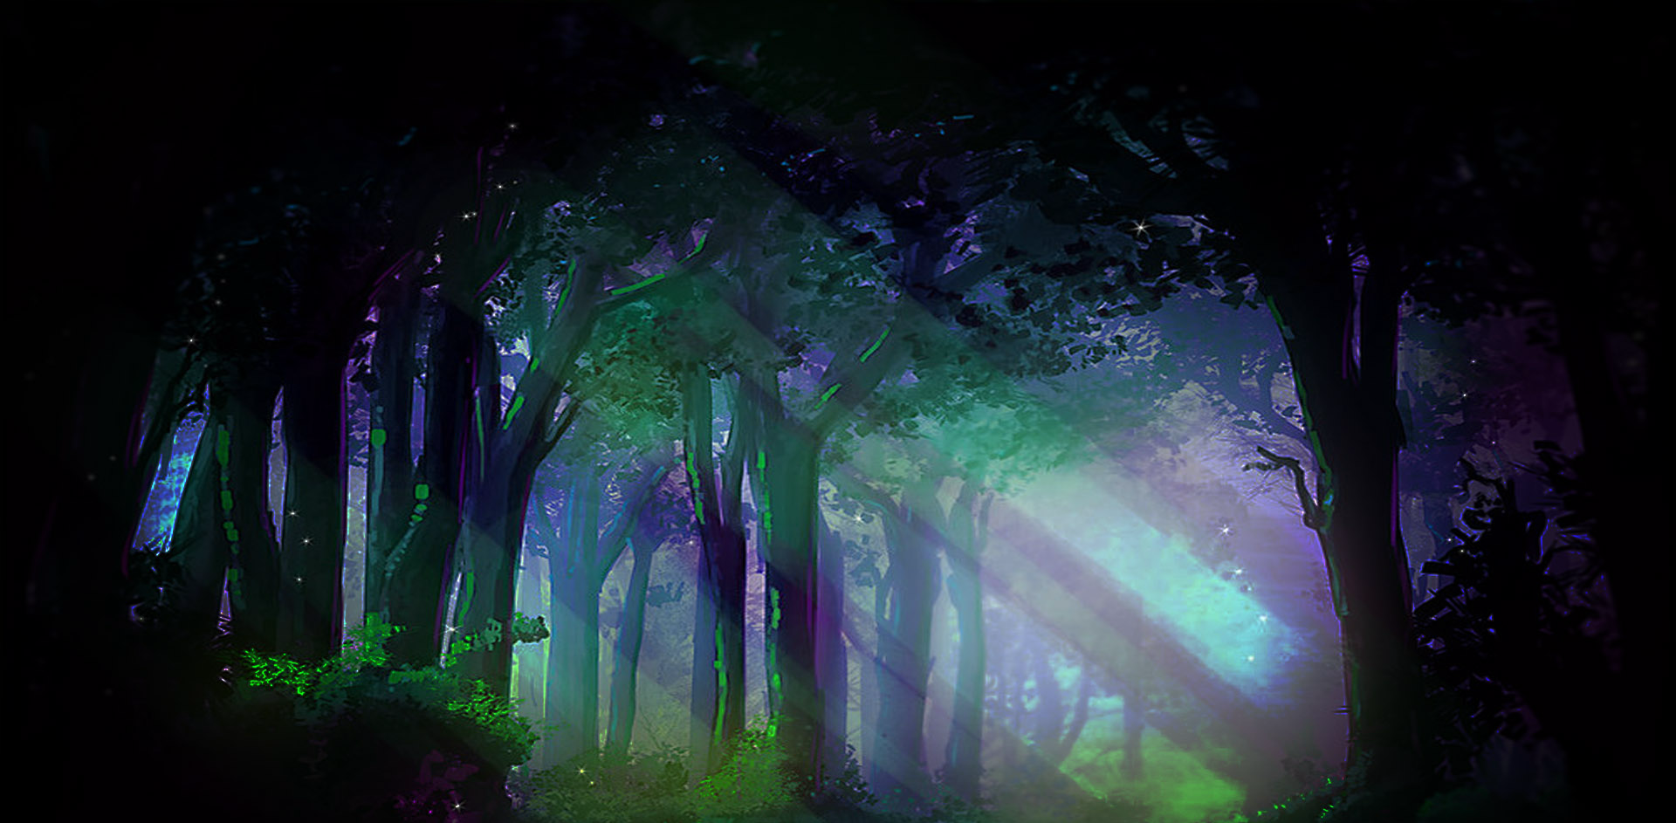
Notes:
So begins the transformative adventure game The Witch’s Way, in which you play a middle-aged woman named Lou, who decides to take a time out from her busy and outwardly successful but inwardly unfulfilled life, and move to the cottage in the woods her aunt has left her. There, she establishes contact with nature, the Unknown Forest behind the cottage, and the mysterious beings that dwell within it. Guided by animal spirits, a wise and quirky bookshelf and her aunt’s magical clues, Lou learns about the Witch’s Way and how to live in greater alignment with herself and the world around her. Conceptualized in four seasons, the first part – Spring – is ready for release and the basis for this paper. It focuses on the re-awakening of creativity through three technologies of magic: Wordlessness, Oneness and Imagination. (Martha Beck, 2012)

Slide 4

Existential Transformative Game Design Framework
Designing Games that contribute to a Meaningful Life by addressing the
Givens of Existence: Death, Purpose, Freedom, Isolation (Yalom, 1980)

Slide 5
“Viewed from an existential perspective, the good life is an authentic life, a life in which we are as fully in harmony as we can be. Inauthenticity is illness, is living in distorted relationship to our true being.”
–James Bugental, “The art of the psychotherapist”, p.246

Slide 6
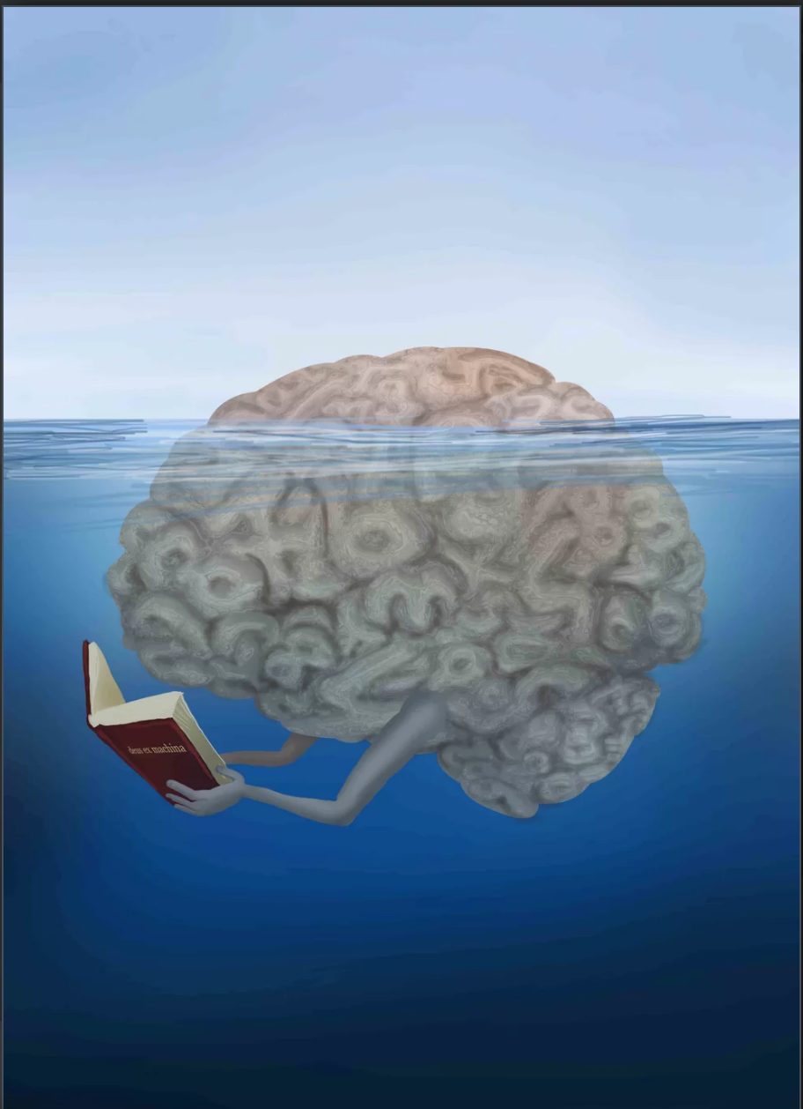
Conscious Self / Social Self
Unconscious Self / Essential Self
Notes:
Martha Beck speaks of the Social Self and the Essential Self. The social self is the self that was developed to respond to the demands and requirements of the world around us (or key figures in that world). The essential self is who we truly are at our core - what we are intrinsically motivated to do; what lights us up and brings us joy.

Slide 7
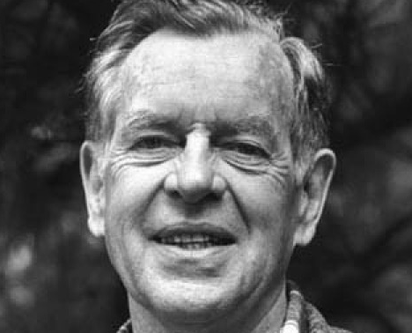
“Pathways to Bliss”
“that deep sense of being present, of doing what you absolutely must do to be yourself.”
Your bliss can guide you to the transcendent mystery, because bliss is the welling up of the transcendent wisdom within you. So when the bliss cuts off, you know you’ve cut off the welling up; try to find it again. And that will be your Hermes Guide. The dog that can follow the invisible trail for you.” (p.xxiv)
Joseph Campbell

Slide 8
Conscious Self / Social Self
Myth
Imagery
Symbolism
Metaphor
Unconscious Self / Essential Self

Slide 9
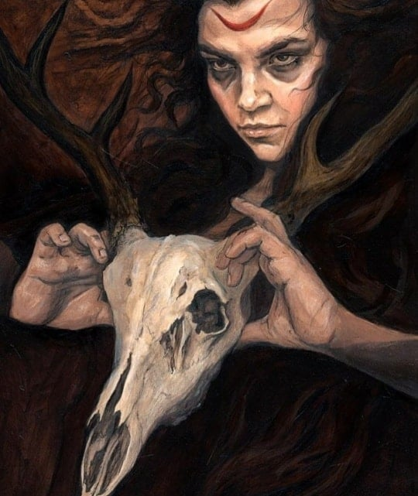

The Witch: archetype of the successful deviant
“They are afraid, for they think: if we cannot survive without our order, how can she survive in solitude? Hers must indeed be a very powerful order to exist so independently, without all the intercooperation and individual compromise which we have to go through to survive.” (Maya Deren, 1947, p.34)

Slide 10

The Witch’s Way is about the Magic inherent in an authentic life,
a life in which we are in alignment with our True Nature and
follow our bliss, purpose and sense of inner calling.

Slide 11
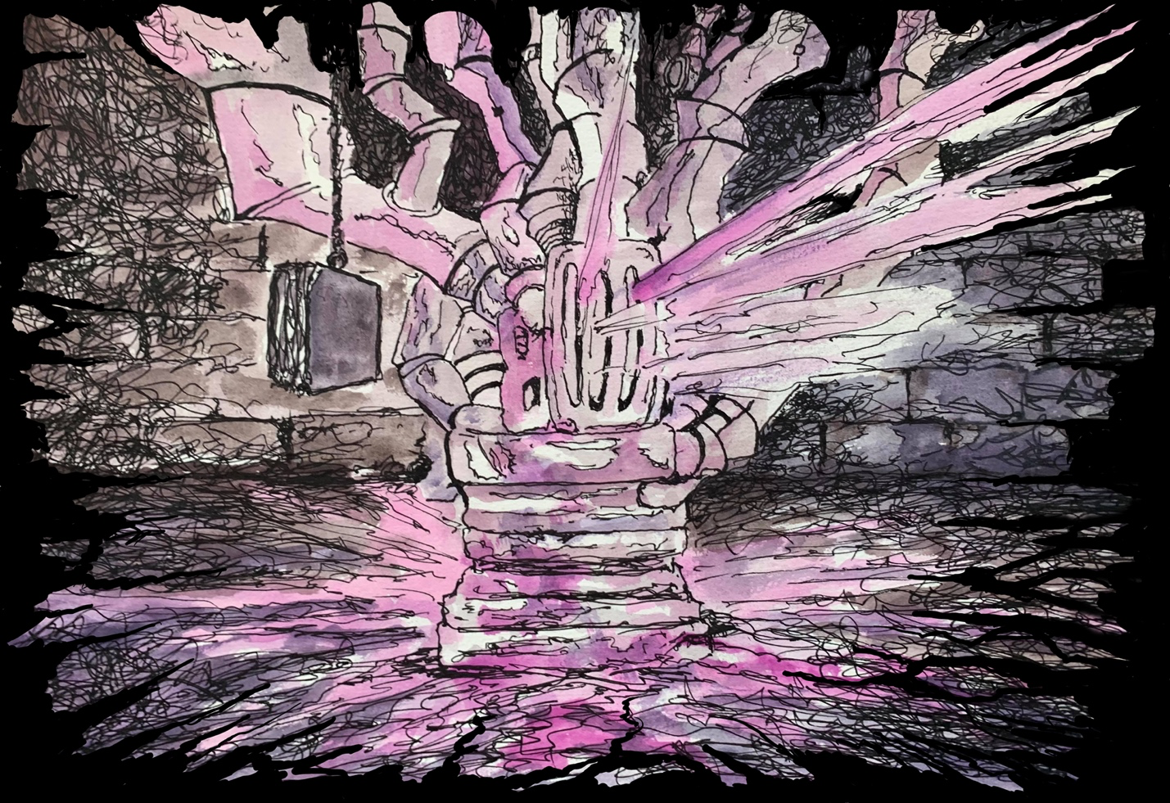
Notes:
The Thaum Pump as the ultimate challenge to wield one’s inner power by finding harmony and balance

Slide 12
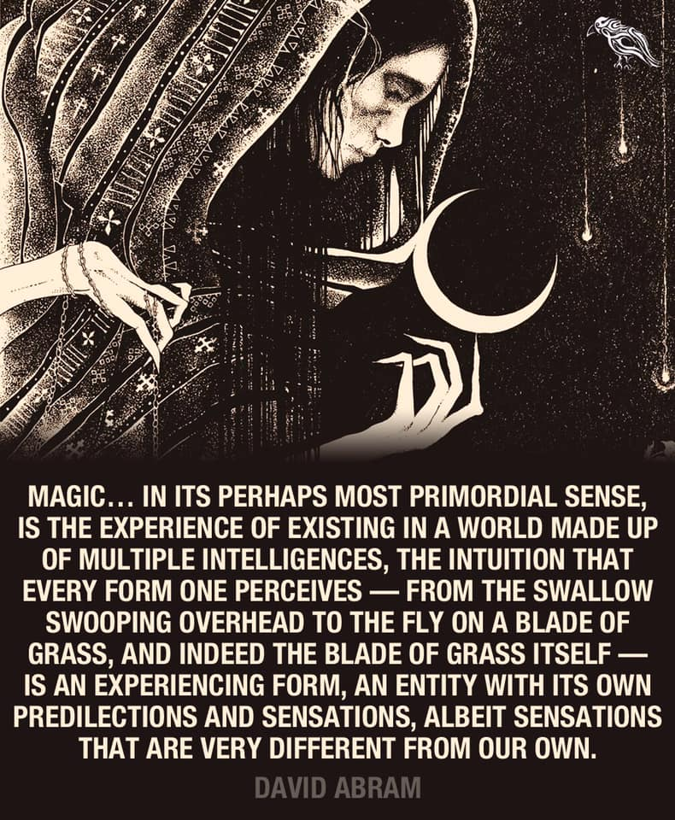

Slide 13
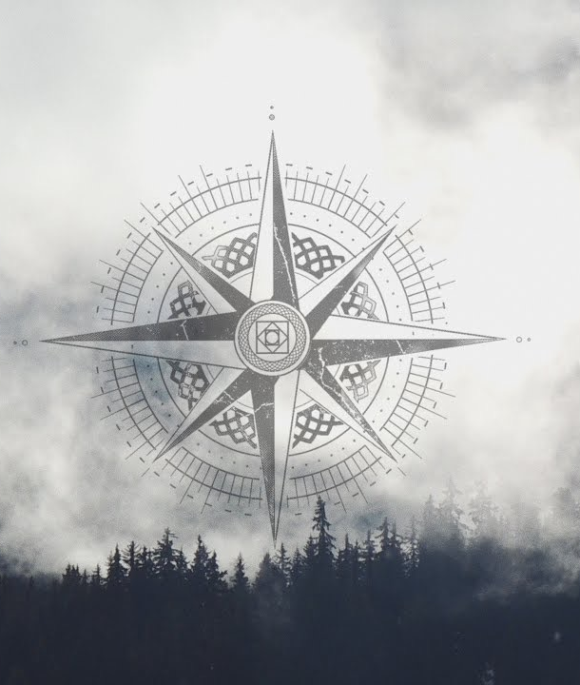
4 Technologies of Magic
Oneness
Wordlessness
Imagination
Forming
(Martha Beck, “Finding Your Way in a Brave New World”)

Slide 14
Wayfinders (Wade Davis)
“The science and art of navigation is holistic. (…) You only know where you are going by knowing precisely where you have been and how you got where you are.” (p.60)

Slide 15
Wayfinders (Wade Davis)
“Navigators do not sleep. They remain monk-like, undisturbed by the crew, with no mundane tasks to perform, sitting alone on a special perch at the stern of the vessel, tracking with their minds.
If you can read the Ocean, if you can see the island in your mind, you will never get lost.” (p.61)

Slide 16
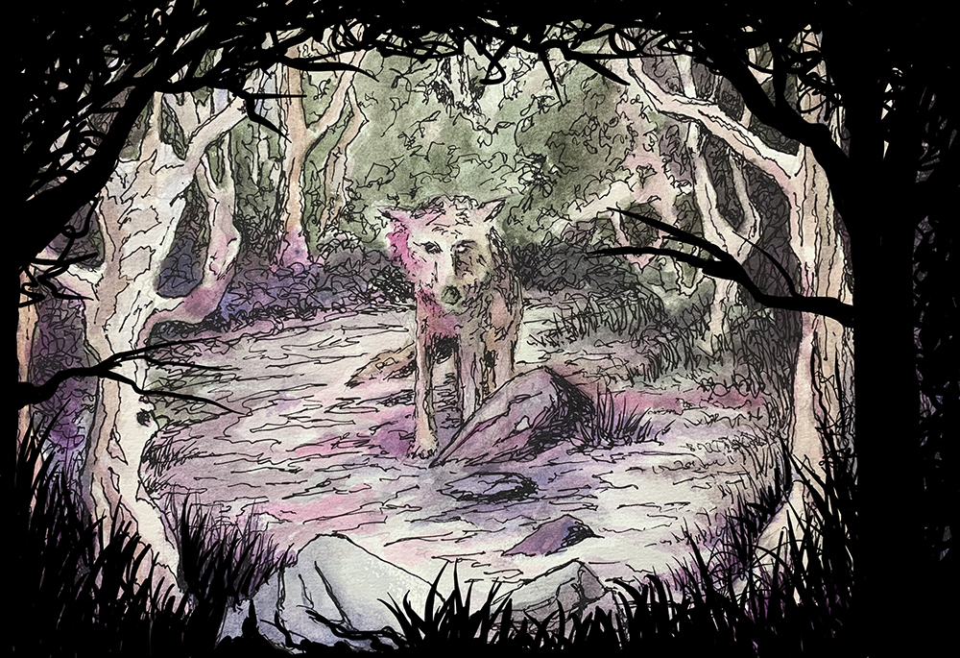
DOG: the Guardian of your Mind’s “Island"
Notes:
the instinctual self
pure experience
presence
playfulness
Wordlessness
Connectedness / Oneness
Beyond the linearity of time
DOG is the inner wayfinder who holds the image of the island in mind, always. But if you ignore him long enough and get distracted by the noise from the “crew on your ship”, you lose connection with him and you lose your way

Slide 17

liberation from the illusionary dungeon

Slide 18
The Bigger Picture:
Games that contribute to a meaningful life
Beyond the individual perspective!

Slide 19
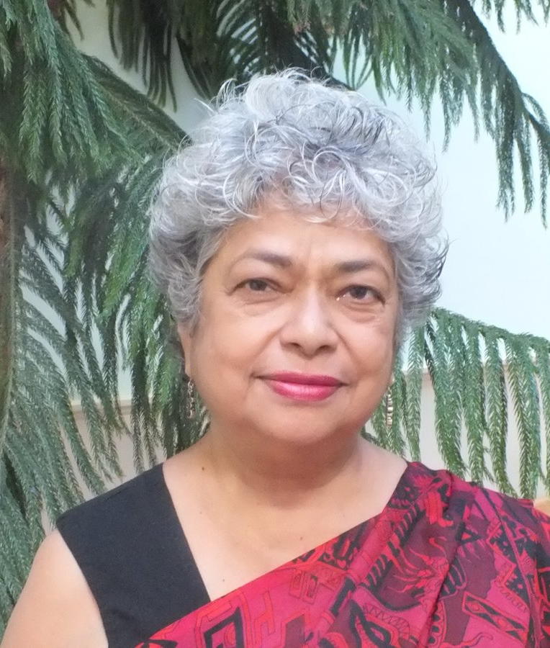
Beyond Dualism
Oneness = spiritual basis of sustainable (self) leadership and transformative action
transformation of self
transformation of environment / systems change
Monica Sharma:
radical transformational leadership for sustainability

Slide 20
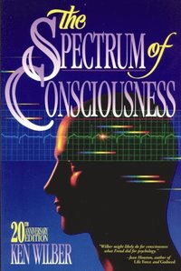

Slide 21
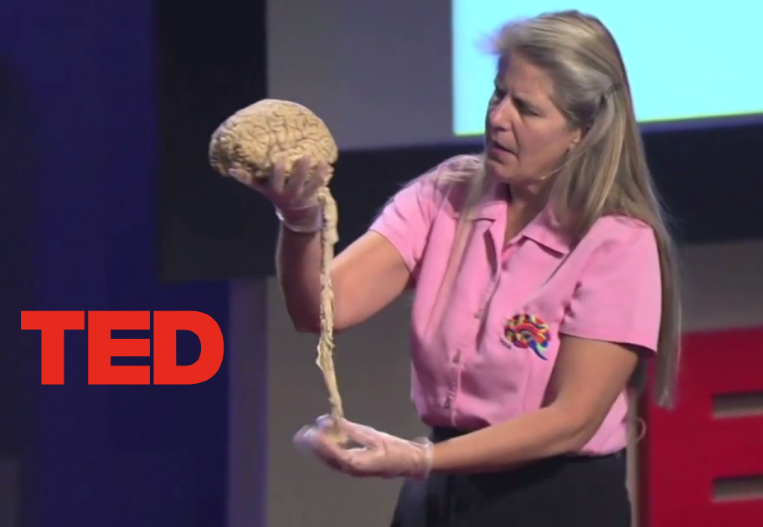
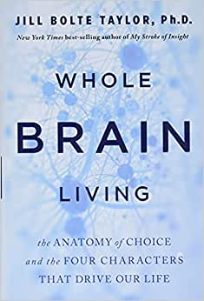
Notes:
support from brain science: the ideas in the Witch’s Way about how our consciousness works / how magic works are supported by neuroscience and neuroanatomy.

Slide 22
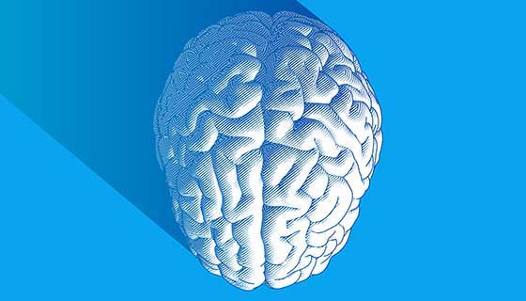
Character 3
Anima /Animus
(feeling / unconscious)
Character 2:
Shadow
(feeling / unconscious)
Character 4
True Self
(thinking / unconscious)
Character 1:
Persona
(thinking / conscious)

Slide 23
Character 3
Anima /Animus
(feeling / unconscious)
Character 2:
Shadow
(feeling / unconscious)
Character 4
True Self
(thinking / unconscious)
Character 1:
Persona
(thinking / conscious)

Slide 24
Summary & Outlook
finding personal meaning and bliss through inner alignment
harnessing myth, metaphor, imagery, symbolism to communicate with the unconscious
“technologies of magic” are states of consciousness beyond dualism
understanding the 4 brain characters to develop whole brain living and competent development of one’s full capacities towards authentic living
how can we design games for Character 4 to further develop the experience of oneness and states of consciousness that promote thriving for ourselves and others?

Slide 25

Go Play! https://andrewphelps.itch.io/the-witches-way/

Slide 26
Thanks and Questions
@D_Carmen @andymphelps

