Slide 1



A (very) Brief History of Games & Education in the past 20ish Years
Scottish Games Week, 2022
Dr. Andrew M. Phelps
Professor of Human Interface Technology, Faculty of Engineering, University of Canterbury, NZ
Professor of Film & Media Arts, School of Communication, American University, USA
Professor of Computer Science, College of Arts & Sciences, American University, USA
Visiting Faculty, Department of Game Design, Uppsala University, Sweden
Director, American University Game Center
President, Higher Education Video Game Alliance

Slide 2

Today’s Talk
PART 0: LOCAL HISTORY
PART I: GLOBAL EMERGENCE
PART II: SOME CONTEMPORARY ISSUES
PART III: SOME STRUCTURAL ISSUES
PART IV: PORTENTS & POSSIBILITIES

Slide 3
PART 0: LOCAL HISTORY
The Lived Experience of the Games in Higher Ed Explosion

Slide 4

So, I was at RIT for about 20 years…
2001 programming
First course in games programming
2002
Electronic Gaming Society
2003
CS/IT Concentration in Game Prog
2006
MSc Game Design & Development
2007
BSc Game Design & Development
2009
Dept. of Interactive Games & Media
2011
School of Interactive Games & Media
2012
Minor in Game Design
2013
RIT Center for Media, Arts, Games, Interaction & Creativity (MAGIC)
2013
MAGIC Spell Studios ®, LLC
2016
$30M MAGIC Spell Studios Initiative
2016
NY State Games HUB
2017
NY State Games Challenge

Slide 5





INCREDIBLE ALUMNI
ALEX CUTTING
Senior Assoc. Producer HALO
Microsoft / 343
CLAUDE JEROME
Gameplay Designer DESTINY
Bungie
DUSTIN KOCHENSPARGER
Line Producer DLC
DESTINY
Bungie
DB Creations (new studio)
SELA DAVIS
Platform Engineer
XBOX / XBOX Live
Microsoft
VReal
ANNA SWEET
Bad Robot Games
Facebook
STEAM
Valve
Oculus
Caffeine.ty
Microsoft XBOX

Slide 6
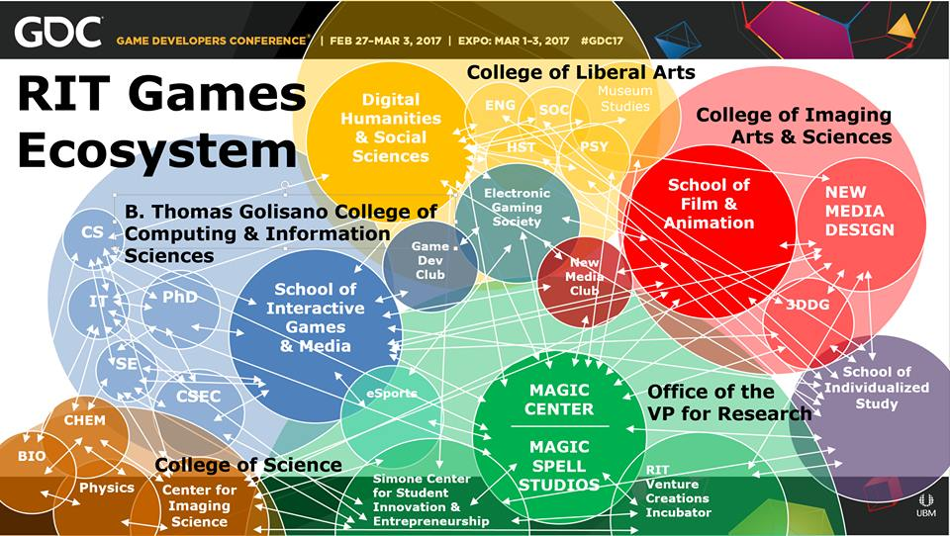

Slide 7

MAGIC Center as one studio example
Notes:
So let’s take a little look at where we are today, in our current home, what we’ve built, where we are going.

Slide 8
PART I: GLOBAL EMERGENCE
The Growth Vector of Games in Higher Education

Slide 9
A little bit on the history of games in higher ed
GAME STUDIES
Circa 2001 I offered a course in ‘game programming’ that was so new the NY Times showed up to over my course. It was a weird day.
There was a mailing list of the other folks I could find that had a game development course in the states. There were 6 people on it.
Similar trajectory in games studies, game design, game art
GAME DEV
GAME DESIGN
GAME ART

Slide 10
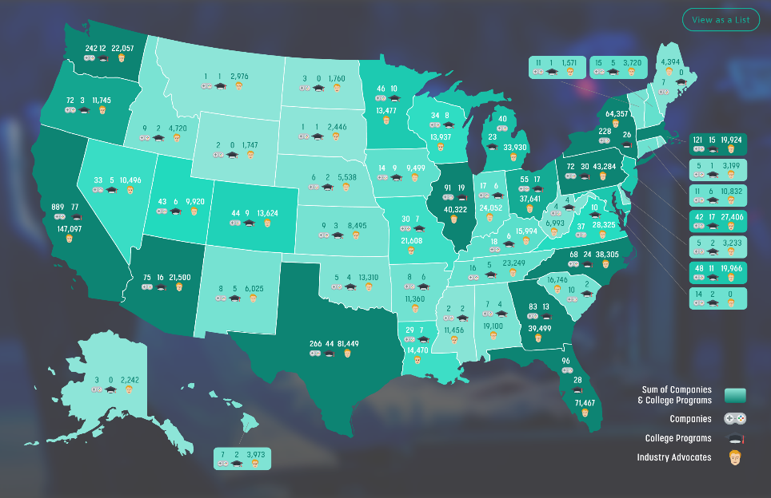
BB 2019, THERE WERE ~521 COLLEGE PROGRAMS IN NORTH AMERICA ALONE
THESE RANGE FROM GAME DESIGN, GAME DEVELOPMENT, GAME STUDIES, GAME ART, COMPUTING, ENGINEERING, AND MORE IN BOTH FORMAL AND INFORMAL PROGRAMS, MAJORS, MINORS, AND COURSES
Notes:
ARE WE IN YOUR STATE? Data map from Entertainment Software Association

Slide 11
THE SAME IS BECOMING TRUE ALL OVER THE WORLD
EUROPE had the early lead and trajectory in Game Studies & Cultural Impact
THE US & CANADA had early leads in computing & engineering directly focused on games and interactive media (i.e. specialized to game dev)
JAPAN has had a ton of success with exchange programs at both student and faculty levels, often involving industry engagement
LATIN AMERICA is one of the fastest growing regions with respect to academic programs and indie development, followed closely by Southeast Asia
CHINA has dominated commercial investment and markets (i.e. Tencent)
The PACIFIC REGION has been at the forefront of the emergence of games+film+virtual combinations and experimentation

Slide 12



FIELD REPORTS & EXAMINATIONS

Slide 13

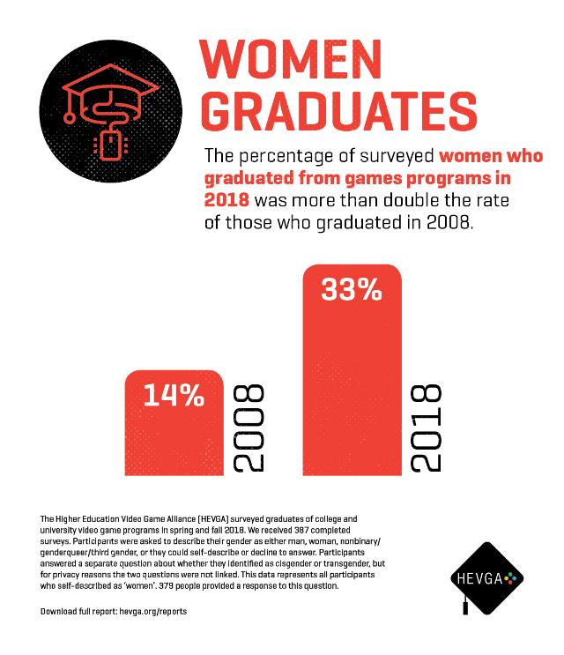

Slide 14
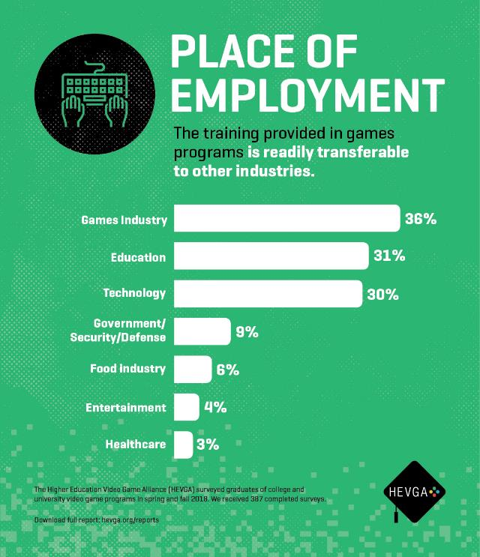


Slide 15
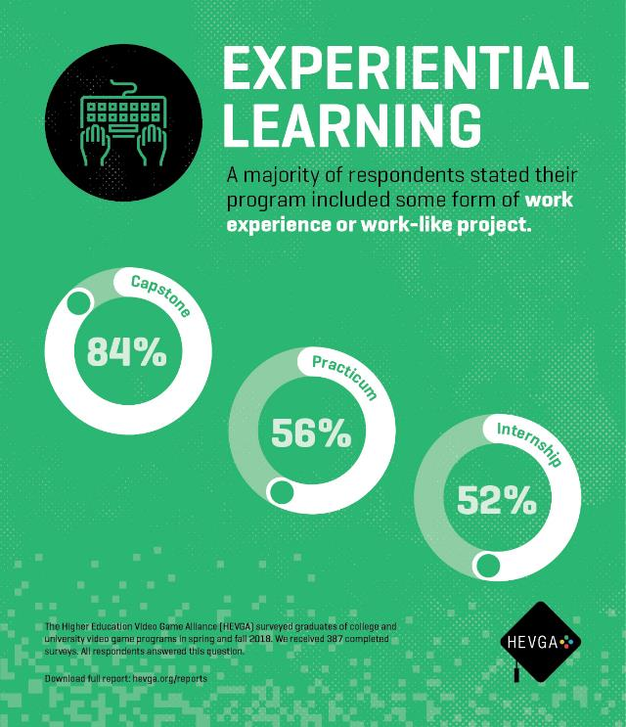
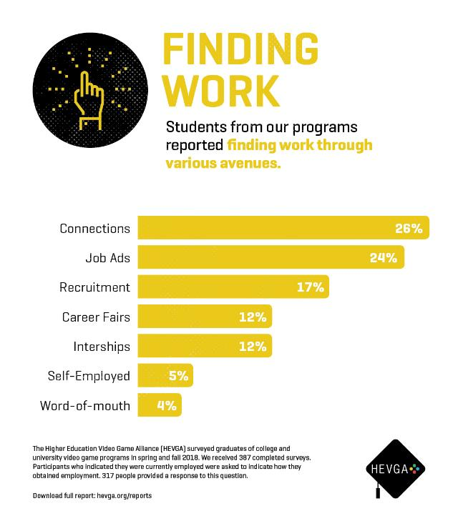

Slide 16




















Today, hevga represents more than 415 colleges and universities around the world, including the eu directly through our European council and associated board member(s)
AND WE ARE BY NO MEANS ALONE…

Slide 17
PART II: SOME CONTEMPORARY ISSUES
Despite Everything We are Learning, Sometimes we Just Aren’t Logical

Slide 18

Games Have Been Implicated in a Variety of Problems:
4 Recent Themes (still) in Discussion Today
VIOLENCE
ADDICTION
HEALTH
SOCIETY
Notes:
Image from GameInformer covering Fortenite: https://www.bing.com/images/search?view=detailV2&ccid=hXkLwpxO&id=0576CA39A94357997C609649DBDEA1DCFA028203&thid=OIP.hXkLwpxOQhYy-JWQRSSA1wHaEY&mediaurl=http%3a%2f%2fwww.xboxygen.com%2fIMG%2fjpg%2ffortnite-gameinformer.jpg&exph=800&expw=1351&q=fortenite&simid=608004708484842375&selectedIndex=19&ajaxhist=0

Slide 19

GAMES & HEALTH (more generally)
In addition to violence/aggression specifically, games are often used as a scapegoat to other health and behavioral issues
And yet, games are often used for positive effect in health, physical therapy, and behavioral intervention
Image: The GAPP Lab, University of Utah Medicine
Notes:
EAE GAPP Laboratory design session

Slide 20
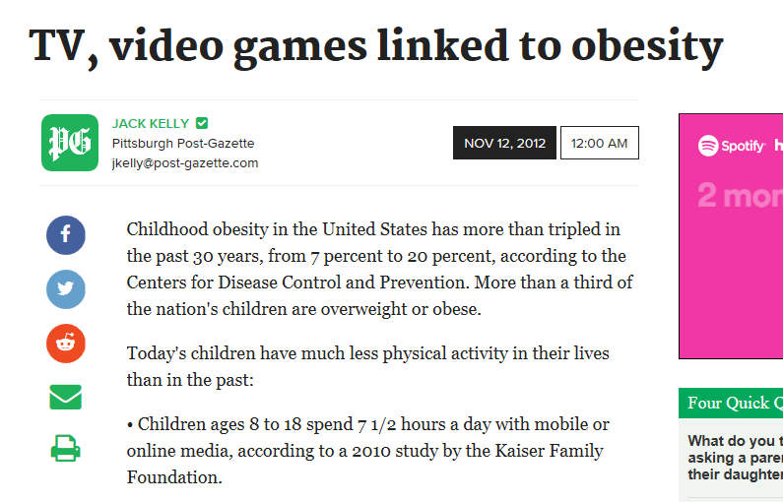

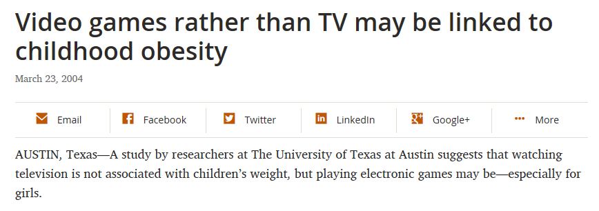

GAMES & HEALTH (more generally)
Notes:
https://news.utexas.edu/2004/03/23/nr_video_games
http://www.post-gazette.com/news/health/2012/11/12/TV-video-games-linked-to-obesity/stories/201211120171
https://www.healio.com/endocrinology/pediatric-endocrinology/news/print/endocrine-today/%7B9eea3b75-8b3d-407a-b8c6-0aa42aa0cdaf%7D/childrens-health-widely-affected-by-tv-computers-video-games

Slide 21


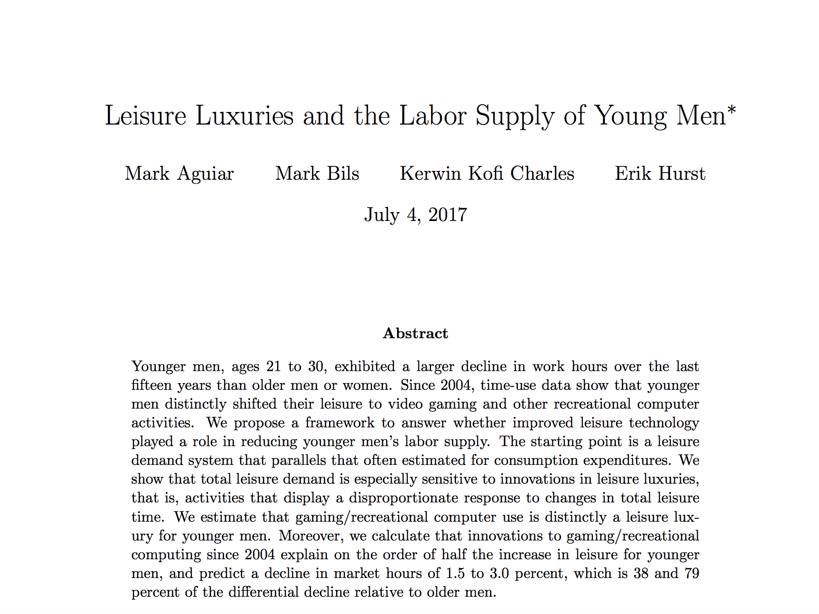
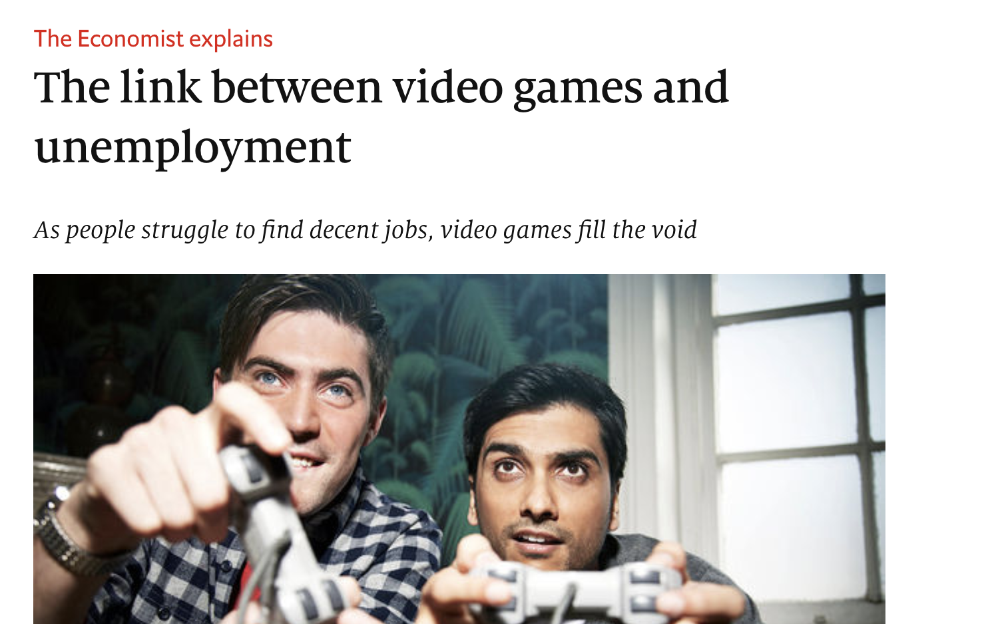

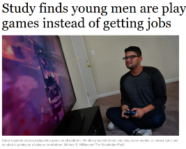
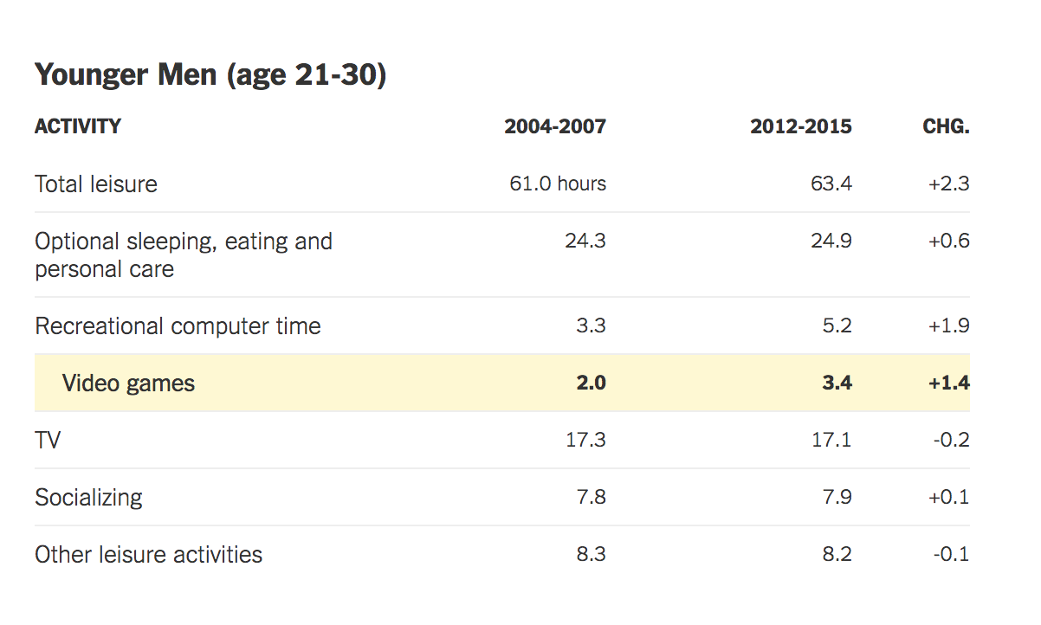
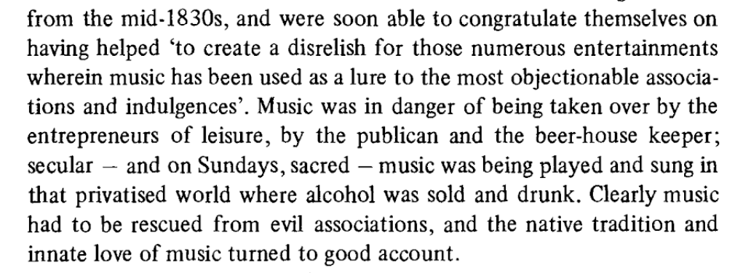
Games Blamed for Unemployment of Young Men in the US
Notes:
Video Killed the Radio Star – Adapted from the speech given at the 527th Convocation at Booth this past June
https://scholar.Princeton.edu/sites/default/files/maguiar/files/leisure-luxuries-labor-june-2017.pdf
http://www.chicagotribune.com/business/ct-video-games-jobs-emploment-20160923-story.html

Slide 22

GAMES & SOCIETY
Typically games are dragged out as a sort of scapegoat for larger, structural issues in society
Generational divides around language and culture are exacerbated
The most sordid elements of games culture are normalized and offered as exemplars
“couch potato” from www.pushingdaisies.com

Slide 23

And then, what future are we really preparing students for, exactly?
And what are our own responsibilities there?
Notes:
Image from https://techcrunch.com/2022/10/13/activision-blizzard-is-once-again-being-sued-for-sexual-harassment/

Slide 24
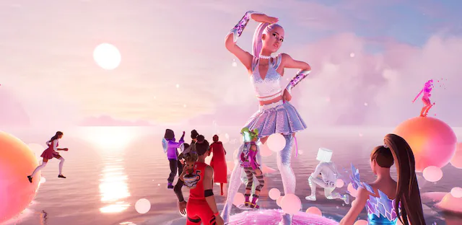
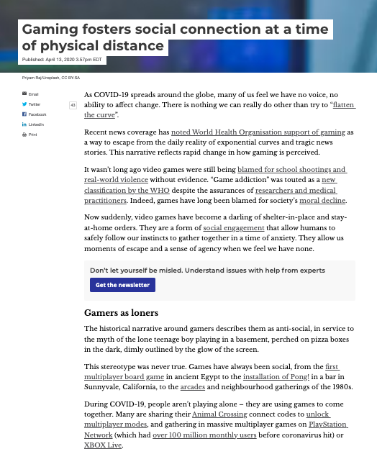
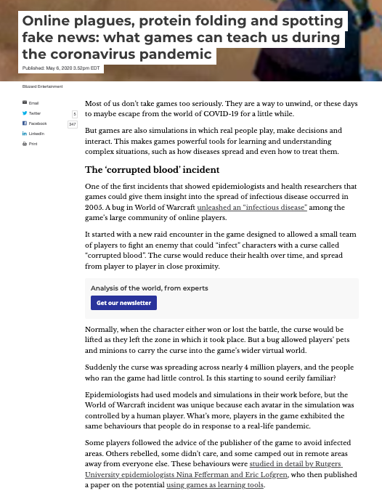
AND YET, GAMES & PLAY MIGHT HAVE A NEWFOUND PLACE IN OUR CULTURE? Maybe?
Notes:
Image from https://www.theverge.com/2021/8/9/22616664/ariana-grande-fortnite-rift-tour-worldbuilding-storytelling
lling

Slide 25
PART III: SOME STRUCTURAL ISSUES
Is the university really the place to be doing this? And if so, how?

Slide 26
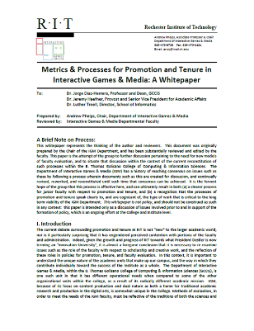
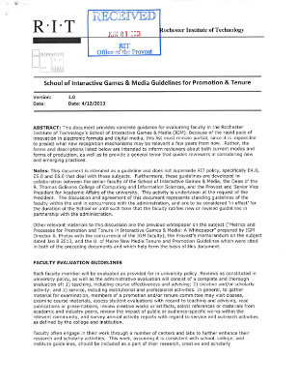

TENURE, PROMOTION & STAFFING POLICY

Slide 27

A few recent questions for the academy
Are we graduating too many ‘game graduates’ ?
Are we ‘preying upon’ the motivations of a young population?
Are we appropriately staffing games programs with a mix of academics and practitioners with actual experience in game-making?
How do we deal effectively with a field that finds itself spanning disciplines and academic cultures?
Multi-disciplinary work is, it turns out, rather more difficult than we like to let on… how do we structure participation and reward engagement?

Slide 28

ESPORTS AND POLICY
Substantial questions around funding models
Integration with academics has a variety of possible directions:
  Production / media
  Game design / development
  Sports / Sports medicine
  None (?)
Substantial questions around diversity and inclusion
  Varsity / Intramural / Club
  TITLE IX and associated compliance rules
Facilities, Equipment, Training, and Scheduling
Reporting & Oversight
  Academic Affairs, Student Affairs, Athletics, ???

Slide 29
PART IV: PORTENTS & POSSIBILITIES
Where do we go now?

Slide 30
THINGS WE (ALMOST) KNOW
The tech will get better
More people will play more and varied kinds of things
Something is happening around VR/AR/Meta-whatever
The internet continues to evolve (with both + and – effects)
Games in higher education is probably here to stay now (NOT A FAD!)

Slide 31
THINGS WE DREAM WE KNOW
Games will help us explore other cultures and combat xenophobia
Games will help us find new solutions to the big problems (health, climate, war, etc.)
Our institutions will reorient attitudes around games, via generational shift if nothing else
Games will continue to bring the world together, as they did briefly during the pandemic

Slide 32
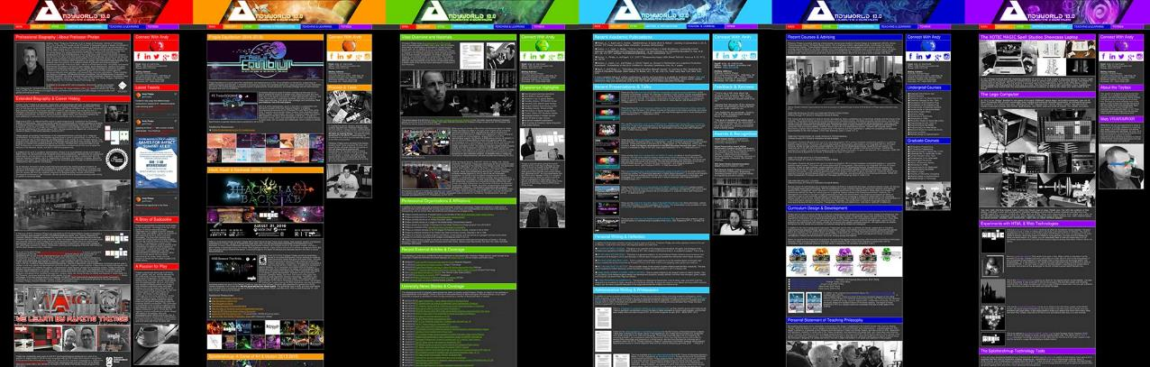
ANDYWORLD.IO | PROFESSORANDREWPHELPS.NET | @ANDYMPHELPS |ANDYMPHELPS@GMAIL.COM
Thanks & Questions

