Slide 1




MAGIC, MYTH & MEANING in GAME DESIGN
Keynote Presentation | Michigan State University | East Lansing, MI
Dr. Andrew M. Phelps
Professor of Human Interface Technology, Faculty of Engineering, University of Canterbury, NZ
Professor of Film & Media Arts, School of Communication, American University, USA
Professor of Computer Science, College of Arts & Sciences, American University, USA
Visiting Faculty, Department of Game Design, Uppsala University, Sweden
Director, American University Game Center
President, Higher Education Video Game Alliance
Dr. Doris C. Rusch
Professor of Game Design, Uppsala University, Sweden
Deputy Head of Department of Game Design
Uppsala University, Gotland, Sweden

Slide 2
Today’s Talk
Part 0: Prior Work, Design Space, etc.
Part 1: Context & Backdrop
Part 2: Magic, Myth & Meaning
Part 3: An Individual Context of Missile Command
Part 4: Future Context & Work
Conclusions & Questions

Slide 3
PART 0
Prior Work, Design Space, etc.

Slide 4


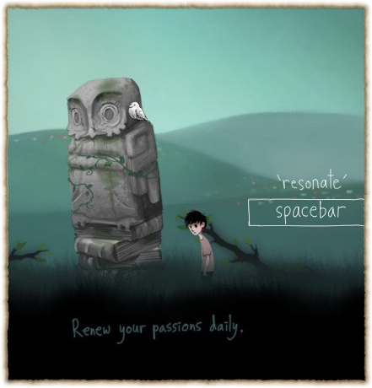
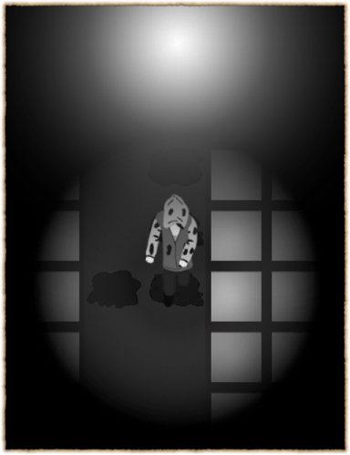

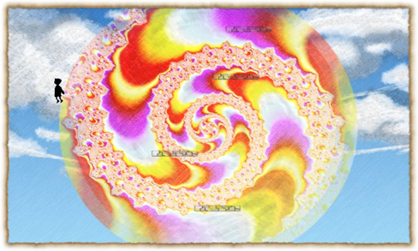
http://fortherecords.org

Slide 5




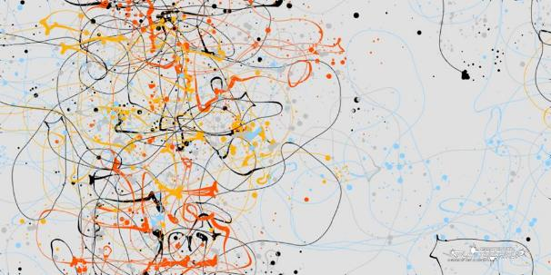
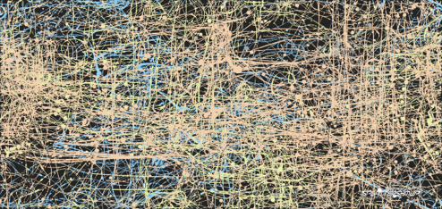

Slide 6
James Bugental (1992)
“viewed from an existential perspective, the good life is an authentic life, a life in which we are as fully in harmony as we can be. Inauthenticity is illness, is our living in distorted relationship with our true being.” (p.246)

Slide 7
“the kinds of change we can clearly measure are not all that interesting.”
–Paolo Pedercini, Games 4 Change keynote, 2014

Slide 8

AS HUMANS, WE BRING OURSELVES TO OUR EXPERIENCES
KNOWLEDGE OF A SYSTEM IS NOT EMPATHY
AND DOES NOT PRESUPPOSE TRANSFORMATION
A large part of games’ transformative potential thus remains either unrealized or invisible (Paolo Pedercini, 2014). But how can we intentionally design for personal transformation without pre-determining the kind of change the game should ignite or seeks to impose upon its players? How can we facilitate profound, organic inner shifts through our designs that allow players to “respond to them of themselves, with recognition, uncoerced[?]” (Campbell 1991).
GAMES ARE NOT JUST COMPLEX SYSTEMS | MECHANICS

Slide 9
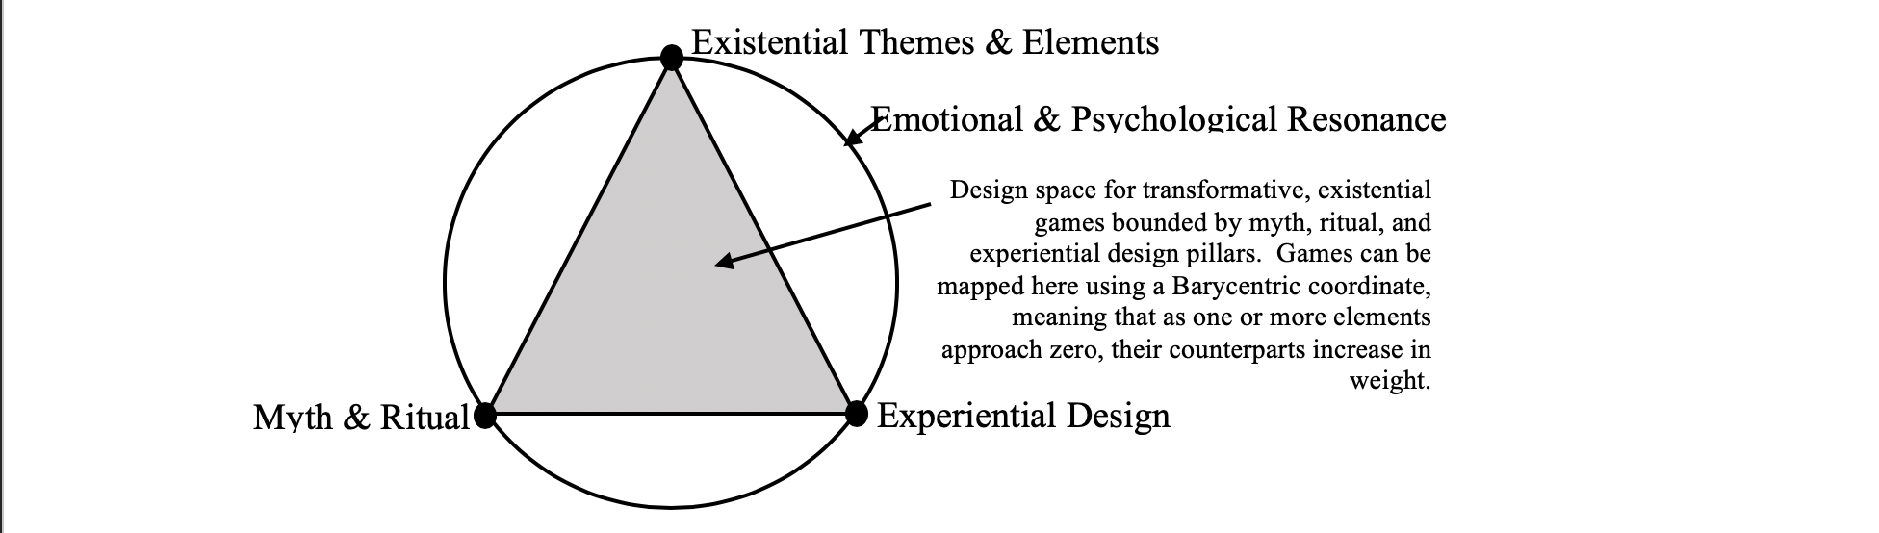
DESIGN SPACE MAP
Mapping a design space for games of the soul
(Rusch & Phelps, DiGRA 2020, 2022)

Slide 10


Slide 11


Slide 12

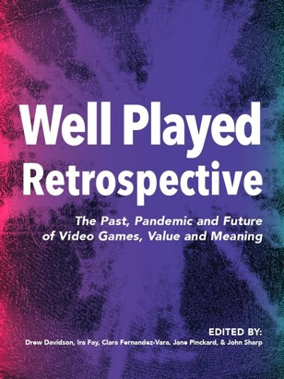
(Wagner, Moger, Consalvo, & Pheps, 2021)

Slide 13


Slide 14
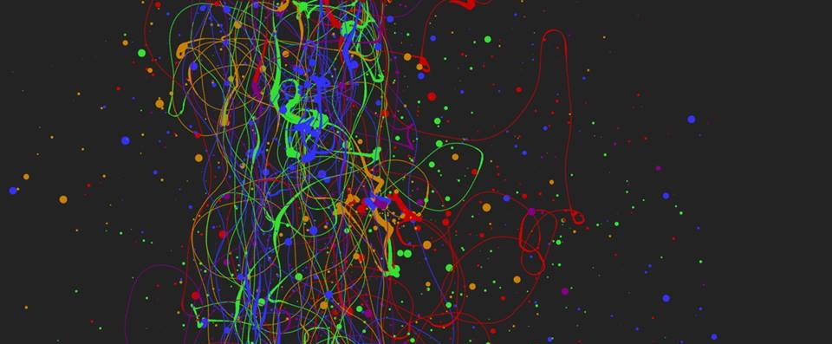
EXPERIENTIAL – “WHAT YOU PLAY IS WHAT YOU GET”
When we refer to experiential design, we mean the entire contextual experience of playing a game, and the interpretation of the experience by the player directly in the context of the experience itself. This kind of ‘what you do is what you get’ game is of increasing interest in the field, and in this manner is essentially an ‘experientially educational’ game (Phelps, Wagner, and Moger, 2020).
Players can gain an understanding of, and empathy for, a given scenario or subject matter merely through the act of playing it, and specifically through the act of interacting with it. (Phelps, 2020)

Slide 15
PART 1
Context & Backdrop

Slide 16

The context in which this conversation happens: global dumpster fire

Slide 17

Let’s Not Predict the Future on the Past

Slide 18
There is nothing less at stake than the future of our species, much of the diversity of life, and the continued evolution of consciousness. If we achieve this “momentous leap” (Graves, 1974) in human self-awareness, what lies ahead of us is the promise of a truly regenerative, collaborative, just, peaceful, and equitable human civilization that flourishes and thrives in its diverse cultural and artistic expressions while restoring ecosystems and regenerating resilience locally and globally. (...) Individually and collectively, we wake up to find out that the world knows and loves itself through our eyes and our hearts. What kind of culture will we create to express this wisdom? Becoming conscious of our interbeing with the world reminds of us our communion with all life as a reflection of our larger being. As conscious relational beings, love for life is our natural state.”
(Wahl, 2016, p.34, designing regenerative cultures)

Slide 19
PART 2
Magic, Myth & Meaning

Slide 20
What is “meaningful” to us? How does it shape our design work?

Slide 21


Slide 22
Transformative Leadership
for Sustainability
Embodied Transformation
Myth
(& Ritual as Enacted Myth)
MAGIC

Slide 23
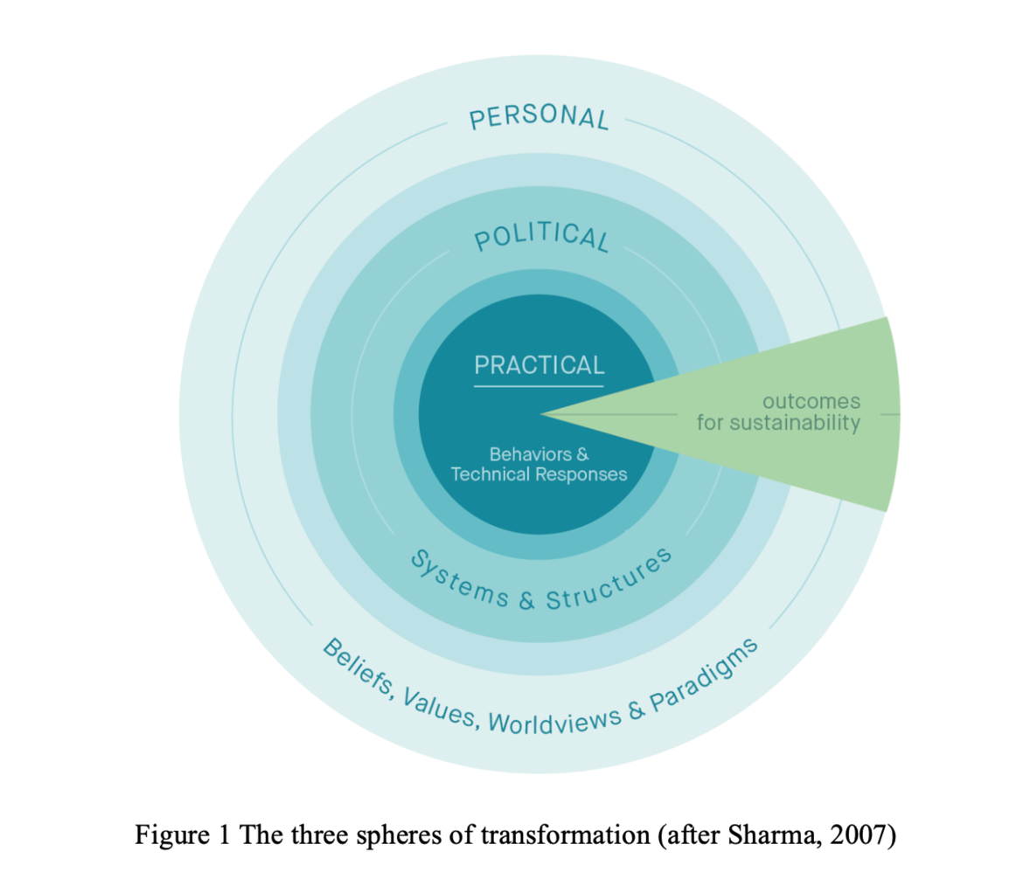

Slide 24
How can games contribute to authenticity and inner balance?

Slide 25
Values = Design Lenses for LIFE
& “response-able” acting and being

Slide 26


GRIT
COMPASSION
HUMOR
EQUITY
DIGNITY
FOR SELF & OTHERS
THIS IS DORIS! <3

Slide 27


Slide 28


Slide 29
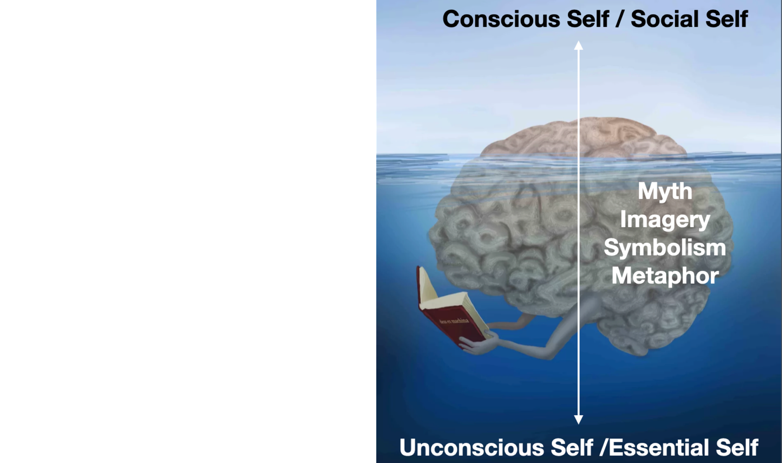

Slide 30
Body
“When I speak of the body I’m referring to the shape of our experience; not the collection of fixed, anatomical parts inherited from the Cartesian discourse. The body is not a machine; its boundaries are not clearly defined. Our experience is subjective, self-responsive, and at the same time constantly responding to the world. We are self-contained, and we merge with others and the environment. We are our bodies when we’re engaged with the air, our neighbors, the landscape, making promises, planning our future, thinking of our loved ones.” (Strozzi-Heckler, Holding the Center)

Slide 31


Slide 32
PART 3
An Individual Context of Missile Command

Slide 33
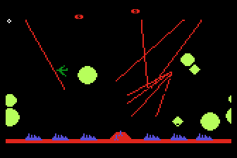
CONTEXT CAN BE EVERYTHING
Missile Command 1982

Slide 34

Myth: Survival (haha), Star Wars (the Reagan kind), etc.
  Ritual: The trackball, the storing of next quarter, the quest for patterns, the ‘pause’ and hang on, etc.
Experiential: It is exactly what it says it is. (and in the original version, even more so)
Existential: I mean, yeah...

Slide 35





Notes:
Images from https://origins.osu.edu/connecting-history/top-ten-origins-civil-defense-nuclear-war-and-duct-tape

Slide 36
PART 4
Future Context & Work

Slide 37

CONCLUSION(ISH): WE NEED MORE AND BETTER KINDS OF ’MEANINGFUL’ GAMES / G4C
Experiential games have a unique place in the design space
By focusing less on procedural rhetoric and more on abstract expression via interaction to trigger transformation, we open different doors in the interaction of humans and technology
Utilizing these different lenses examines UX not through functionality or optimization, but through intuition and interpretation
Measuring differently to allow for different design spaces and methodologies is critical if we want to aspire to different results

Slide 38
The Assessment Trap
(In the original talk there was a picture here of Haley Mills from The Parent Trap by Walt Disney Pictures looking very glum.
(removed for copyright, internet, etc.)
Notes:
REPRISE: KNOWLEDGE OF A SYSTEM IS NOT EMPATHY AND DOES NOT PRESUPPOSE TRANSFORMATION

Slide 39
Where is the blue skies research of meaningful games / G4C?

Slide 40
What does it mean, ultimately, for play to have meaningful impact?

Slide 41
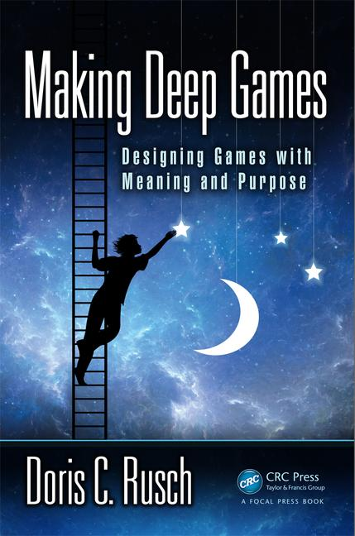


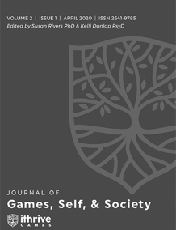
Rusch, D.C. and Phelps, A. (2021) "Games of the Soul." In A Ludic Society by Denk, et al. (pp. 102–126). Donau-Universität Krems, Universitätsbibliothek. ISBN-13: 978-3903150720. Available on Amazon.
Rusch, D.C. and Phelps, A. (2021) 'The Magic of The Witch's Way.' Presented at the Future of Reality & Games (FROG) Conference. Vienna, Austria.
Phelps, A., Wagner, J. and Moger, A. "Experiential Depression and Anxiety Through Proceduralized Play: A Case Study of Fragile Equilibrium." (2020) Journal of Games, Self, & Society, vol. 2, no. 1. Eds. Rivers, S. E., & Dunlap, K. https://doi.org/10.1184/R1/12215417
Rusch, D. ”Existential, Transformative Game Design." (2020) Journal of Games, Self, & Society, vol. 2, no. 1. Eds. Rivers, S. E., & Dunlap, K. https://doi.org/10.1184/R1/12215417
Rusch, D. and Phelps, A. “Existential Transformational Game Design: Harnessing the "Psychomagic" of Symbolic Enactment” Frontiers in Psychology. Special Issue on Digital Games and Mental Health. doi: 10.3389/fpsyg.2020.571522 (in press)
Phelps, A., and Rusch, D. C. (2020) "Navigating Existential, Transformative Game Design." Proceedings of the Digital Games Research Association (DiGRA) 2020 Conference: Play Anywhere. Tampere, Finland. http://www.digra.org/wp-content/uploads/digital-library/DiGRA_2020_paper_21.pdf

Slide 42
Thanks and Questions
@andymphelps @D_Carmen

