Slide 1




NAVIGATING EXISTENTIAL, TRANSFORMATIONAL GAME DESIGN
Digital Games Research Association (DiGRA) 2022|Krakow, Poland
Dr. Andrew M. Phelps
Professor of Human Interface Technology, College of Engineering, University of Canterbury, NZ
Professor of Film & Media Arts, School of Communication, American University, USA
Professor of Computer Science, College of Arts & Sciences, American University, USA
Visiting Faculty, Department of Game Design, Uppsala University, Gotland Sweden
Director, American University Game Lab
President, Higher Education Video Game Alliance
Dr. Doris C. Rusch
Professor, of Game Design, Uppsala University
Deputy Head of Department of Game Design
Uppsala University, Gotland, Sweden

Slide 2
Today’s Talk
Part 0: Background, history, and framing: How did we arrive at this work?
Part 1: Existential Theming
Part 2: Myth and Ritual
Part 3: Experiential Play
DESIGN SPACE MAP
Conclusions & Questions

Slide 3
PART 0
Background, history, and framing: How did we arrive at this work?

Slide 4


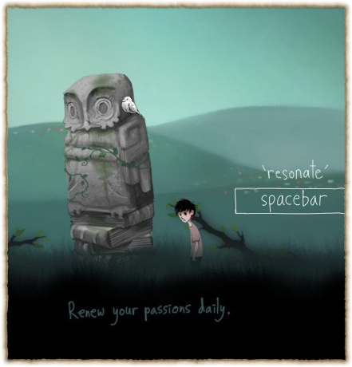
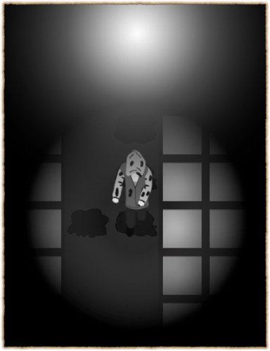

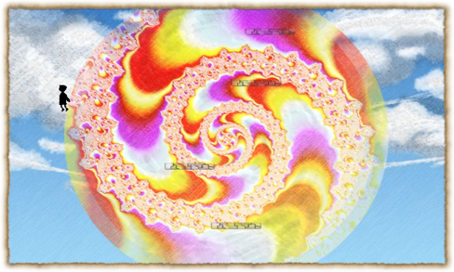
http://fortherecords.org

Slide 5





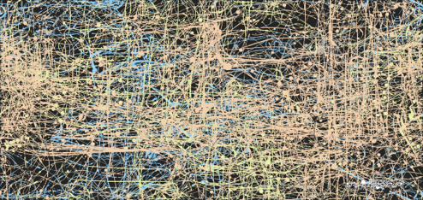

Slide 6


Notes:
this landed me in the games 4 health and games 4 change space. That seemed to work out well for a while, because there was so much interest for games that could promote some kind of growth - but what disturbed me was the idea that games could be a cure. That they could be therapy. And by requiring them to be therapy, they needed to prove they “worked”. Which is a really reductionist view on the human experience and personal transformation.
I had an identity crisis, struggling with the demands of what I had come to view as my disciplinary home and what I felt I wanted to do with games and where their potential lay and that it couldn’t and shouldn’t be reduced to metric and measurable change.

Slide 7
The Transformational Framework
(Sabrina Culyba, 2018)
intention is to change the player
in particular ways
change transfers to real life and lasts
(…and how is this measured? Exactly?)
Notes:
this implies change is measurable.

Slide 8
“the kinds of change we can clearly measure are not all that interesting.”
–Paolo Pedercini, Games 4 Change keynote, 2014

Slide 9
PART 1
Existential Theming

Slide 10
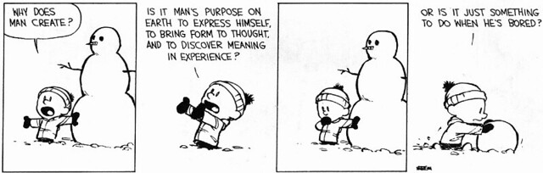
The Existential Givens
life is finite
there is no external meaning
we must make choices
we are ultimately alone

Slide 11
existential humanistic psychotherapy
rejects ideas of “mental illness” and focuses on creating a sense of true self, deep connection, purpose
client vs. patient
client is met where they are at, not with assumptions about who they are supposed to be

Slide 12
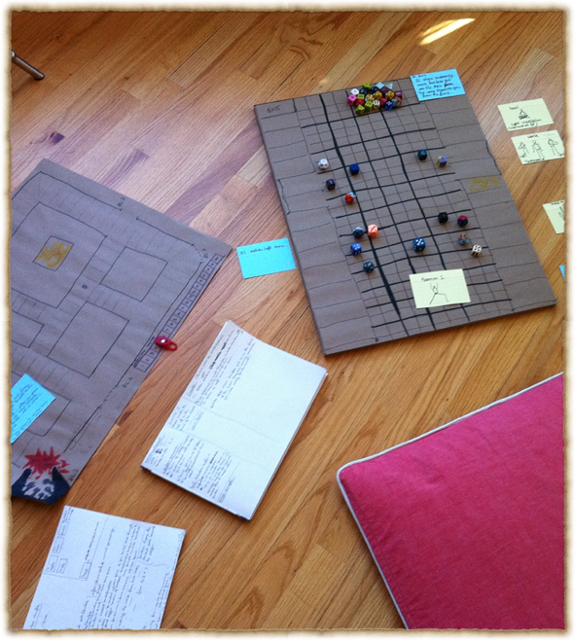
application to game design
transformational design approach that doesn’t try to change player
player is not assumed to need fixing
game aims to provide possibility space to explore and contemplate the game’s existential themes and see what resonates with players out of their own accord.

Slide 13
existential humanistic psychotherapy goals
making clients sensitive to their existence
calling attention to clients’ unique traits
helping clients improve encounters with others
assisting clients in establishing a will to meaning
encouraging clients to make decisions about present and future directions in life.

Slide 14
James Bugental (1992)
“viewed from an existential perspective, the good life is an authentic life, a life in which we are as fully in harmony as we can be. Inauthenticity is illness, is our living in distorted relationship with our true being.” (p.246)

Slide 15
how can games contribute to authenticity and inner balance?

Slide 16
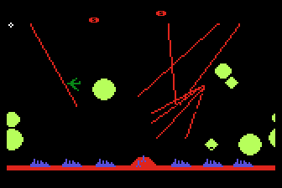
CONTEXT CAN BE EVERYTHING
Missile Command 1982

Slide 17
PART 2
Myth and Ritual

Slide 18

Enter the Unknown Forest
“A myth is a way of making sense in a senseless world.
Myths are narrative patterns that give significance to our existence.” (Rollo May, 1991)
Notes:
key figures of existential psych. turned to myth to deal with the baffling question of meaninglessness. Rollo May: “The Cry for Myth”. When science fails, we turn to art.

Slide 19

Not just stories
Mythic narratives are based on a model of the human psyche“ (Bonnett, 2006)
“Their true meaning is understood as internal processes“ (Kirmayer, 1999)
Myth speaks the language of the Unconscious through symbolism and imagery
Notes:
key figures of existential psych. turned to myth to deal with the baffling question of meaninglessness. Rollo May: “The Cry for Myth”. When science fails, we turn to art.

Slide 20


myths work through resonance
Jung: “the auditor experiences some of the sensations but is not transformed. Their imaginations are stimulated: they go home and through personal fantasies begin the process of transformation for themselves." (Bonnett, 2006)
Notes:
myths are more than just stories. They “spring from powerful and mysterious inner processes.” (Bonnett, 2006, p.4)
they transform us by way of resonance, not coercion.

Slide 21
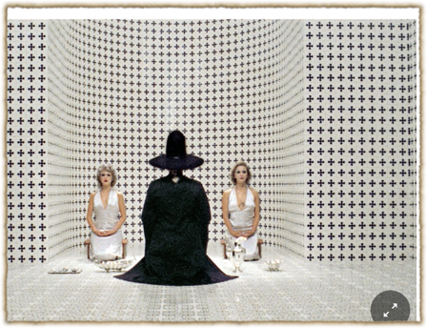
Ritual as Enacted Myth
Transformative potential of symbolic action
Getting a handle on “inner processes” through performance of symbolic actions
Jodorowski: “psychomagic, poetic acts”
Game Mechanics as symbolic enactments of inner processes

Slide 22
Part 3
Experiential Play

Slide 23
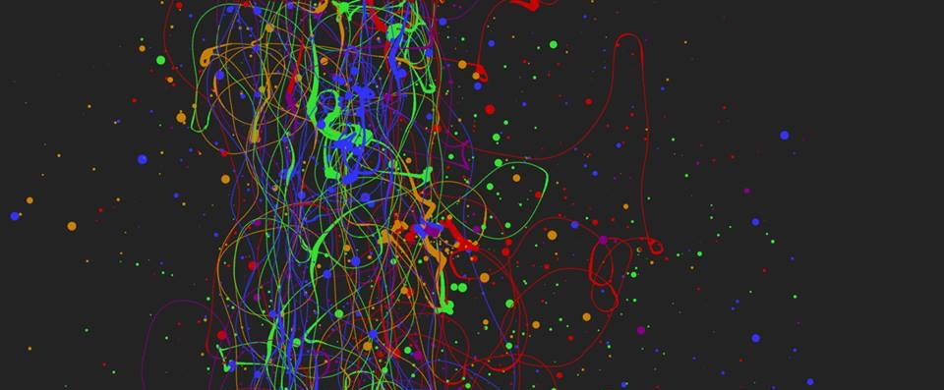
3: EXPERIENTIAL – “WHAT YOU PLAY IS WHAT YOU GET”
When we refer to experiential design, we mean the entire contextual experience of playing a game, and the interpretation of the experience by the player directly in the context of the experience itself. This kind of ‘what you do is what you get’ game is of increasing interest in the field, and in this manner is essentially an ‘experientially educational’ game (Phelps, Wagner, and Moger, 2020).
Players can gain an understanding of, and empathy for, a given scenario or subject matter merely through the act of playing it, and specifically through the act of interacting with it. (Phelps, 2020)

Slide 24

AS HUMANS, WE BRING OURSELVES TO OUR EXPERIENCES
KNOWLEDGE OF A SYSTEM IS NOT EMPATHY
AND DOES NOT PRESUPPOSE TRANSFORMATION
A large part of games’ transformative potential thus remains either unrealized or invisible (Paolo Pedercini, 2014). But how can we intentionally design for personal transformation without pre-determining the kind of change the game should ignite or seeks to impose upon its players? How can we facilitate profound, organic inner shifts through our designs that allow players to “respond to them of themselves, with recognition, uncoerced[?]” (Campbell 1991).
GAMES ARE NOT JUST COMPLEX SYSTEMS | MECHANICS

Slide 25
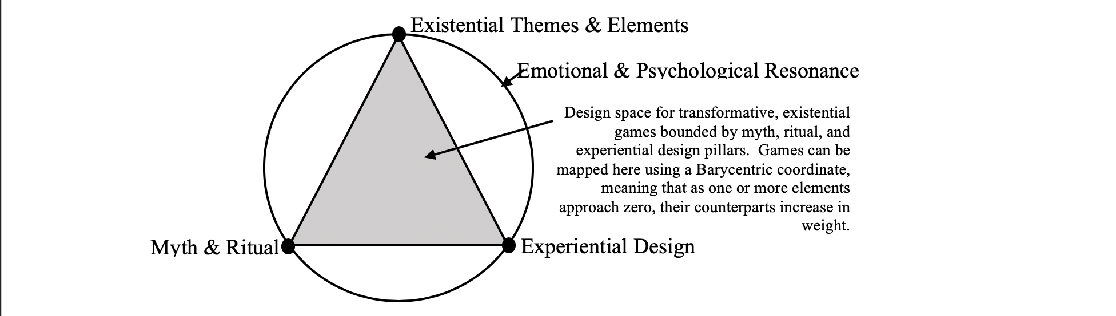
DESIGN SPACE MAP
Mapping a design space for games of the soul
(Rusch & Phelps, DiGRA 2020, 2022)

Slide 26


Slide 27

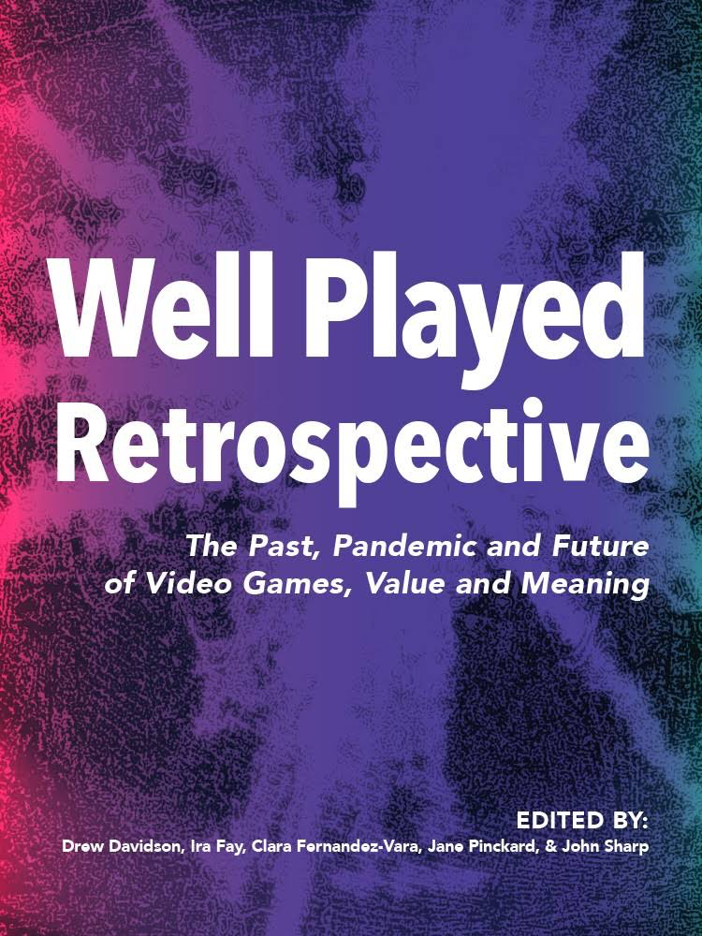

Slide 28


Slide 29
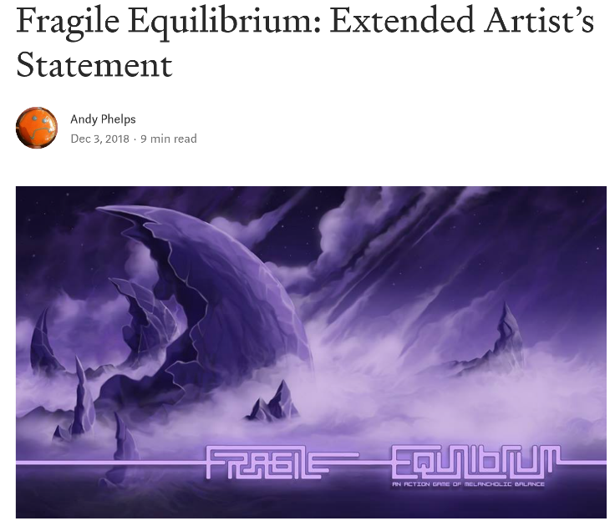
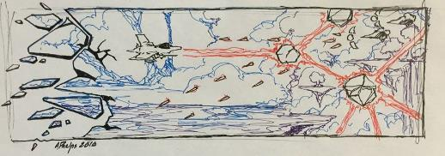
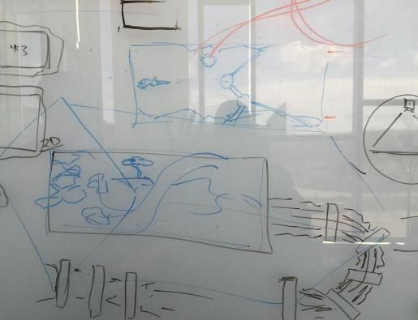

Slide 30


Slide 31

CONCLUSION(ISH): WE NEED MORE AND BETTER KINDS OF ’MEANINGFUL’ GAMES / G4C
Experiential games have a unique place in the design space
By focusing less on procedural rhetoric and more on abstract expression via interaction to trigger transformation, we open different doors in the interaction of humans and technology
Utilizing these different lenses examines UX not through functionality or optimization, but through intuition and interpretation
Measuring differently to allow for different design spaces and methodologies is critical if we want to aspire to different results

Slide 32
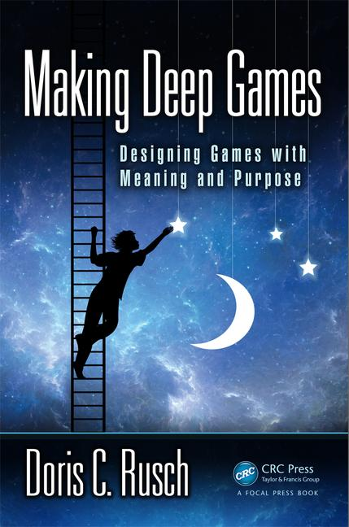

Rusch, D.C. and Phelps, A. (2021) "Games of the Soul." In A Ludic Society by Denk, et al. (pp. 102–126). Donau-Universität Krems, Universitätsbibliothek. ISBN-13: 978-3903150720. Available on Amazon.
Rusch, D.C. and Phelps, A. (2021) 'The Magic of The Witch's Way.' Presented at the Future of Reality & Games (FROG) Conference. Vienna, Austria. Available on YouTube.
Phelps, A., Wagner, J. and Moger, A. "Experiential Depression and Anxiety Through Proceduralized Play: A Case Study of Fragile Equilibrium." (2020) Journal of Games, Self, & Society, vol. 2, no. 1. Eds. Rivers, S. E., & Dunlap, K. https://doi.org/10.1184/R1/12215417
Rusch, D. ”Existential, Transformative Game Design." (2020) Journal of Games, Self, & Society, vol. 2, no. 1. Eds. Rivers, S. E., & Dunlap, K. https://doi.org/10.1184/R1/12215417
Rusch, D. and Phelps, A. “Existential Transformational Game Design: Harnessing the "Psychomagic" of Symbolic Enactment” Frontiers in Psychology. Special Issue on Digital Games and Mental Health. doi: 10.3389/fpsyg.2020.571522 (in press)
Phelps, A., and Rusch, D. C. (2020) "Navigating Existential, Transformative Game Design." Proceedings of the Digital Games Research Association (DiGRA) 2020 Conference: Play Anywhere. Tampere, Finland. http://www.digra.org/wp-content/uploads/digital-library/DiGRA_2020_paper_21.pdf

Slide 33
Thanks and Questions
@andymphelps @D_Carmen

