Slide 1
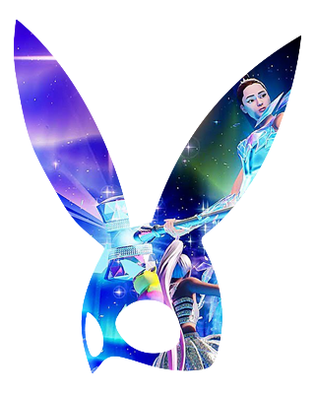
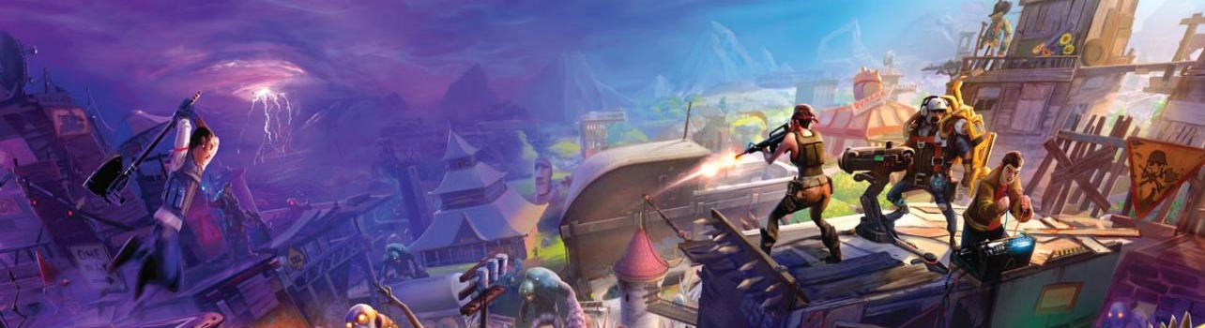


Of Platforms and the Incongruities of Virtual Party Worlds
(There is Much More to the Party Than the House)
THE 19th ANNUAL TAMPERE UNIVERSITY GAME RESEARCH LAB SEMINAR | TAMPERE, FINLAND
Andrew Phelps
Professor of Human Interface Technology, Faculty of Engineering, University of Canterbury, NZ
Professor of Film & Media Arts, School of Communication, American University, USA
Professor of Computer Science, College of Arts & Sciences, American University, USA
Visiting Faculty, Department of Game Design, Uppsala University, Sweden
Director, American University Game Center
President, Higher Education Video Game Alliance
Steven Dashiell
Post-Doctoral Research Fellow, American University Game Center & Department of Sociology
American University, Washington, DC, USA
Notes:
Image from GameInformer covering Fortenite: https://www.bing.com/images/search?view=detailV2&ccid=hXkLwpxO&id=0576CA39A94357997C609649DBDEA1DCFA028203&thid=OIP.hXkLwpxOQhYy-JWQRSSA1wHaEY&mediaurl=http%3a%2f%2fwww.xboxygen.com%2fIMG%2fjpg%2ffortnite-gameinformer.jpg&exph=800&expw=1351&q=fortenite&simid=608004708484842375&selectedIndex=19&ajaxhist=0

Slide 2
I've been here all night
I've been here all day
And boy, got me clickin’ slide to slide

Slide 3
What even is a “party”?
Several kinds of casual leisure
  Play
  Relaxation
  Passive entertainment
  Active entertainment
  Sociable conversation
  Sensory stimulation
    (Stebbins 2001)
Parties Often Have
  Food and/or Drink
  Music
  Casual Conversation
  Lightweight Games

Slide 4
“Lightweight games”
“they are intended to be light, ever present, to provide context and reinforce the casual nature of the experience. And as Stubbins notes, all these forms of leisure have one thing in common: they are hedonic.”

Slide 5
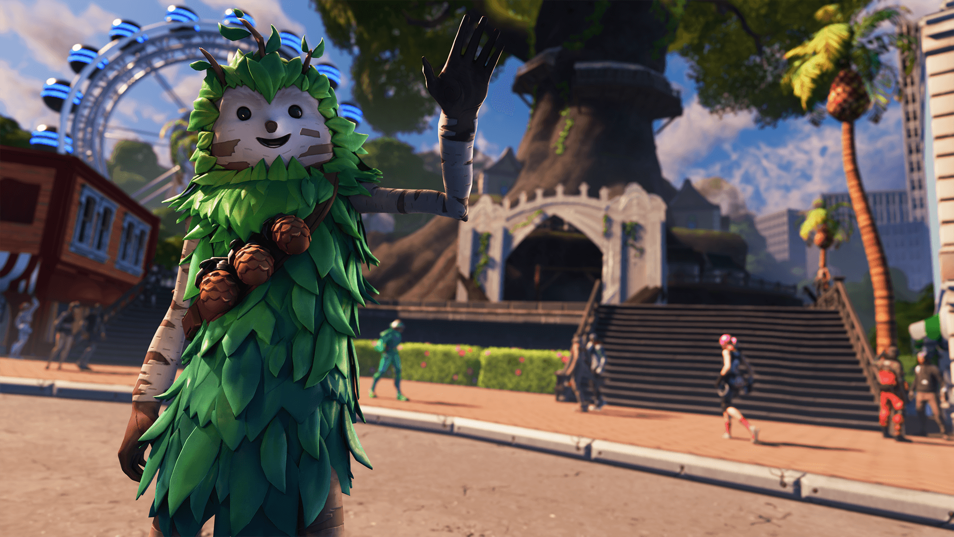
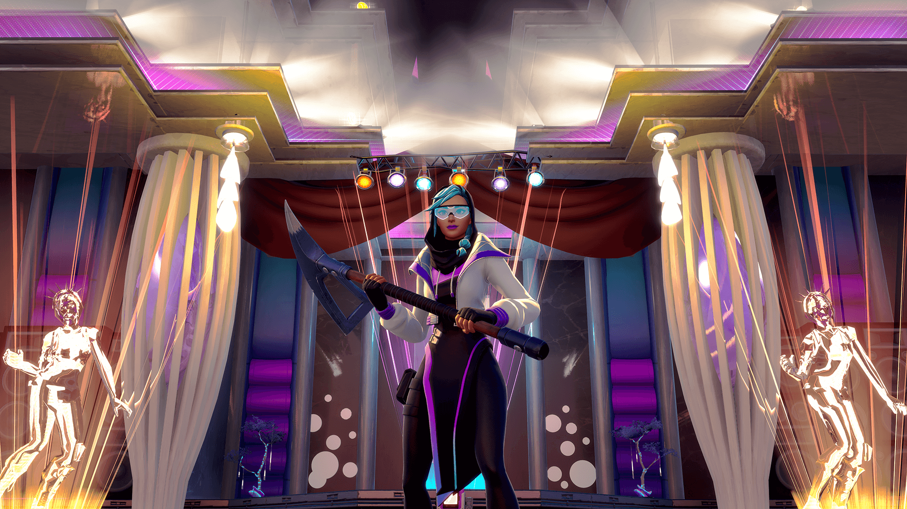
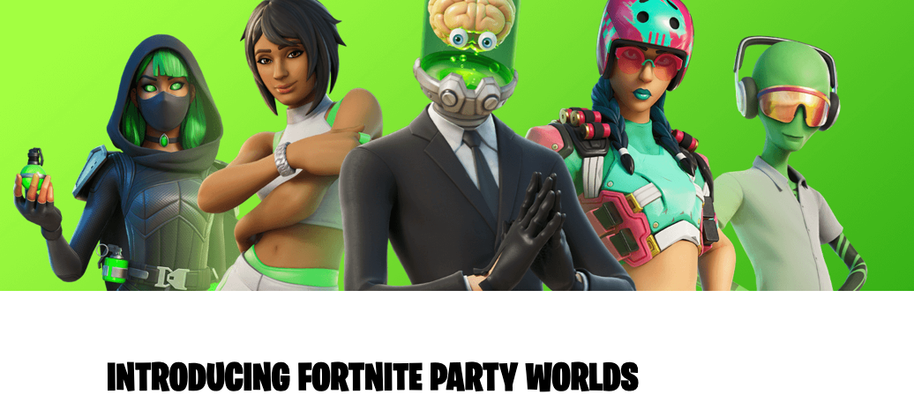
Notes:
Images from https://www.fortnite.com/news/introducing-fortnite-party-worlds/

Slide 6
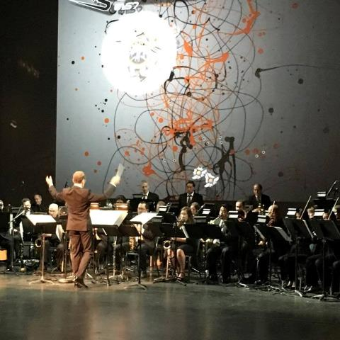
C O N V E R G E N C E
C O N V E R G E N C E
The platforms and technology for film, animation, games, media, and story are converging into new forms, new stories, new experiences, and new knowledge.
Notes:
This picture is from the RIT West Coast board meeting where they showed one of my games set to a live orchestra composition directed by Trustee Kevin Surace.

Slide 7
“GUIDELINES FOR PARTY WORLDS CREATIONS”
Party Worlds should not be threatening. They shouldn’t center on combat or damage.
Party Worlds should have a high focus on self-expression through emotes, sprays, outfit changes, or other mechanics.
Party Worlds should encourage social interaction, giving people a way to make new friends or team up with existing friends in new ways.
Notes:
https://www.fortnite.com/news/introducing-fortnite-party-worlds/

Slide 8
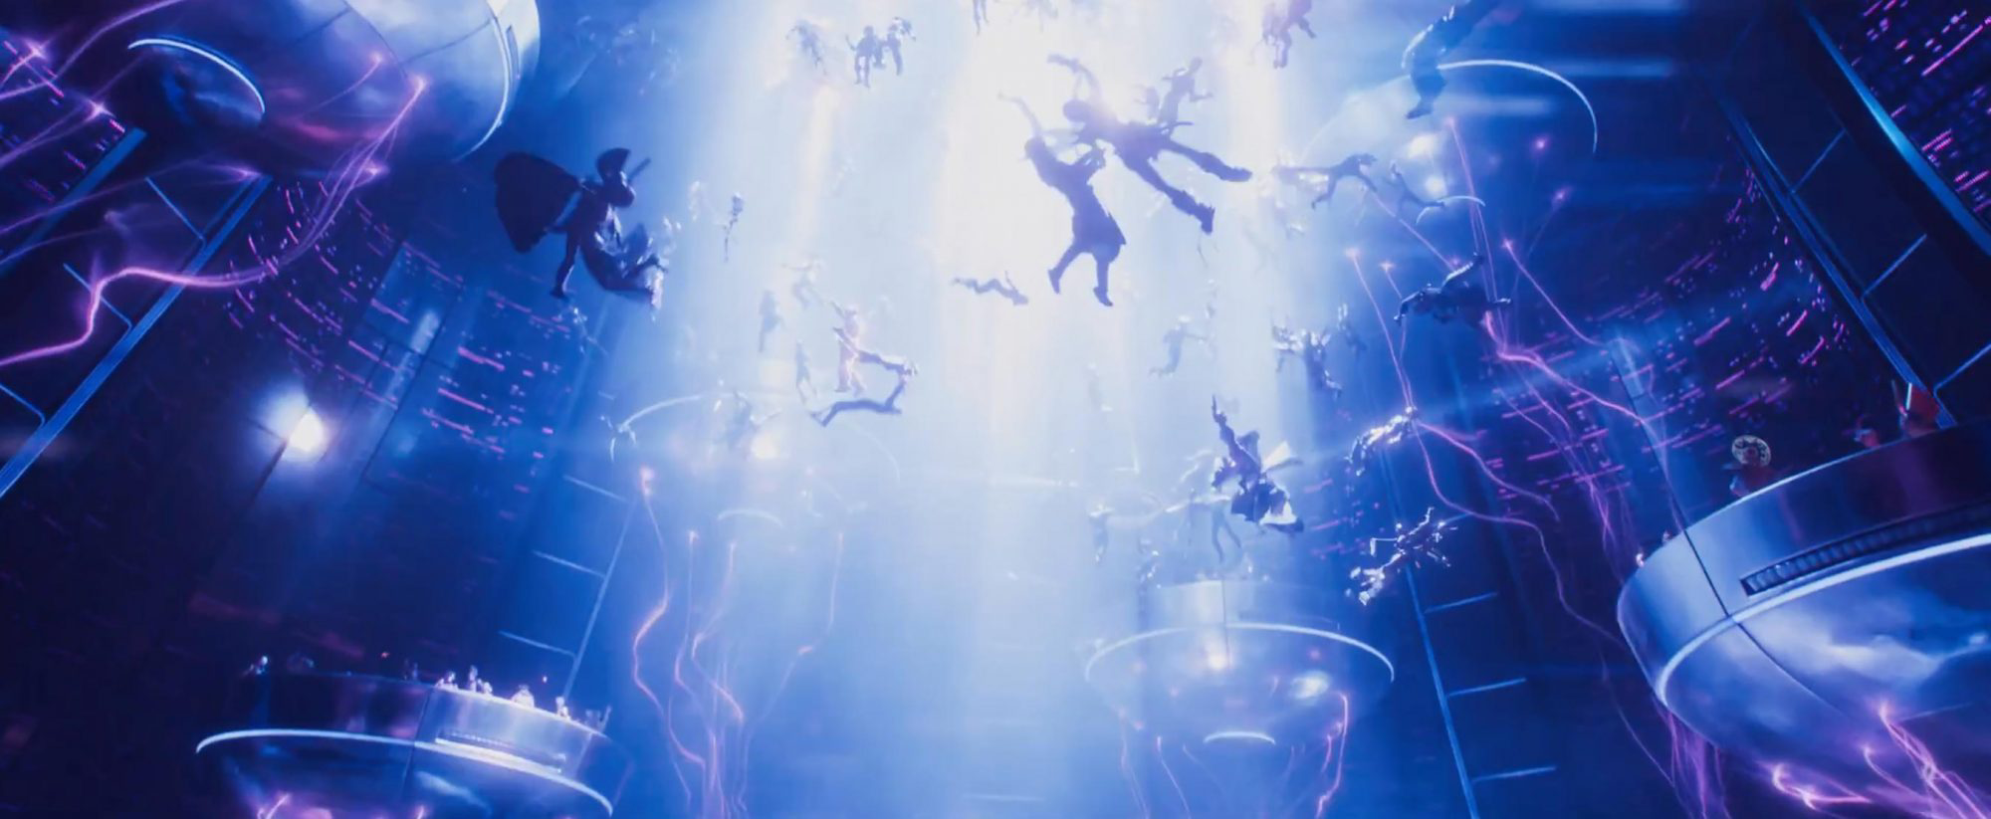
The HEDONIC METAVERSE
Notes:
Image from Ready Player One: https://ew.com/comic-con/ready-player-one-comic-con-trailer-easter-eggs/?slide=5705490#5705490

Slide 9
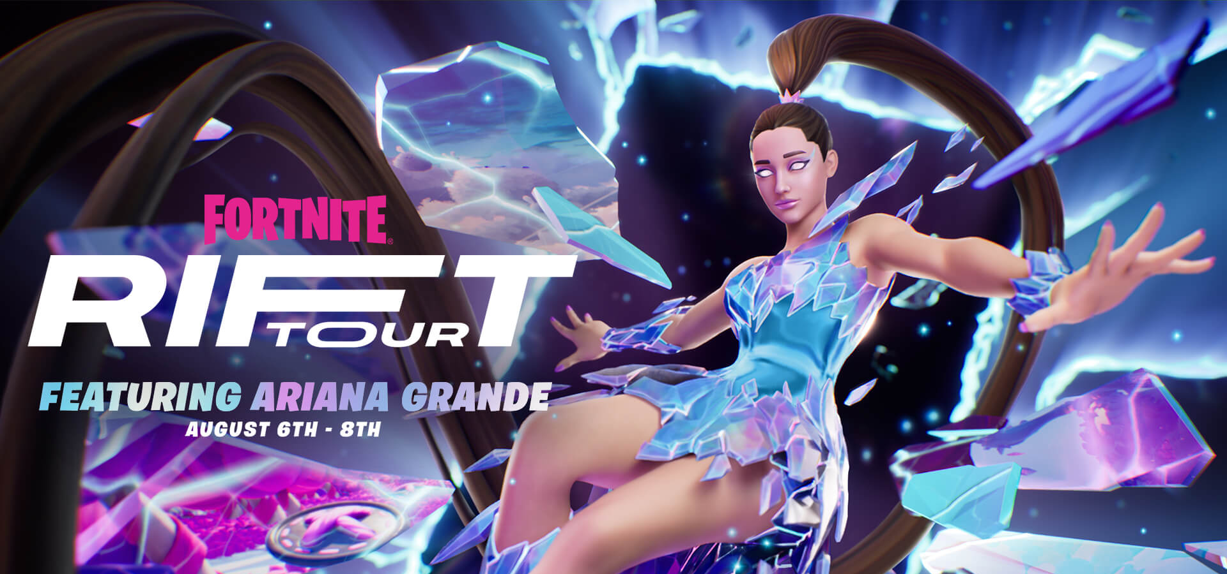
FORTNITE PRESENTS… THE RIFT TOUR FEATURING ARIANA GRANDE
Notes:
Image and Title from https://www.fortnite.com/news/fortnite-presents-the-rift-tour-featuring-ariana-grande

Slide 10
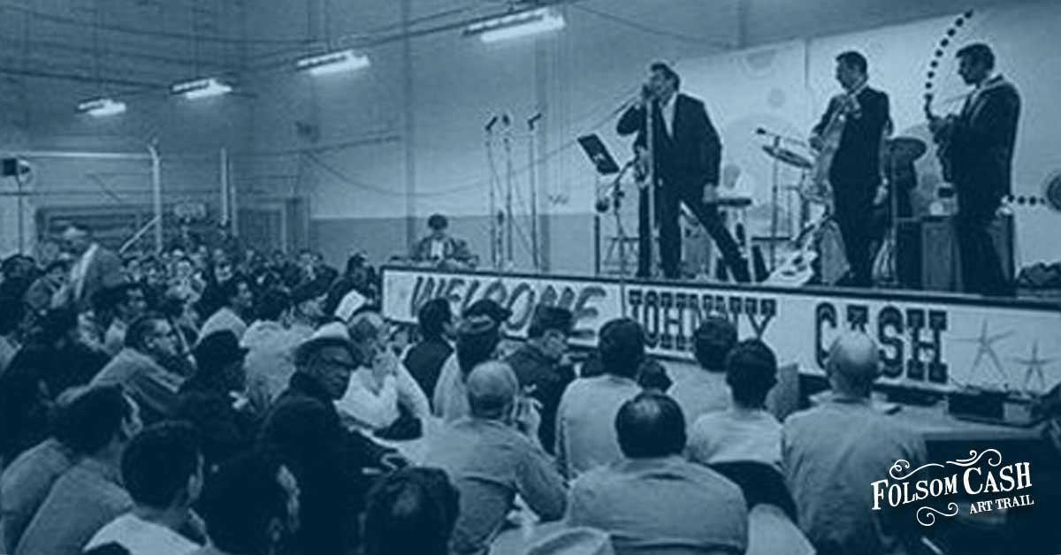
But wait, its still the game world, so its still the game?
An office party takes place in an office, a concert in a prison is still in a prison, and the world of the game is still by and of the game…
Notes:
These worlds are born of game worlds, they are still part and parcel OF these game worlds, there is a corporeality aspect to all of this
Johnny Cash image from: https://folsomcasharttrail.com/the-trail/blog/the-real-story-behind-johnny-cash-folsom-prison-blues

Slide 11
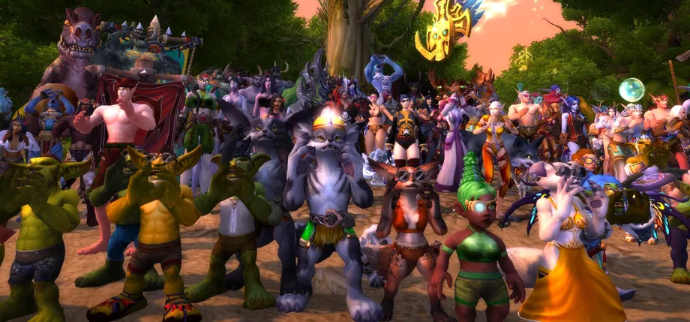
Also, crowds don’t work well in VR, OR IN MMORPGs, OR HONESTLY ONLINE AT ALL
Notes:
Image from https://www.polygon.com/23279429/world-of-warcraft-stranglethorn-bonfire-bash

Slide 12
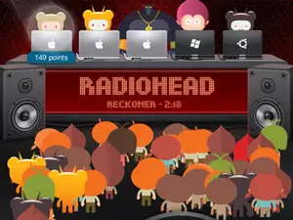
(HERES ONE THAT GOT IT CLOSER TO RIGHT?)
Notes:
Image from https://www.businessinsider.com/how-to-use-turntable-fm-2011-6

Slide 13
In 2016 the skyboxes of Azeroth were modified to include the depiction of Argon as a part of the World of Warcraft Legion expansion. This depiction included a decaying planet being ravished by demons. Player-organizer and festival co-founder Ragewine noted that “In 2017 when Argus had just made its dramatic debut into the skyboxes of Azeroth, the vibe as we partied under it was definitely: ‘This Is Fine. We’re okay with the events which are currently unfolding.’” (Marshall, 2022) Thus, the world in which the party occurs is always a part of the game, and thus the party and the game are inextricably linked by context.

Slide 14
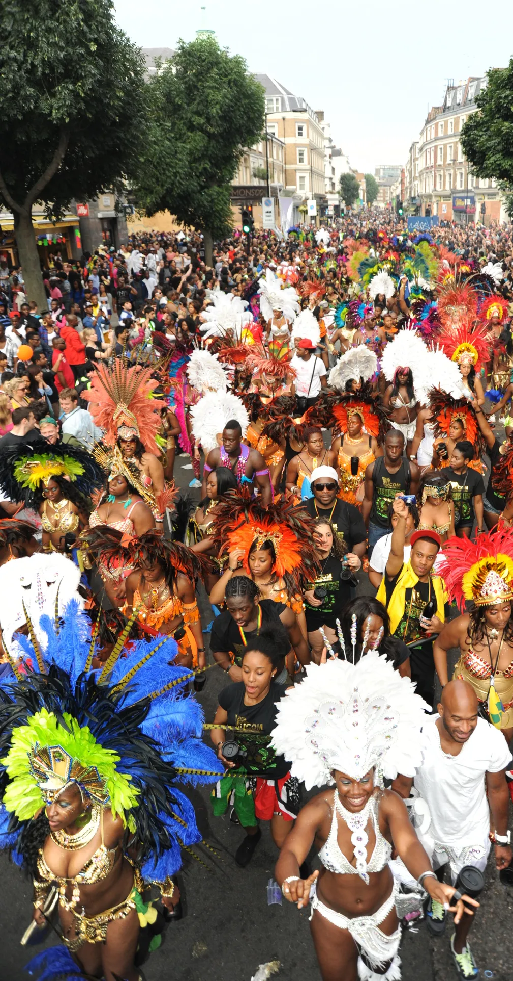
A recent study that explored attempts to digitalize London’s Knotting Hill Festival Caribbean Carnival during the global COVID-19 pandemic using tools such as Zoom noted on the difficulty of recreating in-person performance and audience, with one study participant describing the situation as follows: “Jerome quickly summarized three aspects of carnival in Notting Hill that cannot be replaced by the digitalscape: 1) carnival is a mass phenomenon; 2) it is a contextualized event embedded in its urban location; and 3) it is a multidisciplinary performance where soundscape is a determinant phenomenon.” (Gugolati and Kline-Thomas, 2022).
Notes:
Image by Miles Davies, reproduced by The Guardian at https://www.cntraveller.com/article/notting-hill-carnival-guide

Slide 15
CREATION & CURATION AS A WAY FORWARD?
This linkage between the game context and the party context is why, perhaps, some communities have specifically sought out platforms for which there is very little game context at all, such as Second Life or There.com
But what is interesting in these contexts is that, similar to Minecraft, Roblox, or several of the other platforms typically thought about under the umbrella of the ‘metaverse’ these platforms offer richer content creation tools for players, and are typically less combat- or competitive-game oriented.
In 2022, for the first time, the Stranglethorn Bonfire Bash was held not inside of World of Warcraft, but rather a customized and modded version of Word of Warcraft running via Epsilon

Slide 16
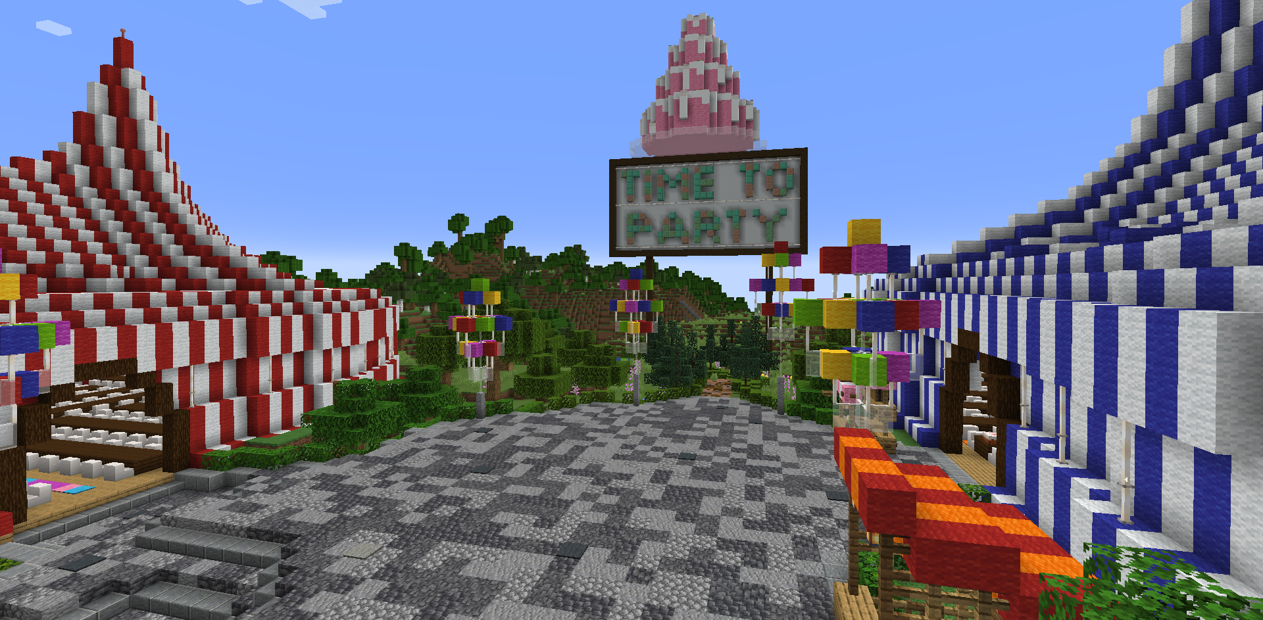
This perhaps is the eventual path these party worlds might take, with less focus on the game that got them there and more focus on customization, content creation, and experience curation. Right now, the games are the focus of creating an audience of scale, and a shared initial context to form friendships and networks, but as these platforms continue to mature it is unclear how this will evolve.
Notes:
Image from https://www.sandlotminecraft.com/threads/sandlot-10th-anniversary-party-world.37046/

Slide 17
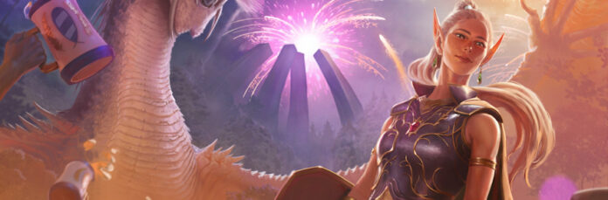
CONCLUSION
It is perhaps an open question as to whether the current form of virtual worlds, given the technology, can ever rise to a definition of party commensurate with the real, or can at best only mimic the deeper, humanistic needs we attend parties in the first place.
Notes:
Image from https://massivelyop.com/2023/03/17/classic-everquest-celebrates-24th-birthday-with-new-mission-new-quests-and-xp-bonus/

Slide 18
AFTERWARD
Ros Alexander: “Ever since I have known [Notting Hill Carnival], ever since I was nine years old, there’s always been a move to try and cancel, move it, shift it. […] The digitalness of it now potentially raises the risk of Notting Hill being changed, there’s potentially the risk that it might go in the park. If you have the money to pay for it, you can pay and enter. If you’ve got a very large family and you don’t have much money … [pauses]. So, it becomes a gentrified event for those people who don’t necessarily understand how important it is. With carnival, you’re not only a spectator but you’re a performer. So, you’re taking away that from the people whose culture it is a part of. But then you have these spectators who… yes, it’s great to look at, but do they understand?” (Gugolati and Kline-Thomas, 2022)

Slide 19
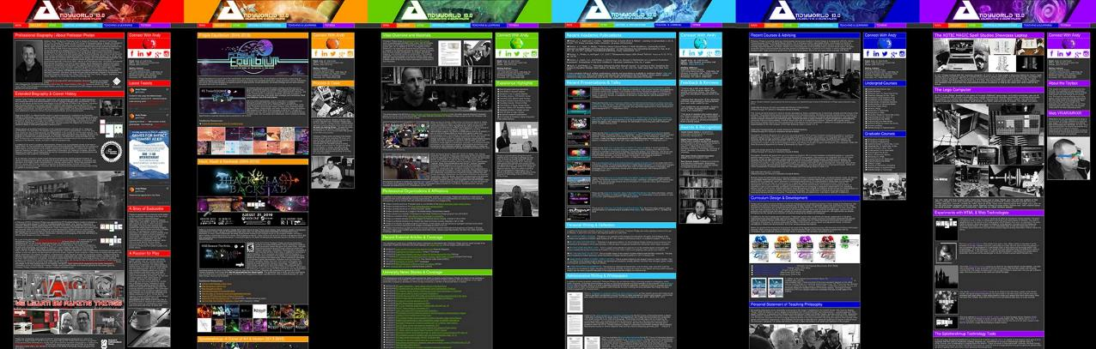
ANDYWORLD.IO | PROFESSORANDREWPHELPS.NET | @ANDYMPHELPS | ANDYMPHELPS@GMAIL.COM
Thanks & Questions

