Slide 1
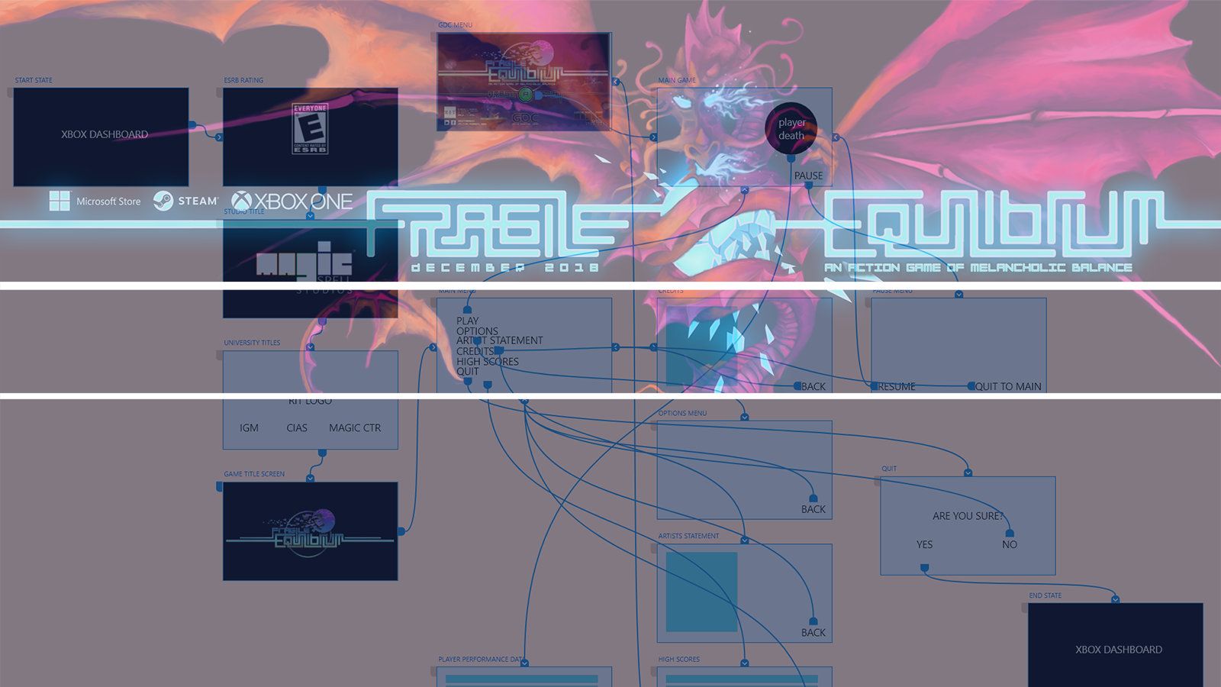


XD 4 GAMES EDUCATION
Andrew Phelps
Professor of Art & Design, Rochester Institute of Technology
Founder, RIT Center for Media, Arts, Games, Interaction & Creativity
Founder, MAGIC Spell Studios, LLC & Founder, RIT School of Interactive Games & Media
President, Higher Education Video Games Alliance
LOS ANGELES, CALIFORNIA
ADOBE MAX 2018

Slide 2
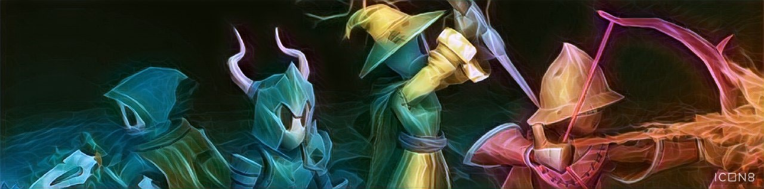
PRESENTATION OVERVIEW
Background of who I am and what I do
Why games with respect to UI/UX?
Why XD? What are we hoping to accomplish?
Future work and potentialities

Slide 3
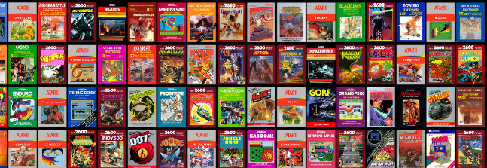

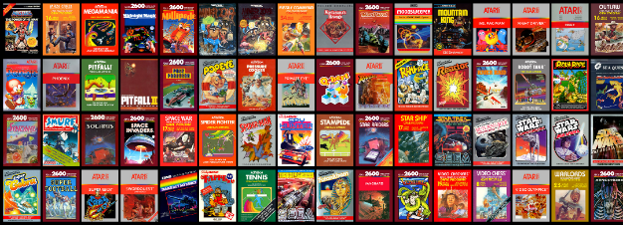
Background of who I am and what I do

Slide 4
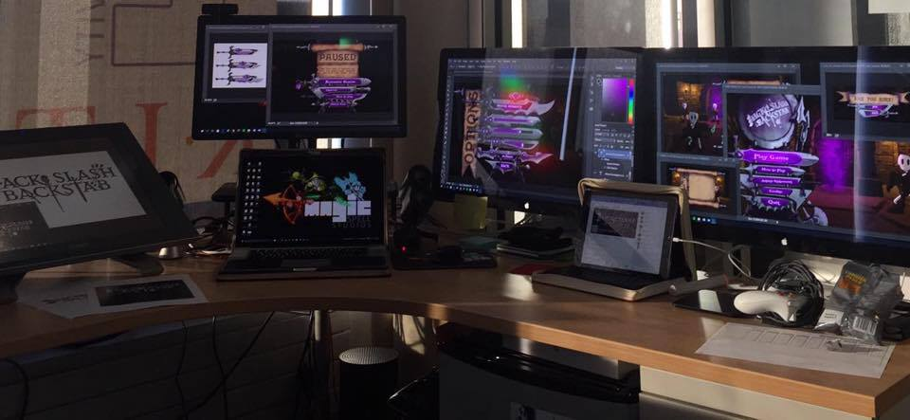
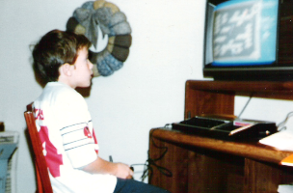
I make things.

Slide 5

RIT GAMES & INTERACTIVE MEDIA TIMELINES
2001 programming
First course in games programming
2002
Electronic Gaming Society
2003
CS/IT Concentration in Game Prog
2006
MSc Game Design & Development
2007
BSc Game Design & Development
2009
Dept. of Interactive Games & Media
2011
School of Interactive Games & Media
2012
Minor in Game Design
2013
RIT Center for Media, Arts, Games, Interaction & Creativity (MAGIC)
2013
MAGIC Spell Studios ®, LLC
2016
$30M MAGIC Spell Studios Initiative
2016
NY State Games HUB
2017
NY State Games Challenge

Slide 6
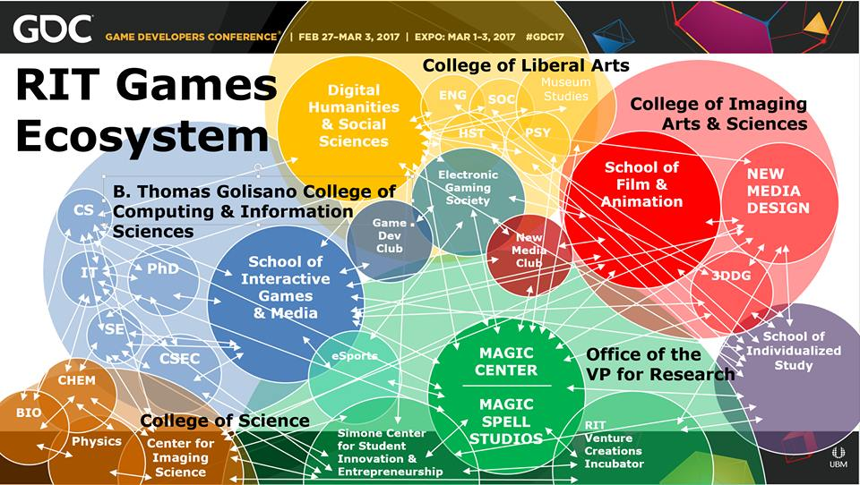

Slide 7





INCREDIBLE ALUMNI
ALEX CUTTING
Senior Assoc. Producer HALO
Microsoft / 343
CLAUDE JEROME
Gameplay Designer DESTINY
Bungie
DUSTIN KOCHENSPARGER
Line Producer DLC
DESTINY
Bungie
SELA DAVIS
Platform Engineer
XBOX / XBOX Live
Microsoft
VReal
ANNA SWEET
Director of 3rd Party Development
STEAM
Valve
Oculus
Caffeine.ty
Microsoft XBOX

Slide 8
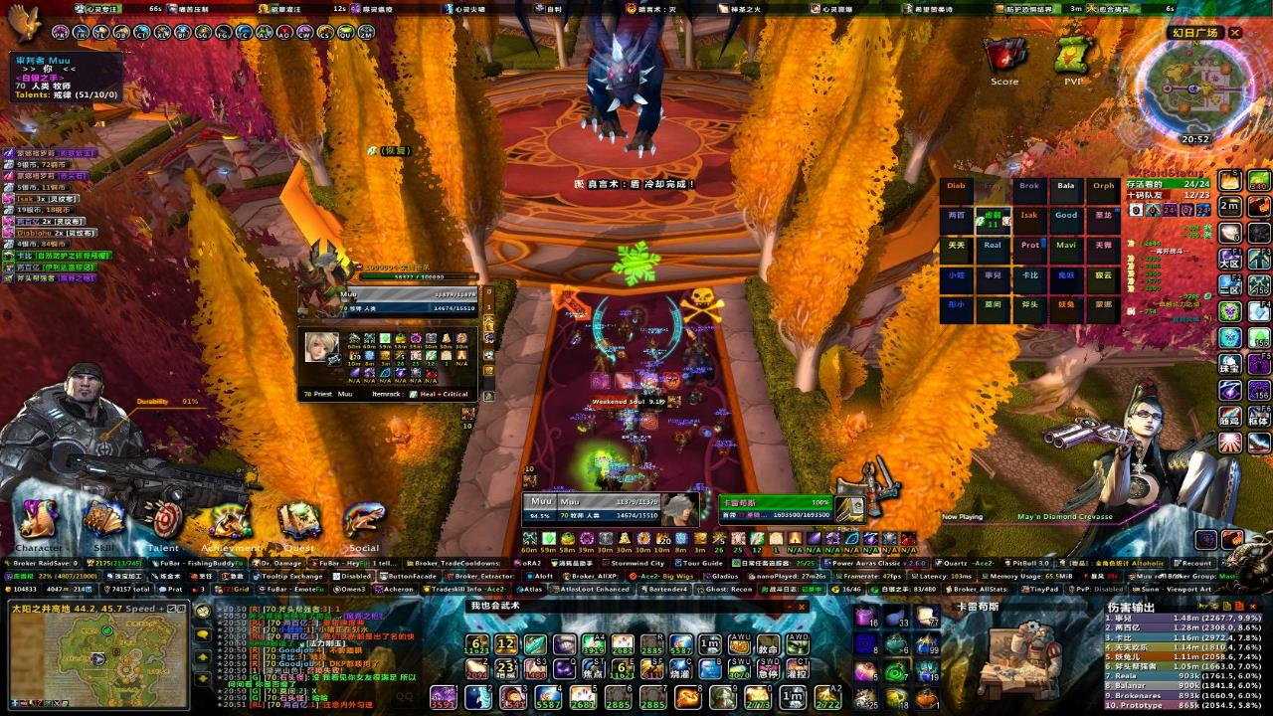
Why games with respect to UI/UX?
Games are complex
Games depend on a variety of inputs and controllers
Games are often customizable by the player
Games are increasingly called upon to be accessible
Games have different needs than traditional software or web applications
Games depend on effective real-time interaction
Games cannot break the immersion of the player
Games borrows from everything else, like Frankenstein
Games are experimental

Slide 9
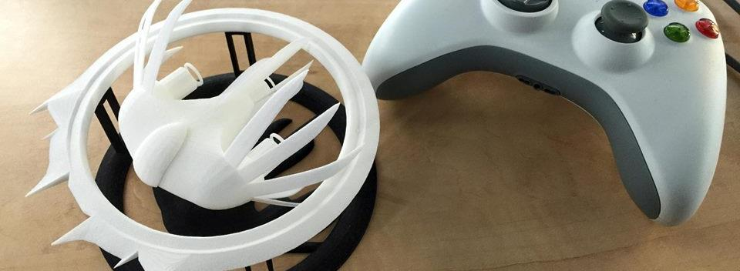
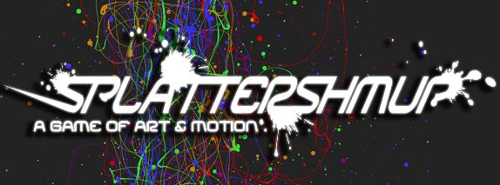
A Strange Game for Strange Reasons
This game taught us (the campus) about making things, production, and scale
This game allowed us to explore using typical game forms for telling a unique story to a very targeted audience
Finalist at GLS Education Arcade, accepted to DiGRA Blank Arcade, and IndieArcade at the Smithsonian American Museum of Art
SPLATTERSHMUP.RIT.EDU – PLAY TODAY! MAKE ART!

Slide 10

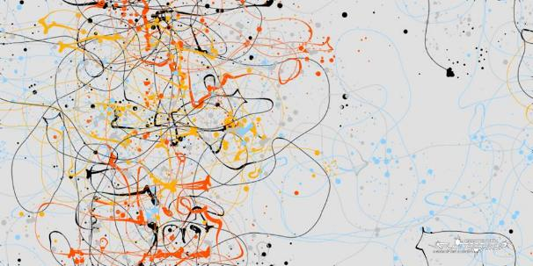
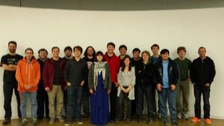
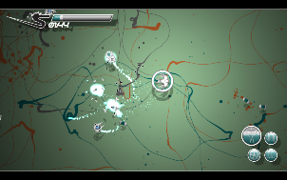
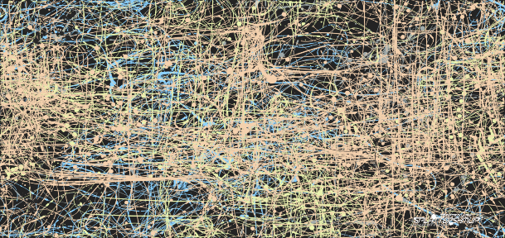




Slide 11
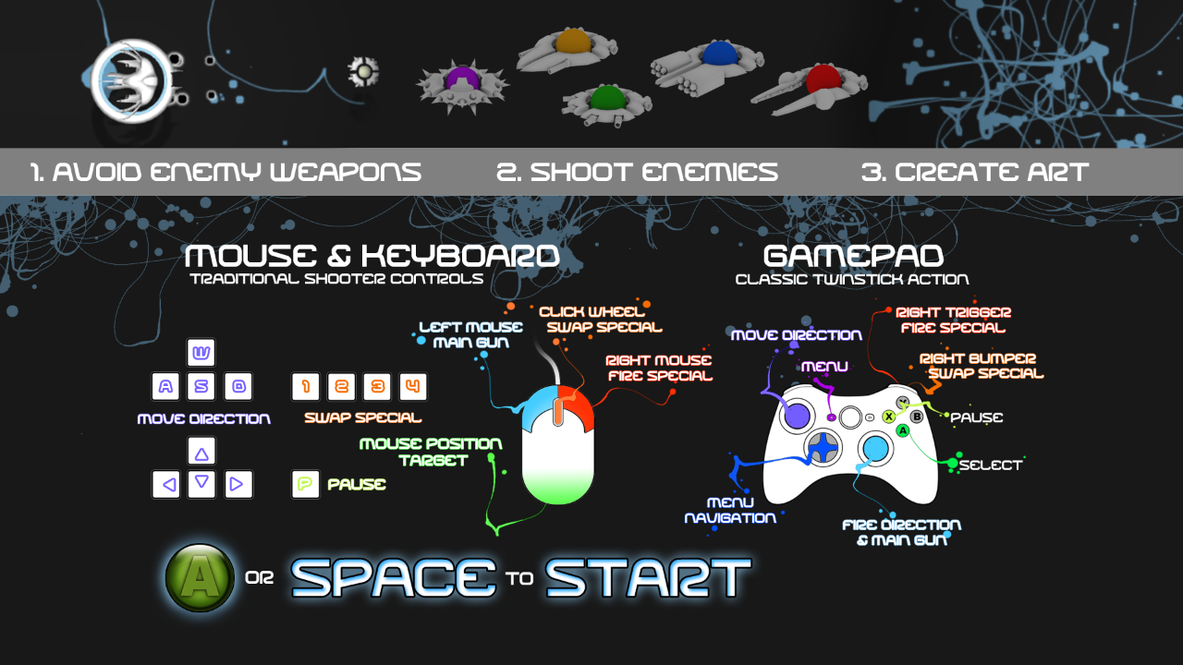

Slide 12


Slide 13
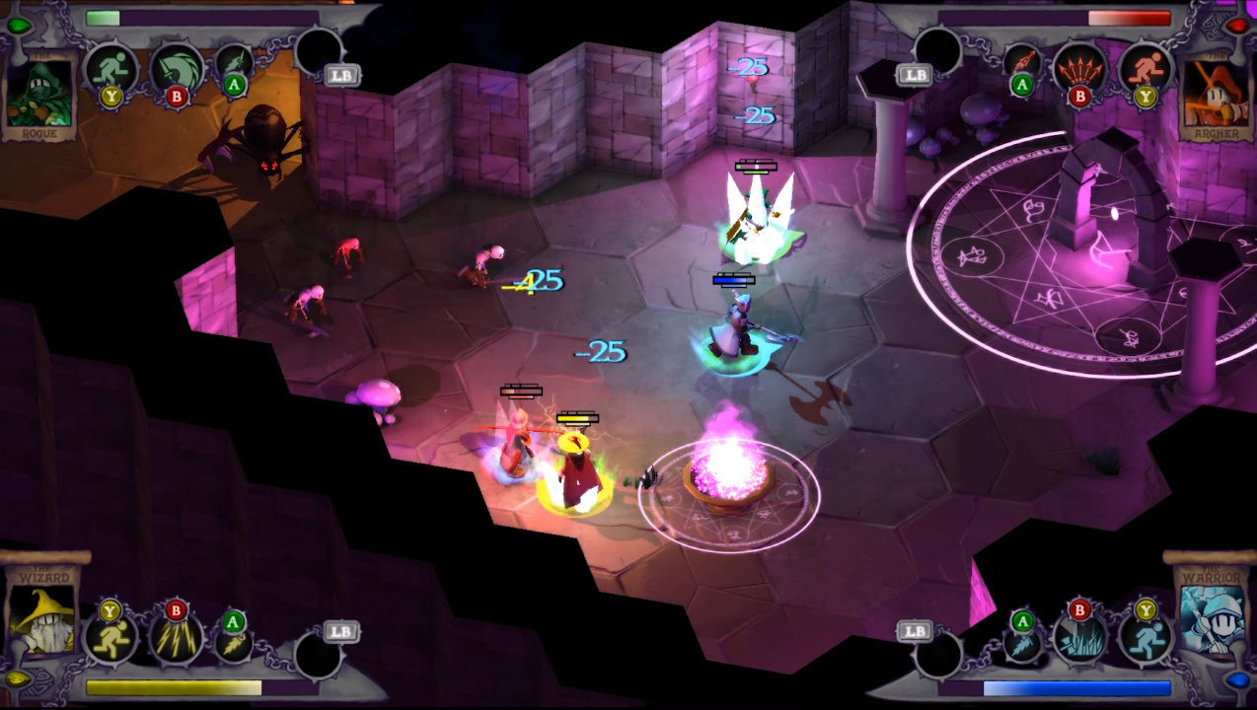
IN-GAME UI/UX ELEMENTS,
INTERACTIVE CONTROLS,
& FEEDBACK ELEMENTS

Slide 14


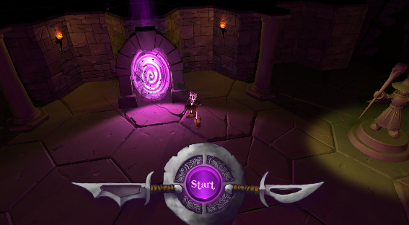
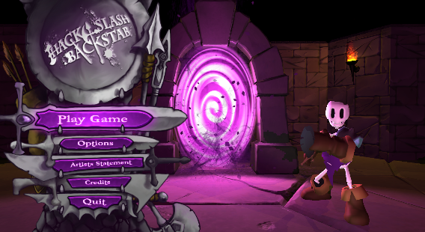
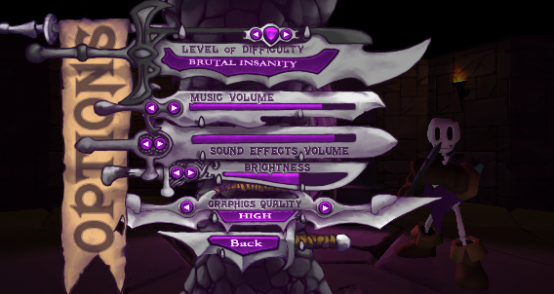
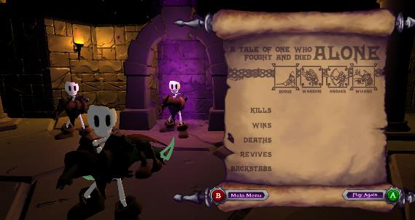
OUT OF GAME UI/UX, MENUS, REPORTING, AND TIE-INS

Slide 15
Structure & Schedule
ANDY
CTO
OPERATIONS MANAGER
Art schedule was fixed at about week 4, for the bulk of the semester (character and anim every 2 weeks)
Dev was more fluid, need based, iterative for specific features & systems... but still time-tasked
AGILE development model, SCRUM based, iterative in all areas, report outs between teams & managers
CREATIVE DIRECTOR
COMMUNICATIONS
OFFICER
PROJECT MANAGER
ART TEAM
AUDIO TEAM
DEV TEAM
UI/UX TEAM

Slide 16
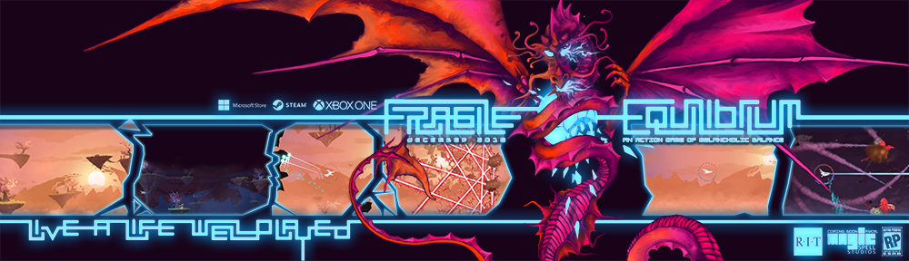
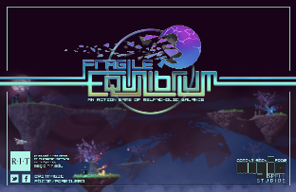
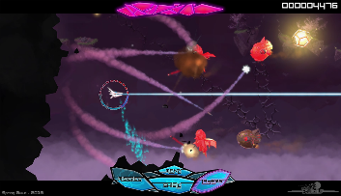
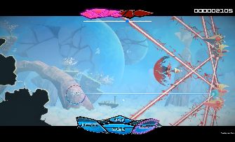
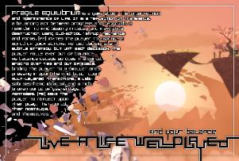

Slide 17
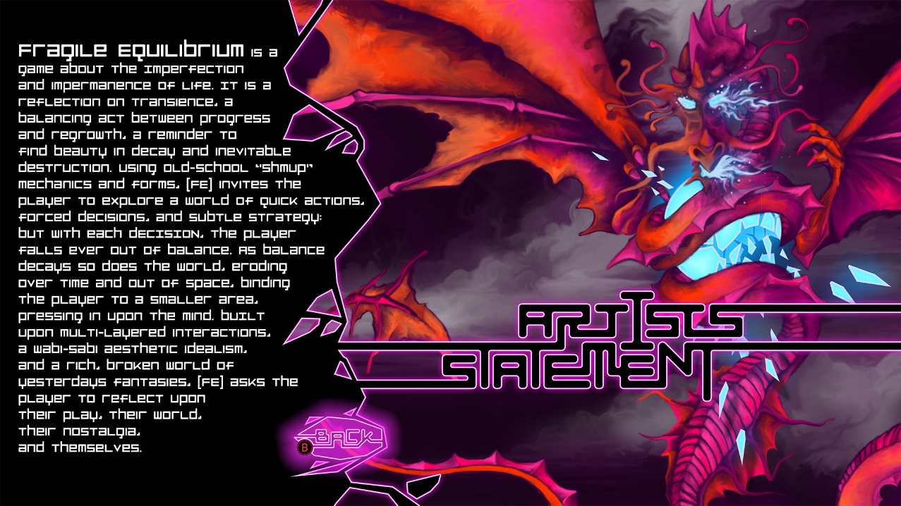

Slide 18
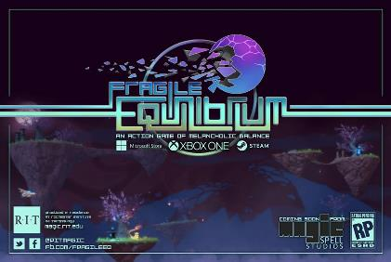
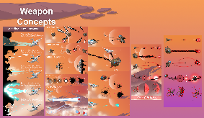
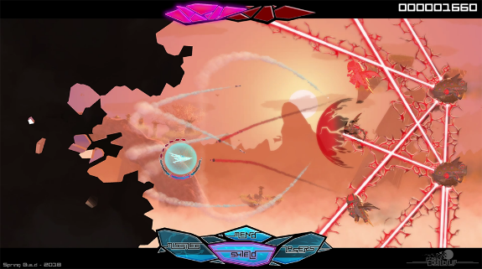
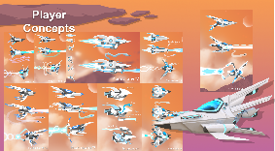
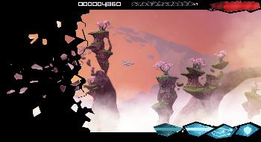
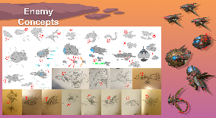
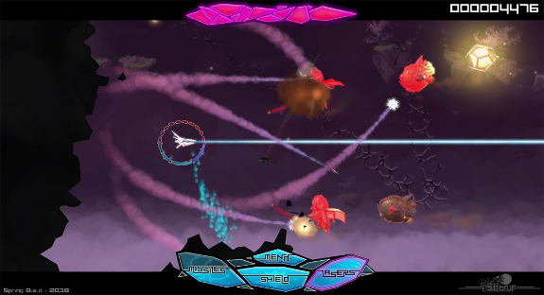

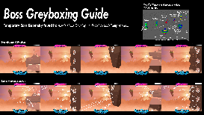
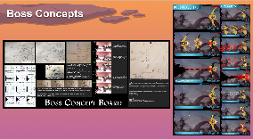

IN GAME UI, DESIGN, GAMEPLAY, ETC.

Slide 19

Why XD? What are we hoping to accomplish?

Slide 20
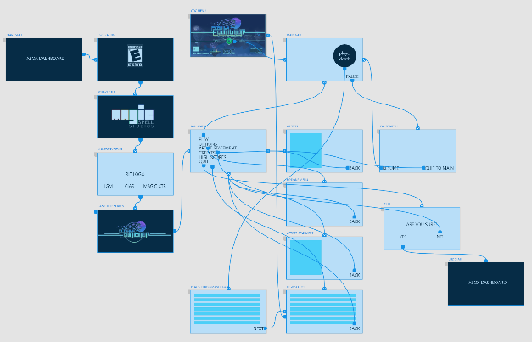
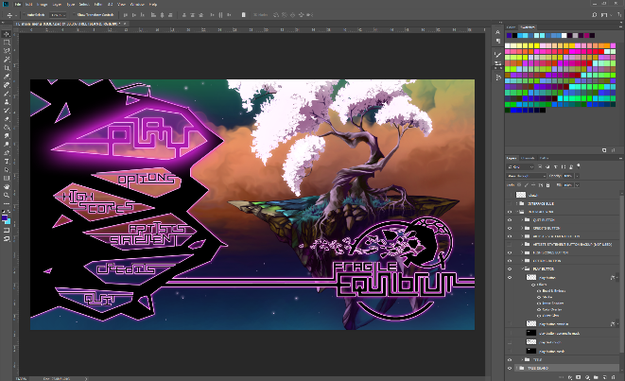




OUT OF GAME UI/UX and MENUFLOW

Slide 21
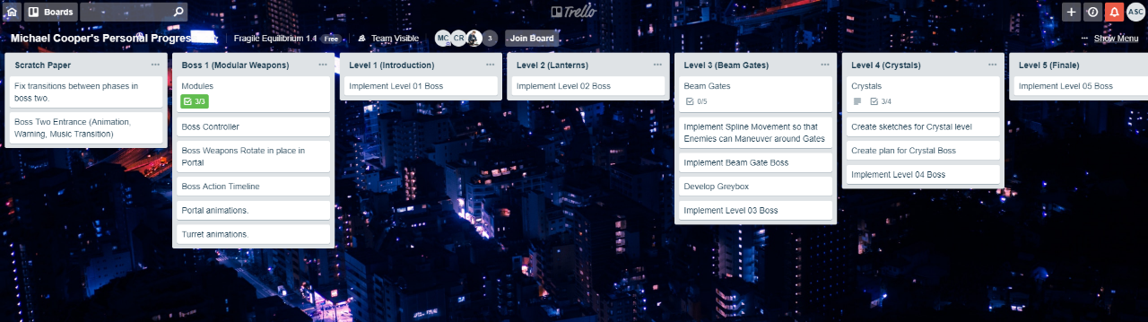

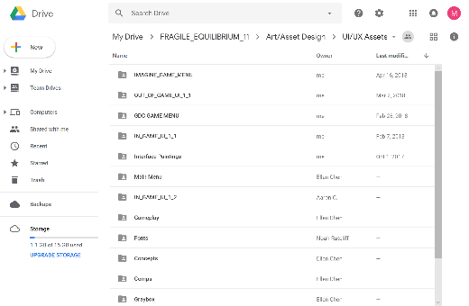
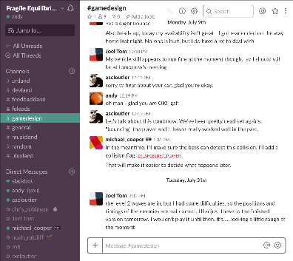

COMMUNICATIONS INFRASTRUCTURE

Slide 22

WHAT BIG PROBLEMS ARE WE TRYING TO SOLVE?
COMMUNICATION – Things get “Lost in Translation” between UI/UX design and dev/engineering…
INFORMATION FLOW – Are there ways to get “trapped” in a given area or interface?
DEVELOPMENT TIME – What can get tested outside the game, without deep engineering engagement?
RESOLUTION INDEPENDENCE – The format and scale of 4K interfaces mean things *move around* a bit, layout isn’t constant. Aspect ratios are imperfect specs, screens are variable…

Slide 23
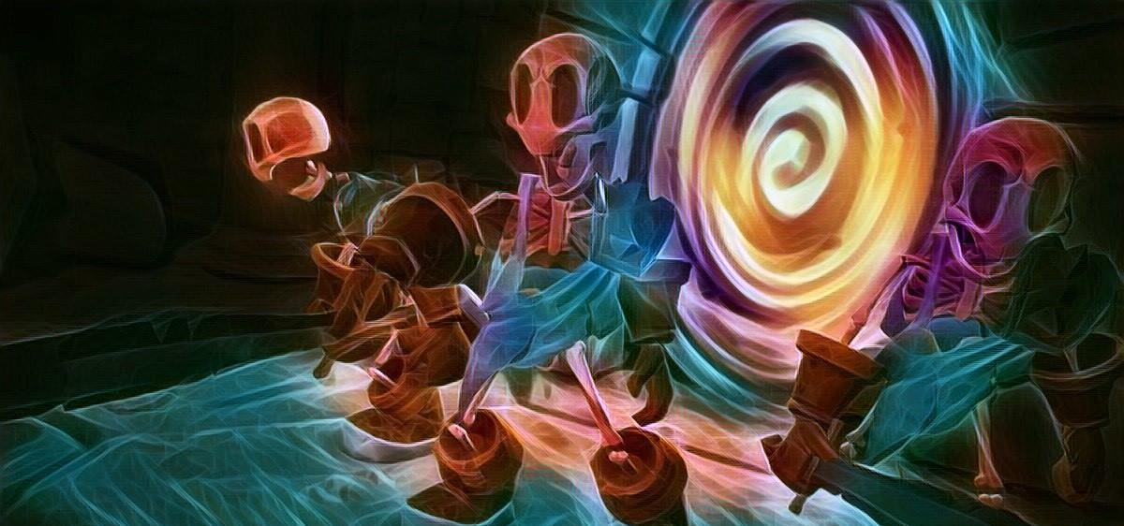
A Love Note on platform requirements
Required length of time for particular screens
Required animation per screen (aka “not dead yet!”)
If the controller is ripped away, what happens?
If the controller is mis-queued, what happens?
If the input is re-mapped, what happens?

Slide 24
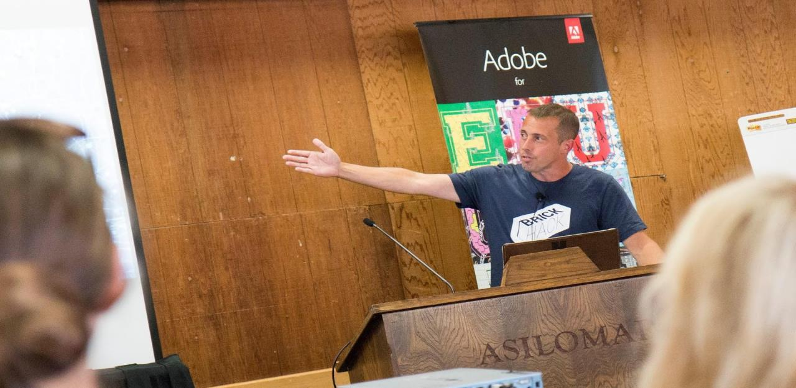
Future work and potentialities

Slide 25

Ideas for the future
REAL SUPPORT FOR GAME CONTROLLERS
  Game controllers are actually really complex…
  Starting with “mapping” support in XD
  Moving towards surfacing additional elements and data
  Ultimately towards “feel” of alternate interfaces
Still in its infancy, and still in development, but a dedicated focus and exciting crew to work with! Thanks Adobe!
Excited to be working with this group on these problems ☺

Slide 26
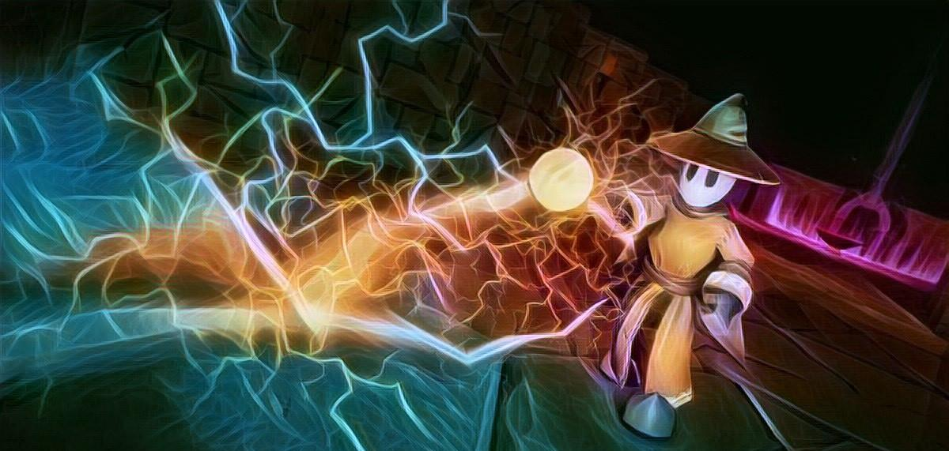
RECOGNIZING THE COMPLEXITY OF THE ISSUES INVOLVED
Engagement with games and interactives as a segment
Consoles, remotes, services, as an integrated content pipeline
First comes mapping, later direct support

Slide 27
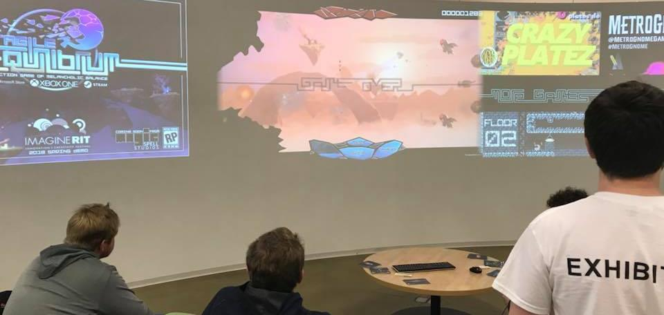
THANKS ADOBE
We all recognize we know a part, but not all, of this puzzle
Scale is a primary concern, from every axis
Small steps towards great things
Building additions to XD that support real work at real scale in games & media product development
Oh, and please play our games & hire our students ☺

Slide 28
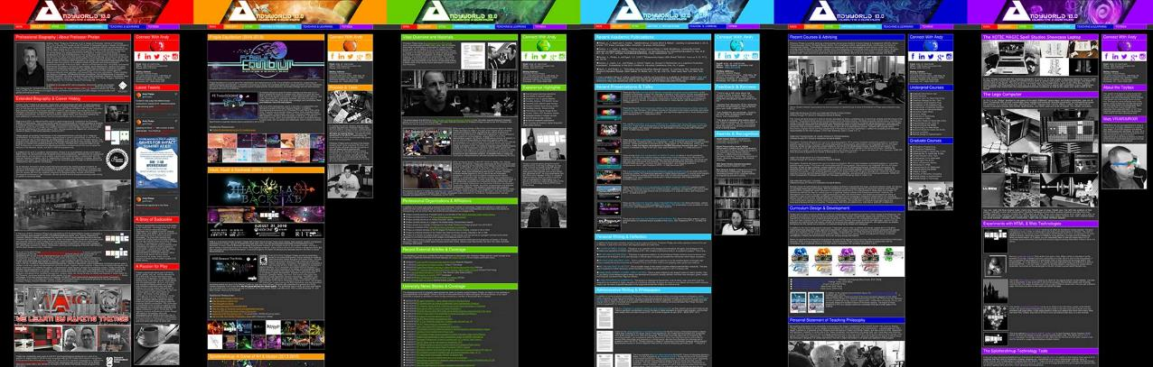
ANDYWORLD.IO | PROFESSORANDREWPHELPS.NET | @RITIGM1 | ANDY@MAIL.RIT.EDU

Slide 29
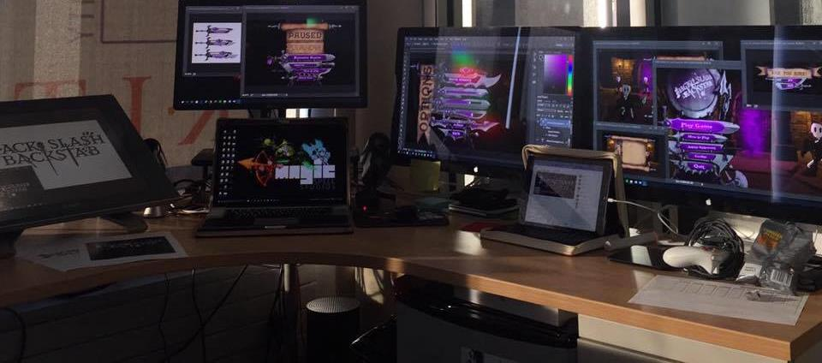
Thanks & Questions
andy@mail.rit.edu | andyworld.io| @ritigm1

