Slide 1


A RETROSPECTIVE AND REEXAMINATION OF TEACHING AND LEARNING GAMES
SALT LAKE CITY, UTAH
Andrew Phelps
President, Higher Education Video Game Alliance
Professor of Art & Design, Rochester Institute of Technology
Founder, RIT School of Interactive Games & Media
Founder, RIT MAGIC Center & MAGIC Spell Studios

Slide 2

Today’s Talk
A bit about me
A bit of lived experience in teaching games for a while
A bit about some of the games I’ve made
A bit about future directions and research and why
A bit on what I think that means for teaching games writ large
Q&A
Hopefully through all of that, some sense of me, my approach, my values, and relevant practices to borrow / bits to steal comes through…

Slide 3
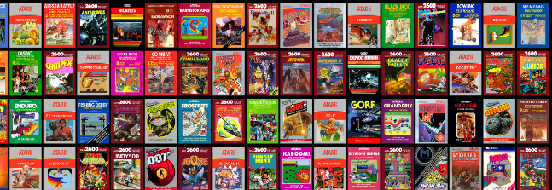

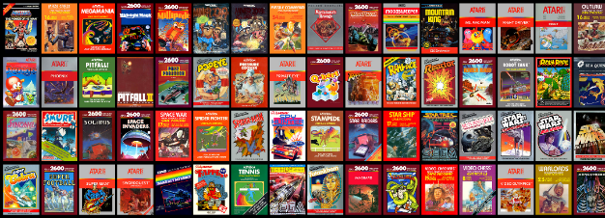
HI, I’m ANDY

Slide 4
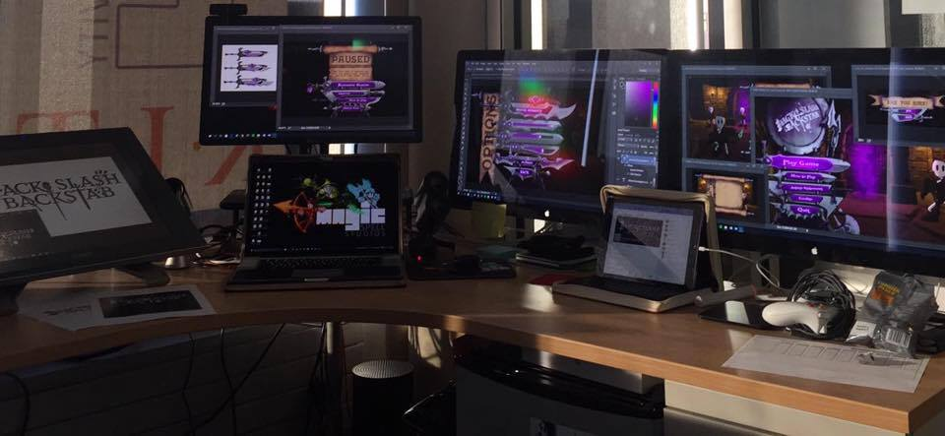
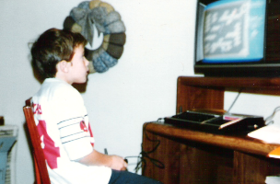
I make things.

Slide 5
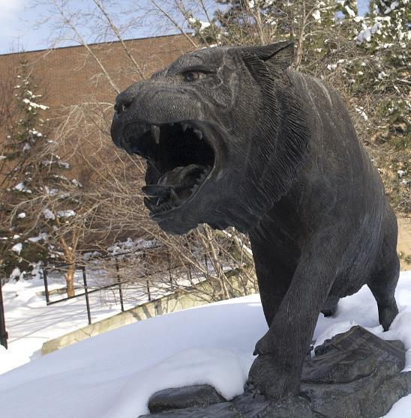
RIT GAMES & INTERACTIVE MEDIA TIMELINES
2001 programming
First course in games programming
2002
Electronic Gaming Society
2003
CS/IT Concentration in Game Prog
2006
MSc Game Design & Development
2007
BSc Game Design & Development
2009
Dept. of Interactive Games & Media
2011
School of Interactive Games & Media
2012
Minor in Game Design
2013
RIT Center for Media, Arts, Games, Interaction & Creativity (MAGIC)
2013
MAGIC Spell Studios ®, LLC
2016
$30M MAGIC Spell Studios Initiative
2016
NY State Games HUB
2017
NY State Games Challenge

Slide 6

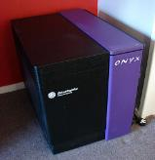
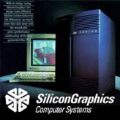

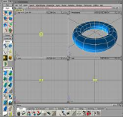
Art|dev|EDU|art|ADMIN|dev|art

Slide 7
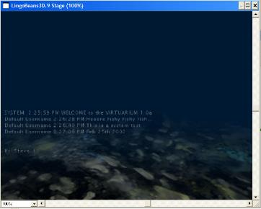

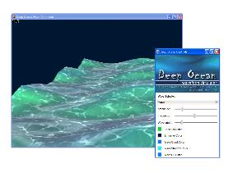
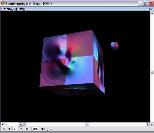
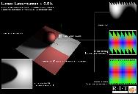

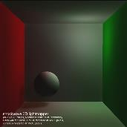


Prior to games / early years
Brand new faculty in Information Technology teaching database, web development, systems programming. (from a thesis in multi-user narratives and virtual worlds)
Quickly tasked to re-engineer the graduate program from which I had just graduated
On the ground floor of work to establish ABET accreditation in Information Technology
Proponent and leader of movement to promote ‘active learning model’ and ‘lab based instruction’
Personal research focus on creating artist and casual tools that allowed for content creation by less technical practitioners…

Slide 8
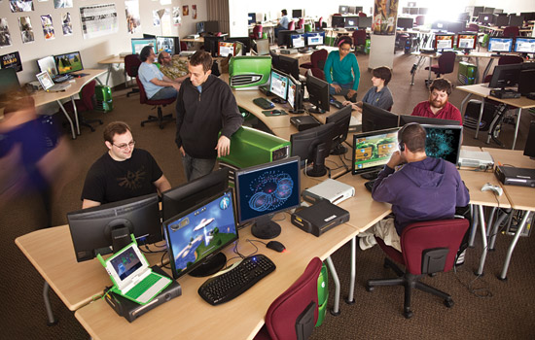
GAME DESIGN & DEVELOPMENT & WHY & HOW
Really, really humble beginnings in 2000 or so
The NYT covered my intro course, and my mom saw it before me
RIT is a very applied, very engineering-oriented place
There was an ongoing culture war around application and games stepped into the middle of it
I was someone with an art background developing an MS degree in a (soon to be) college of computing and information science (eeeeek)
“A Little Bit Of Everything Goes A Long Way”

Slide 9
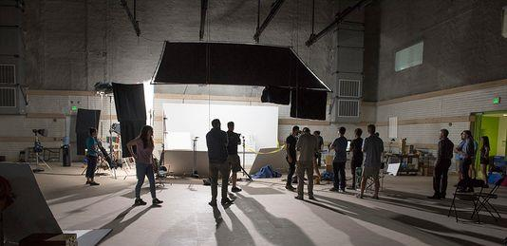
EVERYONE KNOWS WHAT I DID.
I’m THINKING A LOT MORE ABOUT WHY.

Slide 10
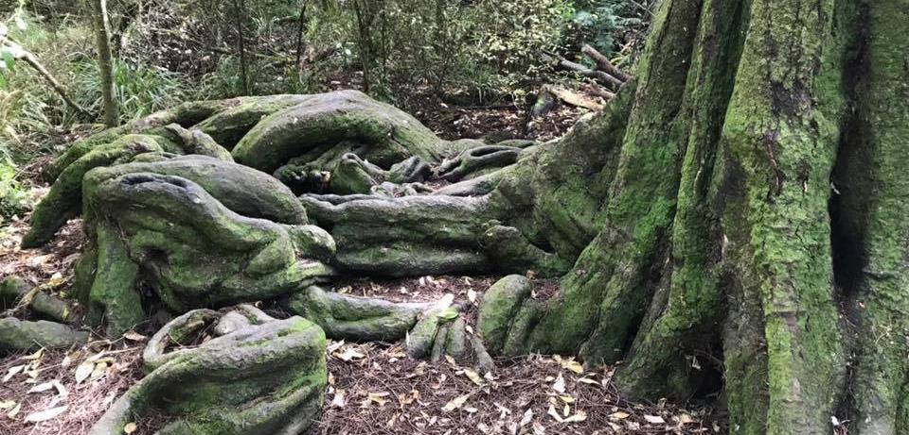
GAME DESIGN & DEVELOPMENT ROOTS
Stories
Mechanics
Rules
Culture
Entertainment/Play
Art
Music
Computing
… [and more]

Slide 11
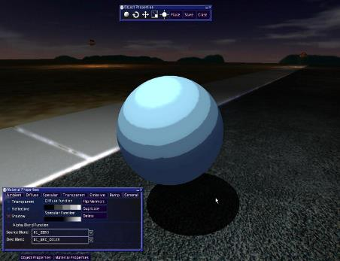
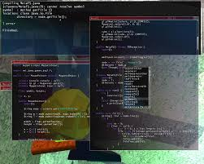
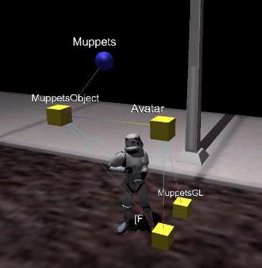
MUPPETS CVE FOR INTRO DEVELOPMENT
Notes:
Published in ACM SIGCSE, ACM QUEUE, SIGGRAPH, ETC. SUPPORTED OTHER FACULTY IN VIRTUAL THEATRE COURSE.
ALICE for GAMES AESTHETIC

Slide 12
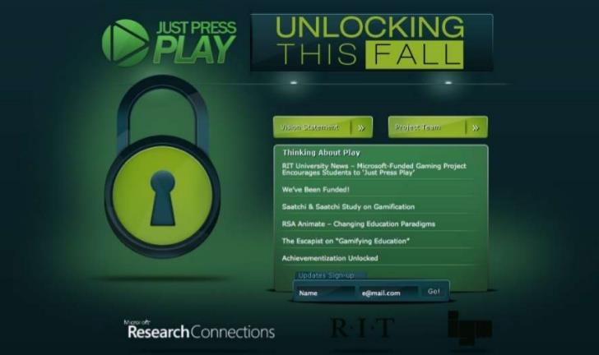
Notes:
Funded by Microsoft Research on games & learning. Three-tier development, cloud based deployment, database coupling

Slide 13
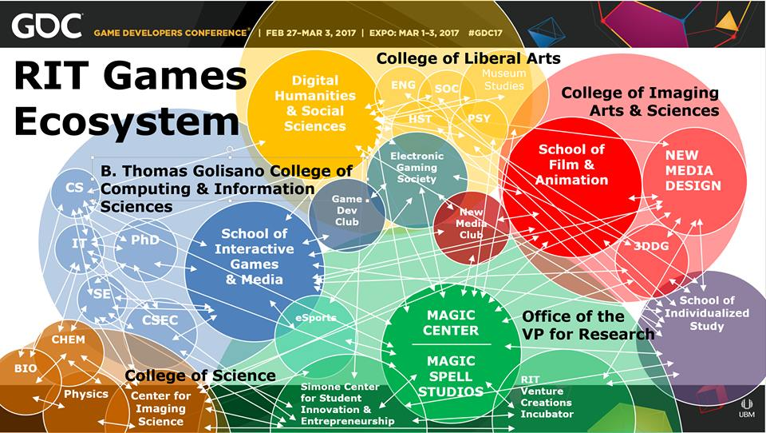

Slide 14


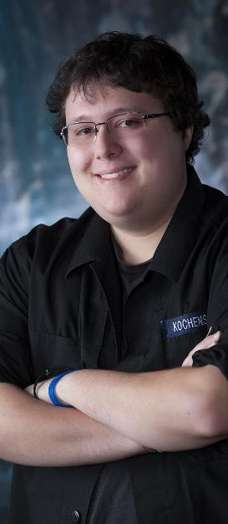


INCREDIBLE ALUMNI
ALEX CUTTING
Senior Assoc. Producer HALO
Microsoft / 343
CLAUDE JEROME
Gameplay Designer DESTINY
Bungie
DUSTIN KOCHENSPARGER
Line Producer DLC
DESTINY
Bungie
SELA DAVIS
Platform Engineer
XBOX / XBOX Live
Microsoft
VReal
ANNA SWEET
Director of 3rd Party Development
STEAM
Valve
Oculus
Caffeine.ty
Microsoft XBOX

Slide 15
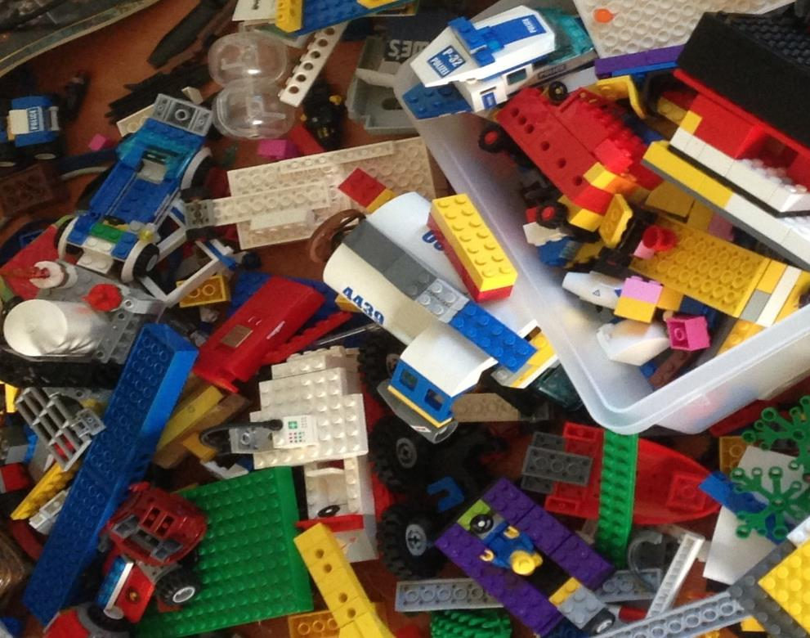
'protecting “making as a
mode of inquiry”’
-Ian Horswill, Northwestern
Notes:
This quote is from Ian Horswill, who said it, I think the first time? sitting on the floor of Microsoft Research at the MSR Faculty Summit a number of years ago. It has been rolling around in the back of my brain ever since – and it was the fundamental thing upon which MAGIC was founded, that somehow design research, making prototypes to test ideas, learning by making new things and new experiences, needed to be recognized and valued. At RIT we’ve sometimes used the rhetoric of STEM and Research to de-value those activities in weird ways.

Slide 16
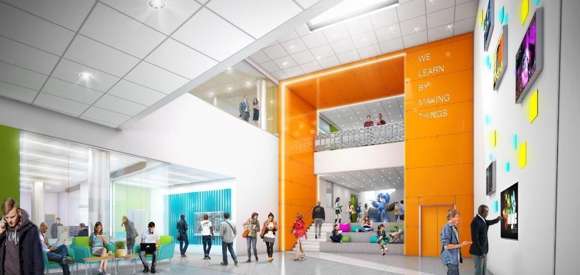
WE LEARN BY MAKING THINGS
Notes:
This is an architectural rendering of the lobby of the new MAGIC Spell Studios building. It will display our tagline ‘We Learn By Making Things’ which is based in part off of Ian’s statement, and reflection that this is a core value of RIT (whether it remembers it all the time or not ;) )

Slide 17
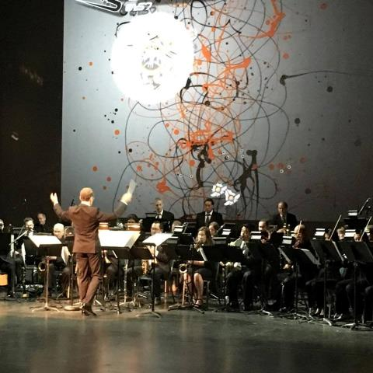
Why IS MAGIC?
C O N V E R G E N C E
C O N V E R G E N C E
The platforms and technology for film, animation, games, media, and story are converging into new forms, new stories, new experiences, and new knowledge.
Notes:
And so we started a multi-disciplinary research center, which is basically the hardest damn thing you can do on a modern college campus. They usually fail by becoming little islands, or by becoming a kind of ‘not really there’ virtual thing, and we’ve run into both of these views as we continue to engage the campus. Nonetheless, we think there is something profound happening in the field right now that is driving the kinds of things we are doing – everything is mashing up on each other. My favorite example of this is the MARVEL extended universe, which is so many different products and experiences rolled together. But there are countless examples big and small. This picture is from the RIT West Coast board meeting where they showed one of my games set to a live orchestra composition directed by Trustee Kevin Surace. Pretty cool.

Slide 18
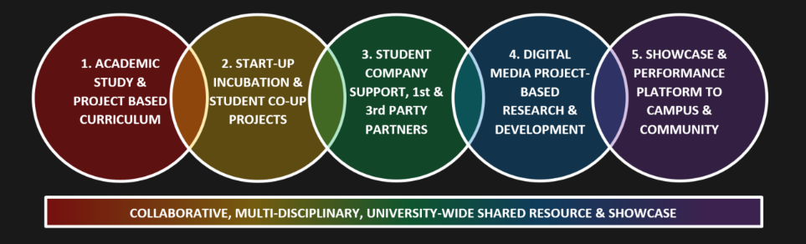
CONVERGENCE OF ANOTHER SORT
Notes:
But there’s another kind of convergence in higher ed right now that has played into MAGIC – this business of bright hard lines between teaching and research, between academic projects, commercial projects, entrepreneurship, technology transfer, etc. is another kind of mashup. The role and purpose of the university is changing in the post-industrial economy, even as it stays true to its roots in the enlightenment (if it can). This idea of little bits of fiefdom for individual programs or little research labs is breaking down because it doesn’t scale, and we’re trying to do something different and profound at MAGIC that links together our work and practice.

Slide 19
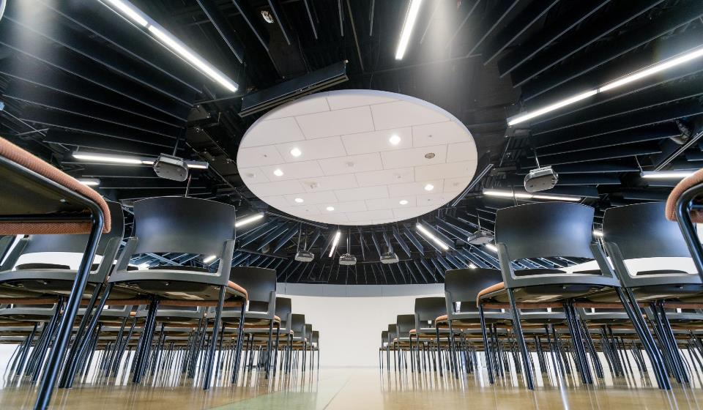


HOW IS MAGIC:
A VERY IMPORTANT DIVISION:
Notes:
Right from Bill’s ‘idea lab’ paper was the idea of an entrepreneurial effort inside the center to help publish and commercialize the things we make. We wanted to call it ‘MAGIC Studios’ at first but we were very afraid we’d get in trouble with The Mouse.

Slide 20
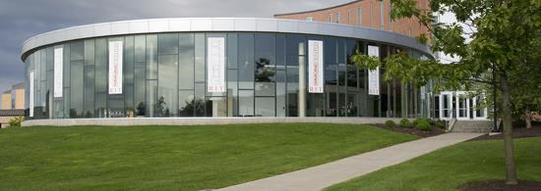

MAGIC TODAY & TOMORROW
Notes:
So let’s take a little look at where we are today, in our current home, what we’ve built, where we are going.

Slide 21

…The M is for Messy
Notes:
The M is for Messy.

Slide 22
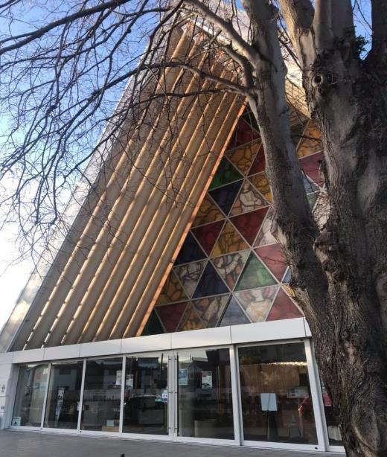
Teaching game production

Slide 23
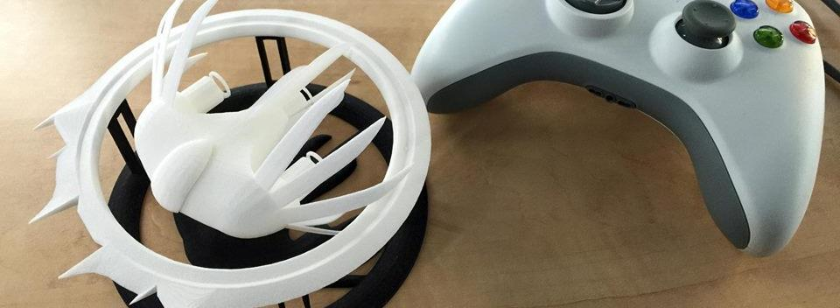

A Strange Game for Strange Reasons
This game taught us (the campus) about making things, production, and scale
This game allowed us to explore using typical game forms for telling a unique story to a very targeted audience
Finalist at GLS Education Arcade, shown at DiGRA Blank Arcade, and IndieArcade at the Smithsonian American Museum of Art
SPLATTERSHMUP.RIT.EDU – PLAY TODAY! MAKE ART!

Slide 24


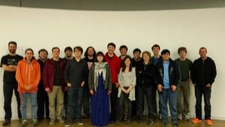
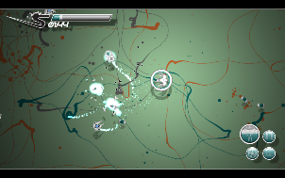
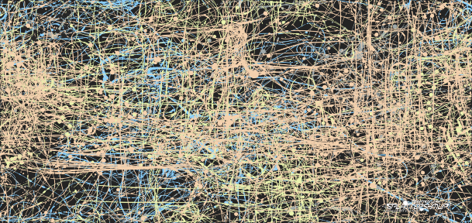




Slide 25
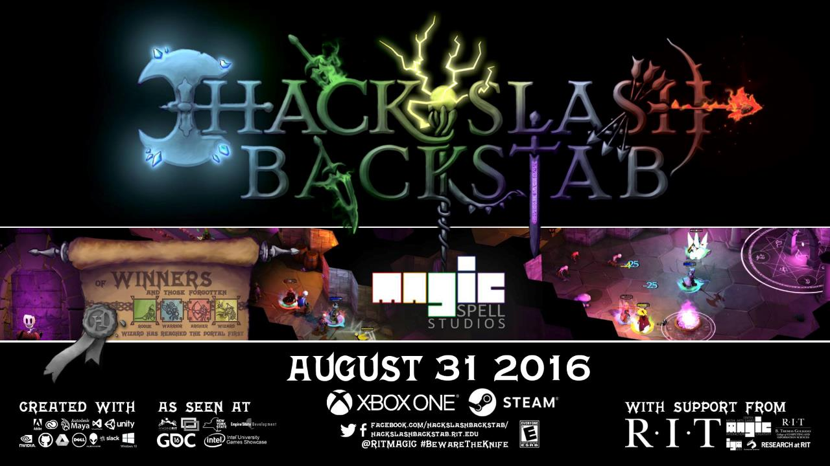

Slide 26

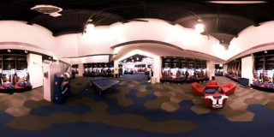


A SUMMER WITH THE
BUFFALO BILLS
Notes:
A big high-vis project that was (a) external client through the studio, (b) multi-disciplinary team, (c) primarily managed entirely by staff

Slide 27
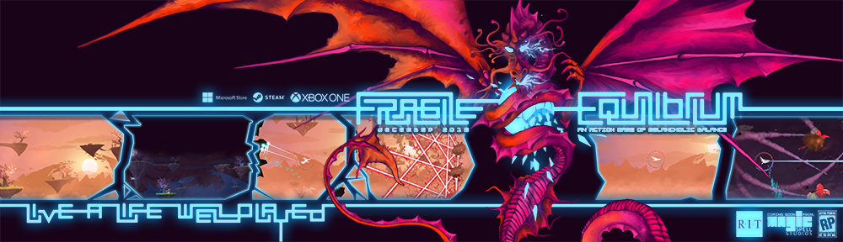
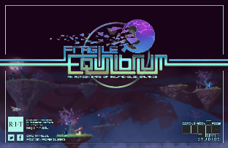
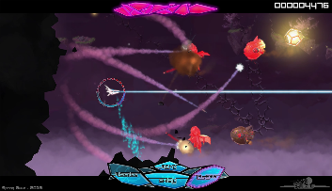
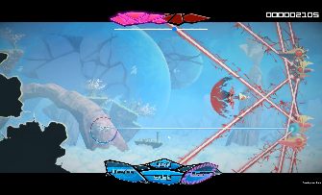
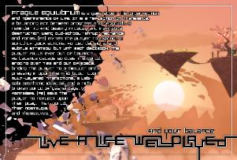

Slide 28
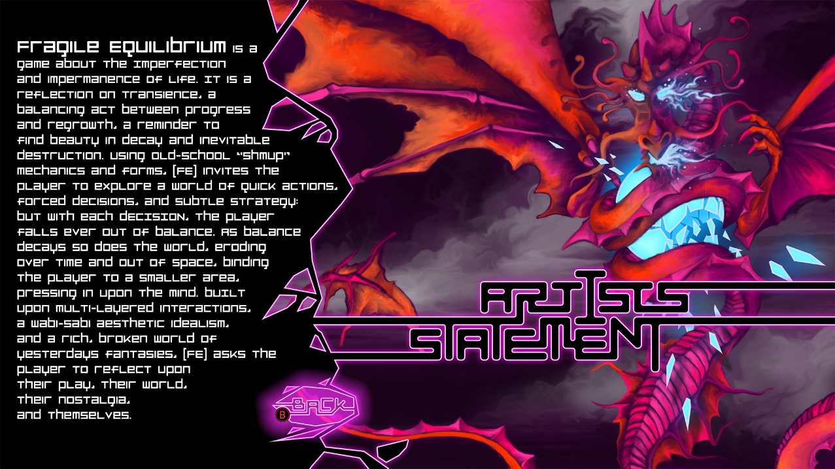


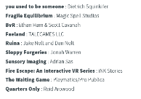

Slide 29
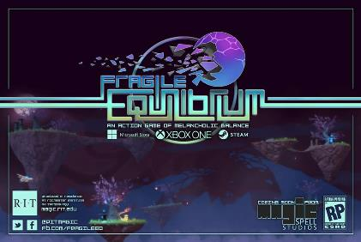
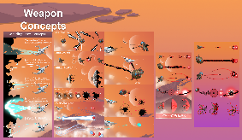
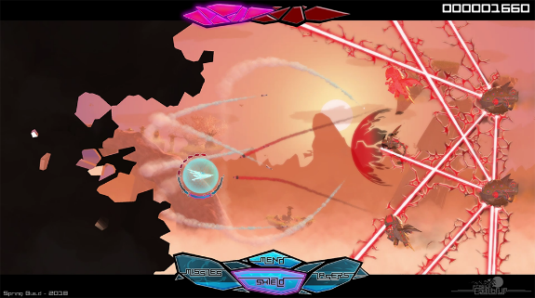
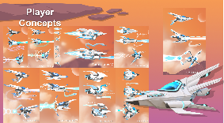
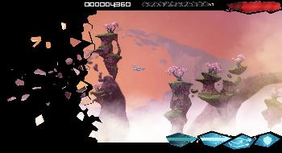
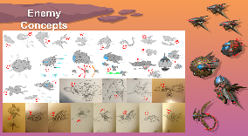
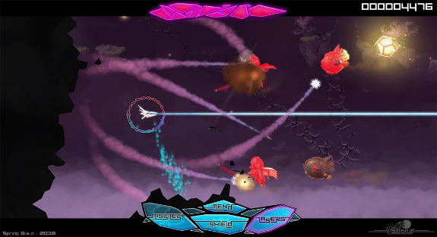

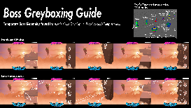


IN GAME UI, DESIGN, GAMEPLAY, ETC.

Slide 30






OUT OF GAME UI/UX and MENUFLOW

Slide 31





COMMUNICATIONS INFRASTRUCTURE

Slide 32




































5 YEARS OF LEARNING THROUGH MAKING AT MAGIC. 5 YEARS OF PROJECTS & MEDIA.
Notes:
So I highlight those 3 because of the things we learned and as data points of growth, but the thing is we did a LOT of stuff from a LOT of work for a LOT of people! It’s a lot bigger a community than people even think about. It’s easy when you are working on ‘your thing’ to not realize the scope and scale of everything else that’s happening and going on.

Slide 33

WHAT BIG PROBLEMS WERE WE TRYING TO SOLVE?
COMMUNICATION – Things get “Lost in Translation” between UI/UX, art, design, dev/engineering, QA…
FORMAL and INFORMAL LEARNING – Not just skills but skills applied to complex practice, situated learning in context. “learn by making things”
CULTURAL DEV & CAPABILITY – Where do games come? What is a repeatable design process? How do studios work? Maturity & Palette?
ACADEMIC IMMERSION – creating a shared space between computing and the arts, between research and practice…

Slide 34


CORE DESIGN PRINCIPLE
NO SPACE SHOULD BE USED FOR ONLY ONE THING, OR BY ONLY ONE CONSTITUENCY: OUR COMMITMENT TO MULTI-DISCIPLINARY AND CROSS-DISCIPLINARY WORK SHOULD EXTEND TO THE PHYSICAL BUILDING DESIGN, TECHNOLOGY SELECTION, ADMINISTRATION AND OPERATIONS, CULTURE & COMMUNITY.
WE WERE TRYING FOR A PARTICLE ACCELERATOR FOR THE HAPPY ACCIDENT.
(AND MODEL FOR OUR STUDENTS HOW COLLABORATION AND TEAMS FUNCTION)

Slide 35

Artech CRE8-A-THON: CHANGING JAM CULTURE
Notes:
This is Dan at the Ar-Tech Cre-8-athon, a hackathon we did that extended between digital and physical, between open source computing and art. We gave away some ridiculously silly prizes, but what we really wanted was to help change the culture of ‘who goes to a hackathon and what are they for’ and get two different communities of practice together

Slide 36

Future work and IDEAS

Slide 37

RETHINKING APPRENTICESHIP ?

Slide 38

NICE SHEEP
Game industry studies
  Co-creativity (John Banks)
  Game talk (Casey O’Donnell)
Live streaming gameplay
  Broadcasting play (TL Taylor)
  Hamilton W. A., Garretson O., & Kerne A. (2014, April 26–May 1). Streaming on Twitch: Fostering Participatory Communities of Play within Live Mixed Media. In Proceedings of the SIGCHI Conference on Human Factors in Computing Systems (CHI ’14). New York, NY, USA.

Slide 39


A tale of two Adams
Adam (1) (programmer making Bot Land)
Chluaid (artist on BrackenSack: A Dashkin Game) (and also named Adam (2) IRL)

Slide 40
A Tale Of Two Adams
“coder adam”
Talk aloud protocol
Careful attention to chat
Lots of questions & advice to/from other developers
Streams as a commitment to practice
Small community, not about audience per se
“artist adam”
A kind of ‘visual stepwise process’
Specifically wanted less feedback
Streams as a commitment to practice
Small community, not about audience per se
Cultivation of community for visibility / connections

Slide 41

DEVELOPMENT Streaming…
A commitment to practice and function?
Less about audience, more about community (maybe?)
A scalable platform for observation, practice and critique?
A form of bi-directional apprenticeship?
A dialog platform for learning communities?
A potentially scaffolded environment?
A quest for authenticity and role models?

Slide 42
Consalvo, M., & Phelps, A. (2019). Performing game development live on Twitch. Presented at the Hawaii International Conference on Systems Science, Maui, HI. Preliminary work presented at AOIR 2018.
Phelps, A., & Consalvo, M. (2018) “Live streaming game design & development: A glimpse behind the mystic curtain with pedagogical possibilities” at The InterPLAY of Game Studies and Game Design, 2018 NCA Preconference, University of Utah. S Orme, University of Suffolk. National Communication Association 104th Annual Conference, Salt Lake City, Utah.
Phelps, A., Consalvo, M., and Egerct, C. (2018) Development Streaming as a Pedagogical and Community
Strategy for Games Education. Workshop on New Research Perspectives on Game Design & Development Education. CHI PLAY 2018, October 28, 2018, Melbourne, Australia.
Decker, A., Egert. C, and Phelps, A. (2018) "Learning to Create or Creating to Learn" International Academic Conference on Meaningful Play, October 11, 2018 East Lansing, Michigan.
Phelps, A., C. Egert and A. Decker. (2018) "Splattershmup: A Game of Art & Motion". Learning in Games Book 3. Ed. K. Schrier. ETC Press, Carnegie Mellon University. (in press, forthcoming)
Decker, A. C. Egert, A. Phelps, (2017) “Trial by a Many-Colored Flame: A Multi-disciplinary, Community-Centric
Approach to Digital Media and Computing Education”, in New Directions for Computing Education
(S. Fee, et al, ed.), pp. 237-257. Springer International Publishing, Cham, Switzerland. 2017.

Slide 43

WHILE ON SABBATICAL
A RECOMMITTMENT TO DAILY PROCESS, (NOT UNLIKE STREAMING)
CURRENTLY EXPLORING MOVING HUNDREDS OF IMAGES INTO VR AND AR, AND WHAT THAT LOOKS LIKE IN COMPARISON TO TRADITIONAL PUBLIC GALLERY & EXHIBITION SPACES

Slide 44

WHATS NEXT FOR GAMES in higher ed?
Increasingly, games programs are known not just for alumni, equipment, labs, faculty, or curriculum, but for what gets made there. (good on Utah, btw)
Research into core areas of computing continues to be critical, but of ever increasing importance is how new discoveries are applied at scale
Similarly, computing is at a crossroads regarding its ethical application, and games are in the cross-hairs of that in several contexts
What we are learning from games has some very broad implications for how people expect to interact with technology & art writ large

Slide 45


What’s next for andy?
Reestablish/advance personal research agenda and associated practice
Continue to advance my teaching (and learning)
Publish out more of the lessons of the last several years -and also new stuff of course (working on this right now w/ ACM, Design Journals, Games Journals, etc.)
Find the right place and right colleagues to do this kind of work, and that has students excited to engage in it
Continue making things, thereby continuing to learn.
Have Fun ☺

Slide 46

ANDYWORLD.IO | PROFESSORANDREWPHELPS.NET | @RITIGM1 | ANDY@MAIL.RIT.EDU

Slide 47

Thanks & Questions
andy@mail.rit.edu | andyworld.io| @ritigm1

