Slide 1





Games for personal growth: Redefining notions of impact and design towards individual transformation
Dr. Andrew M. Phelps
Professor of Human Interface Technology, Faculty of Engineering, University of Canterbury, NZ
Professor of Film & Media Arts, School of Communication, American University, USA
Professor of Computer Science, College of Arts & Sciences, American University, USA
Visiting Faculty, Department of Game Design, Uppsala University, Sweden
Director, American University Game Center
President, Higher Education Video Game Alliance
Dr. Doris C. Rusch
Professor of Game Design, Uppsala University, Sweden
Deputy Head of Department of Game Design
Uppsala University, Gotland, Sweden

Slide 2
How do we examine the impact of games, games for X, and the value of games to players?

Slide 3
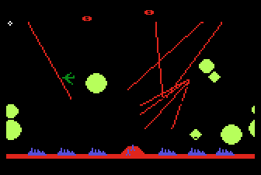
CONTEXT CAN BE EVERYTHING
Missile Command 1982

Slide 4

Myth: Survival (haha), Star Wars (the Reagan kind), etc.
  Ritual: The trackball, the storing of next quarter, the quest for patterns, the ‘pause’ and hang on, etc.
Experiential: It is exactly what it says it is. (and in the original version, even more so)
Existential: I mean, yeah...

Slide 5





Notes:
Images from https://origins.osu.edu/connecting-history/top-ten-origins-civil-defense-nuclear-war-and-duct-tape

Slide 6

AS HUMANS, WE BRING OURSELVES TO OUR EXPERIENCES
KNOWLEDGE OF A SYSTEM IS NOT EMPATHY
AND DOES NOT PRESUPPOSE TRANSFORMATION
A large part of games’ transformative potential thus remains either unrealized or invisible (Paolo Pedercini, 2014). But how can we intentionally design for personal transformation without pre-determining the kind of change the game should ignite or seeks to impose upon its players? How can we facilitate profound, organic inner shifts through our designs that allow players to “respond to them of themselves, with recognition, uncoerced[?]” (Campbell 1991).
GAMES ARE NOT JUST COMPLEX SYSTEMS | MECHANICS

Slide 7
“the kinds of change we can clearly measure are not all that interesting.”
–Paolo Pedercini, Games 4 Change keynote, 2014

Slide 8
The Assessment Trap
Notes:
REPRISE: KNOWLEDGE OF A SYSTEM IS NOT EMPATHY AND DOES NOT PRESUPPOSE TRANSFORMATION

Slide 9
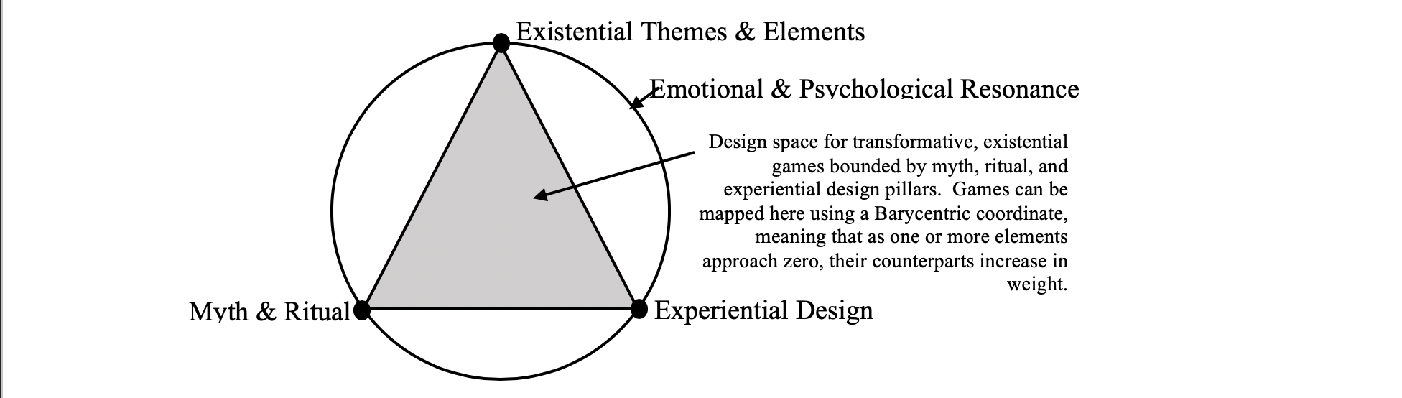
DESIGN SPACE MAP
Mapping a design space for games of the soul
(Rusch & Phelps, DiGRA 2020, 2022)

Slide 10
Where is the ‘blue skies research’ of meaningful play / G4C?

Slide 11


Slide 12


Slide 13


Slide 14
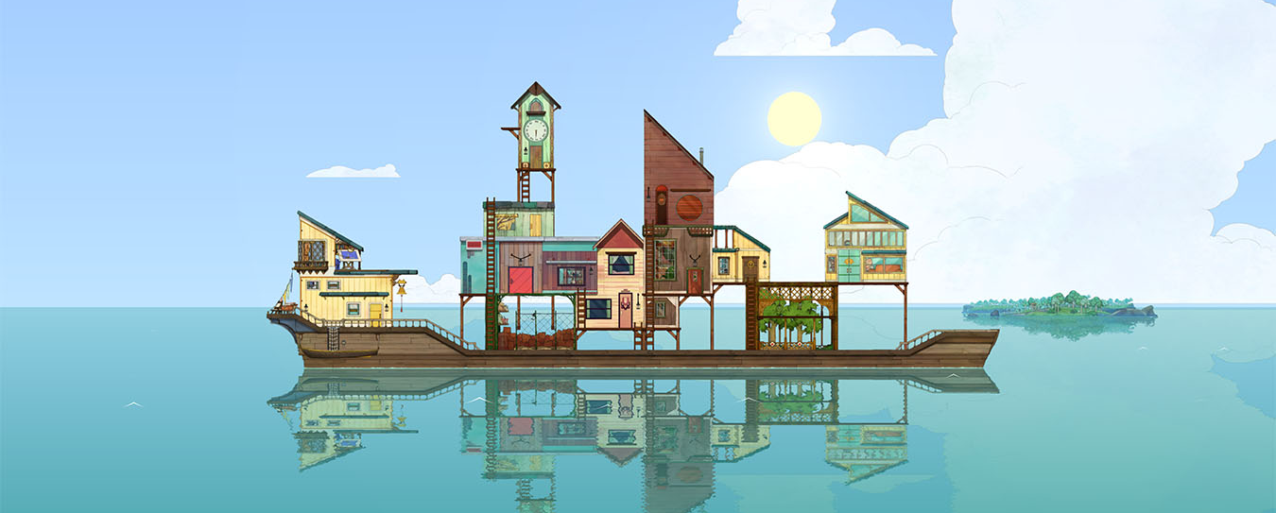
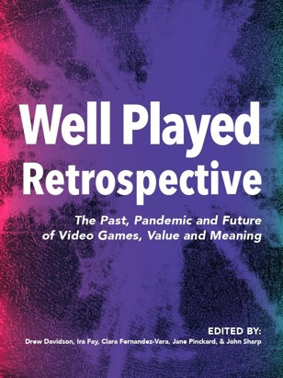
(Wagner, Moger, Consalvo, & Pheps, 2021)

Slide 15
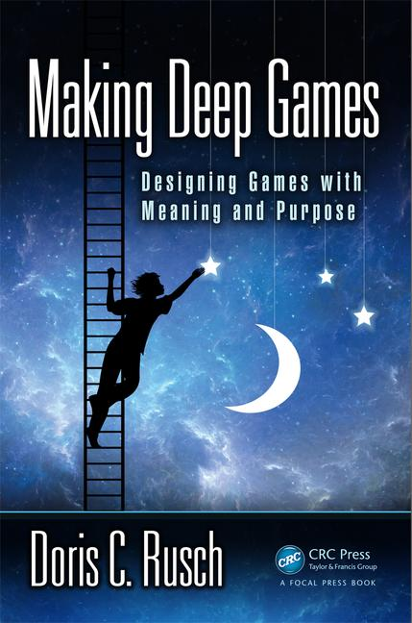


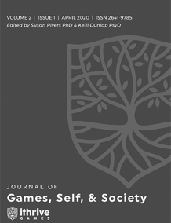
RESOURCES and ADDITIONAL WORKS on THIS KIND OF THING:
Rusch, D.C. and Phelps, A. (2021) "Games of the Soul." In A Ludic Society by Denk, et al. (pp. 102–126). Donau-Universität Krems, Universitätsbibliothek. ISBN-13: 978-3903150720. Available on Amazon.
Rusch, D.C. and Phelps, A. (2021) 'The Magic of The Witch's Way.' Presented at the Future of Reality & Games (FROG) Conference. Vienna, Austria.
Phelps, A., Wagner, J. and Moger, A. "Experiential Depression and Anxiety Through Proceduralized Play: A Case Study of Fragile Equilibrium." (2020) Journal of Games, Self, & Society, vol. 2, no. 1. Eds. Rivers, S. E., & Dunlap, K. https://doi.org/10.1184/R1/12215417
Rusch, D. ”Existential, Transformative Game Design." (2020) Journal of Games, Self, & Society, vol. 2, no. 1. Eds. Rivers, S. E., & Dunlap, K. https://doi.org/10.1184/R1/12215417
Rusch, D. and Phelps, A. “Existential Transformational Game Design: Harnessing the "Psychomagic" of Symbolic Enactment” Frontiers in Psychology. Special Issue on Digital Games and Mental Health. doi: 10.3389/fpsyg.2020.571522 (in press)
Phelps, A., and Rusch, D. C. (2020) "Navigating Existential, Transformative Game Design." Proceedings of the Digital Games Research Association (DiGRA) 2020 Conference: Play Anywhere. Tampere, Finland. http://www.digra.org/wp-content/uploads/digital-library/DiGRA_2020_paper_21.pdf

Slide 16
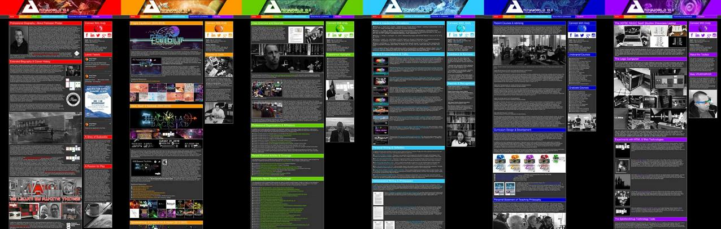
ANDYWORLD.IO | PROFESSORANDREWPHELPS.NET | @ANDYMPHELPS | ANDYMPHELPS@GMAIL.COM

