Slide 1
Games, Cinema, Platforms & Interactivity
A Convergence of Media and Opportunity
Dr. Andrew Phelps
Professor, American University
@andymphelps

Slide 2
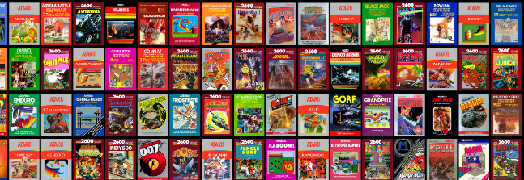
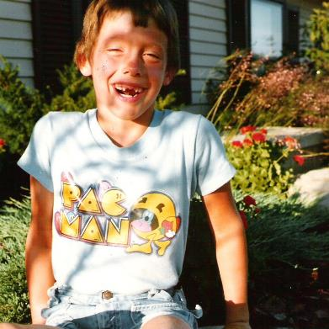
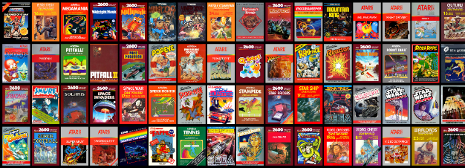
HI, I’m ANDY
I’ve NEVER had a day without games…
I’ve NEVER had a day without movies…

Slide 3
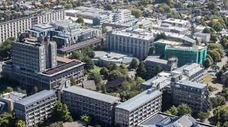
A HISTORY OF GAMES & INTERACTIVE MEDIA
1999-202X
2001 programming
First course in games programming
2002
Electronic Gaming Society
2003
CS/IT Concentration in Game Prog
2006
MSc Game Design & Development
2007
BSc Game Design & Development
2009
Dept. of Interactive Games & Media
2011
School of Interactive Games & Media
2012
Minor in Game Design
2013
RIT Center for Media, Arts, Games, Interaction & Creativity (MAGIC)
2013
MAGIC Spell Studios®, LLC
2016
$30M MAGIC Spell Studios Facility
2016
NY State Games HUB
2017
NY State Games Challenge
2019
American University Game Center
2020
HIT Lab NZ + AIGI (University of Canterbury)
2021+
UC Digital Screen Campus

Slide 4


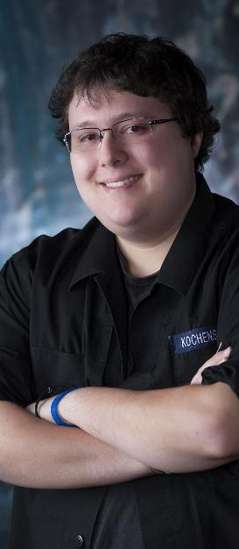

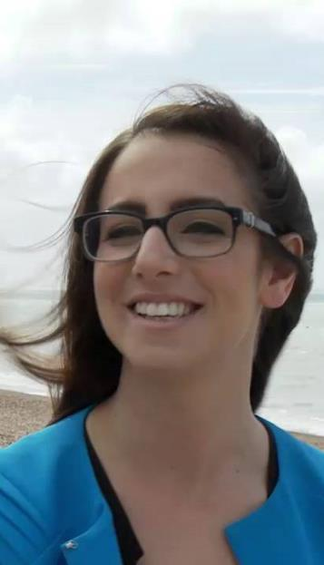
INCREDIBLEY AWESOME ALUMNI
ALEX CUTTING
Senior Assoc. Producer HALO
Microsoft / 343
CLAUDE JEROME
Gameplay Designer DESTINY
Bungie
DUSTIN KOCHENSPARGER
Line Producer DLC
DESTINY
Bungie
DB Creations
SELA DAVIS
Platform Engineer
XBOX / XBOX Live
Microsoft
VReal
ANNA SWEET
Director of 3rd Party Development
STEAM / Valve
Oculus/Meta
Microsoft XBOX
CEO, Bad Robot Games

Slide 5
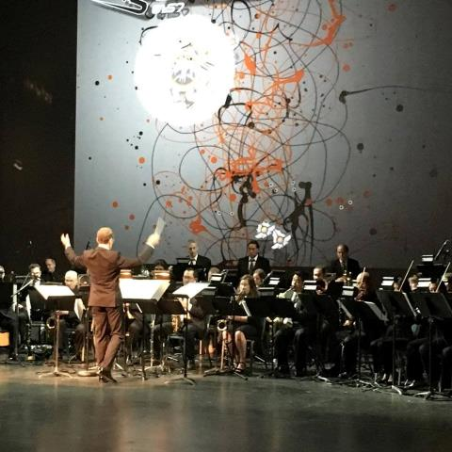
C O N V E R G E N C E
C O N V E R G E N C E
The platforms and technology for film, animation, games, media, and story are converging into new forms, new stories, new experiences, and new knowledge.
Notes:
And so we started a multi-disciplinary research center, which is basically the hardest damn thing you can do on a modern college campus. They usually fail by becoming little islands, or by becoming a kind of ‘not really there’ virtual thing, and we’ve run into both of these views as we continue to engage the campus. Nonetheless, we think there is something profound happening in the field right now that is driving the kinds of things we are doing – everything is mashing up on each other. My favorite example of this is the MARVEL extended universe, which is so many different products and experiences rolled together. But there are countless examples big and small. This picture is from the RIT West Coast board meeting where they showed one of my games set to a live orchestra composition directed by Trustee Kevin Surace. Pretty cool.

Slide 6
1. Platform & Distribution
2. Content and Storyworld(s)
3. Media Creation Tools & Techniques
3 Areas of Convergence between Games, Cinema, Mobile, & VR/AR/MR/XR

Slide 7


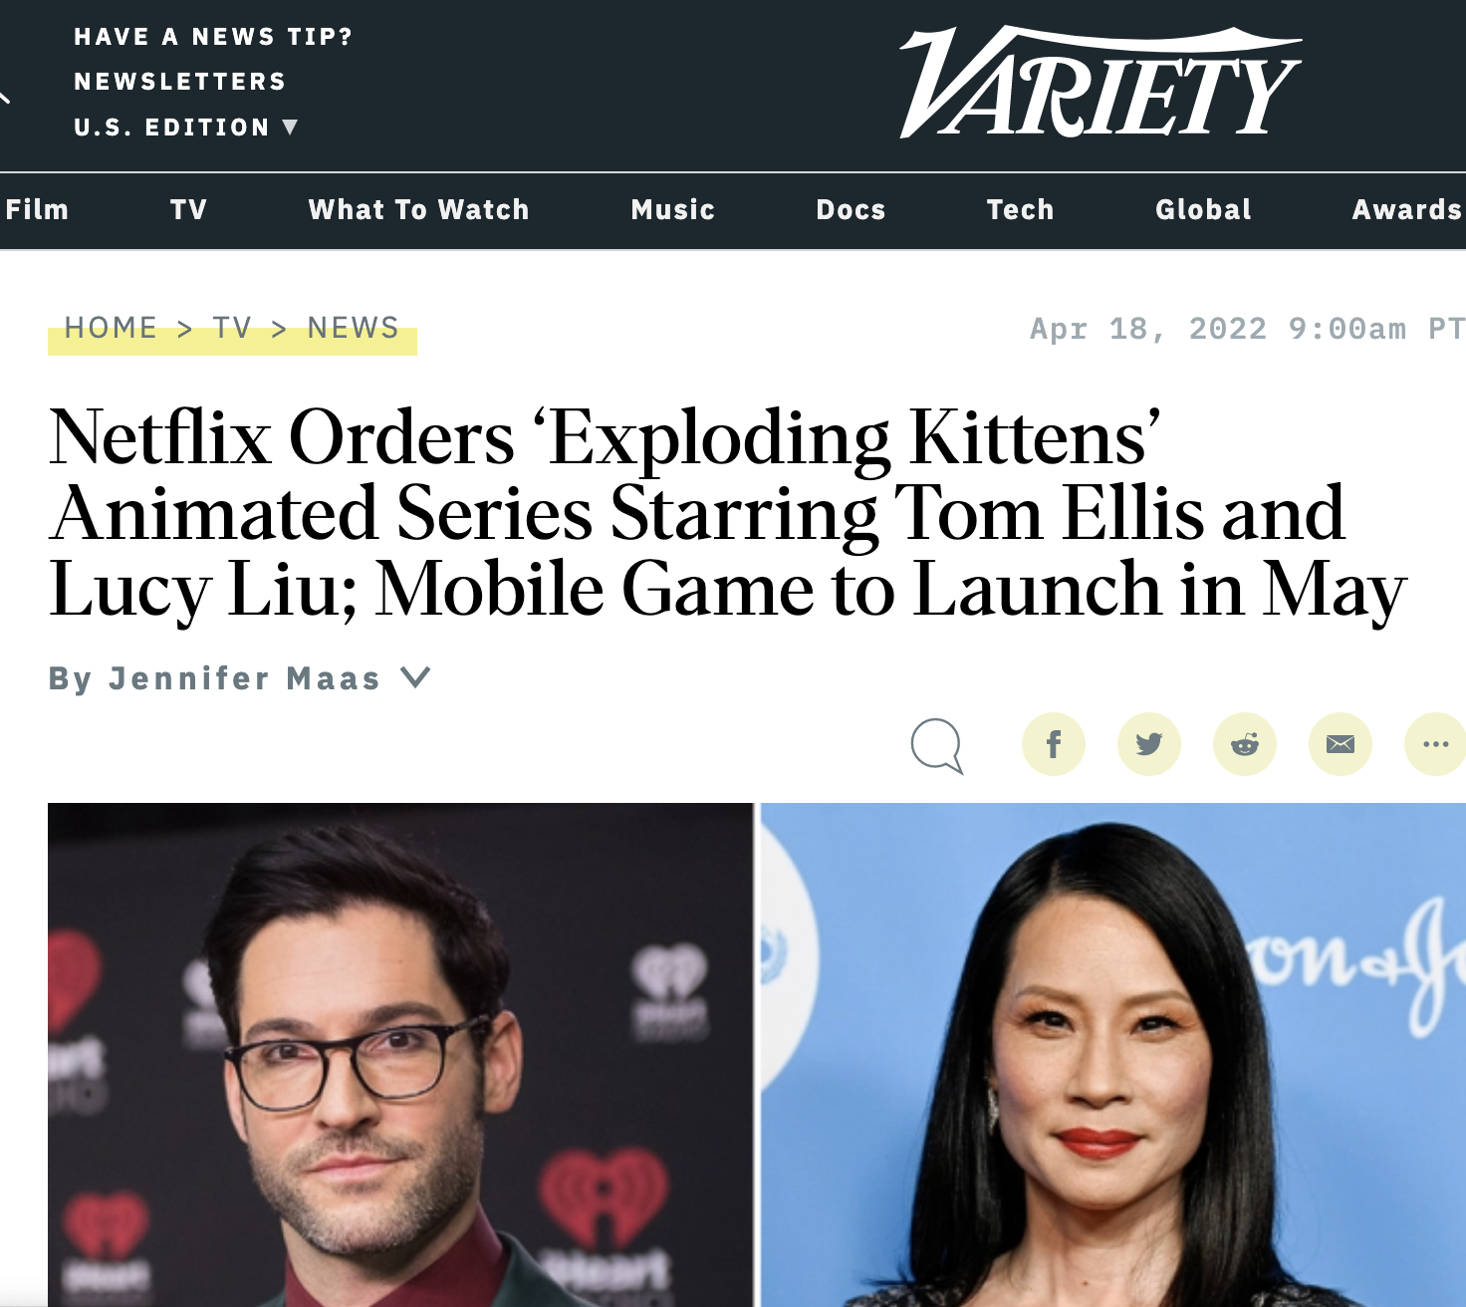
A COUPLE OF RECENT EXAMPLES
PLUS ANY ”STORY UNIVERSE” OF YOUR CHOICE…
Notes:
Exploding kittens means Netflix is doing games, in addition to game adjacent content The tech is converging rapidly ALL OVER THE PLACE, and this is in 3 primaly lenses:
Convergence of CONTENT – which is what Netflix is doing with crossovers or what HBO is doing with animated game series, or what Paramount is doing with HALO, etc.
Convergence of PLATFORM – everyone has started an ecosystem now of big screen, small screen, phone screen. And streaming to all of them and integrating those experiences. Want to see recognition of this? Go look at the bitcoin ad in the superbowl ;P
Convergence of TECHNOLOGY – Unity and Unreal are all over the place, and increasingly being less ‘game tools’ and more ‘everything tools’ – as is Adobe, Autodesk, and all the others.

Slide 8
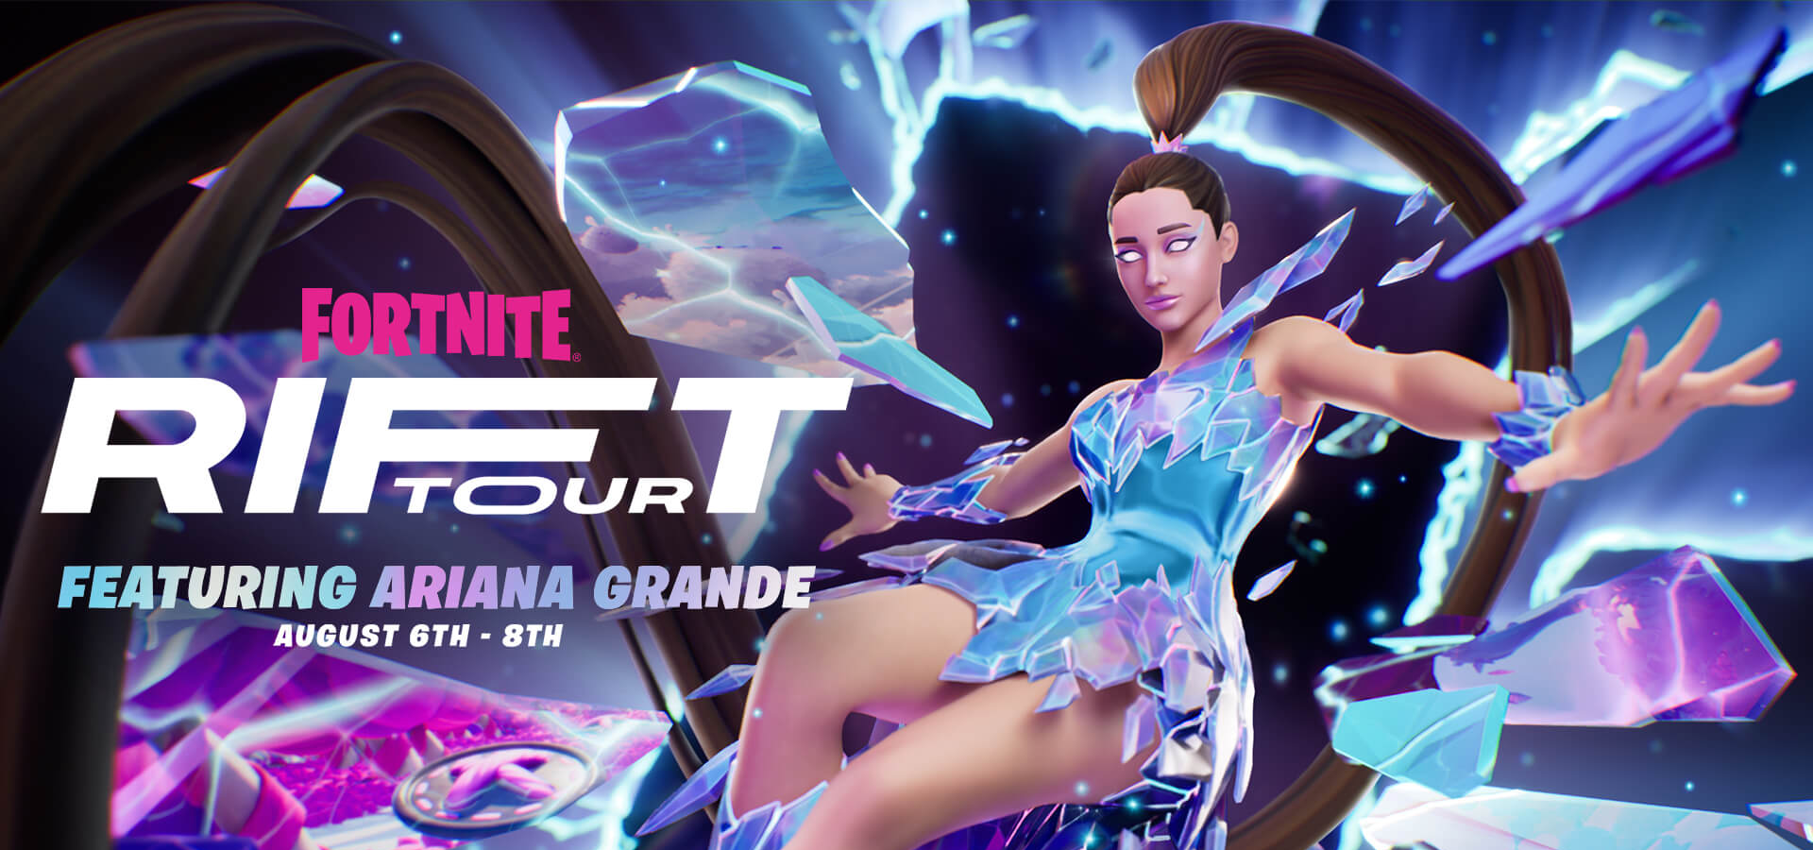
FORTNITE PRESENTS… THE RIFT TOUR FEATURING ARIANA GRANDE
Notes:
Image and Title from https://www.fortnite.com/news/fortnite-presents-the-rift-tour-featuring-ariana-grande

Slide 9
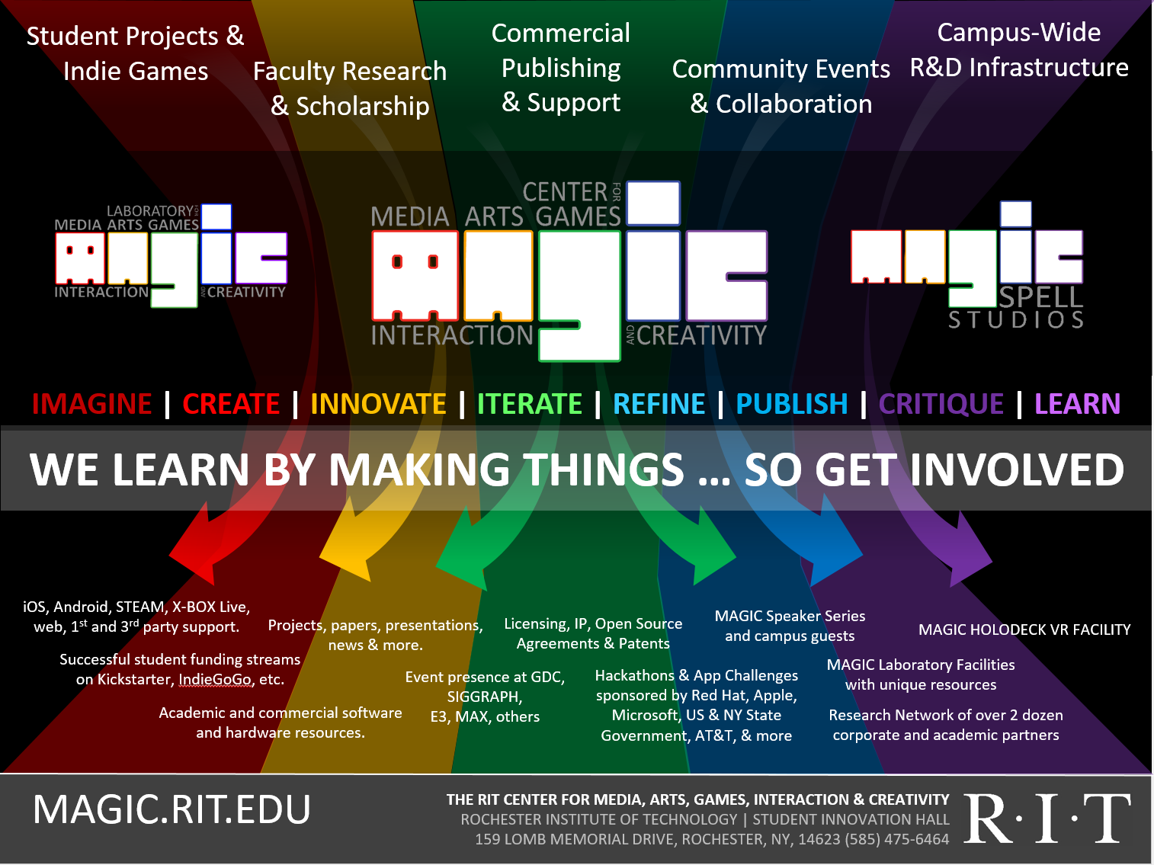



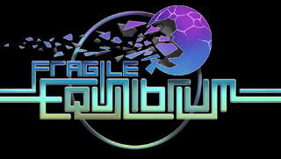
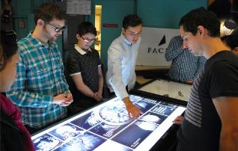
Notes:
It’s messy. It’s really messy. We do a lot of stuff but a lot of stuff is different every time because we’re changing, the projects are changing, the world is changing.

Slide 10
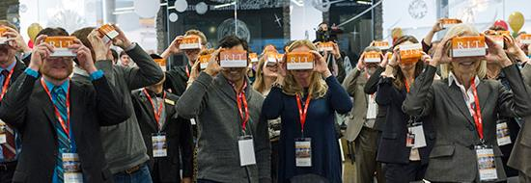
SOME OF OUR WORK
Notes:
Here’s a couple of projects that have meant something significant:

Slide 11







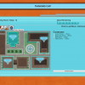
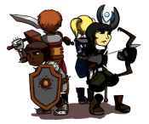








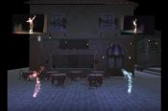
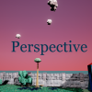








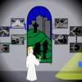



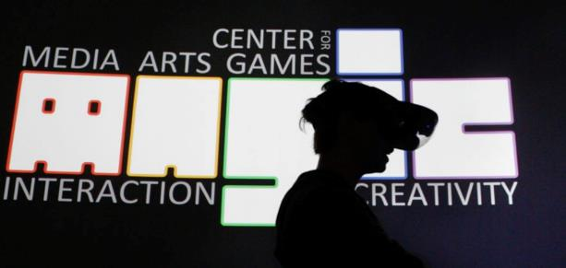




5 YEARS OF LEARNING THROUGH MAKING AT MAGIC. 5 YEARS OF PROJECTS & MEDIA.
Notes:
We did a LOT of stuff from a LOT of work for a LOT of people! It’s a lot bigger a community than people even think about. It’s easy when you are working on ‘your thing’ to not realize the scope and scale of everything else that’s happening and going on.

Slide 12
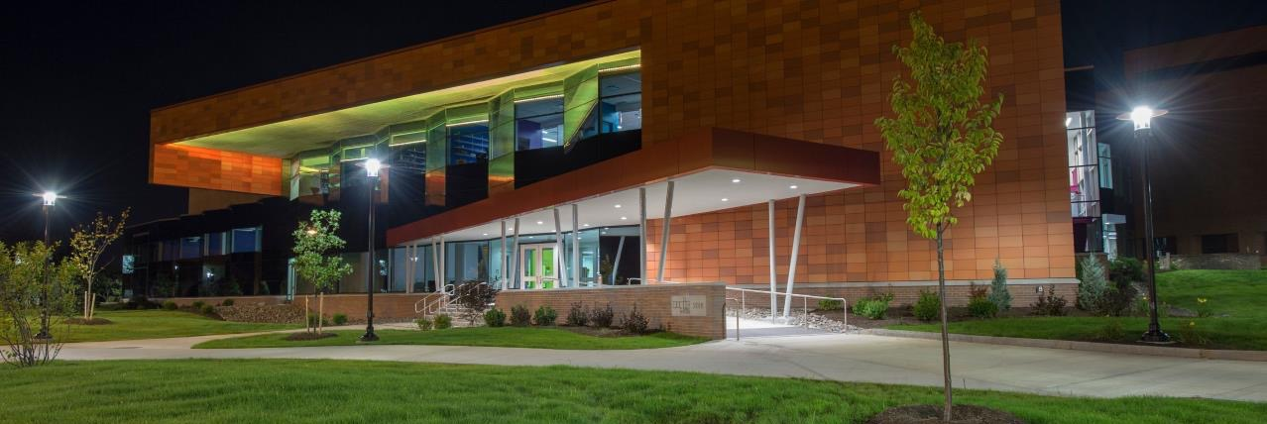
MAGIC SPELL STUDIOS @ RIT
Notes:
This is the building I designed and built at RIT, for better or worse.

Slide 13
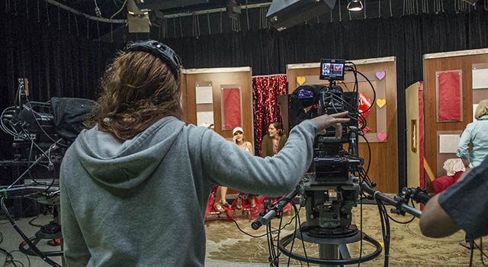
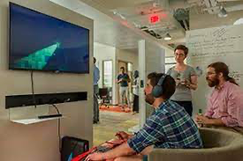
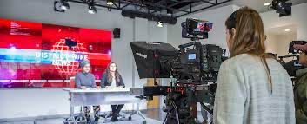
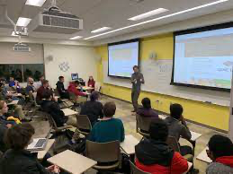
AMERICAN UNIVERSITY FILM & MEDIA ARTS
Notes:
So I found myself at American University and they have an AMAZING film and media arts program, which also happens to house the Game Center. So again, this convergence of ‘games + cinema’ and we built an MFA degree around it.

Slide 14
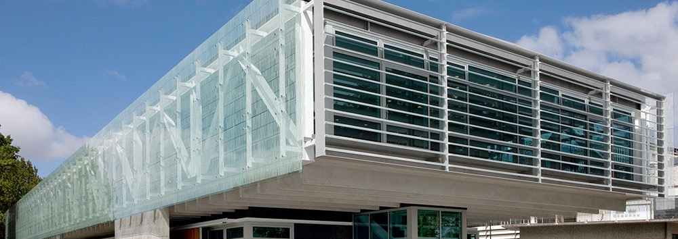





HELLO, NZ
THE DOVEDALE OPPORTUNITY
Notes:
And then I came to Canterbury for AIGI and found a really vibrant community that WANTED to work across engineering and the arts but wasn’t quite sure how to go about it…

Slide 15
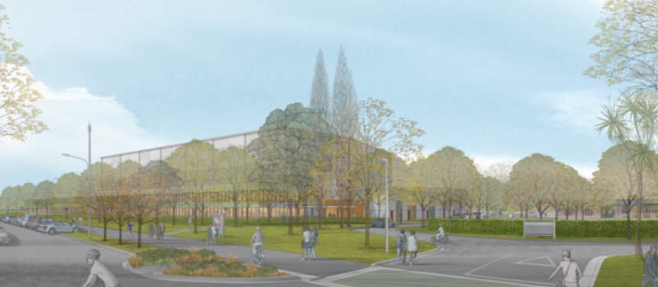
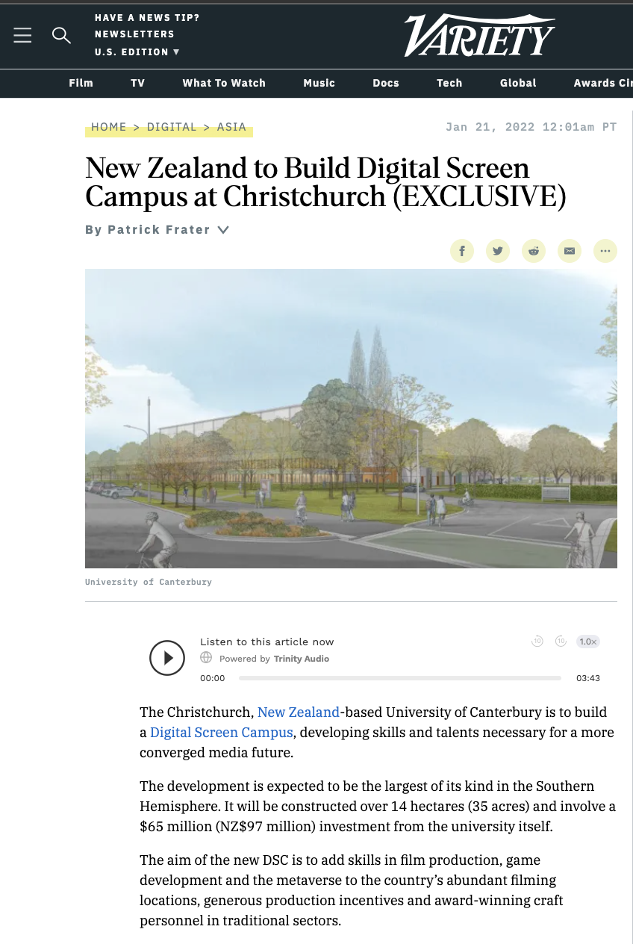
Notes:
UC Digital Screen Campus – see variety article for information: https://variety.com/2022/digital/asia/new-zealand-digital-screen-campus-christchurch-1235159419/

Slide 16
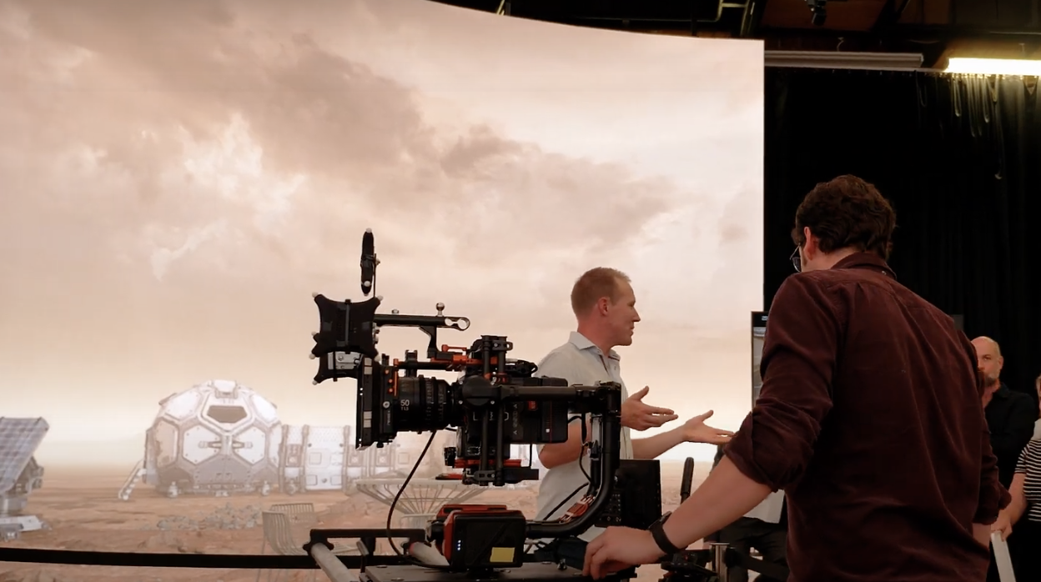
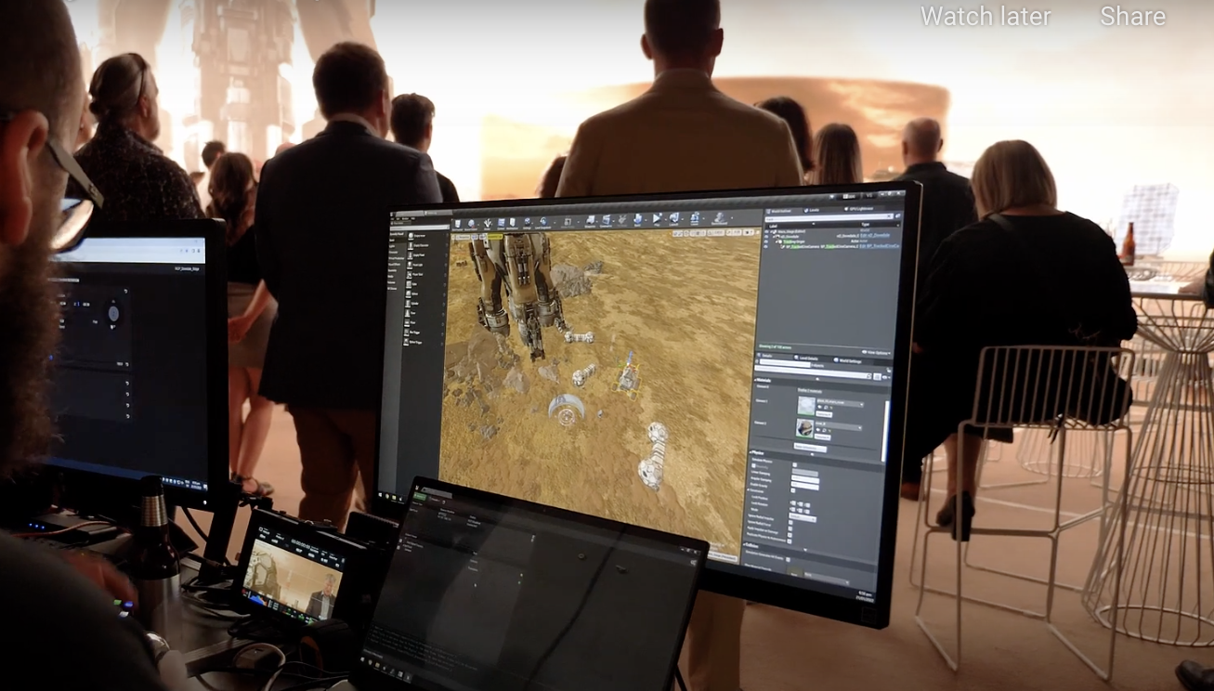
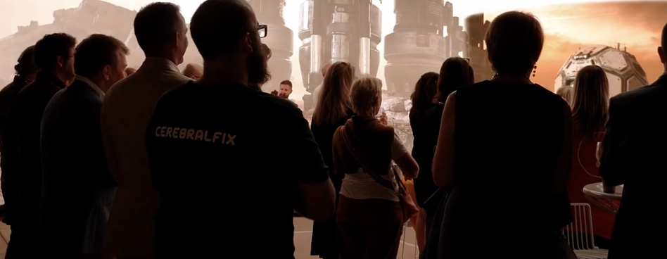
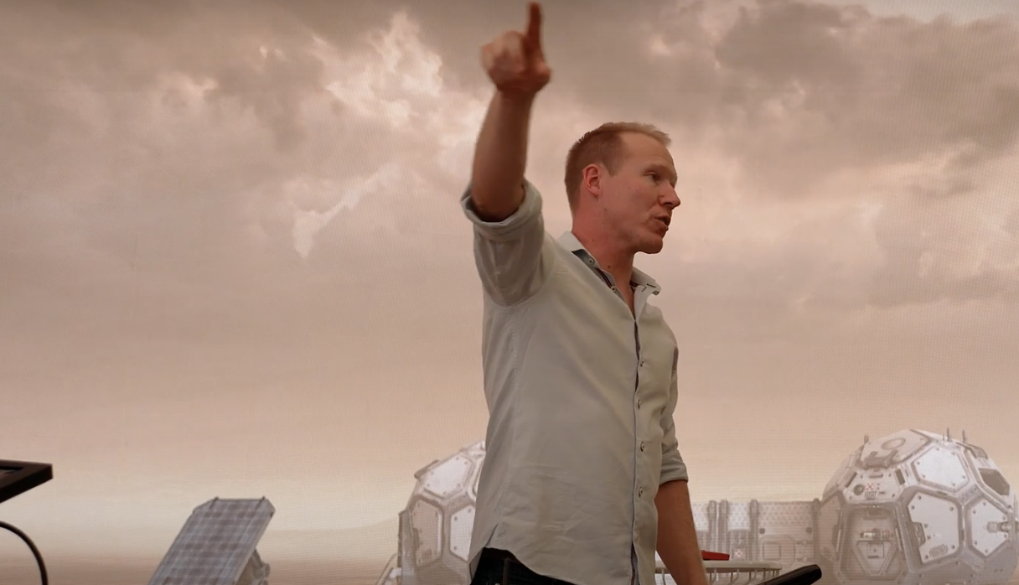


Notes:
UC worked with Resonate and Cerebral Fix for one of its first virtual productions as a proof of concept for this new arena of ‘convergence’ across all of these sectors.

Slide 17
FINAL THOUGHT
CONTENT & INTELLECTUAL PROPERTY
PLATFORMS & DISTRIBUTION
STORYTELLING. NEW, UNIQUE, CREATIVE, AWESOME STORYTELLING.
MEDIA CREATION TOOLS & TECHNIQUES

Slide 18
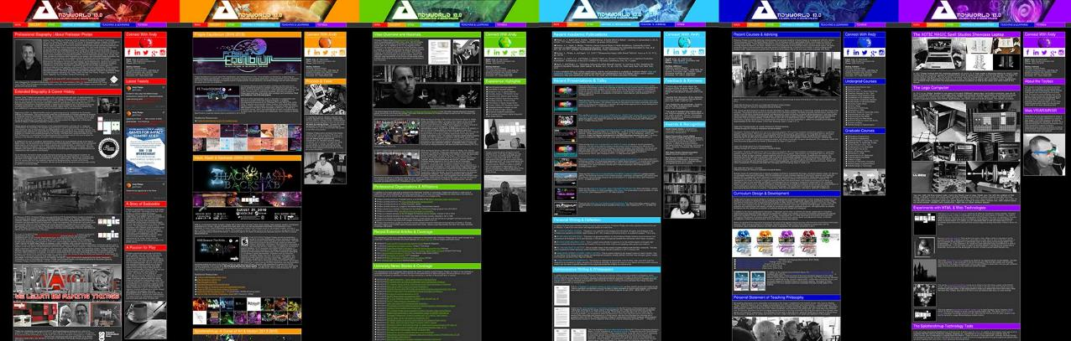
ANDYWORLD.IO | PROFESSORANDREWPHELPS.NET | @ANDYMPHELPS | ANDYMPHELPS@GMAIL.COM
Thanks & Questions

Slide 20



THANK YOU
(please email questions)
Andy Phelps
Professor, American University, Washington DC
andymphelps@gmail.com
@andymphelps
https://www.linkedin.com/in/andymphelps

