Slide 1




Games, Research, Policy and Politics
in Higher Education Today
Not Just A Game V, London 2019
Andrew Phelps
Professor of Human Interface Tech, College of Engineering, University of Canterbury
Professor of Art & Design, College of Art & Design, Rochester Institute of Technology
Games Scholar in Residence, School of Communications, American University
President, Higher Education Video Game Alliance
Founder, RIT MAGIC Center & MAGIC Spell Studios
Founder, RIT School of Interactive Games & Media

Slide 2

Today’s Talk
From moral panics about games and violence, assumptions in multiple directions regarding games and health, misunderstandings and popularization of academic research, tensions between historical preservation and academic use versus intellectual property and brand management, and more, the present slate of issues facing games in higher education is complex and multi-faceted. These issues have far-ranging effects across program design, research prioritization, academic and industry relations, university structure, and more. This talk outlines these present-day issues and their impacts from the viewpoint of the Higher Education Video Game Alliance, a service organization representing over 325 universities world-wide that offer curriculum related to games and media, and grounds the discussion both in the historical advancement of this work within the university as well as looking forward to ways these issues are likely to affect the future of the field.

Slide 3
PART I: EMERGENCE
The Growth Vector of Games in Higher Education

Slide 4
A little bit on the history of games in higher ed
GAME STUDIES
Circa 2001 I offered a course in ‘game programming’ that was so new the NY Times showed up to over my course. It was a weird day.
There was a mailing list of the other folks I could find that had a game development course in the states. There were 6 people on it.
Similar trajectory in games studies, game design, game art
GAME DEV
GAME DESIGN
GAME ART

Slide 5

TODAY, THERE ARE 521 COLLEGE PROGRAMS IN NORTH AMERICA ALONE
THESE RANGE FROM GAME DESIGN, GAME DEVELOPMENT, GAME STUDIES, GAME ART, COMPUTING, ENGINEERING, AND MORE IN FORMAL AND INFORMAL PROGRAMS, MAJORS, MINORS, AND COURSES
Notes:
ARE WE IN YOUR STATE? Data map from Entertainment Software Association

Slide 6
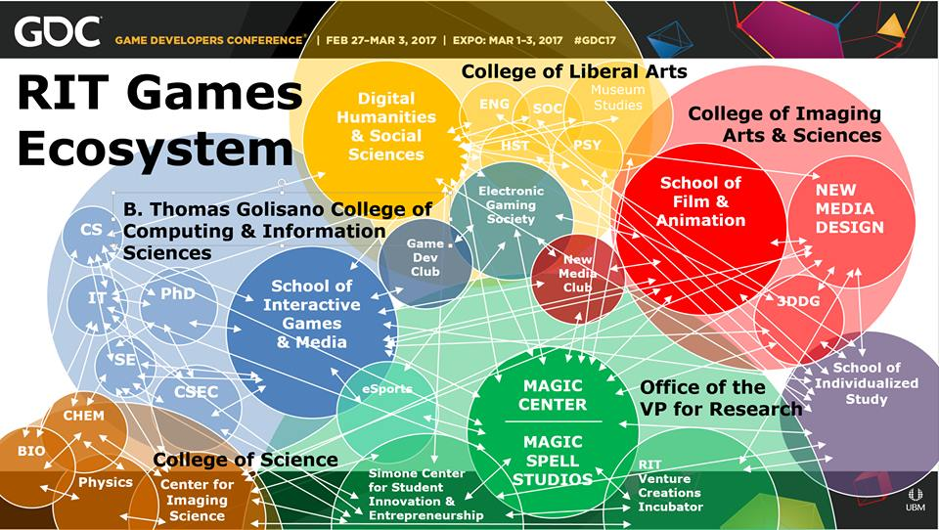

Slide 7


FIELD REPORTS & EXAMINATIONS

Slide 8

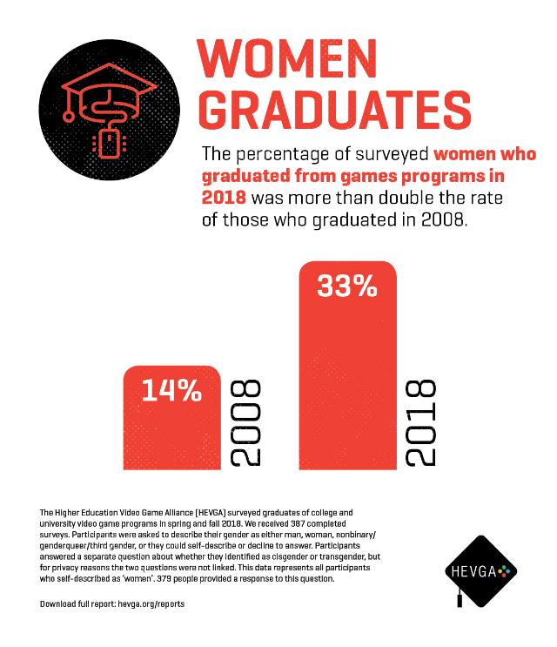

Slide 9
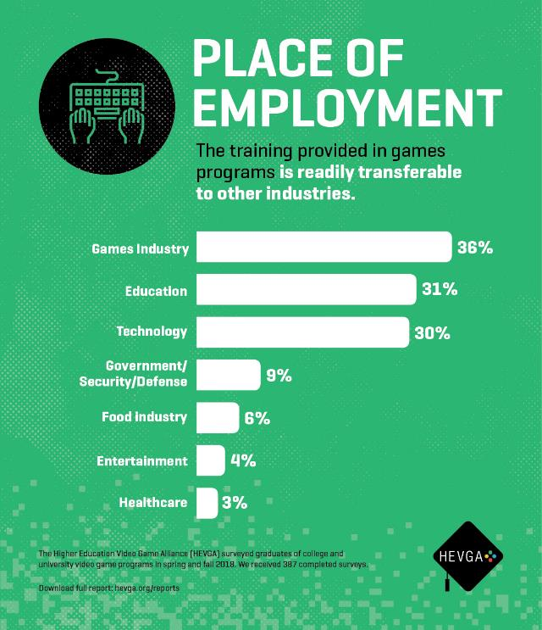


Slide 10



Slide 11
PART II: SOME CONTEMPORARY ISSUES
In Spite of Everything We are Learning, Sometimes we Just Aren’t Logical

Slide 12

Games Have Been Implicated in a Variety of Problems:
4 Recent Themes in Discussion Today
VIOLENCE
ADDICTION
HEALTH
SOCIETY
Notes:
Image from GameInformer covering Fortenite: https://www.bing.com/images/search?view=detailV2&ccid=hXkLwpxO&id=0576CA39A94357997C609649DBDEA1DCFA028203&thid=OIP.hXkLwpxOQhYy-JWQRSSA1wHaEY&mediaurl=http%3a%2f%2fwww.xboxygen.com%2fIMG%2fjpg%2ffortnite-gameinformer.jpg&exph=800&expw=1351&q=fortenite&simid=608004708484842375&selectedIndex=19&ajaxhist=0

Slide 13

GAMES AND VIOLENCE
Often an issue in the wake of gun violence in the USA
Reached a fever pitch (again) in Jan 2017 in the wake of Florida shooting and comments by POTUS, Department of Education Secretary, and others
Also commonly (more generally) referred to as creating “aggression” in (usually) youth
Back again (albeit briefly) in the discussion on NZ
Notes:
Image from https://www.dailymail.co.uk/news/article-1083649/Judge-blames-ultra-violent-video-game-Grand-Theft-Auto-teenage-thugs-sex-assaults.html where a judge blamed ultrao violent video games for sexual assault

Slide 14



Lots of contradictions and lack of consensus
A META-STUDY OF PREVIOUSLY QUESTIONABLE STUDIES, (WITH A QUESTIONABLE METHODOLOGY?)

Slide 15
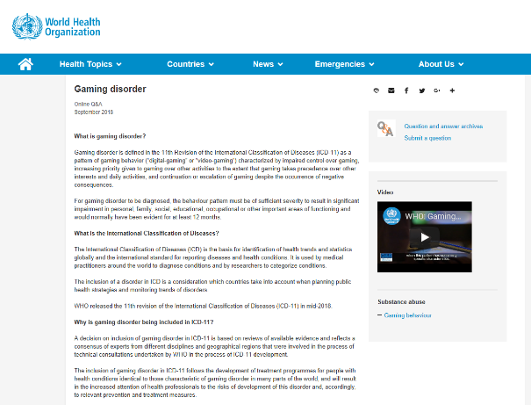

GAMES & ADDICTION
Big issue in 2018 based on WHO classification of ICD-11
Also referred to as fact in several proposed pieces of legislation on loot boxes
Treated more similarly to gambling than to direct chemical dependence, although not always
The issue of ‘detoxification’ camps is often raised in context
Notes:
World of warfract banner from https://www.google.com/search?biw=1630&bih=943&tbm=isch&sa=1&ei=RprQW-SGDMye_QbtgqLoBQ&q=world+of+warcraft&oq=world+of+warcraft&gs_l=img.3..0l10.1372456.1378223..1378337...3.0..2.94.2555.38......1....1..gws-wiz-img.....0..35i39j0i67j0i5i30j0i30.dCddMQ7Mdtk#imgrc=YcTE_qoBcEl-cM:

Slide 16

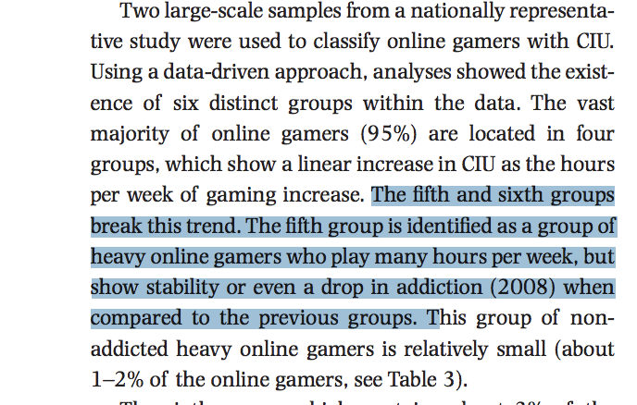
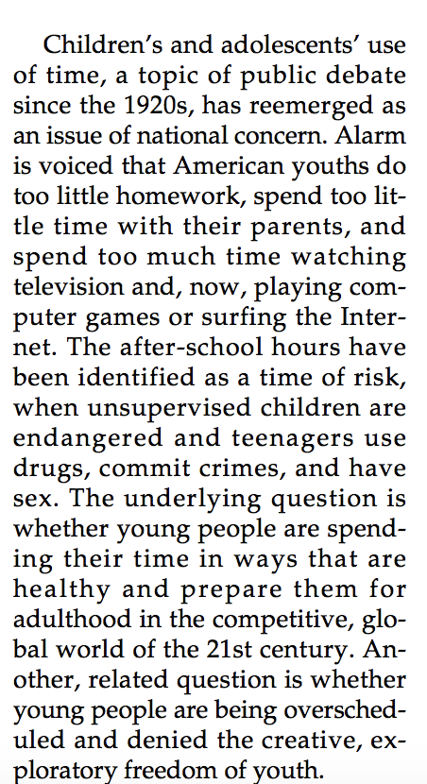
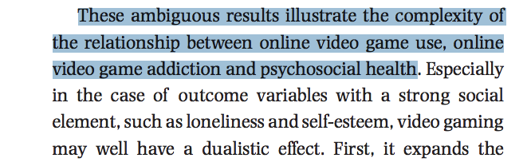
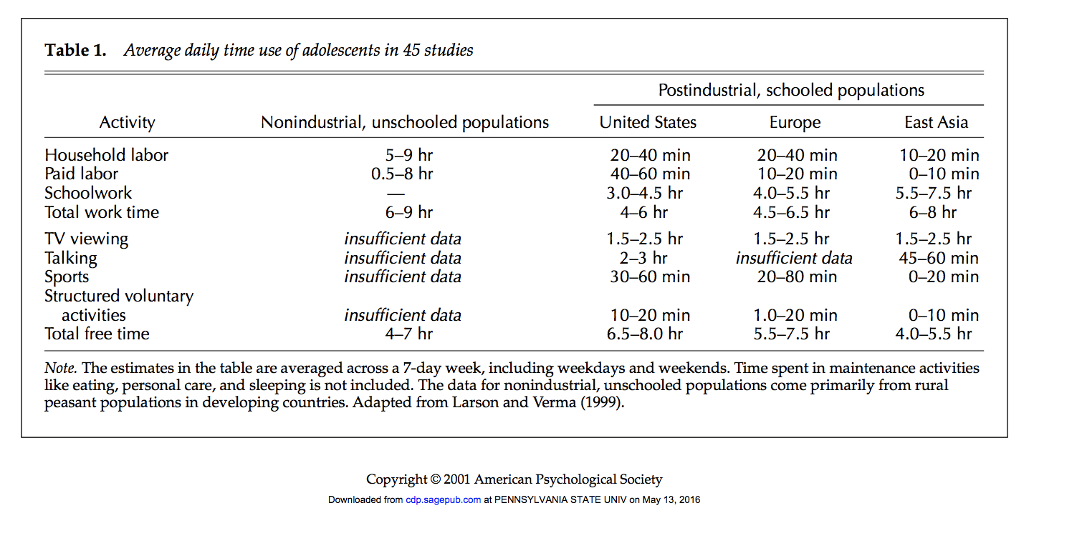

We know a lot less than we say we do…
AND WHAT WE SAY WE KNOW CONFLICTS WITH ITSELF…

Slide 17

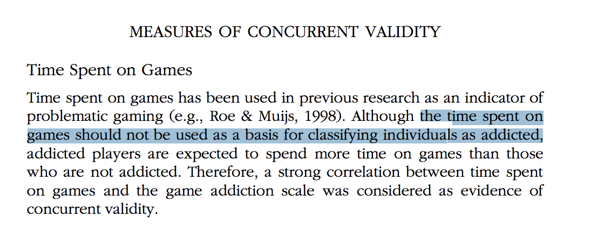
GAMES & ADDICTION
IN OTHER STUDIES OF
ADDICTION, WE MIGHT
TRADITIONALLY USE
SOME OF THE
FOLLOWING
MEASURES:
Life Satisfaction
Loneliness
Social Competence
Aggression

Slide 18



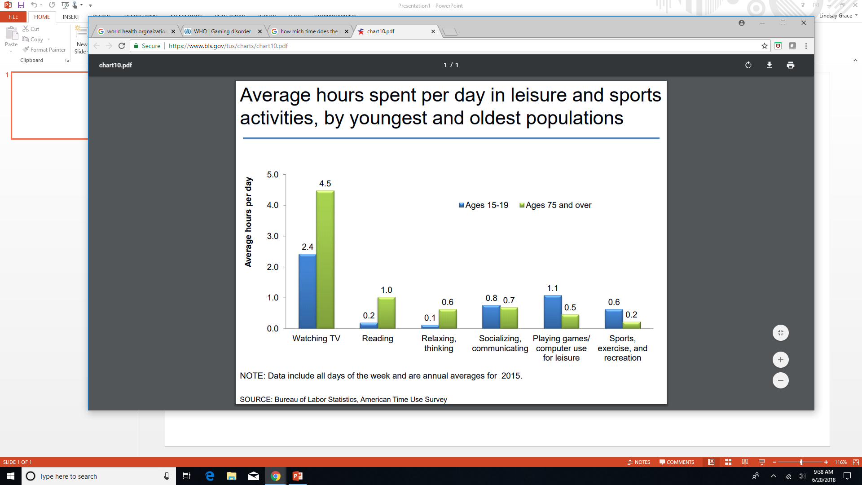
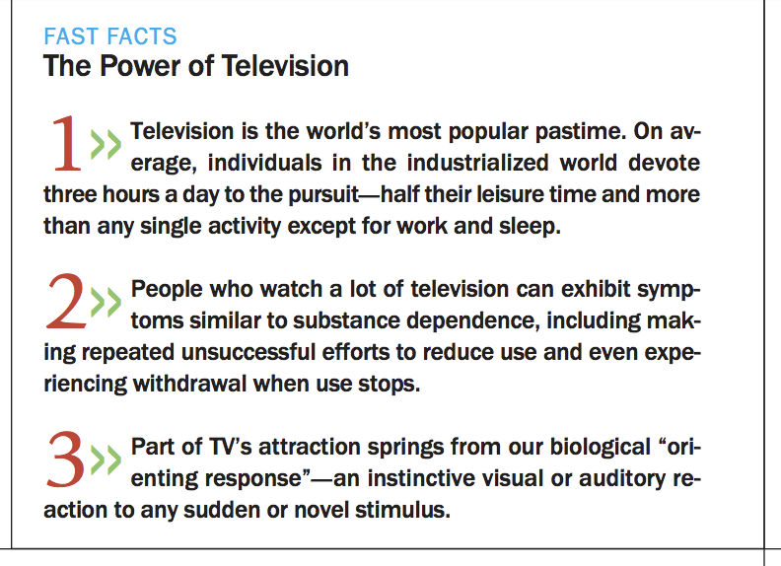
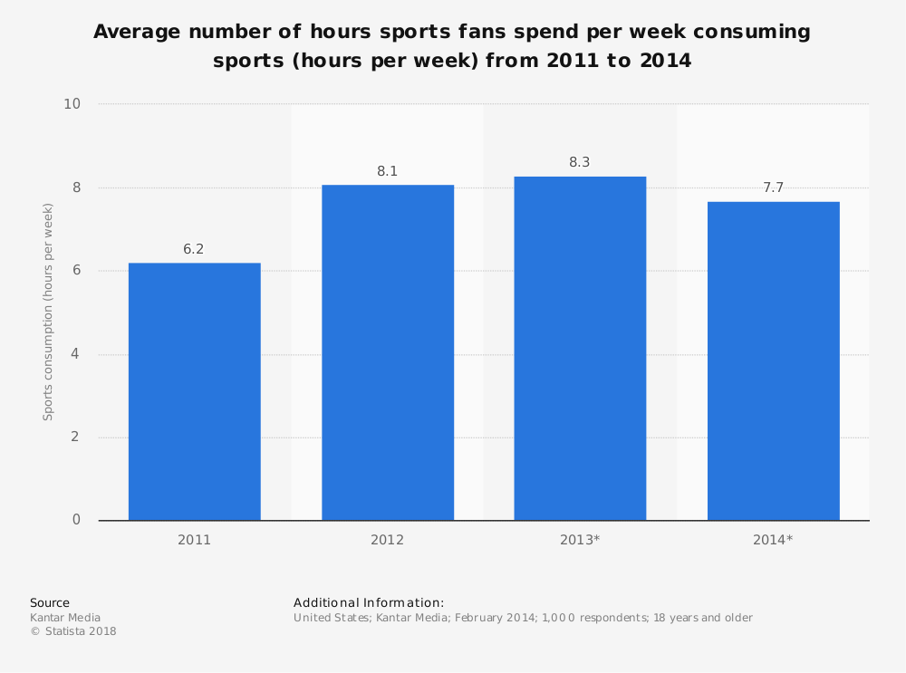
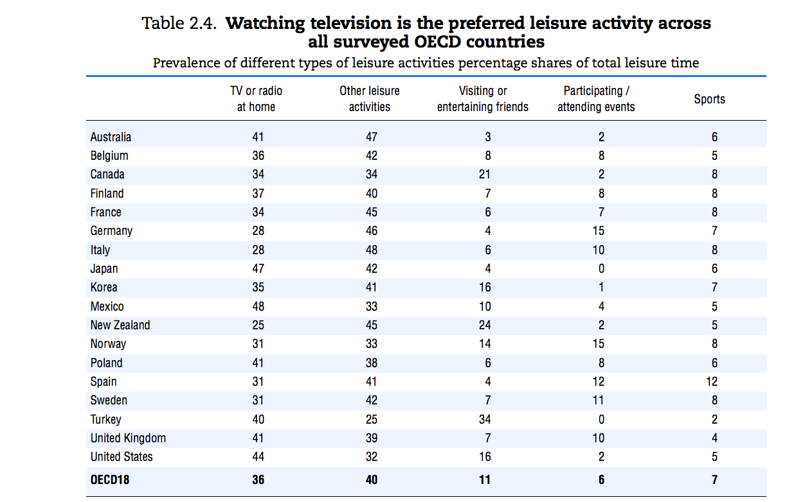
Contextual Awareness Relative to Other Media Forms & Engagements
“But sports are no worse than television,
which is no worse than games”
Notes:
ISBN 978-92-64-04938-3 Society at a Glance 2009 OECD Social Indicators @ OECD 2009 (among others)
Various headlines on the practices relative to TV and Sports consumption and practice. There’s really nothing ‘unique’ here about games relative to other media other than the moral panic of a new media – the time, effects, and engagement factors for television far outstrip games as a cultural influence, despite what we might say about sales in dollar values

Slide 19

GAMES & HEALTH (more generally)
In addition to aggression specifically, games are often used as a scapegoat to other health and behavioral issues
And yet, games are often used for positive effect in health, physical therapy, and behavioral intervention
Image: The GAPP Lab, University of Utah Medicine

Slide 20
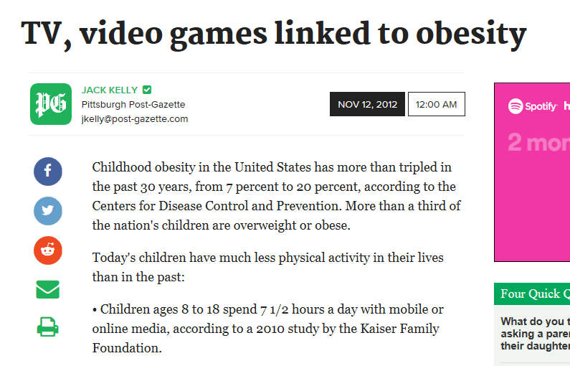

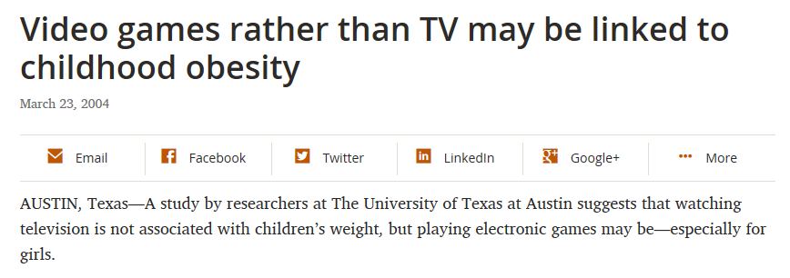

GAMES & HEALTH (more generally)
Notes:
https://news.utexas.edu/2004/03/23/nr_video_games
http://www.post-gazette.com/news/health/2012/11/12/TV-video-games-linked-to-obesity/stories/201211120171
https://www.healio.com/endocrinology/pediatric-endocrinology/news/print/endocrine-today/%7B9eea3b75-8b3d-407a-b8c6-0aa42aa0cdaf%7D/childrens-health-widely-affected-by-tv-computers-video-games

Slide 21

GAMES & SOCIETY
Typically games are dragged out as a sort of scapegoat for larger, structural issues in society
Generational divides around language and culture are exacerbated
The most sordid elements of games culture are normalized and offered as exemplars
“couch potato” from www.pushingdaisies.com

Slide 22


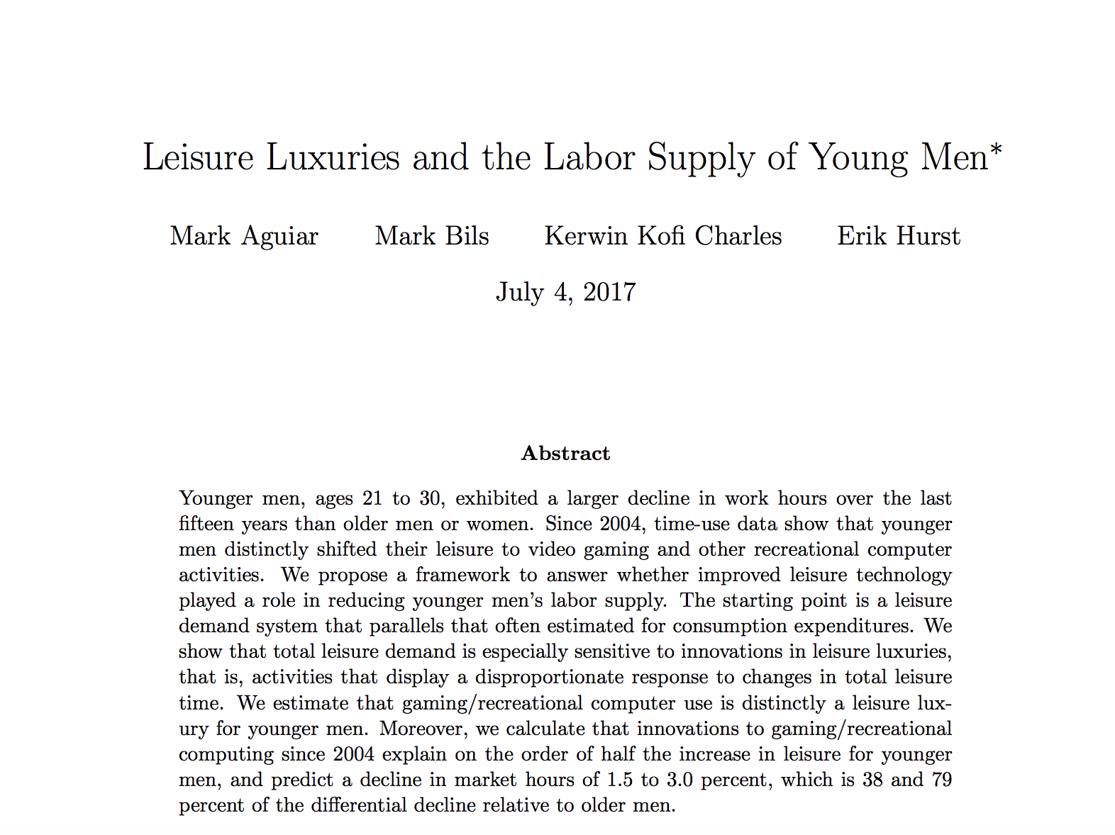
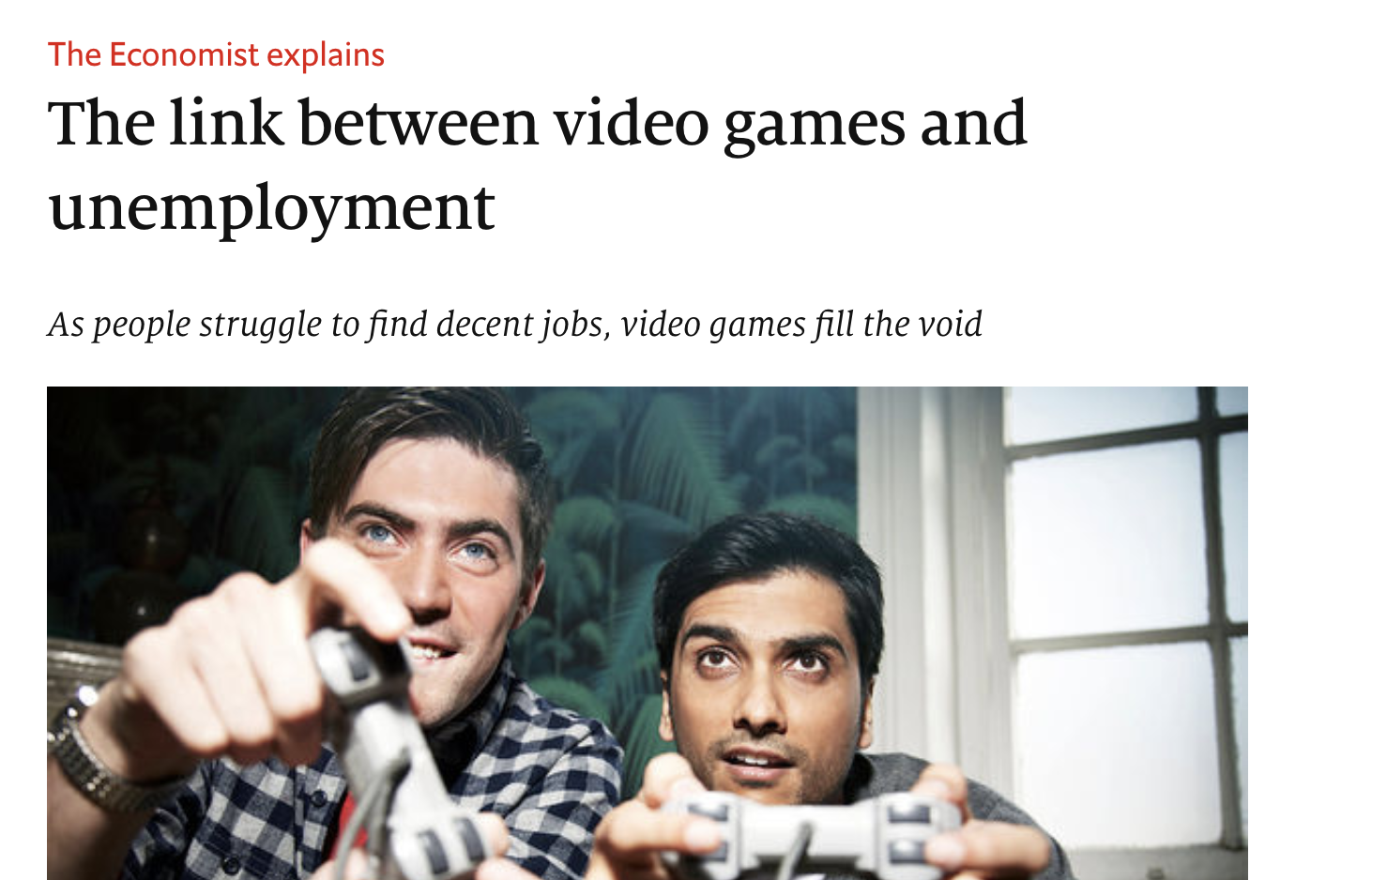

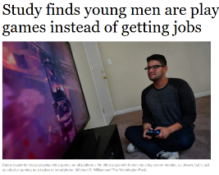
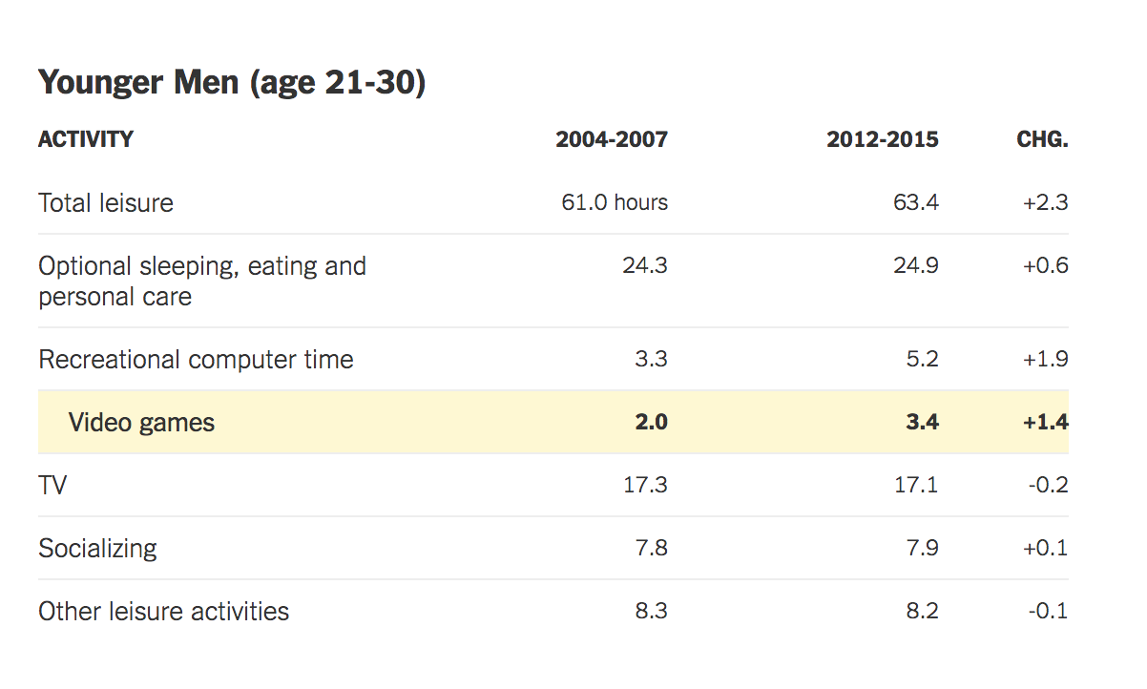
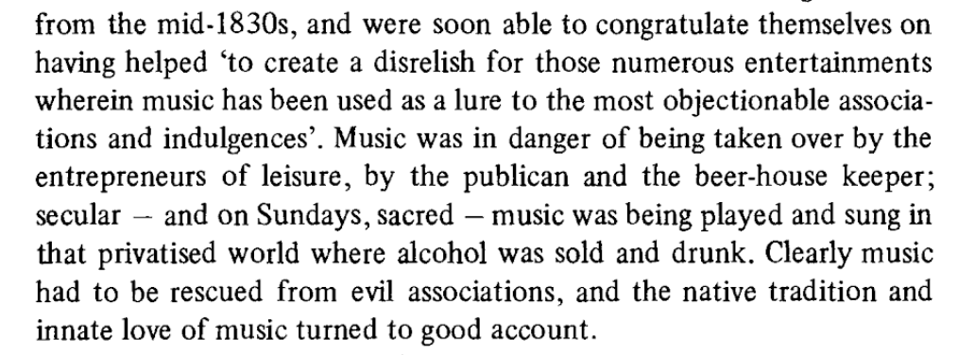
Games Blamed for Unemployment of Young Men in the US
Notes:
Video Killed the Radio Star – Adapted from the speech given at the 527th Convocation at Booth this past June
https://scholar.Princeton.edu/sites/default/files/maguiar/files/leisure-luxuries-labor-june-2017.pdf
http://www.chicagotribune.com/business/ct-video-games-jobs-emploment-20160923-story.html

Slide 23
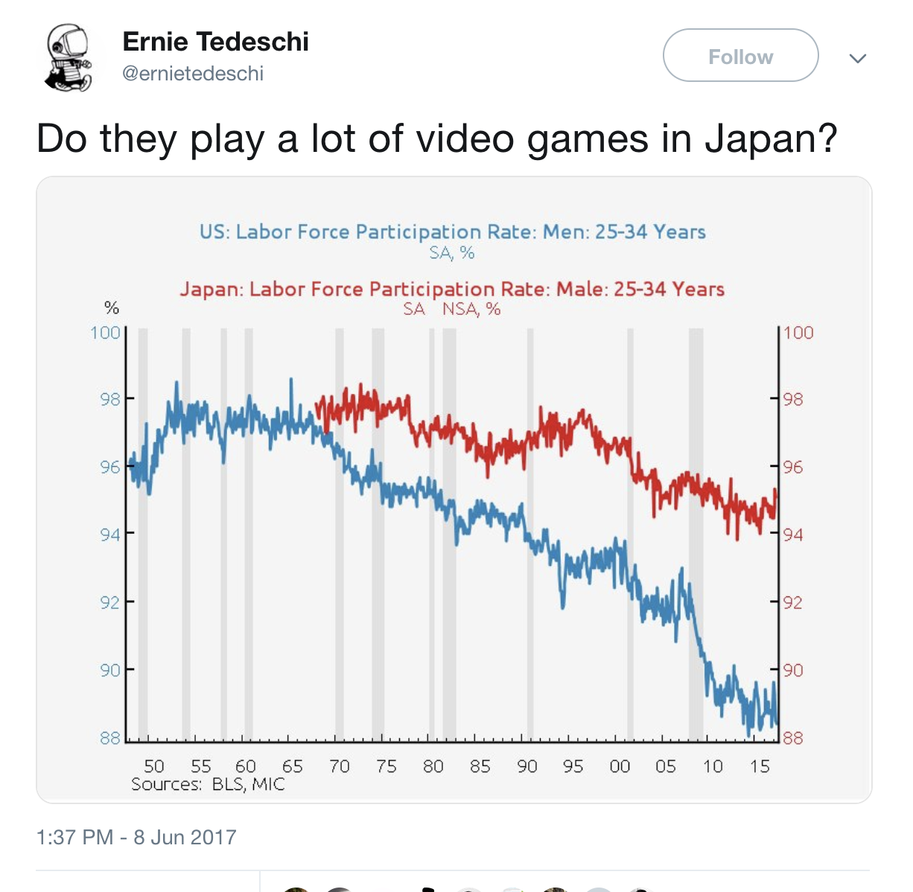

Does not address structural economic issues of the ‘post recession’ economy in the US
Does not even address order of operations (i.e. gaming due to unemployment or vice versa)

Slide 24




IF YOU ARE REALLY INTO THOSE ISSUES AND WANT MORE: GDC PANEL 2 WEEKS AGO WITH THESE FOLKS
Roger Altizer
University of Utah
roger.altizer@utah.edu
@real_rahjur
Mia Consalvo
Concordia University
mconsalvo@gmail.com
@miac
Lindsay Grace
University of Miami
learnvideogames@gmail.com
@mindtoggle
Andy Phelps
Rochester Institute of Tech.
andy@mail.rit.edu
@RITIGM1
Notes:
NOTE: Lindsay will insert a bibliography here with the links to articles cited throughout as well as additional pieces of note and studies that are most relevant

Slide 25

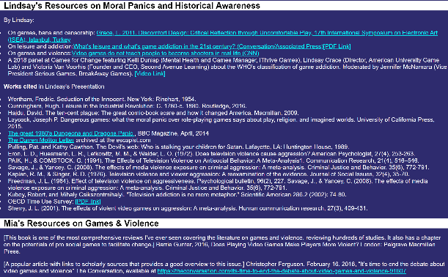
GREAT (NEW) SET OF MATERIALS AT
GAMECLASSES.COM/GAMESADVOCACY

Slide 26
PART 3: POLICY
How do the Rules and Forms of Academic Match Up With All of This?

Slide 27

A few recent questions for the academy
Are we graduating too many ‘game graduates’ ?
Are we ‘preying upon’ the motivations of a young population?
Are we appropriately staffing games programs with a mix of academics and practitioners with actual experience in game-making?
How do we deal effectively with a field that finds itself spanning disciplines and academic cultures?
Multi-disciplinary work is, it turns out, rather more difficult than we like to let on… how do we structure participation and reward engagement?

Slide 28
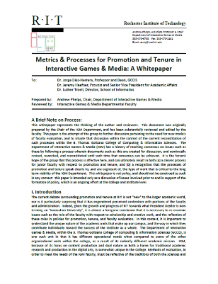
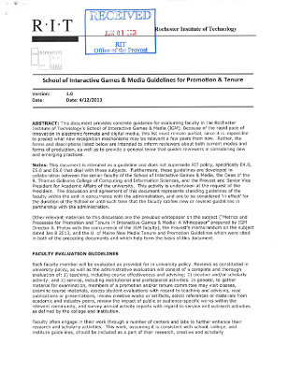

TENURE, PROMOTION & STAFFING POLICY

Slide 29
RESEARCH || AFFIRMATION
Ferguson’s conjecture is that given the WHO there will be a sustained interest in either approving (more likely) or disproving (potentially) the underlying thesis of addiction.
Pryblyzski’s conjecture is that we should get ready to face increased regulation and oversight (regardless of the short-term science, as it will take a long time to play out)
Within the academy, this has already started to warp some discussions about plans for new programs, particularly those centered on the intersection of games and health

Slide 30

ESPORTS AND POLICY
Substantial questions around funding models
Integration with academics has a variety of possible directions:
  Production / media
  Game design / development
  Sports / Sports medicine
  None (?)
Substantial questions around diversity and inclusion
  Varsity / Intramural / Club
  TITLE IX and associated compliance rules
Facilities, Equipment, Training, and Scheduling
Reporting & Oversight
  Academic Affairs, Student Affairs, Athletics, ???

Slide 31
PART 4: POLITICS
Because We Are, In the End, Humans

Slide 32
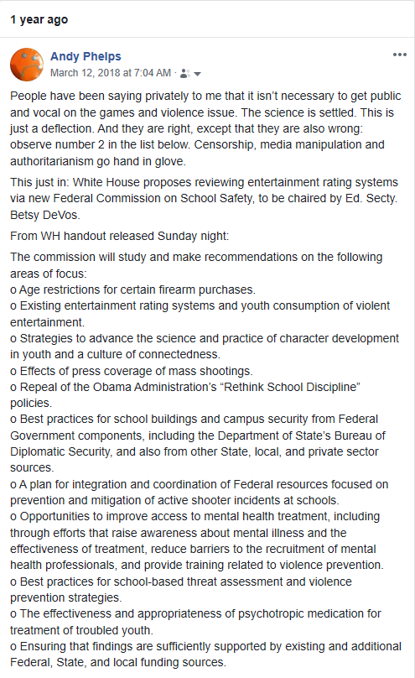
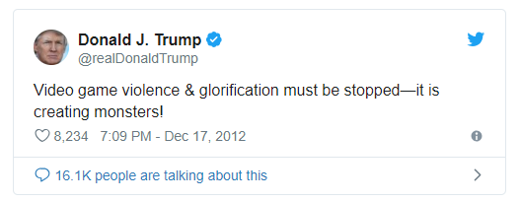
Lets start with a personal story
My friend Constance steps down from HEVGA, and she and the board ask me to take over, Nov 2017...
Take it slow, learn the ropes.
Good advice from the Biden years.
And then…
Notes:
The best part of this is that tweet is from 2012

Slide 33

Everything Old is New Again, Again
But what was different was the number of people saying ‘eh, this will just blow over’
And it did. THROUGH ADVOCACY.
Academics and industry gave a lot of interviews, issued statements, attended meetings, etc.
Notes:
A lot was written about how ineffectual the meeting at the WH was, and it was two sides shouting at each other. But it was also a chance to let a lot of people blow off steam, create some optics, but also illustrate some bright lines to policy makers. It started discussions in the rest of policy and politics and what would and wouldn’t work

Slide 34


THE POLITICS OF FUN
Games will continue to be fairly political inside the academy, and used as an example in political argument, for some time to come.
Senator Flake’s “Waste Report” is a great example – there’s almost always games research featured there each year, and it’s almost always important work. ☺
In the end, games are about fun, and our relationship with fun is complex, and the politics are fun are messy.

Slide 35





INCREDIBLE ALUMNI
ALEX CUTTING
Senior Assoc. Producer HALO
Microsoft / 343
CLAUDE JEROME
Gameplay Designer DESTINY
Bungie
DUSTIN KOCHENSPARGER
Line Producer DLC
DESTINY
Bungie
SELA DAVIS
Platform Engineer
XBOX / XBOX Live
Microsoft
VReal
ANNA SWEET
Director of 3rd Party Development
STEAM
Valve
Oculus
Caffeine.ty
Microsoft XBOX

Slide 36
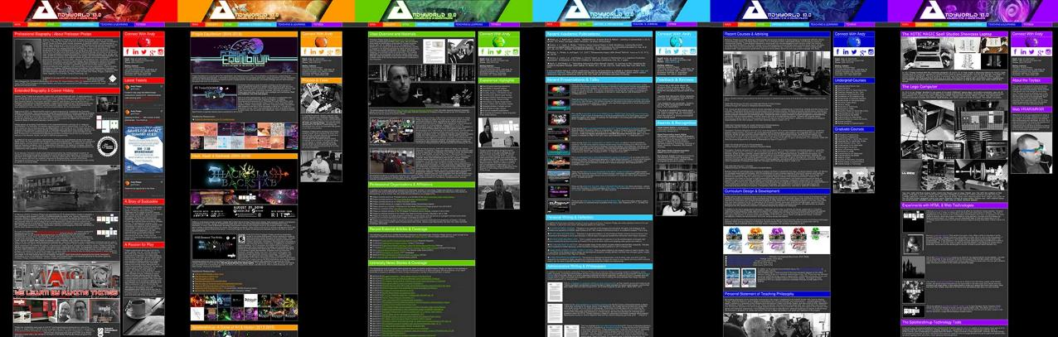
ANDYWORLD.IO | PROFESSORANDREWPHELPS.NET | @RITIGM1 |ANDYMPHELPS@GMAIL.COM
Thanks & Questions

