Slide 1




You Fritter and Waste the Hours: The Politics and Psychologies of Games and Time
More than Just a Game| April 2026 | London
Dr. Andrew M. Phelps
Professor, Film & Media Arts, School of Communication, American University, USA
Director, American University Game Center
Visiting Faculty, Department of Game Design, Uppsala University, Gotland Sweden
President, Higher Education Video Game Alliance
Notes:
Adobe stock image (generated with AI) used with academic license: https://stock.adobe.com/se/search?k=pink+floyd&asset_id=724039053

Slide 2
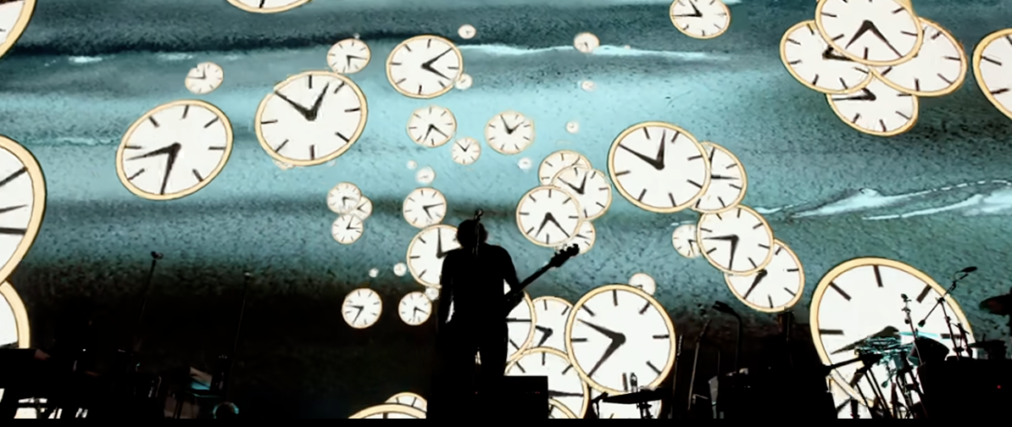
Ticking away
The moments that make up a dull day
You fritter and waste the hours
In an offhand way
-Pink Floyd, 1973
Notes:
Screenshot from https://www.loudersound.com/news/watch-roger-waters-revisit-pink-floyds-time

Slide 3
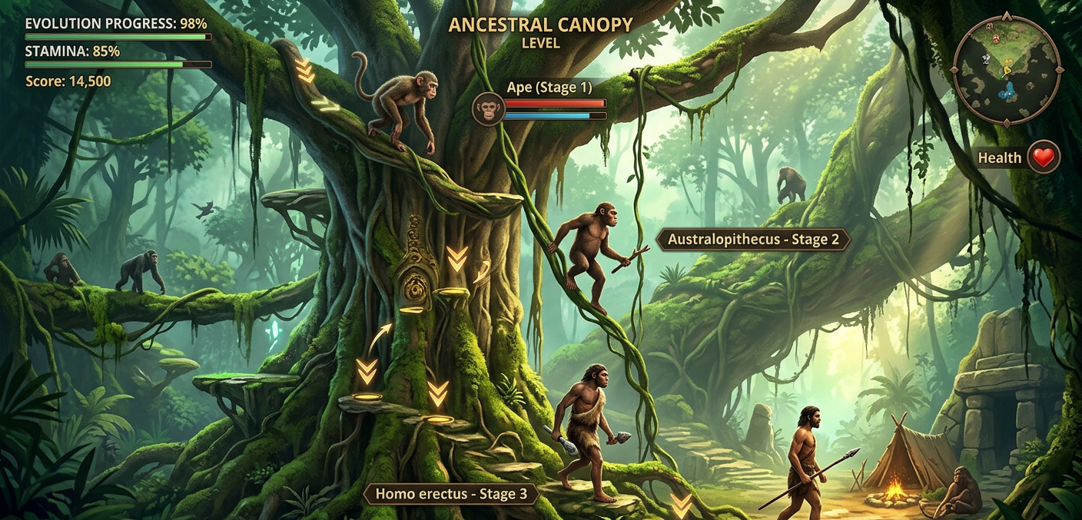
Ever since we climbed down from the trees, we’ve been making the same mistakes…
The ESA will love to tell you that nearly everyone plays video games, and in one sense they are correct.
What they won’t tell you is that our understanding of games, and of all media, is fractured along generational divides that are as clear as day, and that these divides *shift* as we age, just like our politics (which tend to get more conservative)

Slide 4
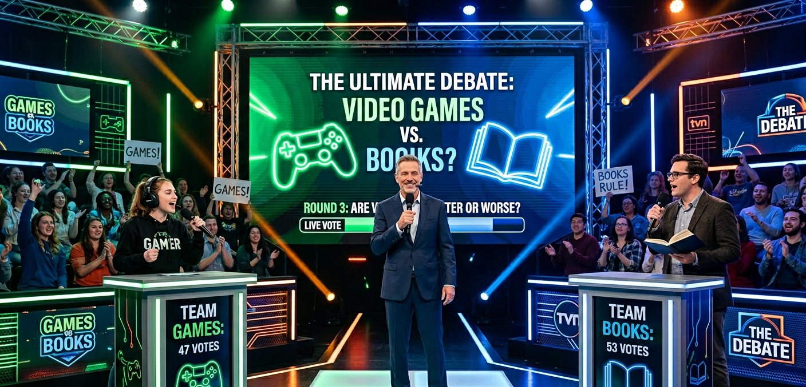
Reading a book is inherently better than playing a video game.
[ ] TRUE [ ] FALSE

Slide 5

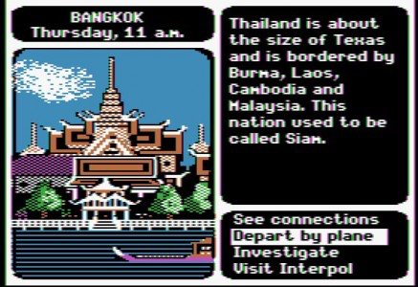
EVEN IF?
THE BOOK: Twilight by Stephenie Meyer
THE GAME: Where in the World is Carmen Sandiego? (Broderbund)

Slide 6
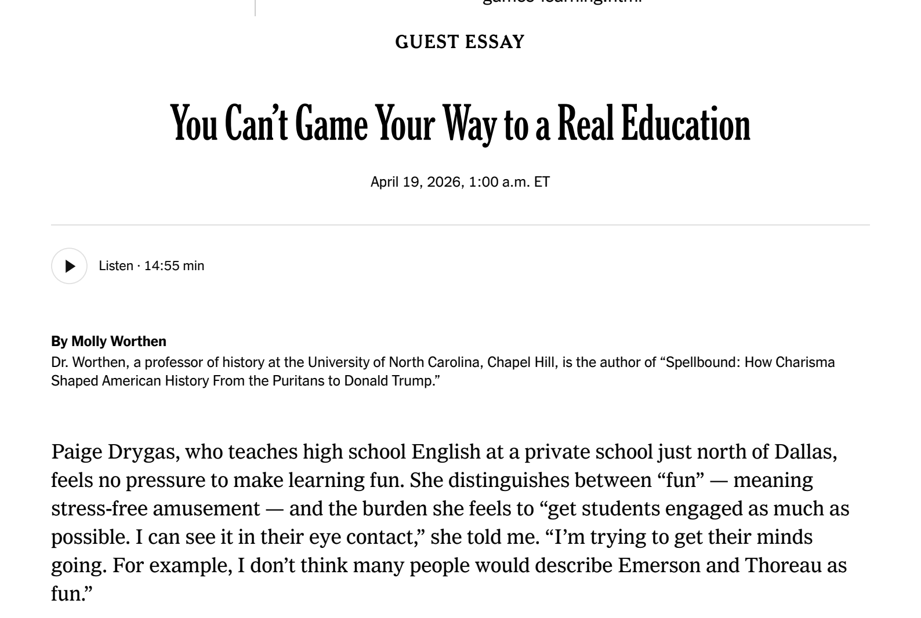

AND YET PEOPLE WILL ARGUE EXACTLY THIS. THAT TIME SPENT ‘READING’ IS ‘BETTER’

Slide 7
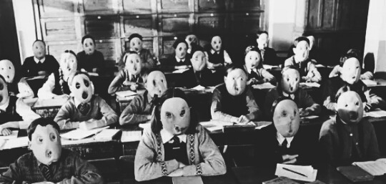
THIS IS FUNDAMENTALLY AN ARGUMENT ABOUT THE VALUE OF TIME AND HOW ITS SPENT
This is where generational and cultural divides take hold: you can almost hear the ‘back in my day’ beginning, and there is no *learning science* in any of these articles. Instead, there is a reactionary fear-mongering about ‘screen time’, student performance, and ‘workplace preparedness’, which feels very MAHA like in its reliance on correlation instead of fact. Will ‘Make America Educated Again’ be as effective as its counterparts?
Notes:
Image from https://www.tumblr.com/a-soul-deep-as-the-ocean/135639652201

Slide 8
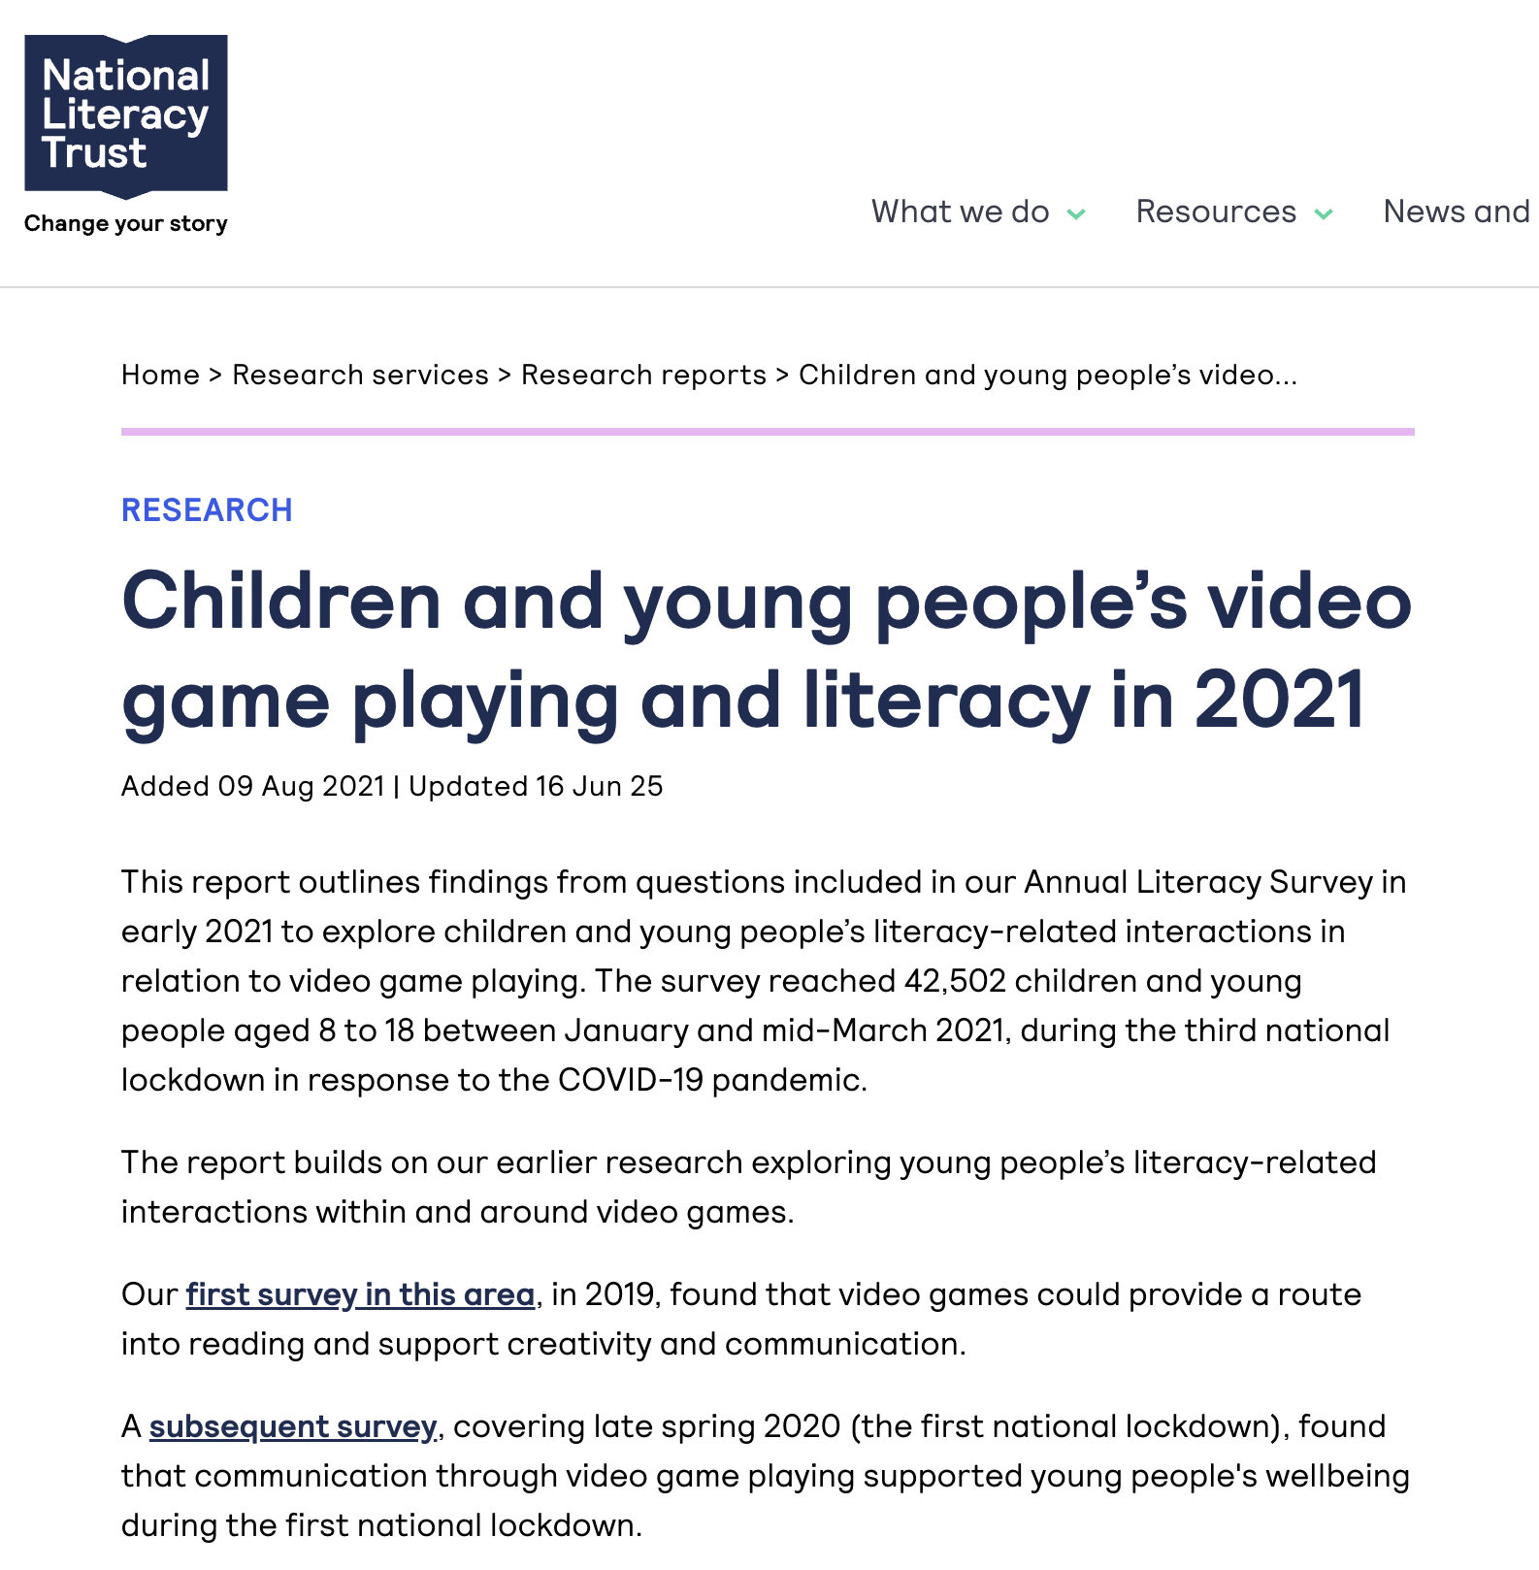
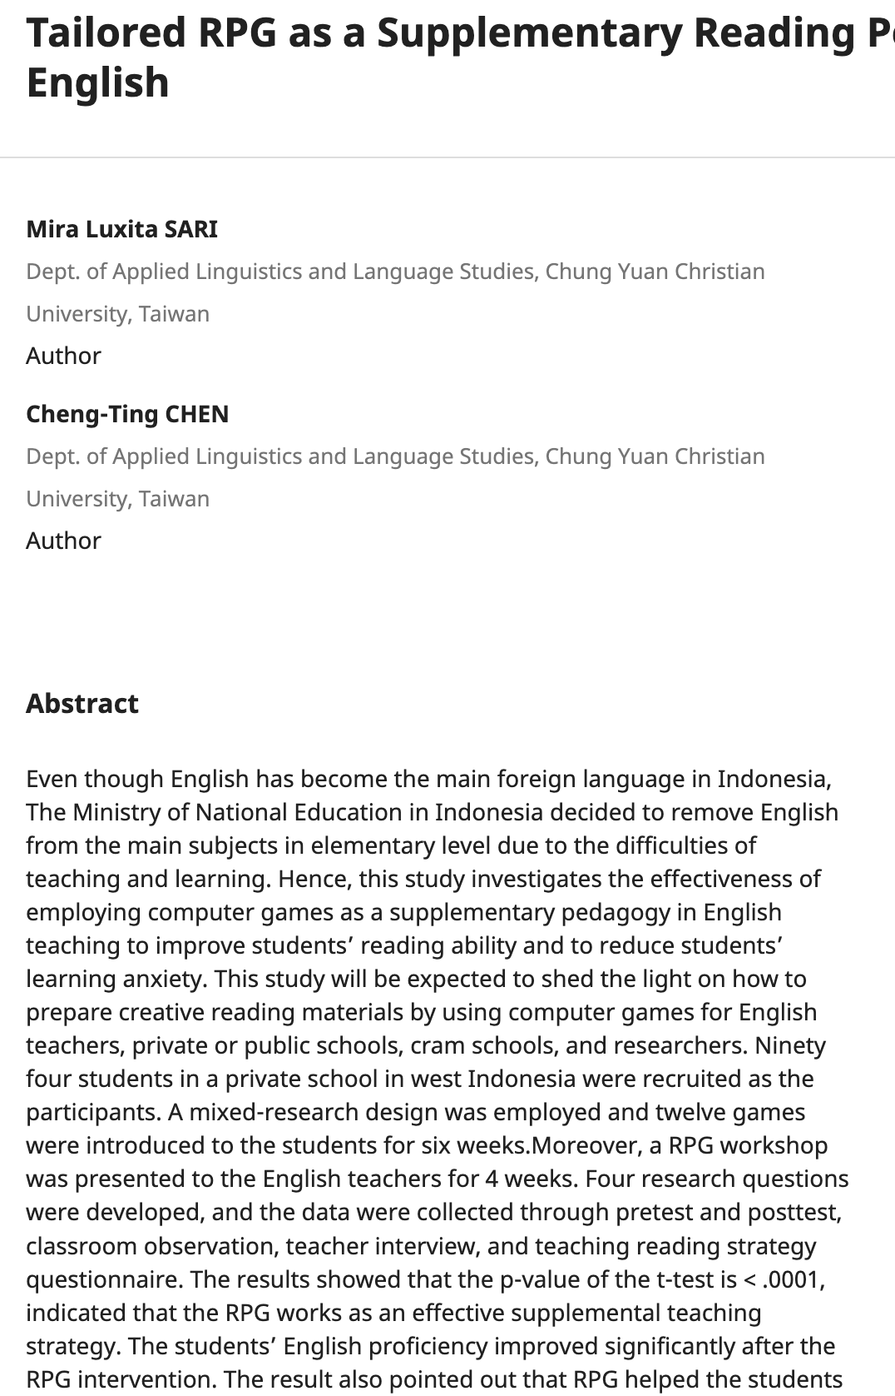
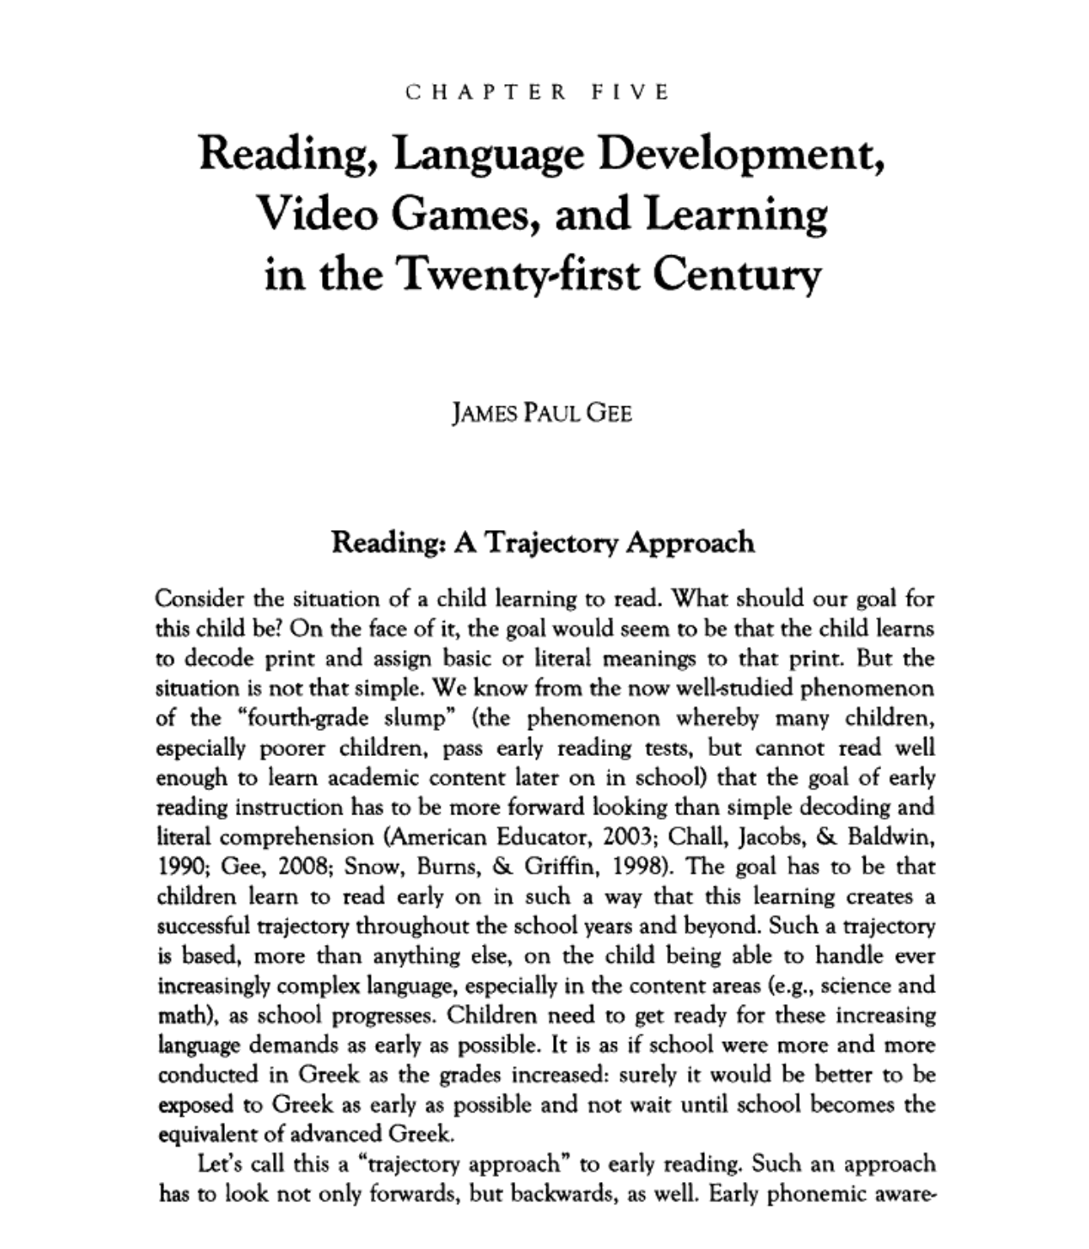
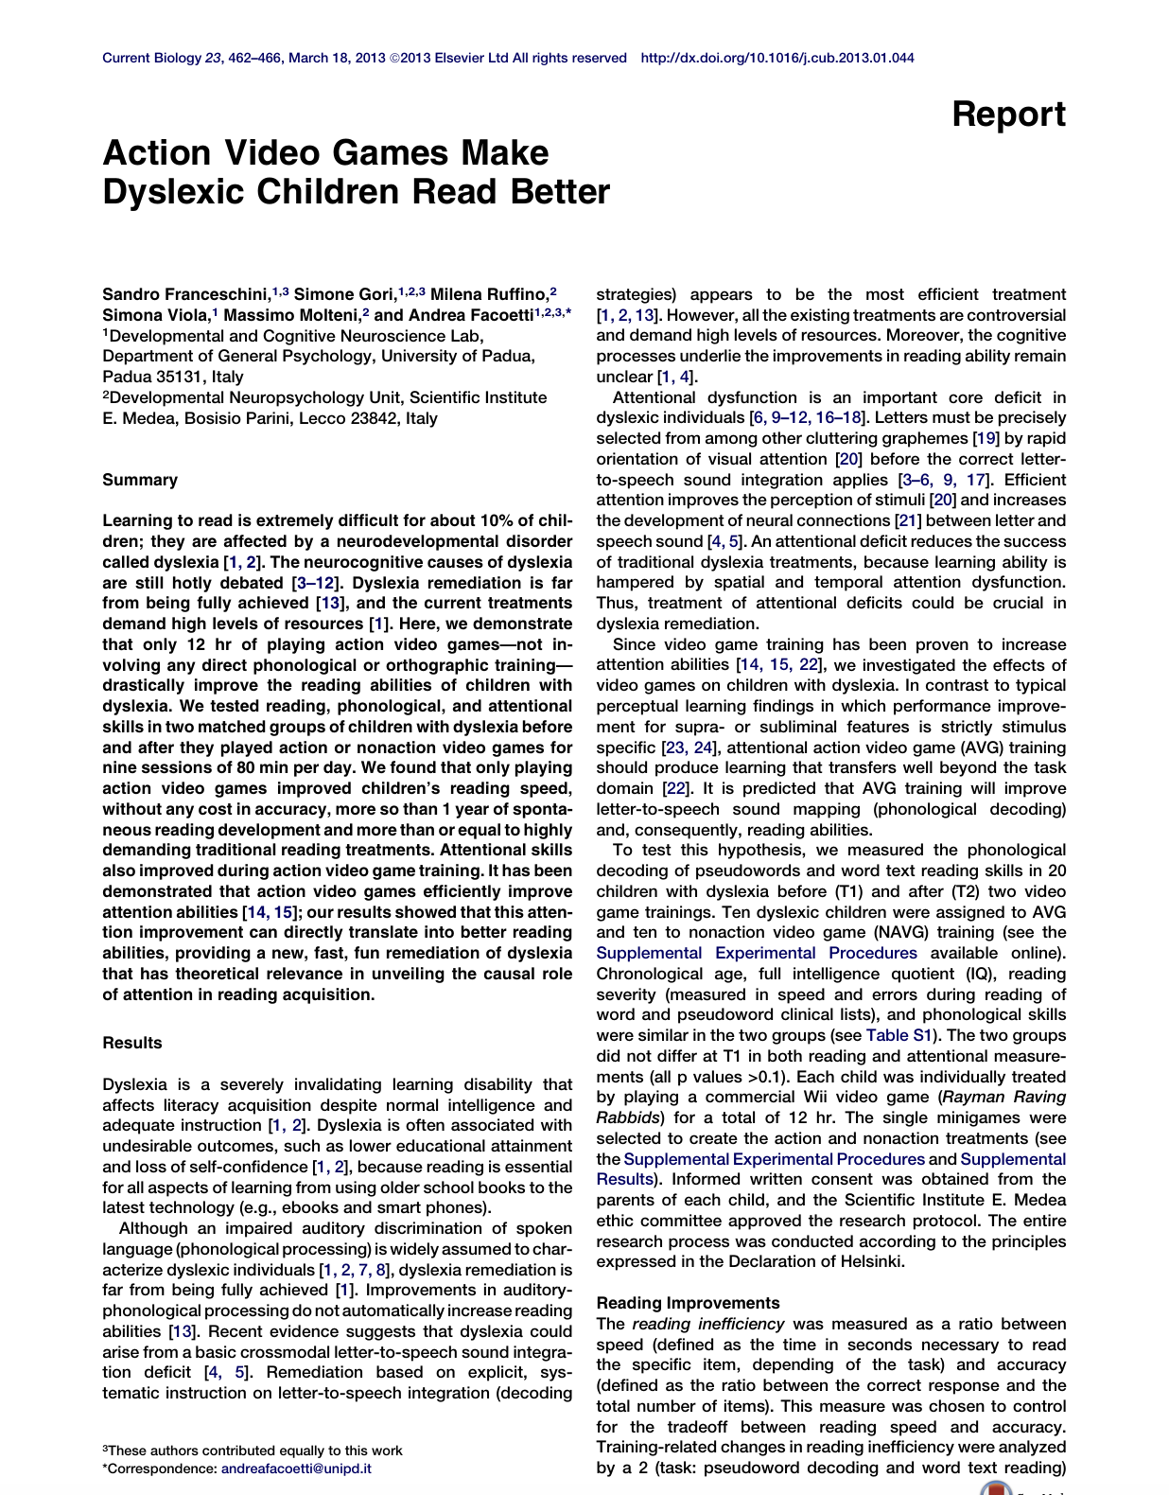
(BY THE WAY, you know, science…)
Notes:
Articles: https://literacytrust.org.uk/research-services/research-reports/children-and-young-peoples-video-game-playing-and-literacy-in-2021/
https://library.apsce.net/index.php/ICCE/article/view/2981
Gee, James Paul. “CHAPTER FIVE: Reading, Language Development, Video Games, and Learning in the Twenty-First Century.” Counterpoints, vol. 387, 2011, pp. 101–27. JSTOR, http://www.jstor.org/stable/42980948. Accessed 20 Apr. 2026.
Franceschini S, Gori S, Ruffino M ...
Action Video Games Make Dyslexic Children Read Better
Current Biology, 2013; 23, 462-466

Slide 9
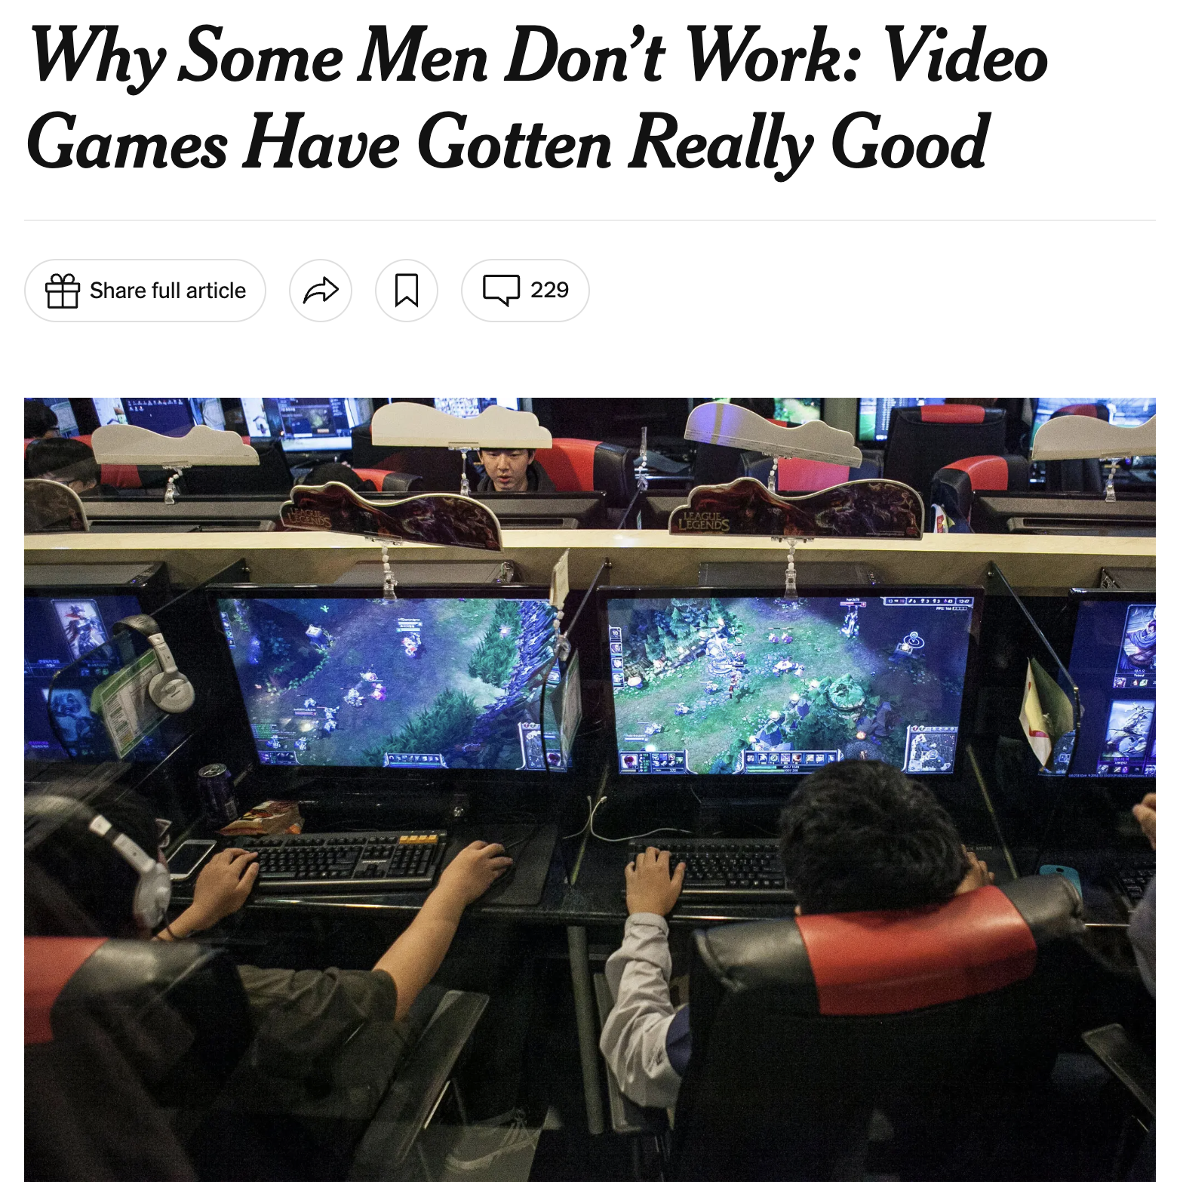


AND WE TAKE THOSE GENERATIONAL DIVIDES AND TURN THEM INTO POLITICS
Outside! Fresh Air!
Builds Character
Harmless Play
Typical Development
Sedentary
Violent*
Lazy / Immoral
Anti-Social
Problematic / Arrested Development
*this is another debate / presentation in itself
Notes:
Boys with weapons screenshot: https://honey.nine.com.au/parenting/why-boys-fight-with-sticks-nerf-guns-reason-behind-aggressive-play-research-development/9173c4b6-0009-4d26-9776-85a641713e77
COD screenshot: https://www.gamespot.com/articles/check-out-these-new-call-of-duty-warzone-screensho/1100-6474556/

Slide 10
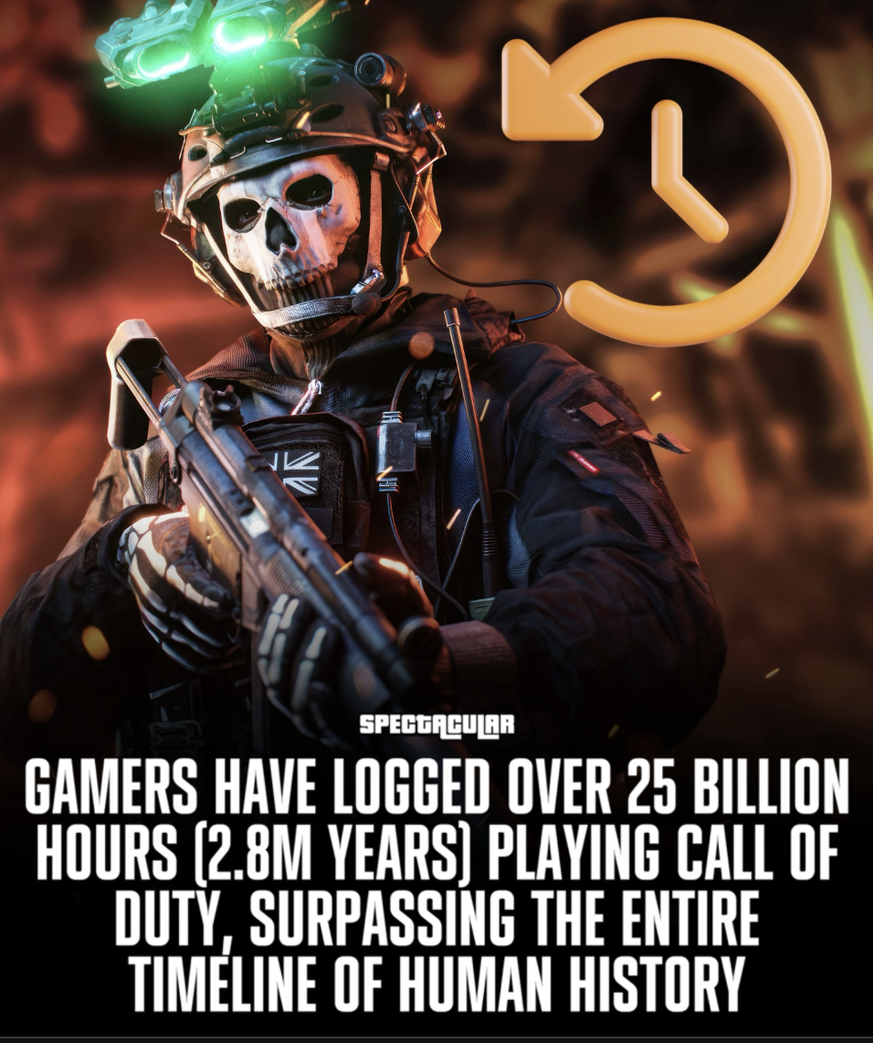
OUR NOTIONS OF TIME AND VALUE ARE STILL PURITAN
How much *time* do we spend when we play an MMORPG? (Runescape holds the Guiness Book of Worlds Records title with 84,2846 years. Estimates as of 2021-2022 suggested that over 9 million years have been cumulatively played in World of Warcraft since its release in 2004)
Notes:
Guiness Book of WR Runescape: https://www.guinnessworldrecords.com/world-records/most-popular-free-mmorpg
WoW 9 million stat: https://www.reddit.com/r/wow/comments/u9kci6/9_million_years_of_world_of_warcraft_has_been/
COD image from https://www.instagram.com/p/DMWGFjcyNHJ/

Slide 11
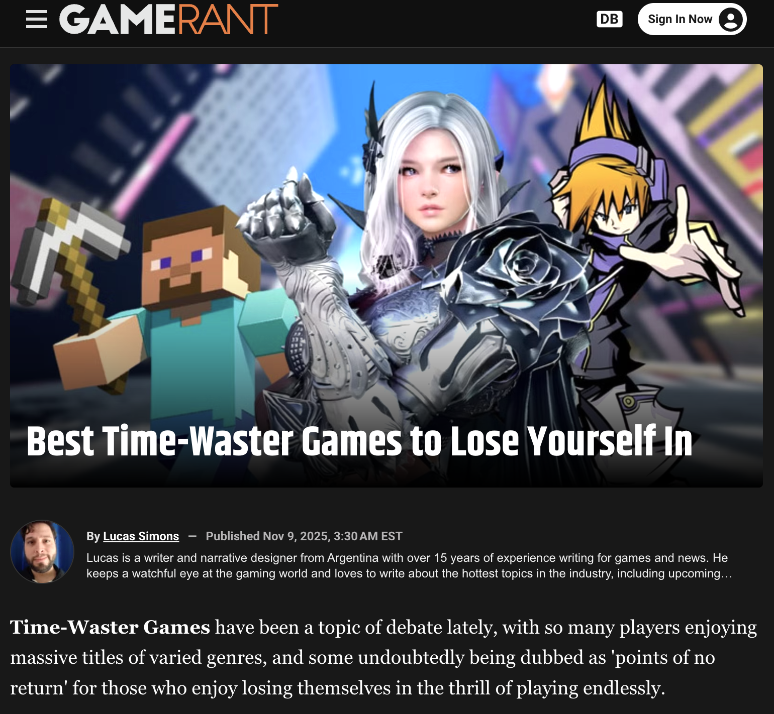
So WE EVEN MARKET THIS NOW, AS ‘TIMEWASTERS’ (thank you games industry)
Notes:
Image from https://gamerant.com/best-time-waster-games-ever/

Slide 12
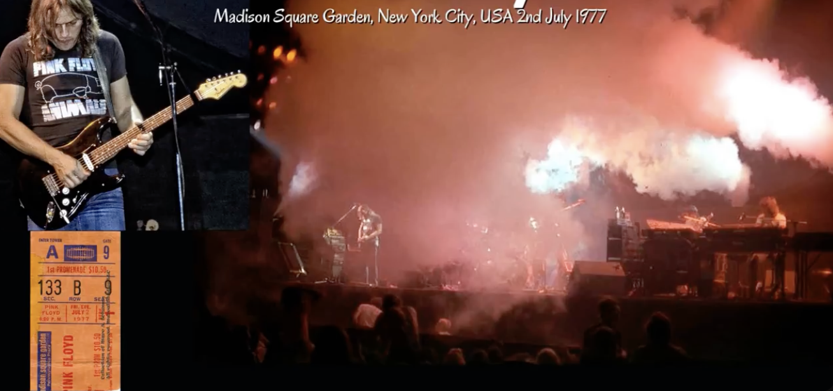

AND TIME, OF COURSE, IS MONEY (ONE MIGHT SAY It’s a gas…)
Notifications
Achievements
In-Game Purchasing
In-Game Currency
Dark Gaming Patterns
Monetization Loops
Pay-To-Win Mechanics
Etc., etc.,
#neverPay #candyCrush
Notes:
Screenshot from: https://www.youtube.com/watch?v=uhPovQNMjxM

Slide 13
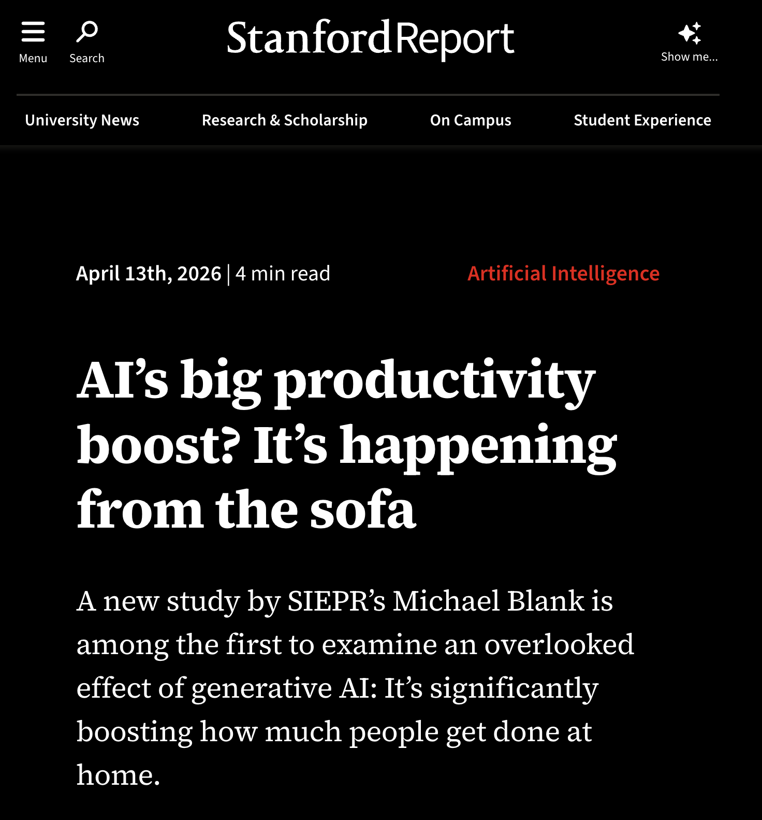
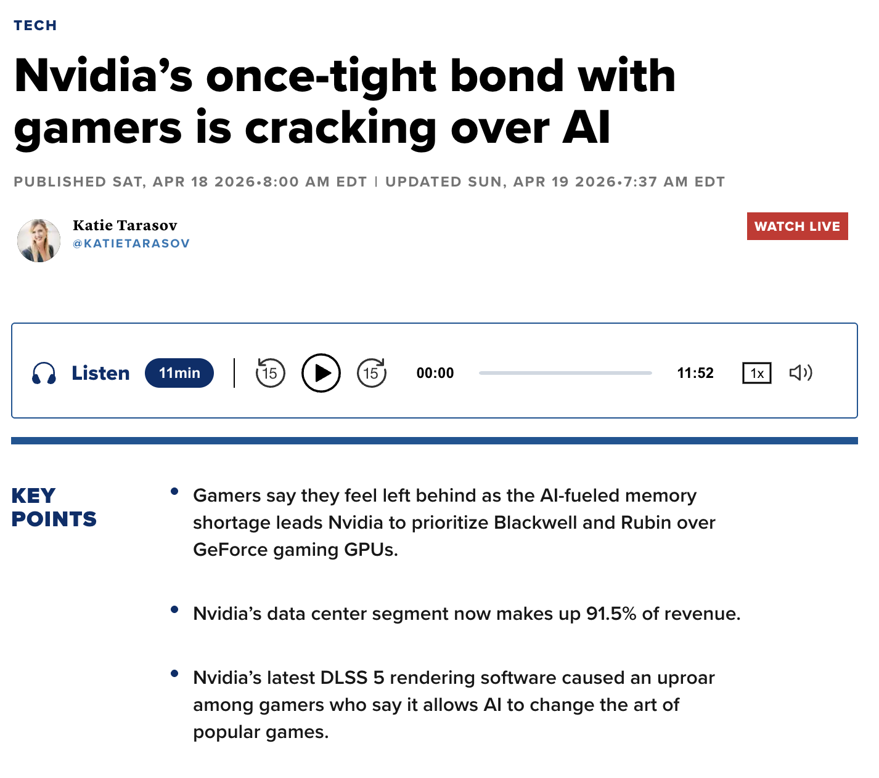
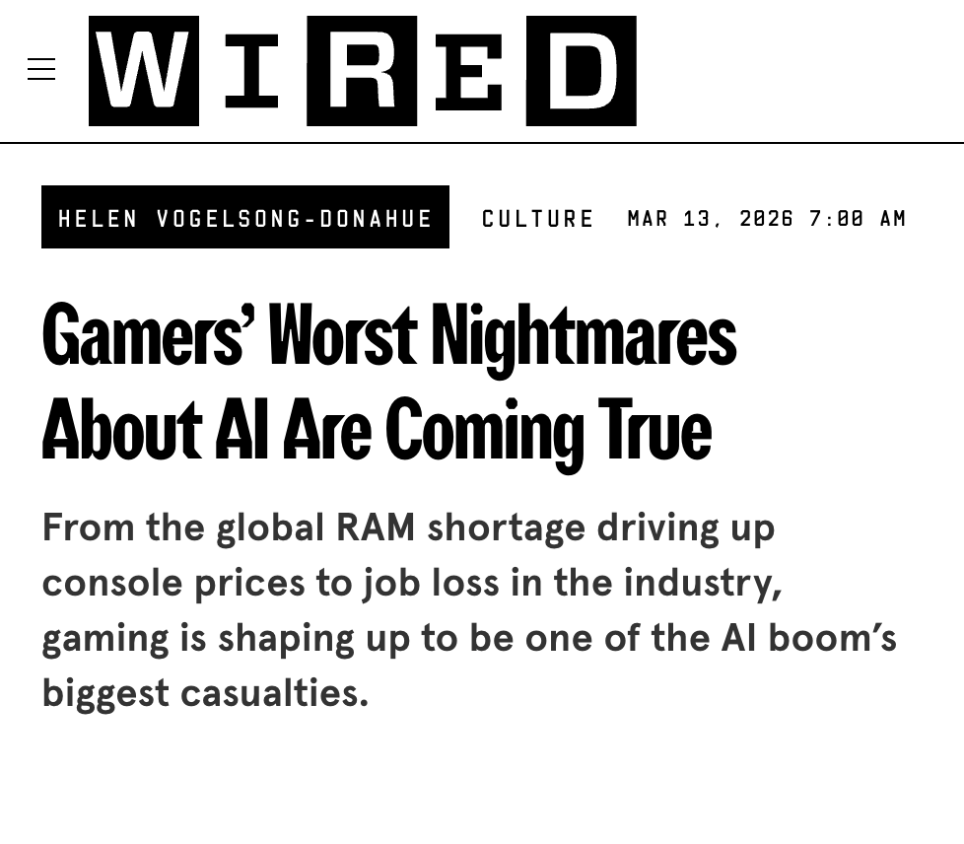
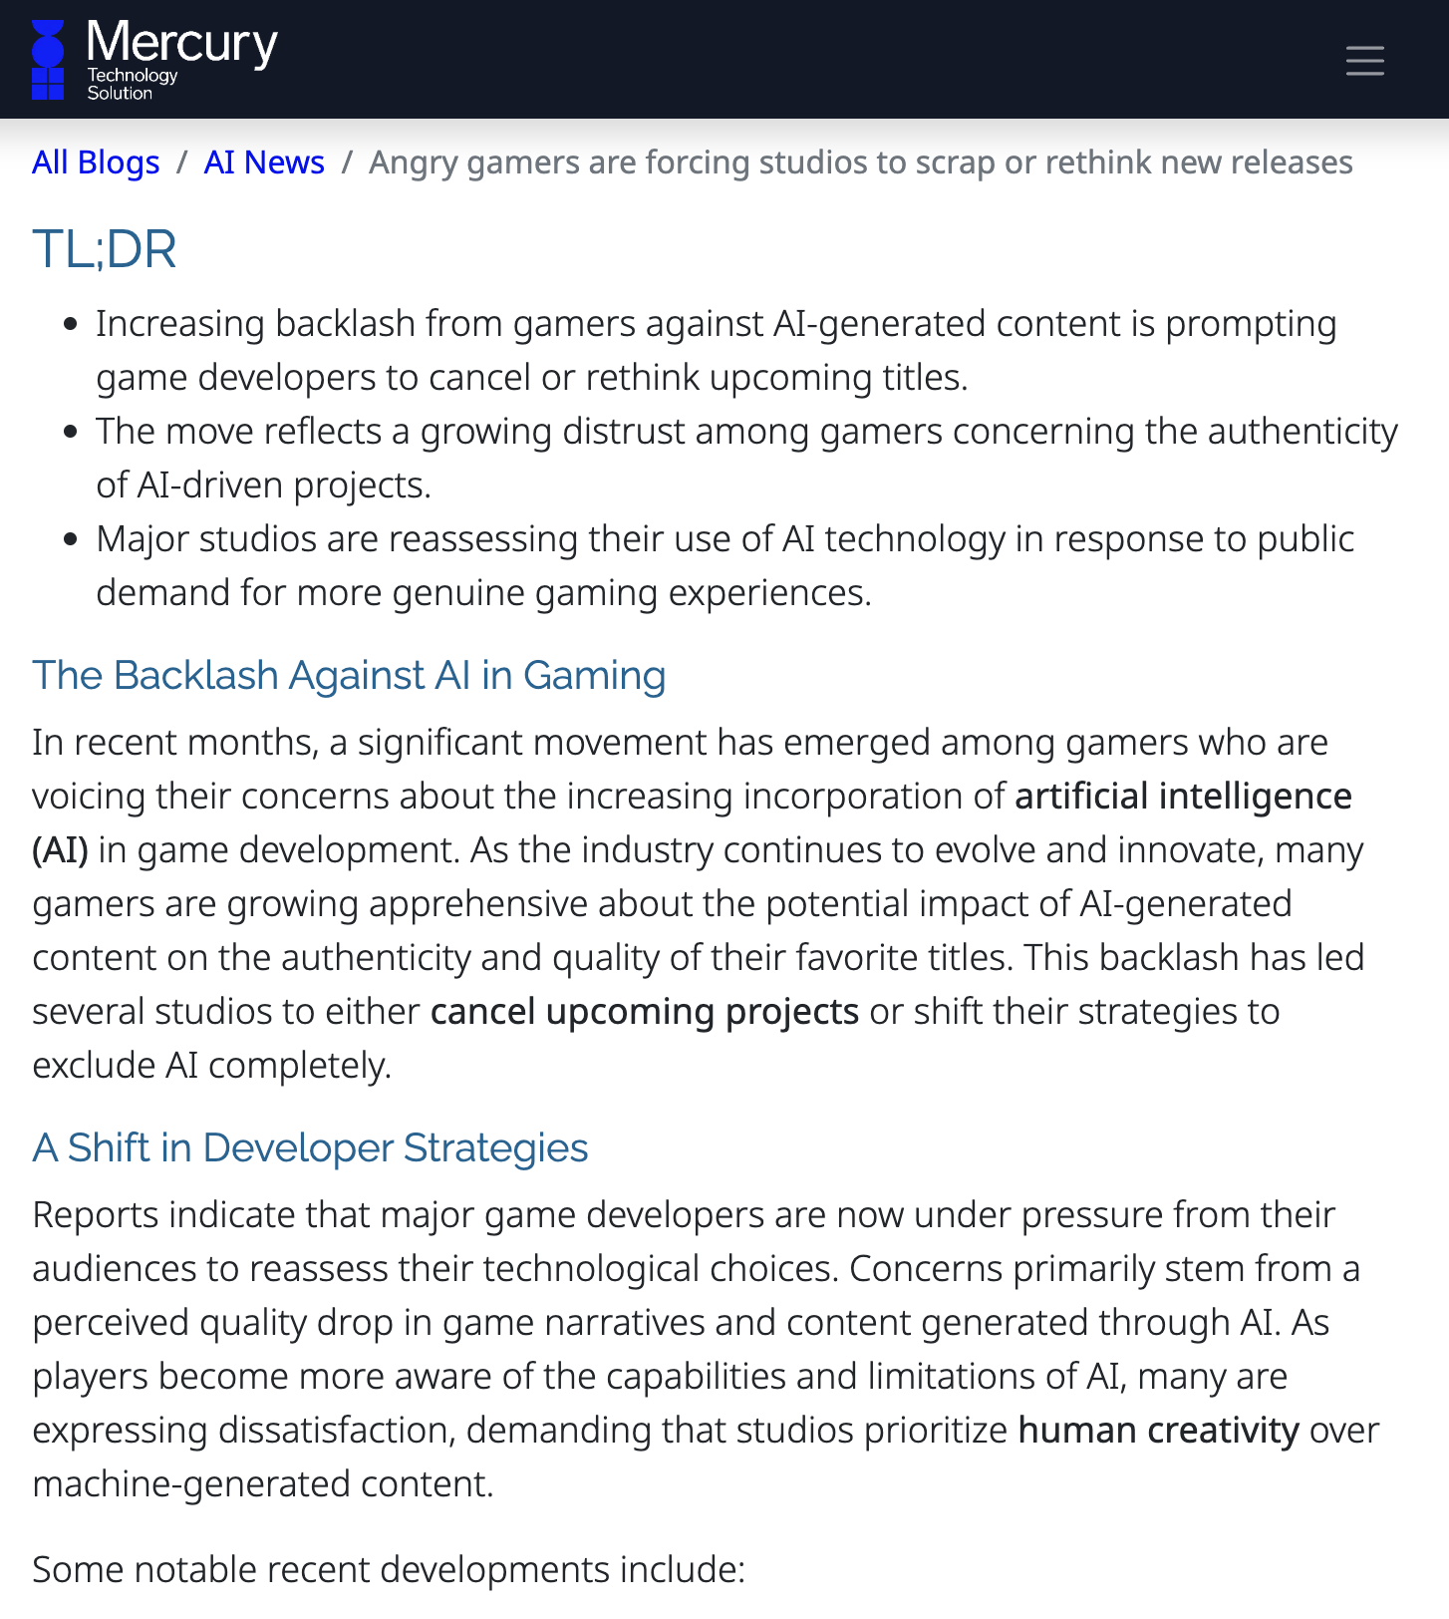
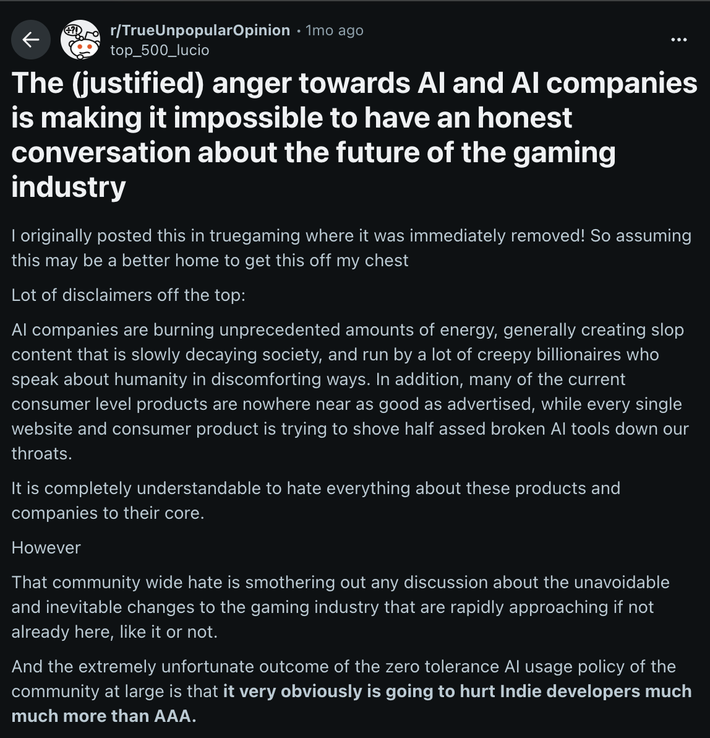
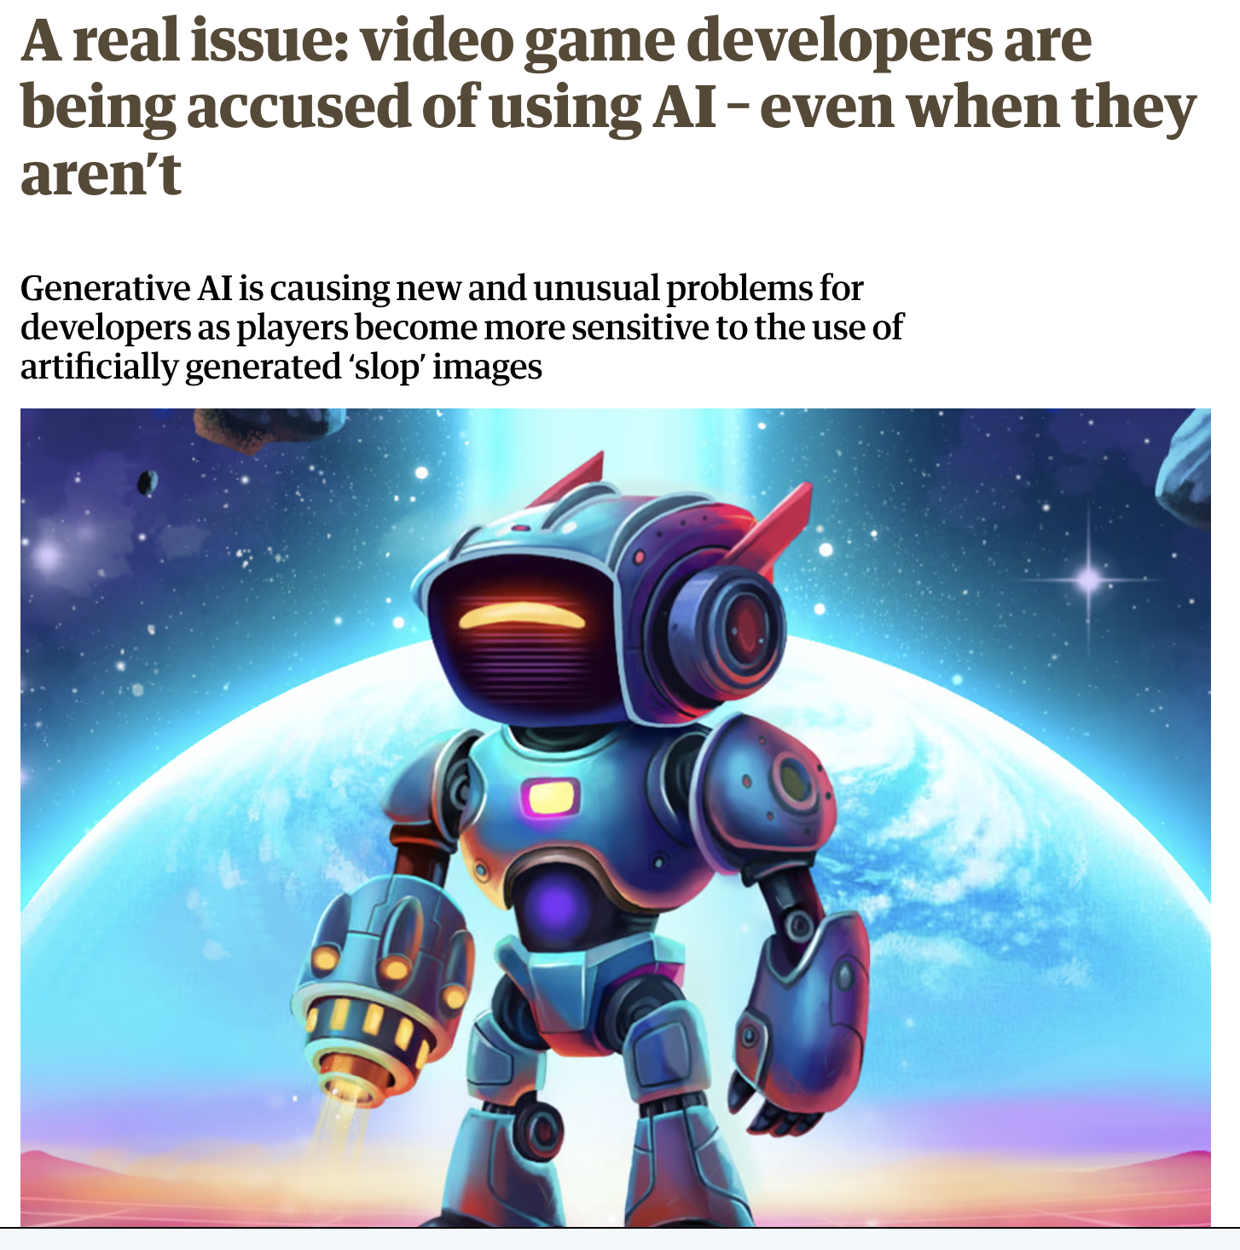
You CAN FEEL THE AI RHETORIC COMING, AND ITS COMING IN GAMES, AND ITS ABOUT TIME vs. VALUE
Notes:
https://news.stanford.edu/stories/2026/04/digital-chores-productivity-boost-research
https://www.cnbc.com/2026/04/18/nvidia-ai-backlash-gamers-geforce-gpu.html
https://www.wired.com/story/gamers-ai-nightmares-are-coming-true/
https://mtsoln.com/blog/ai-news-727/angry-gamers-are-forcing-studios-to-scrap-or-rethink-new-releases-5311
https://www.theguardian.com/games/2025/jun/26/video-game-developers-using-ai-even-when-they-arent-stamina-zero

Slide 14
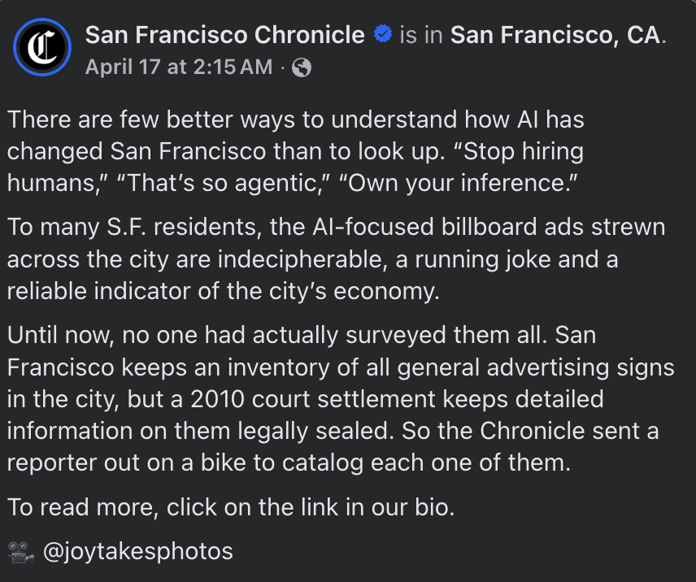


Our default Puritanism and ingrained cultural use of the Calvinist Work Ethic around time and its use are transferring from our divides and debates around games to AI almost entirely en masse.

Slide 15

WE OFTEN TRIVIALIZE GAMES AND PLAY, BUT THE WAY WE SPEND OUR TIME, AND HOW WE THINK ABOUT IT, IS CRITICAL TO OUR UNDERSTANDING OF CULTURE, SELF, and TECHNOLOGY
Notes:
Poster from https://printler.com/sv/print/214922/

Slide 16
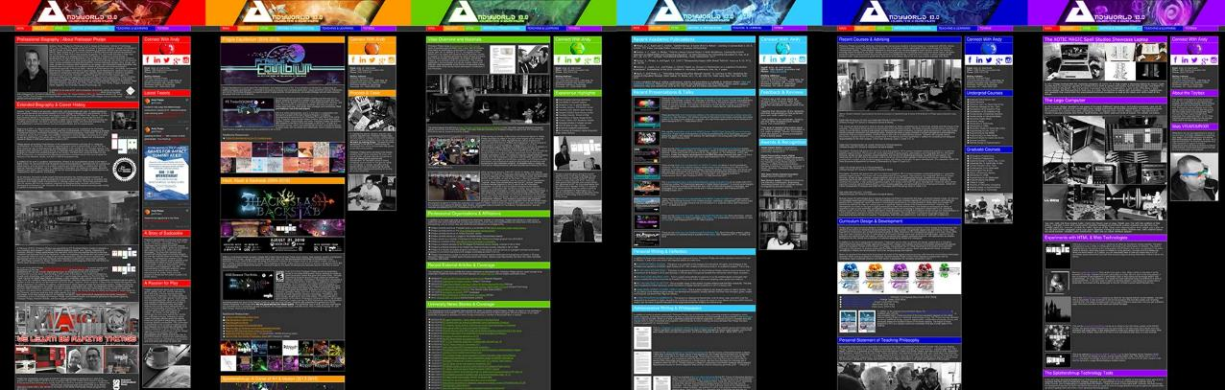
ANDYWORLD.IO | PROFESSORANDREWPHELPS.NET | @ANDYMPHELPS | ANDYMPHELPS@GMAIL.COM
Thanks & Questions

