Slide 1




:
Pushing Boundaries in Academia
(with games)
More than Just a Game 2025| May 2025 | London
Andrew M. Phelps
Professor, Film & Media Arts, School of Communication, American University, USA
Director, American University Game Center
Visiting Faculty, Department of Game Design, Uppsala University, Gotland Sweden
President, Higher Education Video Game Alliance

Slide 2
2005-2025 GAMES EXPLODED IN ACADEMIA
Between 2010 and 2023, the number of postsecondary credentials in video games offered in the United States and Canada grew by more than ten times.
In Canada, the number of postsecondary games-related credentials increased almost tenfold, from 35 in 2010, to at least 318 ten years later.2 In 2020, there were at least 671 games or games-related postsecondary credentials in California alone.3
- The HEVGA 2025 Report on University Games Programs

Slide 3

Games BROUGHT ACADEMIA TOGETHER
(in the weirdest of ways)

Slide 4


GAMES PUSHED OTHER FIELDS FORWARD

Slide 5

ACADEMIA PUSHED GAMES TECH INTO INTERESTING PLACES

Slide 6
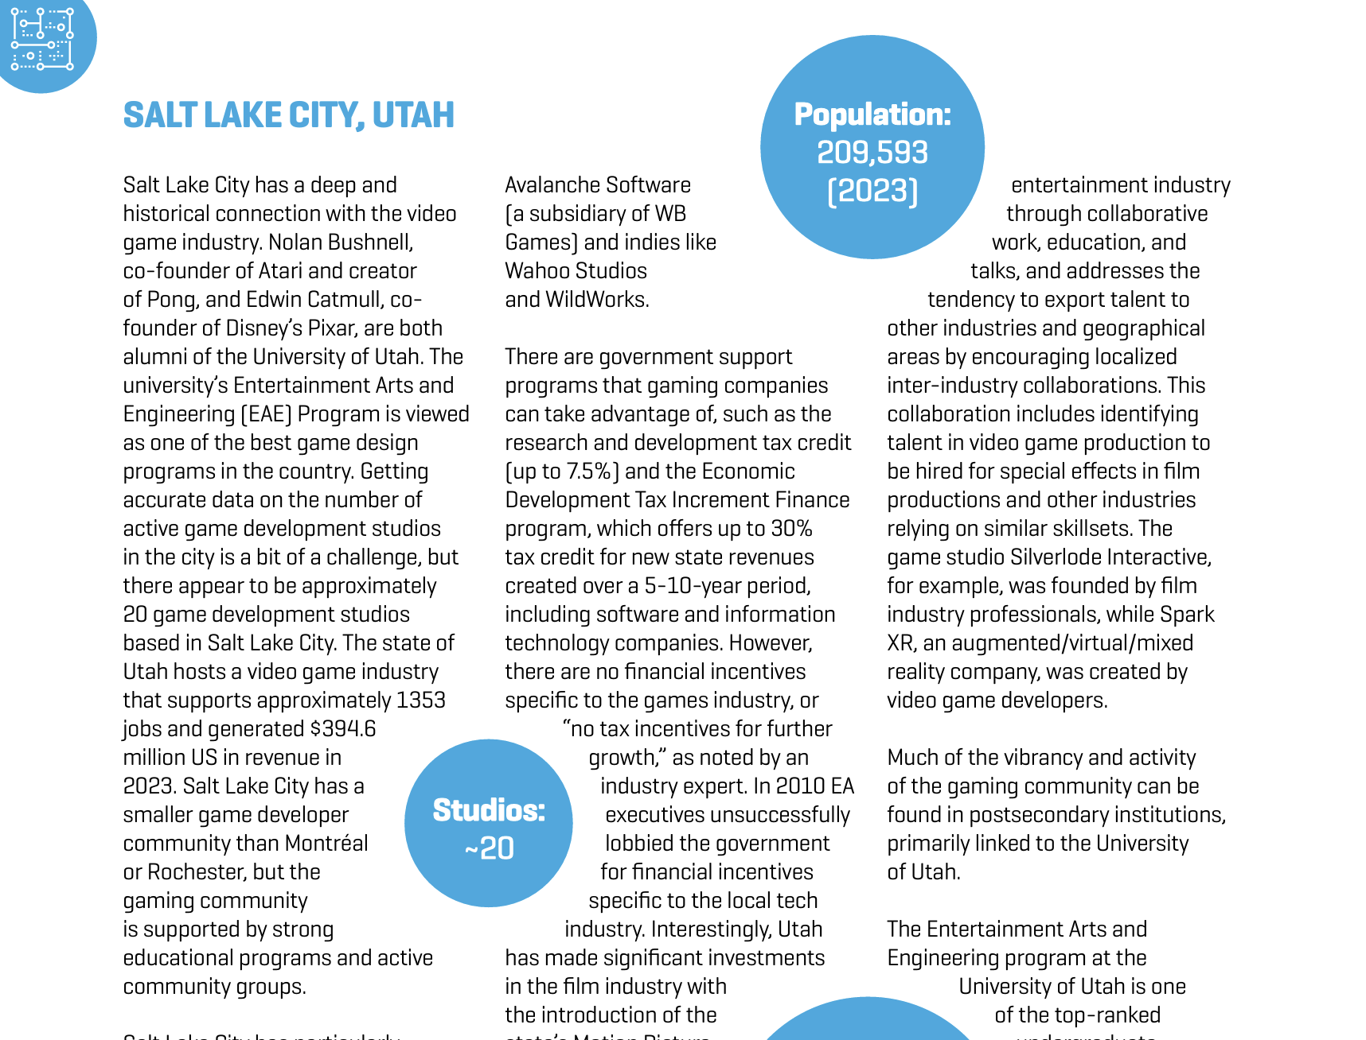
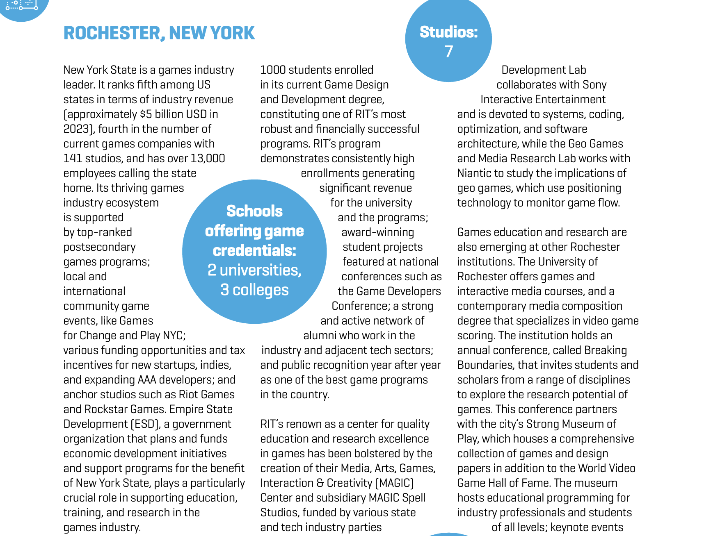
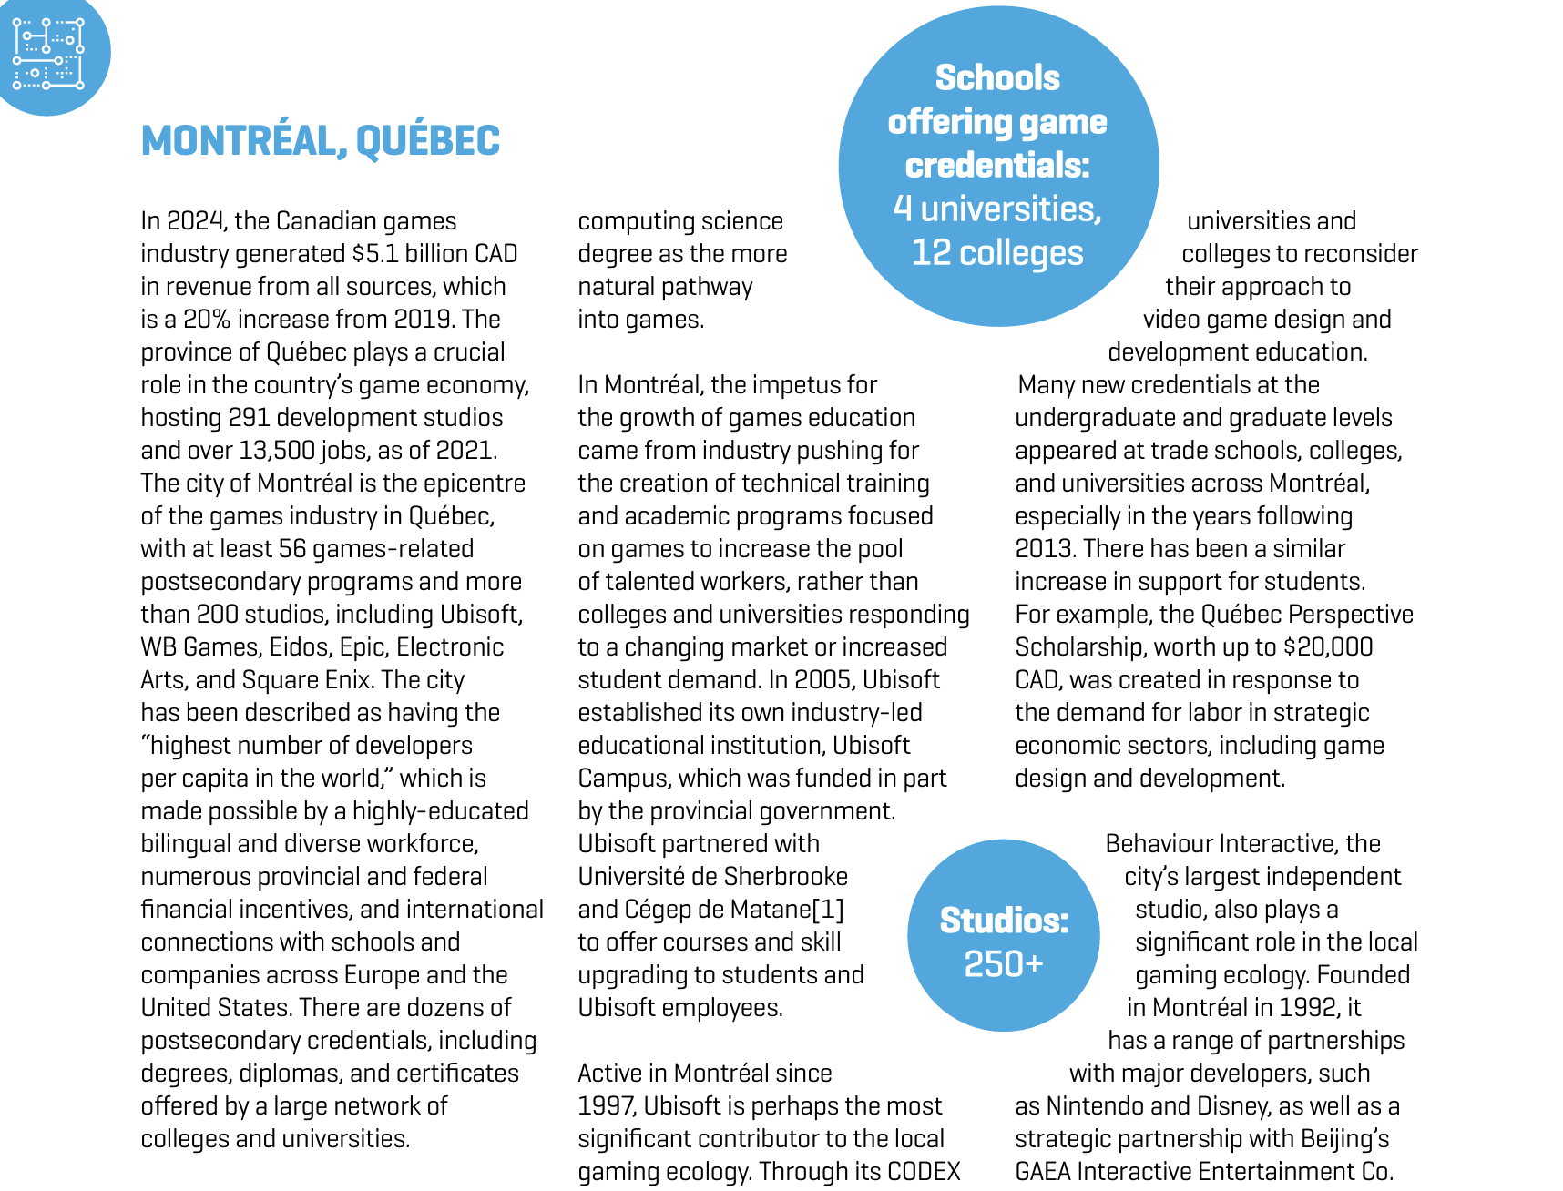
ACADEMIA PUSHED BOUNDARIES IN ECONOMIC DEVELOPMENT
Notes:
Again from HEVGA report

Slide 7
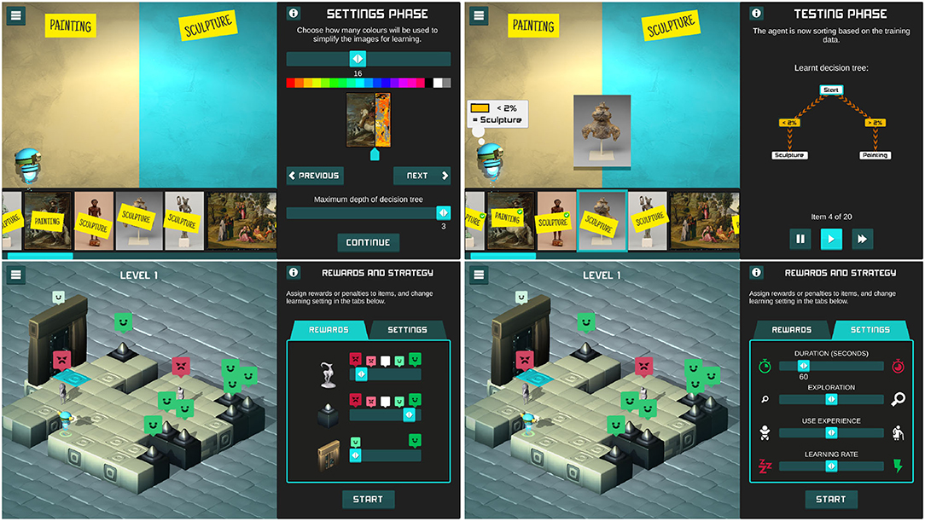
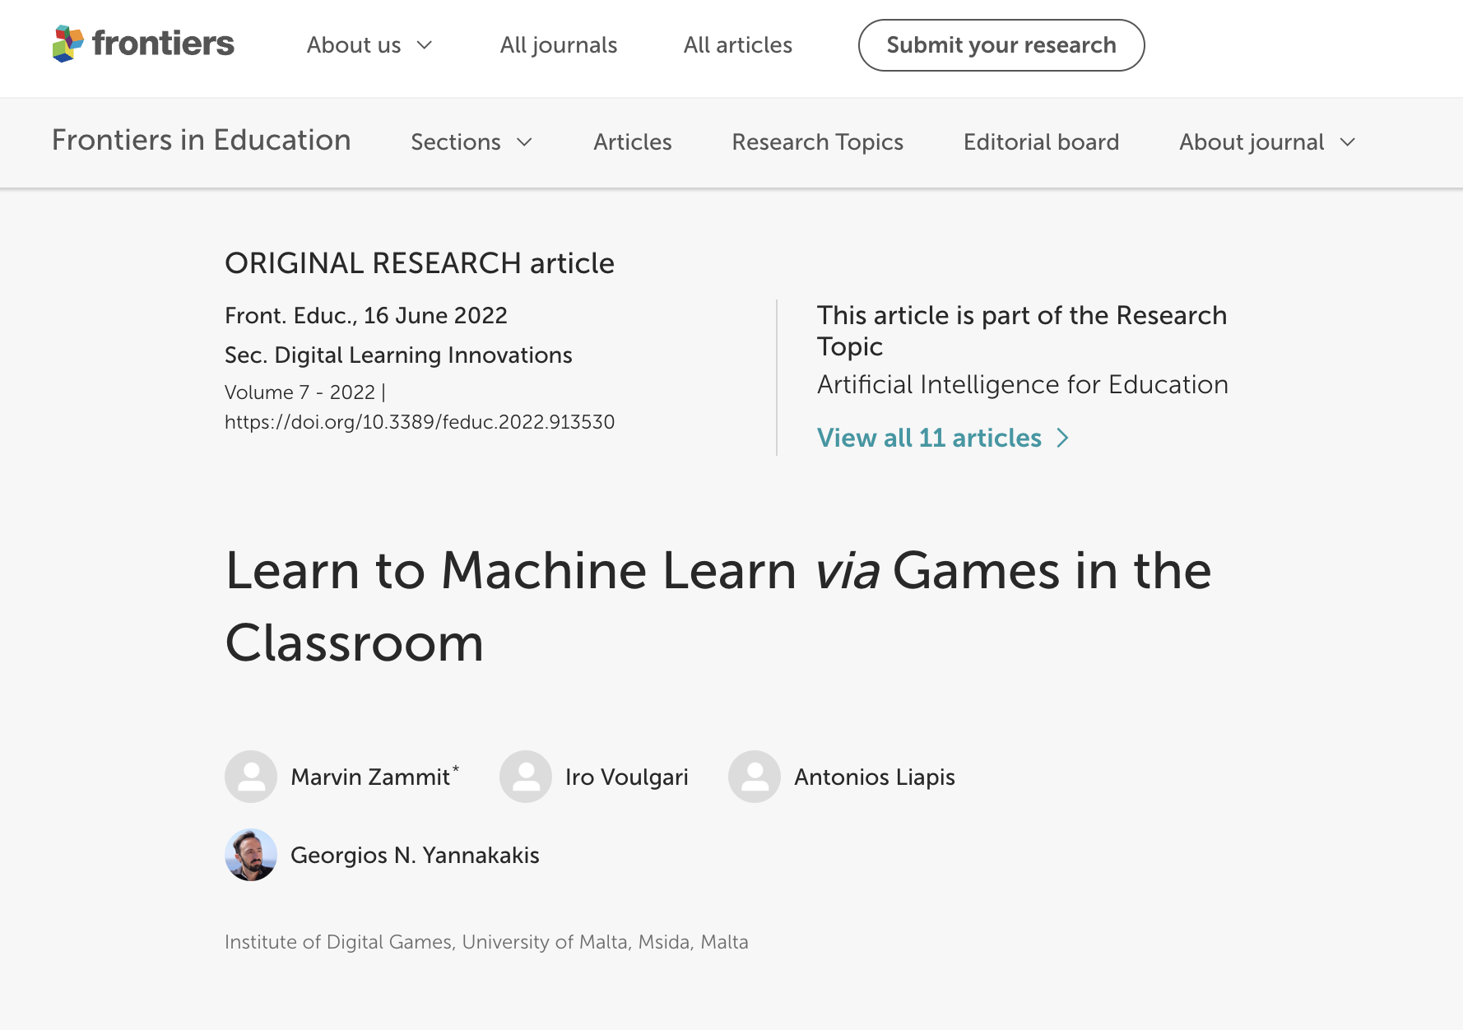
AND HOW GAMES ARE GOING TO PUSH AI TO BE BETTER AND MORE USABLE

Slide 8

ANDYWORLD.IO | PROFESSORANDREWPHELPS.NET | @ANDYMPHELPS | ANDYMPHELPS@GMAIL.COM
Thanks & Questions

