Slide 1




:
Video Games, Culture & Society: When Principles Collide
More than Just a Game 2024| May 2024 | London UK
Andrew M. Phelps
Professor, Film & Media Arts, School of Communication, American University, USA
Chief Learning Officer, Endless Studios
Visiting Faculty, Department of Game Design, Uppsala University, Gotland Sweden
President, Higher Education Video Game Alliance

Slide 2
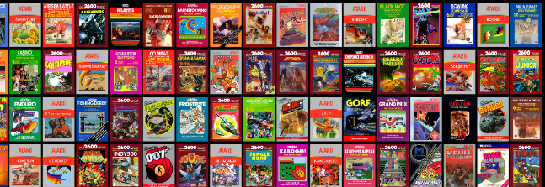
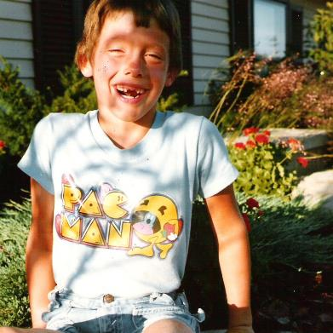
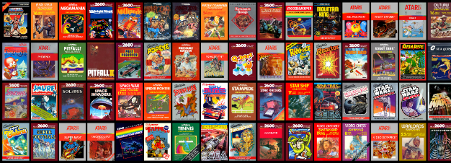
HI, I’m ANDY

Slide 3
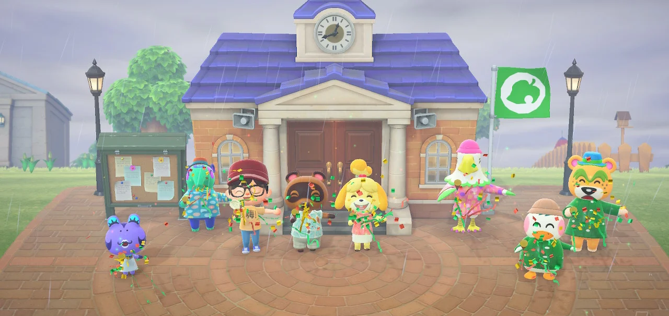
ME FROM 2022: WE WON? SOMEHOW?
“Video games have gone from being blamed to being praised, largely because people have begun to realize how much games connect us and bring us joy.”
  – Stan Pierre-Louis, ESA

Slide 4
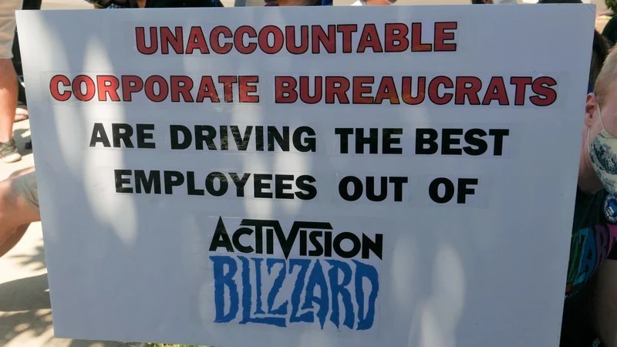
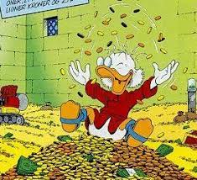
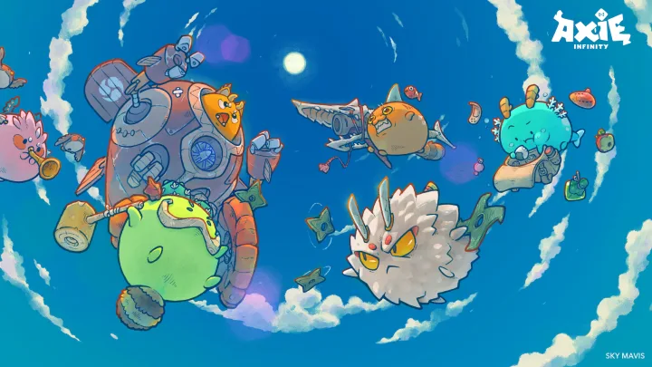


2022: SO LET’S NOT MESS THIS UP?
Notes:
The Activision | Blizzard walkout was yet another highlight of the misogyny and sexism that runs rampant through games and games culture. This damages the credibility and engagement with games by other sectors, and it places games as an ‘other’ for which regulation and control are more sought after by legislators and governments as easy political points in democratic arenas, or conversely as ‘ruining’ children re: playtime and socialization in conservative areas.
People have figured out that games industry has done pretty darn well during all of this, better than, well almost everyone. So there will be some scrutiny of how any of that money goes to public good rather than only shareholders. (There will also be scrutiny by shareholders…) – DESPERATE PLEA FOR R&D?
There is a perception there are ‘too many games’ – this is NOT true, we’re actually in a content glut, but what is happening because some games are so lucrative right now is there are large numbers of copies of basically the SAME game, rather than studios really innovating, and this is dangerous because people get bored and sales slump until someone does something amazing again.
We could ignore 40 years of research into games and virtual worlds and jump on the “new” metaverse in ways where most people think the metaverse is complete garbage right now. Apparently including Elon Musk, whatever that means.
We could rush to market with unproven tech and destroy a lot of public trust: The blockchain system running the popular NFT game Axie Infinity has been hacked in a digital heist of around $625 million in digital assets.

Slide 5
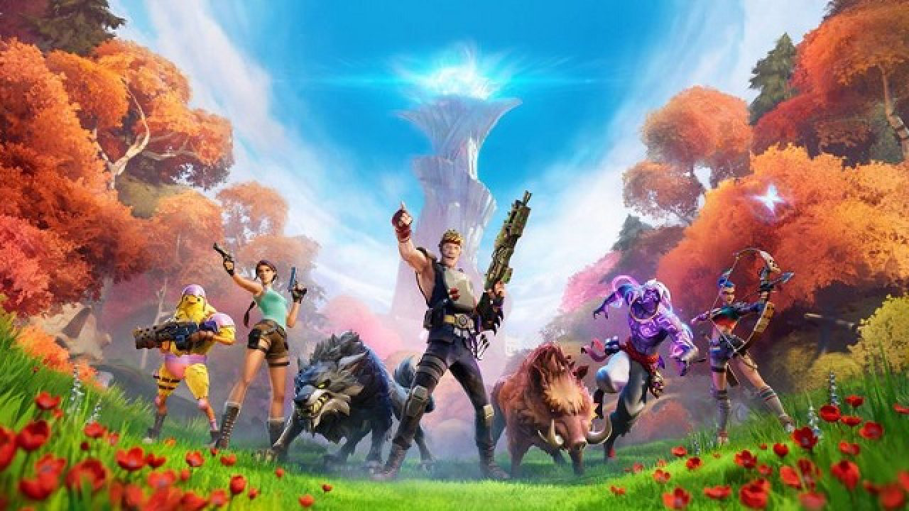


2022: NO REALLY, LET’S NOT MESS THIS UP? PLEASE?
Notes:
Metaverse: What if instead of focusing on what we can BUY and what we can OWN in the metaverse, we looked at WHO we could MEET and WHAT we could LEARN?
Content Moderation: What if instead of sidestepping content moderation and seeking to avoid entanglement we really thought about how to use games and virtual worlds to HELP IMPROVE THE REAL ONE? What if instead of walled gardens we specifically tried to build into games scenarios that got us all to learn a little more about other cultures, other people, and other ways of thinking?
Post-Pandemic: What if we really tried to remember WHAT GAMES DID FOR US during the pandemic and to CARRY THOSE LESSONS FORWARD, to deeply consider the role of games in our society, to continue to RESEARCH and GROW OUR UNDERSTANDING of games and media and their role in being human.
Political Power and Changemaking: What if we APPLIED GAMES to our most serious problems, our most vexing issues, and our widest divides to bring people TOGETHER, to find NEW SOLUTIONS, and to give POWER and VOICE to players and creators alike all over the world.
https://www.playstationlifestyle.net/2022/03/22/fortnite-ukraine-donations-relief-epic-games/

Slide 6

[ 2024: HINT: we messed it up ]
CONFERENCE THEME: WHEN PRINCIPLES COLLIDE
PANEL THEME: VIDEO GAMES, CULTURE & SOCIETY

Slide 7
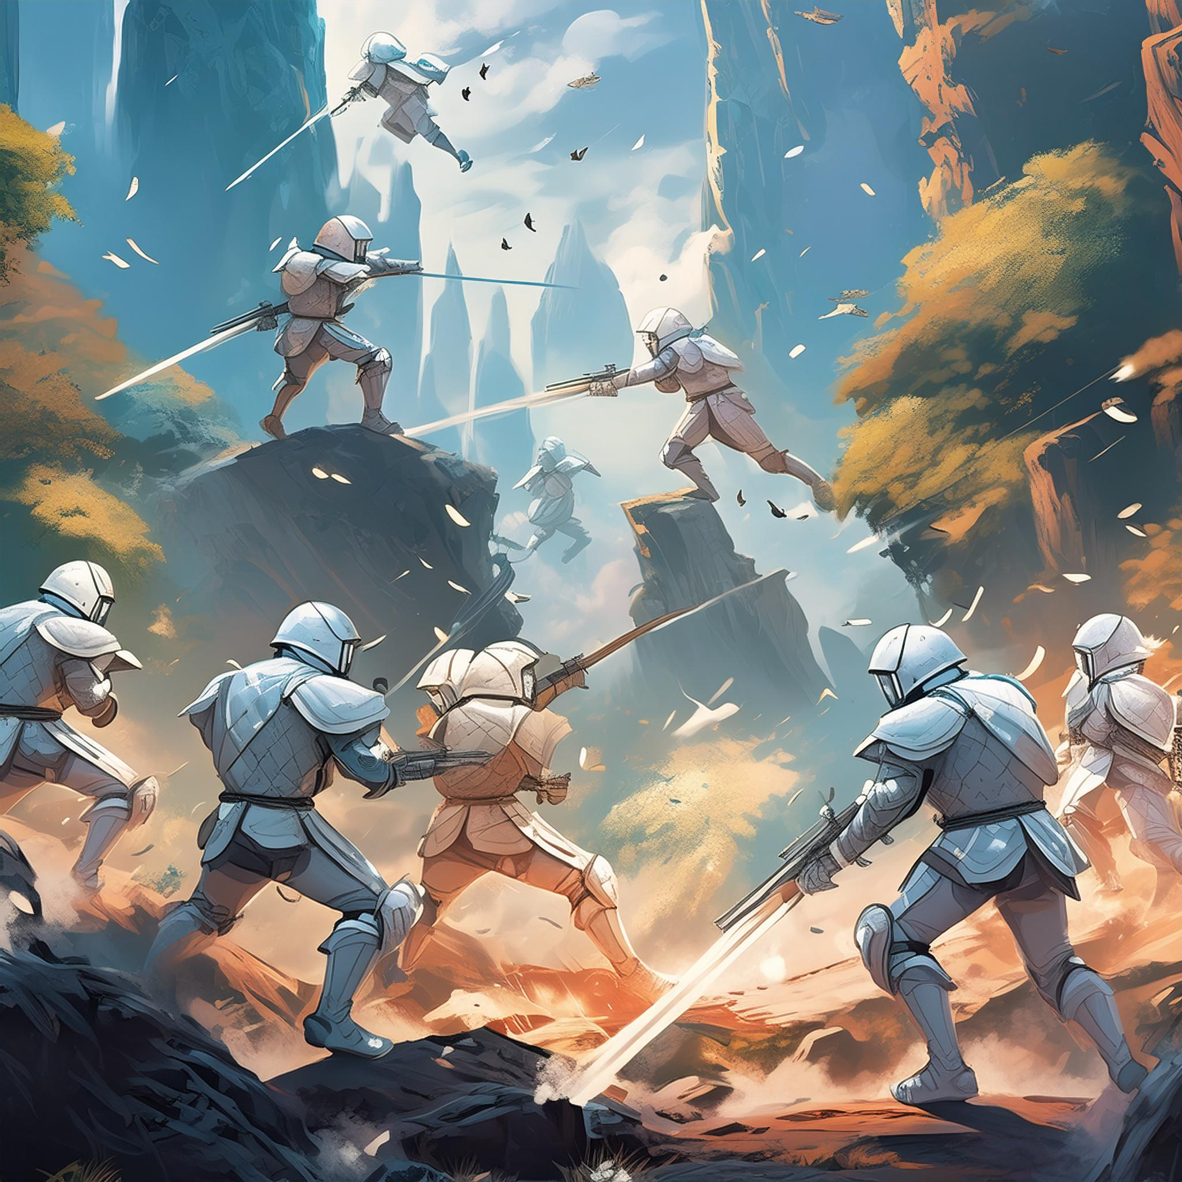

GAMES CAUSE VIOLIENCE
(& MASS SHOOTINGS)
GAMES ARE EMPATHY MACHINES

Slide 8


GAMES WILL **FIX** EDUCATION
GAMES ARE THE DOWNFALL OF ATTENTION SPANS & DEEP REASONING

Slide 9

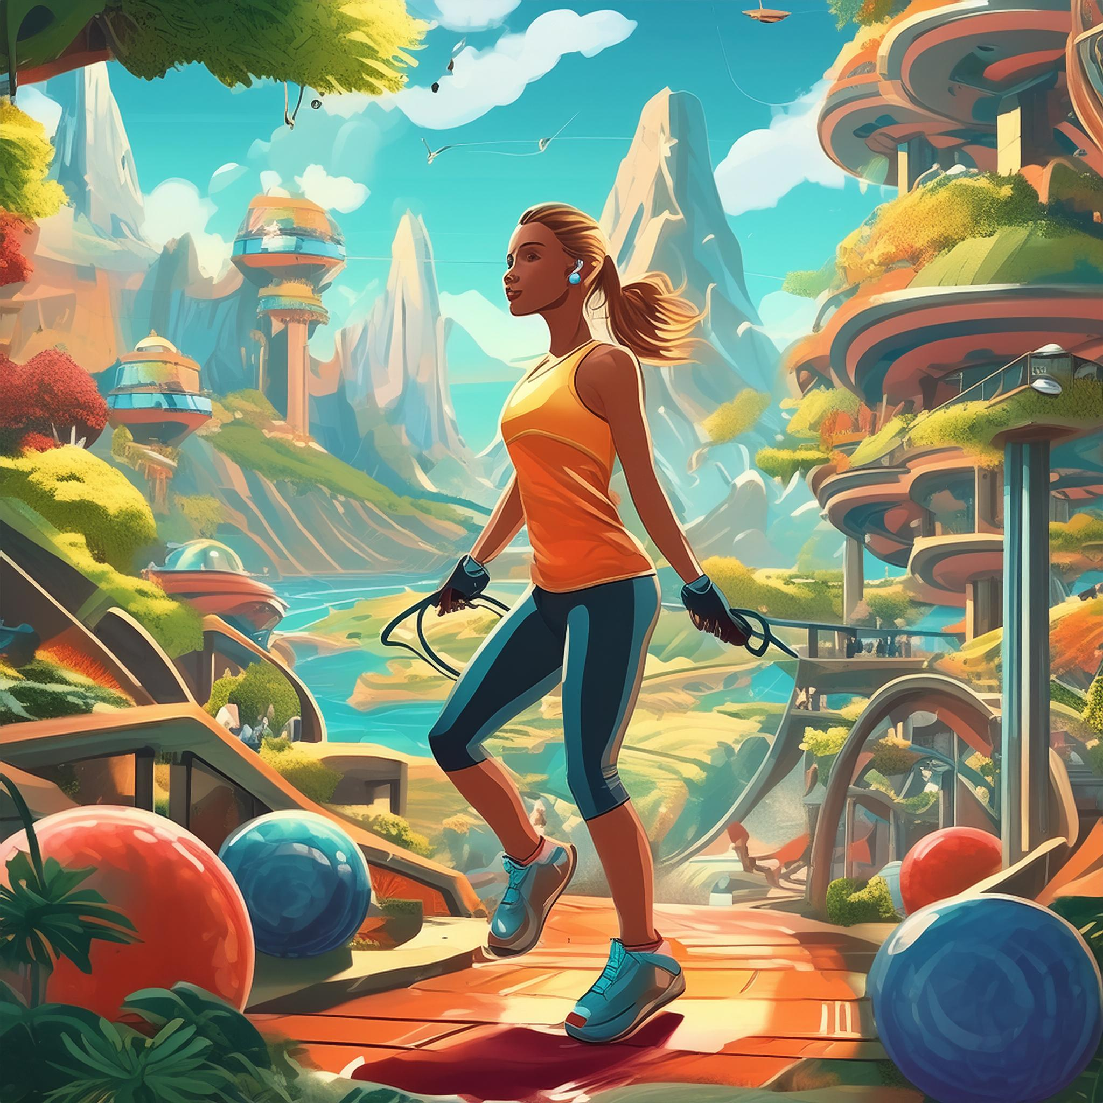
GAMES CAUSE CHILDHOOD OBESITY
GAMES ARE A GREAT WAY TO ‘GAMIFY’ HEALTH

Slide 10


GAMES CAUSE YOUNG MEN NOT TO WORK AND ARE A DRAIN ON THE ECONOMY
GAMES INSPIRE BIG TECH & INNOVATION

Slide 11


GAMES & ESPORTS PROMOTE COLLABORATION, TEAMWORK, & FAIR PLAY
GAMES ARE A WASTELAND OF TOXICITY, HARASSMENT, DISCRIMINATION, & AWFULNESS

Slide 12
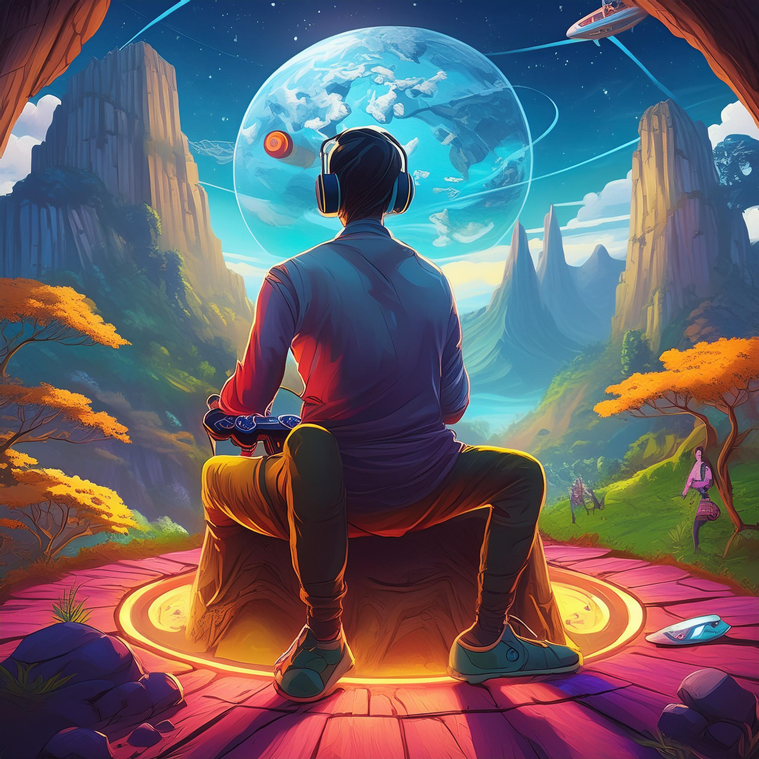
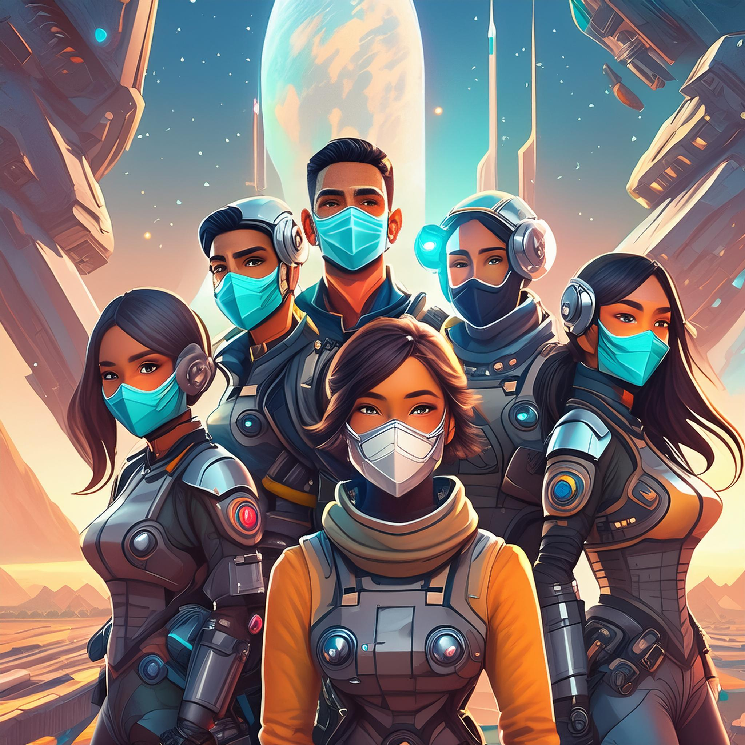
VIDEO GAMES ARE ANTI-SOCIAL, & FOR LONERS, MISFITS, & LOSERS
OMG WE HAD A PANDEMIC, PLZ SHUT UP

Slide 13


GAMES ARE PREDATORY & EXPLOITATIVE ENVIRONMENTS
GAMES ARE THE MOST CREATIVE PLATFORMS YOUTH HAVE EVER HAD FOR CREATION & DISSEMINATION

Slide 14
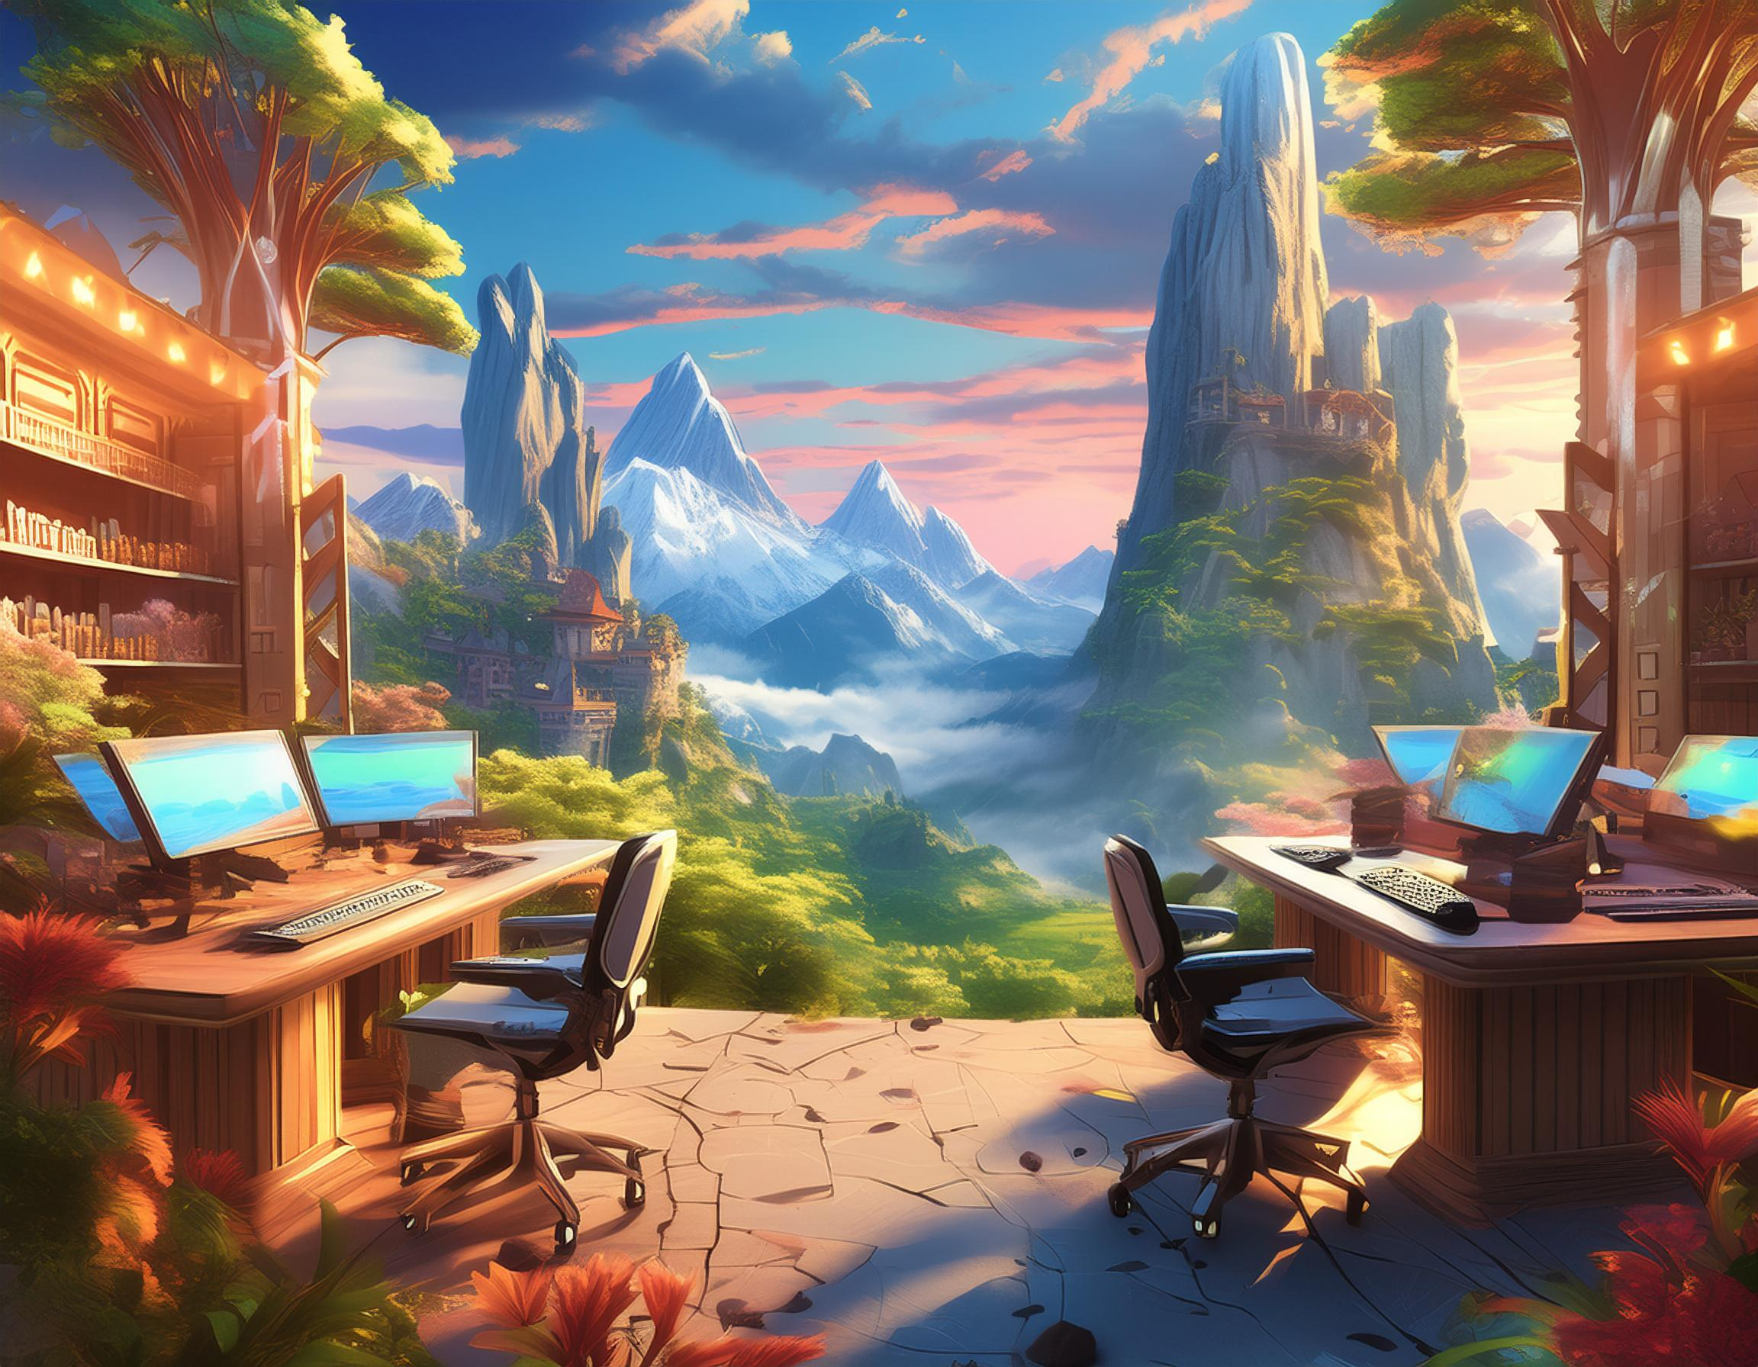

GAMES ARE A VIBRANT AND EXCITING FIELD, A CATALYST TO STEM/STEAM JOB GROWTH, AND A GREAT OPPORTUNITY TO WORK IN TECH, ART, & MORE
Uhmm… Err…

Slide 15
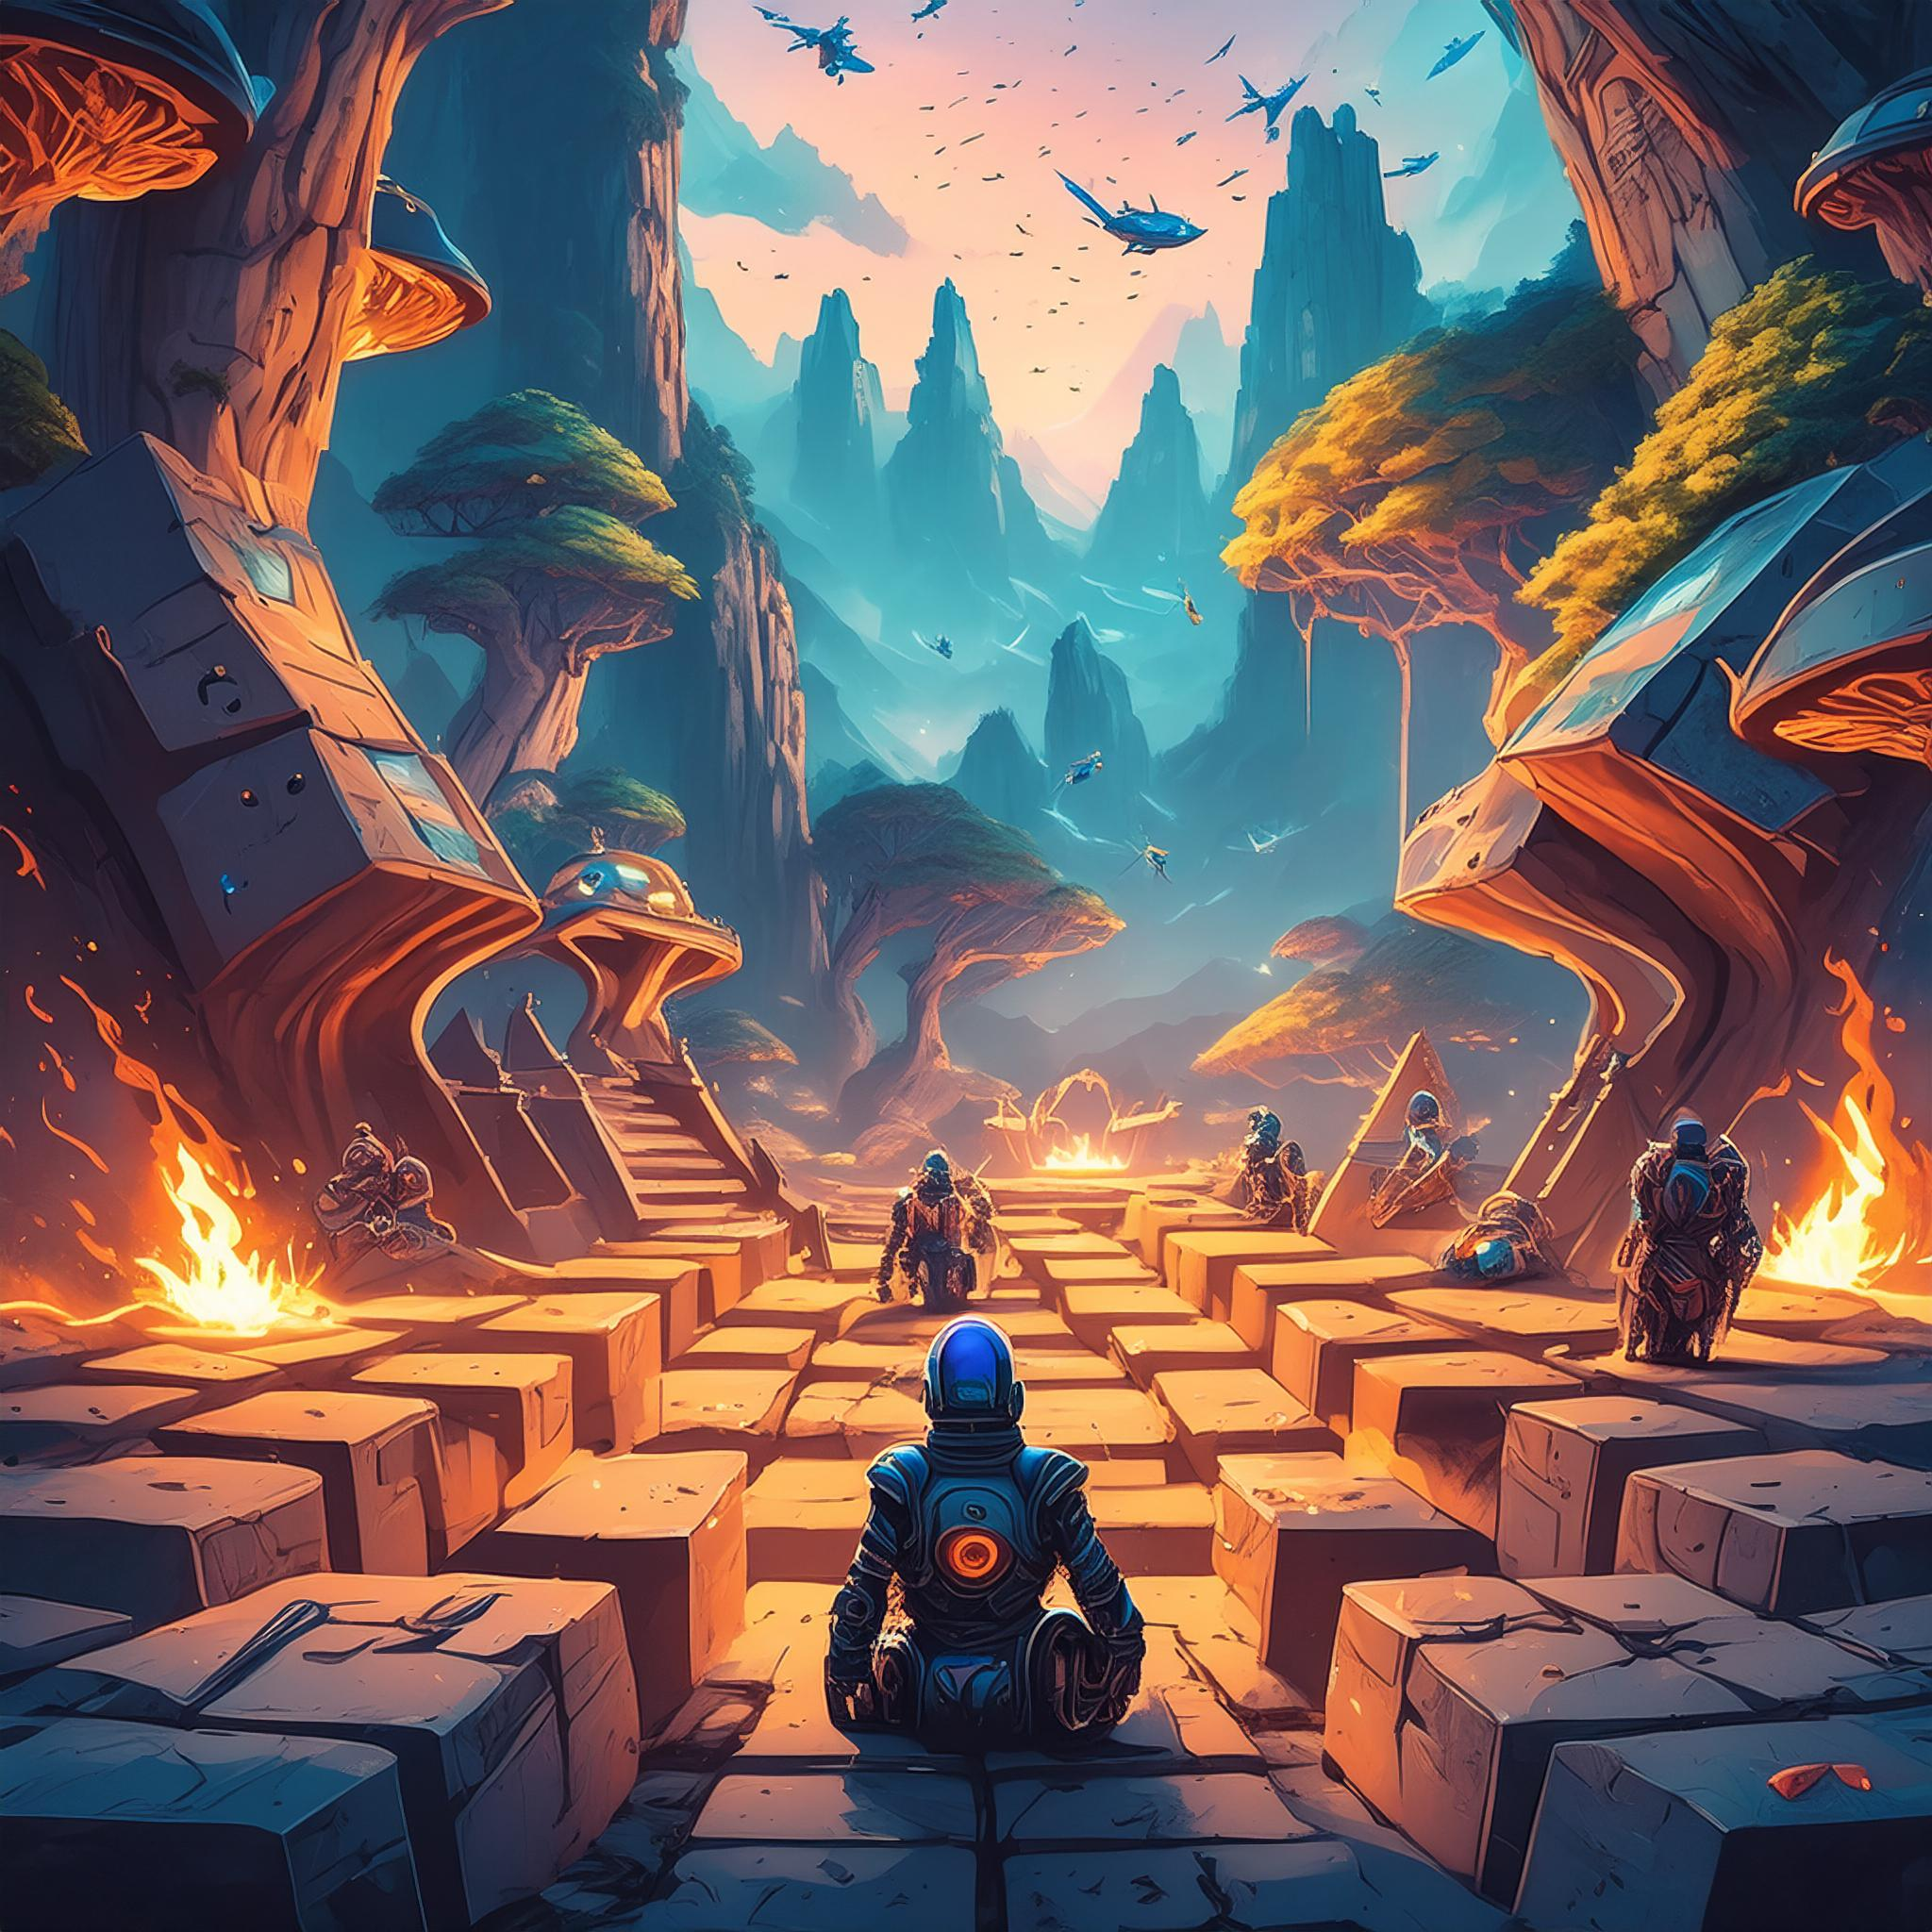

GAMES ARE BAD, BORING, AND ARE NOTHING BUT SEQUELS & NONSENSE
GAMES ARE THE MOST EXPRESSIVE & INTERACTIVE FORM OF HUMAN ART YET CREATED

Slide 16

CONCLUSION?
SOCIETAL NARRATIVES AROUND GAMES ARE STILL ALL OVER THE PLACE
THE INDUSTRY ISN’T HELPING MUCH OF LATE, UNLIKE YEARS PAST
DON’T BE SURPRISED WHEN THESE NARRATIVES SPIN OUT OF CONTROL AGAIN, BECAUSE WE’RE HEADED INTO EVEN MORE COMMUNICATION & CONSPIRACY SILLINESS

Slide 17
ALL IMAGES GENERATED VIA PROMPT WITH ADOBE® FIREFLY AI

Slide 18
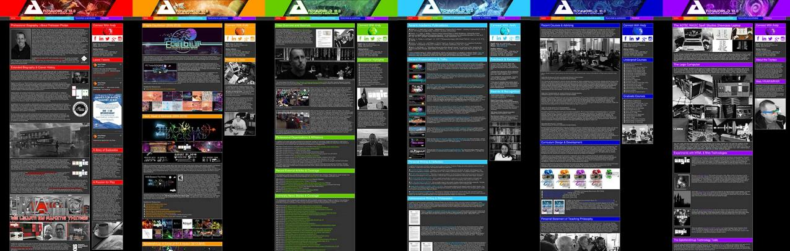
ANDYWORLD.IO | PROFESSORANDREWPHELPS.NET | @ANDYMPHELPS | ANDYMPHELPS@GMAIL.COM
Thanks & Questions

