Slide 1




:
THE [AWESOME] POWER of GAMES and INTERACTIVE ENTERTAINMENT
Presented for More than Just a Game 2022| March 2022 | London UK
Andrew M. Phelps
Professor of Human Interface Technology (HITLabNZ), University of Canterbury, NZ
Professor, Film & Media Arts, School of Communication, American University, USA
Professor, Computer Science, College of Arts & Sciences, American University, USA
Visiting Faculty, Department of Game Design, Uppsala University, Gotland Sweden
Program Director, Digital Screen Campus, University of Canterbury
Director, AU Game Center & American University Game Initiative
President, Higher Education Video Game Alliance

Slide 2
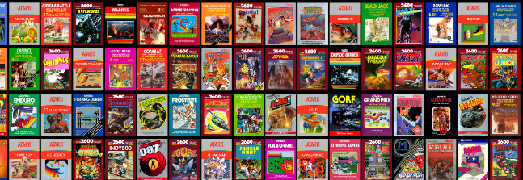
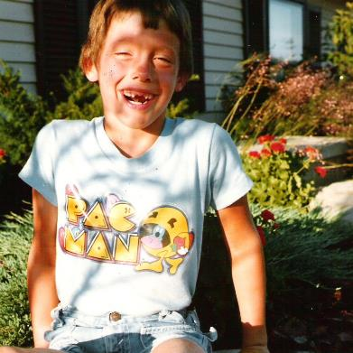
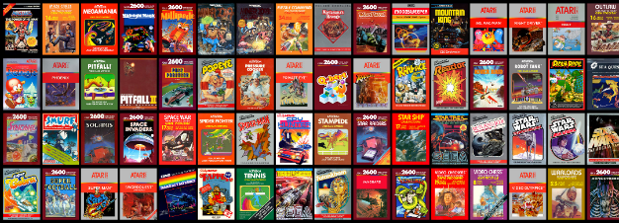
HI, I’m ANDY

Slide 3
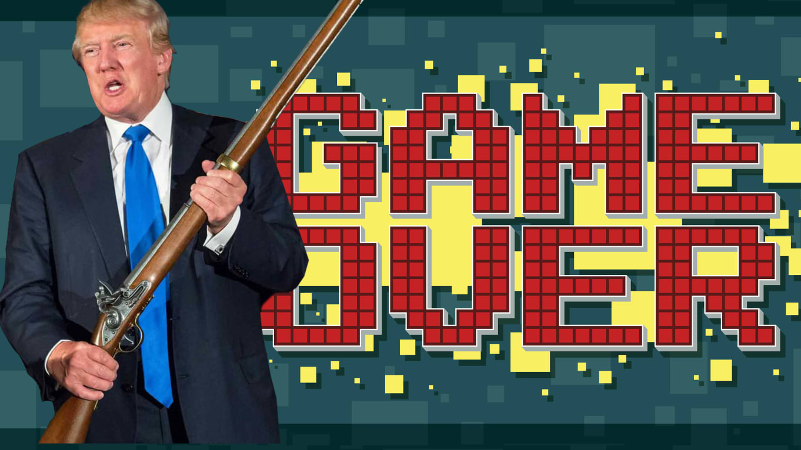


In the before times…
“Screen time” was BAD and should be LIMITED
World Health Organization “Gaming Disorder”
School Safety Report commissioned around ‘Games & Violence’ from Trump White House via Dept. of Education
Games were blamed as a breeding ground of toxicity and far-right-wing culture
Games were (still) often seen as ‘timewasters’ and not ‘educational’ except in certain limited circles
Notes:
Multiple op-eds on how to ‘limit screen time’ and ‘reduce gaming addiction’ and ‘get kids outside’ and so on. A resource: https://www.nytimes.com/2020/07/27/parenting/children-screen-time-games-phones.html
Trump charged the Dept of Education with a School Safety Report in the wake of the shooting at the Marjory Stoneman Douglas High School in Parkland, Florida in 2018. Seventeen students and staff members were killed and 17 others were injured in the shooting. Instead of debates on gun control, this led to a meeting at the white house with the president and multiple CEOs and top execs of the games and media industry.
Chassidy, 19, is better known as Cupcake online, where she streams herself playing Overwatch almost daily live on Twitch, recording and rebroadcasting the hate, discrimination, and abuse of playing online games as a woman. https://www.buzzfeednews.com/article/laurenstrapagiel/overwatch-sexist-harassment

Slide 4

And then came Covid…
#playaparttogether
Notes:
SO COVID comes along, and everything locks down and it all goes nuts.
In Italy, streaming on Twitch goes up 56% as lockdowns settle in, and the national internet structure cant keep up. All over the world, people start burning through Netflix at a incredible rates. EVERYONE starts playing games – but different kinds of games, on different kinds of devices – It’s time to play on WHATEVER YOU ALREADY HAVE because of shortages on equipment.
We turned to games in a time of anxiety, lonliness, and fear. We turned to games to entertain, to calm, and to inspire.
The WHO ACTUALLY RECCOMENDED video games: https://www.businessinsider.com/who-video-games-coronavirus-pandemic-mental-health-disorder-2020-4

Slide 5
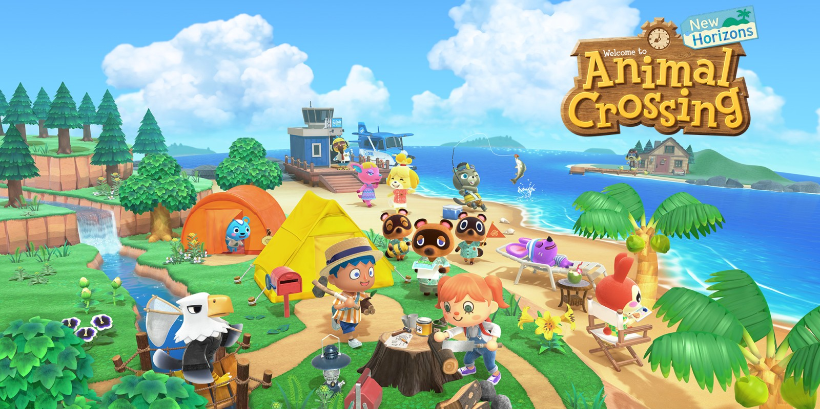
Games connected us
Notes:
ANIMAL CROSSING, or CLASSIC WOW, or MINECRAFT, or CALL of DUTY, or TAKE YOUR PICK. BOARD GAME SIMULATOR. D&D on TWITCH. THERE ARE A MILLION EXAMPELS.

Slide 6
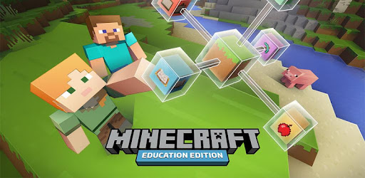
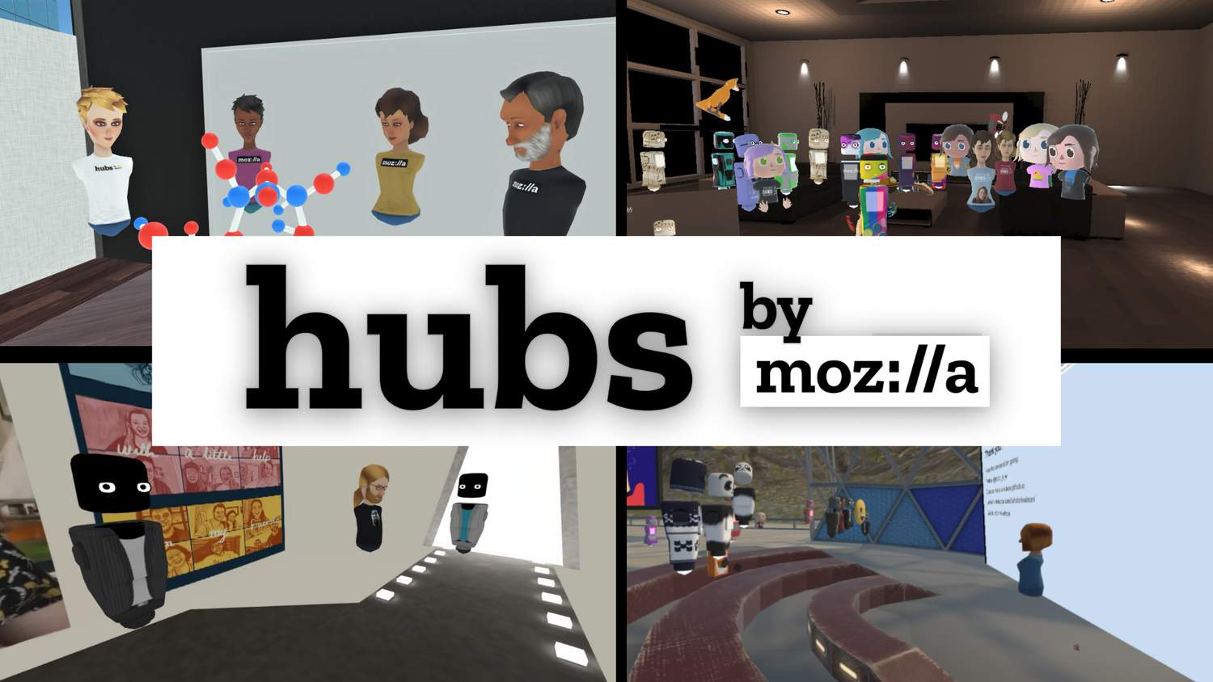
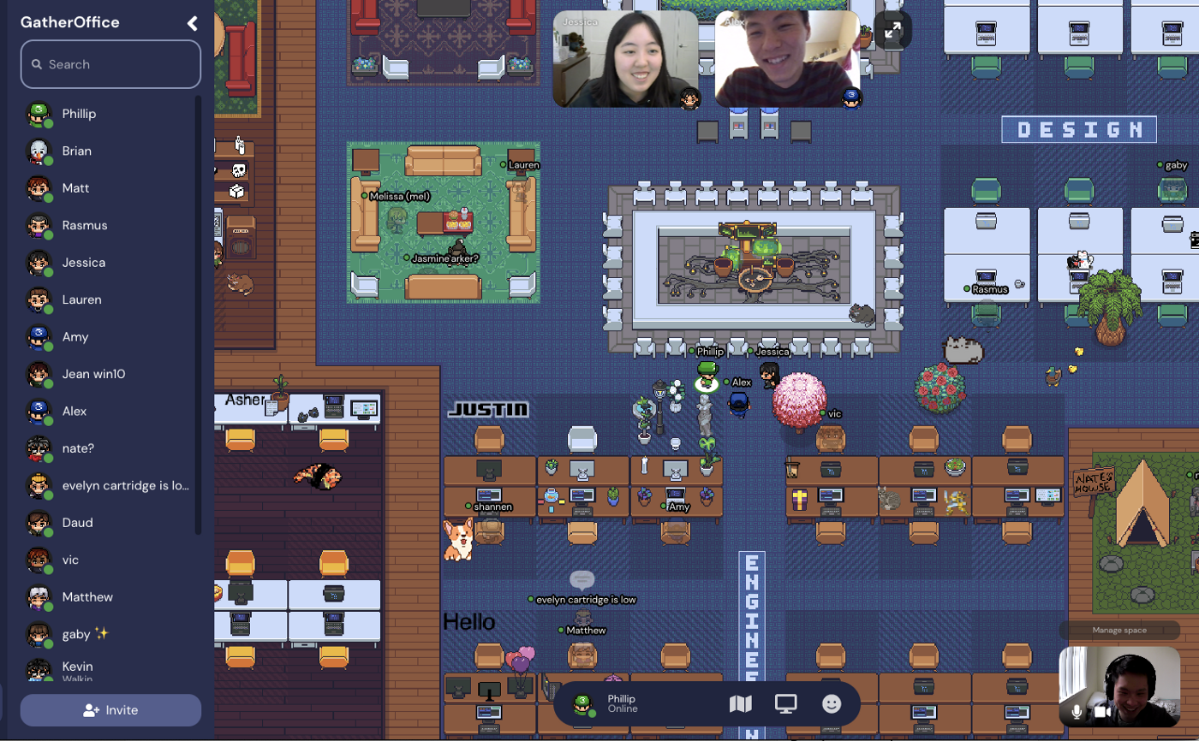
Games TAUGHT us [ BETTER THAN ZOOM! ]
Notes:
Minecraft. Roblox. Board game simulator. Virtual meetings and events and concerts in Hubs. GatherTown. Take your pick. There are once again a MILLION EXAMPLES.

Slide 7

Games HELPED US UNDERSTAND
Notes:
This is a game called ‘It Comes in Waves’ by Dr. Mia Consalvo and her team at Concordia University that invites players to role play the experience of being a health care worker during the pandemic. You play as an aide in two different elder care facilities in Montreal. Dr. Consalvo’s work explores the intersection of games and game design with economic class and mobility (or lack thereof). This is one example of several games during the pandemic that were designed to help players understand just what was even HAPPENING during all of the confusion, chaos, and uncertainty in the midst of a global pandemic.

Slide 8
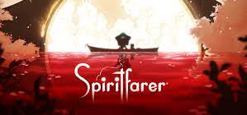
Games HELPED US PROCESS GRIEF
Notes:
Give the Atul example from spiritfarer and how it recognizes the failure in covid to have rituals of grief and mourning – mention that Mia recognized it, and that we miss her this year at MTJG (she couldn’t be here, but hopefully next year!)
Wagner, J., Moger, D., Consalvo, M., and Phelps, A. (2021) "Helping Grandma Home: Spiritfarer’s Progressive Treatment of Older Adults During COVID-19" in Well Played Retrospective: The Past, Pandemic and Future of Video Games, Value and Meaning by Davidson, Fay, Fernandez-Vara, Pinckard and Sharp. (Eds.) ETC Press, Carnegie-Mellon University. https://press.etc.cmu.edu/index.php/product/well-played-retrospective/

Slide 9
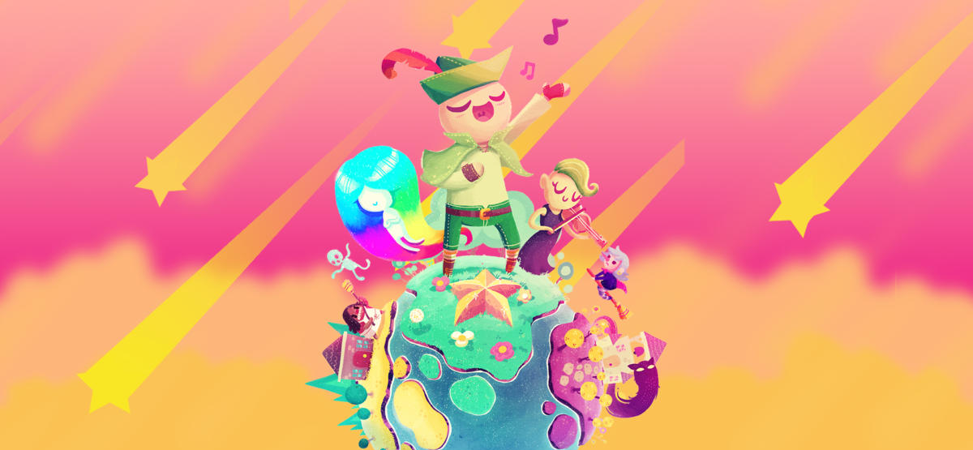
Games gave us joy
Games BROUGHT US JOY
Notes:
You started to see games being considered about how how HAPPY they were, about whether they offered joy, about whether they were a suitable distraction from the death and destruction of the pandemic.
And joy took many forms whether it was little indie games like the ones on this list behind Pokemon: https://culturedvultures.com/best-happy-games-cheer-up/ or the joy of cooperation or betrayal in AmongUs, or the joy of competition in Fortnite, people came together, played together.

Slide 10
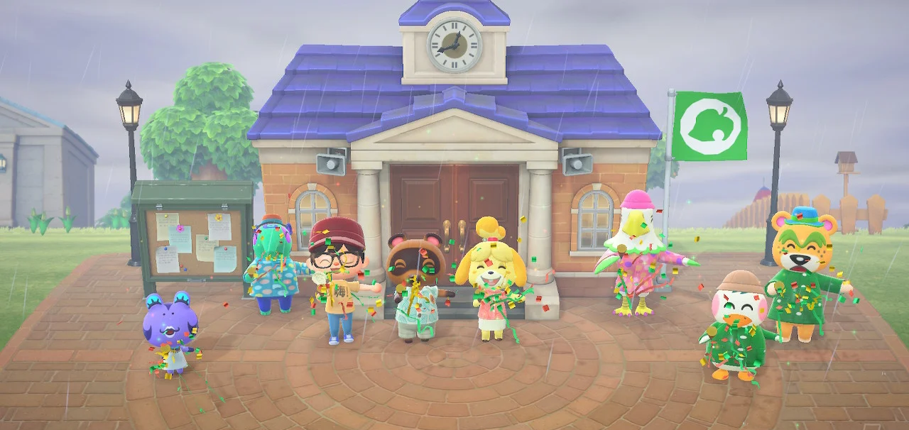
WE WON? SOMEHOW?
“Video games have gone from being blamed to being praised, largely because people have begun to realize how much games connect us and bring us joy.”
  – Stan Pierre-Louis, ESA

Slide 11
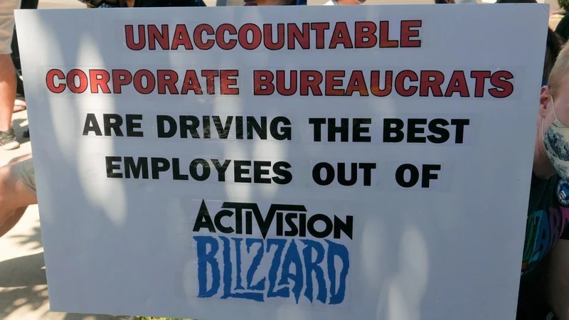

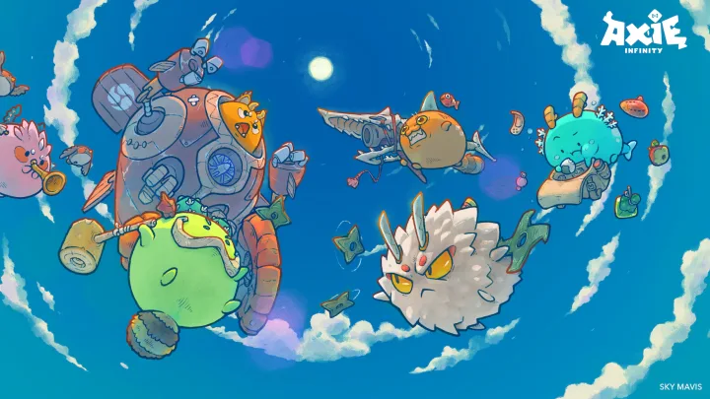


SO LET’S NOT MESS THIS UP?
Notes:
The Activision | Blizzard walkout was yet another highlight of the misogyny and sexism that runs rampant through games and games culture. This damages the credibility and engagement with games by other sectors, and it places games as an ‘other’ for which regulation and control are more sought after by legislators and governments as easy political points in democratic arenas, or conversely as ‘ruining’ children re: playtime and socialization in conservative areas.
People have figured out that games industry has done pretty darn well during all of this, better than, well almost everyone. So there will be some scrutiny of how any of that money goes to public good rather than only shareholders. (There will also be scrutiny by shareholders…) – DESPERATE PLEA FOR R&D?
There is a perception there are ‘too many games’ – this is NOT true, we’re actually in a content glut, but what is happening because some games are so lucrative right now is there are large numbers of copies of basically the SAME game, rather than studios really innovating, and this is dangerous because people get bored and sales slump until someone does something amazing again.
We could ignore 40 years of research into games and virtual worlds and jump on the “new” metaverse in ways where most people think the metaverse is complete garbage right now. Apparently including Elon Musk, whatever that means.
We could rush to market with unproven tech and destroy a lot of public trust: The blockchain system running the popular NFT game Axie Infinity has been hacked in a digital heist of around $625 million in digital assets.

Slide 12
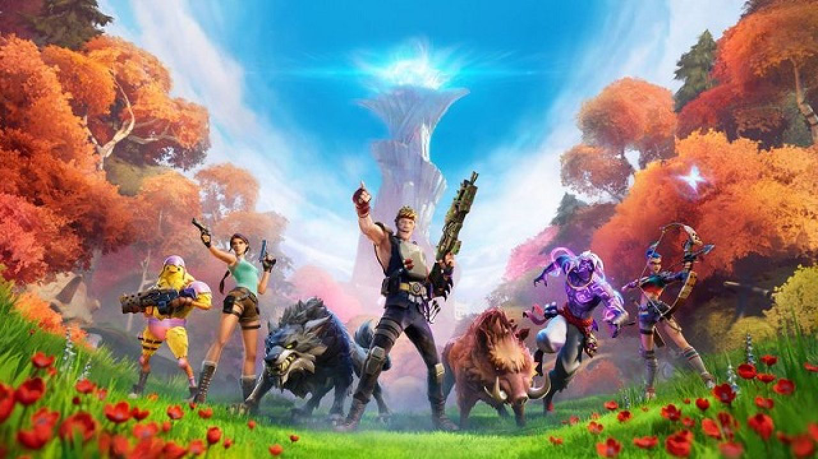
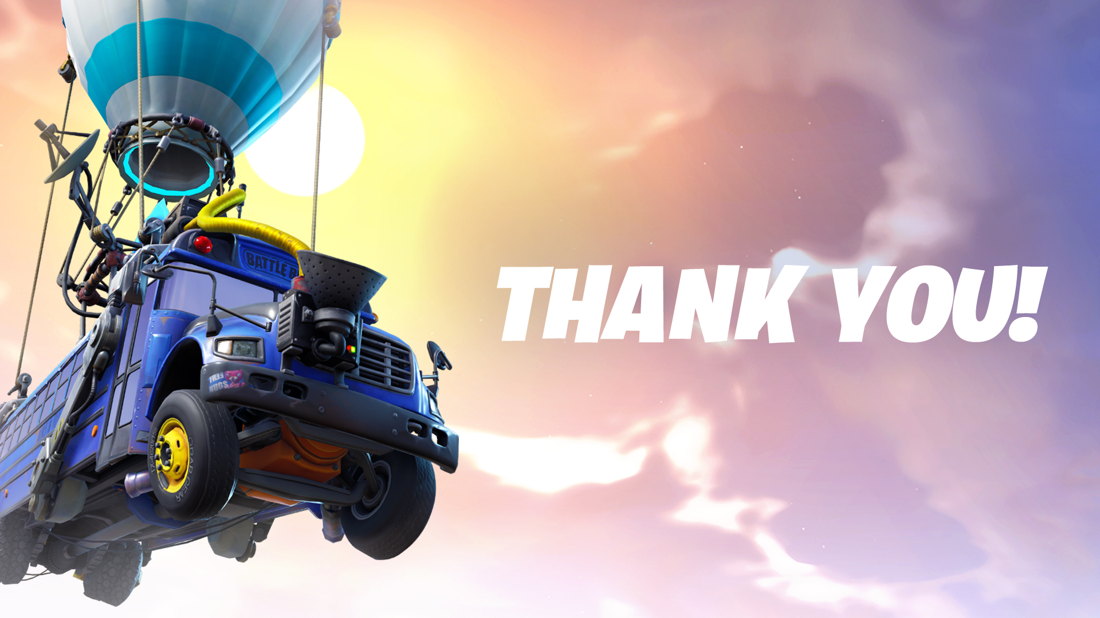

NO REALLY LET’S NOT MESS THIS UP? PLEASE?
Notes:
Metaverse: What if instead of focusing on what we can BUY and what we can OWN in the metaverse, we looked at WHO we could MEET and WHAT we could LEARN?
Content Moderation: What if instead of sidestepping content moderation and seeking to avoid entanglement we really thought about how to use games and virtual worlds to HELP IMPROVE THE REAL ONE? What if instead of walled gardens we specifically tried to build into games scenarios that got us all to learn a little more about other cultures, other people, and other ways of thinking?
Post-Pandemic: What if we really tried to remember WHAT GAMES DID FOR US during the pandemic and to CARRY THOSE LESSONS FORWARD, to deeply consider the role of games in our society, to continue to RESEARCH and GROW OUR UNDERSTANDING of games and media and their role in being human.
Political Power and Changemaking: What if we APPLIED GAMES to our most serious problems, our most vexing issues, and our widest divides to bring people TOGETHER, to find NEW SOLUTIONS, and to give POWER and VOICE to players and creators alike all over the world.
https://www.playstationlifestyle.net/2022/03/22/fortnite-ukraine-donations-relief-epic-games/

Slide 13

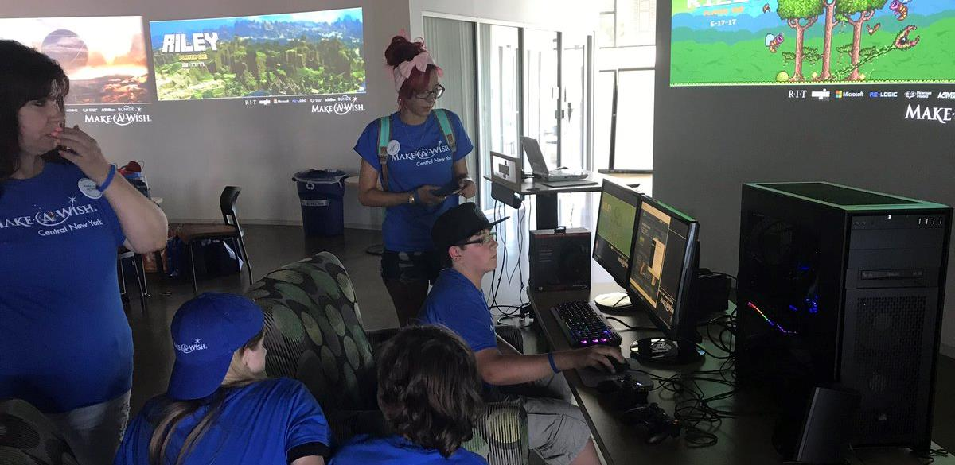
Notes:
One of the most incredible experiences I was a part of at RIT was meeting Riley through the Make-A-Wish foundation. What Make-a-Wish does is fulfill wishes of terminally ill children. Riley was a gamer, and so we built him a custom gaming rig, created custom wallpapers for all his favorite games, got him some signed copies of things and notes and swag from developers, and gifted this all to him on-site at our game lab at the MAGIC Center.
Then we arranged for him to go over and have a behind the scenes 1:1 tour at the Strong National Museum of Play looking at how games get made. He and his entire family had such a wonderful, amazing day.
Riley died of brain cancer the following year.
And I note this to remind us all that games, in the end, are not about rules or tactics or hardware or IP or money, they are MAGIC, and what they mean to our players is ultimately incalculable.
I think it’s important that we all remember that from time to time. Maybe especially now.

Slide 14
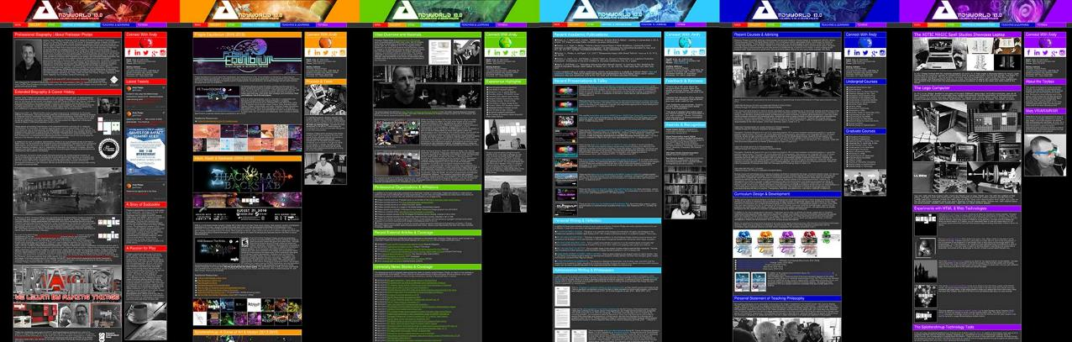
ANDYWORLD.IO | PROFESSORANDREWPHELPS.NET | @ANDYMPHELPS | ANDYMPHELPS@GMAIL.COM
Thanks & Questions

