Slide 1
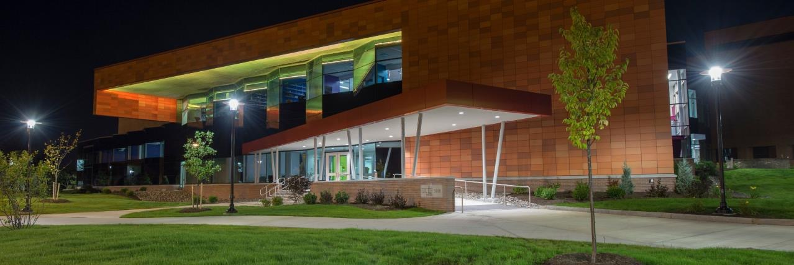
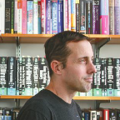
:
A MAGIC POST-MORTEM
From Stories & Spellcraft to Castles of Computing
Presented at the University of Canterbury | PCE Plenary | Christchurch, New Zealand
Andrew M. Phelps
Professor of Human Interface Technology (HITLabNZ), College of Engineering, University of Canterbury, NZ
Professor, Film & Media Arts, School of Communication, American University, USA
Professor, Computer Science, College of Arts & Sciences, American University, USA
Director, AU Game Center & American University Game Initiative
President, Higher Education Video Game Alliance
Founder, Former Director, & Former CEO: RIT Center for Media, Arts, Games,
Interaction & Creativity (MAGIC) and MAGIC Spell Studios

Slide 2
A post-mortem […] is a review held after the completion of a project in order to determine what went well and what could use some reflection before the next project commences.
Notes:
https://www.invisionapp.com/inside-design/running-successful-post-mortem/

Slide 3
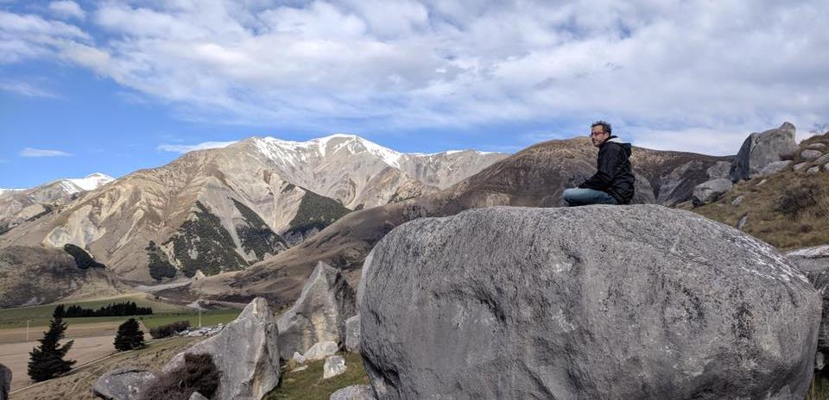
Today’s Talk
PART 0: ANCIENT HISTORY
PART 1: MAGIC is IN THE AIR
PART 2: SOME of OUR WORK – aka ‘MAKING MAGIC’
PART 3: CULTURAL SHIFTS & CAMPUS CONNECTIONS
PART 4: ENTREPRENEURIAL ACTIVITY & BUSINESS INCUBATION
PART 5: THE STUDIO FACILITIES
PART 6: SO, DID IT WORK?
PART 7: THE DOVEDALE OPPORTUNITY
PART 8: Q & A

Slide 4
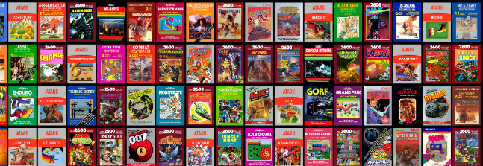
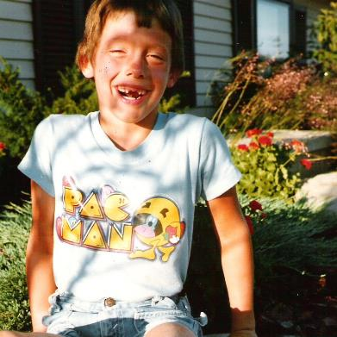
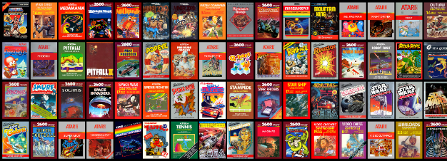
HI, I’m ANDY

Slide 5
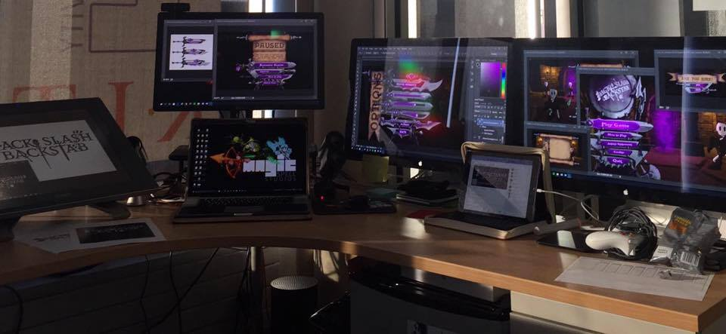
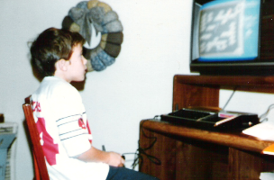
I make things.

Slide 6
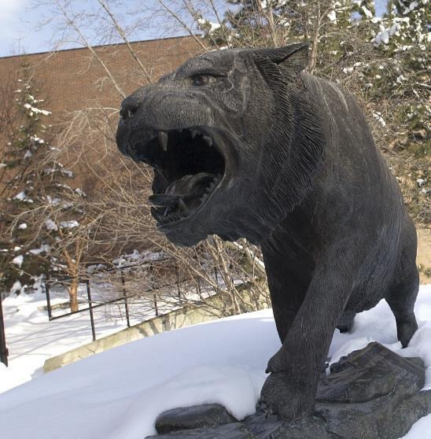
A HISTORY OF GAMES & INTERACTIVE MEDIA
1999-2020
2001 programming
First course in games programming
2002
Electronic Gaming Society
2003
CS/IT Concentration in Game Prog
2006
MSc Game Design & Development
2007
BSc Game Design & Development
2009
Dept. of Interactive Games & Media
2011
School of Interactive Games & Media
2012
Minor in Game Design
2013
RIT Center for Media, Arts, Games, Interaction & Creativity (MAGIC)
2013
MAGIC Spell Studios®, LLC
2016
$30M MAGIC Spell Studios Facility
2016
NY State Games HUB
2017
NY State Games Challenge
2019
American University Game Center
2020
HIT Lab NZ + AIGI

Slide 7
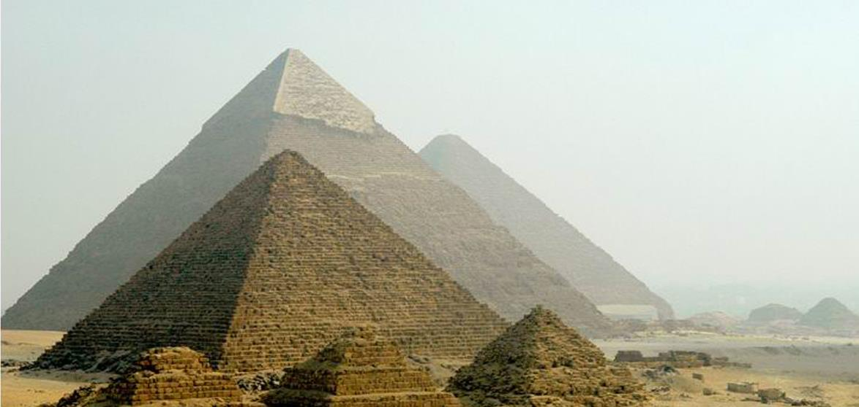
PART 0: ANCIENT HISTORY

Slide 8
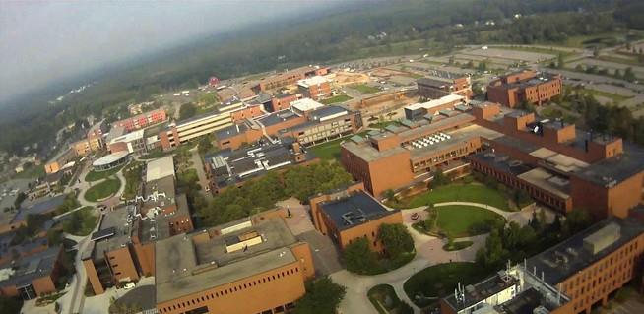
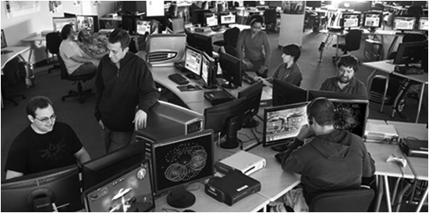



School of Interactive Games & Media

Slide 9
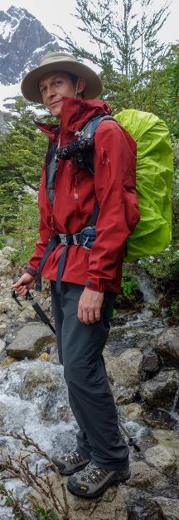

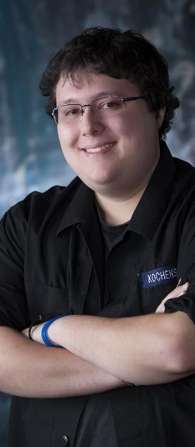
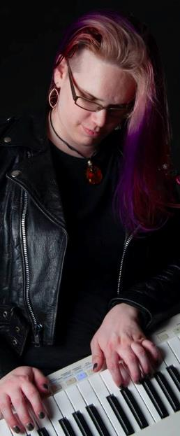
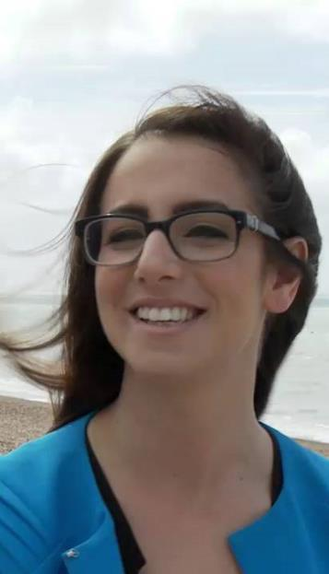
INCREDIBLEY AWESOME ALUMNI
ALEX CUTTING
Senior Assoc. Producer HALO
Microsoft / 343
CLAUDE JEROME
Gameplay Designer DESTINY
Bungie
DUSTIN KOCHENSPARGER
Line Producer DLC
DESTINY
Bungie
SELA DAVIS
Platform Engineer
XBOX / XBOX Live
Microsoft
VReal
ANNA SWEET
Director of 3rd Party Development
STEAM
Valve
Oculus
Caffeine.ty
Microsoft XBOX

Slide 10
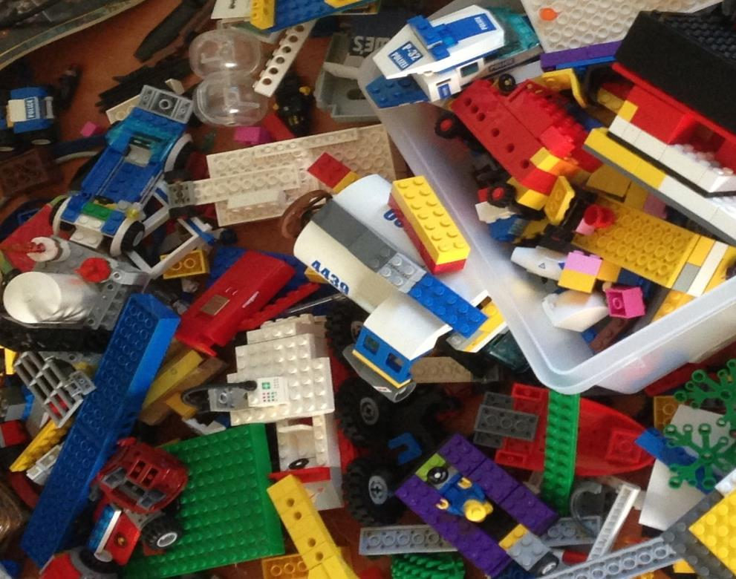
'protecting “making as a
mode of inquiry”’
-Ian Horswill, Northwestern
Notes:
This quote is from Ian Horswill, who said it, I think the first time? sitting on the floor of Microsoft Research at the MSR Faculty Summit a number of years ago. It has been rolling around in the back of my brain ever since – and it was the fundamental thing upon which MAGIC was founded, that somehow design research, making prototypes to test ideas, learning by making new things and new experiences, needed to be recognized and valued. At RIT we’ve sometimes used the rhetoric of STEM and Research to de-value those activities in weird ways.

Slide 11
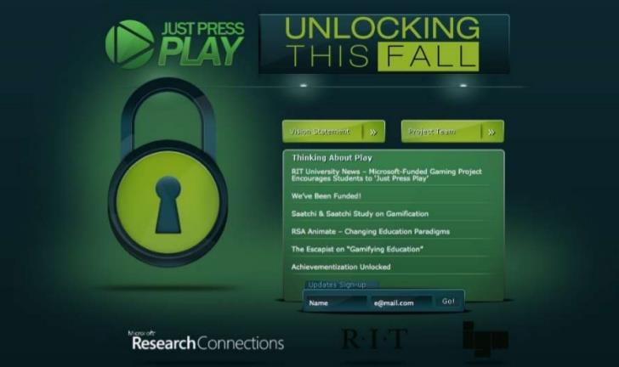
Notes:
Funded by Microsoft Research on games & learning. Three-tier development, cloud based deployment, database coupling

Slide 12
PART 1: MAGIC IS IN THE AIR

Slide 13
In JAN 2013, I had lunch with president Destler, at his request
I had recently stepped away from admin, and we had lunch in his office.
We had [catered] lunch in his office.
We had [catered] lunch [on china] in his office.
We had [catered] lunch [on china] in his office [with several courses].
You see where this is going… it was an odd day.
He showed me a proposal, written on a single sheet of paper, that he would disavow ever writing if it was made public.
Notes:
So in 2013 I had just stepped away from being Department Chair / Director for IGM, the School I founded with my friends and colleagues around the study of games and interactive media. And I didn’t really know what I was going to do next and in all honesty wasn’t sure if I would still have a place at RIT. After a lot of angst and various issues Bill invited me to a ‘lunch meeting’. When I got there he had set up a catered lunch in his office, and basically went full court press on me. He wanted a new ‘idea lab’ that would be ‘the intellectual home of IGM scholarship’ that would be ‘entrepreneurial’ that would ‘enable the kinds of scholarship this new field needed’. He offered me some money and a position within research, and then told me he wouldn’t be nickled and dimed. Turns out, university presidents can be pretty compelling 1:1. Little did I know he was giving me the hardest job I’ve ever had, and made it sound fun :P

Slide 14
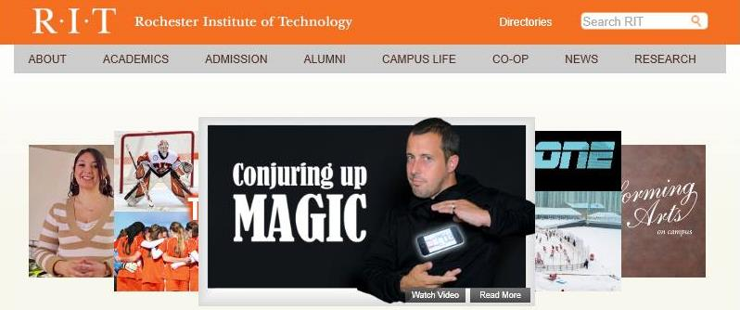
This horrible thing was on the main RIT website for like a year

Slide 15
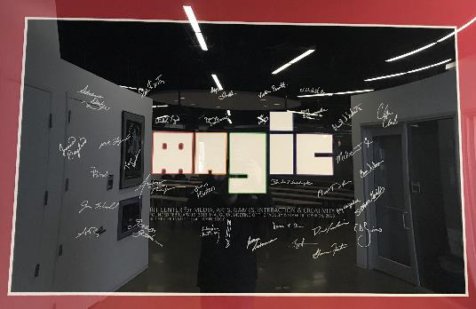
ON OCTOBER 15, 2013, WE HELD THE INNAUGURAL “MEETING OF THE FACULTY”
Notes:
By October we were up and going and had everything set up and were open for business. In October we held the first meeting of the faculty – basically those people who wanted to affiliate with it early on. We all signed a launch poster. VROOOM!

Slide 16
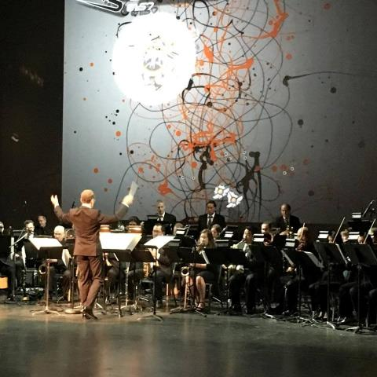
Why IS MAGIC?
C O N V E R G E N C E
C O N V E R G E N C E
The platforms and technology for film, animation, games, media, and story are converging into new forms, new stories, new experiences, and new knowledge.
Notes:
And so we started a multi-disciplinary research center, which is basically the hardest damn thing you can do on a modern college campus. They usually fail by becoming little islands, or by becoming a kind of ‘not really there’ virtual thing, and we’ve run into both of these views as we continue to engage the campus. Nonetheless, we think there is something profound happening in the field right now that is driving the kinds of things we are doing – everything is mashing up on each other. My favorite example of this is the MARVEL extended universe, which is so many different products and experiences rolled together. But there are countless examples big and small. This picture is from the RIT West Coast board meeting where they showed one of my games set to a live orchestra composition directed by Trustee Kevin Surace. Pretty cool.

Slide 17
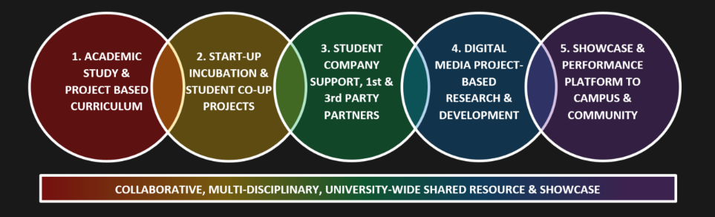
CONVERGENCE OF ANOTHER SORT
Notes:
But there’s another kind of convergence in higher ed right now that has played into MAGIC – this business of bright hard lines between teaching and research, between academic projects, commercial projects, entrepreneurship, technology transfer, etc. is another kind of mashup. The role and purpose of the university is changing in the post-industrial economy, even as it stays true to its roots in the enlightenment (if it can). This idea of little bits of fiefdom for individual programs or little research labs is breaking down because it doesn’t scale, and we’re trying to do something different and profound at MAGIC that links together our work and practice.

Slide 18
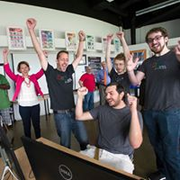
That has meant a lot of work with the Office of the President, the Office of the Provost, Government and Community Relations, Development and Alumni Relations, Information Technology Services, Facilities Management Services, and the Office of the Vice President for Research. We would not be celebrating today without the support of these offices and divisions.
Notes:
For as much as I worked with these groups as a department chair, it is WAY more important the way we work with them now for both our success and institutional success.

Slide 19
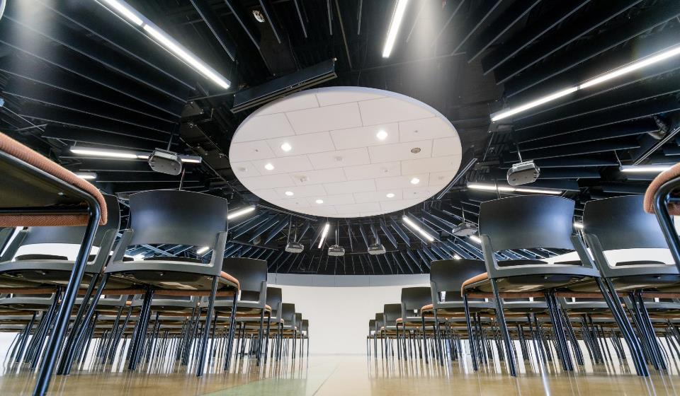


HOW IS MAGIC:
A VERY IMPORTANT DIVISION:
Notes:
Right from Bill’s ‘idea lab’ paper was the idea of an entrepreneurial effort inside the center to help publish and commercialize the things we make. We wanted to call it ‘MAGIC Studios’ at first but we were very afraid we’d get in trouble with The Mouse.

Slide 20
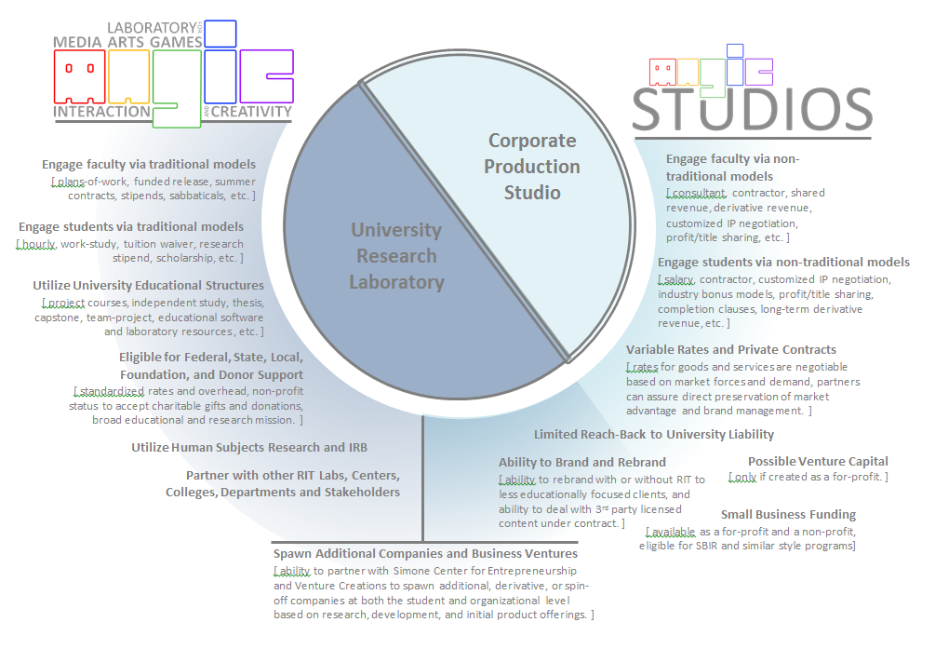

Slide 21
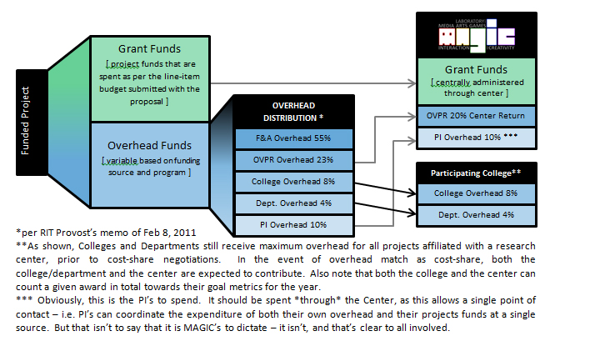
Overhead Distribution (carrot)

Slide 22
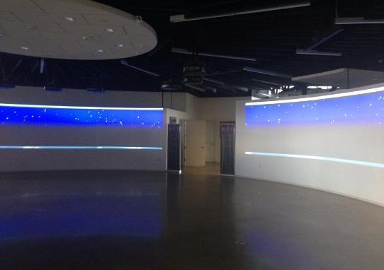
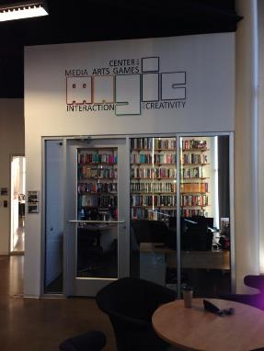
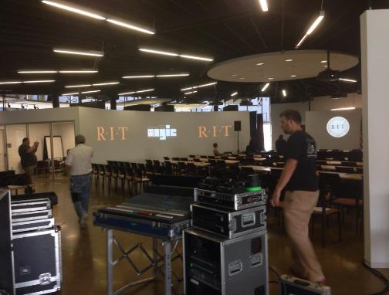
SUMMER 2013 WE CONSTRUCTED OUR “NEW” HOME (THE FIRST ONE)
Notes:
The president decided to put us in what used to be the innovation center, because the innovation center hadn’t totally worked out for a variety of reasons. The meme, of course, was either that we WERE the innovation center, or that we had KILLED the innovation center. Neither one of which is accurate, but it’s kind of the lore now. Anyway, we worked hard on building a new home, I used my personal research money to build the projector rig.

Slide 23
FIVE YEARS, FIVE YEARLY GOALS, FIVE TIMES AT THE PLATE
YEAR 0.5: THE HALF YEAR OF LOGISTICS, MOVING, SET-UP, AND ‘NOT THE INNOVATION CENTER’
YEAR 1: THE YEAR OF THE FACULTY AFFILIATE
YEAR 2: THE YEAR OF THE STUDENT (and extra-curricular activity)
YEAR 3: THE YEAR OF PRODUCTION
YEAR 4: THE ‘A’ IS FOR ARTS
YEAR 5: THE YEAR OF THE STUDIO
…PIVOT…
Notes:
Every year, we’ve tried to start with a theme or goal. We focused really hard that first year on faculty affiliates, trying to figure out the processes and supports they would need to build things here, to attract and manage funding, etc. We appointed 2 associate directors to try to (a) work with faculty on proposals and funding opportunities and (b) go out and attract interest from businesses and foundations and partners to connect these to.
This mostly DID NOT WORK. In hindsight, we were asking faculty to do more and greater scholarship at exactly the wrong time – we had just ‘gone live’ with semesters, and there were some other constraints and messaging that just didn’t work out very well. More on that later. So in year 2 we took a hard left turn and re-imagined the center not just as a research center, but as a student-centered support organization for publishing and digital making. This was always ‘a part of the plan’ but the degree to which we emphasized this in year two, and the focus on student productions at that time was a decided departure from where we thought we were going in year one.
In year 3 we wanted to really challenge what we could do, what production looked like, and what scale looked like.
In year 4 we wanted to really focus on not-just-games but start to drive forward a focus on the arts and creativity in other forms and examples.
And now we are living the year of the studio. Vroom vroom.

Slide 24
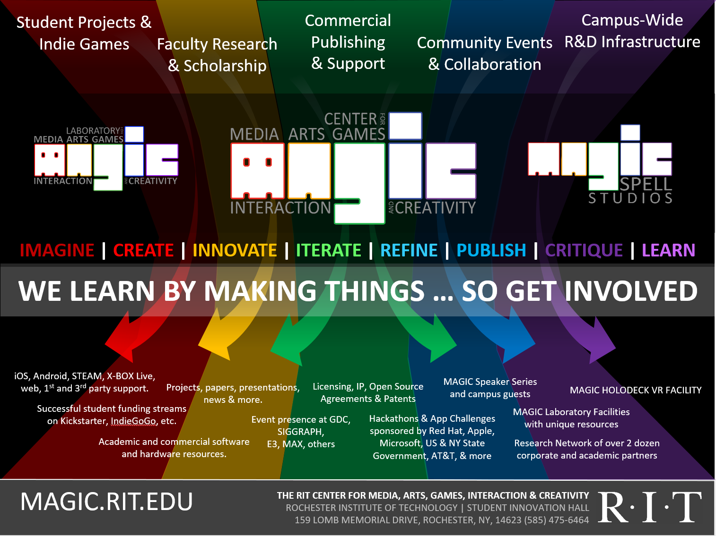




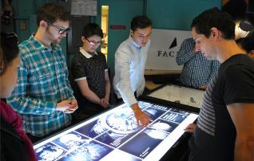
Notes:
It’s messy. It’s really messy. We do a lot of stuff but a lot of stuff is different every time because we’re changing, the projects are changing, the world is changing.

Slide 25
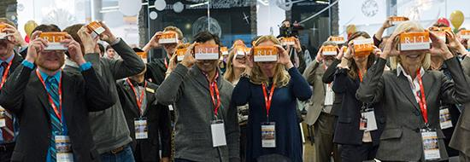
PART 2: SOME OF OUR WORK
Notes:
Here’s a couple of projects that have meant something significatn

Slide 26

ONE OF (MY) EXPERIENTIAL GAMES

Slide 27
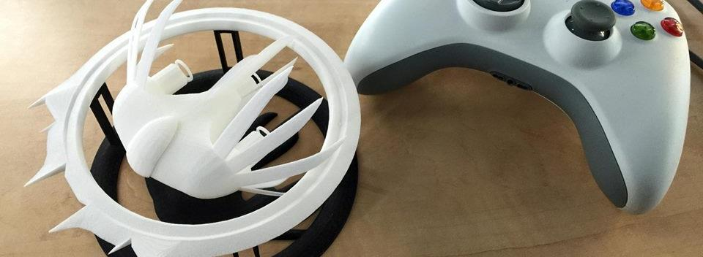

A Strange Game for Strange Reasons
This game taught us (the campus) about making things, production, and scale
This game allowed us to explore using typical game forms for telling a unique story to a very targeted audience
Finalist at GLS Education Arcade, shown at DiGRA Blank Arcade, and IndieArcade at the Smithsonian American Museum of Art
SPLATTERSHMUP.NET – PLAY TODAY! MAKE ART!

Slide 28
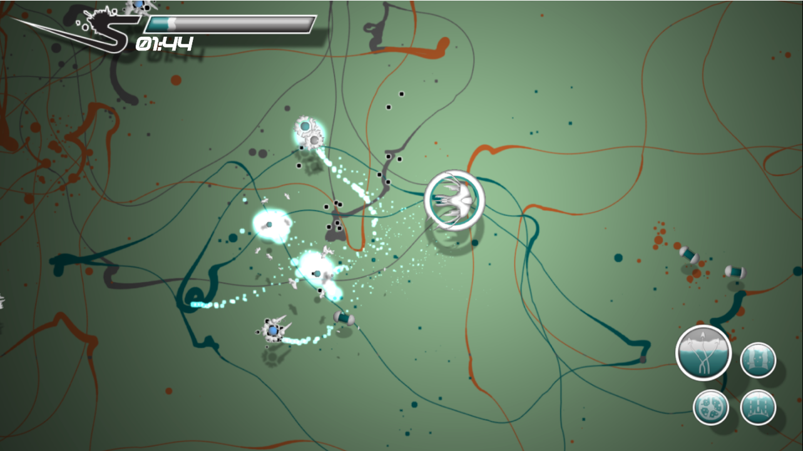

Slide 29

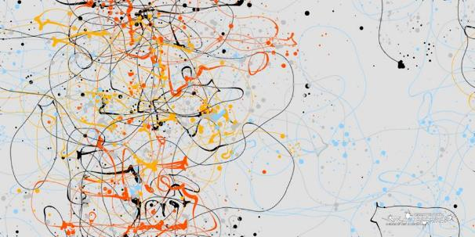
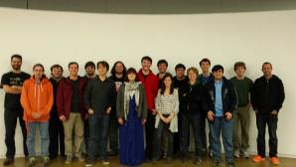
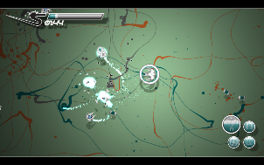
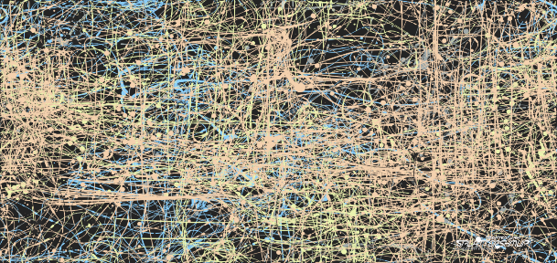
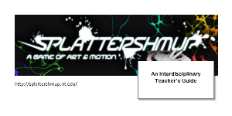



Slide 30
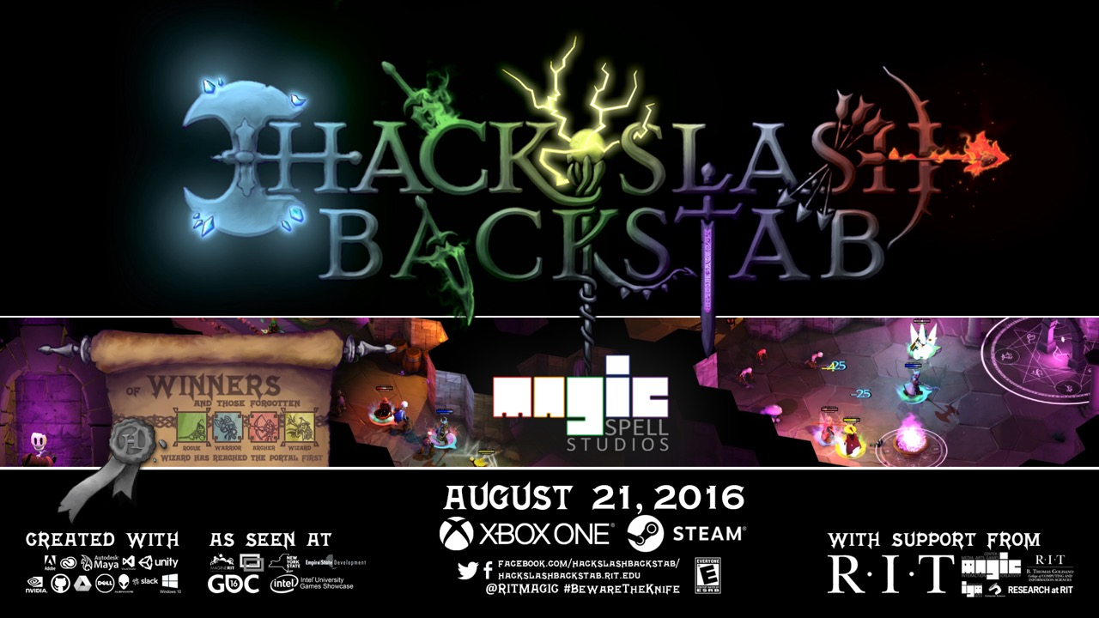
AND ANOTHER ONE…

Slide 31
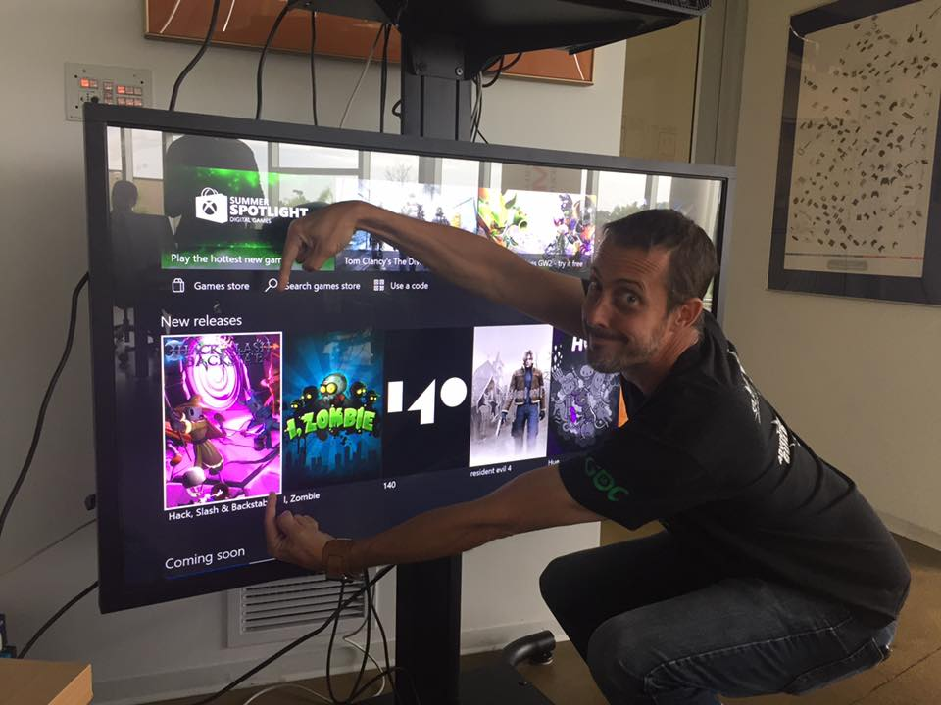
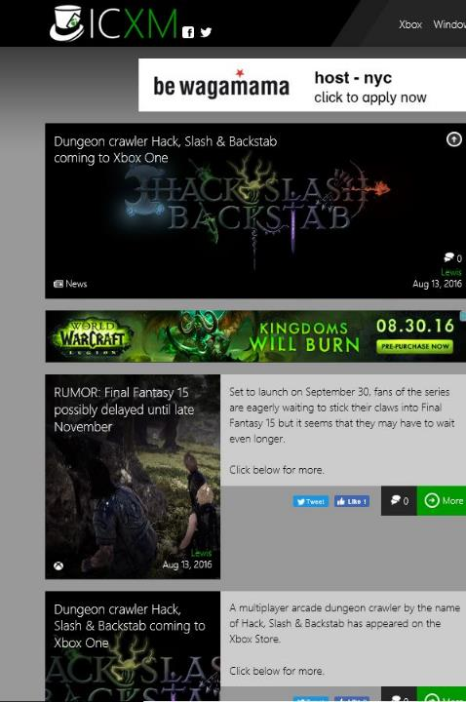
FIRST UNIVERSITY TO PUBLISH DIRECTLY ON XBOX ONE. BRAGGING RIGHTS++
Notes:
We learned SO MUCH about certification, testing, polish, industry relations, press, etc. with this project.

Slide 32


Slide 33
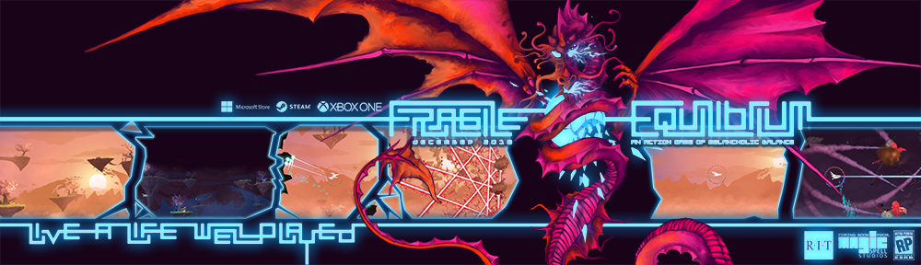
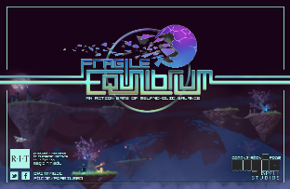
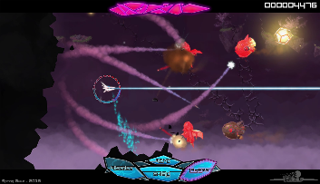
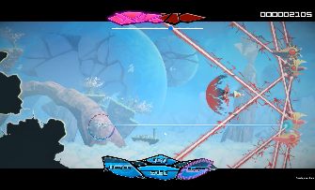
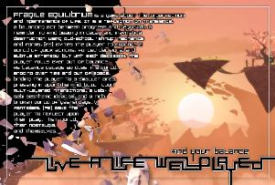

Slide 34
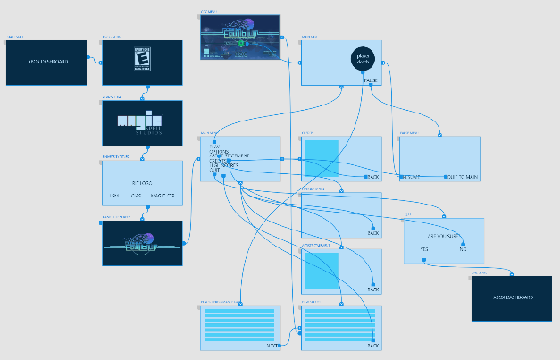
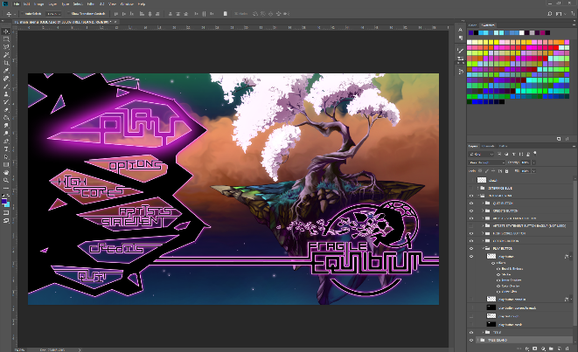





Slide 35
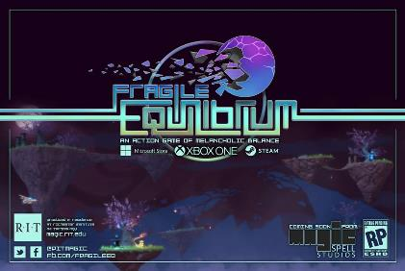











Slide 36




Slide 37







Slide 38




A SUMMER WITH THE
NFL BUFFALO BILLS
Notes:
A big high-vis project that was (a) external client through the studio, (b) multi-disciplinary team, (c) primarily managed entirely by staff

Slide 39




































5 YEARS OF LEARNING THROUGH MAKING AT MAGIC. 5 YEARS OF PROJECTS & MEDIA.
Notes:
So I highlight those 3 because of the things we learned and as data points of growth, but the thing is we did a LOT of stuff from a LOT of work for a LOT of people! It’s a lot bigger a community than people even think about. It’s easy when you are working on ‘your thing’ to not realize the scope and scale of everything else that’s happening and going on.

Slide 40

02/09/2018 Student-made game to be presented at Game Developers Conference
01/26/2018 Emerging 3D-printing applications at RIT
01/11/2018 Top RIT News stories and videos for 2017
01/03/2018 RIT to host statewide Game Dev Challenge kick-off event Jan. 19
01/03/2018 Top RIT News stories for December 2017
12/13/2017 Learn more about RIT’s entrepreneurial ecosystem, leadership in cybersecurity, and donor Austin McChord
12/11/2017 RIT professor launches table-top games to enhance people’s understanding of religion
12/07/2017 Creating a Holo-Assistant with Chirag Kular
11/28/2017 RIT’s Andrew Phelps named president of Higher Education Video Game Alliance
11/02/2017 Student uses technology to help humanitarian causes at UNICEF International
10/16/2017 Rochester Philharmonic Orchestra partners with RIT’s MAGIC Spell Studios, The Strong for ‘Heroes: A Video Game Symphony’ performance Oct. 26
10/03/2017 Top RIT News stories and videos for September 2017
09/25/2017 RIT MAGIC Center co-sponsors game festival at Irondequoit Public Library
09/20/2017 RIT staffer, alumni win big at Digital Rochester GREAT Awards
09/14/2017 Filmmaker Cailleah Scott-Grimes brings her award-winning documentary to RIT Sept. 21
09/11/2017 RIT’s brightest experts to highlight Light and Sound Interactive Sept. 12–14
09/07/2017 RIT helps create virtual reality ‘MAGIC’ for Buffalo Bills
08/18/2017 Summertime, and the students were busy (and in business)
08/02/2017 International conference on Japanese video game industry comes to Rochester Aug. 21–23
07/10/2017 RIT names Adrienne Decker as Fram Faculty Fellow in Applied Critical Thinking
05/23/2017 Staff Spotlight: Robert Mostyn
05/12/2017 New nine-credit general education immersion course is a first for RIT
05/09/2017 RIT MAGIC Center announces winners of statewide Game Development Challenge
05/04/2017 RIT ranked No. 1 game design school on the East Coast
05/03/2017 RIT featured among ‘Colleges That Create Futures’
04/25/2017 RIT is local site for 2017 International NASA Space Apps Challenge, April 29–30
04/25/2017 RIT’s MAGIC speaker series wraps up 2016-2017 season on April 26
03/21/2017 RIT’s video game design programs jump in Princeton Review rankings
03/09/2017 RIT to host statewide Game Dev Challenge kickoff March 10
03/03/2017 RIT student-created game competes in 2017 Intel University Games Showcase
03/01/2017 RIT student John Miller hopes to make an impact at national gaming conference
02/20/2017 RIT students, faculty head to California for annual Game Developers Conference
12/19/2016 RIT professor awarded NEH grant to enhance religious literacy through gaming
12/12/2016 RIT professor awarded NSF grant to benefit the next generation of games and learning scholars
12/09/2016 MAGIC Spell Studios celebrates official launch
12/01/2016 Top RIT News stories and videos for November 2016
11/15/2016 RIT officially launches MAGIC Spell Studios, aimed at convergence of digital media disciplines
11/10/2016 Local video game developers, entrepreneurs will speak on campus Nov. 14
11/01/2016 Rochester Philharmonic Orchestra partners with RIT, MAGIC Spell Studios for ‘Legend of Zelda’ performance Nov. 11
09/15/2016 Card game created by RIT students now licensed by Hasbro
09/12/2016 RIT’s MAGIC speaker series kicks off 2016-2017 season on Sept. 16
08/29/2016 RIT to become first university to publish video game on Xbox One platform
05/09/2017 RIT MAGIC Center announces winners of statewide Game Development Challenge
05/04/2017 RIT ranked No. 1 game design school on the East Coast
05/03/2017 RIT featured among ‘Colleges That Create Futures’
04/25/2017 RIT is local site for 2017 International NASA Space Apps Challenge, April 29–30
04/25/2017 RIT’s MAGIC speaker series wraps up 2016-2017 season on April 26
03/21/2017 RIT’s video game design programs jump in Princeton Review rankings
03/09/2017 RIT to host statewide Game Dev Challenge kickoff March 10
03/03/2017 RIT student-created game competes in 2017 Intel University Games Showcase
03/01/2017 RIT student John Miller hopes to make an impact at national gaming conference
02/20/2017 RIT students, faculty head to California for annual Game Developers Conference
12/19/2016 RIT professor awarded NEH grant to enhance religious literacy through gaming
12/12/2016 RIT professor awarded NSF grant to benefit the next generation of games and learning scholars
12/09/2016 MAGIC Spell Studios celebrates official launch
12/01/2016 Top RIT News stories and videos for November 2016
11/15/2016 RIT officially launches MAGIC Spell Studios, aimed at convergence of digital media disciplines
11/10/2016 Local video game developers, entrepreneurs will speak on campus Nov. 14
11/01/2016 Rochester Philharmonic Orchestra partners with RIT, MAGIC Spell Studios for ‘Legend of Zelda’ performance Nov. 11
09/15/2016 Card game created by RIT students now licensed by Hasbro
09/12/2016 RIT’s MAGIC speaker series kicks off 2016-2017 season on Sept. 16
08/29/2016 RIT to become first university to publish video game on Xbox One platform
08/26/2016 Top RIT News stories and videos from summer 2016
08/17/2016 MAGIC’s trustee-funded Co-Up program wraps up with second successful year
08/17/2016 An Innovation Ecosystem
08/02/2016 We’ve Got the Next Big Idea
06/17/2016 RIT’s Dan Schneiderman represents New York state at White House ‘makers’ event
04/29/2016 Imagine RIT exhibit allows visitors to ‘delve into dungeons’
04/27/2016 Three video games with ties to RIT featured at PAX East Indie showcase
04/21/2016 RIT is local site for 2016 International NASA Space Apps Challenge, April 23–24
04/07/2016 2016 Imagine RIT set for May 7
03/18/2016 RIT takes third place in Best Visual Quality in 2016 Intel University Games Showcase
03/17/2016 RIT’s MAGIC Spell Studios joins forces with virtual reality giant, videogame developer Crytek
03/15/2016 RIT student earns Intel Award for female, underrepresented game design students at international Game Developers Conference
03/15/2016 Princeton Review Ranks RIT as a top video-game design school
03/14/2016 RIT students, faculty head to California for annual Game Developers Conference
02/22/2016 RIT hosts all-women hackathon Feb. 27 and 28
02/15/2016 RIT MAGIC Center kicks off spring speaker series with privacy expert Feb. 18
02/04/2016 Electronic Gaming Society president prepares for Fusion Fest 2016
02/03/2016 Gaming for good: RIT gamers host LAN party to support Cancer Wellness Connections, Feb. 5-6
01/26/2016 RIT named one of three Digital Gaming Hubs in New York state
01/14/2016 MAGIC Spell Studios video game to be displayed at Smithsonian ‘pop-up’ arcade Jan. 16
12/11/2015 RIT to host second annual Congressional App Challenge kick-off event Dec. 12
12/10/2015 MAGIC virtual reality lab will serve as a one-stop shop for interface development, enhancing user experience
11/20/2015 Merging art history with digital gaming
11/04/2015 RIT students vying for Hasbro top prize
10/29/2015 RIT MAGIC Center director briefs Congressional members on U.S. video game industry
10/16/2015 Noted jazz biographer to talk on former Rochesterian Pepper Adams
10/13/2015 RIT’s Center for MAGIC welcomes social-media etiquette expert Oct. 22
09/23/2015 Plans for RIT’s new film industry-standard sound stage begin to come into focus
08/26/2015 Top RIT News stories from the summer
08/14/2015 Co-op gets the MAGIC touch
08/14/2015 RIT announces investments in MAGIC Spell Studios, aimed at spurring growth of local digital media industry
07/22/2015 RIT’s Center for MAGIC develops new initiative to encourage student humanitarian work through technology
07/20/2015 Free and open source software culture at RIT continues to grow
07/09/2015 RIT announces investments in MAGIC Spell Studios, aimed at spurring growth of local digital media industry
06/19/2015 RIT recognized for public relations work at 2015 PRism Awards
06/15/2015 RIT selected to host New Media Consortium in June 2016
06/03/2015 Adobe sponsors new media senior projects for student designers and developers
05/21/2015 RIT center continues to make ‘MAGIC’
04/30/2015 RIT students create video game to help children learn to read
04/24/2015 RIT students take top prize in Microsoft’s U.S. Imagine Cup National Finals
04/14/2015 MAGIC Speaker Series welcomes three speakers in April to discuss digital culture
04/03/2015 The Harmonica and the Blues
04/03/2015 Student-created video game selected for international exhibit
03/24/2015 RIT’s video game design programs jump in Princeton Review rankings
03/17/2015 RIT gamers support Cancer Wellness Connections through LAN party March 20
03/06/2015 RIT students take top award in Intel University Games Showcase
03/04/2015 Class of RIT students develop and publish Splattershmup video game
03/03/2015 Top RIT News stories and videos for February 2015
03/02/2015 RIT students California-bound for Game Developers Conference
02/12/2015 RIT MAGIC Center publishes student video game on Steam for the first time
02/03/2015 Top RIT News stories and videos for January 2015
02/02/2015 MAGIC Speaker Series looks to spark ideas about digital culture at RIT
01/07/2015 Top RIT News stories and videos for 2014
01/07/2015 Top RIT News stories and videos for December 2014
12/17/2014 RIT featured in Google’s Year in Search 2014 video
12/16/2014 Jewish Play Project explores relationship between Jewish creators and the play industries
12/11/2014 RIT project wins funding in NYS Regional Economic Development Councils competition
12/01/2014 Top RIT News stories and videos for November 2014
11/18/2014 Girl Develop It aims to bridge gender gap in tech fields
11/18/2014 The science behind 3D-printed prostheses
11/18/2014 A new hand for Lucas
11/11/2014 MAGIC Speaker Series looks to spark ideas about digital culture at RIT
10/02/2014 Top RIT News stories and videos for September 2014
09/29/2014 RIT takes part in national conference devoted to inexpensive 3D-printed prosthetic devices
09/22/2014 National conference to focus on work begun at RIT
09/16/2014 RIT hosts 2014 Software Freedom Day Rochester Sept. 20–21
08/05/2014 Hackathons help students get jobs, make a difference
07/28/2014 U.S. Assistant Secretary of Commerce tours RIT to review federal investments
07/08/2014 RIT students study abroad to explore video game industry in Germany
07/01/2014 RIT joins top game design programs in founding Higher Education Video Game Alliance
06/23/2014 RIT professor receives Fulbright Grant to develop game design minor in Croatia
05/26/2014 RIT receives $300,000 NSF Innovation Corps Sites grant to advance commercialization
05/14/2014 RIT students, alumni and staff among winners of 2014 AT&T Rochester Civic App Challenge
04/25/2014 Adobe Vice President of Experience Design and Creativity to attend Imagine RIT May 3
04/03/2014 App contest encourages community involvement
04/01/2014 Top RIT News Stories and Videos for March 2014
03/17/2014 MAGIC Speaker Series explores individual privacy on social networks March 19
03/14/2014 Unconference for Rochester area K-12 educators looks to discuss digital media in education
03/11/2014 Princeton Review Ranks RIT as a top video-game design school
03/06/2014 RIT launches nation’s first minor in free and open source software and free culture
02/24/2014 Online community of makers creates and improves 3D printed prosthetics for those in need
02/20/2014 Announcing the AT&T Rochester Civic App Challenge
02/13/2014 Developer ‘breaks the chains’ of traditional video games
01/28/2014 RIT MAGIC Center explores digital media with two speakers Feb. 10 and 12
01/23/2014 RIT/NTID students accepted into high-tech business accelerator
12/05/2013 New treatment helps autistic children navigate the world
12/04/2013 MAGIC Speaker Series looks to spark ideas about digital culture at RIT
11/20/2013 RIT professor earns more than $11,000 in Kickstarter for multi-player video game
11/14/2013 RIT ‘Celebration of Research’ set for Nov. 19
11/07/2013 RIT digital humanities series brings author, Internet freedom advocate to campus Nov. 11
10/16/2013 State Senate committee discussing ways to grow video game development industry
10/10/2013 RIT’s ‘MAGIC’ Center
07/22/2013 New digital media research center makes MAGIC
07/11/2013 ‘Sky Time’ video game selected for White House Champions of Change event July 23
06/20/2013 Q&A with game designers John and Brenda Romero June 28 at RIT
04/22/2013 Two RIT teams head to International NASA Space Apps Challenge
04/08/2013 RIT hosts talk with active learning expert and author Walter Bender April 17
03/28/2013 Red Hat donates to RIT’s MAGIC Center for open source software education program
02/15/2013 RIT launches new research center dedicated to digital media
Notes:
And we’ve worked really hard on telling our own story, over and over, better and better… this is just university press. We’ve also done social media, pictorials, just about every campus publication there is, regional press and television, and a couple of national news stories in Inside Higher Ed, the Chronicle, and a few others.

Slide 41

PART 3: CULTURAL SHIFTS & CAMPUS CONNECTIONS

Slide 42


Slide 43


MAGIC is a NY STATE GAMES HUB,
(TO GROW THE STATE ECONOMY, but also to tell the state *STORY*)

Slide 44










FREE & OPEN SOURCE SOFTWARE
DIGITAL & PHYSICAL MAKER COMMUNITIES
Notes:
If you’ve been following what we’re doing we’re making an effort to be essentially everywhere: here are some of the initiatives and efforts and partners of recent note. We’re taking that notion of working with communities and networks really seriously at local, state, national, and international levels.
The general public doesn’t understand education, doesn’t understand what we do, and is increasingly critical of higher education in specific as overpriced, overblown, and overvalued. So how do we change any of these perceptions other than by cutting costs (which we need to do as well) ?

Slide 45

A FOCUS ON STORY IS A FOCUS ON HUMANS, WITH OBVIOUS IMPLICATIONS
Healthcare – MAGIC has more sustained research interest from health and behavior verticals than any other…
Education – followed closely by the application of media interventions in formal and informal education

Slide 46


MAGICAL BITS FOR IMPACT
Recognition and capitalization on convergence of technology, media, message, and consumption
Constantly pushing beyond cutting-edge work: if it’s been done, we don’t do it again. (this avoids squatting in a comfort zone)
Engagement with local, regional state and national networks of community
Convergence, 1952 by
Jackson Pollock
Notes:
So when I think about the work that we’ve done, the activities we’ve undertaken, the kinds of things that have resulted in success (if you think we are successful) they follow these trends. These are the things that are working to resituate and refocus beyond a narrow, reductionist version of STEM and into a broader and more engaging view of campus as a whole, of multi-disciplinary as a platform, and finding some comfort in between computing and the arts.

Slide 47

TO EDUCATE A NEW GENERATION OF CITIZEN TECHNO-SCHOLARS

Slide 48

ELECTION NIGHT HACKATHON
MAGIC & PUBLIC POLICY
Notes:
Working with public policy and other groups on what the data (and manipulation of data) that happens around the electoral process looks like. This year was kinda weird.

Slide 49

WE HELP STUDENTS TELL THEIR OWN STORIES & DEVELOP SOPHISTICATION
Notes:
We used various pots of funding to co-establish with the Simone Center the ‘Co-Up program’ which helps student teams commercialize ideas for games and digital media products in a ‘pre-incubation’ environment (i.e. not yet ready for Venture Creations or a more formal business incubator)

Slide 50

RILEY & Make a wish FOUNDATION
Notes:
Meet Riley. And also, here’s a thing a research center is doing that has nothing to do with research, and has everything to do with impact.

Slide 51

Artech CRE8-A-THON: CHANGING JAM CULTURE
Notes:
This is Dan at the Ar-Tech Cre-8-athon, a hackathon we did that extended between digital and physical, between open source computing and art. We gave away some ridiculously silly prizes, but what we really wanted was to help change the culture of ‘who goes to a hackathon and what are they for’ and get two different communities of practice together

Slide 52

REMEMBERING THAT MAKING IS MAGICAL
Notes:
This is from an event we recently hosted for Our Lady of Mercy school in collaboration with our K-12 office and other partners. We forget sometimes the role and impact that digital media has, and our obligation as educators to keep that alive, to use it to encourage a study of the mind and the soul.

Slide 53

MAGICAL THEMES FROM THE FIRST 5 YEARS
A focus on ‘data driven design’ in our work, coupled with human-knowledge and expertise through an open critique process.
Projects that require an emotional component and a conveyance of message. Projects that facilitate a human experience, that don’t stop at invention, that TELL STORIES.
Projects that are public and require a direct interaction with their presentation, performance, reception and impact
Understanding that a single capstone class for 16 weeks is Not Enough, that multi-disciplinary is hard, that education > ‘hard’ skills, and that the careers of tomorrow are weird and multi-faceted

Slide 54

PART 4: ENTREPRENEURIAL ACTIVITY & BUSINESS INCUBATION

Slide 55
LAYER 0: “CO-UP”
RIT is a cooperative education university where students break from their undergraduate degrees and earn academic credit for an internship or professional work during two semesters.
MAGIC adapted this model to instead support students, both financially and in terms of facilities and mentoring programs, to allow them to use this time to instead create start-ups.
I raised approximately $1.5M USD, which was allocated each year in $50,000-70,000 allotments for student teams, primarily during the summer but also occasionally during the academic year.
As a part of this program, MAGIC was recognized in conjunction with the Simone Center as a National Science Foundation I-Corps node during my tenure.

Slide 56
LAYER 1: CAMPUS BUSINESS INCUBATOR
MAGIC + RIT Venture Creations business incubator. During my time as director at MAGIC
Darkwind Media (as one example, founded by GD&D alum in 2007)
This company had been slowly growing on contract work during the intervening period, but by using MAGIC as a platform I was able to leverage government support for tax incentives, economic development support, and university support to help that company move out of the RIT incubator and into studio space in the city.
Today, Darkwind has contributed directly to named roles on international titles such as WulverBlade, Republique, and Marvel’s Iron-Man VR.

Slide 57

LAYER 2: RIT INVESTMENT FUND
Dan & Gary Games make Super Daryl Deluxe
Tax credits and working space
Software and hardware support at a distance
Mentorship networks and conference showcase

Slide 58

LAYER 3: EXTERNAL PARTNERS & MENTORS
MAGIC + external partners on specific technical challenges and problems, or to allow them incubation space within MAGIC facilities when it was prudent to do so
NFL Buffalo Bills on VR project
Second Ave Software and Workinman Interactive on NSF funded game interventions for middle-school education in physics targeted at raising success metrics for women and minorities
National Museum of Play on technology paradigms for preserving games and associated media,
FORBES Media on internships and web technologies

Slide 59
LAYER 4: MAGIC PRODUCTION CURRICULUM EXPERIENCES

Slide 60
PART 5: THE STUDIO FACILITIES
THIS IS WHERE MAGIC SPELL STUDIOS REALLY HAPPENED

Slide 61

DEMOCRATIZING CAPABILITIES & POSSIBILITIES
(~$30M NYS ESD PUBLIC/
PRIVATE PARTNERSHIP)
Movie & Gallery Theatre
Sound Stage (7k sq. ft.)
Social gathering lobby and atrium
Sound-Mix Facility
Color-Correction Room
Computer Game & Media Dev Labs
VR/AR Laboratory
Demo Lounge
Animation Classroom & Studio
Collaborative Partner Suite
MAGIC Spell Studios Innovation Suite
Media Research Computing &
  Control Room Facility

Slide 62





Slide 63

FLOOR 1
ANIMATION
CLASS
LAB
INFRA
GAME AND MEDIA DEV LABS
DEMO
SOUND STAGE
SOUND
MIX
COLOR
CORRECT
THEATRE
FOLEY
RECORDING
COLLAB
PARTNER
SUITE

Slide 64

FLOOR 2
MEDIA &
ANIMATION
CLASS -
LAB
VR
AR
STOP
MOTION
GAME &
MEDIA
CLASSLAB
MAGIC
SUITE &
INNOVATION
LABORATORY

Slide 65


CORE DESIGN PRINCIPLE
NO SPACE SHOULD BE USED FOR ONLY ONE THING, OR BY ONLY ONE CONSTITUENCY: OUR COMMITMENT TO MULTI-DISCIPLINARY AND CROSS-DISCIPLINARY WORK SHOULD EXTEND TO THE PHYSICAL BUILDING DESIGN, TECHNOLOGY SELECTION, ADMINISTRATION AND OPERATIONS, CULTURE & COMMUNITY.
IF WE SUCCEED, WE WILL HAVE ENGINEERED A PARTICLE ACCELERATOR FOR THE HAPPY ACCIDENT.
(AND MODEL FOR OUR STUDENTS HOW COLLABORATION AND TEAMS FUNCTION)

Slide 66



























MAGIC MOOD BOARD
MAGIC SPELL STUDIOS – INITIAL MOOD BOARD DESIGN PRESENTATION #1

Slide 67

The GEEKIEST THING WE’VE EVER BUILT
FIRST BUILDING DESIGNED ENTIRELY AROUND A 4K WORKFLOW
FIRST BUILDING DESIGNED ATOP A 10G TO-THE-DESKTOP NETWORK
INTRA-BUILDING SERVICES, CAMPUS LINKED SERVICES, CLOUD BASED SERVICES
HIGHLY SPECIALIZED FACILITIES FOR TEACHING & RESEARCH
VIRTUALIZATION CLUSTERS FOR TESTING & DEPLOYMENT

Slide 68

MAGIC IS
An innovation unit
A digital maker space
A research center
A media studio
An entrepreneurship incubator
A mentorship network
A platform beyond and between degree programs
A multi-disciplinary, cross-institutional organization
A community of makers and thinkers
A New Story…

Slide 69

ULTIMATE MOTIVATION
TO CHALLENGE & TRANSFORM THE UNIVERSITY, OUT OF LOVE <3

Slide 70
PART 6: SO DID IT WORK?

Slide 71
Well, on the one hand
Enrollment went up
Press went (WAY) up
We mentored some companies to (fantastic) success
We engaged some flagship commercial partners
Research dollars went up
The studio is still operational, even after I left
Lots and lots of students have gone on to successful industry experience because they had PRODUCTION EXPERIENCE and a PORTFOLIO OF WORK

Slide 72

…The M is for Messy
Notes:
The M is for Messy.

Slide 73
REALLY, REALLY, MESSY
BUSINESS INCUBATOR & TECHNOLOGY TRANSFER OFFICE
ACADEMIC DEPARTMENTS & COLLEGES
MAGIC LAB
(RESEARCH CENTER)
MAGIC SPELL STUDIOS, LLC
PUBLICLY VISIBLE ACTIVITIES AND PRODUCTS
SPONSORED RESEARCH SERVICES
GOVERNMENT & COMMUNITY RELATIONS
DEVELOPMENT & ALUMNI RELATIONS
ENTREPRENEURSHIP CENTER

Slide 74
AND IT WAS MESSY PAYING FOR IT
START UP FINDING FROM THE UNIVERSITY
BOARD OF TRUSTEES RAISED GIFT FUNDS
RESEARCH OVERHEAD & “SPECIAL” RETURN RATE
PERCENTAGE RETURN FOR GAMES & MEDIA SALES
FUNDING FOR EVENTS & SERVICES
NSF I-CORE NODE GRANT MONEY
CORPORATE GIFTS & GIFT IN KIND SERVICES
CORPORATE R&D CONTRACTS / CLIENT WORK
PASS THROUGH FUNDING ON SBIR GRANTS
NY STATE “GAMES HUB” DESIGNATION & PROGRAM
DIFFERENT GROUPS, METHODS, POOLS, PLATFORMS, & REPORTING MECHANISMS

Slide 75

HOW IS MAGIC:
Several programs from a variety of funding sources:
  Co-UP (with Simone Center, i-Core NSF, RIT BoT, etc.)
  Funded research & development in digital media
  MAGIC academic projects (games, apps, others), and commercial projects (games, apps, others)
  Annual Speaker Series, hackathon series, cre8-a-thons
  Several “initiatives” that operate as mini-centers or labs inside MAGIC including FOSS, RC&P, Frameless labs, LSC, etc.
  Large grant designation from ESD as a ‘NY Games Center” along with RPI and NYU + NYS Game Dev Challenge
  Commercial studio projects and client engagement
  Publication of student work and entrepreneurial efforts
  NYS ESD Affiliated Public-Private partnership with MAGIC Spell Studios facility and associated economic development effort
Notes:
We have established a lot of stuff, grown a ton, and things have gotten very intricate. But it is also kind of STRANGE in the way it’s all come together, it isn’t the model of a typical anything – it’s a bizarre mix, and it just IS NOT LIKE anything else on campus. And that’s OK.

Slide 76
MOST SUCCESSFUL PROJECT (measuring by ACADEMIC impact)
Funded first internally
Then by NEH
Then by NEH (again)
Then we figured out board game creation and printing
Then we figured out publishing
Then we figured out distribution
Then we figured out marketing
Lots of academic recognition

Slide 77

MOST SUCCESSFUL PROJECT
(BY DOLLARS, ONE WAY)
… was an NSF award studying early computer science education that had no “product”
But we used the studio for grant support, designing logos for SIGCSE, providing logistical website support for CFP and workshop coordination, etc.
We also used the studio as a workspace for the NSF grant, and let the software and hardware licenses bleed back into academics
Dedicated staff support, marketing, and logistics

Slide 78

MOST SUCCESSFUL PROJECT
(BY DOLLARS, ANOTHER WAY)
SUPER DARYL DELUXE
First Investment by the RIT Venture Fund in a game
Support for Dan & Gary (the authors) post-graduation, in connection with studio resources
Winner best visuals INTEL Game Challenge
Winner Microsoft Imagine Cup
Released on Playstation and other platforms
Often cited in student applications (which for a tuition based university is a big deal)

Slide 79

MOST SUCCESSFUL PROJECT
(BY DOLLARS, A THIRD WAY)
In raw ROI, the NFL project was the clear winner
No real research or new knowledge though
In institutional reputation gain, things are very mixed and largely unmeasurable ☹

Slide 80

MOST SUCCESSFUL PROJECT
(BY EDUCATIONAL IMPACT)
HACK, SLASH & BACKSTAB
Most students impacted
Longest production run
Highest visibility on console market, and thereby on student portfolio tie-ins and industry reputation
Largest number of students with f/t placements afterward

Slide 81
AND THEN SOME TRUE FAILURES
(AKA LEARNING OPPORTUNITIES)
In spite of all of this, most of the individual colleges/leadership never got on board, we only got a handful of affiliates that were mostly tenured, mostly already established.
Pressures to publish traditionally outstripped support for new-model production of creative works. It became “a playspace of the tenured.”
We never really added research expertise, program growth was met with non-TT lecturers and adjuncts, not reinvestment (partly because of lack of college buy in)
We lost the recognition of the vision, and leadership support. Studios don’t work without sustained leadership and engagement. Ultimately, founders can’t be sustainers.
We also lost the branding and whimsy ☹

Slide 82

I WALKED AWAY in 2018, just after THE BUILDING CAME ONLINE & JUST BEFORE THE GRAND CEREMONIES

Slide 83

Notes:
Welcome / background screen for birthday bash

Slide 84






PART 7:
THE DOVEDALE OPPORTUNITY

Slide 85
PROS & CONS
More space (and less contested space)
Much stronger history of cinematic arts in the region
Awesome film (SCREEN) office at ChristchurchNZ
Lots of campus building blocks / programs of excellence / research capabilities & even some existing infrastructure
3-year model may not be immersive / experiential enough
Open questions on how to best solicit NZ government support
Shared governance and multi-disciplinary projects are hard no matter where they are, particularly on Arts+Engineering models
COVID 19, Immigration & Border Closures

Slide 86

ANDYWORLD.IO | PROFESSORANDREWPHELPS.NET | @ANDYMPHELPS | ANDYMPHELPS@GMAIL.COM
Thanks & Questions

