Slide 1
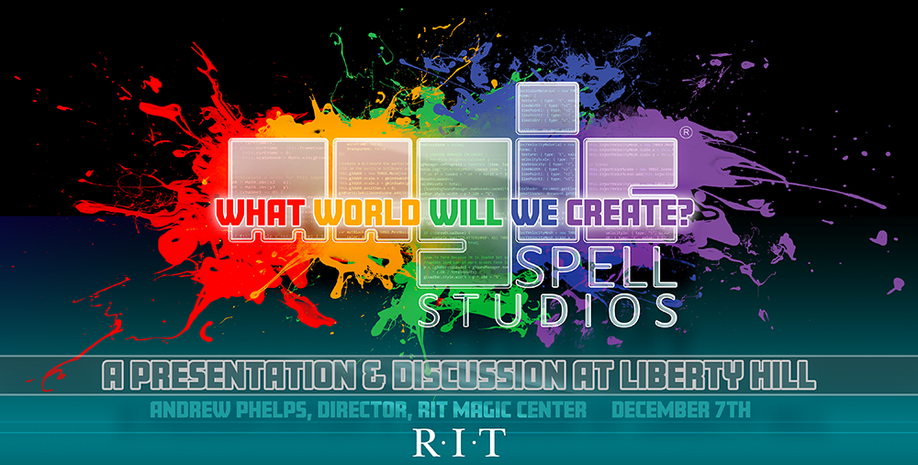

Slide 2
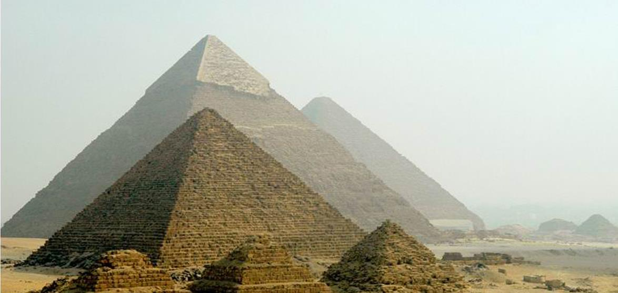
PART 0: ANCIENT HISTORY

Slide 3
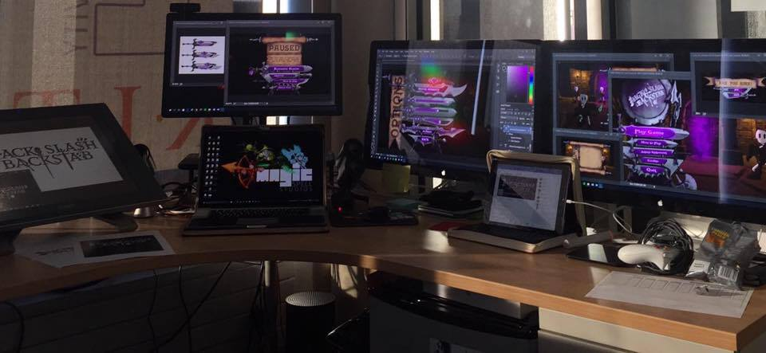
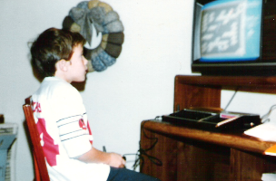
Hi, I’m andy. I make things.

Slide 4
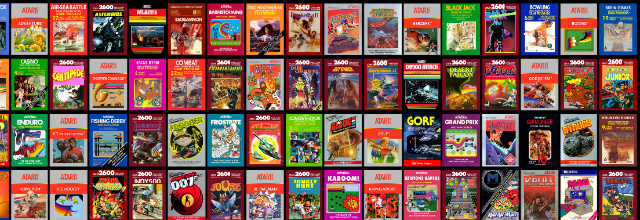
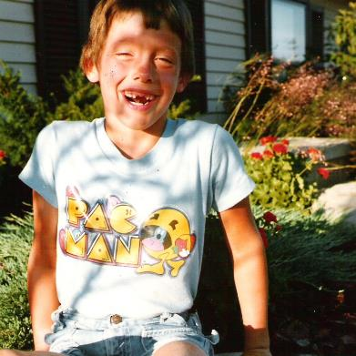
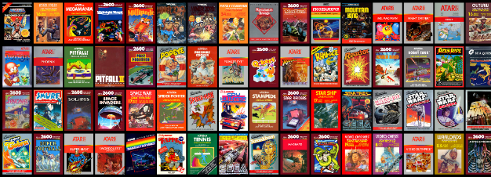
AND I GREW UP A GAMER

Slide 5
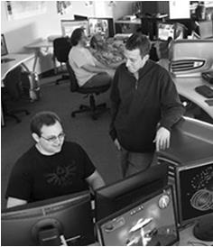
LUCKY TO HAVE MADE THINGS AT RIT
FIRST graduate course in games at RIT (2001-2002!)
Undergraduate course and later concentration in game design and technology
Degree programs in game design & development (bachelors and masters)
Dept / School of Interactive Games and Media
Research & Scholarship practices for Game Design & Development
The MAGIC Center & MAGIC Spell Studios
FIRST university to ship on XBOX One
Higher Education Video Game Alliance
NY State Games HUB
New MAGIC Spell Studios campus facility (fall 2018)

Slide 6
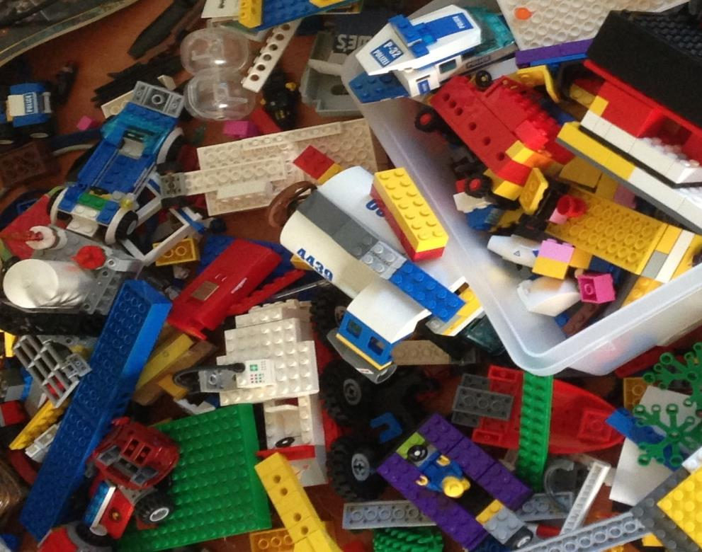
'protecting “making as a
mode of inquiry”’
-Ian Horswill, Northwestern

Slide 7
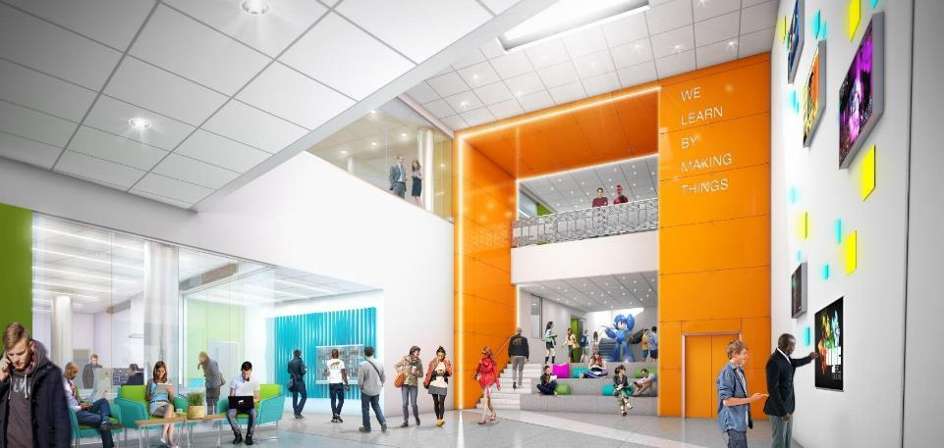
WE LEARN BY MAKING THINGS

Slide 8
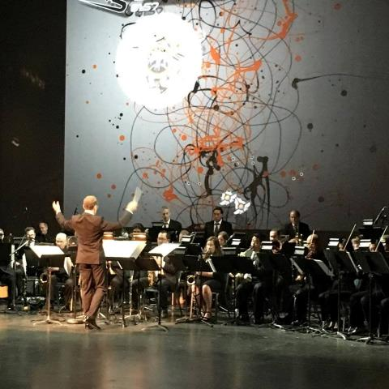
Why IS MAGIC?
C O N V E R G E N C E
C O N V E R G E N C E
The platforms and technology for film, animation, games, media, and story are converging into new forms, new stories, new experiences, and new knowledge.

Slide 9
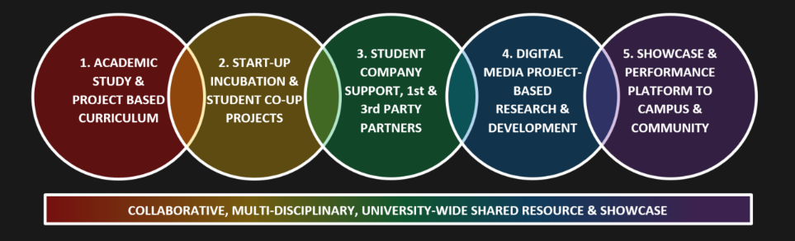
CONVERGENCE OF ANOTHER SORT

Slide 10
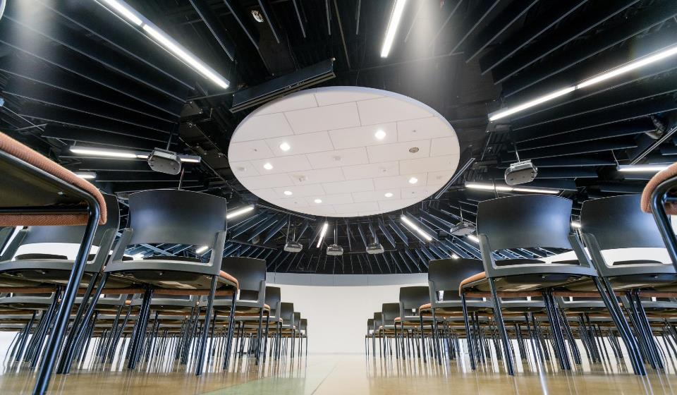

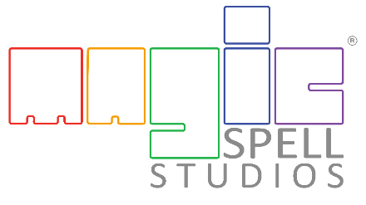
HOW IS MAGIC:
A VERY IMPORTANT DIVISION:

Slide 11
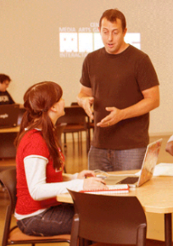
HOW IS MAGIC:
Several programs from a variety of funding sources:
  Co-UP (with Simone Center, i-Core NSF, RIT BoT, etc.)
  Funded research & development in digital media
  MAGIC academic projects (games, apps, others), and commercial projects (games, apps, others)
  Annual Speaker Series, hackathon series, cre8-a-thons
  Several “initiatives” that operate as mini-centers or labs inside MAGIC including FOSS, RC&P, Frameless labs, LSC, etc.
  Large grant designation from ESD as a ‘NY Games Center” along with RPI and NYU + NYS Game Dev Challenge
  Commercial studio projects and client engagement
  Publication of student work and entrepreneurial efforts
  NYS ESD Affiliated Public-Private partnership with MAGIC Spell Studios facility and associated economic development effort

Slide 12
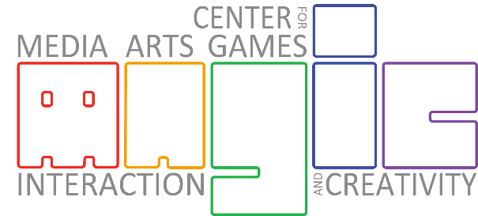
…The M is for Messy
PART I: WHAT DO WE DO?

Slide 13
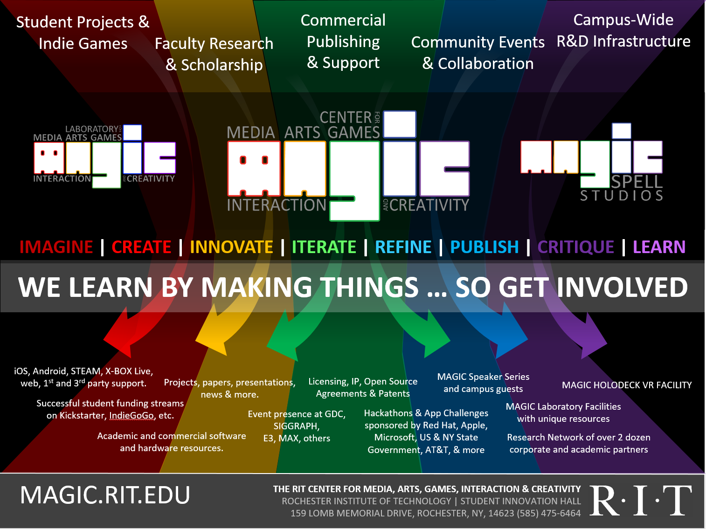


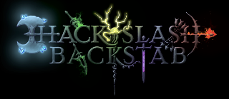

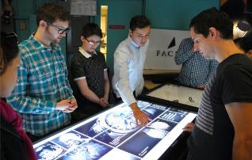

Slide 14
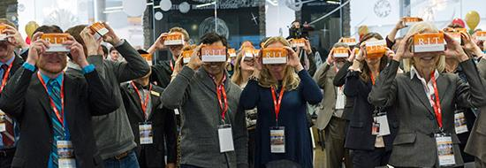
a bit MORE about Our WORK

Slide 15
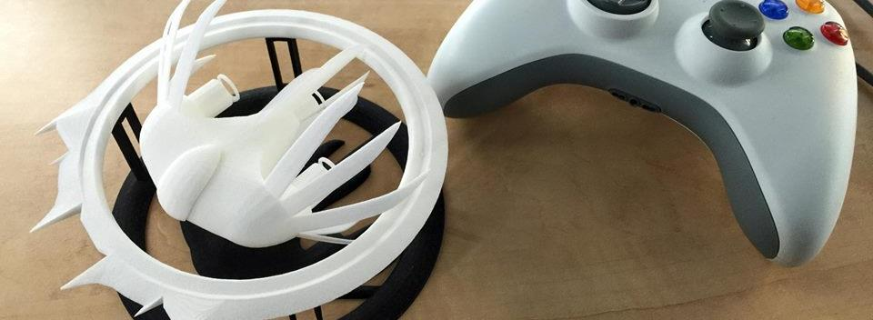

A Strange Game for Strange Reasons
This game taught us (the campus) about making things, production, and scale
This game allowed us to explore using typical game forms for telling a unique story to a very targeted audience
Finalist at GLS Education Arcade, accepted to DiGRA Blank Arcade, and IndieArcade at the Smithsonian American Museum of Art
SPLATTERSHMUP.RIT.EDU – PLAY TODAY! MAKE ART!

Slide 16










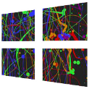




TOOLS, SOURCE & COMPILE TARGETS
+
+
+

Slide 17

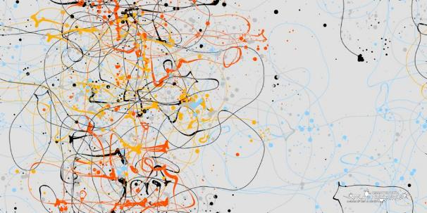
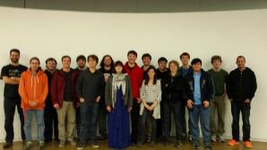
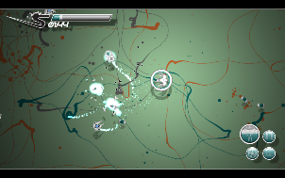
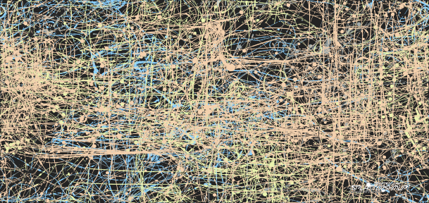
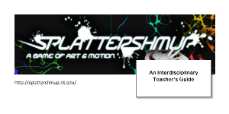



Slide 18
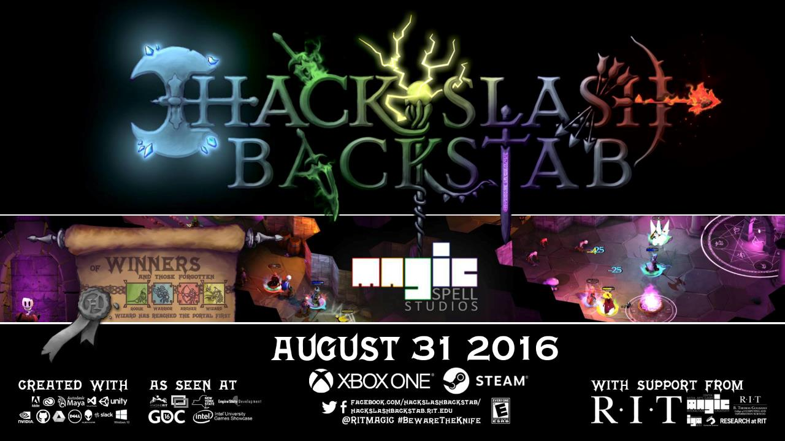

Slide 19
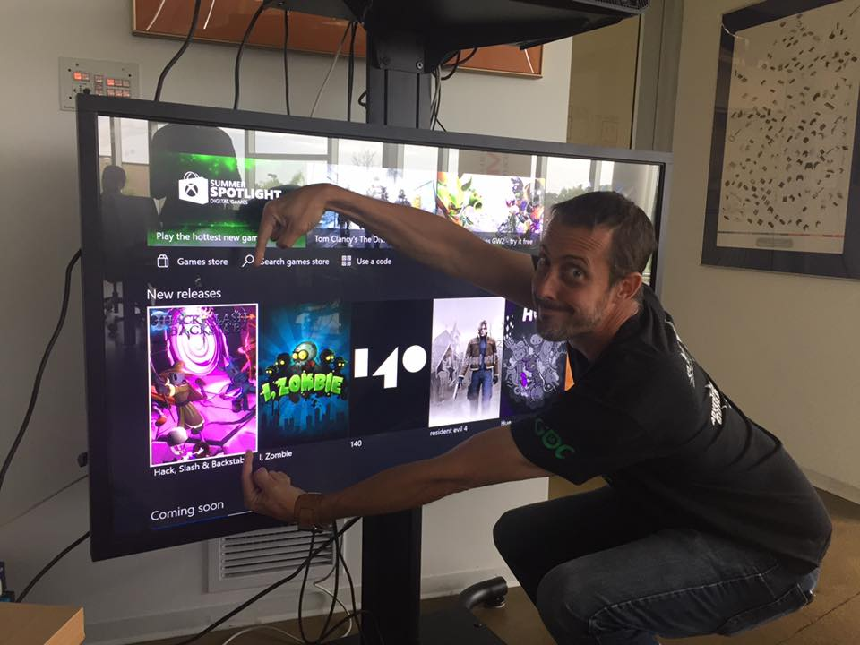
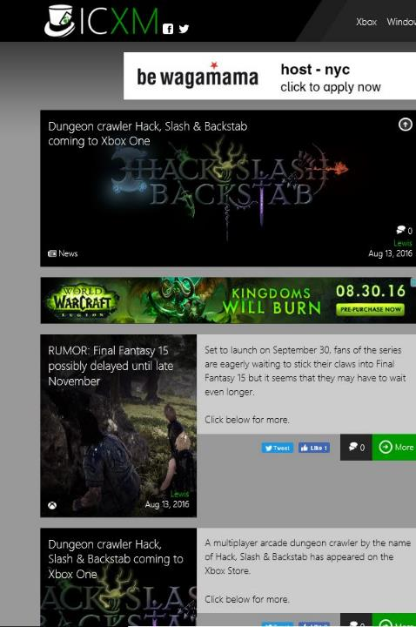
FIRST UNIVERSITY TO PUBLISH DIRECTLY ON XBOX ONE. BRAGGING RIGHTS++

Slide 20

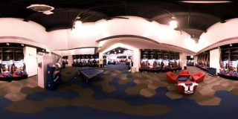

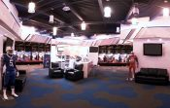
A SUMMER WITH THE
BUFFALO BILLS

Slide 21
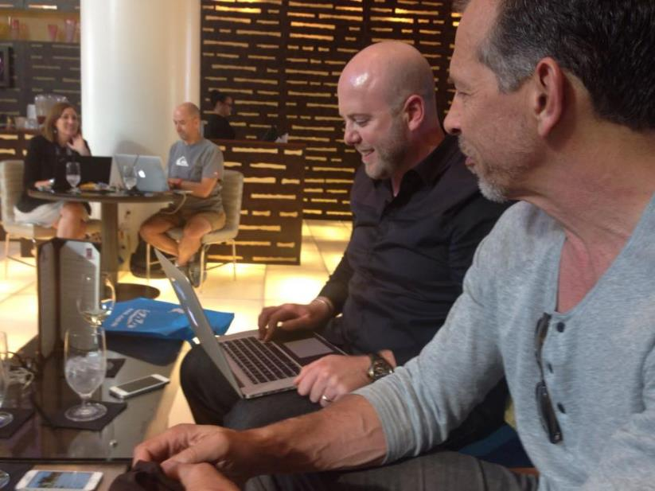
But more important than tools OR PLATFORM OR CLIENT IS STORY

Slide 22
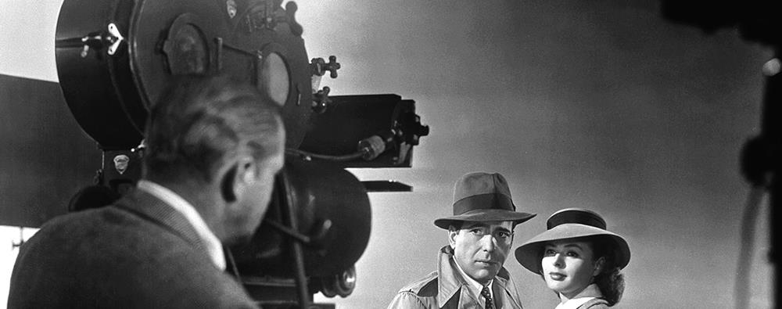
OUR STUDENTS KNOW THIS INSTINCTIVELY, THEY CAME HERE FOR IT

Slide 23
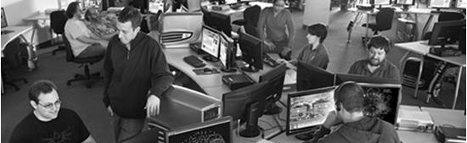
Part II: Motivations
0. TO TELL A STORY THAT ISN’T STEM
1. TO HAVE IMPACT IN OUR WORK AND PRACTICE
2. TO EDUCATE A NEW GENERATION OF CITIZEN SCHOLARS

Slide 24
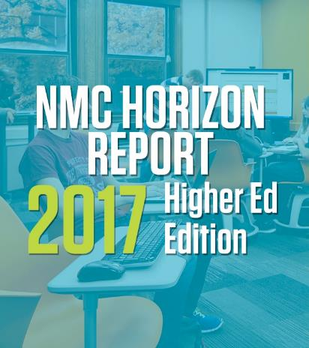
BUT FIRST, NEW MEDIA
Key Trends Accelerating Higher Education Technology Adoption:
  Long-term Trends: (for Five or More Years)
    Advancing Cultures of Innovation
    Cross-Institution and Cross-Sector Collaboration
2018 Key Trends & Analysis →

Slide 25
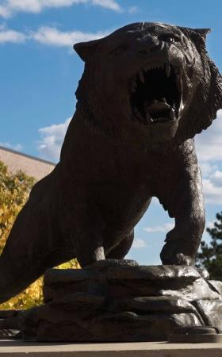
BUT FIRST, SOME OBSERVATIONS
RIT IS A VERY *DEGREE CENTRIC / DEPARTMENT CENTRIC* UNIVERSITY – it forms the core of faculty identity, student identity, and campus culture
Rochester specifically, and NY State generally, are both critically poised for growth in digital media related industries, but only with some changes to the status quo. Rochester is a story-based town, but is getting a new script.
We’re internally often more worried about costs and counting and recording and metrics than we are about the work itself, while at the same time the role of the university is increasingly challenged in society

Slide 26

PART II: NO. 0: TO TELL A STORY THAT ISN’T STEM

Slide 27
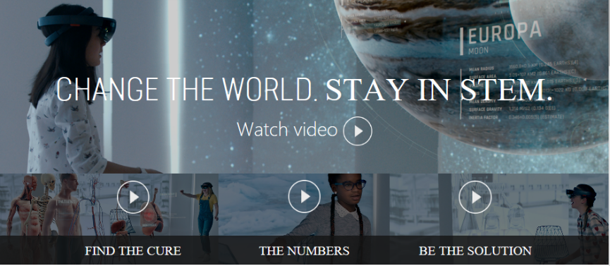
STEM is the single most destructive IDEOLOGY [STORY!] in education TODAY
- zakaria in 2012, NYT OP-ED
(and probably a lot of other PEOPLE AROUND THIS TIME AS WELL)

Slide 28
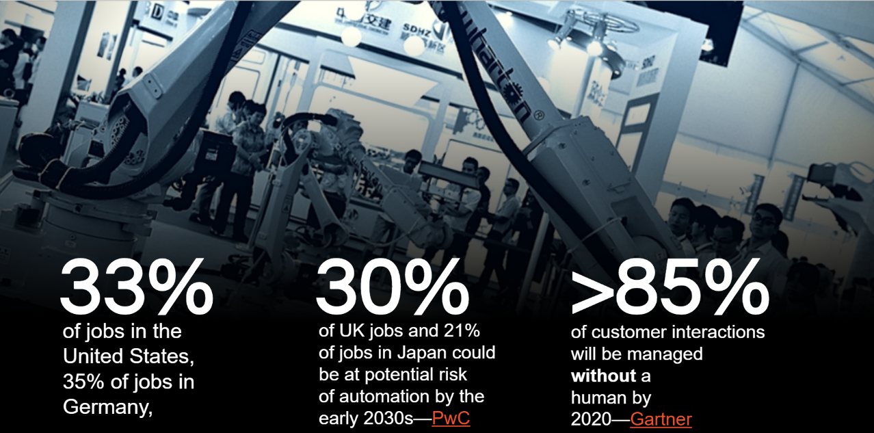

Slide 29

computing WILL EAT ITSELF

Slide 30
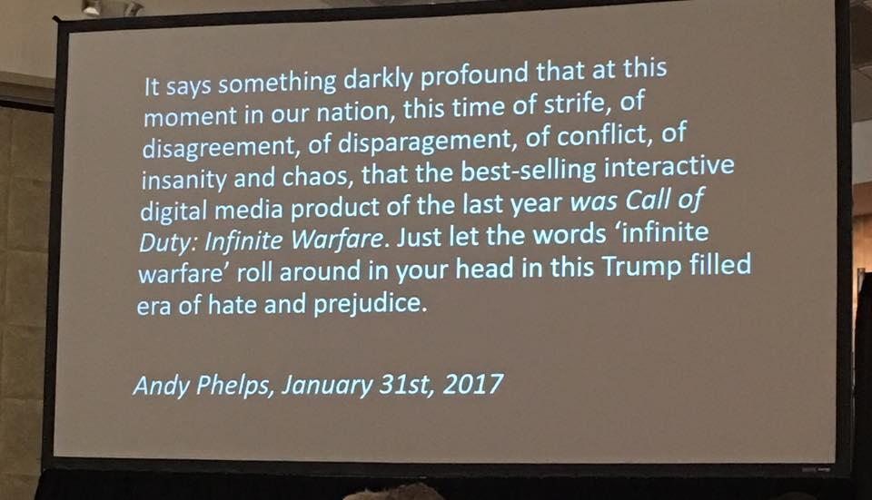

Slide 31
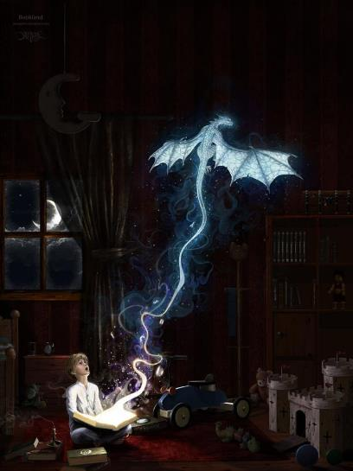
WE NEED A BETTER STORY
STEM created a story, and there is not [yet] a strong, public counter-narrative. Yet we enable ‘tech-bro’ silicon valley culture in our divisions
We added ‘A’ for STE(A)M, some places took the plunge to ‘digital humanities’ or added ‘H’– but we never (re)addressed the core value proposition of education rooted in something other than immediate commercial placement in a post-industrial economy
The role and form of education is currently under attack and increasingly devalued on arguments of relevancy (by applying commercialism to all value contexts and skills-based lenses to learning)

Slide 32
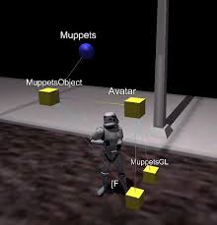
MAGICAL BITS 4 EXTENDING THE STEM STORY
A focus on ‘learn by doing’ at all levels, from ideation to finished products with a mix of internal, external, research, and ‘big name’ clients, big money and volunteer
Embedding a ‘live production studio’ in a research university, contextualizing our work
Shared services model to support and encourage multi-disciplinary work that spans a campus, and straddles art & design & computing & more
Not just creative process: entrepreneurship, legal, IP and (most importantly) start-up and studio culture (both big and small)

Slide 33
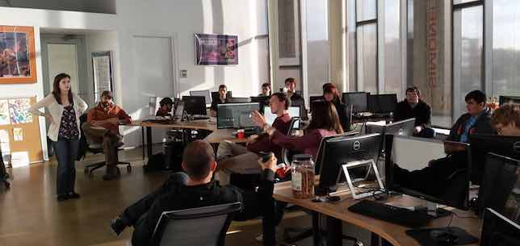
PART II: NO. 1: TO HAVE IMPACT IN OUR WORK AND PRACTICE

Slide 34
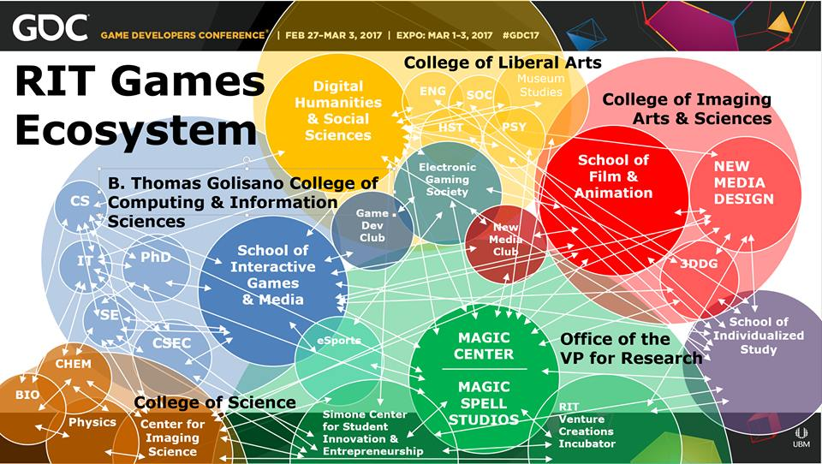

Slide 35
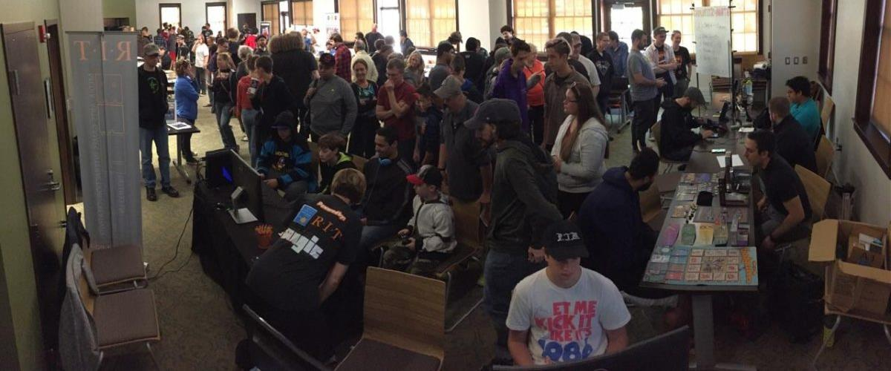
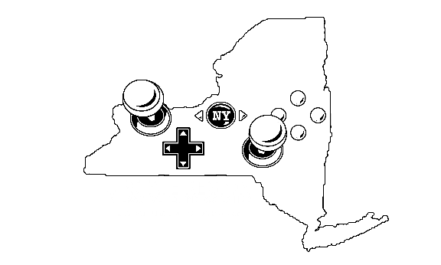
MAGIC is a NY STATE GAMES HUB,
(TO GROW THE STATE ECONOMY, but also to tell the state *STORY*)

Slide 36
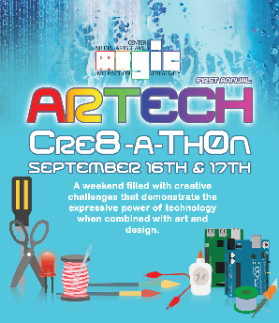









FREE & OPEN SOURCE SOFTWARE
DIGITAL & PHYSICAL MAKER COMMUNITIES
Notes:
If you’ve been following what we’re doing we’re making an effort to be essentially everywhere: here are some of the initiatives and efforts and partners of recent note. We’re taking that notion of working with communities and networks really seriously at local, state, national, and international levels.
The general public doesn’t understand education, doesn’t understand what we do, and is increasingly critical of higher education in specific as overpriced, overblown, and overvalued. So how do we change any of these perceptions other than by cutting costs (which we need to do as well) ?

Slide 37
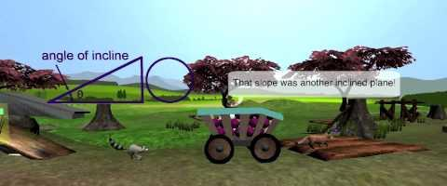
A FOCUS ON STORY IS A FOCUS ON HUMANS, WITH OBVIOUS IMPLICATIONS
Healthcare – MAGIC has more sustained research interest from health and behavior verticals than any other…
Education – followed closely by the application of media interventions in formal and informal education

Slide 38
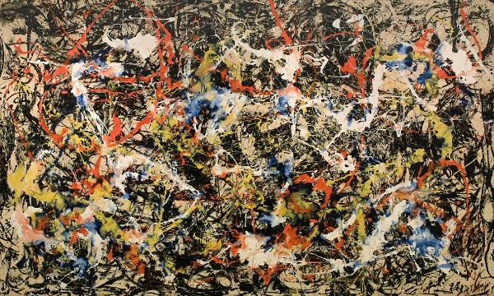

MAGICAL BITS FOR IMPACT
Recognition and capitalization on convergence of technology, media, message, and consumption
Constantly pushing beyond cutting-edge work: if it’s been done, we don’t do it again. (this avoids squatting in a comfort zone)
Engagement with local, regional state and national networks of community
Convergence, 1952 by
Jackson Pollock

Slide 39
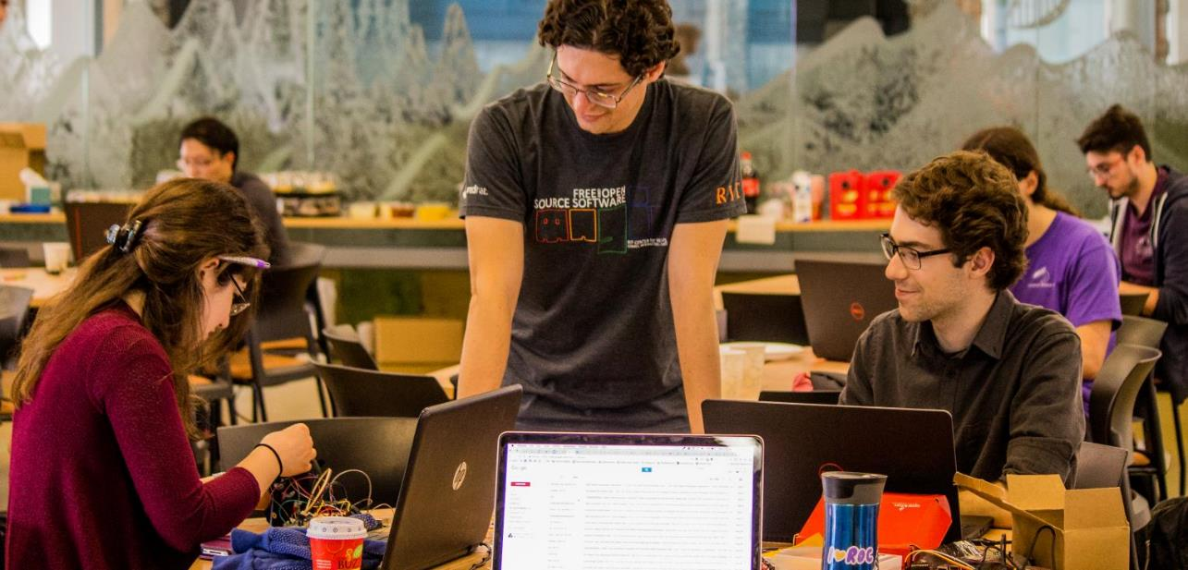
PART II: NO 2: TO EDUCATE A NEW GENERATION OF CITIZEN SCHOLARS

Slide 40

ELECTION NIGHT HACKATHON
MAGIC & PUBLIC POLICY

Slide 41

WE HELP STUDENTS TELL THEIR OWN STORIES & DEVELOP SOPHISTICATION

Slide 42

RILEY & Make a wish FOUNDATION

Slide 43

Artech CRE8-A-THON: CHANGING JAM CULTURE

Slide 44

MAGICAL BITS FOR SOCIETAL REFLECTION
A focus on ‘data driven design’ in our work, coupled with human-knowledge and expertise through an open critique process.
Projects that require an emotional component and a conveyance of message. Projects that facilitate a human experience, that don’t stop at invention, that TELL STORIES.
Projects that are public and require a direct interaction with their presentation, performance, reception and impact

Slide 45

PART III: CONCLUSIONS AND BEGINNINGS (and buildings)
Usually when we pontificate about higher education and it’s role, a lot of discussion goes into democratizing access: tools, platforms, internet, access, scholarship, etc…
The building was not an accident, or a new effort, it was an outgrowth of existing success
The building is a platform to scale up the established model
The building is a resource for the campus to engage more deeply in digital media content creation & production
The building is a research lab for people not even here yet
The building is Julie’s house ☺

Slide 46

DEMOCRATIZING CAPABILITIES & POSSIBILITIES
(~$25M NYS ESD PUBLIC/
PRIVATE PARTNERSHIP)
Movie & Gallery Theatre
Sound Stage (7k sq. ft.)
Social gathering lobby and atrium
Sound-Mix Facility
Color-Correction Room
Computer Game & Media Dev Labs
VR/AR Laboratory
Demo Lounge
Animation Classroom & Studio
Collaborative Partner Suite
MAGIC Spell Studios Innovation Suite
Media Research Computing &
  Control Room Facility

Slide 47





Slide 48

FLOOR 1
ANIMATION
CLASS
LAB
INFRA
GAME AND MEDIA DEV LABS
DEMO
SOUND STAGE
SOUND
MIX
COLOR
CORRECT
THEATRE
FOLEY
RECORDING
COLLAB
PARTNER
SUITE

Slide 49

FLOOR 2
MEDIA &
ANIMATION
CLASS -
LAB
VR
AR
STOP
MOTION
GAME &
MEDIA
CLASSLAB
MAGIC
SUITE &
INNOVATION
LABORATORY

Slide 50


CORE DESIGN PRINCIPLE
NO SPACE SHOULD BE USED FOR ONLY ONE THING, OR BY ONLY ONE CONSTITUENCY: OUR COMMITMENT TO MULTI-DISCIPLINARY AND CROSS-DISCIPLINARY WORK SHOULD EXTEND TO THE PHYSICAL BUILDING DESIGN, TECHNOLOGY SELECTION, ADMINISTRATION AND OPERATIONS, CULTURE & COMMUNITY.
IF WE SUCCEED, WE WILL HAVE ENGINEERED A PARTICLE ACCELERATOR FOR THE HAPPY ACCIDENT.
(AND MODEL FOR OUR STUDENTS HOW COLLABORATION AND TEAMS FUNCTION)

Slide 51

Democratizing access isn’t enough – working with students to tell stories is of paramount importance, enabling storytelling and working with them on content, designs and experiences, generation to generation, mind to mind.
‘Job readiness’ isn’t a path for economic impact by itself – movements like CS4All, Code.org, etc., and sometimes our own metrics and ideals, stop short of providing a contextual, expressive relationship between computing and the arts, between the machine and the human. They don’t contextualize STEM in a flyover state, a gentrified city, or a world at war. Job readiness doesn’t change the world by itself – empowering young people with both tools and skills (which we do), vision, process, experience and empathy does that...

Slide 52

ULTIMATE MOTIVATION
TO CHALLENGE THE UNIVERSITY, OUT OF LOVE

Slide 53

MAGIC IS
A research center
A media studio
An entrepreneurship incubator
A mentorship network
A platform beyond and between degree programs
A multi-disciplinary, cross-institutional organization
A community of makers and thinkers
An innovation unit
A digital maker space
An economic
development
engine and
community partner
A New Story…
… to build a new world.

Slide 54

IN THE RISE OF THE MACHINE-BRAINS, THIS IS EVER MORE TRUE:
Computing is not about computers anymore. It is about living.
~Nicholas Negroponte, Being Digital, 1995
Notes:
Anyway, Raph Koster closed a recent talk I was at with the notion that we in the games industry, but more broadly the media industry, the technology industry, the computing industry, need to consider the notion of DESIGN WITH INTENT. That these systems are so important to our culture that the responsibility falls to us as designers and developers to consider the impact and intent of these patterns and interactions.
And while this is true it is also equally true that perhaps we must re-examine and re-contextualize what it is to LIVE WITH INTENT in the digital age. That roles such as ‘citizen’ or ‘neighbor’ or ‘friend’ or ‘human’ carry with them both opportunity and obligation, that our lives are what we make of them, and our digital lives are included. And wasn’t the role of the university, really, the cultivation of knowledge towards the betterment of the human? We have grown beyond our bodies, but we must each of us consider the patterns and scales of our expanding digital minds.
We must consider the story of what it is to be human, we must consider the stories we tell ourselves about ourselves. We must consider the stories we tell our children, and the effect those stories have on our society. And if we don’t like where we are, we must change our stories and how we tell them.

Slide 55

WHAT WORLD WILL WE CREATE?
Thanks & Questions
andy@magic.rit.edu | magic.rit.edu | @ritmagic

