Slide 1
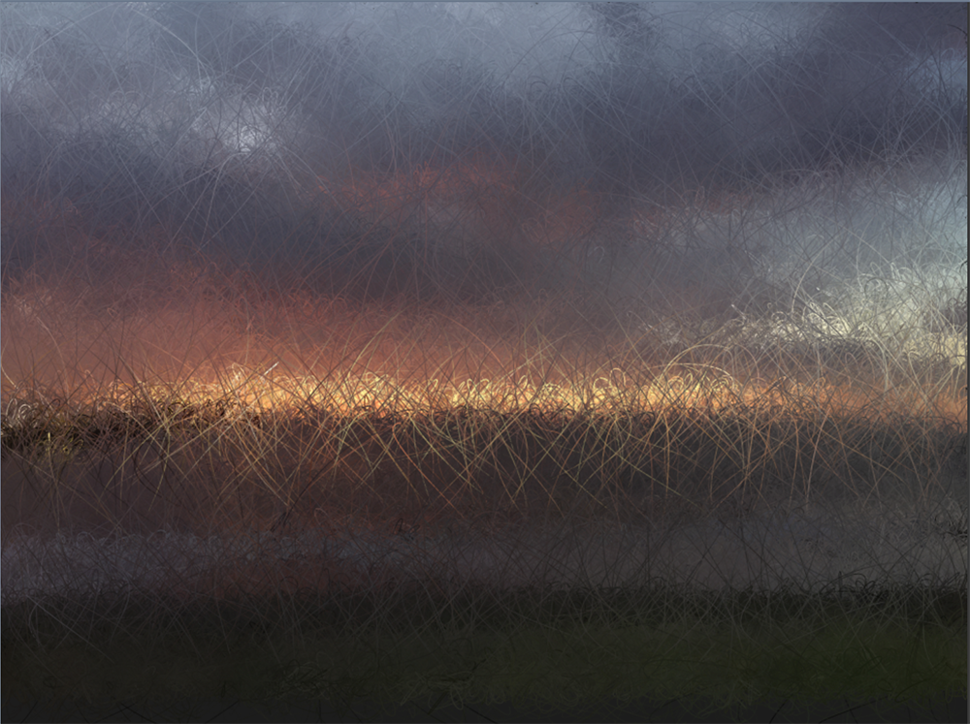
A little bit on learning to make games
Applied Constructionism in Games Curriculum
AND SOME OTHER BITS ALONG THE CONVOLUTED WAY
Andrew Phelps
President, Higher Education Video Game Alliance
Professor of Art & Design, Rochester Institute of Technology
Founder, RIT School of Interactive Games & Media
Founder, RIT MAGIC Center & MAGIC Spell Studios

Slide 2
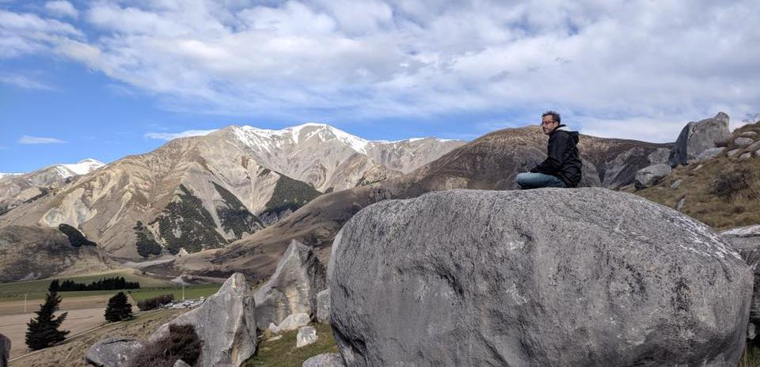
Today’s Talk
A bit about me
A bit of lived experience in building a program, a center, a building, a piece of a field
A bit about some of the games I’ve made
A bit about future directions and research and why
Q&A
Hopefully through all of that, some sense of me, my approach, my values, and relevant practices comes through…

Slide 3
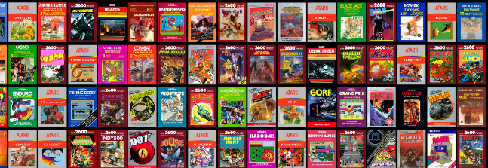
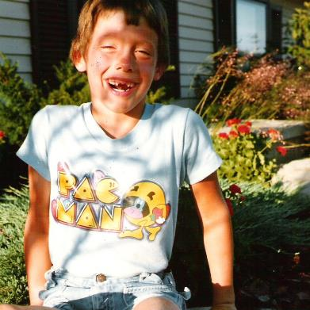
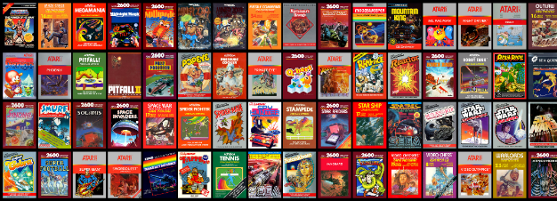
HI, I’m ANDY

Slide 4
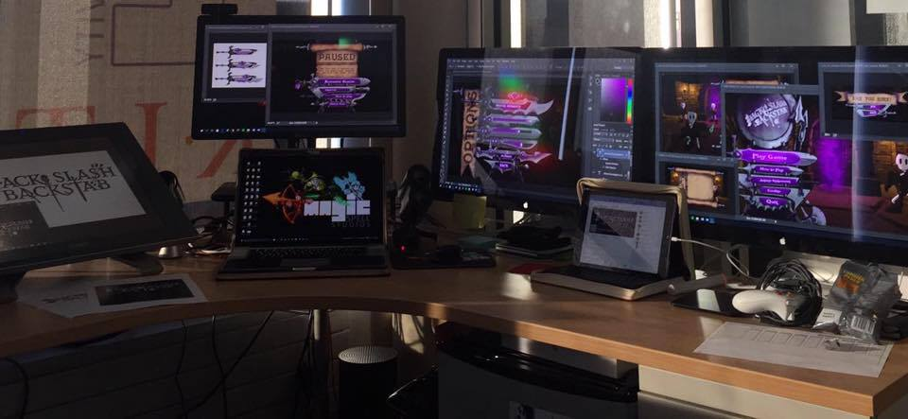
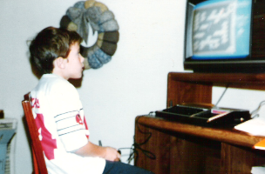
I make things.

Slide 5

Art|dev|EDU|art|ADMIN|dev|art

Slide 6
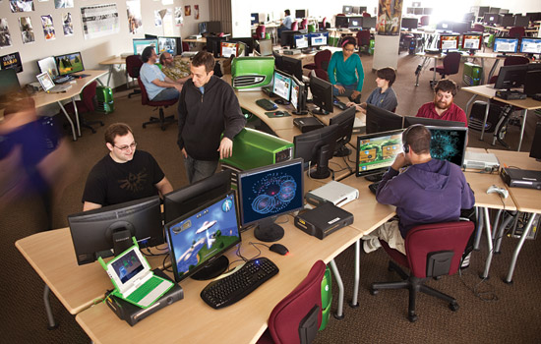
GAME DESIGN & DEVELOPMENT & WHY & HOW
Really, really humble beginnings in 2000 or so
The NYT covered my intro course, and my mom saw it before me
RIT is a very applied, very engineering-oriented place
There was an ongoing culture war around application
I was someone with an art background developing an MS degree in a college of computing and information science (eeeeek)
“A Little Bit Of Everything Goes A Long Way”

Slide 7
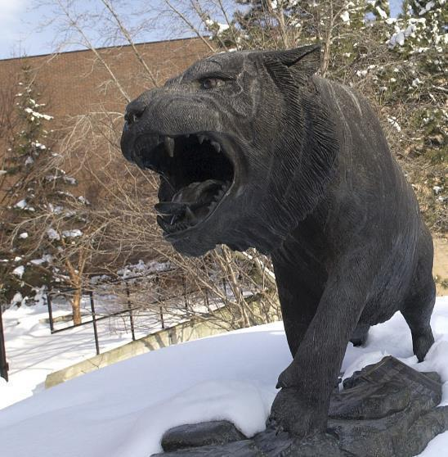
RIT GAMES & INTERACTIVE MEDIA TIMELINES
2001 programming
First course in games programming
2002
Electronic Gaming Society
2003
CS/IT Concentration in Game Prog
2006
MSc Game Design & Development
2007
BSc Game Design & Development
2009
Dept. of Interactive Games & Media
2011
School of Interactive Games & Media
2012
Minor in Game Design
2013
RIT Center for Media, Arts, Games, Interaction & Creativity (MAGIC)
2013
MAGIC Spell Studios ®, LLC
2016
$30M MAGIC Spell Studios Initiative
2016
NY State Games HUB
2017
NY State Games Challenge

Slide 8
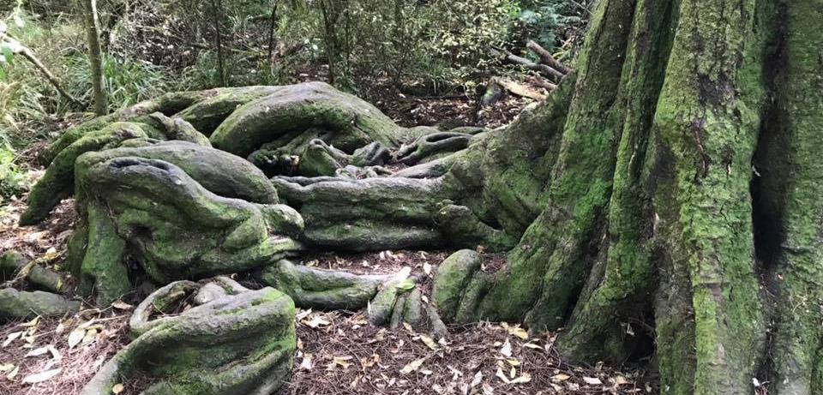
GAME DESIGN & DEVELOPMENT ROOTS
Stories
Mechanics
Rules
Culture
Entertainment/Play
Art
Music
Computing
… [and more]

Slide 9
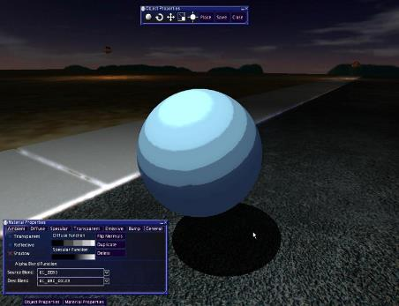
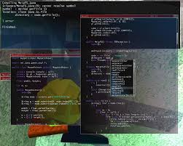
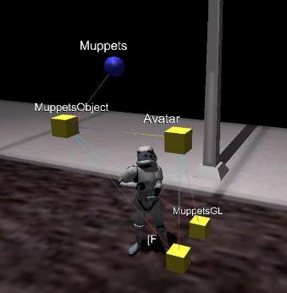
MUPPETS CVE FOR INTRO DEVELOPMENT

Slide 10
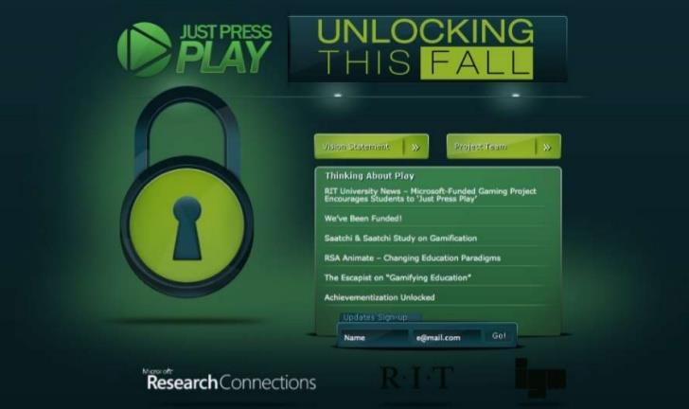

Slide 11
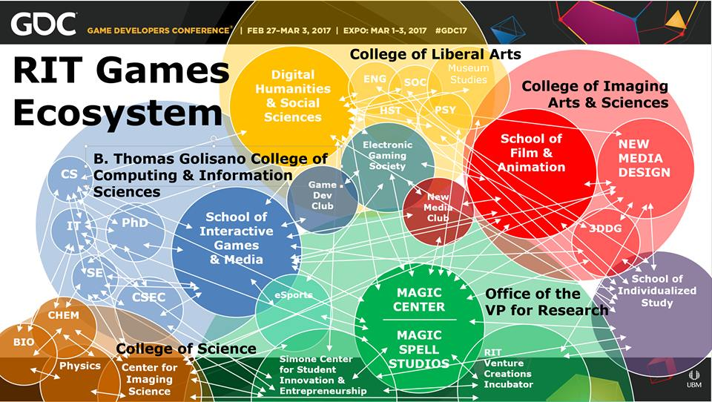

Slide 12


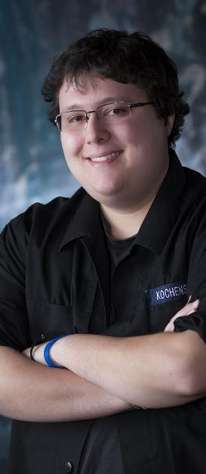


INCREDIBLE ALUMNI
ALEX CUTTING
Senior Assoc. Producer HALO
Microsoft / 343
CLAUDE JEROME
Gameplay Designer DESTINY
Bungie
DUSTIN KOCHENSPARGER
Line Producer DLC
DESTINY
Bungie
SELA DAVIS
Platform Engineer
XBOX / XBOX Live
Microsoft
VReal
ANNA SWEET
Director of 3rd Party Development
STEAM
Valve
Oculus
Caffeine.ty
Microsoft XBOX

Slide 13
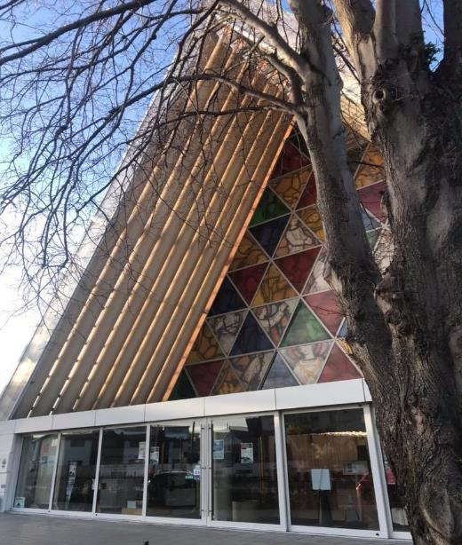
Teaching game production

Slide 14
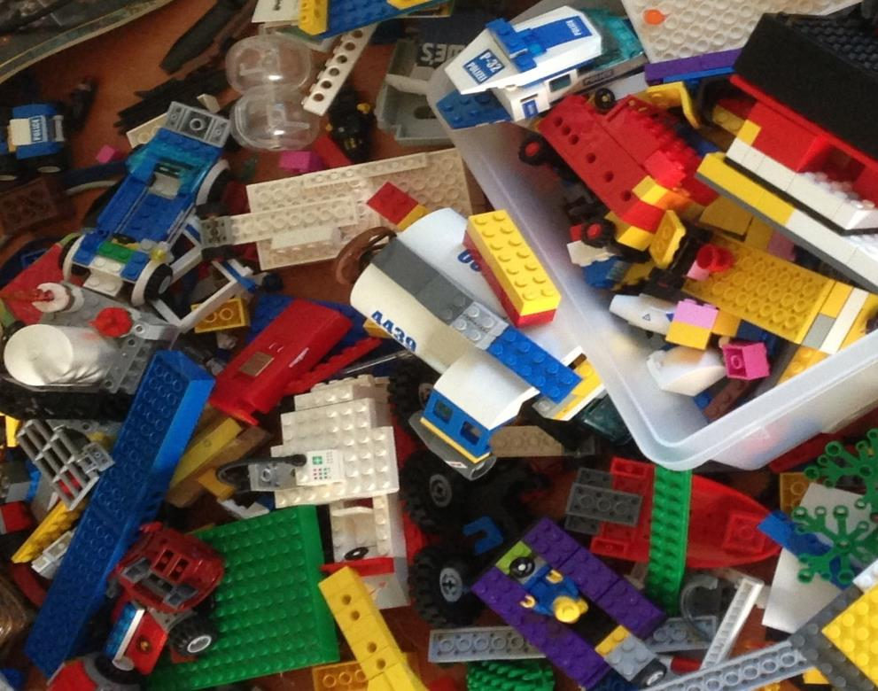
'protecting “making as a
mode of inquiry”’
-Ian Horswill, Northwestern
Notes:
This quote is from Ian Horswill, who said it, I think the first time? sitting on the floor of Microsoft Research at the MSR Faculty Summit a number of years ago. It has been rolling around in the back of my brain ever since – and it was the fundamental thing upon which MAGIC was founded, that somehow design research, making prototypes to test ideas, learning by making new things and new experiences, needed to be recognized and valued. At RIT we’ve sometimes used the rhetoric of STEM and Research to de-value those activities in weird ways.

Slide 15
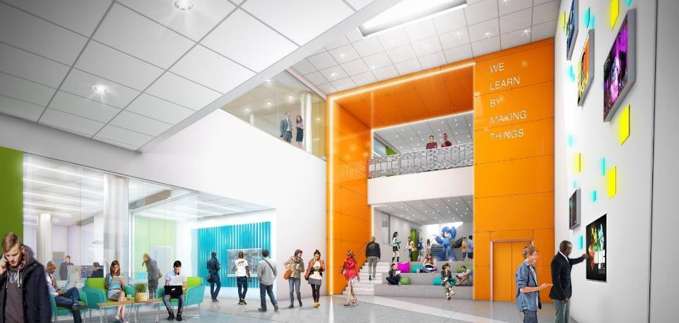
WE LEARN BY MAKING THINGS
Notes:
This is an architectural rendering of the lobby of the new MAGIC Spell Studios building. It will display our tagline ‘We Learn By Making Things’ which is based in part off of Ian’s statement, and reflection that this is a core value of RIT (whether it remembers it all the time or not ;) )

Slide 16
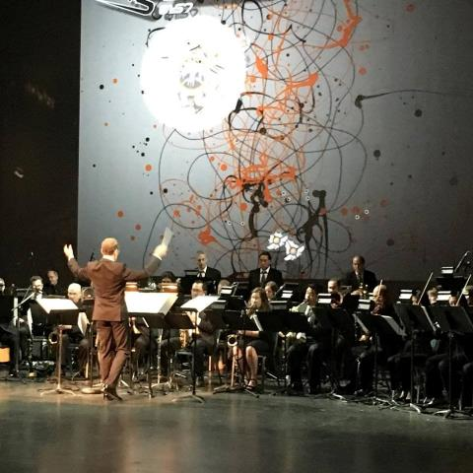
Why IS MAGIC?
C O N V E R G E N C E
C O N V E R G E N C E
The platforms and technology for film, animation, games, media, and story are converging into new forms, new stories, new experiences, and new knowledge.
Notes:
And so we started a multi-disciplinary research center, which is basically the hardest damn thing you can do on a modern college campus. They usually fail by becoming little islands, or by becoming a kind of ‘not really there’ virtual thing, and we’ve run into both of these views as we continue to engage the campus. Nonetheless, we think there is something profound happening in the field right now that is driving the kinds of things we are doing – everything is mashing up on each other. My favorite example of this is the MARVEL extended universe, which is so many different products and experiences rolled together. But there are countless examples big and small. This picture is from the RIT West Coast board meeting where they showed one of my games set to a live orchestra composition directed by Trustee Kevin Surace. Pretty cool.

Slide 17
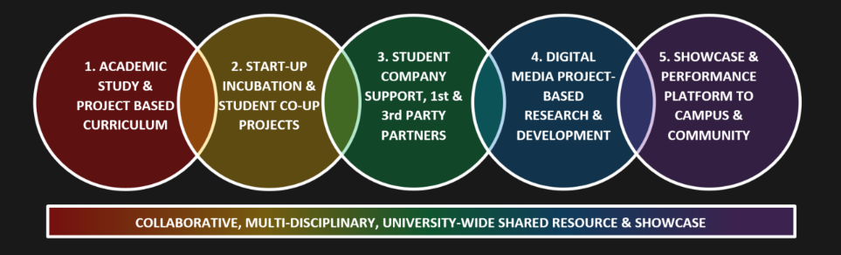
CONVERGENCE OF ANOTHER SORT
Notes:
But there’s another kind of convergence in higher ed right now that has played into MAGIC – this business of bright hard lines between teaching and research, between academic projects, commercial projects, entrepreneurship, technology transfer, etc. is another kind of mashup. The role and purpose of the university is changing in the post-industrial economy, even as it stays true to its roots in the enlightenment (if it can). This idea of little bits of fiefdom for individual programs or little research labs is breaking down because it doesn’t scale, and we’re trying to do something different and profound at MAGIC that links together our work and practice.

Slide 18
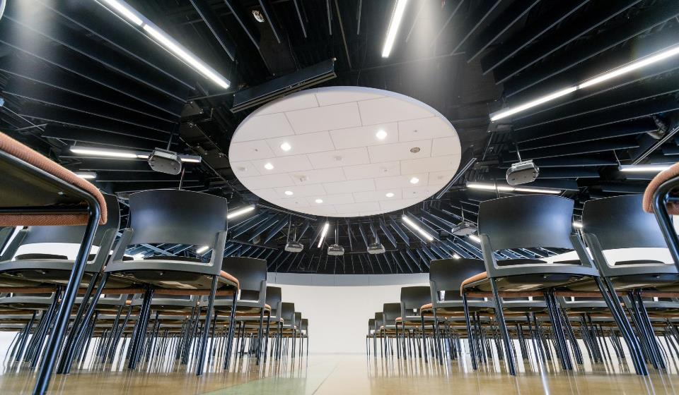


HOW IS MAGIC:
A VERY IMPORTANT DIVISION:
Notes:
Right from Bill’s ‘idea lab’ paper was the idea of an entrepreneurial effort inside the center to help publish and commercialize the things we make. We wanted to call it ‘MAGIC Studios’ at first but we were very afraid we’d get in trouble with The Mouse.

Slide 19
FIVE YEARS, FIVE YEARLY GOALS, FIVE TIMES AT THE PLATE
YEAR 0.5: THE HALF YEAR OF LOGISTICS, MOVING, SET-UP, AND ‘NOT THE INNOVATION CENTER’
YEAR 1: THE YEAR OF THE FACULTY AFFILIATE
YEAR 2: THE YEAR OF THE STUDENT (and extra-curricular activity)
YEAR 3: THE YEAR OF PRODUCTION
YEAR 4: THE ‘A’ IS FOR ARTS
YEAR 5: THE YEAR OF THE STUDIO
…PIVOT…
Notes:
Every year, we’ve tried to start with a theme or goal. We focused really hard that first year on faculty affiliates, trying to figure out the processes and supports they would need to build things here, to attract and manage funding, etc. We appointed 2 associate directors to try to (a) work with faculty on proposals and funding opportunities and (b) go out and attract interest from businesses and foundations and partners to connect these to.
This mostly DID NOT WORK. In hindsight, we were asking faculty to do more and greater scholarship at exactly the wrong time – we had just ‘gone live’ with semesters, and there were some other constraints and messaging that just didn’t work out very well. More on that later. So in year 2 we took a hard left turn and re-imagined the center not just as a research center, but as a student-centered support organization for publishing and digital making. This was always ‘a part of the plan’ but the degree to which we emphasized this in year two, and the focus on student productions at that time was a decided departure from where we thought we were going in year one.
In year 3 we wanted to really challenge what we could do, what production looked like, and what scale looked like.
In year 4 we wanted to really focus on not-just-games but start to drive forward a focus on the arts and creativity in other forms and examples.
And now we are living the year of the studio. Vroom vroom.

Slide 20
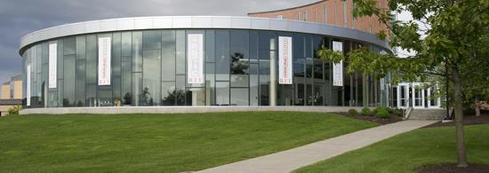
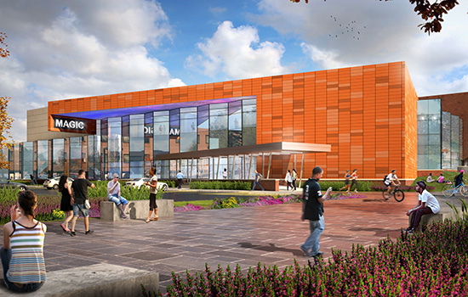
MAGIC TODAY & TOMORROW
Notes:
So let’s take a little look at where we are today, in our current home, what we’ve built, where we are going.

Slide 21
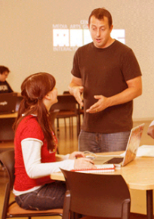
HOW IS MAGIC:
Several programs from a variety of funding sources:
  Co-UP (with Simone Center, i-Core NSF, RIT BoT, etc.)
  Funded research & development in digital media
  MAGIC academic projects (games, apps, others), and commercial projects (games, apps, others)
  Annual Speaker Series, hackathon series, cre8-a-thons
  Several “initiatives” that operate as mini-centers or labs inside MAGIC including FOSS, RC&P, Frameless labs, LSC, etc.
  Large grant designation from ESD as a ‘NY Games Center” along with RPI and NYU + NYS Game Dev Challenge
  Commercial studio projects and client engagement
  Publication of student work and entrepreneurial efforts
  NYS ESD Affiliated Public-Private partnership with MAGIC Spell Studios facility and associated economic development effort
Notes:
We have established a lot of stuff, grown a ton, and things have gotten very intricate. But it is also kind of STRANGE in the way it’s all come together, it isn’t the model of a typical anything – it’s a bizarre mix, and it just IS NOT LIKE anything else on campus. And that’s OK.

Slide 22
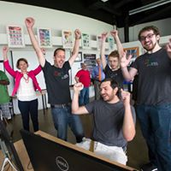
That has meant a lot of work with the Office of the President, the Office of the Provost, Government and Community Relations, Development and Alumni Relations, Information Technology Services, Facilities Management Services, and the Office of the Vice President for Research. We would not be celebrating today without the support of these offices and divisions, as well as the more generalized support of numerous academic units and partners.
Notes:
For as much as I worked with these groups as a department chair, it is WAY more important the way we work with them now for both our success and institutional success.

Slide 23
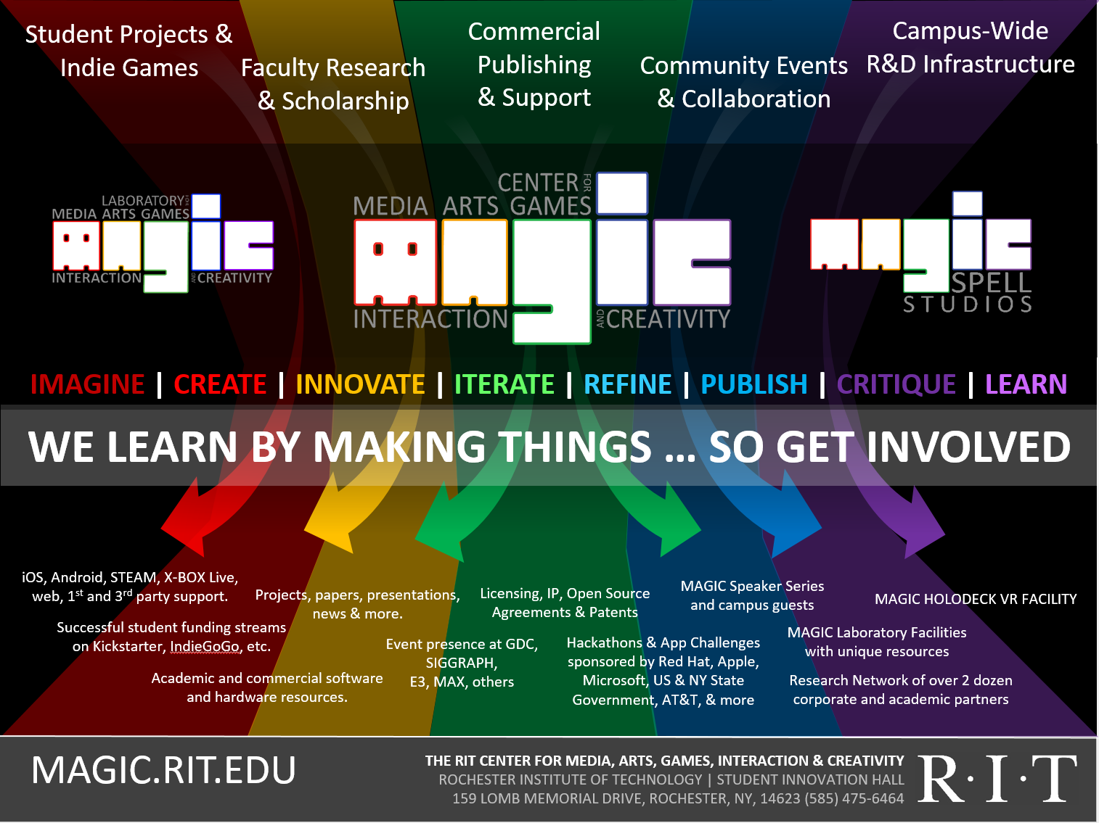




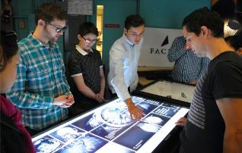
Notes:
It’s messy. It’s really messy. We do a lot of stuff but a lot of stuff is different every time because we’re changing, the projects are changing, the world is changing.

Slide 24

…The M is for Messy
Notes:
The M is for Messy.

Slide 25
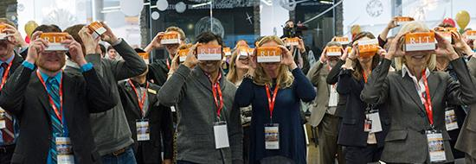
A BIT ABOUT THE GAMES…
Notes:
Here’s a couple of projects that have meant something significatn

Slide 26
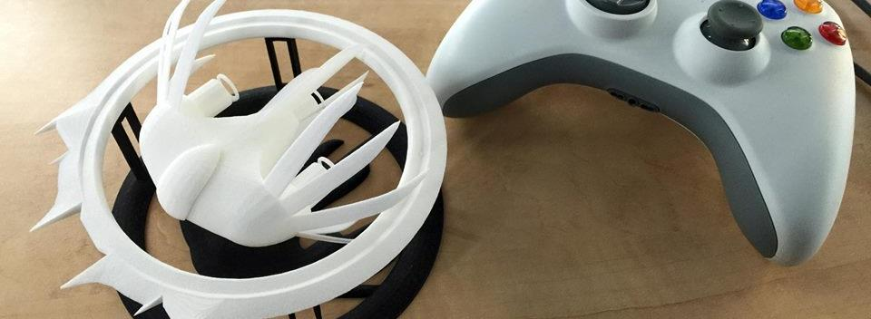

A Strange Game for Strange Reasons
This game taught us (the campus) about making things, production, and scale
This game allowed us to explore using typical game forms for telling a unique story to a very targeted audience
Finalist at GLS Education Arcade, accepted to DiGRA Blank Arcade, and IndieArcade at the Smithsonian American Museum of Art
SPLATTERSHMUP.RIT.EDU – PLAY TODAY! MAKE ART!

Slide 27

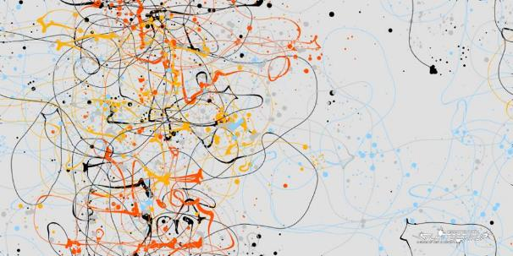
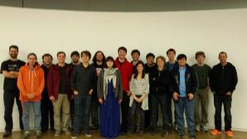
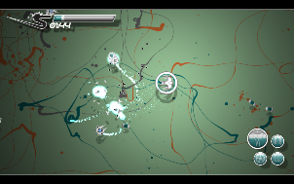
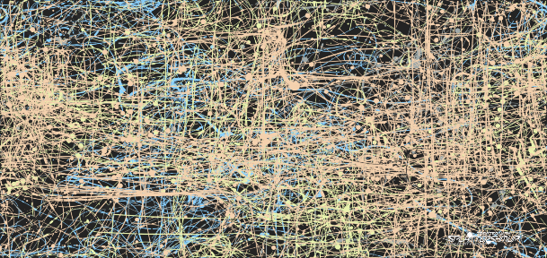
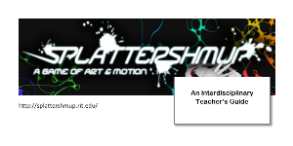



Slide 28
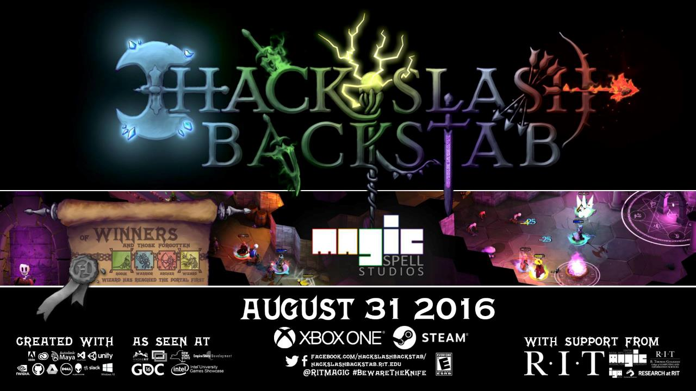

Slide 29

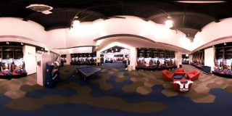

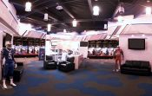
A SUMMER WITH THE
BUFFALO BILLS
Notes:
A big high-vis project that was (a) external client through the studio, (b) multi-disciplinary team, (c) primarily managed entirely by staff

Slide 30
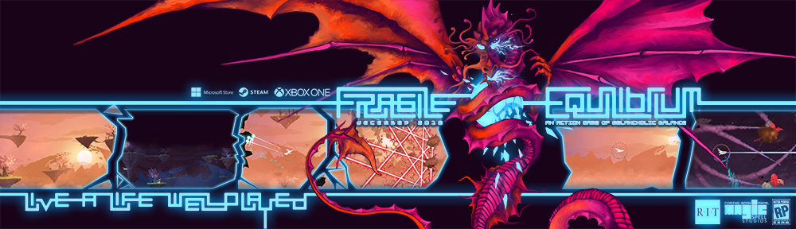
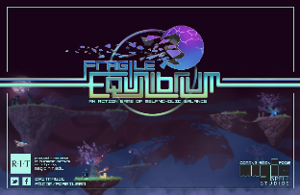
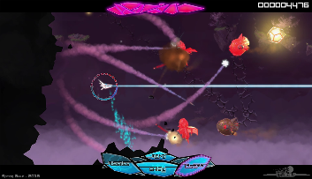
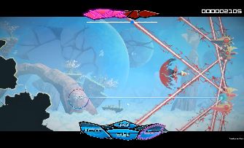
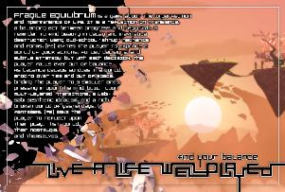

Slide 31
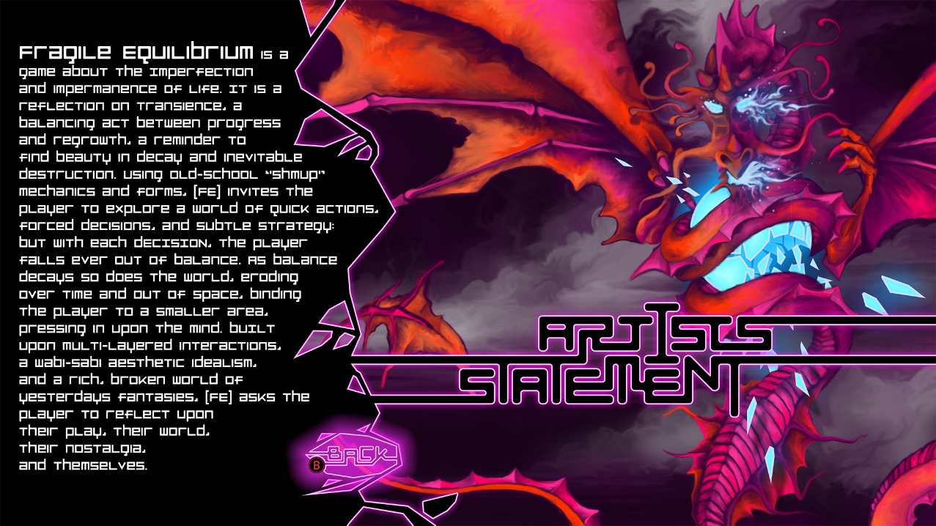

Slide 32
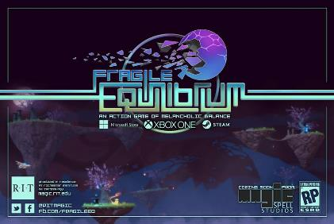
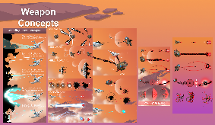
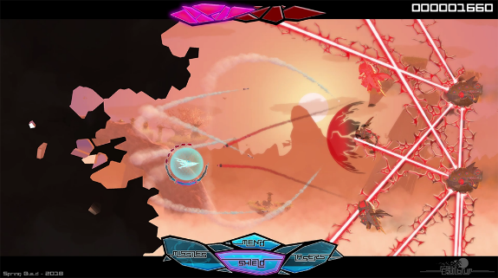
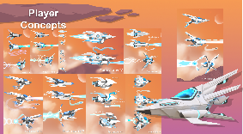
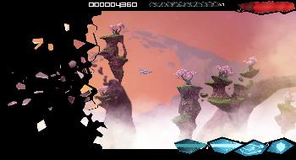
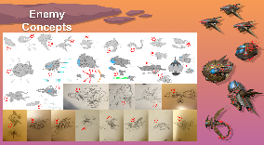





IN GAME UI, DESIGN, GAMEPLAY, ETC.

Slide 33






OUT OF GAME UI/UX and MENUFLOW

Slide 34





COMMUNICATIONS INFRASTRUCTURE

Slide 35




































5 YEARS OF LEARNING THROUGH MAKING AT MAGIC. 5 YEARS OF PROJECTS & MEDIA.
Notes:
So I highlight those 3 because of the things we learned and as data points of growth, but the thing is we did a LOT of stuff from a LOT of work for a LOT of people! It’s a lot bigger a community than people even think about. It’s easy when you are working on ‘your thing’ to not realize the scope and scale of everything else that’s happening and going on.

Slide 36

WHAT BIG PROBLEMS WERE WE TRYING TO SOLVE?
COMMUNICATION – Things get “Lost in Translation” between UI/UX, art, design, dev/engineering, QA…
FORMAL and INFORMAL LEARNING – Not just skills but skills applied to complex practice, situated learning in context. “learn by making things”
CULTURAL DEV & CAPABILITY – Where do games come? What is a repeatable design process? How do studios work? Maturity & Palette?
ACADEMIC IMMERSION – creating a shared space between computing and the arts, between research and practice…

Slide 37


CORE DESIGN PRINCIPLE
NO SPACE SHOULD BE USED FOR ONLY ONE THING, OR BY ONLY ONE CONSTITUENCY: OUR COMMITMENT TO MULTI-DISCIPLINARY AND CROSS-DISCIPLINARY WORK SHOULD EXTEND TO THE PHYSICAL BUILDING DESIGN, TECHNOLOGY SELECTION, ADMINISTRATION AND OPERATIONS, CULTURE & COMMUNITY.
WE WERE TRYING FOR A PARTICLE ACCELERATOR FOR THE HAPPY ACCIDENT.
(AND MODEL FOR OUR STUDENTS HOW COLLABORATION AND TEAMS FUNCTION)

Slide 38

02/09/2018 Student-made game to be presented at Game Developers Conference
01/26/2018 Emerging 3D-printing applications at RIT
01/11/2018 Top RIT News stories and videos for 2017
01/03/2018 RIT to host statewide Game Dev Challenge kick-off event Jan. 19
01/03/2018 Top RIT News stories for December 2017
12/13/2017 Learn more about RIT’s entrepreneurial ecosystem, leadership in cybersecurity, and donor Austin McChord
12/11/2017 RIT professor launches table-top games to enhance people’s understanding of religion
12/07/2017 Creating a Holo-Assistant with Chirag Kular
11/28/2017 RIT’s Andrew Phelps named president of Higher Education Video Game Alliance
11/02/2017 Student uses technology to help humanitarian causes at UNICEF International
10/16/2017 Rochester Philharmonic Orchestra partners with RIT’s MAGIC Spell Studios, The Strong for ‘Heroes: A Video Game Symphony’ performance Oct. 26
10/03/2017 Top RIT News stories and videos for September 2017
09/25/2017 RIT MAGIC Center co-sponsors game festival at Irondequoit Public Library
09/20/2017 RIT staffer, alumni win big at Digital Rochester GREAT Awards
09/14/2017 Filmmaker Cailleah Scott-Grimes brings her award-winning documentary to RIT Sept. 21
09/11/2017 RIT’s brightest experts to highlight Light and Sound Interactive Sept. 12–14
09/07/2017 RIT helps create virtual reality ‘MAGIC’ for Buffalo Bills
08/18/2017 Summertime, and the students were busy (and in business)
08/02/2017 International conference on Japanese video game industry comes to Rochester Aug. 21–23
07/10/2017 RIT names Adrienne Decker as Fram Faculty Fellow in Applied Critical Thinking
05/23/2017 Staff Spotlight: Robert Mostyn
05/12/2017 New nine-credit general education immersion course is a first for RIT
05/09/2017 RIT MAGIC Center announces winners of statewide Game Development Challenge
05/04/2017 RIT ranked No. 1 game design school on the East Coast
05/03/2017 RIT featured among ‘Colleges That Create Futures’
04/25/2017 RIT is local site for 2017 International NASA Space Apps Challenge, April 29–30
04/25/2017 RIT’s MAGIC speaker series wraps up 2016-2017 season on April 26
03/21/2017 RIT’s video game design programs jump in Princeton Review rankings
03/09/2017 RIT to host statewide Game Dev Challenge kickoff March 10
03/03/2017 RIT student-created game competes in 2017 Intel University Games Showcase
03/01/2017 RIT student John Miller hopes to make an impact at national gaming conference
02/20/2017 RIT students, faculty head to California for annual Game Developers Conference
12/19/2016 RIT professor awarded NEH grant to enhance religious literacy through gaming
12/12/2016 RIT professor awarded NSF grant to benefit the next generation of games and learning scholars
12/09/2016 MAGIC Spell Studios celebrates official launch
12/01/2016 Top RIT News stories and videos for November 2016
11/15/2016 RIT officially launches MAGIC Spell Studios, aimed at convergence of digital media disciplines
11/10/2016 Local video game developers, entrepreneurs will speak on campus Nov. 14
11/01/2016 Rochester Philharmonic Orchestra partners with RIT, MAGIC Spell Studios for ‘Legend of Zelda’ performance Nov. 11
09/15/2016 Card game created by RIT students now licensed by Hasbro
09/12/2016 RIT’s MAGIC speaker series kicks off 2016-2017 season on Sept. 16
08/29/2016 RIT to become first university to publish video game on Xbox One platform
05/09/2017 RIT MAGIC Center announces winners of statewide Game Development Challenge
05/04/2017 RIT ranked No. 1 game design school on the East Coast
05/03/2017 RIT featured among ‘Colleges That Create Futures’
04/25/2017 RIT is local site for 2017 International NASA Space Apps Challenge, April 29–30
04/25/2017 RIT’s MAGIC speaker series wraps up 2016-2017 season on April 26
03/21/2017 RIT’s video game design programs jump in Princeton Review rankings
03/09/2017 RIT to host statewide Game Dev Challenge kickoff March 10
03/03/2017 RIT student-created game competes in 2017 Intel University Games Showcase
03/01/2017 RIT student John Miller hopes to make an impact at national gaming conference
02/20/2017 RIT students, faculty head to California for annual Game Developers Conference
12/19/2016 RIT professor awarded NEH grant to enhance religious literacy through gaming
12/12/2016 RIT professor awarded NSF grant to benefit the next generation of games and learning scholars
12/09/2016 MAGIC Spell Studios celebrates official launch
12/01/2016 Top RIT News stories and videos for November 2016
11/15/2016 RIT officially launches MAGIC Spell Studios, aimed at convergence of digital media disciplines
11/10/2016 Local video game developers, entrepreneurs will speak on campus Nov. 14
11/01/2016 Rochester Philharmonic Orchestra partners with RIT, MAGIC Spell Studios for ‘Legend of Zelda’ performance Nov. 11
09/15/2016 Card game created by RIT students now licensed by Hasbro
09/12/2016 RIT’s MAGIC speaker series kicks off 2016-2017 season on Sept. 16
08/29/2016 RIT to become first university to publish video game on Xbox One platform
08/26/2016 Top RIT News stories and videos from summer 2016
08/17/2016 MAGIC’s trustee-funded Co-Up program wraps up with second successful year
08/17/2016 An Innovation Ecosystem
08/02/2016 We’ve Got the Next Big Idea
06/17/2016 RIT’s Dan Schneiderman represents New York state at White House ‘makers’ event
04/29/2016 Imagine RIT exhibit allows visitors to ‘delve into dungeons’
04/27/2016 Three video games with ties to RIT featured at PAX East Indie showcase
04/21/2016 RIT is local site for 2016 International NASA Space Apps Challenge, April 23–24
04/07/2016 2016 Imagine RIT set for May 7
03/18/2016 RIT takes third place in Best Visual Quality in 2016 Intel University Games Showcase
03/17/2016 RIT’s MAGIC Spell Studios joins forces with virtual reality giant, videogame developer Crytek
03/15/2016 RIT student earns Intel Award for female, underrepresented game design students at international Game Developers Conference
03/15/2016 Princeton Review Ranks RIT as a top video-game design school
03/14/2016 RIT students, faculty head to California for annual Game Developers Conference
02/22/2016 RIT hosts all-women hackathon Feb. 27 and 28
02/15/2016 RIT MAGIC Center kicks off spring speaker series with privacy expert Feb. 18
02/04/2016 Electronic Gaming Society president prepares for Fusion Fest 2016
02/03/2016 Gaming for good: RIT gamers host LAN party to support Cancer Wellness Connections, Feb. 5-6
01/26/2016 RIT named one of three Digital Gaming Hubs in New York state
01/14/2016 MAGIC Spell Studios video game to be displayed at Smithsonian ‘pop-up’ arcade Jan. 16
12/11/2015 RIT to host second annual Congressional App Challenge kick-off event Dec. 12
12/10/2015 MAGIC virtual reality lab will serve as a one-stop shop for interface development, enhancing user experience
11/20/2015 Merging art history with digital gaming
11/04/2015 RIT students vying for Hasbro top prize
10/29/2015 RIT MAGIC Center director briefs Congressional members on U.S. video game industry
10/16/2015 Noted jazz biographer to talk on former Rochesterian Pepper Adams
10/13/2015 RIT’s Center for MAGIC welcomes social-media etiquette expert Oct. 22
09/23/2015 Plans for RIT’s new film industry-standard sound stage begin to come into focus
08/26/2015 Top RIT News stories from the summer
08/14/2015 Co-op gets the MAGIC touch
08/14/2015 RIT announces investments in MAGIC Spell Studios, aimed at spurring growth of local digital media industry
07/22/2015 RIT’s Center for MAGIC develops new initiative to encourage student humanitarian work through technology
07/20/2015 Free and open source software culture at RIT continues to grow
07/09/2015 RIT announces investments in MAGIC Spell Studios, aimed at spurring growth of local digital media industry
06/19/2015 RIT recognized for public relations work at 2015 PRism Awards
06/15/2015 RIT selected to host New Media Consortium in June 2016
06/03/2015 Adobe sponsors new media senior projects for student designers and developers
05/21/2015 RIT center continues to make ‘MAGIC’
04/30/2015 RIT students create video game to help children learn to read
04/24/2015 RIT students take top prize in Microsoft’s U.S. Imagine Cup National Finals
04/14/2015 MAGIC Speaker Series welcomes three speakers in April to discuss digital culture
04/03/2015 The Harmonica and the Blues
04/03/2015 Student-created video game selected for international exhibit
03/24/2015 RIT’s video game design programs jump in Princeton Review rankings
03/17/2015 RIT gamers support Cancer Wellness Connections through LAN party March 20
03/06/2015 RIT students take top award in Intel University Games Showcase
03/04/2015 Class of RIT students develop and publish Splattershmup video game
03/03/2015 Top RIT News stories and videos for February 2015
03/02/2015 RIT students California-bound for Game Developers Conference
02/12/2015 RIT MAGIC Center publishes student video game on Steam for the first time
02/03/2015 Top RIT News stories and videos for January 2015
02/02/2015 MAGIC Speaker Series looks to spark ideas about digital culture at RIT
01/07/2015 Top RIT News stories and videos for 2014
01/07/2015 Top RIT News stories and videos for December 2014
12/17/2014 RIT featured in Google’s Year in Search 2014 video
12/16/2014 Jewish Play Project explores relationship between Jewish creators and the play industries
12/11/2014 RIT project wins funding in NYS Regional Economic Development Councils competition
12/01/2014 Top RIT News stories and videos for November 2014
11/18/2014 Girl Develop It aims to bridge gender gap in tech fields
11/18/2014 The science behind 3D-printed prostheses
11/18/2014 A new hand for Lucas
11/11/2014 MAGIC Speaker Series looks to spark ideas about digital culture at RIT
10/02/2014 Top RIT News stories and videos for September 2014
09/29/2014 RIT takes part in national conference devoted to inexpensive 3D-printed prosthetic devices
09/22/2014 National conference to focus on work begun at RIT
09/16/2014 RIT hosts 2014 Software Freedom Day Rochester Sept. 20–21
08/05/2014 Hackathons help students get jobs, make a difference
07/28/2014 U.S. Assistant Secretary of Commerce tours RIT to review federal investments
07/08/2014 RIT students study abroad to explore video game industry in Germany
07/01/2014 RIT joins top game design programs in founding Higher Education Video Game Alliance
06/23/2014 RIT professor receives Fulbright Grant to develop game design minor in Croatia
05/26/2014 RIT receives $300,000 NSF Innovation Corps Sites grant to advance commercialization
05/14/2014 RIT students, alumni and staff among winners of 2014 AT&T Rochester Civic App Challenge
04/25/2014 Adobe Vice President of Experience Design and Creativity to attend Imagine RIT May 3
04/03/2014 App contest encourages community involvement
04/01/2014 Top RIT News Stories and Videos for March 2014
03/17/2014 MAGIC Speaker Series explores individual privacy on social networks March 19
03/14/2014 Unconference for Rochester area K-12 educators looks to discuss digital media in education
03/11/2014 Princeton Review Ranks RIT as a top video-game design school
03/06/2014 RIT launches nation’s first minor in free and open source software and free culture
02/24/2014 Online community of makers creates and improves 3D printed prosthetics for those in need
02/20/2014 Announcing the AT&T Rochester Civic App Challenge
02/13/2014 Developer ‘breaks the chains’ of traditional video games
01/28/2014 RIT MAGIC Center explores digital media with two speakers Feb. 10 and 12
01/23/2014 RIT/NTID students accepted into high-tech business accelerator
12/05/2013 New treatment helps autistic children navigate the world
12/04/2013 MAGIC Speaker Series looks to spark ideas about digital culture at RIT
11/20/2013 RIT professor earns more than $11,000 in Kickstarter for multi-player video game
11/14/2013 RIT ‘Celebration of Research’ set for Nov. 19
11/07/2013 RIT digital humanities series brings author, Internet freedom advocate to campus Nov. 11
10/16/2013 State Senate committee discussing ways to grow video game development industry
10/10/2013 RIT’s ‘MAGIC’ Center
07/22/2013 New digital media research center makes MAGIC
07/11/2013 ‘Sky Time’ video game selected for White House Champions of Change event July 23
06/20/2013 Q&A with game designers John and Brenda Romero June 28 at RIT
04/22/2013 Two RIT teams head to International NASA Space Apps Challenge
04/08/2013 RIT hosts talk with active learning expert and author Walter Bender April 17
03/28/2013 Red Hat donates to RIT’s MAGIC Center for open source software education program
02/15/2013 RIT launches new research center dedicated to digital media
Notes:
And we’ve worked really hard on telling our own story, over and over, better and better… this is just university press. We’ve also done social media, pictorials, just about every campus publication there is, regional press and television, and a couple of national news stories in Inside Higher Ed, the Chronicle, and a few others.

Slide 39

RILEY & Make a wish FOUNDATION
Notes:
Meet Riley. And also, here’s a thing a research center is doing that has nothing to do with research, and has everything to do with impact.

Slide 40

Artech CRE8-A-THON: CHANGING JAM CULTURE
Notes:
This is Dan at the Ar-Tech Cre-8-athon, a hackathon we did that extended between digital and physical, between open source computing and art. We gave away some ridiculously silly prizes, but what we really wanted was to help change the culture of ‘who goes to a hackathon and what are they for’ and get two different communities of practice together

Slide 41

Future work and IDEAS

Slide 42

RETHINKING APPRENTICESHIP ?

Slide 43

NICE SHEEP
Game industry studies
  Co-creativity (John Banks)
  Game talk (Casey O’Donnell)
Live streaming gameplay
  Broadcasting play (TL Taylor)
  Hamilton W. A., Garretson O., & Kerne A. (2014, April 26–May 1). Streaming on Twitch: Fostering Participatory Communities of Play within Live Mixed Media. In Proceedings of the SIGCHI Conference on Human Factors in Computing Systems (CHI ’14). New York, NY, USA.

Slide 44

A tale of two Adams
Adam (programmer making Bot Land)
Chluaid (artist on BrackenSack: A Dashkin Game) (and also named Adam IRL)

Slide 45
A Tale Of Two Adams
“coder adam”
Talk aloud protocol
Careful attention to chat
Lots of questions & advice to/from other developers
Streams as a commitment to practice
Small community, not about audience per se
“artist adam”
A kind of ‘visual stepwise process’
Specifically wanted less feedback
Streams as a commitment to practice
Small community, not about audience per se
Cultivation of community for visibility / connections

Slide 46

DEVELOPMENT Streaming…
A commitment to practice and function?
Less about audience, more about community (maybe?)
A scalable platform for observation, practice and critique?
A form of bi-directional apprenticeship?
A dialog platform for learning communities?
A potentially scaffolded environment?
A quest for authenticity and role models?

Slide 47
Consalvo, M., & Phelps, A. (2019). Performing game development live on Twitch. Presented at the Hawaii International Conference on Systems Science, Maui, HI. Preliminary work presented at AOIR 2018.
Phelps, A., & Consalvo, M. (2018) “Live streaming game design & development: A glimpse behind the mystic curtain with pedagogical possibilities” at The InterPLAY of Game Studies and Game Design, 2018 NCA Preconference, University of Utah. S Orme, University of Suffolk. National Communication Association 104th Annual Conference, Salt Lake City, Utah.
Phelps, A., Consalvo, M., and Egerct, C. (2018) Development Streaming as a Pedagogical and Community
Strategy for Games Education. Workshop on New Research Perspectives on Game Design & Development Education. CHI PLAY 2018, October 28, 2018, Melbourne, Australia.
Decker, A., Egert. C, and Phelps, A. (2018) "Learning to Create or Creating to Learn" International Academic Conference on Meaningful Play, October 11, 2018 East Lansing, Michigan.
Phelps, A., C. Egert and A. Decker. (2018) "Splattershmup: A Game of Art & Motion". Learning in Games Book 3. Ed. K. Schrier. ETC Press, Carnegie Mellon University. (in press, forthcoming)
Decker, A. C. Egert, A. Phelps, (2017) “Trial by a Many-Colored Flame: A Multi-disciplinary, Community-Centric
Approach to Digital Media and Computing Education”, in New Directions for Computing Education
(S. Fee, et al, ed.), pp. 237-257. Springer International Publishing, Cham, Switzerland. 2017.

Slide 48

WHILE ON SABBATICAL
A RECOMMITTMENT TO DAILY PROCESS, NOT UNLIKE STREAMING (WHICH I AM THINKING ABOUT…)
CURRENTLY EXPLORING MOVING HUNDREDS OF IMAGES INTO VR AND AR, AND WHAT THAT LOOKS LIKE IN COMPARISON TO TRADITIONAL PUBLIC GALLERY & EXHIBITION SPACES

Slide 49

ANDYWORLD.IO | PROFESSORANDREWPHELPS.NET | @RITIGM1 | ANDY@MAIL.RIT.EDU

Slide 50

Thanks & Questions
andy@mail.rit.edu | andyworld.io| @ritigm1

