Slide 1



Slide 2
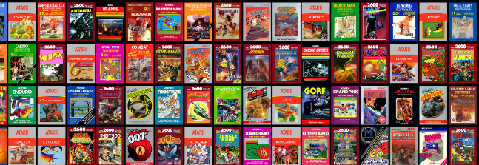
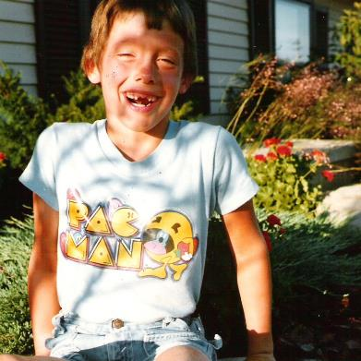
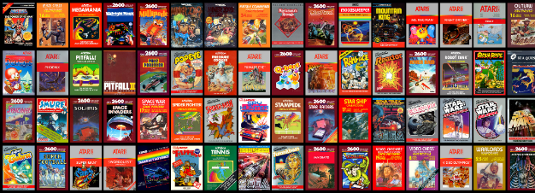
I’m ANDY & I GREW UP A GAMER

Slide 3
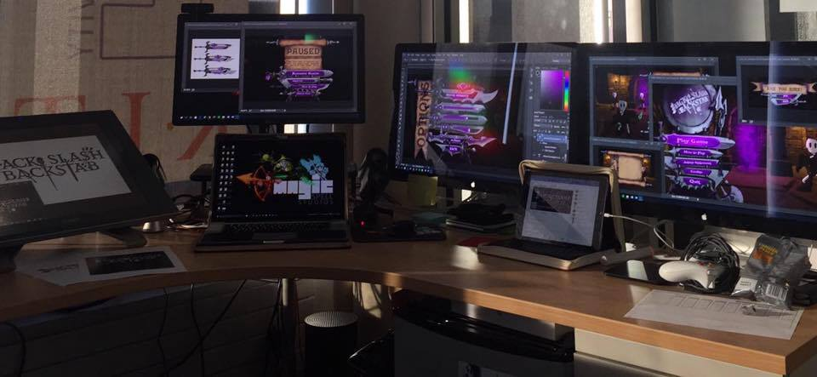
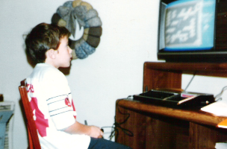
I make things.

Slide 4
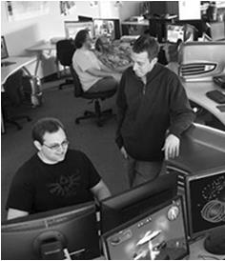
LUCKY TO HAVE MADE THINGS AT RIT
FIRST graduate course in games at RIT (2001-2002!)
Undergraduate course and later concentration in game design and technology
Degree programs in game design & development (bachelors and masters)
Dept / School of Interactive Games and Media
Research & Scholarship practices for Game Design & Development
The MAGIC Center & MAGIC Spell Studios
University game shipped on XBOX One
Higher Education Video Game Alliance
NY State Games HUB
New MAGIC Spell Studios campus facility (fall 2018)

Slide 5
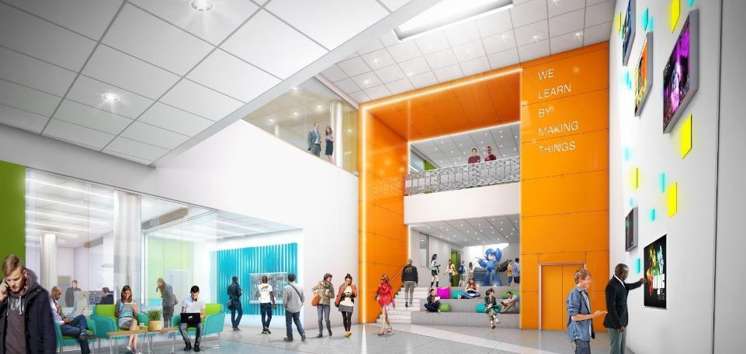
WE LEARN BY MAKING THINGS

Slide 6
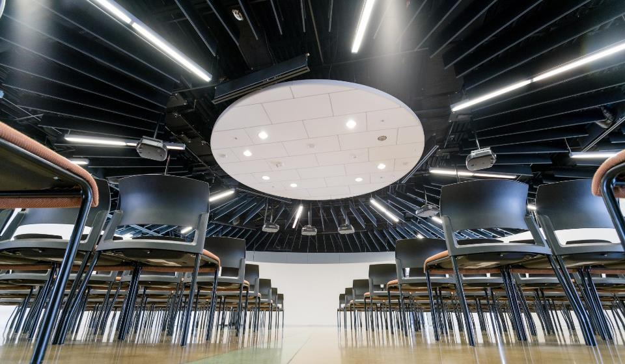


HOW IS MAGIC:
A VERY IMPORTANT DIVISION:

Slide 7
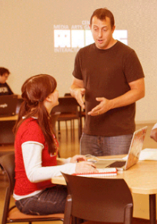
HOW IS MAGIC:
Several programs from a variety of funding sources:
  Co-UP (with Simone Center, i-Core NSF, RIT BoT, etc.)
  Funded research & development in digital media
  MAGIC academic projects (games, apps, others), and commercial projects (games, apps, others)
  Annual Speaker Series, hackathon series, cre8-a-thons
  Several “initiatives” that operate as mini-centers or labs inside MAGIC including FOSS, RC&P, Frameless labs, LSC, etc.
  Large grant designation from ESD as a ‘NY Games Center” along with RPI and NYU + NYS Game Dev Challenge
  Commercial studio projects and client engagement
  Publication of student work and entrepreneurial efforts
  NYS ESD Affiliated Public-Private partnership with MAGIC Spell Studios facility and associated economic development effort

Slide 8
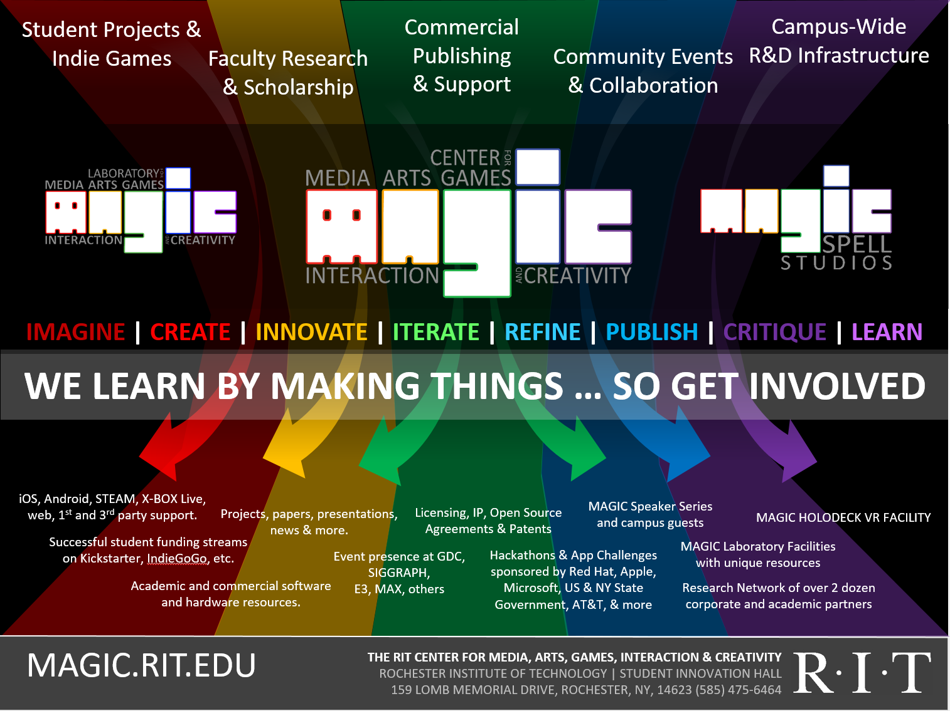




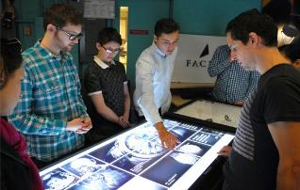

Slide 9

…The M is for Messy

Slide 10
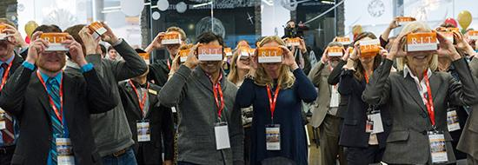
a bit MORE about Our WORK

Slide 11
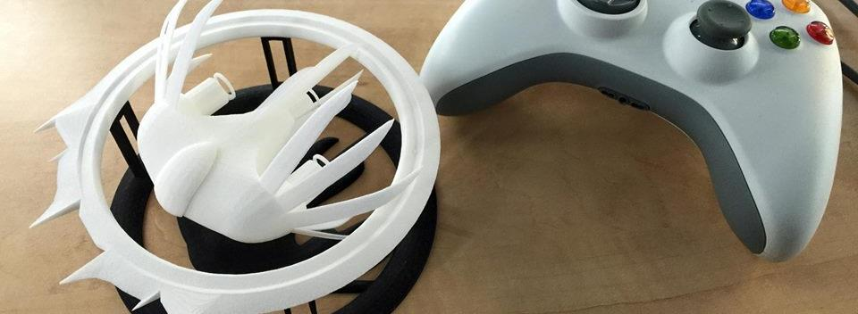

A Strange Game for Strange Reasons
This game taught us (the campus) about making things, production, and scale
This game allowed us to explore using typical game forms for telling a unique story to a very targeted audience
Finalist at GLS Education Arcade, accepted to DiGRA Blank Arcade, and IndieArcade at the Smithsonian American Museum of Art
SPLATTERSHMUP.RIT.EDU – PLAY TODAY! MAKE ART!

Slide 12

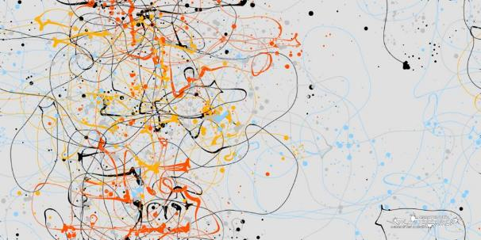
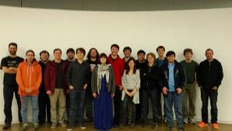
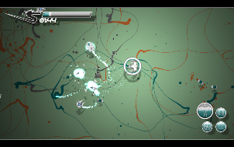
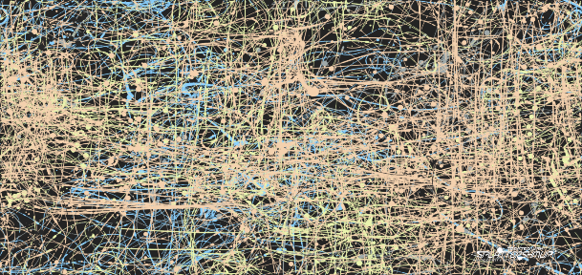
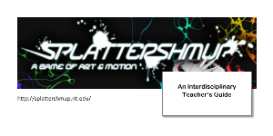



Slide 13
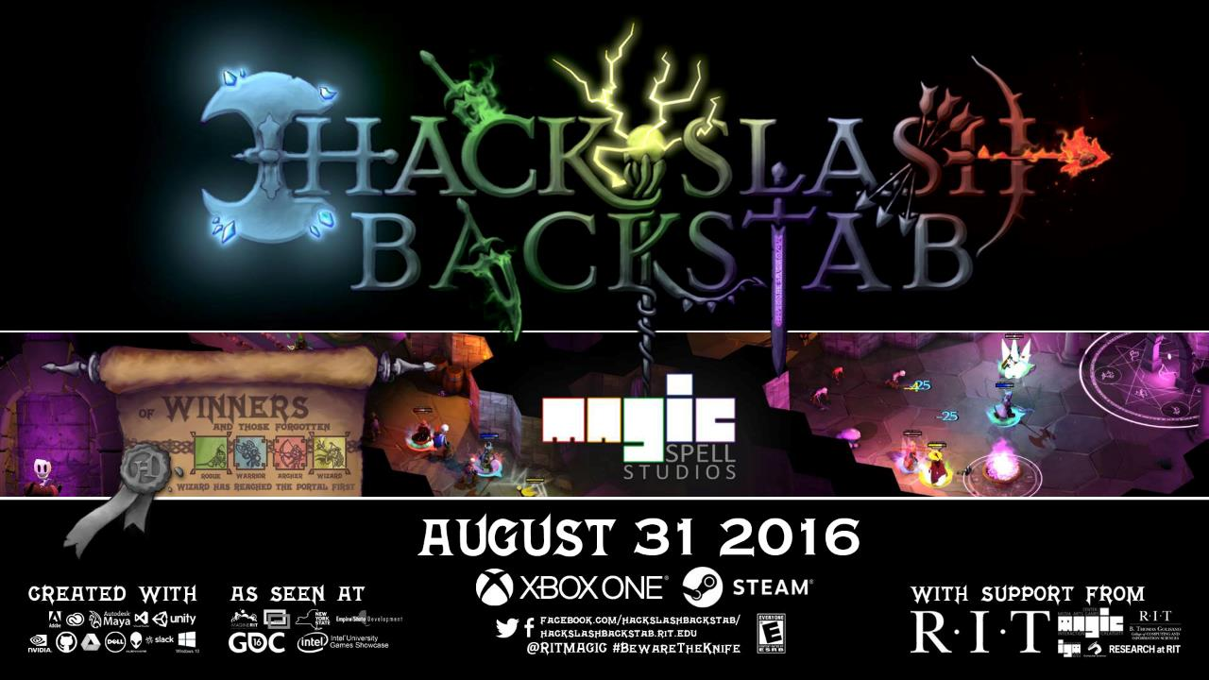

Slide 14

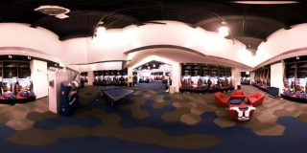

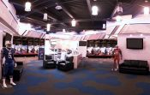
A SUMMER WITH THE
BUFFALO BILLS

Slide 15
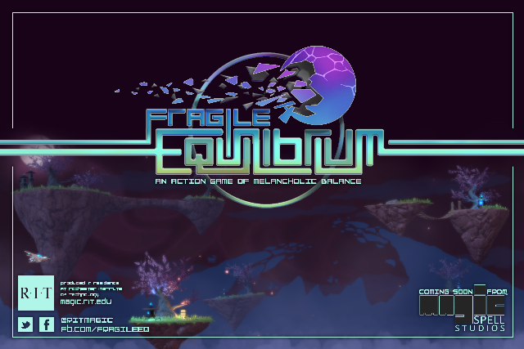
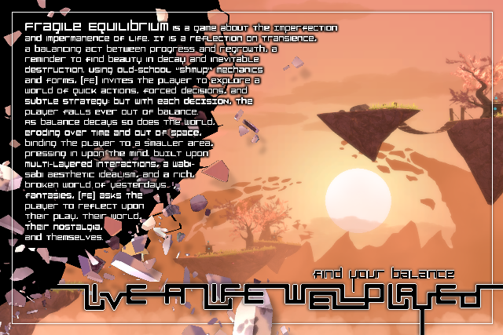

Slide 16







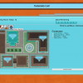
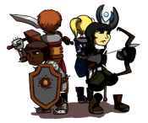







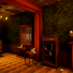
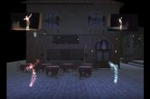
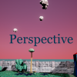








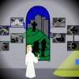



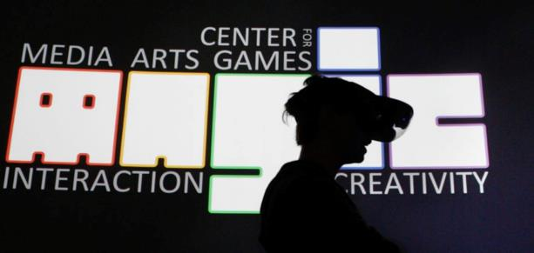




5 YEARS OF LEARNING THROUGH MAKING. 5 YEARS OF PROJECTS & MEDIA.
Notes:
So I highlight those 3 because of the things we learned and as data points of growth, but the thing is we did a LOT of stuff from a LOT of work for a LOT of people! It’s a lot bigger a community than people even think about. It’s easy when you are working on ‘your thing’ to not realize the scope and scale of everything else that’s happening and going on.

Slide 17

02/09/2018 Student-made game to be presented at Game Developers Conference
01/26/2018 Emerging 3D-printing applications at RIT
01/11/2018 Top RIT News stories and videos for 2017
01/03/2018 RIT to host statewide Game Dev Challenge kick-off event Jan. 19
01/03/2018 Top RIT News stories for December 2017
12/13/2017 Learn more about RIT’s entrepreneurial ecosystem, leadership in cybersecurity, and donor Austin McChord
12/11/2017 RIT professor launches table-top games to enhance people’s understanding of religion
12/07/2017 Creating a Holo-Assistant with Chirag Kular
11/28/2017 RIT’s Andrew Phelps named president of Higher Education Video Game Alliance
11/02/2017 Student uses technology to help humanitarian causes at UNICEF International
10/16/2017 Rochester Philharmonic Orchestra partners with RIT’s MAGIC Spell Studios, The Strong for ‘Heroes: A Video Game Symphony’ performance Oct. 26
10/03/2017 Top RIT News stories and videos for September 2017
09/25/2017 RIT MAGIC Center co-sponsors game festival at Irondequoit Public Library
09/20/2017 RIT staffer, alumni win big at Digital Rochester GREAT Awards
09/14/2017 Filmmaker Cailleah Scott-Grimes brings her award-winning documentary to RIT Sept. 21
09/11/2017 RIT’s brightest experts to highlight Light and Sound Interactive Sept. 12–14
09/07/2017 RIT helps create virtual reality ‘MAGIC’ for Buffalo Bills
08/18/2017 Summertime, and the students were busy (and in business)
08/02/2017 International conference on Japanese video game industry comes to Rochester Aug. 21–23
07/10/2017 RIT names Adrienne Decker as Fram Faculty Fellow in Applied Critical Thinking
05/23/2017 Staff Spotlight: Robert Mostyn
05/12/2017 New nine-credit general education immersion course is a first for RIT
05/09/2017 RIT MAGIC Center announces winners of statewide Game Development Challenge
05/04/2017 RIT ranked No. 1 game design school on the East Coast
05/03/2017 RIT featured among ‘Colleges That Create Futures’
04/25/2017 RIT is local site for 2017 International NASA Space Apps Challenge, April 29–30
04/25/2017 RIT’s MAGIC speaker series wraps up 2016-2017 season on April 26
03/21/2017 RIT’s video game design programs jump in Princeton Review rankings
03/09/2017 RIT to host statewide Game Dev Challenge kickoff March 10
03/03/2017 RIT student-created game competes in 2017 Intel University Games Showcase
03/01/2017 RIT student John Miller hopes to make an impact at national gaming conference
02/20/2017 RIT students, faculty head to California for annual Game Developers Conference
12/19/2016 RIT professor awarded NEH grant to enhance religious literacy through gaming
12/12/2016 RIT professor awarded NSF grant to benefit the next generation of games and learning scholars
12/09/2016 MAGIC Spell Studios celebrates official launch
12/01/2016 Top RIT News stories and videos for November 2016
11/15/2016 RIT officially launches MAGIC Spell Studios, aimed at convergence of digital media disciplines
11/10/2016 Local video game developers, entrepreneurs will speak on campus Nov. 14
11/01/2016 Rochester Philharmonic Orchestra partners with RIT, MAGIC Spell Studios for ‘Legend of Zelda’ performance Nov. 11
09/15/2016 Card game created by RIT students now licensed by Hasbro
09/12/2016 RIT’s MAGIC speaker series kicks off 2016-2017 season on Sept. 16
08/29/2016 RIT to become first university to publish video game on Xbox One platform
05/09/2017 RIT MAGIC Center announces winners of statewide Game Development Challenge
05/04/2017 RIT ranked No. 1 game design school on the East Coast
05/03/2017 RIT featured among ‘Colleges That Create Futures’
04/25/2017 RIT is local site for 2017 International NASA Space Apps Challenge, April 29–30
04/25/2017 RIT’s MAGIC speaker series wraps up 2016-2017 season on April 26
03/21/2017 RIT’s video game design programs jump in Princeton Review rankings
03/09/2017 RIT to host statewide Game Dev Challenge kickoff March 10
03/03/2017 RIT student-created game competes in 2017 Intel University Games Showcase
03/01/2017 RIT student John Miller hopes to make an impact at national gaming conference
02/20/2017 RIT students, faculty head to California for annual Game Developers Conference
12/19/2016 RIT professor awarded NEH grant to enhance religious literacy through gaming
12/12/2016 RIT professor awarded NSF grant to benefit the next generation of games and learning scholars
12/09/2016 MAGIC Spell Studios celebrates official launch
12/01/2016 Top RIT News stories and videos for November 2016
11/15/2016 RIT officially launches MAGIC Spell Studios, aimed at convergence of digital media disciplines
11/10/2016 Local video game developers, entrepreneurs will speak on campus Nov. 14
11/01/2016 Rochester Philharmonic Orchestra partners with RIT, MAGIC Spell Studios for ‘Legend of Zelda’ performance Nov. 11
09/15/2016 Card game created by RIT students now licensed by Hasbro
09/12/2016 RIT’s MAGIC speaker series kicks off 2016-2017 season on Sept. 16
08/29/2016 RIT to become first university to publish video game on Xbox One platform
08/26/2016 Top RIT News stories and videos from summer 2016
08/17/2016 MAGIC’s trustee-funded Co-Up program wraps up with second successful year
08/17/2016 An Innovation Ecosystem
08/02/2016 We’ve Got the Next Big Idea
06/17/2016 RIT’s Dan Schneiderman represents New York state at White House ‘makers’ event
04/29/2016 Imagine RIT exhibit allows visitors to ‘delve into dungeons’
04/27/2016 Three video games with ties to RIT featured at PAX East Indie showcase
04/21/2016 RIT is local site for 2016 International NASA Space Apps Challenge, April 23–24
04/07/2016 2016 Imagine RIT set for May 7
03/18/2016 RIT takes third place in Best Visual Quality in 2016 Intel University Games Showcase
03/17/2016 RIT’s MAGIC Spell Studios joins forces with virtual reality giant, videogame developer Crytek
03/15/2016 RIT student earns Intel Award for female, underrepresented game design students at international Game Developers Conference
03/15/2016 Princeton Review Ranks RIT as a top video-game design school
03/14/2016 RIT students, faculty head to California for annual Game Developers Conference
02/22/2016 RIT hosts all-women hackathon Feb. 27 and 28
02/15/2016 RIT MAGIC Center kicks off spring speaker series with privacy expert Feb. 18
02/04/2016 Electronic Gaming Society president prepares for Fusion Fest 2016
02/03/2016 Gaming for good: RIT gamers host LAN party to support Cancer Wellness Connections, Feb. 5-6
01/26/2016 RIT named one of three Digital Gaming Hubs in New York state
01/14/2016 MAGIC Spell Studios video game to be displayed at Smithsonian ‘pop-up’ arcade Jan. 16
12/11/2015 RIT to host second annual Congressional App Challenge kick-off event Dec. 12
12/10/2015 MAGIC virtual reality lab will serve as a one-stop shop for interface development, enhancing user experience
11/20/2015 Merging art history with digital gaming
11/04/2015 RIT students vying for Hasbro top prize
10/29/2015 RIT MAGIC Center director briefs Congressional members on U.S. video game industry
10/16/2015 Noted jazz biographer to talk on former Rochesterian Pepper Adams
10/13/2015 RIT’s Center for MAGIC welcomes social-media etiquette expert Oct. 22
09/23/2015 Plans for RIT’s new film industry-standard sound stage begin to come into focus
08/26/2015 Top RIT News stories from the summer
08/14/2015 Co-op gets the MAGIC touch
08/14/2015 RIT announces investments in MAGIC Spell Studios, aimed at spurring growth of local digital media industry
07/22/2015 RIT’s Center for MAGIC develops new initiative to encourage student humanitarian work through technology
07/20/2015 Free and open source software culture at RIT continues to grow
07/09/2015 RIT announces investments in MAGIC Spell Studios, aimed at spurring growth of local digital media industry
06/19/2015 RIT recognized for public relations work at 2015 PRism Awards
06/15/2015 RIT selected to host New Media Consortium in June 2016
06/03/2015 Adobe sponsors new media senior projects for student designers and developers
05/21/2015 RIT center continues to make ‘MAGIC’
04/30/2015 RIT students create video game to help children learn to read
04/24/2015 RIT students take top prize in Microsoft’s U.S. Imagine Cup National Finals
04/14/2015 MAGIC Speaker Series welcomes three speakers in April to discuss digital culture
04/03/2015 The Harmonica and the Blues
04/03/2015 Student-created video game selected for international exhibit
03/24/2015 RIT’s video game design programs jump in Princeton Review rankings
03/17/2015 RIT gamers support Cancer Wellness Connections through LAN party March 20
03/06/2015 RIT students take top award in Intel University Games Showcase
03/04/2015 Class of RIT students develop and publish Splattershmup video game
03/03/2015 Top RIT News stories and videos for February 2015
03/02/2015 RIT students California-bound for Game Developers Conference
02/12/2015 RIT MAGIC Center publishes student video game on Steam for the first time
02/03/2015 Top RIT News stories and videos for January 2015
02/02/2015 MAGIC Speaker Series looks to spark ideas about digital culture at RIT
01/07/2015 Top RIT News stories and videos for 2014
01/07/2015 Top RIT News stories and videos for December 2014
12/17/2014 RIT featured in Google’s Year in Search 2014 video
12/16/2014 Jewish Play Project explores relationship between Jewish creators and the play industries
12/11/2014 RIT project wins funding in NYS Regional Economic Development Councils competition
12/01/2014 Top RIT News stories and videos for November 2014
11/18/2014 Girl Develop It aims to bridge gender gap in tech fields
11/18/2014 The science behind 3D-printed prostheses
11/18/2014 A new hand for Lucas
11/11/2014 MAGIC Speaker Series looks to spark ideas about digital culture at RIT
10/02/2014 Top RIT News stories and videos for September 2014
09/29/2014 RIT takes part in national conference devoted to inexpensive 3D-printed prosthetic devices
09/22/2014 National conference to focus on work begun at RIT
09/16/2014 RIT hosts 2014 Software Freedom Day Rochester Sept. 20–21
08/05/2014 Hackathons help students get jobs, make a difference
07/28/2014 U.S. Assistant Secretary of Commerce tours RIT to review federal investments
07/08/2014 RIT students study abroad to explore video game industry in Germany
07/01/2014 RIT joins top game design programs in founding Higher Education Video Game Alliance
06/23/2014 RIT professor receives Fulbright Grant to develop game design minor in Croatia
05/26/2014 RIT receives $300,000 NSF Innovation Corps Sites grant to advance commercialization
05/14/2014 RIT students, alumni and staff among winners of 2014 AT&T Rochester Civic App Challenge
04/25/2014 Adobe Vice President of Experience Design and Creativity to attend Imagine RIT May 3
04/03/2014 App contest encourages community involvement
04/01/2014 Top RIT News Stories and Videos for March 2014
03/17/2014 MAGIC Speaker Series explores individual privacy on social networks March 19
03/14/2014 Unconference for Rochester area K-12 educators looks to discuss digital media in education
03/11/2014 Princeton Review Ranks RIT as a top video-game design school
03/06/2014 RIT launches nation’s first minor in free and open source software and free culture
02/24/2014 Online community of makers creates and improves 3D printed prosthetics for those in need
02/20/2014 Announcing the AT&T Rochester Civic App Challenge
02/13/2014 Developer ‘breaks the chains’ of traditional video games
01/28/2014 RIT MAGIC Center explores digital media with two speakers Feb. 10 and 12
01/23/2014 RIT/NTID students accepted into high-tech business accelerator
12/05/2013 New treatment helps autistic children navigate the world
12/04/2013 MAGIC Speaker Series looks to spark ideas about digital culture at RIT
11/20/2013 RIT professor earns more than $11,000 in Kickstarter for multi-player video game
11/14/2013 RIT ‘Celebration of Research’ set for Nov. 19
11/07/2013 RIT digital humanities series brings author, Internet freedom advocate to campus Nov. 11
10/16/2013 State Senate committee discussing ways to grow video game development industry
10/10/2013 RIT’s ‘MAGIC’ Center
07/22/2013 New digital media research center makes MAGIC
07/11/2013 ‘Sky Time’ video game selected for White House Champions of Change event July 23
06/20/2013 Q&A with game designers John and Brenda Romero June 28 at RIT
04/22/2013 Two RIT teams head to International NASA Space Apps Challenge
04/08/2013 RIT hosts talk with active learning expert and author Walter Bender April 17
03/28/2013 Red Hat donates to RIT’s MAGIC Center for open source software education program
02/15/2013 RIT launches new research center dedicated to digital media
Notes:
And we’ve worked really hard on telling our own story, over and over, better and better… this is just university press. We’ve also done social media, pictorials, just about every campus publication there is, regional press and television, and a couple of national news stories in Inside Higher Ed, the Chronicle, and a few others.

Slide 18
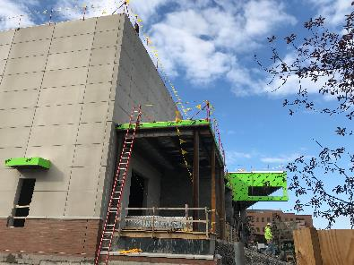
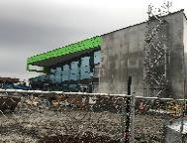
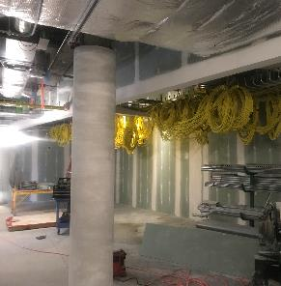
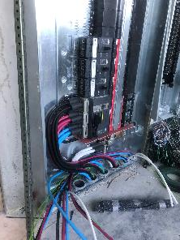
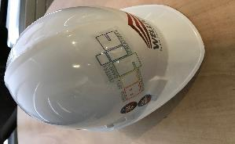
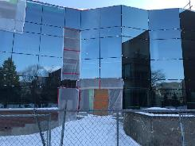
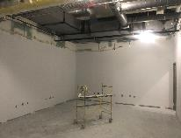
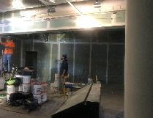
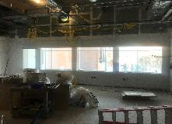
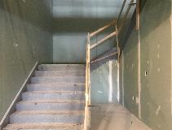
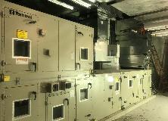
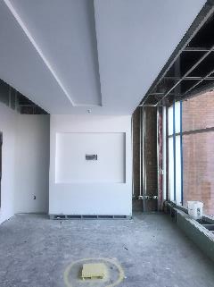
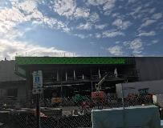
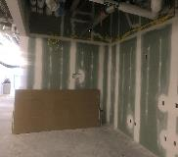
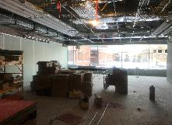
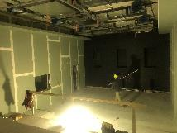
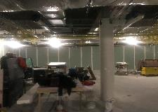

Slide 19
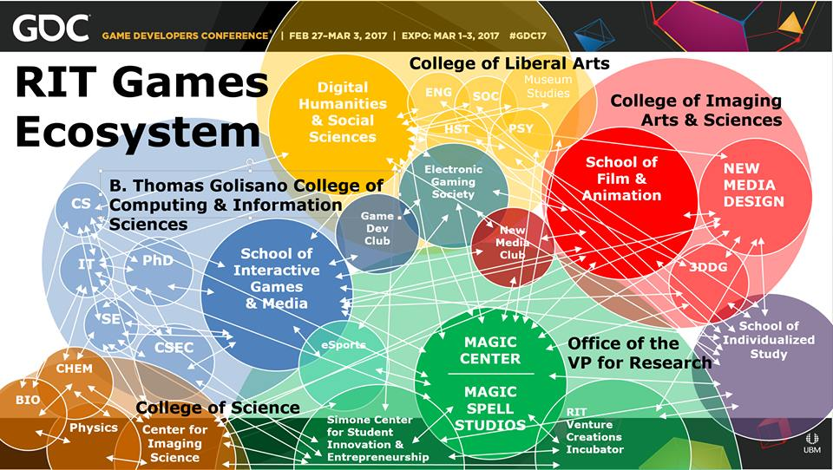

Slide 20











DIGITAL & PHYSICAL MAKING & HACKING

Slide 21
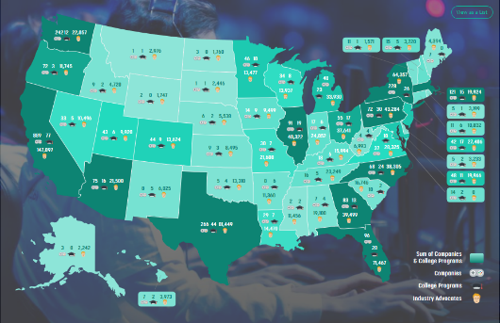
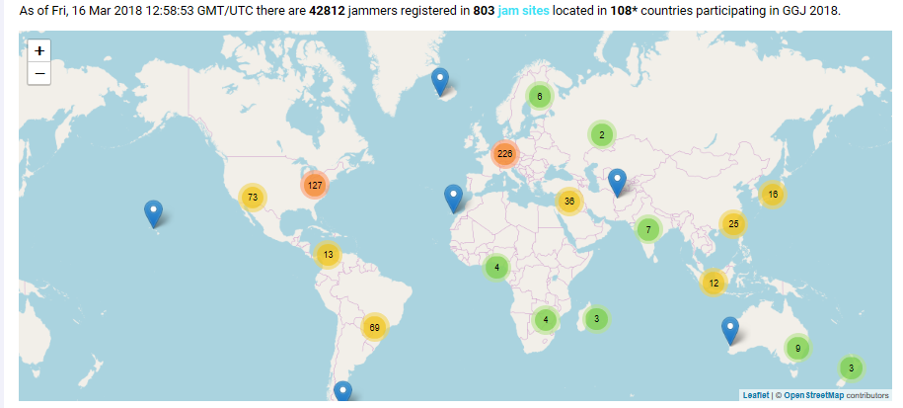
…AND THAT IS JUST A LITTLE MICROCOSM in upstate NY…
Notes:
521 academic programs, 42812 game jammers in 108 countries…

Slide 22

…AND THEN THERE’S THIS GUY SAYING STUFF ABOUT VIDEO GAMES…
Notes:
Pic from https://pics.onsizzle.com/the-ultimate-q-trump-doom-videogames-arcade-crookedhillary-hillaryclinton-killary-12875002.png

Slide 23
AND I’VE STILL ONLY TALKED ABOUT GAMES SO FAR
I haven’t talked about GLOBAL WARMING
I haven’t talked about HEALTH CARE
I haven’t talked about HUMAN RIGHTS
I haven’t talked about POVERTY & WEALTH DISTRIBUTION
I haven’t talked about GOVERNMENT & POLITICS
I haven’t talked about FOSSIL FUELS & GREEN ENERGY
I haven’t talked about NUCLEAR WEAPONS PROLIFERATION
I haven’t talked about SOCIAL NETWORKS COMMUNICATIONS
I haven’t talked about THE HUMAN GENOME
Notes:
I have seen game jams on every one of these topics and more, by the way…

Slide 24
And if I had to describe all of that to people in a single word it might be that I would struggle with that and it would be difficult and people ask you what you do and its hard to explain and in the end perhaps a single word that wraps all that up is EXHAUSTING.

Slide 25

The pace & COMPLEXITY of the world is COMPLETELY out of control
Notes:
Image fromhttps://wallpaperscraft.com/download/minecraft_planet_cube_cubes_world_2228/1920x1200#

Slide 26
Wat do?

Slide 27

Games teach us something profound in dealing with the world
START SMALL. JOURNEY WELL. SAVE EVERYTHING. PRACTICE. STEP BY STEP.
Notes:
Screenshot is King’s Quest 1

Slide 28

Put PEOPLE in a SHARED ENVIRONMENT with some FOOD & CONVERSATION, some SIMPLE SHARED HIGH-LEVEL GOALS, and a purposeful LACK OF STRUCTURE.
WAIT for SEEDS of GREATNESS amidst FUN & FAILURE
Notes:
Image from http://www.vaporplants.com/blog/growing-seeds-with-hydroponics-in-door-garden-easier-start

Slide 29

ELECTION NIGHT HACKATHON
MAGIC & PUBLIC POLICY

Slide 30


ART & tech together

Slide 31













Slide 32






Slide 33



FROM GAME JAM TO GDC GAME & INTEL UNIVERSITY GAME CHALLENGE
METROGNOME
Notes:
John Blau, center; Barrington Campbell, left; and Matthew Barry are three of the five team members who created MetroGnome.

Slide 34

Game jams and hackathons allow us to get out of our own way
THEY REMIND US THAT
MAKING THINGS IS A FORM OF PLAY
Notes:
The RIT group competed in a game jam with German students from the University of Paderborn. The teams had 48-hours to create video games with the theme of freedom of speech or fake news.

Slide 35

REMEMBERING THAT MAKING IS MAGICAL
Notes:
This is from an event we recently hosted for Our Lady of Mercy school in collaboration with our K-12 office and other partners. We forget sometimes the role and impact that digital media has, and our obligation as educators to keep that alive, to use it to encourage a study of the mind and the soul.

Slide 36

NEXT WEEK WE GO BACK TO MAKING THINGS.

Slide 37

Thanks & Questions
andy@magic.rit.edu | magic.rit.edu | @ritmagic

