Slide 1

The Intersection of Games & Youth Culture: A Brief Overview
Andrew Phelps, Professor, RIT College of Imaging Arts & Sciences
Pediatric Grand Rounds & Spinner Lectureship
University of Rochester Medical Center | 5/16/2018

Slide 2
A fun game of past & Present
I gave a talk here at Grand Rounds in 2006.
Some of these slides are from that talk. Some of them aren’t.
Let’s see how much has changed…

Slide 3
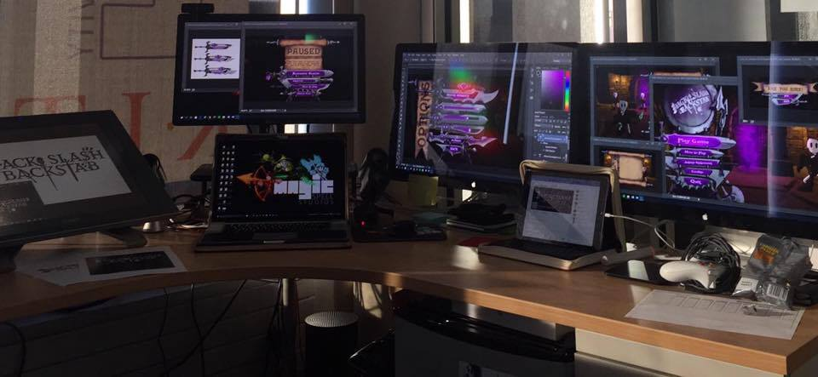
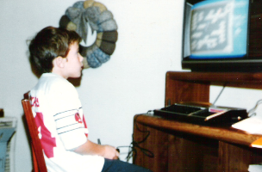
Hi, I’m andy. I make things.

Slide 4
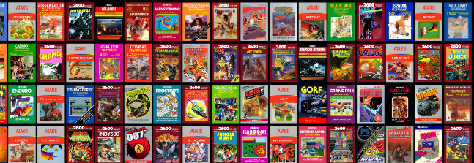

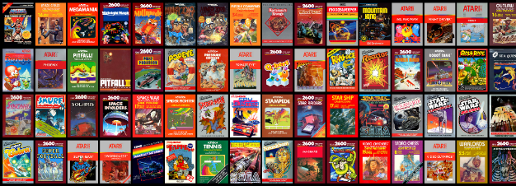
AND I GREW UP A GAMER

Slide 5
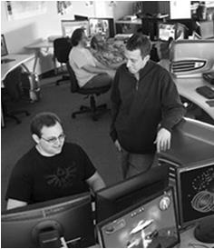
LUCKY TO HAVE MADE THINGS AT RIT
FIRST graduate course in games at RIT (2001-2002!)
Undergraduate course and later concentration in game design and technology
Degree programs in game design & development (bachelors and masters)
Dept / School of Interactive Games and Media
Research & Scholarship practices for Game Design & Development
The MAGIC Center & MAGIC Spell Studios
FIRST university to ship on XBOX One
Higher Education Video Game Alliance
NY State Games HUB
New MAGIC Spell Studios campus facility (fall 2018)

Slide 6
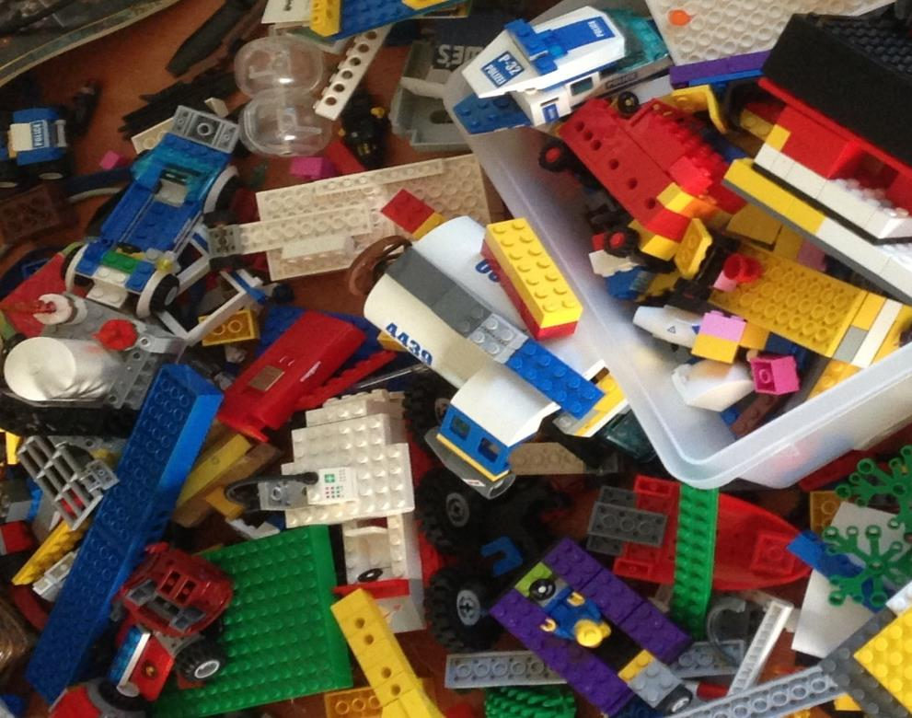
'protecting “making as a
mode of inquiry”’
-Ian Horswill, Northwestern

Slide 7
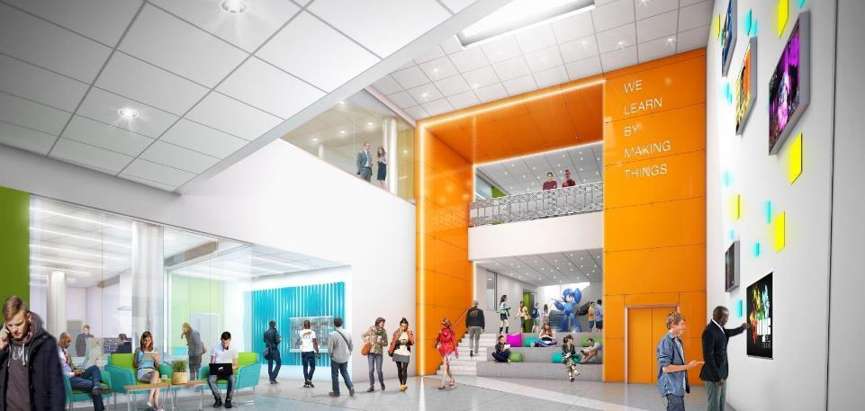
WE LEARN BY MAKING THINGS

Slide 8
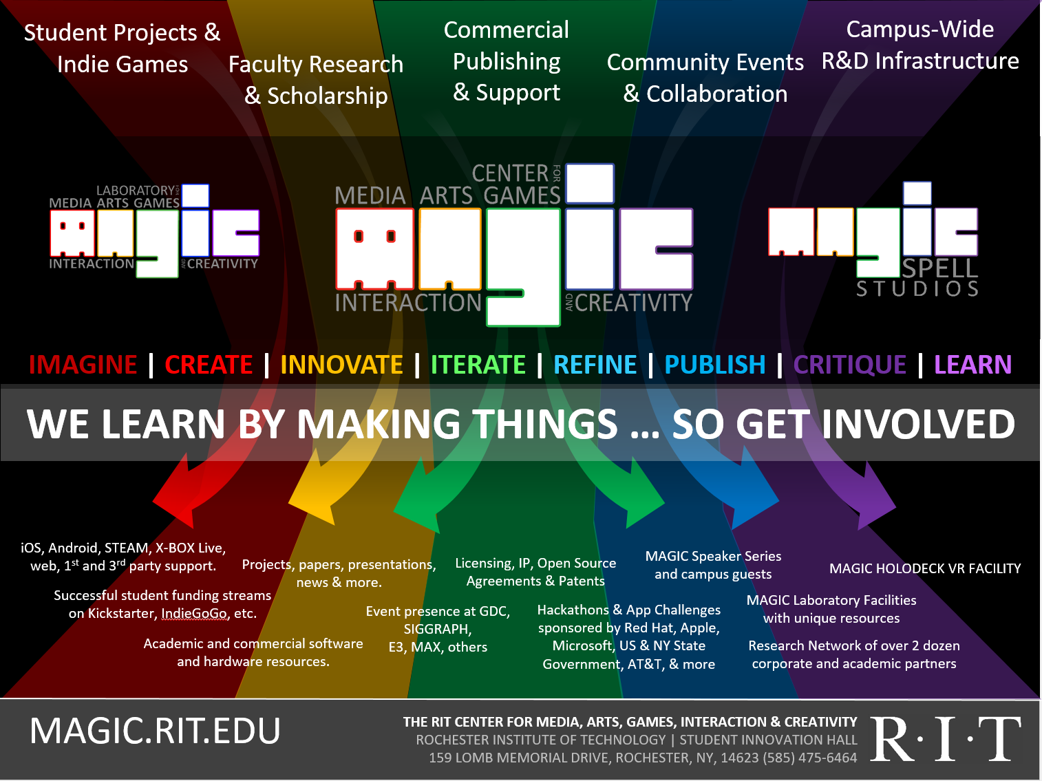




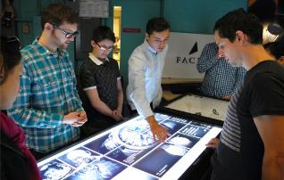

Slide 9

…The M is for Messy
PART I: WHAT DO WE DO?

Slide 10
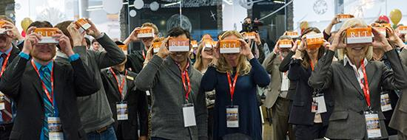
a bit MORE about Our WORK

Slide 11
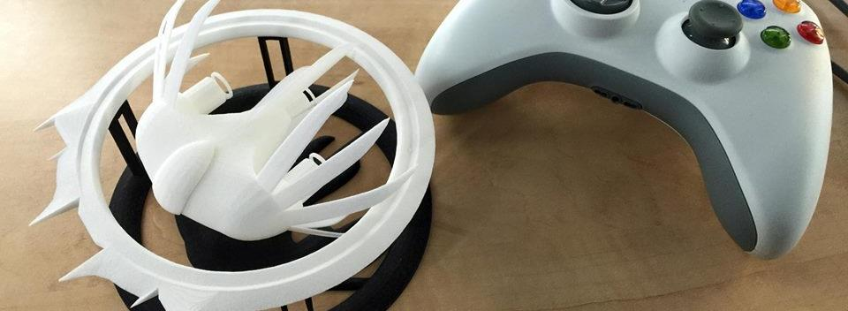

A Strange Game for Strange Reasons
This game taught us (the campus) about making things, production, and scale
This game allowed us to explore using typical game forms for telling a unique story to a very targeted audience
Finalist at GLS Education Arcade, accepted to DiGRA Blank Arcade, and IndieArcade at the Smithsonian American Museum of Art
SPLATTERSHMUP.RIT.EDU – PLAY TODAY! MAKE ART!

Slide 12


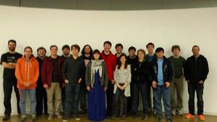
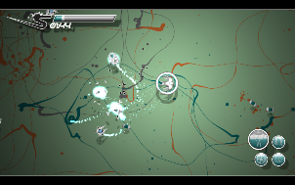





Slide 13


Slide 14
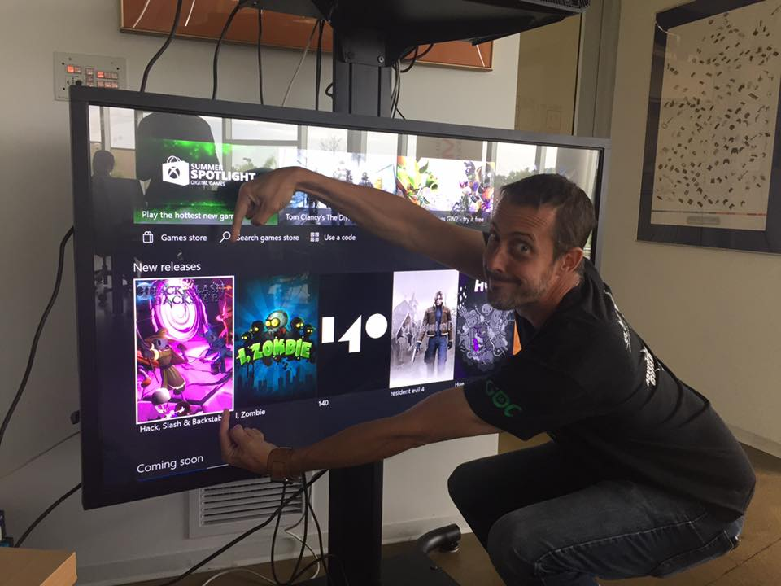
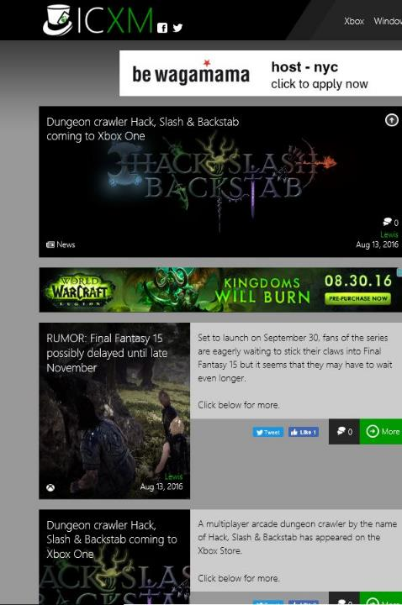
FIRST UNIVERSITY TO PUBLISH DIRECTLY ON XBOX ONE. BRAGGING RIGHTS++

Slide 15

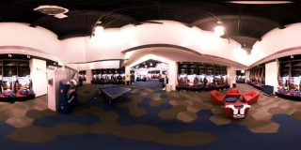


A SUMMER WITH THE
BUFFALO BILLS

Slide 16
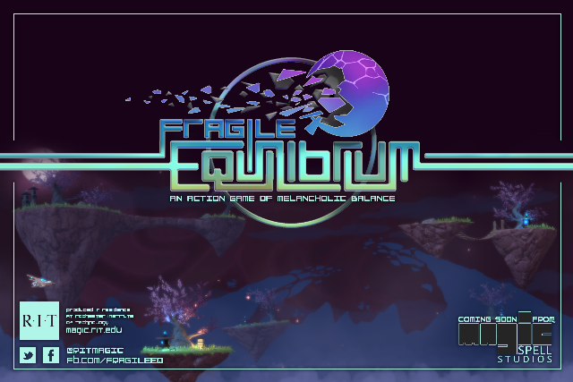
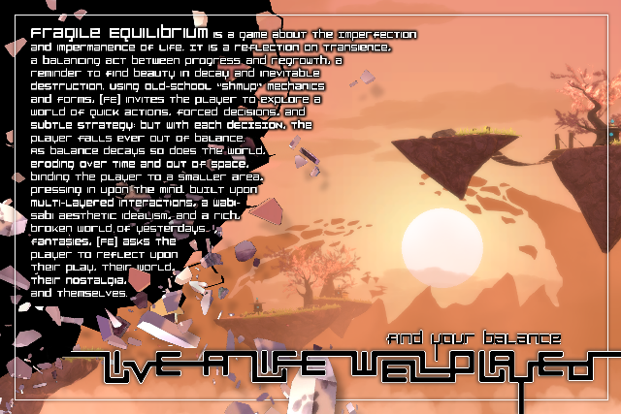

Slide 17







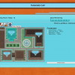
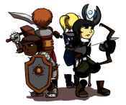








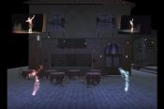
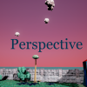








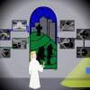



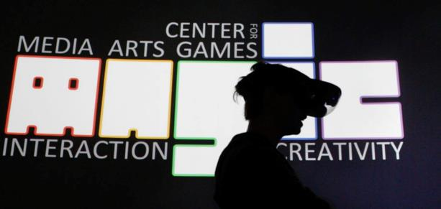




5 YEARS OF LEARNING THROUGH MAKING. 5 YEARS OF PROJECTS & MEDIA.
Notes:
So I highlight those 3 because of the things we learned and as data points of growth, but the thing is we did a LOT of stuff from a LOT of work for a LOT of people! It’s a lot bigger a community than people even think about. It’s easy when you are working on ‘your thing’ to not realize the scope and scale of everything else that’s happening and going on.

Slide 18
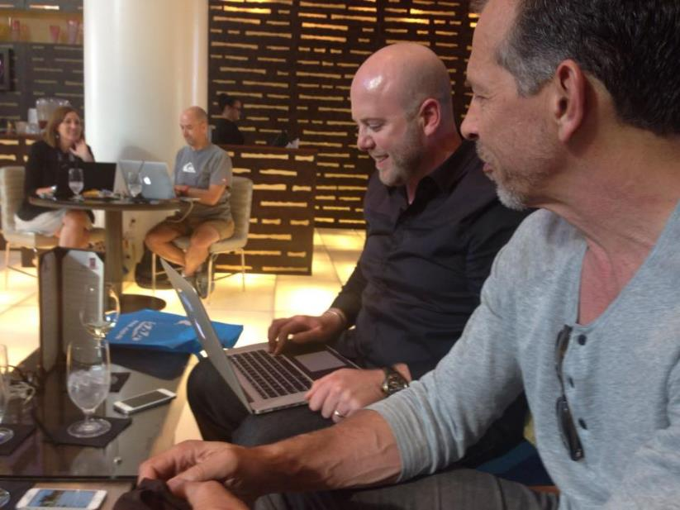
But more important than tools OR PLATFORM OR CLIENT IS STORY

Slide 19
Perceptions & Personas
“The best that can be said of them [video games] is that they may help promote eye-hand coordination in children. The worst that can be said is that they sanction, and even promote aggression and violent responses to conflict. But what can be said with much greater certainty is this: most computer games are a colossal waste of time” - Dr. Spock, 2004 ed.

Slide 20

Perceptions & Personas
Capitol Hill & the “Rise of Violent Video Games”
  Hillary Clinton
  Joe Lieberman
Researchers from the University of Oklahoma recently found that two-thirds of school fights were instigated by regular video game players, but only 4% were started by children who had never played such games.
Other studies showed that violent games would not cause serious problems in healthy families, but could do so in families where children were left alone for many hours. [2]
Grand Theft Auto: Liberty City Rockstar Entertainment

Slide 21

Perceptions & Personas
“ALL children play violent video games”
“ALL video games are violent”
“THE INDUSTRY is to blame for peddling violence to children”
“GAMES are co-opting American education and ruining our youth”
“GAMES are the cause of childhood obesity”
“couch potato” from www.pushingdaisies.com

Slide 22

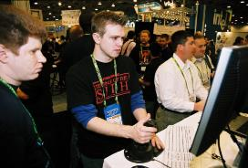
…with a capital “T”…
“And if there is one cultural form that is subjected to this debate, it is the often-despised phenomenon of videogames. Almost since their inception, videogames have been met with rampant prejudice, legislation and stigma. Indeed, they are often 'beneath popular culture'. This is usually related to violence, children and education, or diminished social skills.” [25]

Slide 23
Notions of Media Valuation
[ ] True
[ ] False
Reading books is a better way for a child to spend their time than playing games.

Slide 24
Notions of Media Valuation
[ ] True
[ ] False
The Book = The Chronicles of Conan #8: Brothers of the Blade & Other Stories
The Game = 1890 historical world recreation by the MIT Education Arcade

Slide 25
…and that rhymes with “P”, and that stands for “Pool”
H1, The ‘River City’ Hypothesis. The advent of a new medium will first give rise to fears of displacement of ‘constructive’ activities and of associations with deviant behavior.
H2 , The Fear Order Hypothesis. With the advent of video games, news frames involving children will occur in the following order: fears of destructive displacement of worthwhile activities (H1); fears of negative health effects; and, then, fears about the effects of content on values, attitudes and behavior. [4]

Slide 26







Parent Education
The entire GTA Controversy took place between a game rating that specifies that a game may “have content that may be suitable for persons ages 17 and older” and a rating that specifies a game “has content that should only be played by persons 18 years and older.”

Slide 27
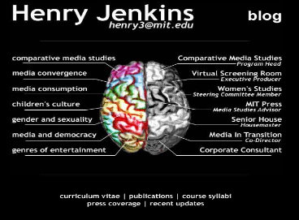
Prof. Jenkins Goes to Washington
Henry Jenkins
Director of Comparative Media Studies @ MIT
“The increased visibility of youth culture. Children fourteen and under now constitute roughly 30 percent of The American population, a demographic group larger than the baby boom itself. Adults are feeling more and more estranged from the dominant forms of popular culture, which now reflect their children's values rather than their own. Despite our unfamiliarity with this new technology, the fantasies shaping contemporary video games are not profoundly different from those that shaped backyard play a generation ago.” [6]

Slide 28
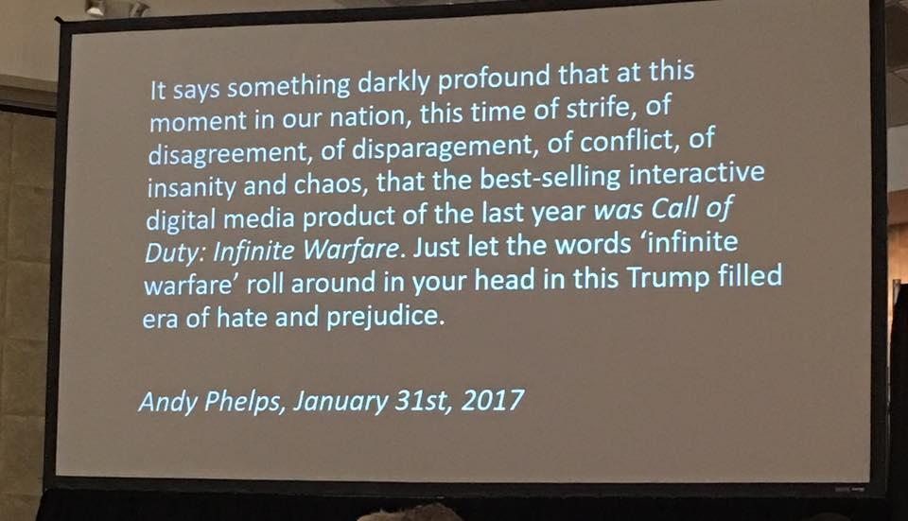

Slide 29

…AND THEN THERE’S THIS GUY SAYING STUFF ABOUT VIDEO GAMES AS IF IT WERE FACT…
https://medium.com/@Andy_at_RITMAGIC/of-fake-guns-and-real-hope-a6b1af02c05f
Notes:
Pic from https://pics.onsizzle.com/the-ultimate-q-trump-doom-videogames-arcade-crookedhillary-hillaryclinton-killary-12875002.png

Slide 30

WHAT DID WE LEARN FROM GAMERGATE, IF ANYTHING?
“And so while I am saddened by GamerGate, I am not surprised. It is part and parcel of a focus on technology without similar attention on the ethical frameworks and historical roots of that technology, without concern or consideration for its societal impacts, and without a sustained national focus on integrating technology, arts, sciences, and humanities.”
https://medium.com/@Andy_at_RITMAGIC/a-few-thoughts-on-gamergate-62c151c0eebb
Notes:
Image from http://gawker.com/what-is-gamergate-and-why-an-explainer-for-non-geeks-1642909080

Slide 31
AND SO THAT’S HOW THE MEDIA OFTEN TALKS ABOUT VIDEO GAMES. YAY.

Slide 32
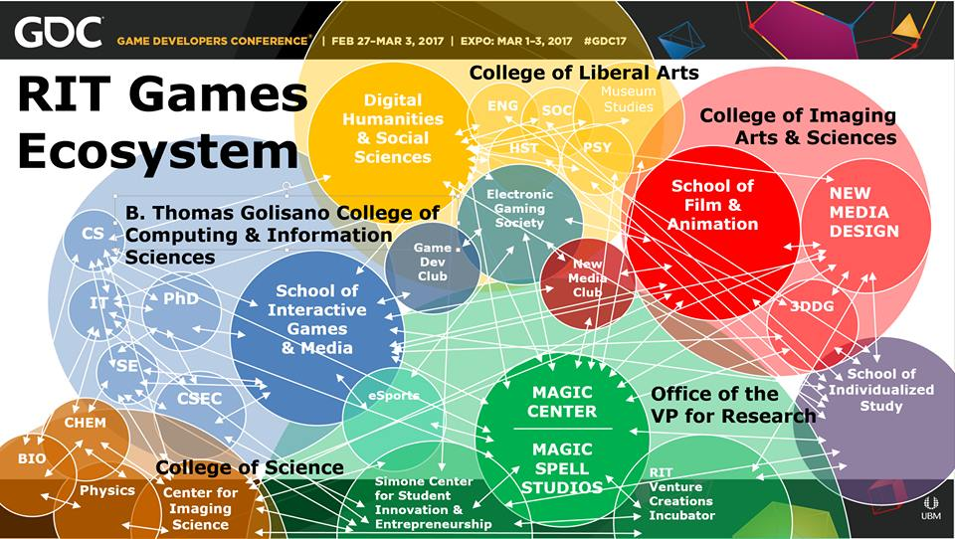

Slide 33
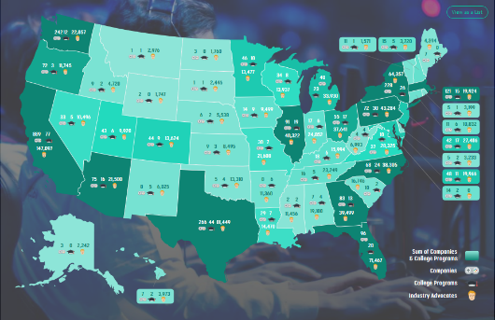
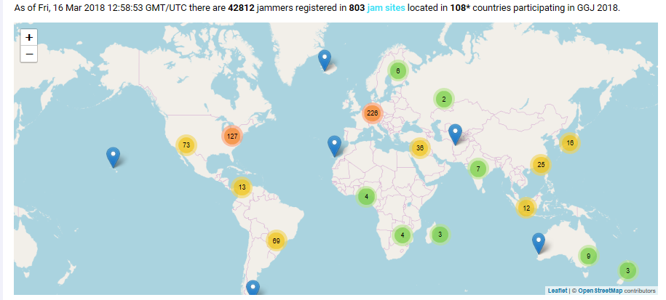
…AND THAT IS JUST A LITTLE MICROCOSM in upstate NY…
Notes:
521 academic programs, 42812 game jammers in 108 countries…

Slide 34
Rise of a platform
Justin.tv in 2006/2007
Rebranded “gaming” section as Twitch.tv in 2011
Justin.tv itself ceased operations in 2014
Twitch sold to Amazon in 2014 for $970 million USD
In 2014 4th largest driver of Internet traffic in the US

Slide 35
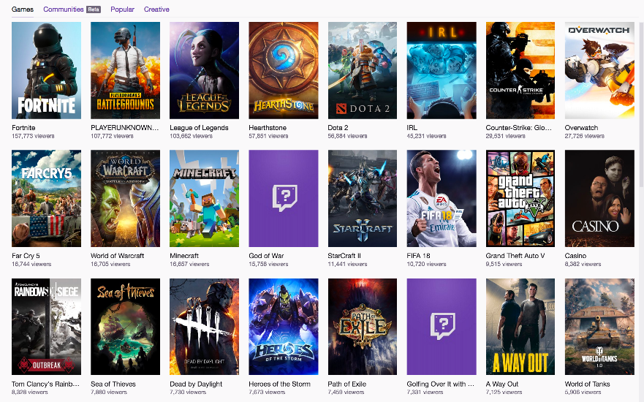
The rise of variety streaming

Slide 36
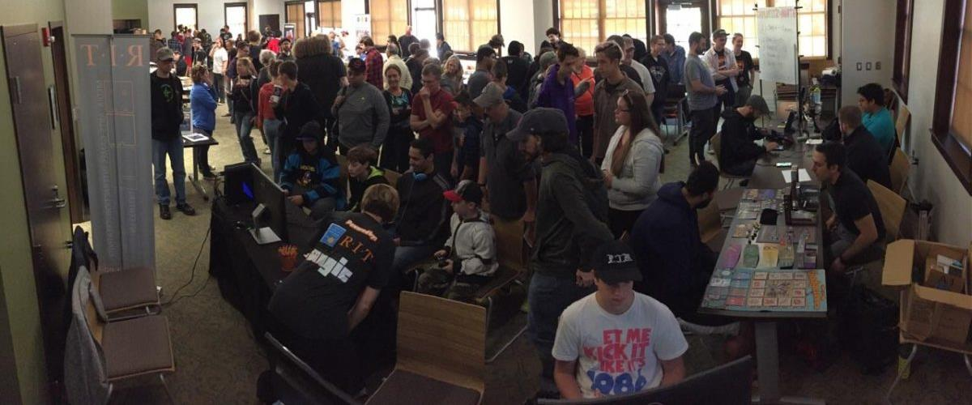
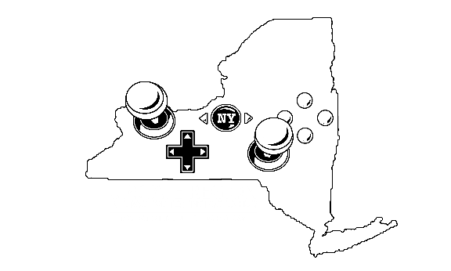
MAGIC is a NY STATE GAMES HUB,
(TO GROW THE STATE ECONOMY, but also to tell the state *STORY*)

Slide 37
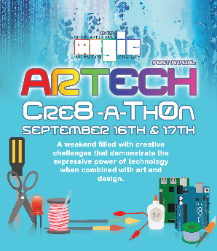









FREE & OPEN SOURCE SOFTWARE
DIGITAL & PHYSICAL MAKER COMMUNITIES
Notes:
If you’ve been following what we’re doing we’re making an effort to be essentially everywhere: here are some of the initiatives and efforts and partners of recent note. We’re taking that notion of working with communities and networks really seriously at local, state, national, and international levels.
The general public doesn’t understand education, doesn’t understand what we do, and is increasingly critical of higher education in specific as overpriced, overblown, and overvalued. So how do we change any of these perceptions other than by cutting costs (which we need to do as well) ?

Slide 38

WE NEED A BETTER STORY
STEM created a story, and there is not [yet] a strong, public counter-narrative. Yet we enable ‘tech-bro’ silicon valley culture in our divisions
We added ‘A’ for STE(A)M, some places took the plunge to ‘digital humanities’ or added ‘H’– but we never (re)addressed the core value proposition of education rooted in something other than immediate commercial placement in a post-industrial economy
The role and form of education is currently under attack and increasingly devalued on arguments of relevancy (by applying commercialism to all value contexts and skills-based lenses to learning)

Slide 39
Games = Motivation? Inspiration?
“I want to be a game developer when I grow up” – #2 national survey of 5th graders
Games as a “hard problem” and a “created artifact”

Slide 40
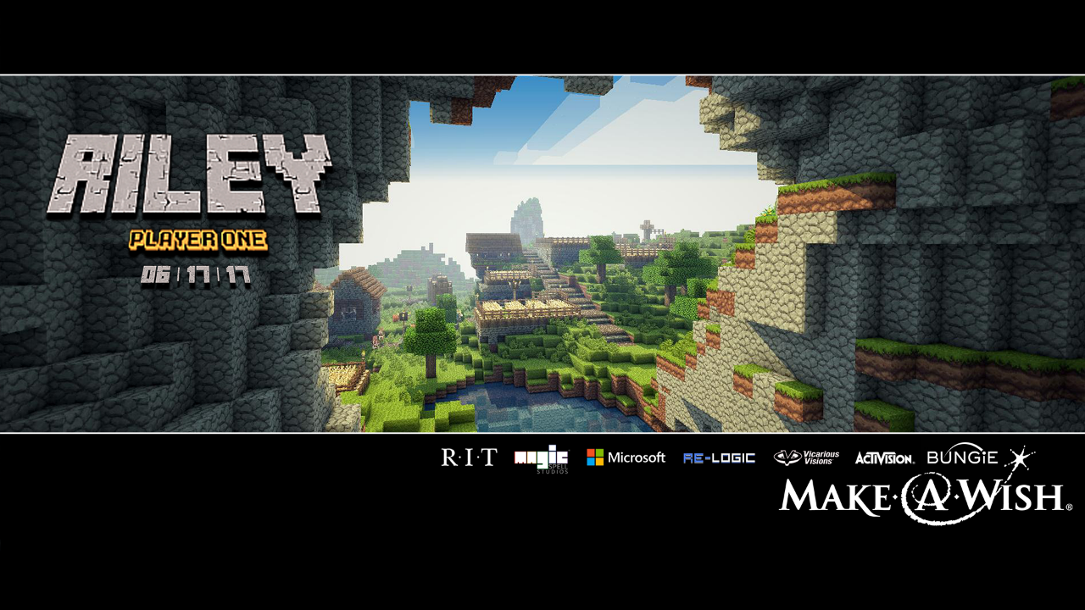
Notes:
Hooray for minecraft. You can BUILD things. Wheee.

Slide 41
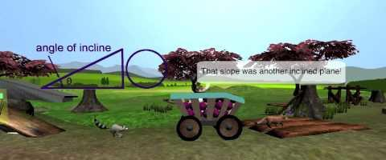
A FOCUS ON STORY IS A FOCUS ON HUMANS, WITH OBVIOUS IMPLICATIONS
Healthcare – MAGIC has more sustained research interest from health and behavior verticals than any other…
Education – followed closely by the application of media interventions in formal and informal education

Slide 42
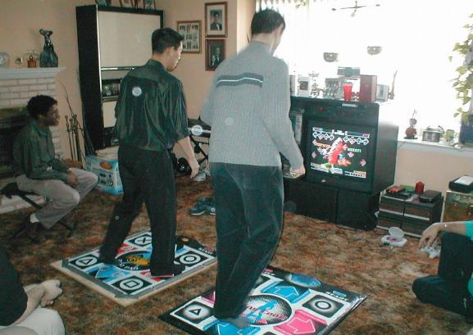
Could Games be an Answer?
[ ] Social Activity
[ ] Aerobic Activity
[ ] Obesity Prevention
[ ] Fun
[ ] Best-Selling Game
DDR Image Google Search Result: http://www.8ttb.com/_images/pics/pictures/mini-6%20-%20injik%20is%20a%20DDR%20junkie.JPG

Slide 43
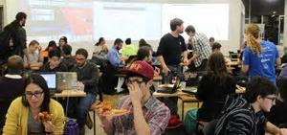
ELECTION NIGHT HACKATHON
MAGIC & PUBLIC POLICY

Slide 44
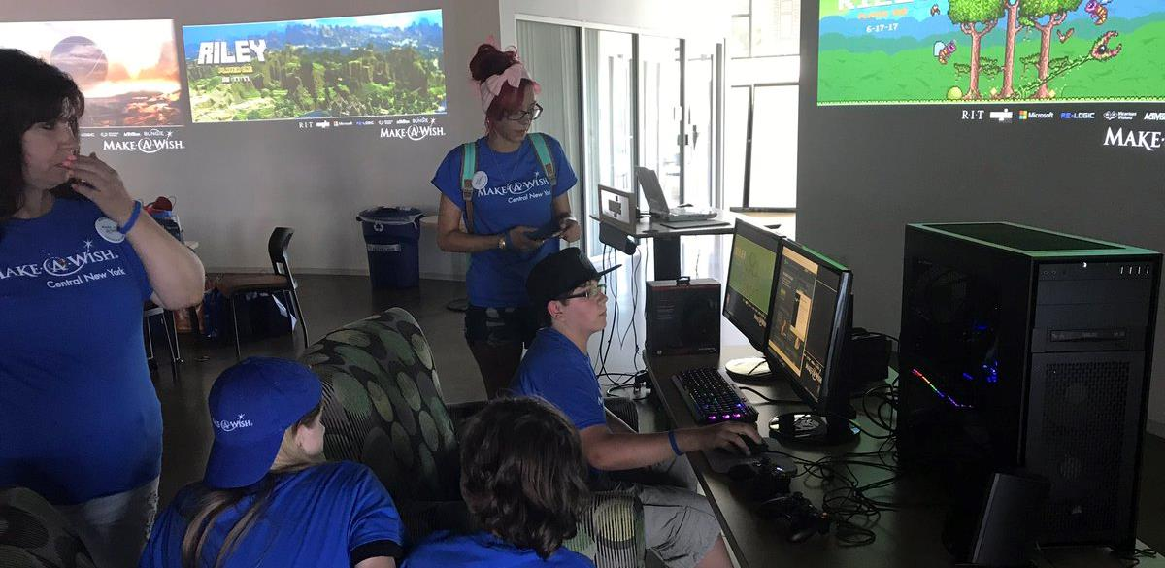
RILEY & Make a wish FOUNDATION

Slide 45
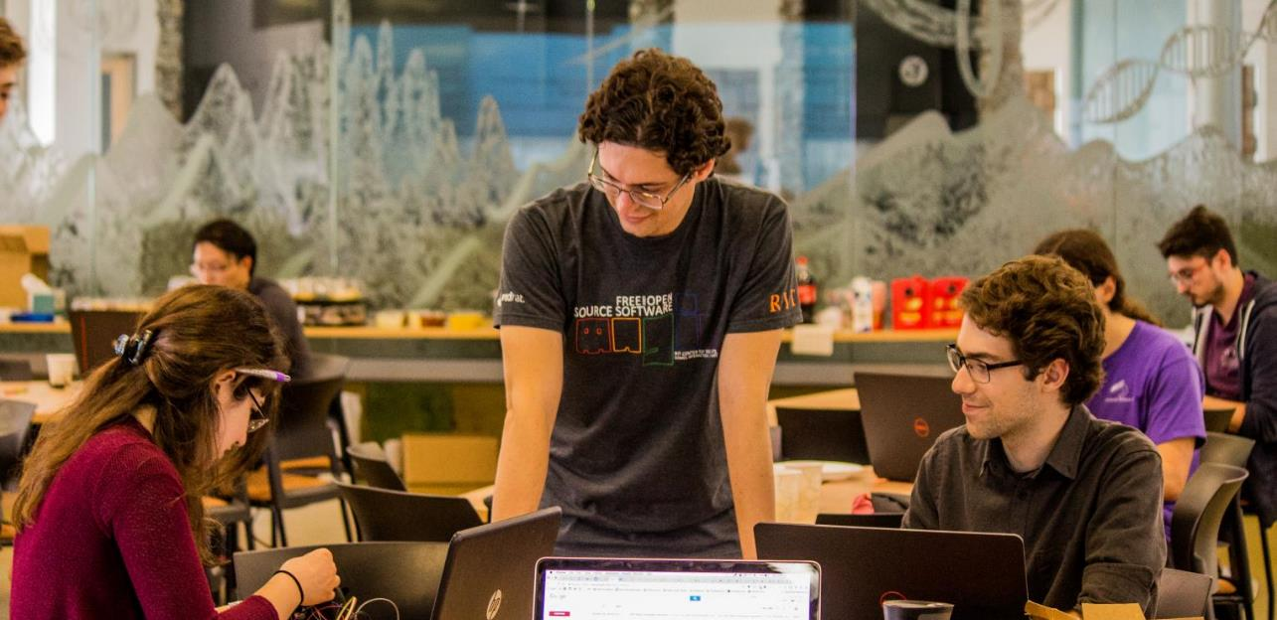
Artech CRE8-A-THON: CHANGING JAM CULTURE

Slide 46

Democratizing access isn’t enough – working with students to tell stories is of paramount importance, enabling storytelling and working with them on content, designs and experiences, generation to generation, mind to mind.
‘Job readiness’ isn’t a path for economic impact by itself – movements like CS4All, Code.org, etc., and sometimes our own metrics and ideals, stop short of providing a contextual, expressive relationship between computing and the arts, between the machine and the human. They don’t contextualize STEM in a flyover state, a gentrified city, or a world at war. Job readiness doesn’t change the world by itself – empowering young people with both tools and skills (which we do), vision, process, experience and empathy does that...

Slide 47
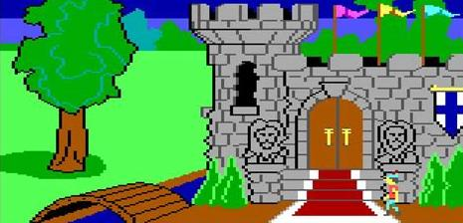
Games teach us something profound in dealing with the world
START SMALL. JOURNEY WELL. SAVE EVERYTHING. PRACTICE. STEP BY STEP.
Notes:
Screenshot is King’s Quest 1

Slide 48

Put PEOPLE in a SHARED ENVIRONMENT with some FOOD & CONVERSATION, some SIMPLE SHARED GOALS, and a purposeful LACK OF STRUCTURE.
WAIT for SEEDS of GREATNESS amidst FUN & FAILURE
Notes:
Image from http://www.vaporplants.com/blog/growing-seeds-with-hydroponics-in-door-garden-easier-start

Slide 49
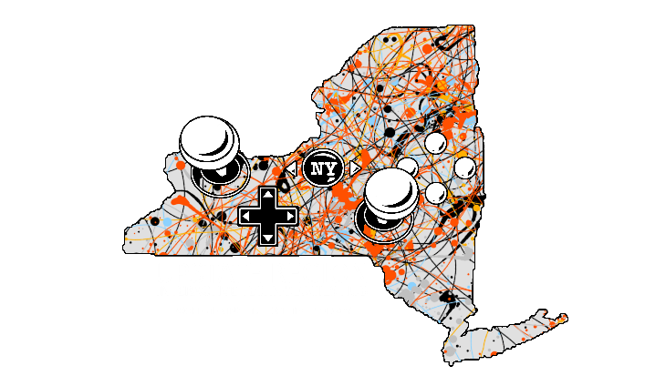




Rochester Institute of Technology
University of Rochester
Eastman School of Music
St. John Fisher
Nazareth College
Workinman Interactive
Darkwind Media
Second Ave Software
ROC Game Dev
IGDA* (coming soon)
Digital Rochester
Rochester Downtown Development Corp
Lots of other companies, second-and third-party work, optics, hardware, etc.

Slide 50

IN THE RISE OF THE MACHINE-BRAINS, THIS IS EVER MORE TRUE:
Computing is not about computers anymore. It is about living.
~Nicholas Negroponte, Being Digital, 1995
Notes:
Anyway, Raph Koster closed a recent talk I was at with the notion that we in the games industry, but more broadly the media industry, the technology industry, the computing industry, need to consider the notion of DESIGN WITH INTENT. That these systems are so important to our culture that the responsibility falls to us as designers and developers to consider the impact and intent of these patterns and interactions.
And while this is true it is also equally true that perhaps we must re-examine and re-contextualize what it is to LIVE WITH INTENT in the digital age. That roles such as ‘citizen’ or ‘neighbor’ or ‘friend’ or ‘human’ carry with them both opportunity and obligation, that our lives are what we make of them, and our digital lives are included. And wasn’t the role of the university, really, the cultivation of knowledge towards the betterment of the human? We have grown beyond our bodies, but we must each of us consider the patterns and scales of our expanding digital minds.
We must consider the story of what it is to be human, we must consider the stories we tell ourselves about ourselves. We must consider the stories we tell our children, and the effect those stories have on our society. And if we don’t like where we are, we must change our stories and how we tell them.

Slide 51
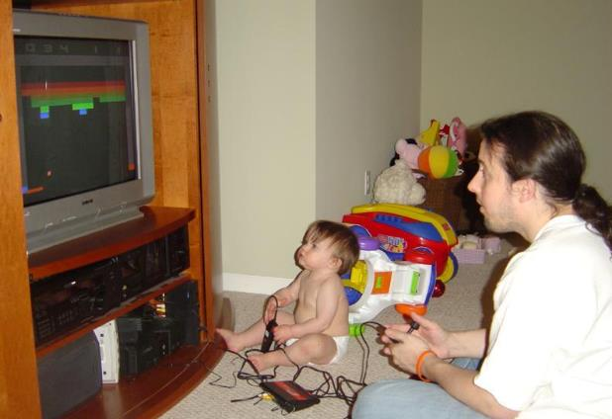
Thank You
Thanks for having me,
and for all of your truly important work.
[ Strong NICU “Pod D2” weeks 1-2, surgery day 3, perfectly happy gamer at age 2.5…
…now she’s 14, so, yeah. ]

Slide 52
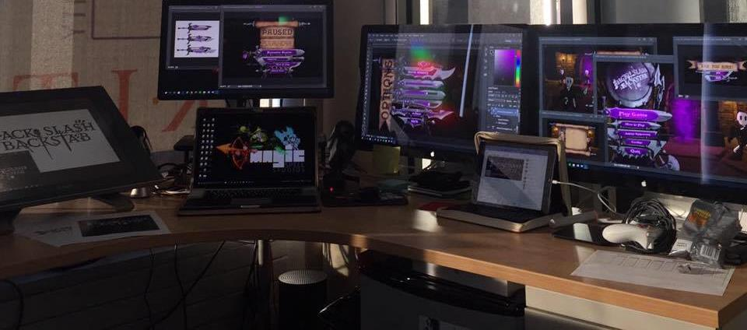
Thanks & Questions
andy@magic.rit.edu | magic.rit.edu | @ritmagic

