Slide 1



:
TEACHING GAME PRODUCTION
( at scale )
GOTLAND GAME CONFERENCE | GAME EDUCATORS SUMMIT | VISBY, SWEDEN 2019
Andrew Phelps
Professor of Human Interface Technology, University of Canterbury, NZ
Professor of Art & Design, Rochester Institute of Technology, USA
Games Scholar in Residence, American University, USA
President, Higher Education Video Game Alliance
Founder, RIT MAGIC Center & MAGIC Spell Studios
Founder, RIT School of Interactive Games & Media

Slide 2
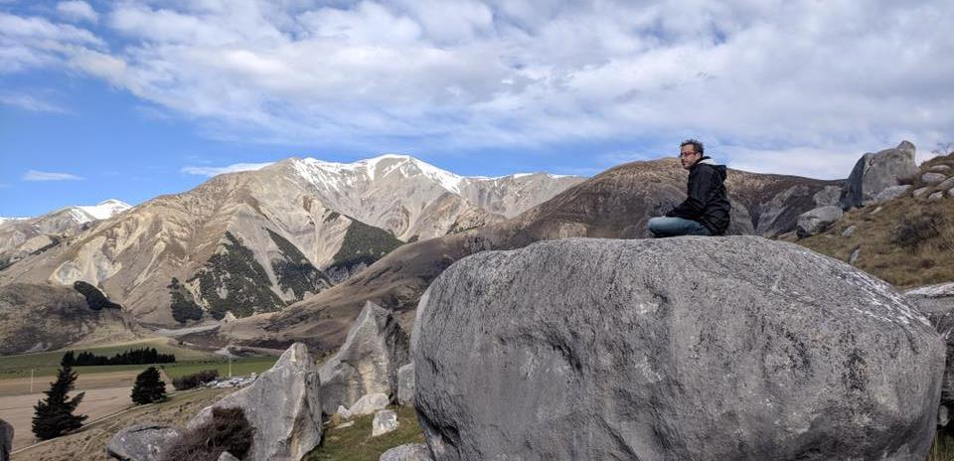
Today’s Talk
Ancient history and setting the stage
Some case examples of game production
Some lessons learned in doing it
Some really messy bits under the hood
Hopefully some great Q&A? Or a beach walk?

Slide 3
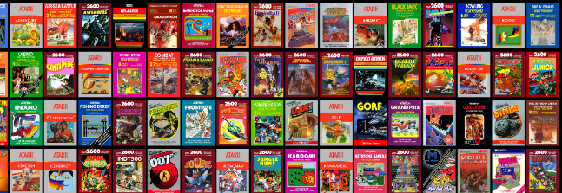

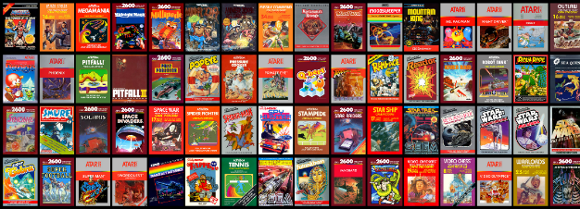
HI, I’m ANDY

Slide 4
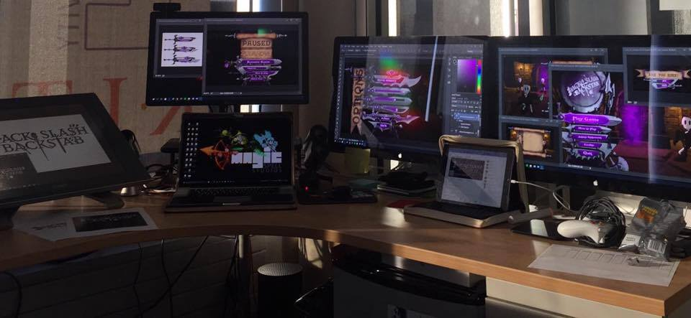
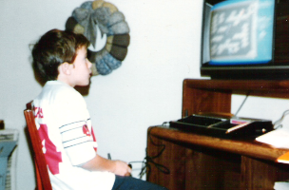
I make things.

Slide 5
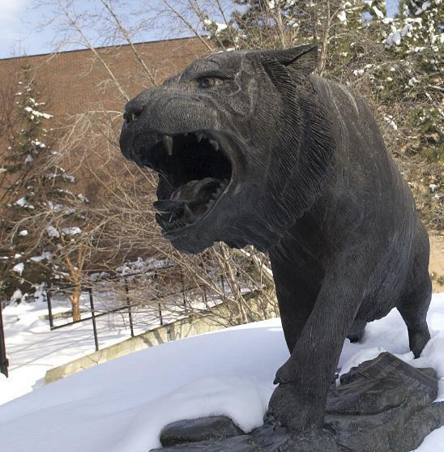
RIT GAMES & INTERACTIVE MEDIA TIMELINES
2001 programming
First course in games programming
2002
Electronic Gaming Society
2003
CS/IT Concentration in Game Prog
2006
MSc Game Design & Development
2007
BSc Game Design & Development
2009
Dept. of Interactive Games & Media
2011
School of Interactive Games & Media
2012
Minor in Game Design
2013
RIT Center for Media, Arts, Games, Interaction & Creativity (MAGIC)
2013
MAGIC Spell Studios ®, LLC
2016
$30M MAGIC Spell Studios Initiative
2016
NY State Games HUB
2017
NY State Games Challenge

Slide 6
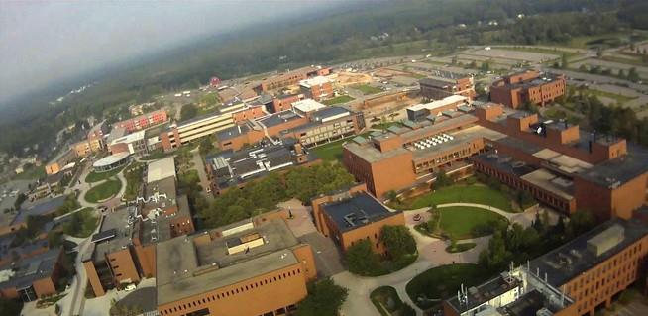
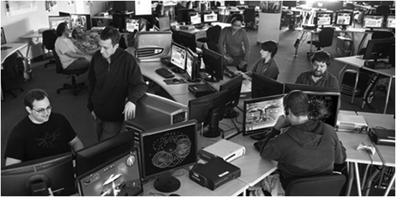



School of Interactive Games & Media

Slide 7


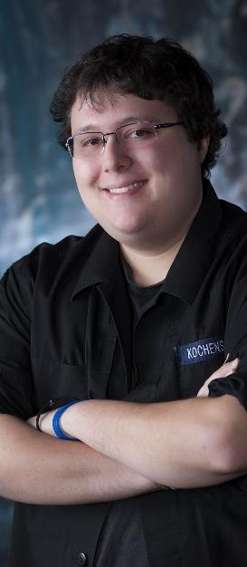


INCREDIBLE ALUMNI
ALEX CUTTING
Senior Assoc. Producer HALO
Microsoft / 343
CLAUDE JEROME
Gameplay Designer DESTINY
Bungie
DUSTIN KOCHENSPARGER
Line Producer DLC
DESTINY
Bungie
SELA DAVIS
Platform Engineer
XBOX / XBOX Live
Microsoft
VReal
ANNA SWEET
Director of 3rd Party Development
STEAM
Valve
Oculus
Caffeine.ty
Microsoft XBOX

Slide 8
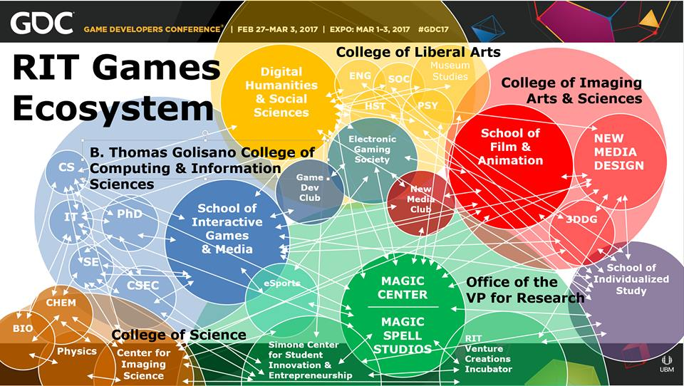

Slide 9
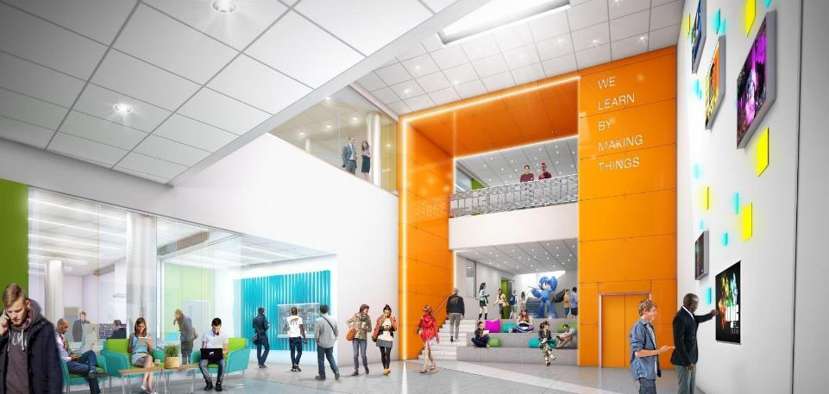
WE LEARN BY MAKING THINGS
Notes:
This is an architectural rendering of the lobby of the new MAGIC Spell Studios building. It will display our tagline ‘We Learn By Making Things’ which is based in part off of Ian’s statement, and reflection that this is a core value of RIT (whether it remembers it all the time or not ;) )

Slide 10
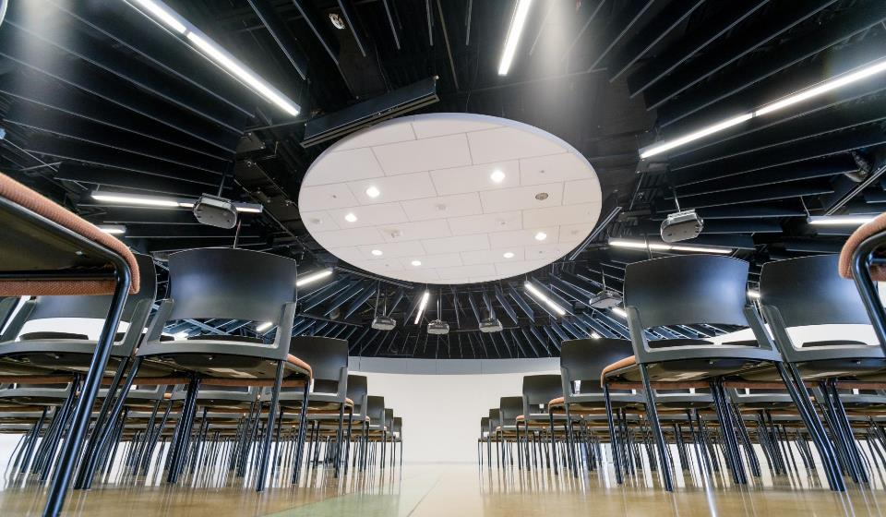


HOW IS MAGIC:
A VERY IMPORTANT DIVISION:
Notes:
Right from Bill’s ‘idea lab’ paper was the idea of an entrepreneurial effort inside the center to help publish and commercialize the things we make. We wanted to call it ‘MAGIC Studios’ at first but we were very afraid we’d get in trouble with The Mouse.

Slide 11
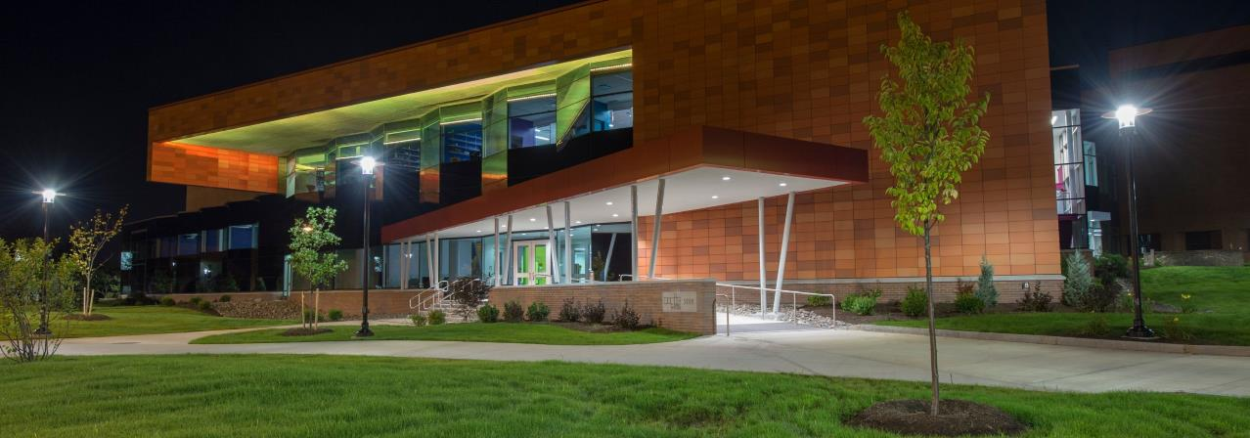
MAGIC TODAY & TOMORROW
Notes:
So let’s take a little look at where we are today, in our current home, what we’ve built, where we are going.

Slide 12
A little bit on the history of games in higher ed
GAME STUDIES
Circa 2001 I offered a course in ‘game programming’ that was so new the NY Times showed up to over my course. It was a weird day.
There was a mailing list of the other folks I could find that had a game development course in the states. There were 6 people on it.
Similar trajectory in game dev, games studies, game design, game art
GAME DEV
GAME DESIGN
GAME ART

Slide 13
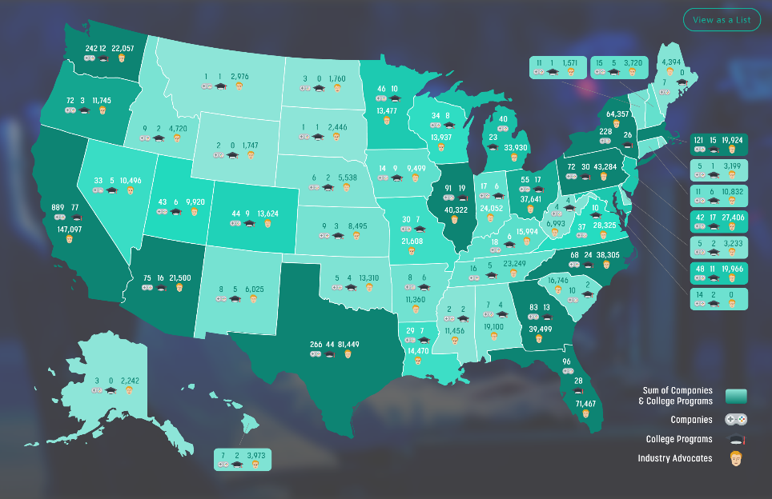
TODAY, THERE ARE 521 COLLEGE PROGRAMS IN NORTH AMERICA ALONE
THESE RANGE FROM GAME DESIGN, GAME DEVELOPMENT, GAME STUDIES, GAME ART, COMPUTING, ENGINEERING, AND MORE IN FORMAL AND INFORMAL PROGRAMS, MAJORS, MINORS, AND COURSES
Notes:
ARE WE IN YOUR STATE? Data map from Entertainment Software Association

Slide 14
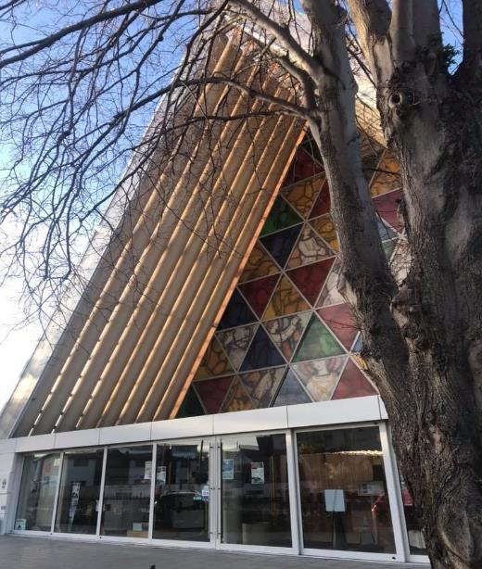
Teaching game production
(the last ~5 years)

Slide 15
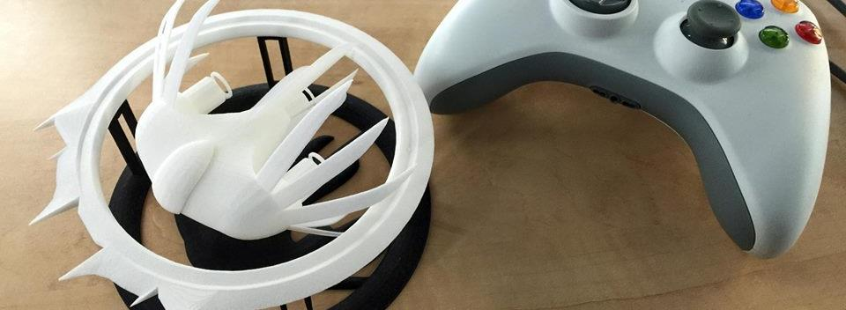

A Strange Game for Strange Reasons
This game taught us (the campus) about making things, production, and scale
This game allowed us to explore using typical game forms for telling a unique story to a very targeted audience
Finalist at GLS Education Arcade, shown at DiGRA Blank Arcade, and IndieArcade at the Smithsonian American Museum of Art
SPLATTERSHMUP.RIT.EDU – PLAY TODAY! MAKE ART!

Slide 16

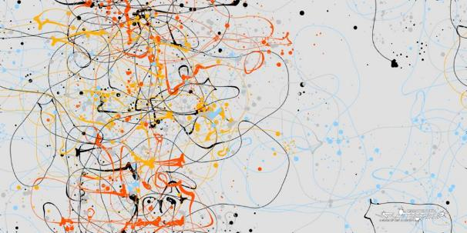
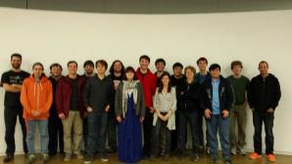
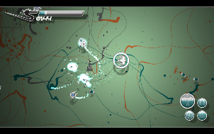
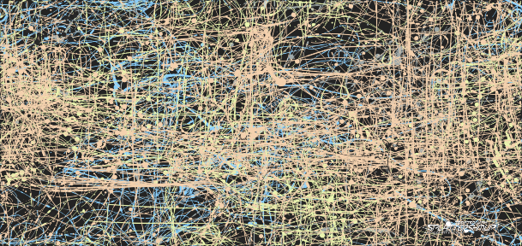




Slide 17


Slide 18
Structure & Schedule
ANDY
CTO
OPERATIONS MANAGER
Art schedule was fixed at about week 4, for the bulk of the semester (character and anim every 2 weeks)
Dev was more fluid, need based, iterative for specific features & systems... but still time-tasked
AGILE development model, SCRUM based, iterative in all areas, report outs between teams & managers
CREATIVE DIRECTOR
COMMUNICATIONS
OFFICER
PROJECT MANAGER
ART TEAM
AUDIO TEAM
DEV TEAM
UI/UX TEAM

Slide 19

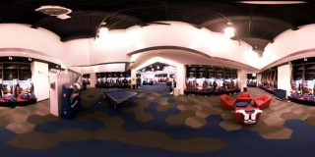

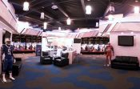
A SUMMER WITH THE
BUFFALO BILLS
Notes:
A big high-vis project that was (a) external client through the studio, (b) multi-disciplinary team, (c) primarily managed entirely by staff

Slide 20



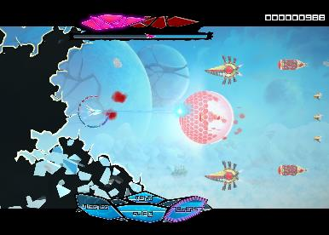
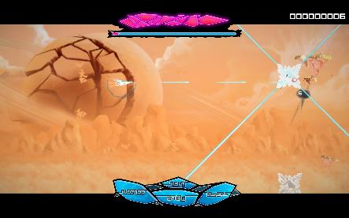
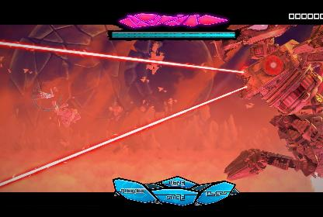

Slide 21
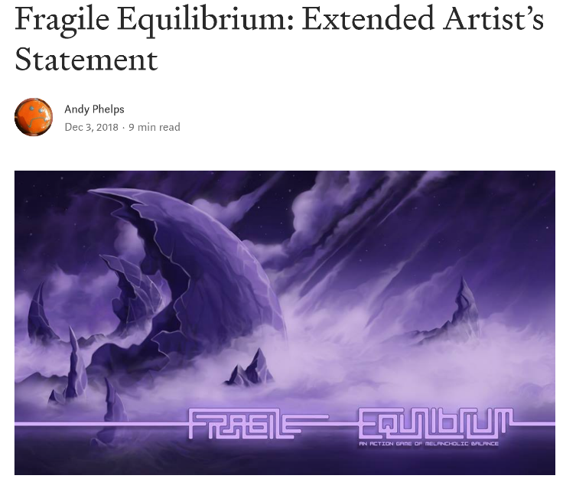
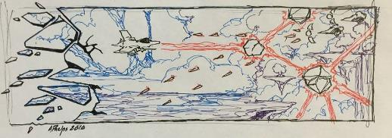
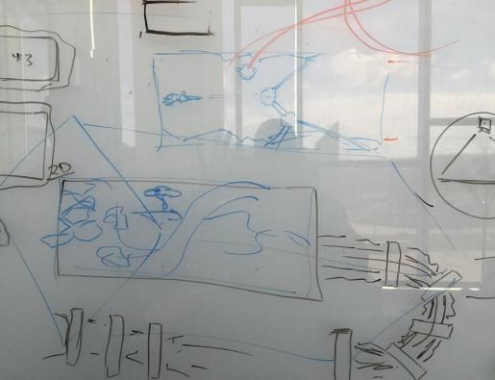

Slide 22
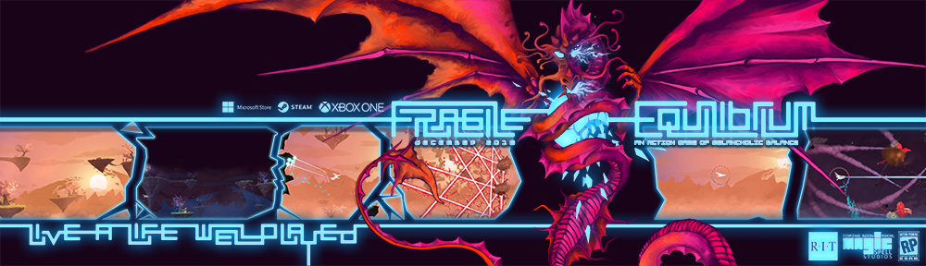
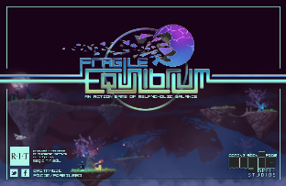
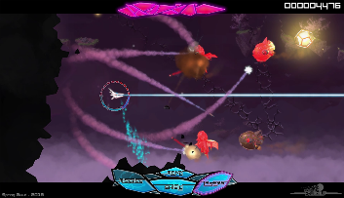
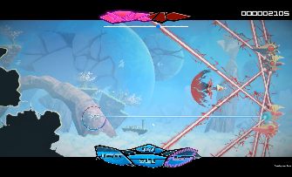
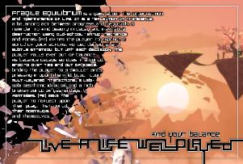

Slide 23
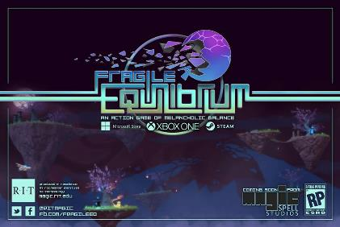
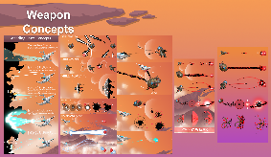
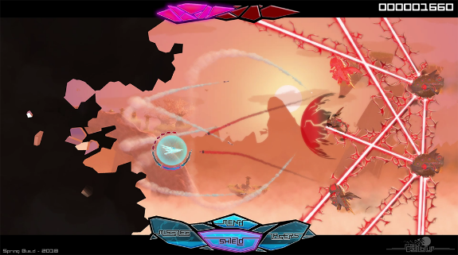
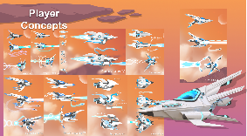
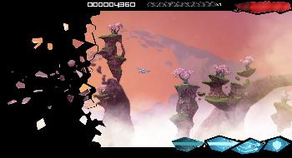
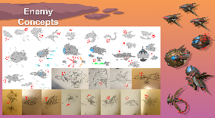
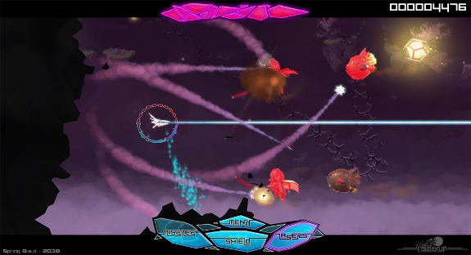

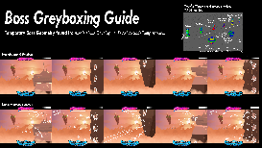
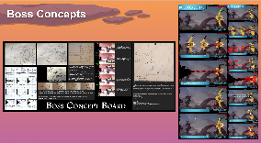

IN GAME UI, DESIGN, GAMEPLAY, ETC.

Slide 24
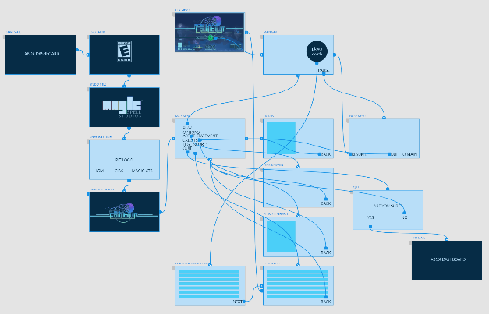





OUT OF GAME UI/UX and MENUFLOW

Slide 25
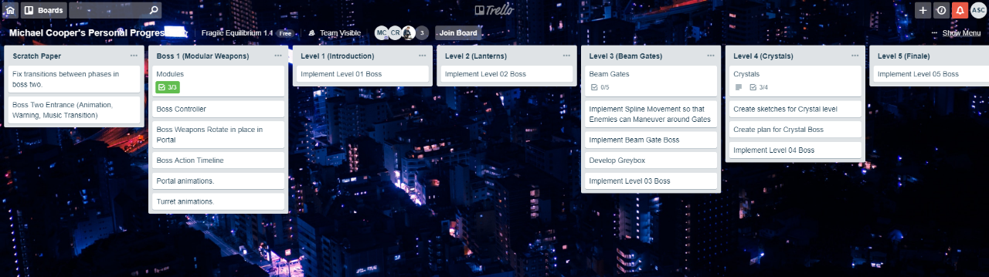

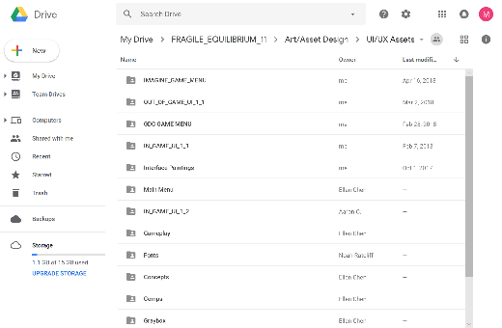
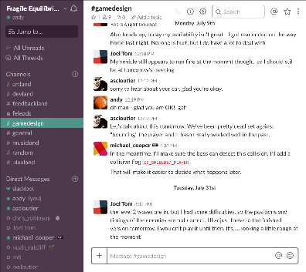

COMMUNICATIONS INFRASTRUCTURE

Slide 26







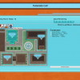
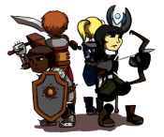








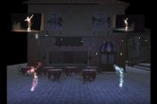
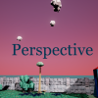

















5 YEARS OF LEARNING THROUGH MAKING AT MAGIC. 5 YEARS OF PROJECTS & MEDIA.
Notes:
So I highlight those 3 because of the things we learned and as data points of growth, but the thing is we did a LOT of stuff from a LOT of work for a LOT of people! It’s a lot bigger a community than people even think about. It’s easy when you are working on ‘your thing’ to not realize the scope and scale of everything else that’s happening and going on.

Slide 27


CORE DESIGN PRINCIPLE
NO SPACE SHOULD BE USED FOR ONLY ONE THING, OR BY ONLY ONE CONSTITUENCY: OUR COMMITMENT TO MULTI-DISCIPLINARY AND CROSS-DISCIPLINARY WORK SHOULD EXTEND TO THE PHYSICAL BUILDING DESIGN, TECHNOLOGY SELECTION, ADMINISTRATION AND OPERATIONS, CULTURE & COMMUNITY.
WE WERE TRYING FOR A PARTICLE ACCELERATOR FOR THE HAPPY ACCIDENT.
(AND MODEL FOR OUR STUDENTS HOW COLLABORATION AND TEAMS FUNCTION)

Slide 28

…The M is for Messy
Notes:
The M is for Messy.

Slide 29
NO REALLY, REALLY, MESSY
BUSINESS INCUBATOR & TECHNOLOGY TRANSFER OFFICE
ACADEMIC DEPARTMENTS & COLLEGES
MAGIC LAB
(RESEARCH CENTER)
MAGIC SPELL STUDIOS, LLC
PUBLICLY VISIBLE ACTIVITIES AND PRODUCTS
SPONSORED RESEARCH SERVICES
GOVERNMENT & COMMUNITY RELATIONS
DEVELOPMENT & ALUMNI RELATIONS
ENTREPRENEURSHIP CENTER

Slide 30
AND IT WAS MESSY PAYING FOR IT
START UP FINDING FROM THE UNIVERSITY
BOARD OF TRUSTEES RAISED GIFT FUNDS
RESEARCH OVERHEAD & “SPECIAL” RETURN RATE
PERCENTAGE RETURN FOR GAMES & MEDIA SALES
FUNDING FOR EVENTS & SERVICES
NSF I-CORE NODE GRANT MONEY
CORPORATE GIFTS & GIFT IN KIND SERVICES
CORPORATE R&D CONTRACTS / CLIENT WORK
PASS THROUGH FUNDING ON SBIR GRANTS
NY STATE “GAMES HUB” DESIGNATION & PROGRAM
DIFFERENT GROUPS, METHODS, POOLS, PLATFORMS, & REPORTING MECHANISMS

Slide 31

SO WHAT DID I LEARN ABOUT TEACHING GAME PRODUCTION, IF ANYTHING?

Slide 32

WHAT BIG PROBLEMS WERE WE TRYING TO SOLVE?
COMMUNICATION – Things get “Lost in Translation” between UI/UX, art, design, dev/engineering, QA…
FORMAL and INFORMAL LEARNING – Not just skills but skills applied to complex practice, situated learning in context. “learn by making things”
CULTURAL DEV & CAPABILITY – Where do games come from? What is a repeatable design process? How do studios work? Maturity & Palette?
ACADEMIC IMMERSION – creating a shared space between computing and the arts, between research and practice…

Slide 33
MOST SUCCESSFUL PROJECT (measuring by ACADEMIC impact)
Funded first internally
Then by NEH
Then by NEH (again)
Then we figured out board game creation and printing
Then we figured out publishing
Then we figured out distribution
Then we figured out marketing
You’ll see it here in May, or lots of other places, and ICHENG/SMOP

Slide 34

MOST SUCCESSFUL PROJECT
(BY DOLLARS, ONE WAY)
… was an NSF award studying early computer science education that had no “product”
But we used the studio for grant support, designing logos for SIGCSE, providing logistical website support for CFP and workshop coordination, etc.
We also used the studio as a workspace for the NSF grant, and let the software and hardware licenses bleed back into academics
Dedicated staff support, marketing, and logistics

Slide 35

MOST SUCCESSFUL PROJECT
(BY DOLLARS, ANOTHER WAY)
SUPER DARYL DELUXE
First Investment by the RIT Venture Fund in a game
Support for Dan & Gary (the authors) post-graduation, in connection with studio resources
Winner best visuals INTEL Game Challenge
Winner Microsoft Imagine Cup
Released on Playstation and other platforms
Often cited in student applications (which for a tuition based university is a big deal)

Slide 36

MOST SUCCESSFUL PROJECT
(BY DOLLARS, A THIRD WAY)
In raw ROI, the NFL project was the clear winner
In institutional reputation gain, things are very mixed and largely unmeasurable ☹

Slide 37

MOST SUCCESSFUL PROJECT
(BY EDUCATIONAL IMPACT)
HACK, SLASH & BACKSTAB
Most students impacted
Longest production run
Highest visibility on console market, and thereby on student portfolio tie-ins and industry reputation
Largest number of students with f/t placements afterward

Slide 38

A Love Note on platform requirements
Required length of time for particular screens
Required animation per screen (aka “not dead yet!”)
If the controller is ripped away, what happens?
If the controller is mis-queued, what happens?
If the input is re-mapped, what happens? Accessibility?

Slide 39

And in the theme of GGC
We tried to model a constant touch, iterative approach…
…that purposefully also built in downtime….
…and structures to help with communication and conflict resolution…
…which really, has to start with us (which presumes (☺) that faculty are good at this)…
… how do you teach a deeply malleable, highly experiential, slippery thing?

Slide 40

RETHINKING APPRENTICESHIP ?

Slide 41

ANDYWORLD.IO | PROFESSORANDREWPHELPS.NET | @ANDYMPHELPS | ANDYMPHELPS@GMAIL.COM
Thanks & Questions

