Slide 1


:
How To Talk About Video Games Today:
So What Do We Do About It?
GAMES 4 CHANGE FESTIVAL | NEW YORK CITY 2019
Andrew Phelps
Professor of Human Interface Technology, University of Canterbury, NZ
Professor of Art & Design, Rochester Institute of Technology, USA
Games Scholar in Residence, American University, USA
President, Higher Education Video Game Alliance
Founder, RIT MAGIC Center & MAGIC Spell Studios
Founder, RIT School of Interactive Games & Media

Slide 2
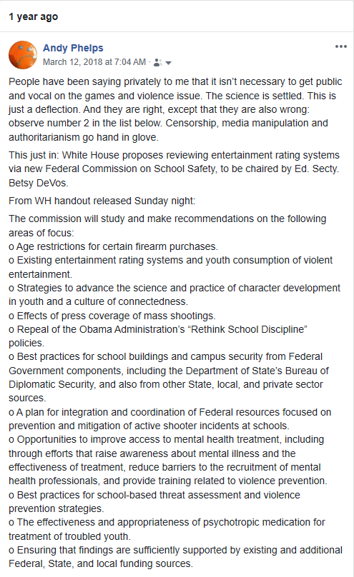
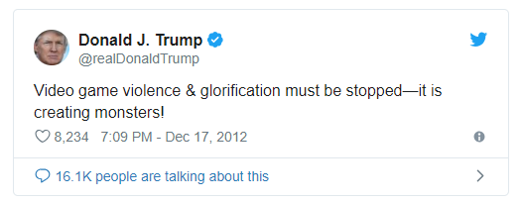
Lets start with a personal story
My friend Constance steps down from HEVGA, and she & the board ask me to take over, Nov 2017...
Take it slow, learn the ropes.
Good advice from the Biden years.
Notes:
The best part of this is that tweet is from 2012

Slide 3
Everything Old is New Again, Again
But what was different was the number of people saying ‘eh, this will just blow over’
And it did. THROUGH ADVOCACY.
“We” focused on the industry representatives, the CEOs, and what “the industry” is doing with games…
But behind the scenes, both academics and industry gave a lot of interviews, issued statements, attended meetings, etc.
Notes:
A lot was written about how ineffectual the meeting at the WH was, and it was two sides shouting at each other. But it was also a chance to let a lot of people blow off steam, create some optics, but also illustrate some bright lines to policy makers. It started discussions in the rest of policy and politics and what would and wouldn’t work

Slide 4

How Does This Affect You?
That’s why games was written out of the school safety commission report, whereas the MPAA was not.
How does this affect you? Because the 1A case decision by the Supreme Court could be challenged or thwarted. And that’s just the USA.
Notes:
EU at Steam on RapeDay recently, etc., legislation over gambling and lootcrates, and more.

Slide 5
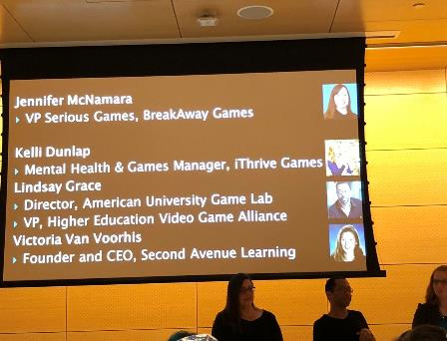


Then Games & Addiction & WHO
HEVGA issues a very similar statement, calling out research that was suspect, meta-analysis of potentially flawed studies, etc.
And yet I watched academics who on violence wanted careful research and study toss around terms like ‘addiction’ and ‘I’ve seen it’ and ‘games are designed for that’
Great panel discussion at G4C 2018

Slide 6

PROFESSOR Chris Ferguson, CHIPLAY 2018
“It is time for a reassessment of games research and how a societal culture of moral panic impacted games research over the past few decades. However, these cultural issues can be repaired first by understanding the historical patterns of moral panic that scholars contributed to and second by embracing a culture of open science.”

Slide 7


Professor Andrew Przybylski, GDC 2019
Associate Professor, Senior Research Fellow and Director of Research, Oxford Internet Institute
Pretty darn critical of “the industry” and what it was doing regarding research presentation, but also critical of WHO and their approach
(Yes, you can be critical of TWO things at once, a theme for later)

Slide 8
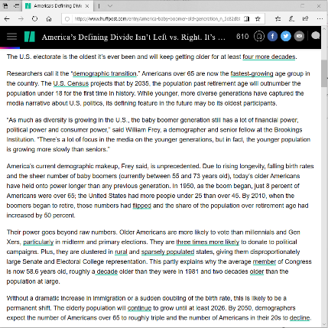
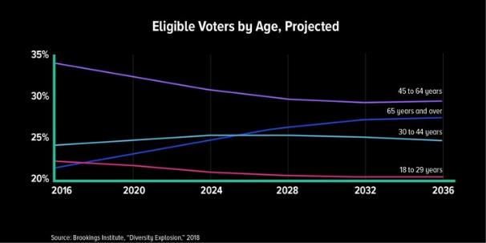
There are Big Generational Divides Regarding Attitudes About Games
Lots of people play games, but lots of people play very different kinds of games
The US is about to get ridiculous, because we have an election coming up
Notes:
https://www.huffpost.com/entry/america-baby-boomer-old-generation_n_5c82db8de4b0ed0a00136b0c

Slide 9
SO WHAT CAN WE DO / WHAT COMES NEXT?
First, let’s remember that even today in 2019, there isn’t really a good public narrative about how games get made or by whom.
MAGIC PIXIE STUFF
IDEA PERSON!
YAY A GAME!

Slide 10

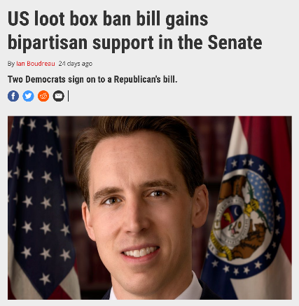
We’ve Talked About Big National and International Examples
But this applies to state and local levels
This matters at a school near you, or a library, or a pediatric office, or a coffee shop
This is an issue in local and state politics
Notes:
Last year Hawaii was among a handful of states to look at regulating loot crates independently. VT had a commission pass a resolution restricting violent video games. https://geekmountainstate.com/2018/04/13/vermont-house-passes-resolution-to-urging-restrictions-on-violent-video-games/
Now the issue is at the congressional level with support from Connecticut and Missouri and Massacheusettes
Hawley, a US Senator representing Missouri, released the full text of the The Protecting Children from Abusive Games Act (pdf) yesterday, along with Democratic co-sponsors Senator Richard Blumenthal of Connecticut and Senator Ed Markey of Massachusetts.

Slide 11







If we profess to care about this medium, to aspire to games as art, and to hold ourselves to the highest academic and professional standards, then that also means using our knowledge and expertise to help the public better understand these issues and make informed decisions.
SOME RESOURCES:

Slide 12
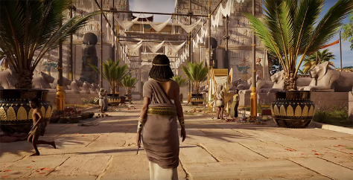


AND LETS REMEMBER SOME AWESOME THINGS GAMES HAVE DONE ALONG THE WAY
Both for Education & Entertainment
Notes:
https://geekandsundry.com/how-assassins-creed-is-helping-students-learn-about-history/
Minecraft.com
FoldIt screenshot (retrieved online)
But a key point here is not to just get lost on the ‘serious games’ stuff either – making entertainment products also has societal value. It is also of benefit. It is also ‘worthy’ of public support and engagement.

Slide 13
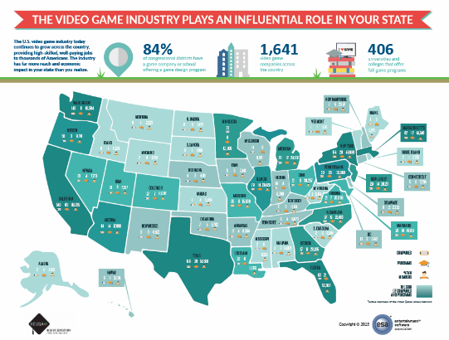
Conclusions Part I
Beware the ‘media rumor’
Remember that we have been here before
Beware of unpublished or ‘preliminary’ research or ‘sponsored’ studies
Seek empathy with motivations of parents
Remember that you are an expert on the creation of games – most people have no idea how games are planned, made, marketed, or sold

Slide 14

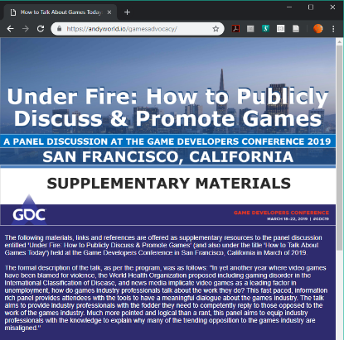
Conclusions Part II
Our relationship with games is complex, just as with any form of media
A lot of times the research is less clear in any direction than headlines will allow
A lot of what we know about other media is not used comparatively when discussing games
The way we talk about games influences a lot of what is said about them, and where future research is targeted
YOU make a difference when you speak as a games creator, researcher, or professional
SUPPLEMENTARY MATERIALS FOR YOU TO USE! REACH OUT TO IGDA, HEVGA, G4C, GGJ, AND OTHERS FOR HELP!

Slide 15


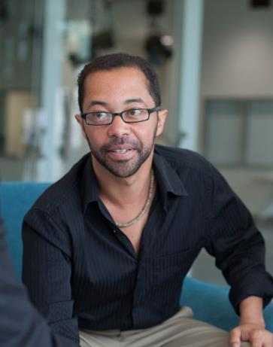

THANKS & Q&A WITH OUR PANELISTS
Roger Altizer
University of Utah
roger.altizer@utah.edu
@real_rahjur
Mia Consalvo
Concordia University
mconsalvo@gmail.com
@miac
Lindsay Grace
University of Miami
learnvideogames@gmail.com
@mindtoggle
Andy Phelps
Rochester Institute of Tech.
andy@mail.rit.edu
@andymphelps
Notes:
NOTE: Lindsay will insert a bibliography here with the links to articles cited throughout as well as additional pieces of note and studies that are most relevant

Slide 16
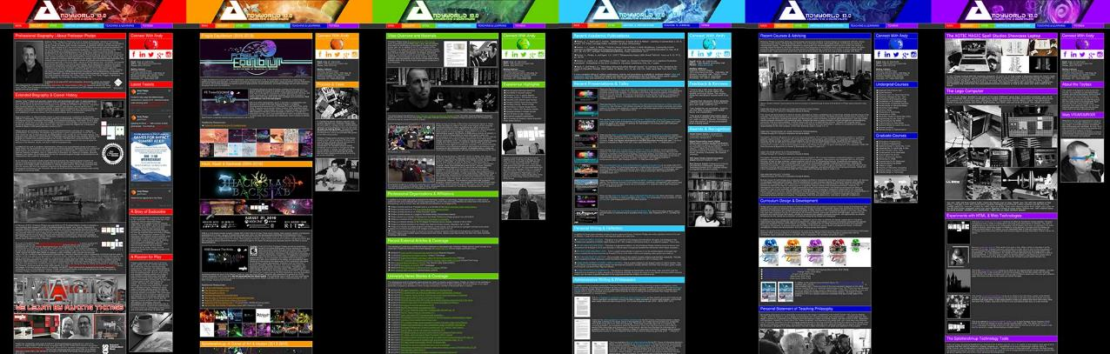
ANDYWORLD.IO | PROFESSORANDREWPHELPS.NET | @ANDYMPHELPS | ANDYMPHELPS@GMAIL.COM
Thanks & Questions

