Slide 1



Theorizing a Design Model for Transformative Play
A Case Study Approach using
Fragile Equilibrium: an Action Game of Melancholic Balance
:
Human Interface Technology Laboratory New Zealand (HITLabNZ)
Andrew M. Phelps
Professor of Human Interface Technology, College of Engineering, University of Canterbury, NZ
Professor, Film & Media Arts, School of Communication, American University, USA
Director, AU Game Lab & American University Game Initiative
President, Higher Education Video Game Alliance
Co-Founder, Applied Immersive Gaming Initiative
THIS TALK IS PRESENTED IN COLLABORATION WITH FORTHCOMING CO-AUTHORED WORK WITH DORIS C. RUSCH.

Slide 2

Today’s Talk
Intro in 2 minutes
Overview of Fragile Equilibrium: An Action Game of Melancholic Balance
Ruins and Nostalgia in Fragile Equilibrium
A Case for Experiential Games
A Model for Transformational Game Design / Designing for Psychological and Emotional Resonance
Current thinking & challenges
Request for Feedback & Critique

Slide 3
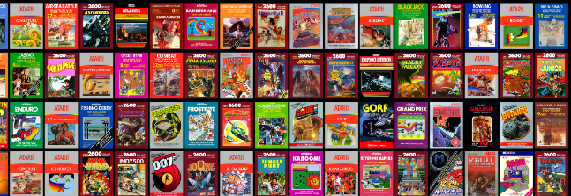

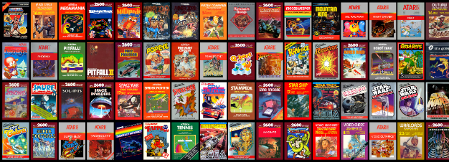
HI, I’m ANDY

Slide 4

A HISTORY OF GAMES & INTERACTIVE MEDIA
1999-2020
2001 programming
First course in games programming
2002
Electronic Gaming Society
2003
CS/IT Concentration in Game Prog
2006
MSc Game Design & Development
2007
BSc Game Design & Development
2009
Dept. of Interactive Games & Media
2011
School of Interactive Games & Media
2012
Minor in Game Design
2013
RIT Center for Media, Arts, Games, Interaction & Creativity (MAGIC)
2013
MAGIC Spell Studios ®, LLC
2016
$30M MAGIC Spell Studios Initiative
2016
NY State Games HUB
2017
NY State Games Challenge
2019
American University Game Lab
2020
HIT Lab NZ + AIGI

Slide 5





School of Interactive Games & Media

Slide 6

CENTER for MAGIC, ARTS, GAMES, INTERACTION & CREATIVITY (MAGIC)
MAGIC SPELL STUDIOS

Slide 7





INCREDIBLEY AWESOME ALUMNI
ALEX CUTTING
Senior Assoc. Producer HALO
Microsoft / 343
CLAUDE JEROME
Gameplay Designer DESTINY
Bungie
DUSTIN KOCHENSPARGER
Line Producer DLC
DESTINY
Bungie
SELA DAVIS
Platform Engineer
XBOX / XBOX Live
Microsoft
VReal
ANNA SWEET
Director of 3rd Party Development
STEAM
Valve
Oculus
Caffeine.ty
Microsoft XBOX

Slide 8




Art|dev|EDU|art|ADMIN|dev|art

Slide 9
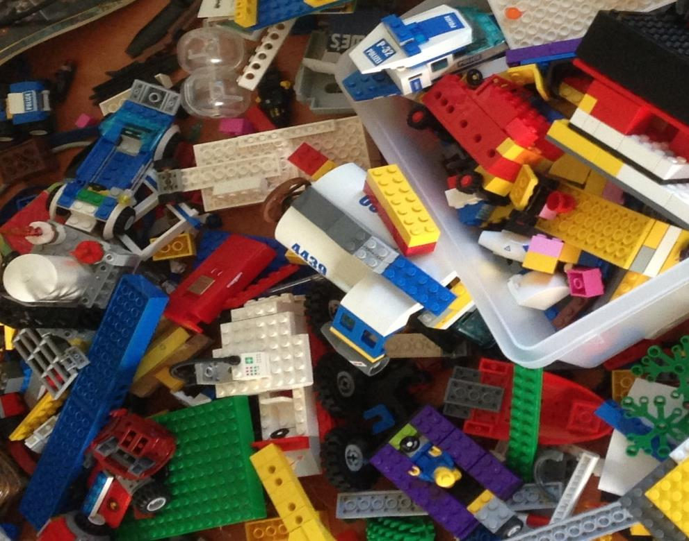
'protecting “making as a
mode of inquiry”’
-Ian Horswill, Northwestern
Notes:
This quote is from Ian Horswill, who said it, I think the first time? sitting on the floor of Microsoft Research at the MSR Faculty Summit a number of years ago. It has been rolling around in the back of my brain ever since – and it was the fundamental thing upon which MAGIC was founded, that somehow design research, making prototypes to test ideas, learning by making new things and new experiences, needed to be recognized and valued. At RIT we’ve sometimes used the rhetoric of STEM and Research to de-value those activities in weird ways.

Slide 10
GAMES OF THE SOUL

Slide 11
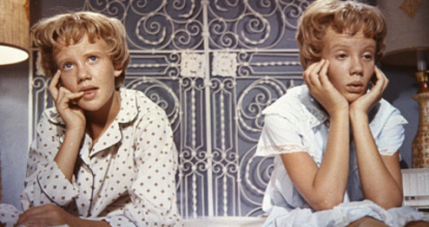
PROVOCATION: GAMES FOR CHANGE IS BROKEN
Measuring change is most possible if it is agenda driven and has clearly defined pre / post conditions. Relative to this work, such an approach is proposed by Culyba’s (2018) Transformational framework, which has become the state of the art in the games for change community.
This is problematic for two main reasons: 1) it limits the kinds of change we aim to design for to those that are measurable and 2) it precludes us from being able to acknowledge and meaningfully discuss powerful, but less clearly measurable, transformations. (Rusch & Phelps, 2020)
THE ASSESSMENT TRAP

Slide 12
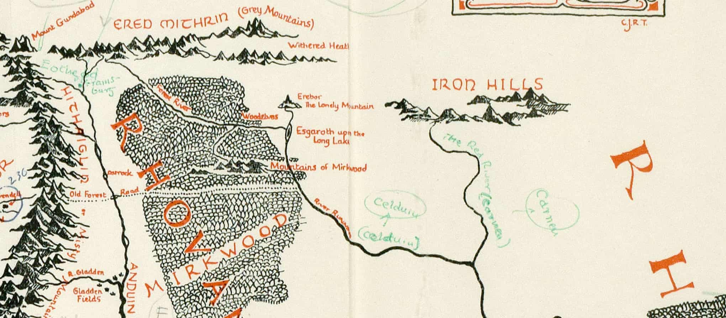
AS HUMANS, WE BRING OURSELVES TO OUR EXPERIENCES
KNOWLEDGE OF A SYSTEM IS NOT EMPATHY
AND DOES NOT PRESUPPOSE TRANSFORMATION
A large part of games’ transformative potential thus remains either unrealized or invisible (Paolo Pedercini, 2014). But how can we intentionally design for personal transformation without pre-determining the kind of change the game should ignite or seeks to impose upon its players? How can we facilitate profound, organic inner shifts through our designs that allow players to “respond to them of themselves, with recognition, uncoerced[?]” (Campbell 1991, p.3).
GAMES ARE NOT JUST COMPLEX SYSTEMS | MECHANICS

Slide 13
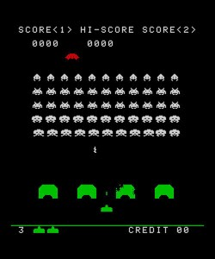
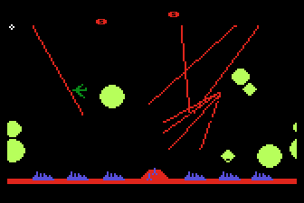
CONTEXT CAN BE EVERYTHING
Space Invaders 1978
Missile Command 1982

Slide 14
A VIDEO WAS HERE, AND IS AVAILABLE AT: https://youtu.be/EjBNro2cbI8

Slide 15


Slide 16
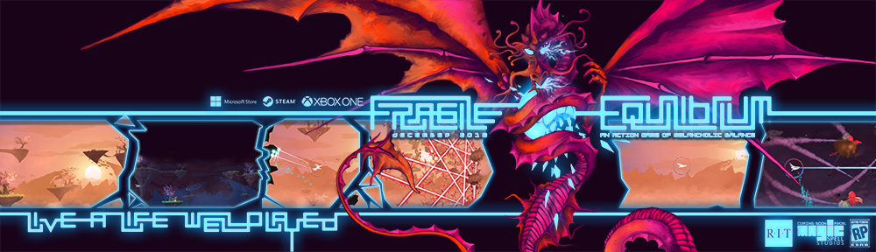
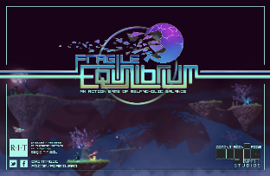
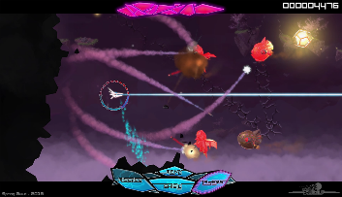
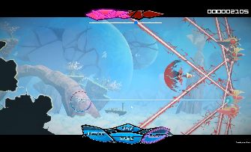
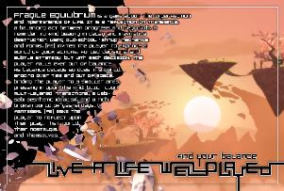

Slide 17
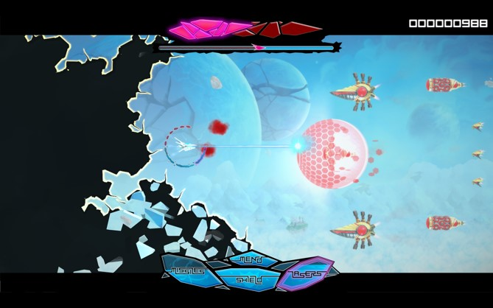
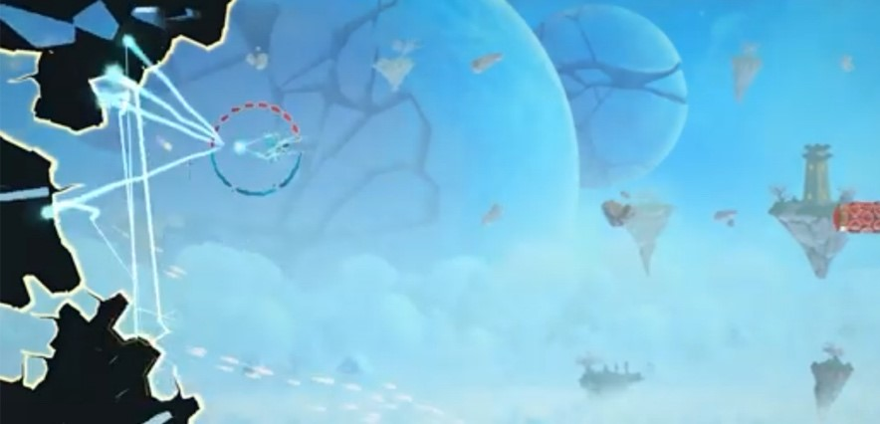
Fragile Equilibrium in both ‘shmup facing mode’ (left) and ‘repair mode’ (right).

Slide 18
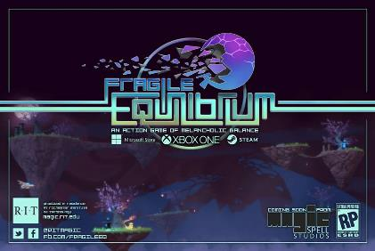
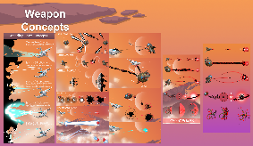
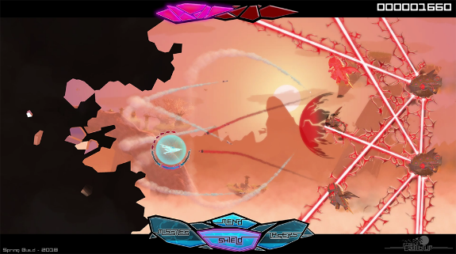
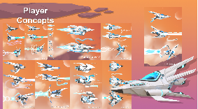
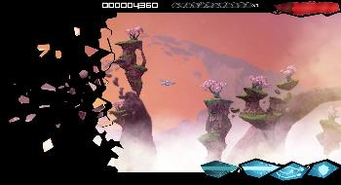
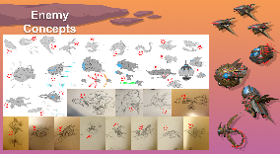
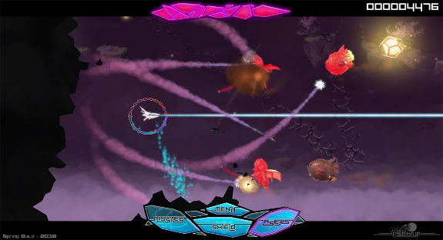

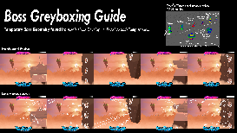
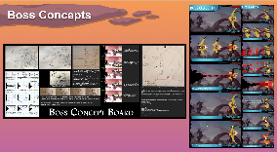

A lot went into this metaphor…

Slide 19
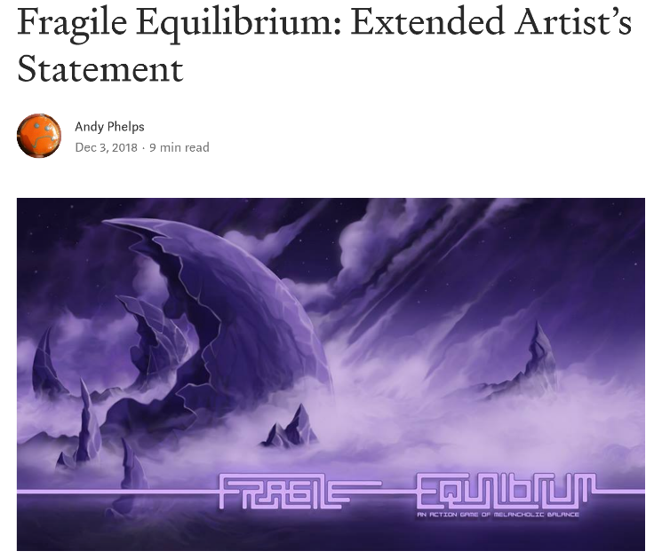
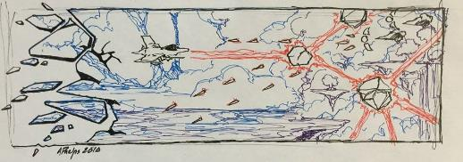
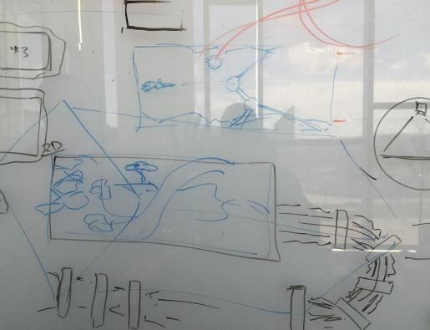

Slide 20
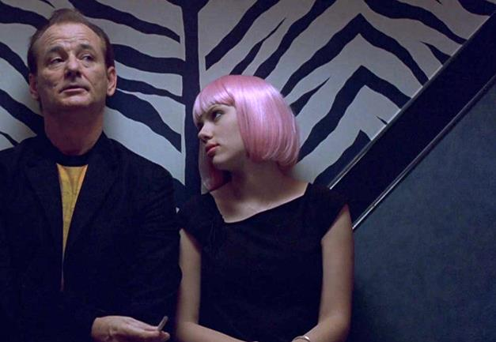
So what is this really all about?
This whole game is a metaphor for living and coping with depression and anxiety
It is intended not as an educational game, but as an experiential game.
The idea is to simply convey a feeling – the idea of compression, of balance, of a constant need to evaluate and course correct in the midst of other action and experience
Notes:
Reference to Lost in Translation for obvious reasons (i.e. that this is an experiential game in part the way that movie tried to convey the cultural dissonance)

Slide 21
AN ARGUMENT FOR THE EXPERIENTIAL GAME
ACTIVE LEARNING THEORY (Kiili 2005, Cziksentmihalyi 1990)
  concrete experience
  reflective observation
  abstract conceptualization
  active experimentation
  CONSTRUCTIVIST (Phillips, 1995) and and CONSTRUCTIONIST (Papert, 1991) theory
  “the model stresses the continuous nature of learning and the appropriate feedback which provides the basis for a continuous process of goal-directed action” (Kiili, 2005). In other words, the experiential learning model promotes uninterrupted engagement with and reframing of certain concepts, cementing them through repetition and iteration within the learner’s own experience.”

Slide 22

setting of the world consists of a form of ruination and nostalgia
inspirations from Treasure’s Ikaruga, Kaihatsu’s Rai Den, and Irem’s R-Type
the artworks of Roger Dean
similar visual narratives from the late 1970s and early 1980s
In this way, the game seeks to directly employ a sense of post-apocalyptic nostalgia (Fuchs, 2017) for the era when ‘shmups’ were at their height
FE also makes a designed play on agency with regard to ruin, seeking to specifically extend a form of “‘deconstruction mode’ in which buildings or objects are turned into ruins ‘on demand’, so to speak, within the context of a game” (Lowe, 2012, chap. 3.) as the view of the world is brought to literal ruin during play
Notes:
Artwork by Roger Dean

Slide 23



VISUAL AESTHETIC

Slide 24

THE METAPHOR IN DEPTH
The designers of the game have spoken openly about the game as a metaphor for depression (Phelps, 2018), and also in the context of the Wabi Sabi aesthetic. (Koren, 2008)

Slide 25
REPETITION & LAYERS
As noted previously, this mechanic, along with other elements of the game, is meant as an experiential metaphor (as described by Rusch in Making Deep Games (2017)) for depression, mental health, and self-care. The player must at once both ‘deal with’ the normal ‘shmup world’– i.e. the external enemies and projectiles that come at them wave by wave, but also with the need to (literally) turn around and focus on their own view of the game world that is literally breaking apart. In this sense, the game invites players to reflect on external and internal conceptualizations of the world.
Ian Bogost (2007) discussed how repetition of actions or rules in video games can function to inform us about something rather than it being told to us. Phelps and Consalvo (2019) argued that “repetitive acts in gameplay can function procedurally as metaphors themselves” (p. 2).

Slide 26



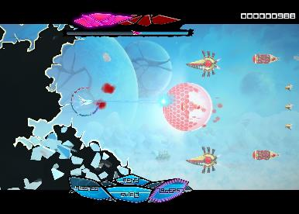
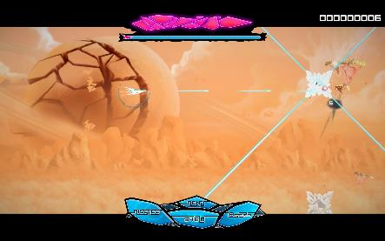
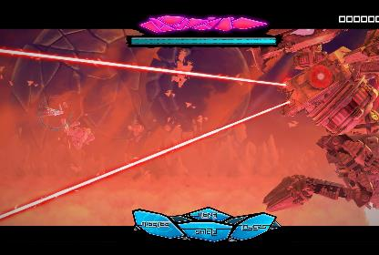

Slide 27
PLAYER ANALYSIS AND RECEPTION
“what is this? Manifestation of all the bad feels going on? Cuz often times things like depression and whatnot are shown to be like goop like that, just sticky, icky bad feelings and all that. Bogs you down…” (Mr Skysen, 2019a).
“...it’s not just recreating everything, you're just pulling it all back into place. You're not creating a new reality, you're just fixing it. You're trying to hold everything all together as best you can in this crazy world…” (Mr Skysen, 2019c).

Slide 28
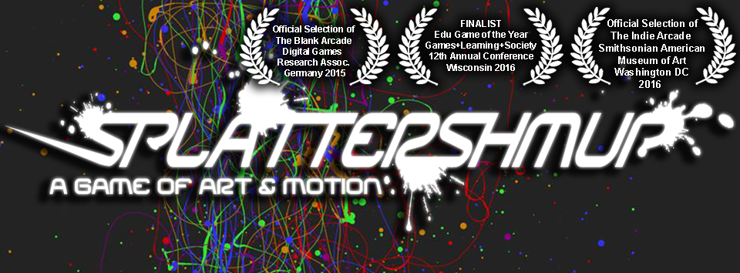
ANOTHER OF (MY) EXPERIENTIAL GAMES

Slide 29

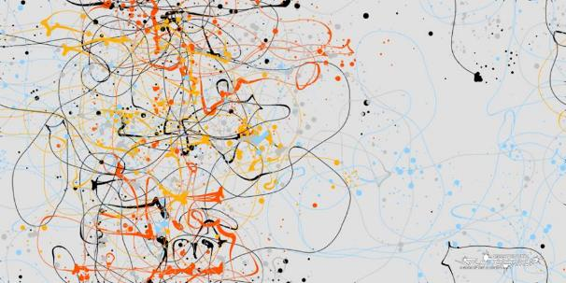

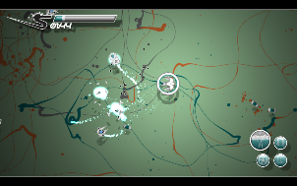
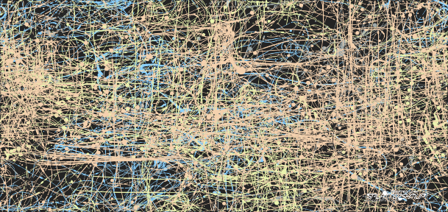




Slide 30
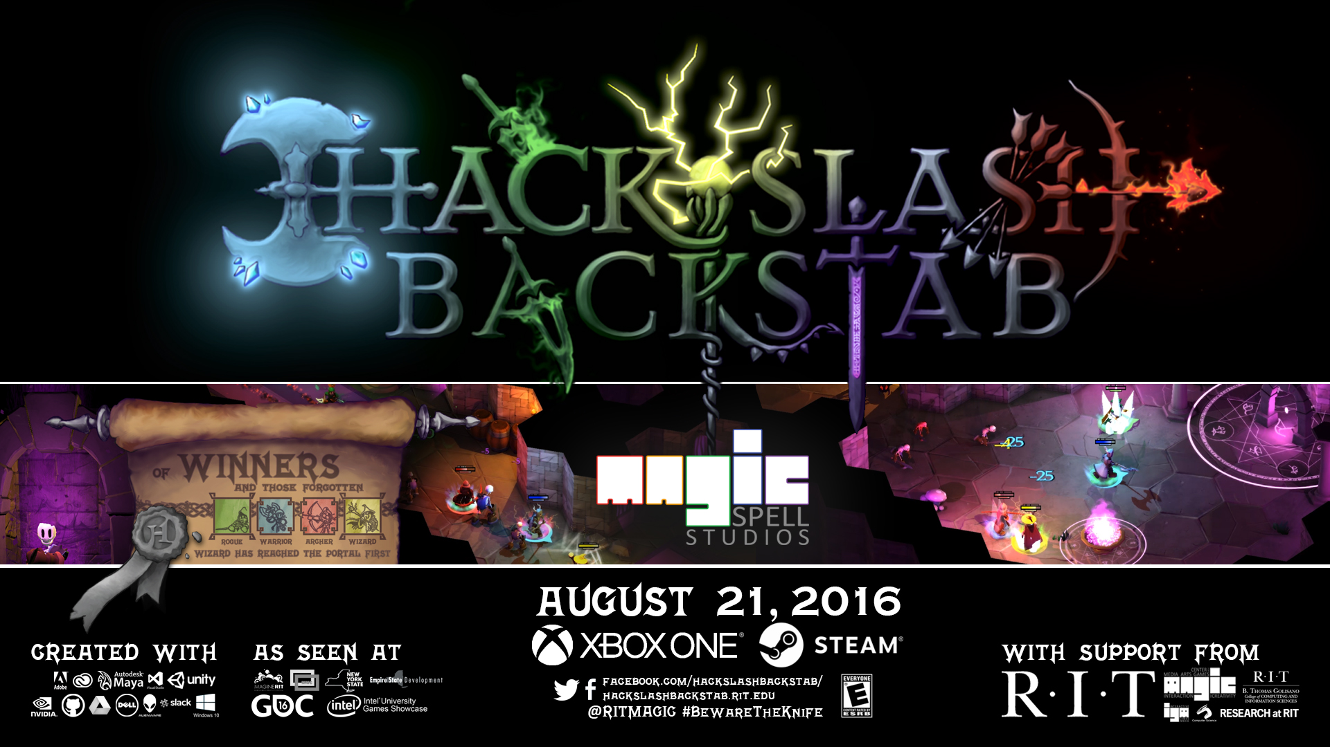
AND ANOTHER ONE…

Slide 31
SITUATING FRAGILE EQUILIBRIUM IN REPRESENTATIONAL CONTEXT
Depression Quest by Zoe Quinn
Hellblade: Senua’s Sacrifice by Ninja Theory
Night in the Woods by Infinite Fall
Mianichi by Mattie Brice
Elude by Doris Rusch

Slide 32
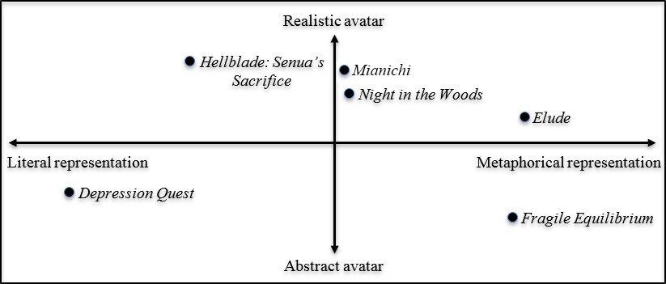
A two-axes plot analysis of design elements of recent games with sophisticated depictions of mental illness, examining a range of games from the literal to metaphorical, and from realistic to abstract avatar representation.

Slide 33
3 PILLAR DESIGN THEORY FOR TRANSFORMATIONAL GAMES
[Rush and Phelps, 2020] propose a transformational game design framework that shifts the locus of control in regards to a potential transformation to the player by basing it on the concept of emotional and “psychological resonance” (Goodwyn, 2016). As C.G. Jung wrote about the transformative power of resonant expressions: “The auditor experiences some of the sensations but is not transformed. Their imaginations are stimulated: they go home and through personal fantasies begin the process of transformation for themselves." (Bonnett, 2006, p.27).

Slide 34
1: EXISTENTIAL THEMES AND TOPICS
Existential psychotherapy is a useful source because it deals with the universal concerns of the human experience such as death, freedom and choice, existential isolation, and meaninglessness (Yalom 1980, pp.8-9). Deep, transformative experiences are often connected to our approach and attitudes towards these ‘givens of existence’ (Rusch, 2020). We can learn from the themes and goals of existential psychotherapy and how it goes about achieving them to create games that facilitate contemplation of existential issues. (Rusch, 2020)

Slide 35
2: MYTH AND RITUAL AS TOOLS TO REACH THE UNCONSCIOUS
Myth and ritual have been used as vehicles to orient ourselves towards universal, existential concerns and have thus been leveraged extensively in existential psychotherapy and depth psychology (May, 1991; Feinstein and Krippner, 1988, 1997; Larsen 1996; Hillman, 1996). Indexical symbolic enactments of inner conflicts can send powerful signals to the unconscious mind, thus contributing to greater authenticity and inner balance. (Rusch, 2020)
Notes:
Those guidelines can be summarized as 1) identifying a narrative theme and structure that is inspired by the three types of rituals: liberation, transformation and commemoration / celebration. 2) embedding symbolic enactment into a metaphorical environment, because metaphors make intangible concepts like inner themes tangible, and orient players in regards to the deeper meaning of the game and its symbolic nature 3) considerations of contextual mechanisms that allow players to “warm up” to the inner conflict modeled in the game, and promote its “processing” 4) designing for psychological resonance by aiming for emotional evocativeness, sensual vividness, minimal counter-intuitiveness and low complexity of actions and objects involved in the enactment.

Slide 36
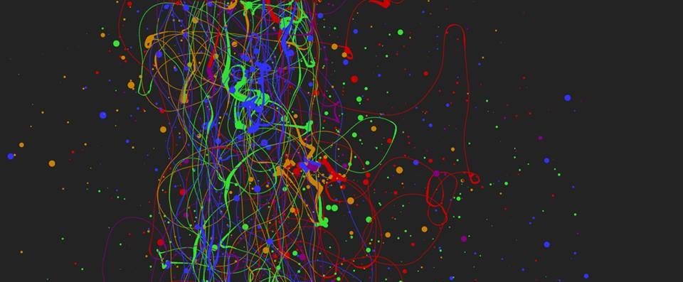
3: EXPERIENTIAL – “WHAT YOU PLAY IS WHAT YOU GET”
When we refer to experiential design, we mean the entire contextual experience of playing a game, and the interpretation of the experience by the player directly in the context of the experience itself. This kind of ‘what you do is what you get’ game is of increasing interest in the field, and in this manner is essentially an ‘experientially educational’ game (Phelps, Wagner, and Moger, 2020). Players can gain an understanding of, and empathy for, a given scenario or subject matter merely through the act of playing it, and specifically through the act of interacting with it. (Phelps, 2020)

Slide 37
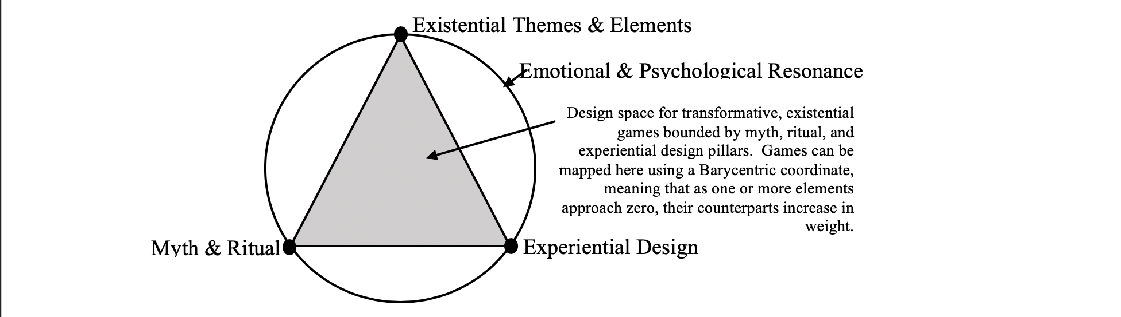
Mapping a design space for games of the soul
(Rusch & Phelps, 2020)

Slide 38

CONCLUSION(ISH) on RUINS
In this manner, the game directly deals with the concept of ruins in games in two distinct yet intertwined ways, which echoes discussions on the combination of spatial play and environmental gameplay elements by Fraser, albeit without the further context of the urban environment. (Fraser, p159)
The passive scenic elements of the game intent on provoking nostalgia, calm, beauty, and remembrance, and the active decay and reconstruction of the player’s view of the world work together to help achieve the vision of FE as a melancholic reflection.

Slide 39
CONCLUSION(ISH) ON TRANSFORMATONAL GAMES: WE NEED MORE AND BETTER KINDS OF ’MEANINGFUL’ GAMES
Experiential games have a unique place in the design space
By focusing less on procedural rhetoric and more on abstract expression via interaction to trigger transformation, we open different doors in the interaction of humans and technology
Utilizing these different lenses examines UX not through functionality or optimization, but through intuition and interpretation
Measuring differently to allow for different design spaces and methodologies is critical if we want to aspire to different results

Slide 40
FORTHCOMING WORK ON THIS THINKING
Phelps, A., Wagner, J. and Moger, A. (2020) "Experiential Depression and Anxiety Through Proceduralized Play: A Case Study of Fragile Equilibrium." Journal of Games, Self and Society. (2) v.1. (in press)
Rusch, Doris C. and Phelps, A. (2020) "Navigating Existential, Transformative Game Design." Digital Games Research Association (DiGRA) 2020. Center of Excellence in Game Culture Studies. Tampere, Finland. (June, 2020)
Phelps, A. (2020) “Fragile Equilibrium: An Action Game of Melancholic Balance.” The International Conference on Interactive Digital Storytelling (ICIDS) 2019 Art Show Book. Eds. R. Bown and B. Salisbury. Entertainment Technology Center (ETC) Press, Carnegie Mellon University. Pittsburg, Penn.

Slide 41
REFERENCES (ON RUINS)
Lowe, Dunstan. “Always Already Ancient: Ruins in the Virtual World.” In Greek and Roman Games in the Computer Age, edited by T. S. Thorsen, 53–90. Trondheim, Norway: Akademika Publishing, 2012. https://kar.kent.ac.uk/30968/.
Dean, Roger, and Amanda Shields. Dragon’s Dream. New York: Collins Design, 2008.
Dean, Roger, Dominy Hamilton, and Carla Capalbo. Views. New York: Collins Design, 2009.
Fraser, Emma. “Awakening in Ruins: The Virtual Spectacle of the End of the City in Video Games.” Journal of Gaming & Virtual Worlds 8, no. 2 (June 1, 2016): 177–96. https://doi.org/10.1386/jgvw.8.2.177_1
Fuchs, Mathias. “‘Ruinensehnsucht’: Longing for Decay in Computer Games.” Transactions of the Digital Games Research Association 3, no. 2 (2017). https://doi.org/10.26503/todigra.v3i2.68.
Phelps, Andrew. “Fragile Equilibrium: Extended Artists Statement.” Medium (blog), December 3, 2018. https://medium.com/@Andy_at_RITMAGIC/fragile-equilibrium-extended-artists-statement-5f3d84548411.
Koren, Leonard. Wabi-Sabi for Artists, Designers, Poets & Philosophers. Point Reyes, Calif: Imperfect Publ, 2008.

Slide 42
REFERENCES: ON FRAMEWORK MODEL
Bonnett, J. 2006. Stealing Fire from the Gods. Studio City, CA: Michael Wiese Productions.
Campbell, J. 1991. Creative Mythology. New York, NY: Arkana Books.
Culyba, S. 2018. The Transformational Framework. Pittsburgh, PA: ETC Press.
Feinstein, D. & Krippner, S. 1988. Personal Mythology. New York, NY: Tarcher/Putnam.
Feinstein, D. & Krippner, S. 1997. The Mythic Path. New York, NY: Tarcher/Putnam.
Goodwyn, E. 2016: Healing Symbols in Psychotherapy. London and New York: Routledge.
G4C14 [Games 4 Change]: 2014, May, 1 Paolo Pedercini Making Games in an F**** Up World. [Video file]. Retrieved from https://www.youtube.com/watch?v=MflkwKt7tl4
Kiili, K. 2005. Digital game-based learning: Towards an experiential gaming model. The Internet and Higher Education, 8(1), pp. 13-24. https://doi.org/10.1016/j.iheduc.2004.12.001
Kiili, K., de Freitas, S., Arnab, S., & Lainema, T. 2012. The design principles for flow
experience in educational games. Procedia Computer Science, 15, pp. 78-91. https://doi.org/10.1016/j.procs.2012.10.060

Slide 43
REFERENCES: ON FRAMEWORK MODEL
Hillman, J. 1996. The Soul’s Code. New York, NY: Ballentine Books.
Larsen, S. 1996. The Mythic Imagination. Rochester, VT: Inner Traditions.
May, R. 1991. The Cry for Myth. New York and London: W.W. Norton & Company.
Papert, S. 1991. Situating constructionism. In S. Papert & I. Harel (Eds.), Constructionism: Research reports and essays, 1985-1990. Westport, CT: Ablex Publishing Corporation.
Egert, C. A. & Phelps, A. M. 2011. Motivating Science Education through Games. Learning to
Play: Exploring the Future of Education with Video Games, 53, 129.
Phillips, D.C. 1995. The Good, the Bad, and the Ugly: The Many Faces of
Constructivism. Educational Researcher, 24(7), pp. 5-12. https://doi.org/10.3102/0013189X024007005
Yalom, I. 1980. Existential Psychotherapy. New York, NY: Basic Books.

Slide 44
REFERENCES: ON EXPERIENTIAL GAME DESIGN
Adobe. (2018). Adobe MAX – The creativity conference. Retrieved from https://max.adobe.com
Alloy, L. B., Kelly, K. A., Mineka, S., & Clements, C. M. (1990). Comorbidity of anxiety and depressive disorders: A helplessness-hopelessness perspective. In J. D. Maser & C. R. Cloninger (Eds.), Comorbidity of mood and anxiety disorders (499–543). American Psychiatric Association.
American Psychiatric Association. (2013). Diagnostic and statistical manual of mental disorders (Fifth Edition). American Psychiatric Association. https://doi.org/10.1176/appi.books.9780890425596
Antoniades, T. (2017). Hellblade: Senua's sacrifice [video game]. Cambridge, UK: Ninja Theory.
Ashley, J. (2018, July). Honest mental health and Night in The Woods. New Normative. Retrieved from http://newnormative.com/2018/07/19/honest-mental-health-and-night-in-the-woods/

Slide 45
REFERENCES: ON EXPERIENTIAL GAME DESIGN
Barnhill, J. W., & American Psychiatric Association. (2014). DSM-5 clinical cases. https://dsm.psychiatryonline.org/doi/book/10.1176/appi.books.9781585624836
Bartle, R.A. (1996). Hearts, clubs, diamonds, spades: Players who suit MUDs. Retrieved from http://mud.co.uk/richard/hcds.htm
Bech, P., Gram, L. F., Reisby, N., and Rafaelsen, O. J. 1980. The WHO Depression Scale: relationship to the Newcastle scales. Acta Psychiatr. Scand. 62: 140–153.
Bogost, I. (2007). Persuasive games: The expressive power of videogames. Cambridge, MA: Massachusetts Institute of Technology.
Brice, M. (2012, November 6). Mainichi. Mattie Brice. http://www.mattiebrice.com/mainichi/
Brice, M. (2014). Postpartum: Mainichi How personal experience became a game. https://www.gamasutra.com/blogs/MattieBrice/20121113/181401/Postpartum_Mainichi__How_Personal_Experience_Became_a_Game.php

Slide 46
REFERENCES: ON EXPERIENTIAL GAME DESIGN
Brooks, J.G. & Brooks, M.G. (1993). In search of understanding: The case for constructivist classrooms. Alexandria, VA: Association for Supervision and Curriculum Development.
Campbell, K. (1999). The web: Design for active learning [PDF file]. Retrieved from http://www.cordonline.net/mntutorial2/module_1/Reading%201-3%20Design%20for%20Active%20Learning.pdf
Consalvo, M. & Paul, C.A. (2019). Real games: What’s legitimate and what’s not in contemporary video games. Cambridge, MA: Massachusetts Institute of Technology.
Cowley, B., Charles, D., Black, M., & Hickey R. (2008). Toward an understanding of flow in video games. Computers in Entertainment (CIE) - Theoretical and Practical Computer Applications in Entertainment, 6 (2). https://doi.org/10.1145/1371216.1371223
Cziksentmihalyi, M. (1990). Flow—The psychology of optimal experience [PDF file]. Retrieved from https://www.researchgate.net/profile/Mihaly_Csikszentmihalyi/publication/224927532_Flow_The_Psychology_of_Optimal_Experience/links/55ad6c2f08aed614b097b39e.pdf

Slide 47
REFERENCES: ON EXPERIENTIAL GAME DESIGN
Dean, R., Hamilton, D., & Capalbo, C. (2009). Views. New York: Collins Design.
Dean, R., & Shields, A. (2008). Dragon’s dream. New York: Collins Design.
Decker, A., Egert, C. A., & Phelps, A. (2016). Splat! er, shmup? A postmortem on a capstone
production experience. 2016 IEEE Frontiers in Education Conference (FIE), 1–9. https://doi.org/10.1109/FIE.2016.7757399
Depression (major depressive disorder). (2018, February). Mayo Clinic. Retrieved from
https://www.mayoclinic.org/diseases-conditions/depression/symptoms-causes/syc-20356007
Edwards, S. (2005). Constructivism does not only happen in the individual: Sociocultural theory and early childhood education. Early Child Development and Care, 175(1), 37-47. https://doi.org/10.1080/0300443042000230311

Slide 48
REFERENCES: ON EXPERIENTIAL GAME DESIGN
Fernández-Vara, Clara. 2011. Game spaces speak volumes: Indexical storytelling. In 2011 DiGRA international conference: Think design play.
Filmgate Miami. (2018, December). Miami at play—Filmgate Miami. Retrieved from https://www.filmgate.miami/miami-at-play
Fried, E. I., Epskamp, S., Nesse, R. M., Tuerlinckx, F., & Borsboom, D. (2016). What are “good” depression symptoms? Comparing the centrality of DSM and non-DSM symptoms of depression in a network analysis. Journal of Affective Disorders, 189, 314–320. https://doi.org/10.1016/j.jad.2015.09.005
Fuchs, M. (2016, August). “Ruinensehnsucht” – Longing for decay in computer games. DiGRA/FDG '16 - Proceedings of the first international joint conference of DiGRA and FDG, 13(1). Retrieved from http://www.digra.org/digital-library/publications/ruinensehnsucht-longing-for-decay-in-computer-games/
Gee, J.P. (2004). Situated language and learning: A critique of traditional schooling. New York, NY: Routledge.

Slide 49
REFERENCES: ON EXPERIENTIAL GAME DESIGN
Glasofer, Deborah R. (2019). How is generalized anxiety disorder diagnosed using the dsm-5? Verywell Mind. Retrieved January 31, 2020, from https://www.verywellmind.com/dsm-5-criteria-for-generalized-anxiety-disorder-1393147
Gordon, R. (2019, May). How hellblade gets mental health right (& what other games can learn). Screen Rant. Retrieved from https://screenrant.com/hellblade-mental-health-video-games/
Grant, C. (2104). On gamergate: A letter from the editor. Polygon. Retrieved from https://www.polygon.com/2014/10/17/6996601/on-gamergate-a-letter-from-the-editor
Greer, S. (2018, August). Hellblade was a good depiction of mental illness but games need to be sharper. Eurogamer. Retrieved from https://www.eurogamer.net/articles/2018-08-08-hellblade-was-a-good-depiction-of-mental-illness-but-games-need-to-be-sharper

Slide 50
REFERENCES: ON EXPERIENTIAL GAME DESIGN
Games for Change (2010). Elude. Games for Change. Retrieved from http://www.gamesforchange.org/game/elude/
Hoffman, K. (2017). Social and cognitive affordances of two depression-themed games. Games and Culture, 14(7-8), 875-895. Retrieved from https://journals.sagepub.com/doi/full/10.1177/1555412017742307
Holowka, A., Benson, S., & Hockenberry, B. (2017). Night in the woods [video game]. Grand Rapids, MI: Finji.
Huta, V., & Ryan, R. M. (2010). Pursuing pleasure or virtue: The differential and overlapping well-being benefits of hedonic and eudaimonic motives. Journal of Happiness Studies, 11, 735–762. Retrieved from http://dx .doi.org/10.1007/s10902-009-9171-4
International Communication Association. (2019). Games + Communication Ante-Conference. Retrieved from https://icagamesanteconf.info/

Slide 51
REFERENCES: ON EXPERIENTIAL GAME DESIGN
Jablensky, A., Sartorius, N., Gulbinat, W., & Ernberg, G. (1986). The who instruments for the assessment of depressive disorders. In N. Sartorius & T. A. Ban (Eds.), Assessment of Depression (pp. 61–81). Springer Berlin Heidelberg. https://doi.org/10.1007/978-3-642-70486-4_9
Japanese Aesthetics. (n.d.). Retrieved September 24, 2019 from https://plato.stanford.edu/entries/japanese-aesthetics/
Johnston, C. (2014). Chat logs show how 4chan users created #gamergate controversy. Retrieved from https://arstechnica.com/gaming/2014/09/new-chat-logs-show-how-4chan-users-pushed-gamergate-into-the-national-spotlight/
Kiili, K. (2005). Digital game-based learning: Towards an experiential gaming model. The Internet and Higher Education, 8(1), 13-24. https://doi.org/10.1016/j.iheduc.2004.12.001
Kiili, K., de Freitas, S., Arnab, S., & Lainema, T. (2012). The design principles for flow experience in educational games. Procedia Computer Science, 15, 78-91. https://doi.org/10.1016/j.procs.2012.10.060

Slide 52
REFERENCES: ON EXPERIENTIAL GAME DESIGN
Kivinen, O., & Ristelä, P. (2003). From Constructivism to a Pragmatist Conception of Learning. Oxford Review of Education, 29(3), 363-375. Retrieved from www.jstor.org/stable/3595447
Kluwe, C. (2014). Why #gamergaters piss me the f*** off. Retrieved from https://the-cauldron.com/why-gamergaters-piss-me-the-f-off-a7e4c7f6d8a6
Kolb, D.A., Boyatzis, R.E., & Mainemelis, C. (2001). Experiential learning theory: Previous research and new directions. In Sternberg, R.J. & Zhang, L. (Eds.), Perspectives on Thinking, Learning, and Cognitive Styles (227-245). Mahwah, NJ: Lawrence Erlbaum Associates, Inc, Publishers.
Koren, L. (2008). Wabi-sabi for artists, designers, poets & philosophers. Point Reyes, CA: Imperfect Publ.
Lacina, D. (2017, September). What hellblade: Senua’s sacrifice gets wrong about mental illness. Polygon. Retrieved from https://www.polygon.com/2017/9/15/16316014/hellblade-senuas-sacrifice-mental-illness

Slide 53
REFERENCES: ON EXPERIENTIAL GAME DESIGN
Lloyd, J. (2018, April). How hellblade: Senua’s sacrifice deals with psychosis. Science Focus. Retrieved from https://www.sciencefocus.com/the-human-body/how-hellblade-senuas-sacrifice-deals-with-psychosis/
McElroy, J. (2017, March). Night in the woods review. Polygon. Retrieved from https://www.polygon.com/2017/3/3/14807446/night-in-the-woods-review
Mr Skysen Games (2019a). Let's play: fragile equilibrium (finale) (perfectly balanced!). YouTube. Retrieved from https://www.youtube.com/watch?v=YcUiYa7KVLo
Mainichi. (n.d.). Games for Change. Retrieved February 1, 2020, from
http://www.gamesforchange.org/game/mainichi/
Mr Skysen Games (2019b). Let’s play: fragile equilibrium (world shattering peace!). YouTube. Retrieved from https://www.youtube.com/watch?v=C7yZsSE7M4A

Slide 54
REFERENCES: ON EXPERIENTIAL GAME DESIGN
Mr Skysen Games (2019c). Let's play: fragile equilibrium (2) (crumble!). YouTube. Retrieved from https://www.youtube.com/watch?v=9xwGRuKZbuI&t=1s
Mr Skysen Games (2019d). Let's play: fragile equilibrium (3) (erosion!). YouTube. Retrieved from https://www.youtube.com/watch?v=FqjDqfKqiSE&t=6s
National Institute of Mental Health (n.d.). Mental illness. National Institute of Mental Health. Retrieved from https://www.nimh.nih.gov/health/statistics/mental-illness.shtml
National Institute of Mental Health (n.d.). What is psychosis?. National Institute of Mental Health. Retrieved from https://www.nimh.nih.gov/health/topics/schizophrenia/raise/what-is-psychosis.shtml

Slide 55
REFERENCES: ON EXPERIENTIAL GAME DESIGN
Oliver, M. B., Bowman, N. D., Woolley, J. K., Rogers, R., Sherrick, B. I., & Chung, M. Y. (2015). Video games as meaningful entertainment experiences. Psychology of Popular Media Culture [Advance online publication]. Retrieved from http://dx.doi.org/10.1037/ppm0000066
Orland, K. (2014, August). What depression quest taught me about dealing with mental illness. Ars Technica. Retrieved from https://arstechnica.com/gaming/2014/08/what-depression-quest-taught-me-about-dealing-with-mental-illness/
OuttaSite (2019). Indie games exhibit episode 8 (10 indies!). YouTube. Retrieved from https://www.youtube.com/watch?time_continue=1&v=zZuXs8dJ9Ps
Papert, S. (1991). Situating constructionism. In S. Papert & I. Harel (Eds.), Constructionism: Research reports and essays, 1985-1990. Westport, CT: Ablex Publishing Corporation.

Slide 56
REFERENCES: ON EXPERIENTIAL GAME DESIGN
Parekh, R. (2017, January). What are anxiety disorders? American Psychiatric Association. https://www.psychiatry.org/patients-families/anxiety-disorders/what-are-anxiety-disorders
Parkin, S. (2014, September). Zoe Quinn’s depression quest. The New Yorker. Retrieved from https://www.newyorker.com/tech/annals-of-technology/zoe-quinns-depression-quest
Phelps, A. (2018a). Fragile equilibrium [video game]. MAGIC Spell Studios.
Phelps, A. (2018b, December). Fragile equilibrium: extended artist’s statement. Medium. Retrieved from https://medium.com/@andymphelps/fragile-equilibrium-extended-artists-statement-5f3d84548411
Phelps, A. & Consalvo, M. (2019) Getting through a tough day (again): what Possum Springs says about mental health and social class. 15th Annual Tampere University Games Research Lab Seminar. Retrieved from https://urbanplayseminar.wordpress.com/

Slide 57
REFERENCES: ON EXPERIENTIAL GAME DESIGN
Phillips, D. C. (1995). The good, the bad, and the ugly: The many faces of constructivism. Educational Researcher, 24(7), 5–12. https://doi.org/10.3102/0013189X024007005
Porpentine. (2012, November 11). Live free, play hard: The week’s finest free indie games. Rock, Paper, Shotgun. https://www.rockpapershotgun.com/2012/11/11/live-free-play-hard-the-weeks-finest-free-indie-games-3/
Powers, K., & Powers, D.T. (1999). Making sense of teaching methods in computer science. In Proceedings of the 29th ASEE/IEEE Frontiers in Education Conference (11B3-30 - 11B3-35). San Juan, PR.
Puntambekar, S. (1999). An integrated approach to individual and collaborative learning in a web-based learning environment. In Proceedings of the Computer Support for Collaborative Learning (CSCL) 1999 Conference (458-465), Stanford, CA.

Slide 58
REFERENCES: ON EXPERIENTIAL GAME DESIGN
Quinn, Z. (2013). Depression quest [video game]. The Quinnspiracy.
RIT MAGIC Center (n.d.). RIT magic spell studios home page. Retrieved from https://magic.rit.edu/
Rehak, B. (2013, October 8). Playing at being: Psychoanalysis and the avatar. The Video Game Theory Reader. https://doi.org/10.4324/9780203700457-12
Roehr, B. (2013). American psychiatric association explains dsm-5. BMJ, 346(jun06 1), f3591–f3591. https://doi.org/10.1136/bmj.f3591
Rusch, D. (2010). Elude [video game]. Singapore-MIT Gambit Game Lab.
Rusch, D. (2012, May). “Elude” – Designing depression. Retrieved from https://www.researchgate.net/publication/241623340_Elude_designing_depression

Slide 59
REFERENCES: ON EXPERIENTIAL GAME DESIGN
Rusch, D. (2017). Making deep games: Designing games with meaning and purpose. Boca Raton, FL: Taylor & Francis Group LLC.
Salter, A. & Blodgett, B. (2017). Toxic geek masculinity in media. Cham, Switzerland: Springer International Publishing.
Seersucker, inactivated, Jay, pikappp, The Hooloovoo, ZerothShell, … Outtasite. Fragile equilibrium reviews. Steam. Retrieved from https://steamcommunity.com/app/999560/reviews/?browsefilter=toprated&snr=1_5_100010_&filterLanguage=all
Shapiro, S., & Rotter, M. (2016). Graphic depictions: Portrayals of mental illness in video games. Journal of Forensic Sciences, 61(6), 1592-1595. Retrieved from https://onlinelibrary.wiley.com/doi/full/10.1111/1556-4029.13214

Slide 60
REFERENCES: ON EXPERIENTIAL GAME DESIGN
Smith, C. (2013). Depression quest dev faces harassment after steam submission - update. Retrieved from http://www.escapistmagazine.com/news/view/130525-Depression-Quest-Dev-Faces-Harassment-after-Steam-Submission-Update
Spencer, C. (2017, August). Night in the woods treats depression like a part of life. Kotaku. Retrieved from https://kotaku.com/night-in-the-woods-treats-depression-like-a-part-of-lif-1797400607
Squire, K. (2003). Video games in education. Computers in Entertainment, 2(1), 49-62. https://doi.org/10.1145/950566.950583
Vygotsky, L.S. (1987). The collected works of L.S. Vygotsky (vol. 1). R. W. Rieber (Ed.). New York, NY; Plenum Press
Waggoner, Z. (2009). My avatar, my self: Identity in video role-playing games. McFarland.

Slide 61
REFERENCES: ON EXPERIENTIAL GAME DESIGN
Webster, J., Trevino, L. K., & Ryan, L. (1993). The dimensionality and correlates of flow in human-computer interactions. Computers in Human Behavior, 9(4), 411-426. Retrieved from https://doi.org/10.1016/0747-5632(93)90032-N
Zimmerman, M., & Coryell, W. (1987). The Inventory to Diagnose Depression (Idd): A self-report scale to diagnose major depressive disorder. Journal of Consulting and Clinical Psychology, 55(1), 55–59. https://doi.org/10.1037/0022-006X.55.1.55

Slide 62
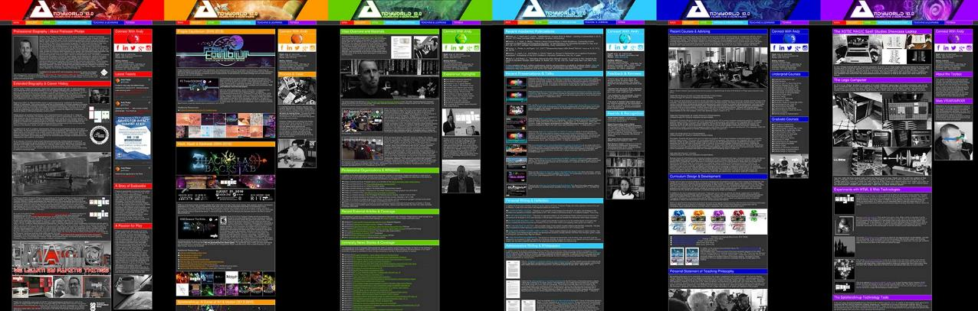
ANDYWORLD.IO | PROFESSORANDREWPHELPS.NET | @ANDYMPHELPS | ANDYMPHELPS@GMAIL.COM
Thanks & Questions

