Slide 1









Getting Through a Tough Day (Again):
What Possum Springs Says about Mental Health and Social Class
THE 15th ANNUAL TAMPERE UNIVERSITY GAME RESEARCH LAB SEMINAR | TAMPERE, FINLAND
Mia Consalvo
Professor of Communication Studies
Canada Research Chair in Games Studies & Design
Founding Director, mLab
Centre for Technoculture, Art & Games (TAG)
Concordia University
Andrew Phelps
Professor of Human Interface Technology, University of Canterbury
Professor of Art & Design, Rochester Institute of Technology
President, Higher Education Video Game Alliance
2019 Games Scholar in Residence, American University
Founder, RIT MAGIC Center & MAGIC Spell Studios
Founder, RIT School of Interactive Games & Media

Slide 2
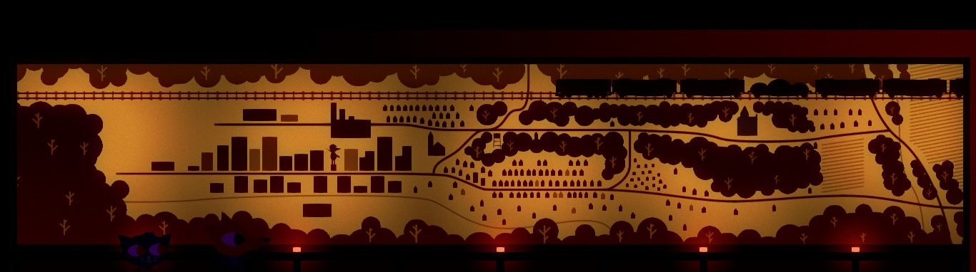
Towns and Cities in games are often considered to be settings, but rarely considered to ALSO be actors
A Home for NPCs
A Navigable Space for Exploration
Set Theme / Mood
Items and Resources
Clues

Slide 3
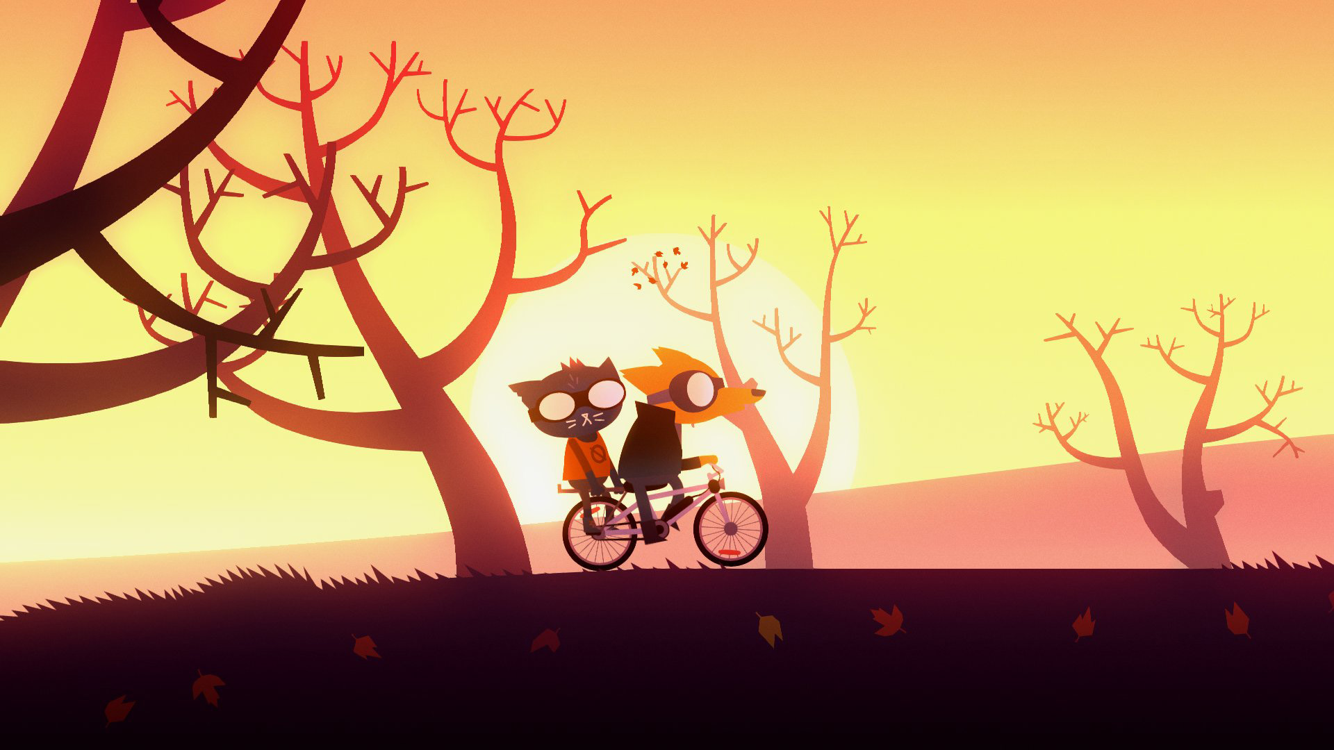
Night in the woods takes place in possum springs
The vast majority of the game takes place while moving through possum springs in a repetitive fashion
Notes:
Night in the Woods features anthropomorphized animals who live in the
town of Possum Springs, a fictional town set in rural Western Pennsylvania in the United States.
A former mining town, the place has seen better days. Mae, the central character, has dropped
out of college to return home, seemingly with no good reason. She attempts to pick up the
threads of her old life, reconnecting with old friends Bea, Gregg, and Angus while reacquainting
herself with her hometown. In addition to managing those ongoing relationships (along with
regular chats with her parents) Mae is plagued by nightmares, perhaps triggered or magnified by
the discovery of a severed arm by the town’s diner, the disappearance of an acquaintance, and
the eventual uncovering of a demonic ritual engaged in by village elders to keep the town from
further decay. Although Mae and her friends can “defeat” the elders at the end of the game, it’s
left unsaid whether this will actually improve their situation, or perhaps make it even worse.
Other critics have pointed to the game’s ending as a strange addition to an otherwise compelling
and realistic portrayal of working class life, and likewise discuss the mental health of the game’s
various characters in depth (Oxford 2017; Spencer 2017). Given that the majority of game time
is spent in the “everyday-ness” of moving through the town and encountering (and reencountering)
its mundanity, that is where we choose to focus this analysis.

Slide 4
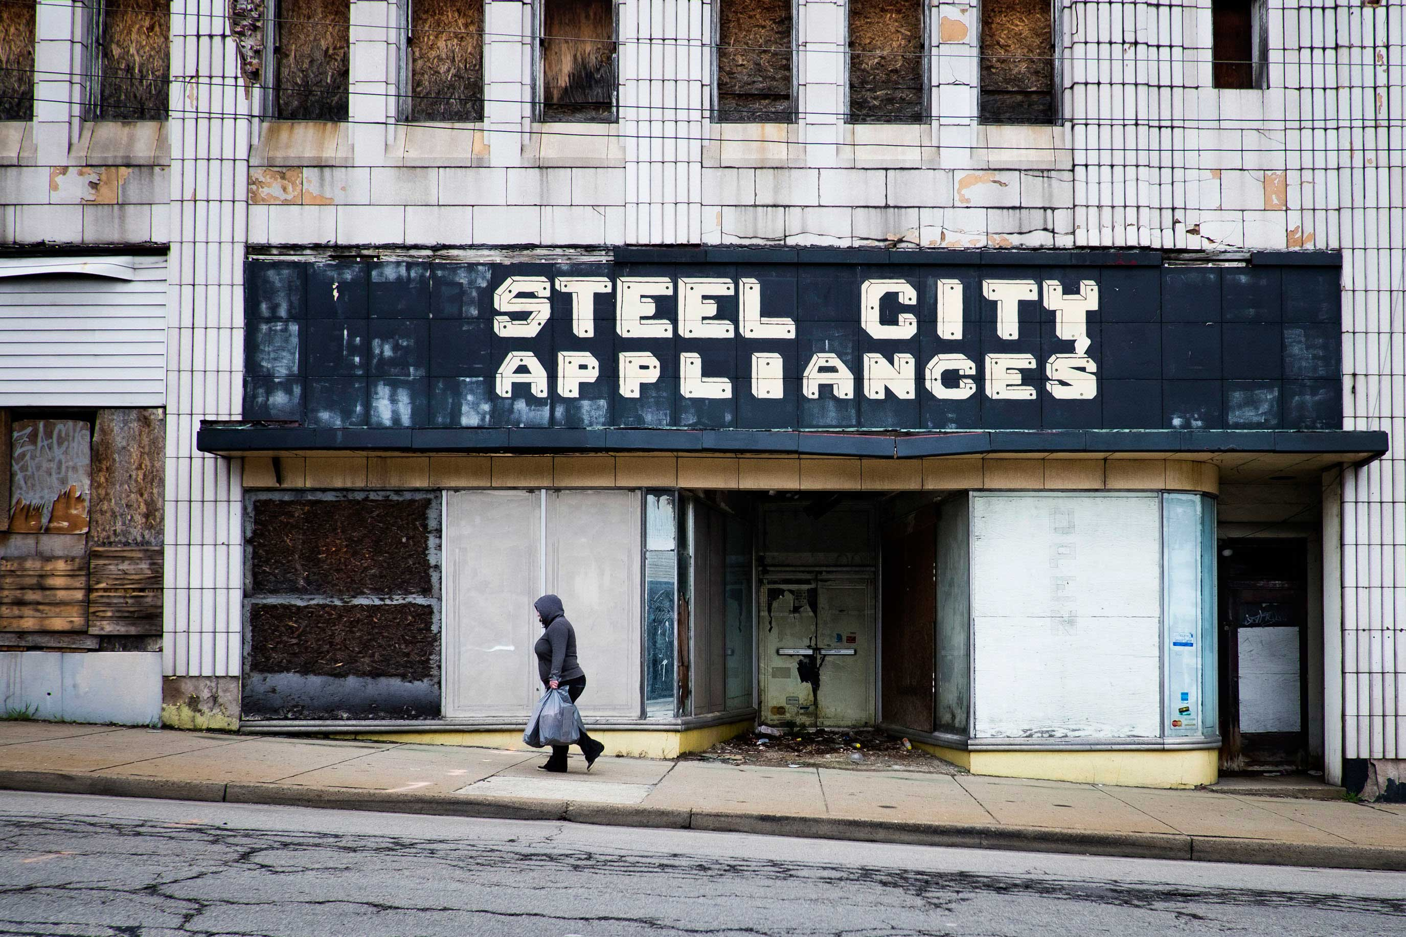
The town itself speaks DIRECTLY to ISSUES OF social class
Speaks directly to working class experiences, as opposed to middle-class representations in Molle Industria’s Every Day the Same Dream
Uses small interactions and scenic elements to continue to press the point of economic instability and downward mobility
Essentially all the choices are dismal
A woman walks up one of the main streets in Clairton, Pa.. Photo: Pete Marovich
“American Dream Sequence: Left Behind in the Monongahela River Valley” at the Carnegie Museum of Art
Notes:
What happens to the flaneur when the town/arcade is dying?
Mae as flaneur in a dying town. Walter Benjamin Arcade Project
https://en.wikipedia.org/wiki/Flâneur
https://en.wikipedia.org/wiki/Arcades_Project

Slide 5
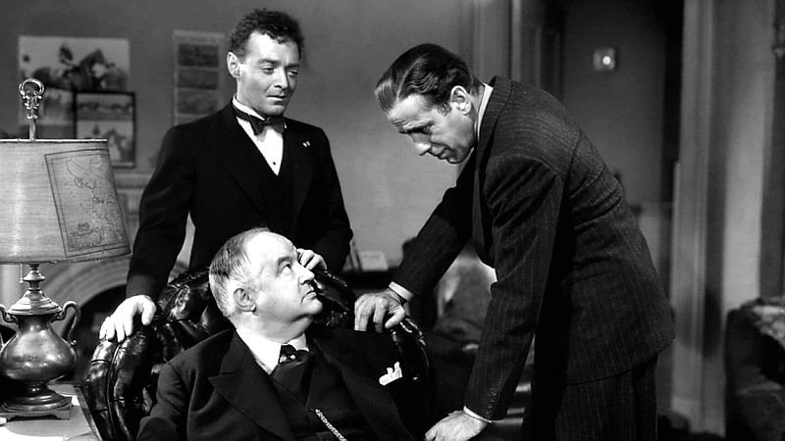
This is in direct contrast to a hero narrative
There is ultimately no way to “win” or “fix” the economic issues that plague the town – and in this NiTW makes a statement on small-town America in the post-industrial economy.
The game juxtaposes expectations of agency with environmental immersion to drive home the inability of affected citizenry to locally change larger forces causing these economic conditions.
Is this a sort of film noir approach to game interaction using the environment as the conduit?
Notes:
Some interesting juxtapositions here thought as NiTW uses a female protagonist (unlike traditional 1940s noir), and also there is the notion of ‘psychological noir’ in which the protagonist cannot retreat to a safe space (an office, etc.) – think Tyler Durdin in

Slide 6
Mental health and possum springs
Mae’s history and mental issues are clear but are never specifically spelled out or detailed, in contrast to games such as Depression Quest (well known) and others dealing with these subjects
Mae can never get effective answers or support from the doctor is a clear metaphor for access to mental health in small-town Americana.
Similarly, the way she is known for ‘beating up a boy while having a breakdown’ and the way that reputation follows her throughout all interactions details the stigma surrounding issues of mental health today.

Slide 7
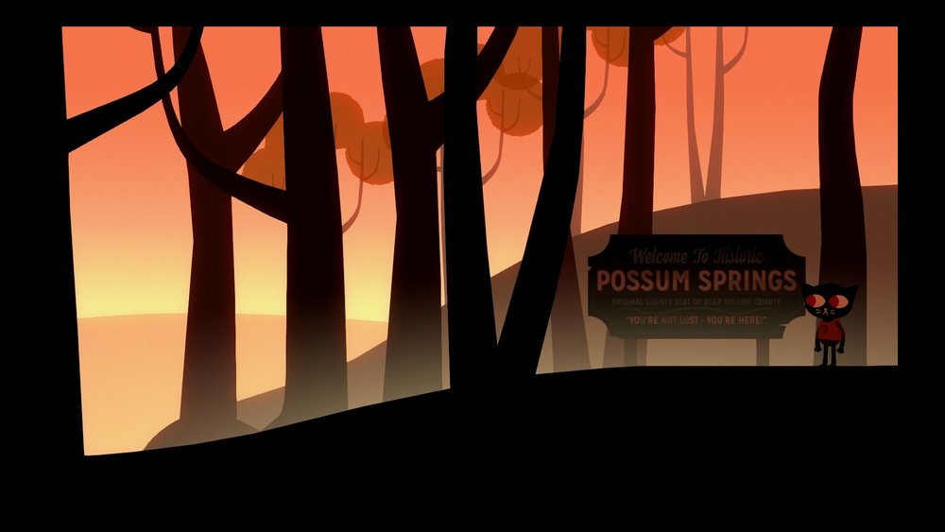
Proceduralization of environmental interaction
Core loop of getting up and guiding Mae through the same locale over and over again is both a parody of the symptoms of depression and anxiety AND its typical treatment through CBT (particularly the way CBT is translated into layperson self-care regiments)
Similar to the lack of agency with social class, there is no way to “fix” Mae or to “change” the character – her position in the environment is fixed, and this parallels the notion that depression is a condition that is “lived with” or “managed” rather than “cured”
Notes:
Many people that suffer from depression will describe feeling increasingly isolated, unable to
form meaningful bonds with others. Some use sarcasm and humor as avoidance mechanisms,
and these themes are clearly on display in Mae’s character, as well as how she relates to other
characters in the game, and resonate with many of the players drawn to this portrayal (Ashley
2018). At one point in the game, one of the characters says to Mae “If anyone’s going to ruin
your night, it should be you.” This statement was also used by Kevin Veale as the title of his own
paper analyzing the game to understand how “the player would respond in the same situation,
and to tell a story that uses their perception of responsibility to explore themes of rural
marginalisation under capitalism, mental illness, horror, desperation and hope” (Veale 2019, 2).
But this quote also speaks to the role of isolation and self-loathing in those suffering from
depression, and situations where friends and family are not often equipped to be capable
caregivers and provide the emotional network of needed support. Further, the phrase emphasizes
how depression is stereotyped both by those suffering from it and more generally in a cultural
context, written off as ‘feeling bad’ or something to ‘just get over’ by various individuals and
groups. In this manner, the social class and economic issues that form the backdrop of NiTW are
directly intertwined in the portrayal of depression and anxiety core to Mae’s character.

Slide 8

Proceduralization of environmental interaction (cont)
Hellblade: Senua’s Sacrifice – voices heard only by the player
Mae’s nightmare’s as reflective of dissociative disorder (‘the world in shapes’). These issues follow the player even into ‘sleep’
  Grow in complexity over time
  Lights lit
  Elements destroyed
  Most “game-y” part (other than conclusion)
  This also (interestingly?) mirrors a lot of the early design framing around ‘effect on environment’ in early shared-world environments
Notes:
https://www.fandom.com/articles/hellblade-mental-health

Slide 9
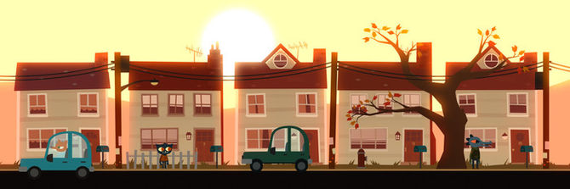
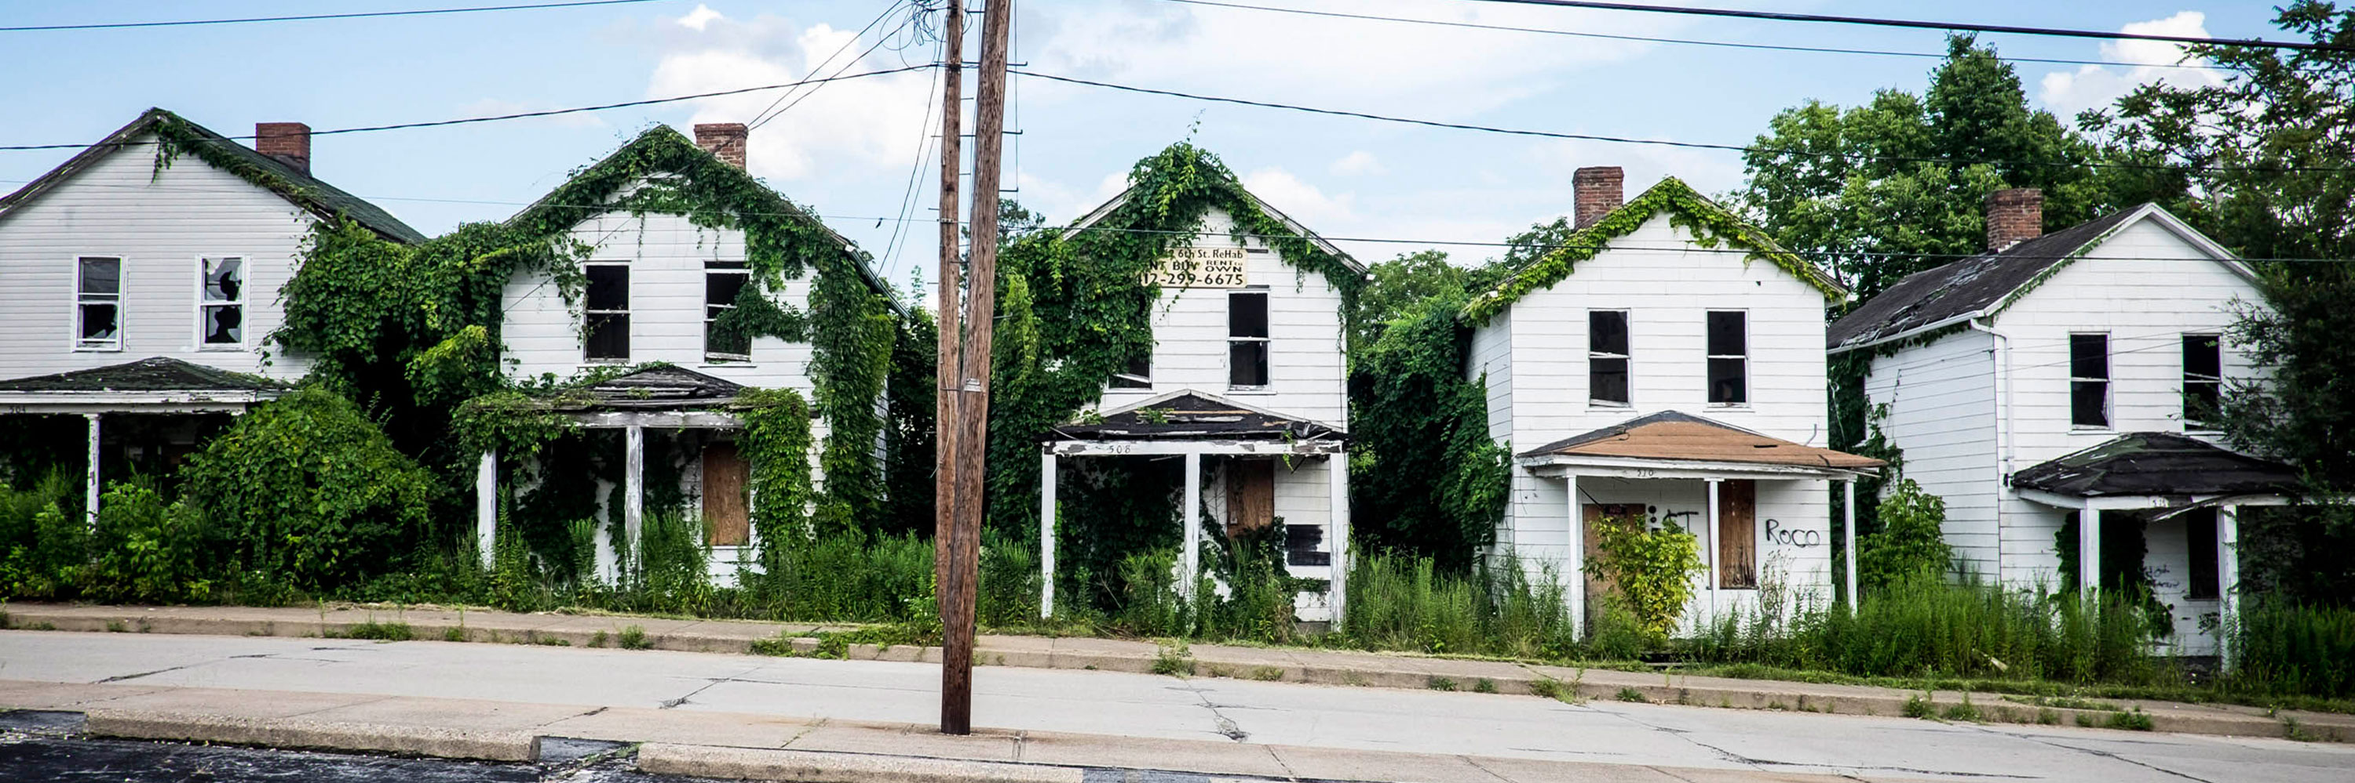
These issues are intertwined
The environment allows for these two unchangeable pillars of experience to mix and bleed between them: one relates directly to the other as Mae uses sarcasm and irony to try to limit her engagement and thus hopefully her misery.
Through these design decisions, NiTW provides an interesting case of using the environment of a game as a designated actor - the town of Possum Springs does not merely provide a setting, or distant history, or provide clues.
The proceduralized and repetitive interactions with the environment force the player to directly consider their engagement with the core themes of the game.
Row houses slated for demolition in Monessen, Pa. Photo: Pete Marovich
“American Dream Sequence: Left Behind in the Monongahela River Valley” at the Carnegie Museum of Art
Notes:
This is another way that NiTW represents class in the environment – these row houses are clearly indicative of the acchitecture of lower class housing a-la east coast small town architecture circa 1930s/1940s
A direct contrast to https://www.metmuseum.org/art/collection/search/19346
The Monongahela River Valley, Pennsylvania,1931 – a “celebration of the industrialization of America’
John Kane American, Scottish
At the Metropolitan Museum of Art

Slide 10
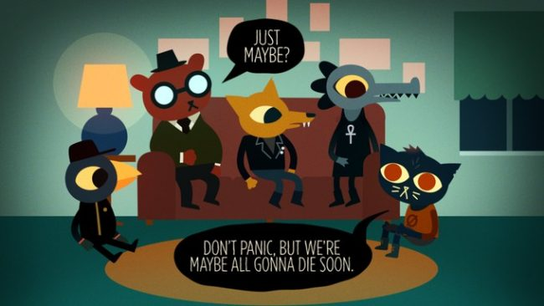
What’s Next?
Where do we go from here?
Are there substantial additions to these arguments, and along what lines?
Ideas for tying to additional theory / literature to strengthen particular elements of this analysis?
Additional points of comparison with relevant work?
Notes:
Background image is fan art from the NiTW Reddit

Slide 11
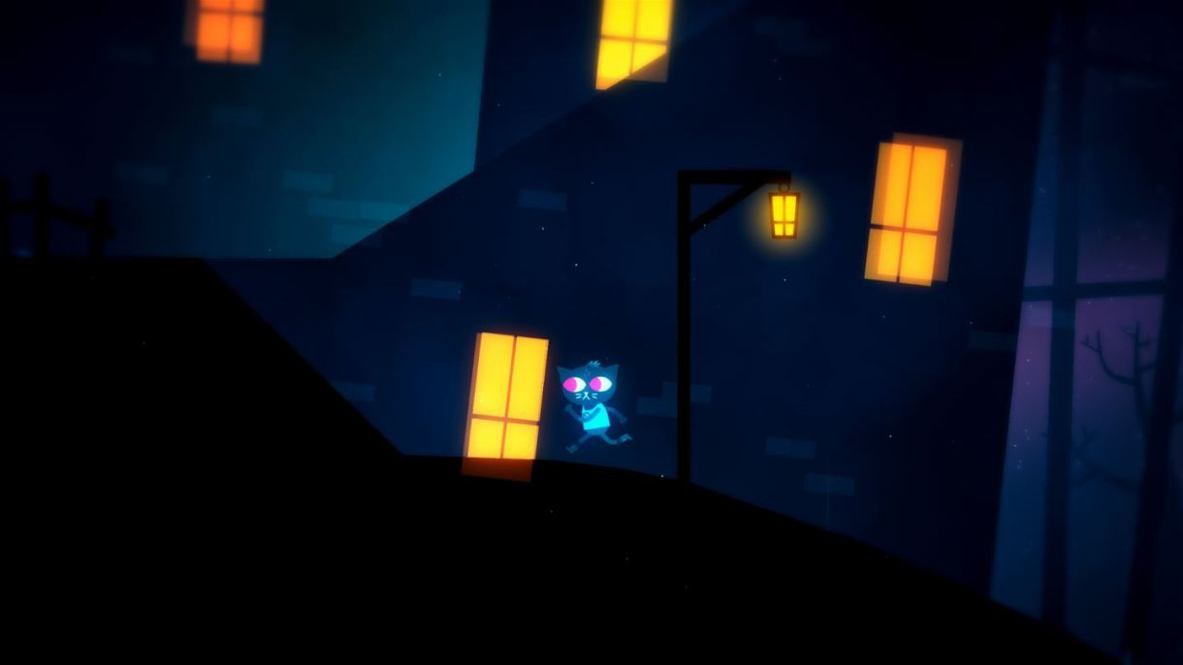
Thanks and questions

