Slide 1





LIVE STREAMING GAME DESIGN & DEVELOPMENT: A GLIMPSE BEHIND THE MYSTIC CURTAIN WITH PEDAGOGICAL POSSIBILITIES
Andrew Phelps
Professor of Art & Design
President, Higher Education Video Game Alliance
Founder, RIT MAGIC Center & MAGIC Spell Studios
Founder, RIT School of Interactive Games & Media
Rochester Institute of Technology
The InterPLAY of Game Studies and Game Design
National Communication Association 104th Annual Convention: Communication at Play
SALT LAKE CITY, UTAH 2018
The InterPLAY of Game Studies and Game Design
Hosted by the University of Utah Arts & Engineering Program
National Communication Association 104th Annual Convention: Communication at Play
SALT LAKE CITY, UTAH 2018
Mia Consalvo
Professor of Communications Studies
Canada Research Chair for Games Studies & Design
Founding Director, mLab
Centre for Technoculture, Art & Games (TAG)
Concordia University

Slide 2

Game development is not well understood
Notes:
From the infamous “tighten up the graphics a little bit” line in a commercial by Westwood College, which in modern meme slang now means 1) to work at an introductory-level tech position, and/or 2) to attempt a feat without knowledge of how it can be done. (Urban Dictionary: https://www.urbandictionary.com/define.php?term=tighten%20up%20the%20graphics)
More formally, O’Donnel has noted the cloak of secrecy the games industry perpetuates is very purposeful (O’Donnell 2014). Consequently there is not a large, over-simplified public-cultural narrative around the creation of games in the same way there is for film or music, and aspiring developers often have significant difference as to what, exactly, it even means to design and/or develop games.

Slide 3
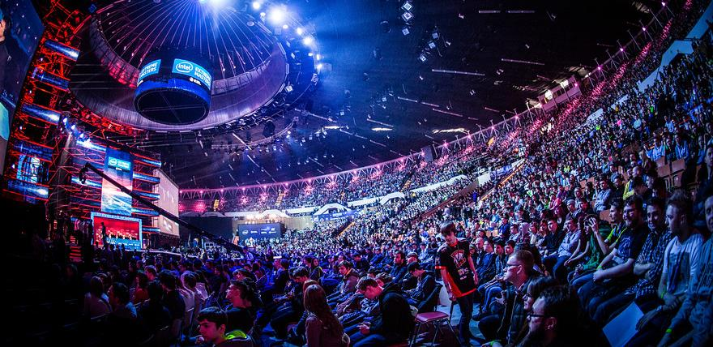
NOTE: Development streaming != esports
Notes:
Through this work, the authors are seeking to engage the audience in the criticality of studying development streaming, which is currently an often overlooked area of research, as most work to date on streaming has focused either on eSports or more generally on gameplay and review (Consalvo, forthcoming; Georgen, Duncan, & Cook, 2015; Johnson & Woodcock, 2017). While these are important topics, this emerging work speaks to a much-needed exploration on development streaming and its potential to engage a broad segment of the public and to better educate players and consumers about the process of game development behind the scenes, with potential impacts on player communities, consumer culture, policy, and education.
Twitch (among others) has started creating categories to help interested viewers find such content, and the platform officially launched the “Game Development” category in late 2014 (Crecente, 2014). While the category does not attract large numbers of viewers, its continued presence suggests one possible way for a generalist audience to gain access to the processes of game development as it unfolds live and unedited.

Slide 4
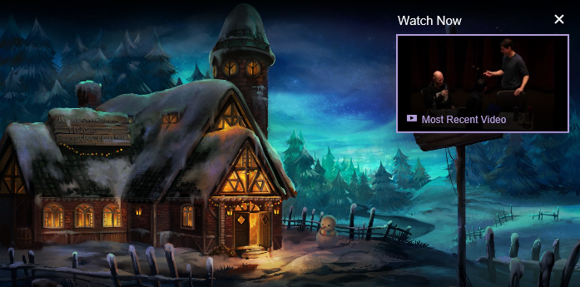
MAYBE DEVELOPMENT STREAMING CAN HELP public understanding of gamedev?
Notes:
Of course cracks have appeared in that wall of secrecy. Smaller and independent game developers have started to share information and best practices amongst one another (Browne, 2015; Whitson, 2015).
One recent development that has significant potential to demystify the practice of game making for the non-practitioner is the recent phenomenon of “development streaming” – i.e. the livestreaming not of a game being played, but rather a game being constructed. Live streaming of games being played has received growing attention from researchers, yet on sites such as Twitch.tv, we are seeing an increase in live streaming of creative activities as well. Recognizing that growing interest, Twitch (among others) has started creating categories to help interested viewers find such content, and the platform officially launched the “Game Development” category in late 2014 (Crecente, 2014).
https://www.twitch.tv/handmade_hero – “Handmade Hero is an ongoing project to create a complete, professional-quality game accompanied by videos that explain every single line of its source code. It is intended as an educational resource for people interested in learning how game engines are developed in practice.”

Slide 5
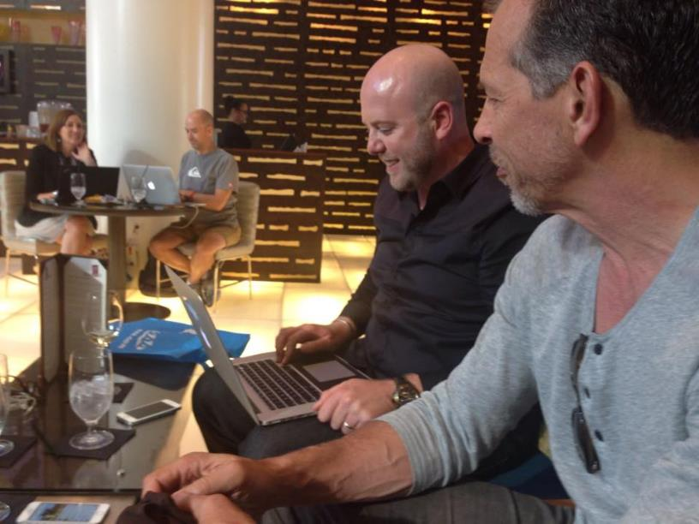
RETHINKING APPRENTICESHIP ?
Notes:
Various developers have begun to engage in such streams, from casual indie developers looking for accountability, sociality, and possibly seeking to support a portion of their work through advertisements or other funding mechanisms inherent in platforms like Twitch, YouTube, Mixer, Caffiene.tv, etc. to the occasional guest stream of a famous developer or designer discussing their process or sometimes just letting people ‘watch over their shoulder’ (Consalvo & Phelps, 2019).

Slide 6

Potential criterion for evaluating streams
1) the degree to which formal and informal design processes and principles are discussed and presented to the audience
2) the type of design vocabulary employed in the stream sessions
3) how streaming as an activity forces (or fails to enforce) a type of reflexive self-study of the role of a game designer, developer and/or artist
4) the role of the stream audience during the live session as an interactive influence on the design of the game itself
5) the potential of the stream in question to help inform novice- or non-developers about issues and paradigms in game design, development and production
Notes:
To better understand this phenomenon, the authors are engaged in several studies exploring the phenomenon of development streaming and its potential impact. For this presentation, they have observed the streams of several designers, developers, and artists engaged in game production, and report on how these streamers understand game development as well as the authors experience and observation of how these streams’ language and descriptions of their activity reflects the work they actually engage in. Particular attention is paid to several facets of these streams, including: 1) the degree to which formal and informal design processes and principles are discussed and presented to the audience, 2) the type of design vocabulary employed in the stream sessions, 3) how streaming as an activity forces (or fails to enforce) a type of reflexive self-study of the role of a game designer, developer and/or artist, 4) the role of the stream audience during the live session as an interactive influence on the design of the game itself, and 5) the potential of the stream in question to help inform novice- or non-developers about issues and paradigms in game design, development and production.

Slide 7

NICE SHEEP
Game industry studies
  Co-creativity (John Banks)
  Game talk (Casey O’Donnell)
Live streaming gameplay
  Broadcasting play (TL Taylor)
  Hamilton W. A., Garretson O., & Kerne A. (2014, April 26–May 1). Streaming on Twitch: Fostering Participatory Communities of Play within Live Mixed Media. In Proceedings of the SIGCHI Conference on Human Factors in Computing Systems (CHI ’14). New York, NY, USA.

Slide 8
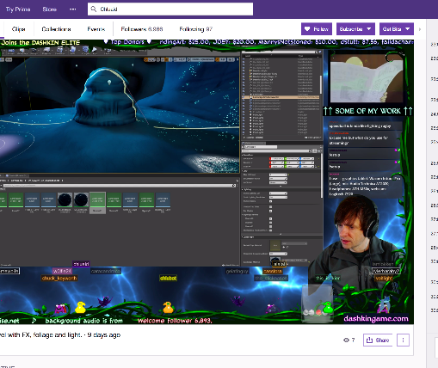
A tale of two Adams
Adam (1) (programmer making Bot Land)
Chluaid (artist on BrackenSack: A Dashkin Game) (and also named Adam (2) IRL)

Slide 9
A Tale Of Two Adams
“coder adam” (1)
Talk aloud protocol
Careful attention to chat
Lots of questions & advice to/from other developers
Streams as a commitment to practice
Small community, not about audience per se
“artist adam” (2)
A kind of ‘visual stepwise process’
Specifically wanted less feedback
Streams as a commitment to practice
Small community, not about audience per se
Cultivation of community for visibility / connections

Slide 10

DEVELOPMENT Streaming…
A commitment to practice and function?
Less about audience, more about community (maybe?)
A scalable platform for observation, practice and critique?
A form of bi-directional apprenticeship?
A dialog platform for learning communities?
A potentially scaffolded environment?
A quest for authenticity and role models?

Slide 11
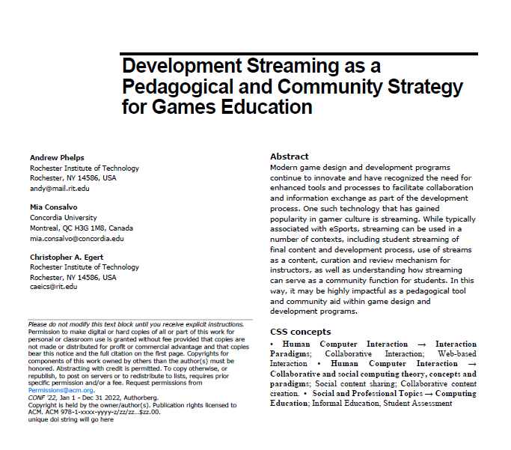
…as a tool for teaching and learning?
A first use of developer streams is for the instructor to use the technology to stream themselves performing various tasks and activities.
Second, there may be significant value in having students stream their own creations either as a form of ‘well played’ exercise, or simply as a walkthrough and talk-aloud critique of the project they have delivered.
Third, along with streaming final games and prototypes, having students stream their own development work to then examine and reflect on it could be incredibly valuable.
Fourth, having students stream their own work and development process can surface such work across an entire student body.
Fifth, development streaming has the potential to engage students in a wider community that extends substantially beyond the campus.
Finally, it may be useful to explore having students essentially “cross the streams” to help acclimatize students in a given role with their counterparts in other majors or areas of a curriculum.

Slide 12

Potential problems
Stressing out over streaming / status / practice / etc.
Diversity and inclusion, harassment, and cultural failings online
Student privacy and compliance with relevant edu statutes
Large technical infrastructure and expertise
Content search / noise / ambiguity
Notes:
Image from https://freebeacon.com/issues/feds-fund-study-of-the-toxic-speech-of-video-gamers/

Slide 13
Work in progress
Consalvo, M., & Phelps, A. (2019). Performing game development live on Twitch. Presented at the Hawaii International Conference on Systems Science, Maui, HI.
Consalvo, M. (forthcoming). Kaceytron and transgressive play on Twitch.tv. In K. Jørgensen & F. Karlsen (Eds.), Transgressions in games and play. Cambridge, MA: MIT Press.
Phelps, A., & Consalvo, M. (2018) “Live streaming game design & development: A glimpse behind the mystic curtain with pedagogical possibilities” at The InterPLAY of Game Studies and Game Design, 2018 NCA Preconference, University of Utah. S Orme, University of Suffolk. National Communication Association 104th Annual Conference, Salt Lake City, Utah.
Phelps, A., Consalvo, M., and Egert, C. (2018) Development Streaming as a Pedagogical and Community
Strategy for Games Education. Workshop on New Research Perspectives on Game Design & Development Education. CHI PLAY 2018, October 28, 2018, Melbourne, Australia.

Slide 14
POSITION PAPER REFERENCES
Bai, Matt. (2013. April 20) “Thrown for a Curve in Rhode Island.” The New York Times, retrieved from https://www.nytimes.com/2013/04/21/business/curt-schilling-rhode-island-and-the-fall-of-38-studios.html
Browne, P. (2015). Jumping the gap: Indie labour and the imagined indie community. Concordia University, Montreal, Canada.
Crecente, B. (2014, October 29). Watch people develop games live in Twitch’s latest category. Retrieved June 16, 2018, from https://www.polygon.com/2014/10/29/7091727/twitch-game-development-live
Entertainment Software Association (ESA) (2018). Are we in your State? Retrieved August 14, 2018 from https://www.areweinyourstate.org.
Georgen, C., Duncan, S. C., & Cook, L. (2015). From lurking to participatory spectatorship: Understanding affordances of the Dota 2 noob stream. International Society of the Learning Sciences, Inc.[ISLS].
Johnson, M. R., & Woodcock, J. (2017). ‘It’s like the gold rush’: the lives and careers of professional video game streamers on Twitch.tv. Information, Communication & Society, 1–16. https://doi.org/10.1080/1369118X.2017.1386229
MacDonald, K. (2018, July 20). No Man’s Sky developer Sean Murray: ‘It was as bad as things can get.’ The Guardian. Retrieved from https://www.theguardian.com/games/2018/jul/20/no-mans-sky-next-hello-games-sean-murray-harassment-interview
O’Donnell, C. (2014). Developer’s dilemma: the secret world of videogame creators. Cambridge, Massachusetts: The MIT Press.
Planells, A. (2015) Video games and the crowdfunding ideology: From the gamer-buyer to the
prosumer-investor. Journal of Consumer Culture Vol 17, Issue 3, 620-638.
https://doi.org/10.1177%2F1469540515611200
Whitson, J. (2015). Re-appropriating big data: Independent developers’ strategic use of analytics. Presented at the International Association for Media and Communication Research Conference, Montreal, Canada.

Slide 15
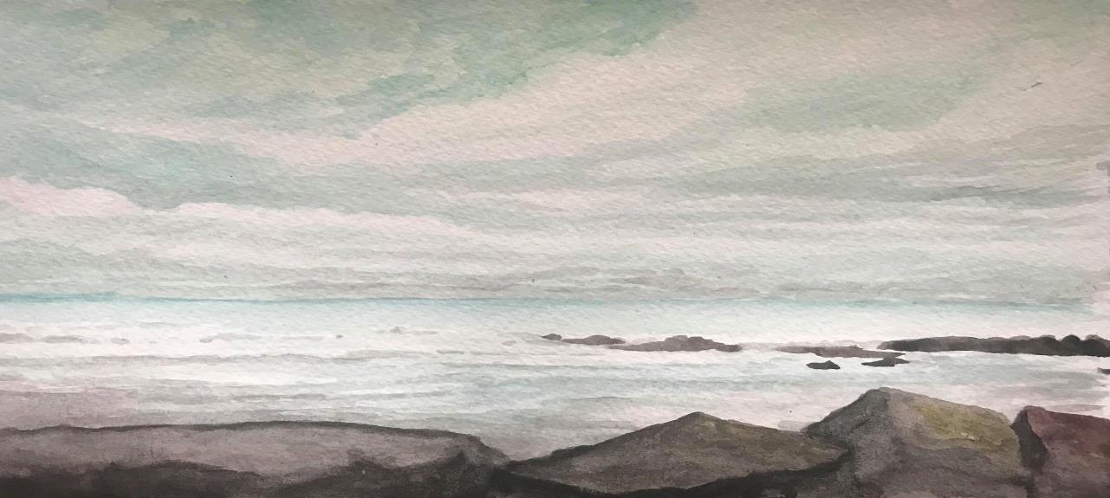
Thanks & Questions
andy@mail.rit.edu|andyworld.io|@ritigm1
mconsalvo@gmail.com|about.me/mconsalvo|@miac

