Slide 1




Development Streaming and Authenticity
Cultural Connections, Participatory Democracy and Potential Practices of Engagement
Media in Transition 10 | MIT | Boston 2019
Andrew Phelps
Professor of Art & Design, Rochester Institute of Technology
Professor of Human Interface Technology, University of Canterbury
2019 Games Scholar in Residence, American University
President, Higher Education Video Game Alliance
Founder, RIT MAGIC Center & MAGIC Spell Studios
Founder, RIT School of Interactive Games & Media
Mia Consalvo
Professor of Communication Studies
Canada Research Chair in Game Studies & Design
Founding Director, mLab
Centre for Technoculture, Art & Games (TAG)
Concordia University

Slide 2
RISE OF A PLATFORM
2006–2007
Justin.tv in 2006/2007
2011
Rebranded “gaming” section as Twitch.tv in 2011
2014
Justin.tv itself ceased operations in 2014
2014
In 2014 4th largest driver of Internet traffic in the US
2018
560 billion minutes of Twitch viewed over 2018 – a 58% increase on 2017
2.2 million daily broadcasters, and 15 million daily Twitch viewers on average
Twitch users watch 95 minutes per day on average
Twitch sold to Amazon in 2014 for $970 million USD
Notes:
Source on 2018 http://www.businessofapps.com/data/twitch-statistics/

Slide 3
INITIAL Research Questions
How/in what ways do game developers engage in co-creative practices with audiences while live streaming their game development work
How/in what ways do game developers engage in game talk with audiences while live streaming their game development work?

Slide 4

Game development is not well understood
Notes:
From the infamous “tighten up the graphics a little bit” line in a commercial by Westwood College, which in modern meme slang now means 1) to work at an introductory-level tech position, and/or 2) to attempt a feat without knowledge of how it can be done. (Urban Dictionary: https://www.urbandictionary.com/define.php?term=tighten%20up%20the%20graphics)
More formally, O’Donnel has noted the cloak of secrecy the games industry perpetuates is very purposeful (O’Donnell 2014). Consequently there is not a large, over-simplified public-cultural narrative around the creation of games in the same way there is for film or music, and aspiring developers often have significant difference as to what, exactly, it even means to design and/or develop games.

Slide 5
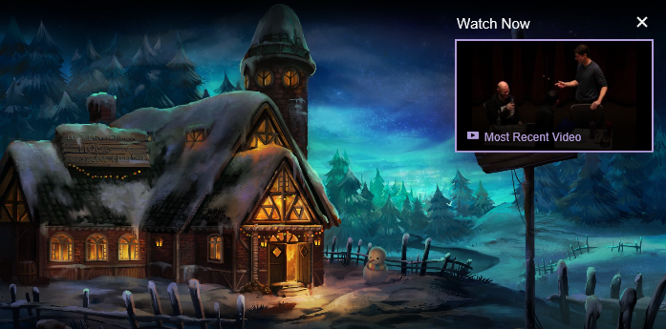
MAYBE DEVELOPMENT STREAMING CAN HELP public understanding of gamedev?
Notes:
Of course cracks have appeared in that wall of secrecy. Smaller and independent game developers have started to share information and best practices amongst one another (Browne, 2015; Whitson, 2015).
One recent development that has significant potential to demystify the practice of game making for the non-practitioner is the recent phenomenon of “development streaming” – i.e. the livestreaming not of a game being played, but rather a game being constructed. Live streaming of games being played has received growing attention from researchers, yet on sites such as Twitch.tv, we are seeing an increase in live streaming of creative activities as well. Recognizing that growing interest, Twitch (among others) has started creating categories to help interested viewers find such content, and the platform officially launched the “Game Development” category in late 2014 (Crecente, 2014).
https://www.twitch.tv/handmade_hero – “Handmade Hero is an ongoing project to create a complete, professional-quality game accompanied by videos that explain every single line of its source code. It is intended as an educational resource for people interested in learning how game engines are developed in practice.”

Slide 6
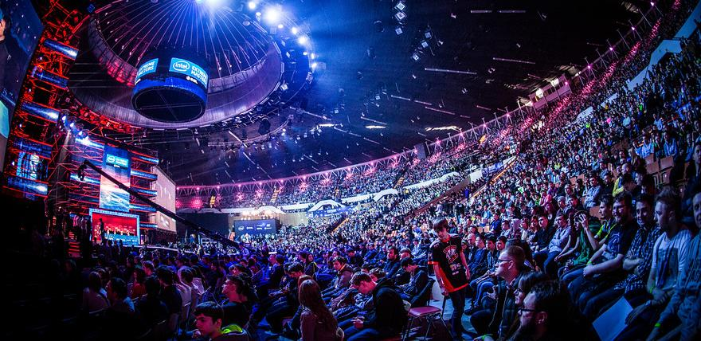
NOTE: Development streaming != esports
Notes:
Through this work, the authors are seeking to engage the audience in the criticality of studying development streaming, which is currently an often overlooked area of research, as most work to date on streaming has focused either on eSports or more generally on gameplay and review (Consalvo, forthcoming; Georgen, Duncan, & Cook, 2015; Johnson & Woodcock, 2017). While these are important topics, this emerging work speaks to a much-needed exploration on development streaming and its potential to engage a broad segment of the public and to better educate players and consumers about the process of game development behind the scenes, with potential impacts on player communities, consumer culture, policy, and education.
Twitch (among others) has started creating categories to help interested viewers find such content, and the platform officially launched the “Game Development” category in late 2014 (Crecente, 2014). While the category does not attract large numbers of viewers, its continued presence suggests one possible way for a generalist audience to gain access to the processes of game development as it unfolds live and unedited.

Slide 7
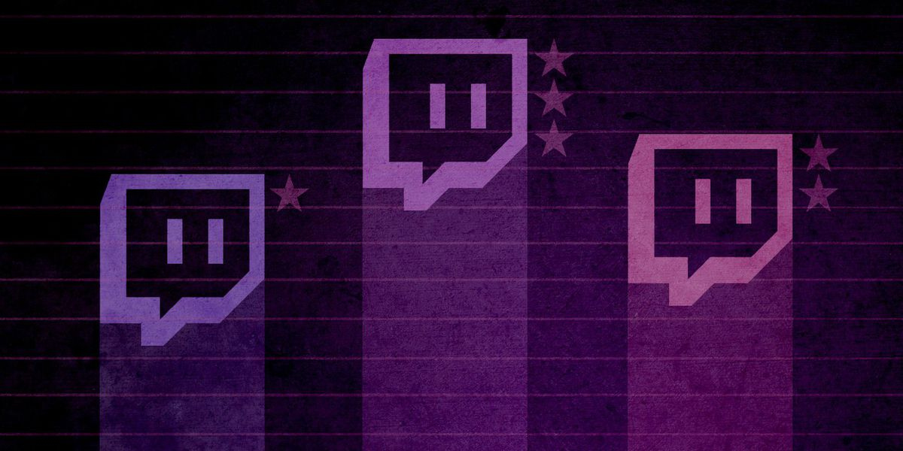
Potential criterion for evaluating streams
1) the degree to which formal and informal design processes and principles are discussed and presented to the audience
2) the type of design vocabulary employed in the stream sessions
3) how streaming as an activity forces (or fails to enforce) a type of reflexive self-study of the role of a game designer, developer and/or artist
4) the role of the stream audience during the live session as an interactive influence on the design of the game itself
5) the potential of the stream in question to help inform novice- or non-developers about issues and paradigms in game design, development and production
Notes:
To better understand this phenomenon, the authors are engaged in several studies exploring the phenomenon of development streaming and its potential impact. For this presentation, they have observed the streams of several designers, developers, and artists engaged in game production, and report on how these streamers understand game development as well as the authors experience and observation of how these streams’ language and descriptions of their activity reflects the work they actually engage in. Particular attention is paid to several facets of these streams, including: 1) the degree to which formal and informal design processes and principles are discussed and presented to the audience, 2) the type of design vocabulary employed in the stream sessions, 3) how streaming as an activity forces (or fails to enforce) a type of reflexive self-study of the role of a game designer, developer and/or artist, 4) the role of the stream audience during the live session as an interactive influence on the design of the game itself, and 5) the potential of the stream in question to help inform novice- or non-developers about issues and paradigms in game design, development and production.

Slide 8

Background Research
Game industry studies
  Co-creativity (John Banks)
  Game talk (Casey O’Donnell)
Live streaming gameplay
  Broadcasting play (TL Taylor)
  Hamilton W. A., Garretson O., & Kerne A. (2014, April 26–May 1). Streaming on Twitch: Fostering Participatory Communities of Play within Live Mixed Media. In Proceedings of the SIGCHI Conference on Human Factors in Computing Systems (CHI ’14). New York, NY, USA.

Slide 9
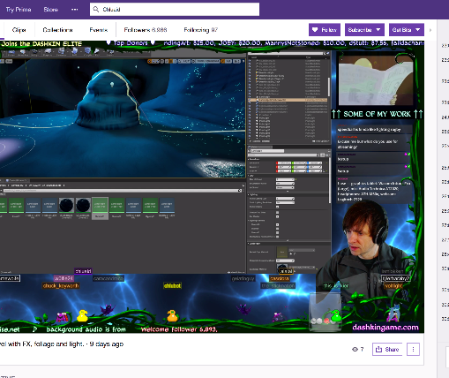
A tale of two Adams
Adam (1) (programmer making Bot Land)
Chluaid (artist on BrackenSack: A Dashkin Game) (and also named Adam (2) IRL)

Slide 10
A Tale Of Two Adams
“coder adam” (1)
Talk aloud protocol
Careful attention to chat
Lots of questions & advice to/from other developers
Streams as a commitment to practice
Small community, not about audience per se
“artist adam” (2)
A kind of ‘visual stepwise process’
Specifically wanted less feedback
Streams as a commitment to practice
Small community, not about audience per se
Cultivation of community for visibility / connections

Slide 11

DEVELOPMENT Streaming…
A commitment to practice and function?
Less about audience, more about community (maybe?)
A scalable platform for observation, practice and critique?
A form of bi-directional apprenticeship?
A dialog platform for learning communities?
A potentially scaffolded environment?
A quest for authenticity and role models?

Slide 12
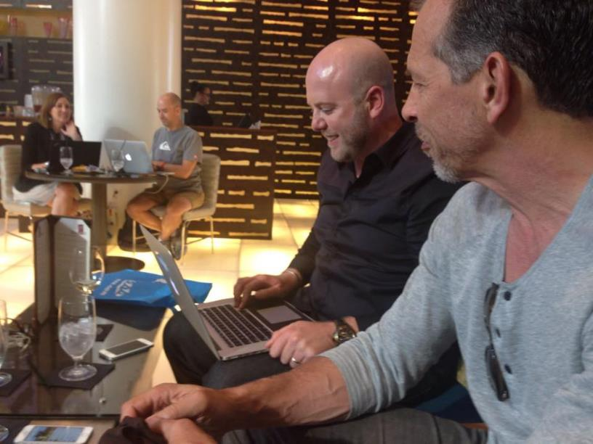
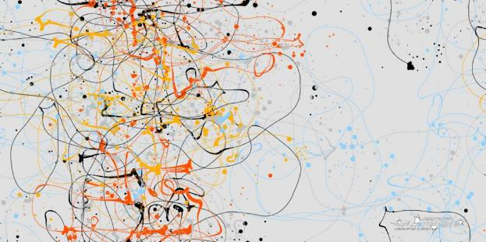
RETHINKING APPRENTICESHIP ?
Notes:
Various developers have begun to engage in such streams, from casual indie developers looking for accountability, sociality, and possibly seeking to support a portion of their work through advertisements or other funding mechanisms inherent in platforms like Twitch, YouTube, Mixer, Caffiene.tv, etc. to the occasional guest stream of a famous developer or designer discussing their process or sometimes just letting people ‘watch over their shoulder’ (Consalvo & Phelps, 2019).

Slide 13
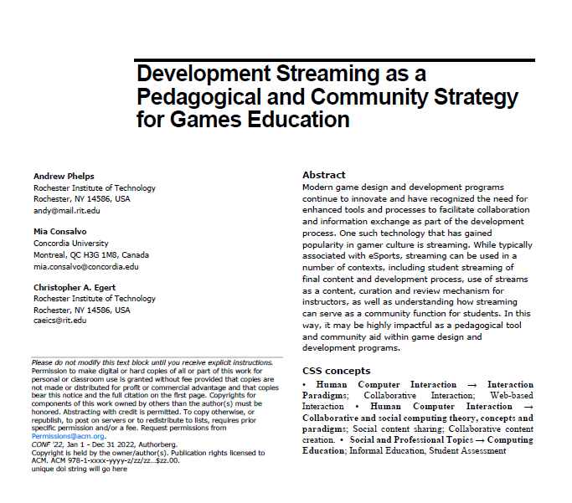
…as a tool for teaching and learning?
A first use of developer streams is for the instructor to use the technology to stream themselves performing various tasks and activities.
Second, there may be significant value in having students stream their own creations either as a form of ‘well played’ exercise, or simply as a walkthrough and talk-aloud critique of the project they have delivered.
Third, along with streaming final games and prototypes, having students stream their own development work to then examine and reflect on it could be incredibly valuable.
Fourth, having students stream their own work and development process can surface such work across an entire student body.
Fifth, development streaming has the potential to engage students in a wider community that extends substantially beyond the campus.
Finally, it may be useful to explore having students essentially “cross the streams” to help acclimatize students in a given role with their counterparts in other majors or areas of a curriculum.

Slide 14

Art streaming

Slide 15
methodology
Explore early observations of this activity over approximately a year.
During this period, different streams were selected several times weekly from the first three pages of the Twitch ‘Art’ channel, with an effort to vary the gender, presumed age, location, and artistic subject of the streamer.
Streams were observed for an hour or more, both watching the stream live and monitoring the chat.
During this time notes were taken in real time on the activities therein, and analyzed later to draw conclusions and recognize repeated patterns of behavior.
As such, this presentation represents early work in exploring and understanding this activity.

Slide 16
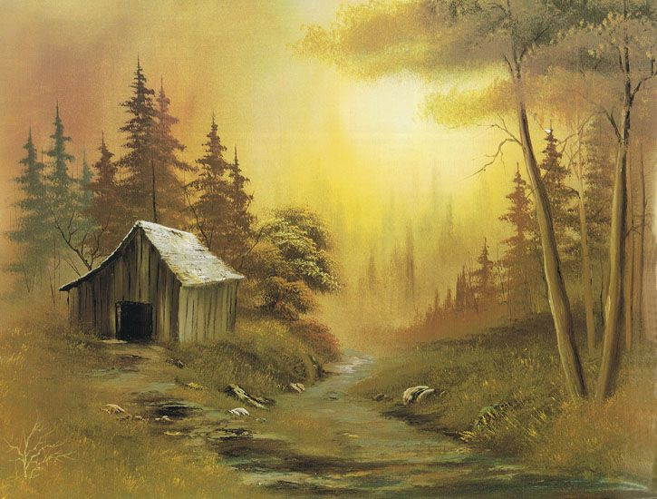
THE BOB ROSS THING
many art streamers attempt to mimic a formulaic step-wise, talk aloud protocol as popularized most famously by Bob Ross on his television program “The Joy of Painting”, but there are numerous exceptions and experiments.
Indeed, the retro-style Ross stream is the most widely viewed in this entire sub-culture, often with a focus on merely connecting socially while satirizing the medium
occasionally to reflect upon subject, technique, and practice in ways that explore both the creation of the work itself as well as the performative act of creating work for a television program (which is related in obvious fashion to particular aspects of streaming).
CABIN CHANCE

Slide 17
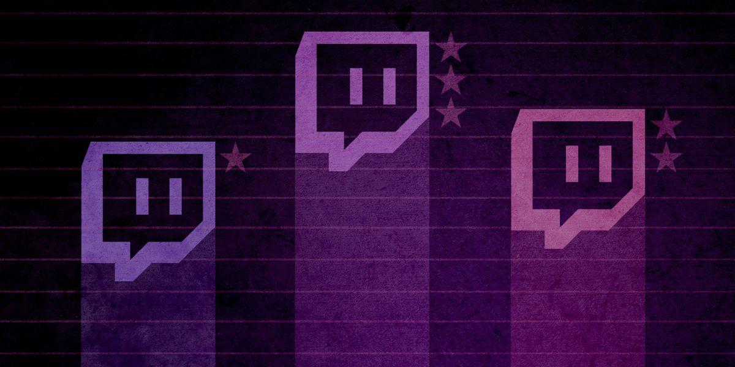
Why care?
Currently within the academy there is mounting pressure to deliver education via distance learning methodologies, and studio arts are often seen as problematic in that context.
Most current approaches focus on blending on-site studio practice with online reflection and critique (Bender et al 2006)
Yet in streaming, the scale and format of critique in a given online space often matures organically from a somewhat sophomoric from to discussion of both art streaming as a performative act as well as a discussion of the piece and critique of artistic process
There is also an informal system of skill levelling and knowledge acquisition as individual streamers seek to associate with others who are producing work at a similar or slightly aspirational level, in addition to pursuit of consuming celebrity streams or post-mortems of famous work.

Slide 18
Link to games & (sometimes) esports
Additionally, the practice of these streamers often involves the pre-negotiation of ‘attend my stream and I’ll attend yours’ for both individual collaboration and review, as well as the bolstering of Twitch-based metrics’
Individual streams and groups arise from common artistic practices (i.e. exploring ‘brushing technique’ or ‘experimenting with palette’ or particular forms or subjects, as well as process-oriented paradigms such as ‘sketch to paint’ or ‘polishing and print techniques’)
There is also significant anecdotal evidence that these linkages, relationships, and connection patterns are informed by, and intertwined with, other networks that surround commercial games and esports

Slide 19
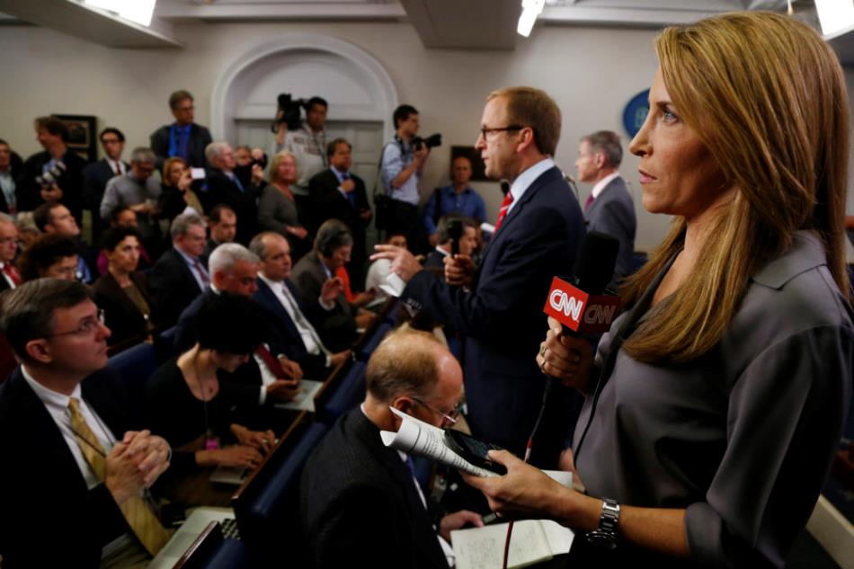
Like game development,
Journalism is not well understood
Where and how does the news get constructed?
What decisions shape what we see?
How ‘real’ is the news? What are the issues, practices, policies, and institutions that shape journalistic coverage?
“Authenticity like relatability” in satirical novel reading one:
Jessica Yellin and ‘Savage News’ - https://www.wbur.org/onpoint/2019/04/12/jessica-yellin-savage-news-cnn-cable-news
Authenticity and relateability > content

Slide 20

The Instagram Aesthetic Is Over
The look made famous by the platform just doesn’t resonate anymore
Taylor Lorenz – The Atlantic, 2019
You can photoshop any girl into that background and it will be the same post,” said Claire, a 15-year-old who asked to be referred to by a pseudonym because of her age. “It’s not cool anymore to be manufactured.”
“For my generation, people are more willing to be who they are and not make up a fake identity,” she says. “We are trying to show a real person doing cool things as a real person, not trying to create a persona that isn’t actually you.”

Slide 21
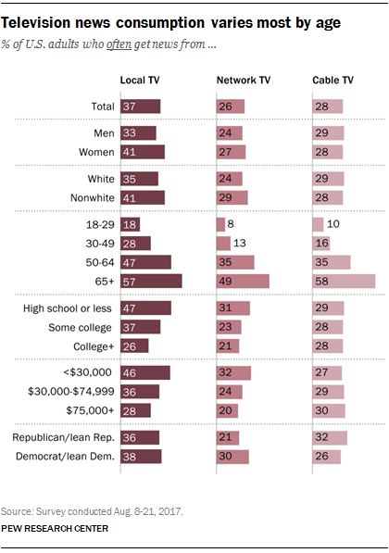
AND WE MIGHT ALSO IMAGINE THAT GOVERNMENT IS NOT WELL UNDERSTOOD?
“Ocasio-Cortez – who at 29 is the youngest member of the House of Representatives – is something of a lightning rod in the US at the moment, partly because of her unabashedly left politics, but also thanks to her skillful use of social media platforms like Twitter. She’s now added Twitch to that portfolio.”
NPR: If there’s a performative nature of television, what’s wrong with pressing for authenticity? Yellin: In Tvland this is a ‘branding’ thing. Authenticity is inauthentic.
Notes:
https://www.pcgamesn.com/aoc-visits-twitch-stream

Slide 22

So what can we do to leverage what’s Happening in development streaming to aid public understanding of the news as a process?

Slide 23
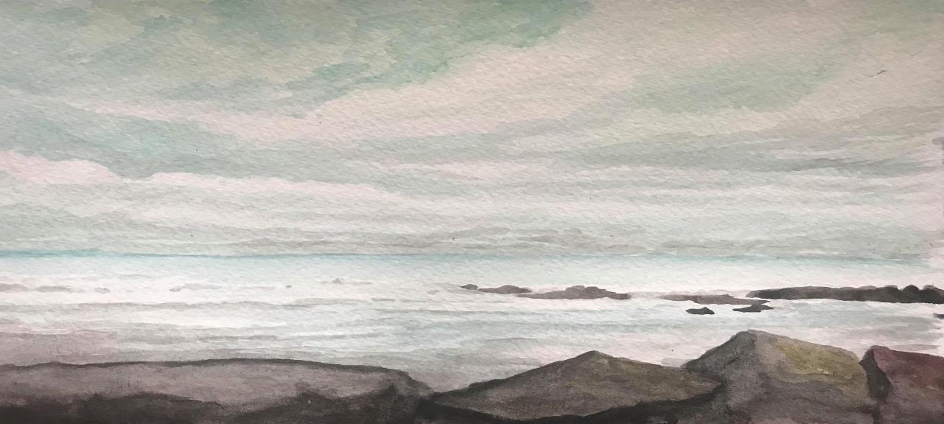
Thanks & Questions
andymphelps@gmail.com|andyworld.io|@ritigm1
mconsalvo@gmail.com|about.me/mconsalvo|@miac

