Slide 1

Loss in Video Games
What is Well Played?
Andy Phelps & Mia Consalvo

Slide 2
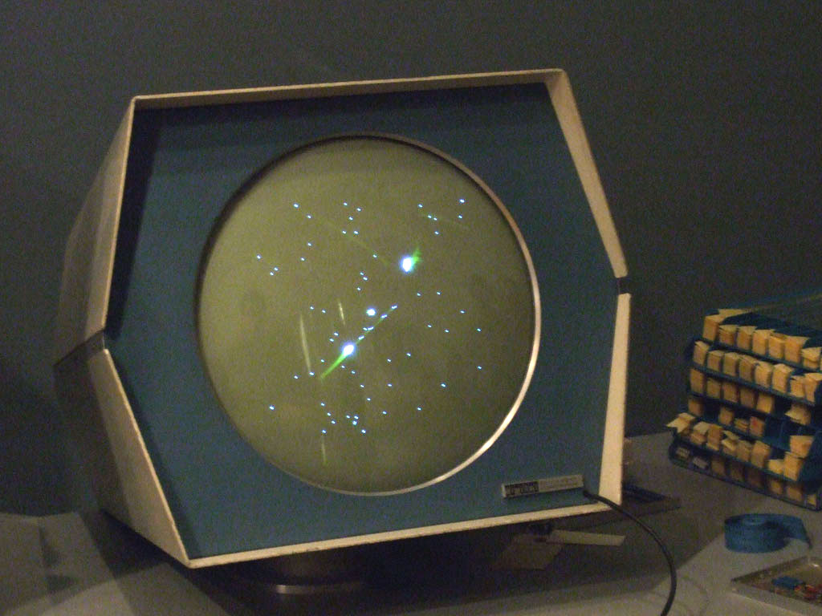
Early Games were Defined by Loss
With very early electronic games loss was the ending condition (there was no “winning”)
SpaceWar & Tennis for Two, etc. – winning is simply evasion of loss
In multiplayer you could ‘win’ by lasting longer
Only later did ‘completion’ or ‘win states’ emerge

Slide 3
What is loss? What do we mean?
Player death
Loss of equipment
Loss of experience
Loss of currency or materials
Loss of access / region / travel (!!)
Loss of community (i.e. WoW, EQ, Faunasphere, etc.)
Loss of standing or reputation (streaming, esports)
Loss of environment / original setting (i.e. live service games)

Slide 4
Quantification and Qualification of Loss
Losing an aged loved one who ‘lived a full life’ is very different than a child who dies in a tragic accident, for example, or losing a childhood friend who drifted away as one grows older feels different than a former friend with whom one has had an acrimonious split.
Loss is a complex, deeply personal, and highly subjective feeling that we continually re-evaluate and even attempt to quantify to ourselves.

Slide 5
How does this affect us in games?
How are these notions of loss reflected in our games and interactive media, which are designed as stories to mirror our relationships in the real world?
And what can we learn about ourselves in examining how we design different notions of loss in virtual spaces?

Slide 6
Obvious first example: Player loss (death)
Often internalized as the players “fault” (i.e. need more skill) but *not always*
  Example: EQ and the Griffen
  The notion of the “Well Played” game, or a respectable outcome or challenge

Slide 7
Permadeath (i.e. lose it all) in Diablo Hardcore
Loss can also be a key motivation in ‘permadeath’ game options, where players risk their entire played history with the game, starting completely over should they die (such as Diablo ‘hard core’ mode).
This heightens some players enjoyment with the game, but changes their play to be defensive, lower-risk, and (somewhat surprisingly) more collaborative…
notions of value intrude where players describe losing characters that ‘had a good run’ vs. the unfairness of losing characters to power outages or internet lag

Slide 8
Minimization of Loss by Design
”Cozy” Games
  Seek to minimize loss and avoid real-world loss (Waszkiewicz and Martyna, 2020)
  Seek to minimize competition and potential of player v player attack
  Very few (if any) failure states, from actions and agency to materials/generation/world
  See Boudreau, Consalvo & Phelps (2025) for recap of terminology and core themes of ”cozy games” as debated amongst players, games press, and games developers.

Slide 9

(“a cozy management game about dying”)

Slide 10

Feeling Cheated: Atul
But one character purposefully leaves the world as their story completes without this ritual, and players feel deeply angered by the lack of procession and the chance to say goodbye, just as we felt the absence of funerals and gatherings as we mourned during Covid (Wagner et al, 2021, Glaser et al, 2024).

Slide 11
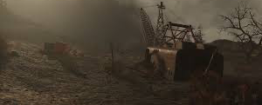
Other games render loss not through characters or relationships, but through ruination and nostalgia
Notes:
Bowman and Wulf, 2023, Fuchs, 2017

Slide 12
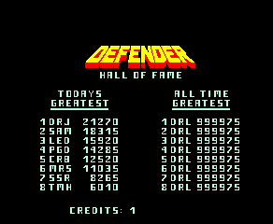
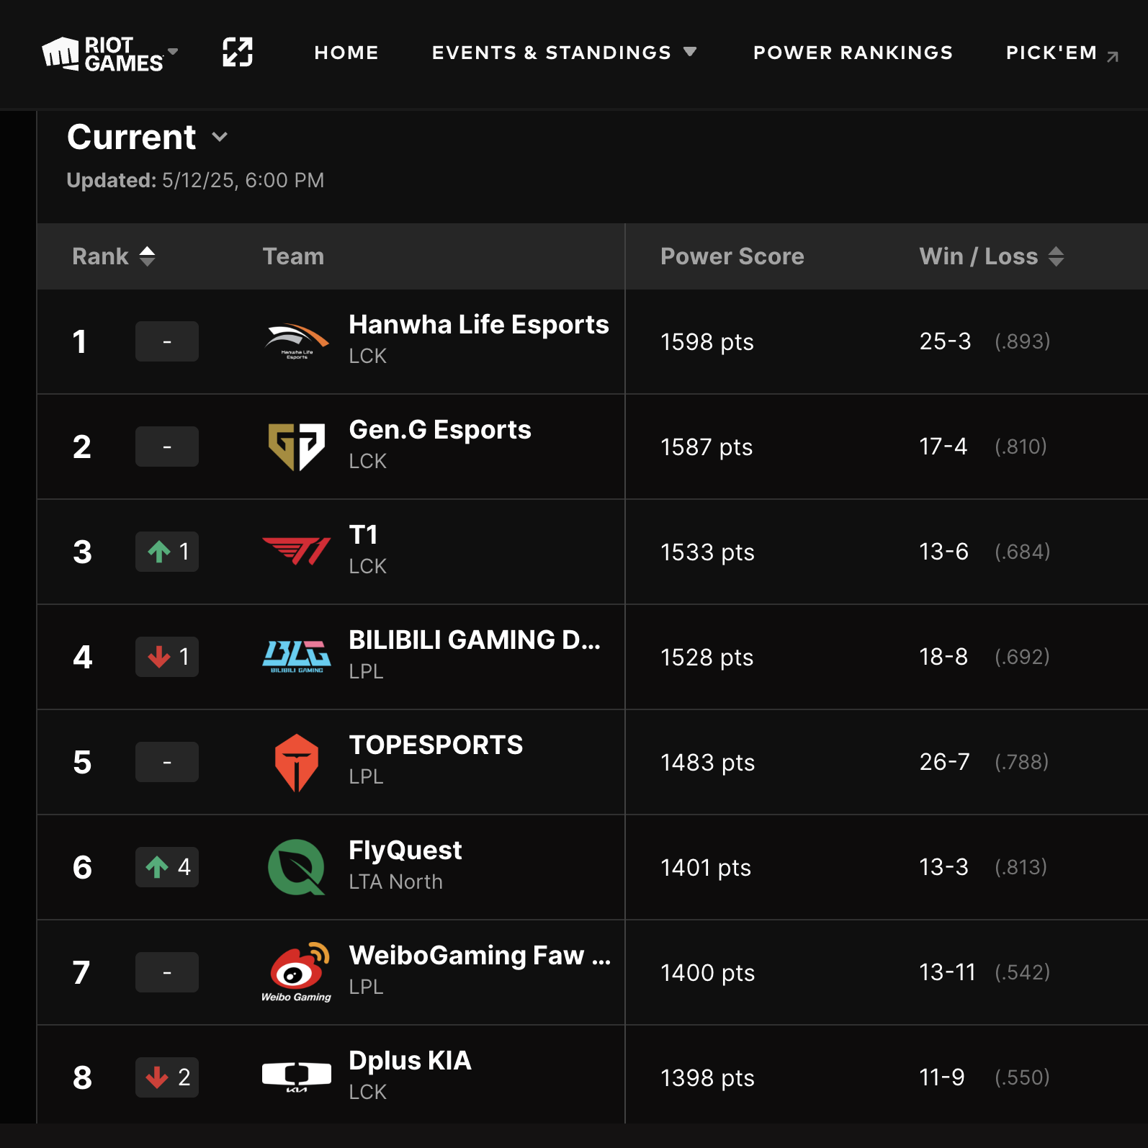
Games have always had notions of reputational gain and loss

Slide 13
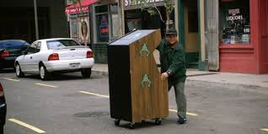

Slide 14

Or render loss through lack of agency (i.e. you can’t fix what’s wrong)

Slide 15
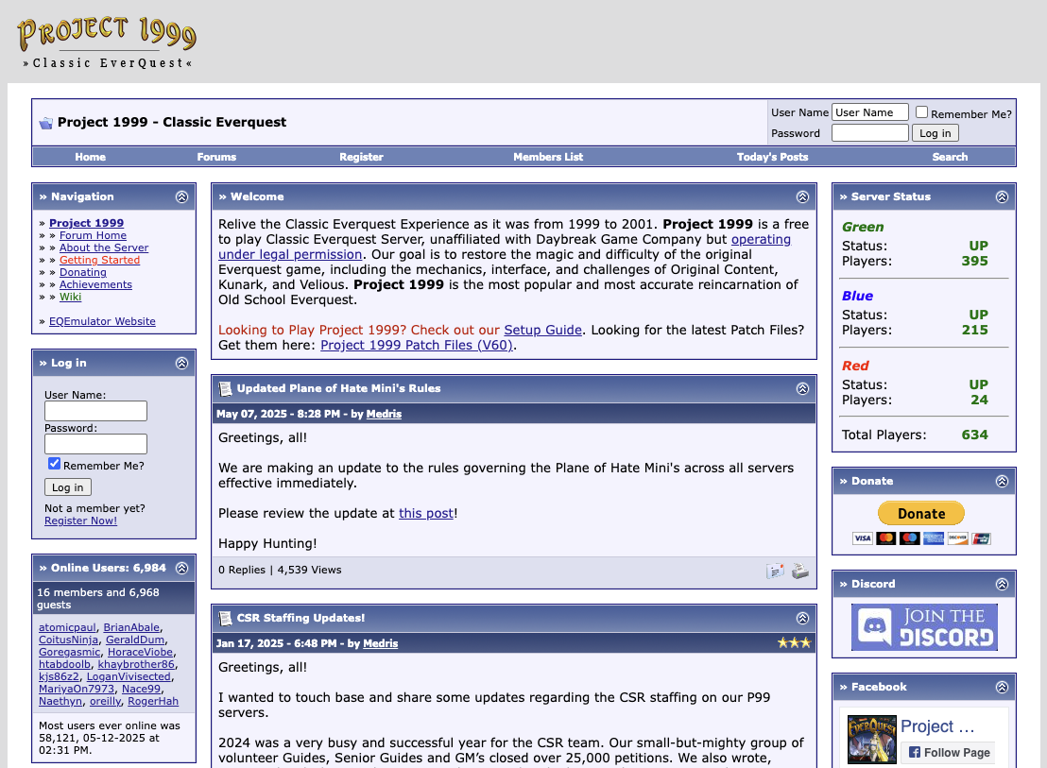
And a slew of other possibilities
Other games depict loss through missing or destroyed items of importance, and even through the modification, updating, re-interpreting, and eventual closure of games, virtual worlds, and live service elements themselves, as well as a variety of other means.

Slide 16
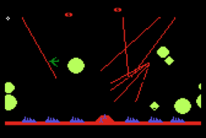
Conclusion: What is ‘Well Played’ ?
Given eventual loss along several different axis, what constitutes the idea of ‘well played’ ?
In what ways do we evaluate a gameplay experience as having transcended the elements of loss?
Marathon gamer Victor Sandberg played the game for 72 hours, earning an incredible 103,809,990 points. See: Shearer, S. (2013, December 31). Missile commander record holder plays game for nearly 72 hours | the escapist.

Slide 17
Thanks & Questions

