Slide 1




Laboring Artists: Art Streaming on the Videogame Platform Twitch
Andrew Phelps
Professor of Human Interface Technology
University of Canterbury, Christchurch, NZ
Professor of Film & Media Arts
Director, American University Game Lab
American University, Washington, DC
President, Higher Education Video Game Alliance
Mia Consalvo
Professor of Communication Studies
Canada Research Chair for Games Studies & Design
Founding Director, mLab
Centre for Technoculture, Art & Games (TAG)
Concordia University
Hawaii International Conference on Systems Science

Slide 2

Last year at HICSS…
We presented on some streaming research in a small study that looked at professional developers streaming their work, both as programmers and as game artists.
This got us interested in how the labor of games and game streaming mirrors the labor of other forms of streaming in this “games centric” or “games adjacent” platform.

Slide 3
Research Questions
Does the labor of game streaming inform the types of labor present in other forms of streaming, specifically more generalized art streaming?
If so, in what ways is the platform itself informing these practices or pushing this conformity?
What are examples of this kind of crossover?

Slide 4
Part I: The Labor of Games
What do we know of games, labor, playbour, and streaming?

Slide 5
Labor and playbour in games
Dyer-Witheford & de Peuter: most labor today is ‘immaterial labor’ or “work that creates ‘immaterial products’ such as ‘knowledge, information, communication, a relationship or an emotional response”
Boellstorff says we are seeing the spread of ‘creationist capitalism’ where “labor is understood in terms of creativity, so that production is understood as creation”
Kücklich demonstrated the labor involved in modding digital games

Slide 6
Labor, play ,and the increasing influence of platforms
Bogost and Montfort write platforms can be software or hardware that forms the “underlying computing systems” that “enable, constrain, shape and support the creative work that is done on them”
Gillespie argues that the term ‘platform’ doesn’t “drop from the sky” but rather comes from “stakeholders with specific aims”
By examining the history of labor in games we can see the increasing strength of commercial platforms in shaping/narrowing what individuals can do (or see as possibilities)

Slide 7
Modding
Standardization of game file structures, increasing use of similar/licensed game engines allowed players to modify game files in ways that suited them
Communities grew up around various games that offered player-created tools, help
Increasingly game companies have sought to limit and constrain modding practices – through licensed mod kits, mod packs, etc.
Minecraft remains an important (and weird) exception

Slide 8
Walkthroughs
Player created walkthroughs offered a free alternative to commercial strategy guides
  Walkthroughs appeared on individual sites as well as through sites like gamefaqs.com
Guides have also moved to YouTube via Let’s Play videos as well as individual influencers who create regular update/instructional videos for specific games
To earn money from such activities, individuals have to conform to increasingly narrow expectations of what LPs or update videos should be

Slide 9
Gold farming
Gold farming began as an automated task using macros to change “an input into a more valuable output” via bots
Eventually this shifted to human workers in non-OECD countries becoming ‘gold farmers’
Early games research mainly focused on the cheating aspect of this activity
Another important critique was the racism that accompanied player sentiments around “Chinese gold farmers”
Julian Dibbell’s examination of gold farmers’ long hours isn’t that different from current critiques of game live streamers’ similar schedules

Slide 10
YouTube and Twitch
Platforms like YouTube and Twitch have created specific pathways for the labor that players add to their gaming
Players are encouraged to (want to) monetize their gameplay
Successful YouTubers and Twitch streamers further promote ’the right way’ to be successful
Twitch’s large focus on game streaming and ways to do it ‘successfully’ have bounced back to influence how other types of live streaming ‘should’ be done

Slide 11
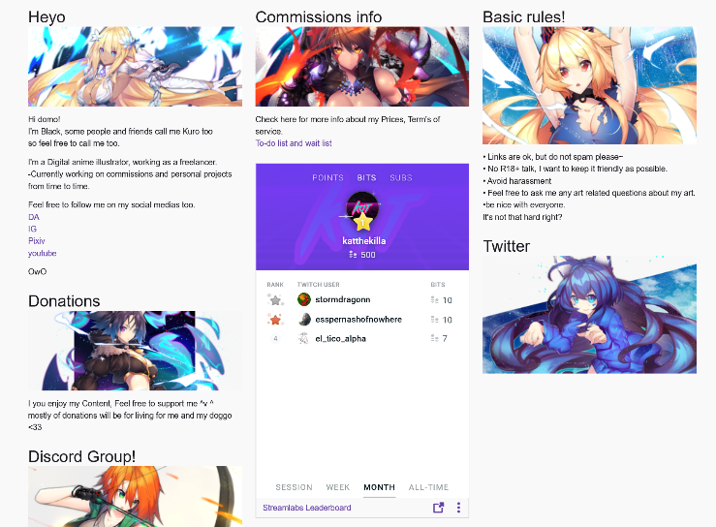
Part II: Art Streaming in Detail
And how does game labor inform art streaming labor?

Slide 12
Last Year at HICSS: A Tale Of Two Adams
“coder adam” (1)
Talk aloud protocol
Careful attention to chat
Lots of questions & advice to/from other developers
Streams as a commitment to practice
Small community, not about audience per se
“artist adam” (2)
A kind of ‘visual stepwise process’
Specifically wanted less feedback
Streams as a commitment to practice
Small community, not about audience per se
Cultivation of community for visibility / connections

Slide 13
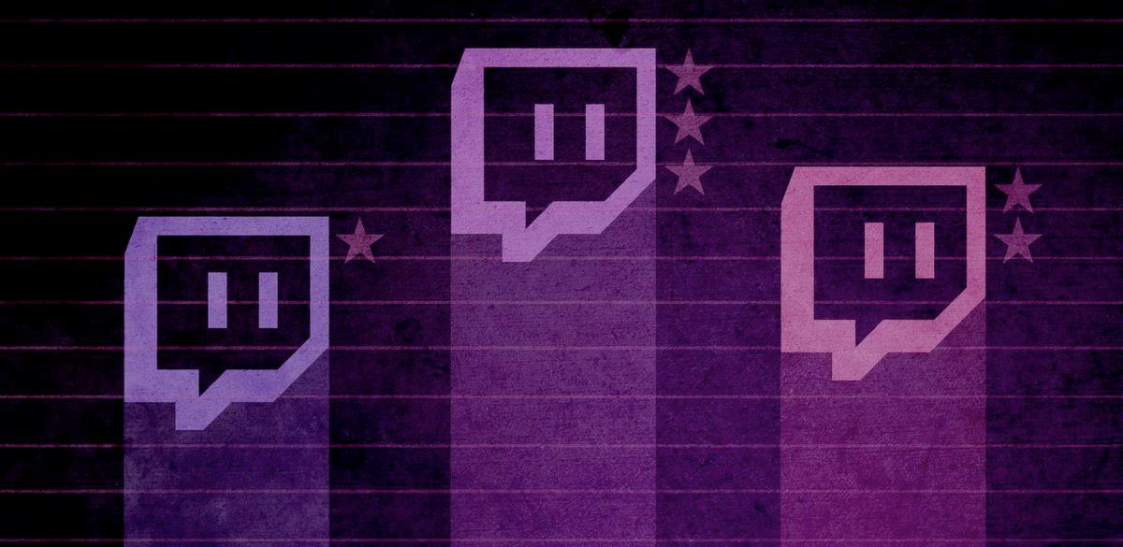
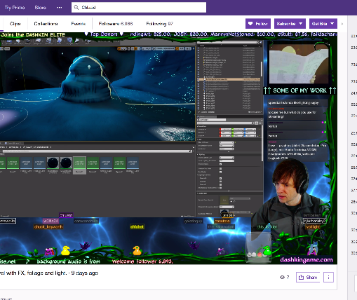
A tale of two Adams
Adam (1) (programmer making Bot Land)
Chluaid (artist on BrackenSack: A Dashkin Game) (and also named Adam (2) IRL)

Slide 14
So that got me thinking about “Artist Adam” & others
Art streaming, or ‘art development streaming’, is an underexplored area of the Twitch community that shares many facets of its operation with other hobby- or quasi-professional-based streaming communities.
At its core, art streaming is the activity of streaming the creation of art: drawing, painting, sketching, watercolor, etc. as well as digital drawing and painting in packages such as Adobe Photoshop, Adobe Illustrator, and a multitude of packages designed for anime, comic art, etc.
This has become popularized to the point that a dedicated channel has emerged on Twitch, the so-called ‘Art Channel’ which is in the ‘Creative’ section of Twitch.
Notes:
Interestingly, there is substantial consternation within this community that the deletion of ‘Twitch IRL’ and subsequent creation of specialized channels by Twitch itself within the ‘Creative’ umbrella [2] has damaged the overall general audience of viewers not engaged in art streaming themselves, as it has discouraged those outside the activity to browse the content in an integrated dashboard.

Slide 15
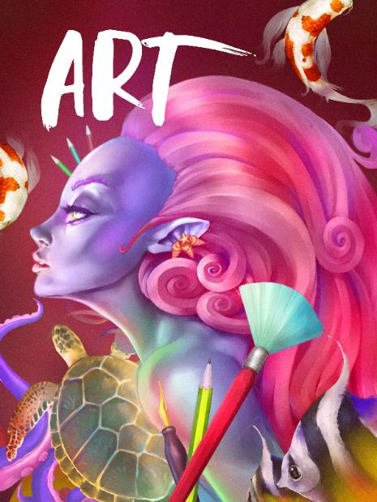
So we watched way too many hours of art streaming
Art Streaming Study
  Streamers selected from first 3 pages of ‘Twitch Art Channel’
  Attempt to vary presumed gender, presumed age, location, and artistic subject
  Approximately 280 observed, some repeatedly
  Vast majority <5 audience (minus me)
  Limited to 2D Drawing & Painting
  Field notes from observing both stream and chat

Slide 16
Motivations & Labor
The vast majority of these streams are VERY SMALL.
The vast majority of these streams do not actually support their artists financially over time (despite Patreon and other linkages)
The vast majority of these streams are people essentially trying to ‘skill up’
  Informal skill levelling
  Informal → formal critique (aka ‘O’Donnell’ game talk)
  Critique as a means of ‘gamer capital’ (Consalvo)
  Commitment to DAILY PRACTICE
  MAKE BETTER ART (more on that in a bit)
Notes:
This mimics standard art education practices that often rely on daily sketching, painting, or drawing as a form of immersion and practice of technique and craft and is often assigned in introductory courses in studio disciplines. In observation,
Needless to say, this activity is obviously and foremost a form of individual labor, albeit purposefully and directly engaged in by choice as the purpose of engaging in art streaming is to engage in the creation of art.

Slide 17
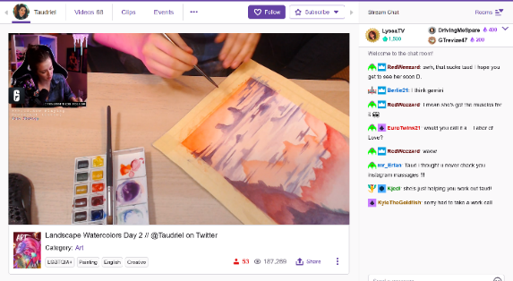
NEGOTIATED LABOR WITH THE PLATFORM ITSELF
1) the work being created (either digital -i.e. screenshare, or physical -i.e. webcam)
2) their hands using the brush, stylus, tablet surface, or other input device during the physical act of painting or drawing
3) their face or other representation such that a live avatar was presented for narration, persona, and engagement
4) views of the software menus, palettes, and layers (if digital), and/or materials, palette, and studio space (if physical).
Streamer Taudriel engaged in watercolor work, with associated stream cam, chat, and other elements of the Twitch platform.
Notes:
It must also be noted that this activity is also a form of negotiated labor just in terms of engagement with the platform: how to best stream art creation is itself an open question, just as TL Taylor found with respect to variety streamers who were constantly tweaking and adjusting their streaming protocols
Typical reverence and mimicry of Bob Ross style stepwise “paint”through, but significant experimentation with approach and scale in certain streamers / corners
This is in addition to, or forms a layer of complexity on top of, the multiple forms of engagement required by streamers to engage technically with the platform in effective fashion, which include camera management, music, sound, the augmentation of their streams with bots, gifs, surveys, and more.

Slide 18
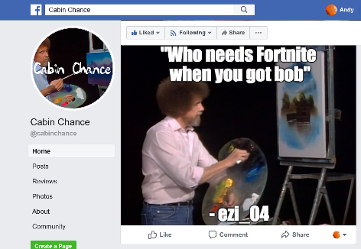
“MAKE BETTER ART”
through a combination of streaming their own practice and getting feedback,
being able to review their own process by recording their stream,
by watching the streams of others for new techniques and ideas,
and by seeking to engage in a community of practitioners that, to some extent, mimics a more traditional studio culture.
(Also, interesting mediation on what it means to “capture” process ☺)
“Cabin Chance” Facebook group, curating “the best” from the Bob Ross Weekend Marathon channel chat

Slide 19







Monetization & Audience
(yet more labor)
Intricate system of multiple, sometimes competing, platforms and interests
Vast majority are (of course) not supporting themselves via these means
A lot less emphasis on public spectacle / fame / following
Negotiated audience participation across networks (games ←→ art, etc.)

Slide 20
Here is that complexity in practice
Screenshot of the various galleries,
websites, channels, and communications for art
streamer BlackKurone

Slide 21
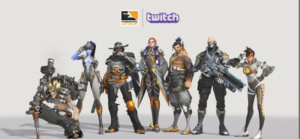
Community, Engagement, and Crossover, Oh My! (LABOR++)
More on that game ← → art thing…
And other formats / groups / crossovers (of course)

Slide 22

Toxicity (infinite labor)
forcibly engaged in the labor of mitigating or managing toxicity, mainly due to being a woman, person of color, or recognizably LGBTQ+
Sometimes though there remained a fixation on sexualized subject matter coupled
observed instances of individual streamers attempting to exert ‘expert knowledge’(often this is less about subject matter and more about the persona of the streamer)
Sometimes policed moreso by the community than the individual artist, with stereotypes around the purpose of the stream (i.e. “take that $&@* to a games stream!”)

Slide 23
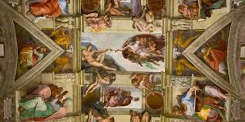
Authenticity
Own not just a commission but the (interactive) process of creation
UNIQUENESS is the currency of the post-industrial/information economy fabrication-on-demand-economy
Addition of rulesets, communication norms, and functional practices surrounding feedback, time, and engagement
Twitch itself as a platform has proven largely disinterested in proactively assisting streamers in such cases, or in dealing effectively with the culture writ large (toxicity and other tools/issues)
Notes:
Reyson et al “Examination of Anime Content and Associations between Anime Consumption, Genre Preferences, and Ambivalent Sexism” as one example of the rabbit trail of literature here
https://www.polygon.com/2019/2/13/18223558/adl-anti-defamation-league-study-twitch-discord-harassment and so on

Slide 24

SIDE NOTE: MOAR RES34CH PLZ
(and better tools…)
Notes:
Image from Filament games regarding game based learning, but what about ‘game adjacent’ learning?

Slide 25
Conclusions
The labor of game streaming informs the types of labor present in art streaming, and understanding games will teach us more about these other platforms and ‘authenticity’ in this context.
The platforms themselves actively push and shape these practices of labor.

Slide 26

THANKS & QUESTIONS
ANDY
@andymphelps
andymphelps -at- gmail.com
andyworld.io
MIA
@miac
mconsalvo -at- gmail.com
about.me/mconsalvo

