Slide 1



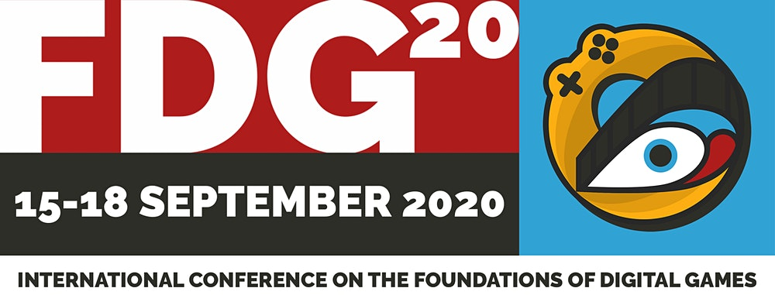
Teaching Students How to Make Games for Research-Creation/Meaningful Impact
(Is Hard)
Teaching Students How to Make Games for Research-Creation/Meaningful Impact
(Is Hard)
Andrew Phelps
Professor of Human Interface Technology
University of Canterbury, Christchurch, NZ
Professor of Film & Media Arts
Professor of Computer Science
Director, American University Game Lab
American University, Washington, DC
President, Higher Education Video Game Alliance
Mia Consalvo
Professor of Communication Studies
Canada Research Chair for Games Studies & Design
Founding Director, mLab
Centre for Technoculture, Art & Games (TAG)
Concordia University

Slide 2
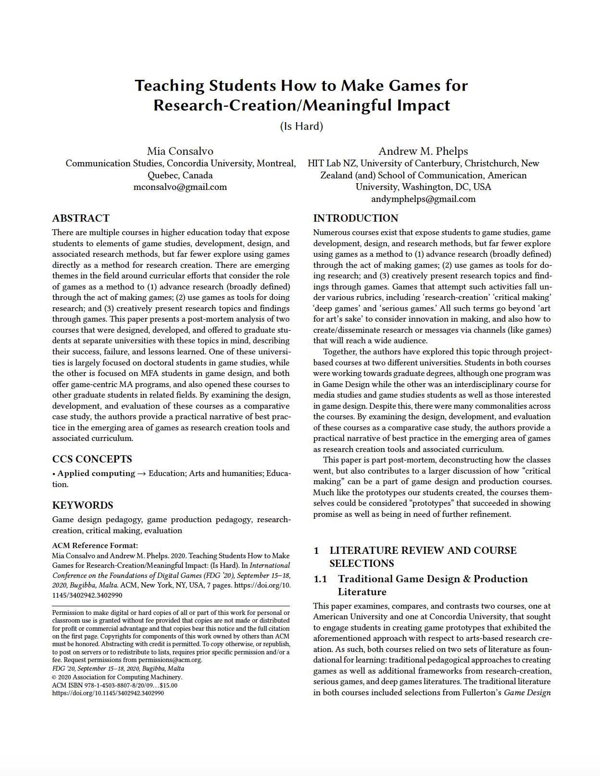
Emerging Themes
1) advance research (broadly defined) through the act of making games;
2) use games as tools for doing research; and
3) creatively present research topics and findings through games.

Slide 3
Research Creation, Dissemination and Meaning Literature
Go read the paper!
(no really, there is a lot there we just don’t have the presentation time)

Slide 4
A Tale of Two Courses
CONCORDIA COURSE
Mixture of MA and PhD students
Mostly non-production focused students
Engaged in their own research topics
Wildly different forms/levels of academic and game playing experience
AMERICAN COURSE
Mostly MA & MFA students
Engaged in their own game productions
Course is a lead-in to capstone
Most students in our games program or related things like film and interactive media
Not a lot of prior production experience

Slide 5
Course 1: Games as Research Creation (Mia’s course)
Two central questions:
  What exactly is research creation for games?
  How can it be evaluated? (how do we know what is good)
Knowledge sharing in multiple ways
Digital and Physical Prototypes (3 total)
  At least one physical game
  At least one digital game
  Games could iterate on one another

Slide 6
Post-Mortem of Course 1
Too many assignments.
Students lacked knowledge in game-specific domains.
Playtesting didn’t occur outside of the course.

Slide 7
Selected Examples of Student Work Course 1
Alex Custodio designed two prototypes, Web and then Dot-MatriX-Stitch, to explore cross-stitching as a mechanic that encouraged “slowness, materiality, and reflection on games.” In Dot-MatriX-Stitch, four players had their own cross stitch board and yarn color, which could be passed to other players via different game events. Players also drew “conversation cards” that offered prompts for talking about various subjects. The intimacy of stitching and the slowness of the act itself combined with conversational prompts led to very stimulating discussions.
Custodio’s games were provocative answers to Fron et al.’s manifesto about the “hegemony of play” still being practiced by the commercial game industry.

Slide 8
Evaluation of Student Work, and of Course 1
Assignments were designed to encourage students to determine for each project what success meant and what failure mean. Failure wasn’t negative.
How do you grade experimental work that is often not polished or even finished?
Documentation was the fallback for considering how “well” students grasped ideas, planned and executed them.

Slide 9
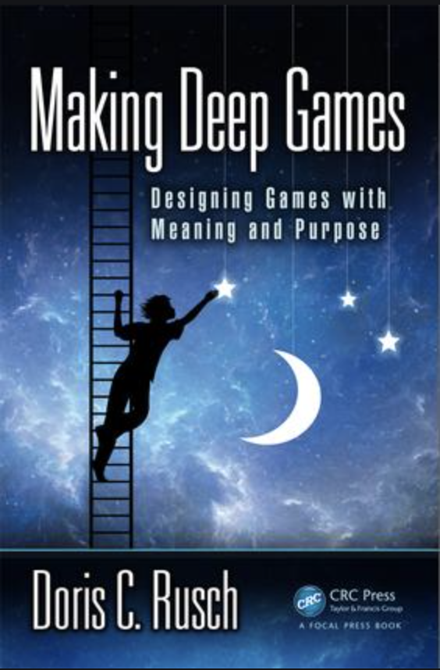
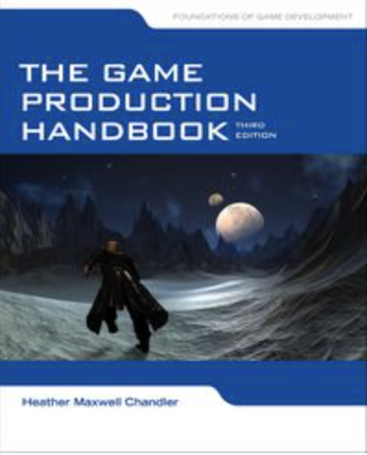
Course 2: Making Meaningful Games (Andy’s course)
Course overview and intent
Student Preparation
Digital and Physical Prototypes (2 total)
Readings from: Making Deep Games, Game Production Handbook, others (Fullerton, Schell, etc.
Split focus on ‘making’ – a tension between teaching design and production
Andyworld.io/teaching.html – GAME620 syllabus

Slide 10
Course 2: Post Course Analysis
Student Preparation and Core Skills
Student Engagement with Metaphor and Abstraction
Playtesting Lacked Structure.

Slide 11

Course 2: Selected Examples of Student Prototypes
Lunch in Paradise by Hazel Arroyo that asked the player to continually order lunch each day from a small beachside restaurant menu. Over the course of the game, the items on the menu shift from local island food items to bland Americanized items typical of a fast-food menu. The costs increase, and the player will eventually fall into dept in attempting to continue to buy food. The game functions as a metaphor exploring the relationship between Puerto Rico and the United States, with an ending reveal of several of the underlying points of tension surrounding the cultural and economic issues at play.
From an arts-based research creation perspective, the core question the explores is an examination of whether a small simulation game is effective in portraying the emotions and cultural dissonance that surrounds this relationship.

Slide 12
Course 2: Evaluation of Student Work, and of the Course
This is a gigantic mess.
Everyone loved the course, and the fact that there was a methodology, that it was taught as a design process exploration, and that there were concrete examples of production and design.
But did we really make progress on games as research? Did we really achieve the goals we were after?
And, for that matter, is this objective or subjective?
Documentation also became a fallback here also.

Slide 13
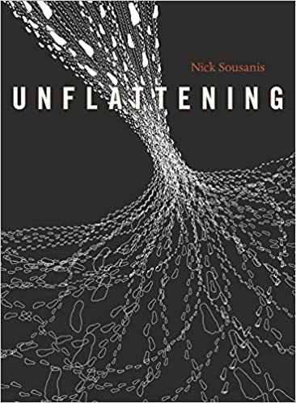
Commonalities & Questions
In his foundational book Unflattening, Nick Sousanis writes that bringing together words and images in his work allows for “a simultaneous engagement of multiple vantage points from which to engender new ways of seeing”
Kuttner et al ask incisive questions about comics-based research: “can something be a bad comic but still be good research? If so, will anyone actually want to read it? . . . Can a good comic make up for poorly done research”?

Slide 14
Commonalities & Questions & Conclusions
Students weren’t sure what a ‘good research game’ looked like
Students lacked critical game history knowledge to avoid reinventing wheels.
Students with greater traditional design knowledge sometimes had trouble breaking free from their initial assumptions about what a ‘good game’ should look like or how it should function
This issue was also centrally at play in the decision to create prototypes as opposed to more polished forms of design with respect to the evaluation of how well such games could serve as tools of research dissemination
In considering the concept of games as platforms for research dissemination, what does it mean to embrace the ‘game-ness’ of this form of media?

Slide 15
Thank you, John
FDG will always be about you, and we are in your debt every year to have this space to ask these questions, and to continue to explore how to better teach our students, and to learn ourselves.

Slide 16
THANKS & QUESTIONS
ANDY
@andymphelps
andymphelps -at- gmail.com
andyworld.io
MIA
@miac
mconsalvo -at- gmail.com
about.me/mconsalvo

