Slide 1





Development Streaming as a Pedagogical and Community Strategy for Games Education
Andrew Phelps
Professor of Art & Design
President, Higher Education Video Game Alliance
Founder, RIT MAGIC Center, MAGIC Spell Studios
Founder, School of Interactive Games & Media
Rochester Institute of Technology
Workshop on New Research Perspectives on Game Design & Development Education
CHI PLAY 2018, MELBOURNE, AUSTRALIA
Mia Consalvo
Professor of Communications Studies
Canada Research Chair for Games Studies
Centre for Technoculture, Art & Games (TAG)
Concordia University
Christopher Egert
Professor of Game Design & Development
Co-Founder, School of Interactive Games & Media
Rochester Institute of Technology

Slide 2
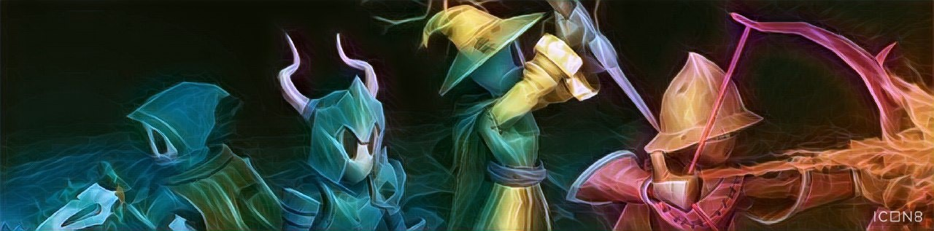
PRESENTATION OVERVIEW
Background of who I am and what I do
Why Development Streaming?
What are we hoping to accomplish?
Future work and potentialities

Slide 3
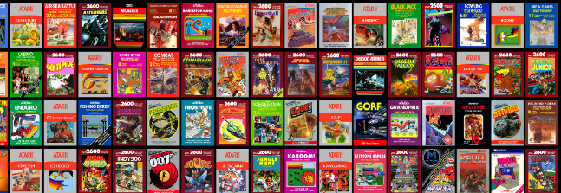

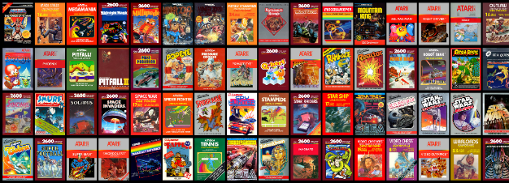
I’m ANDY & I GREW UP A GAMER

Slide 4
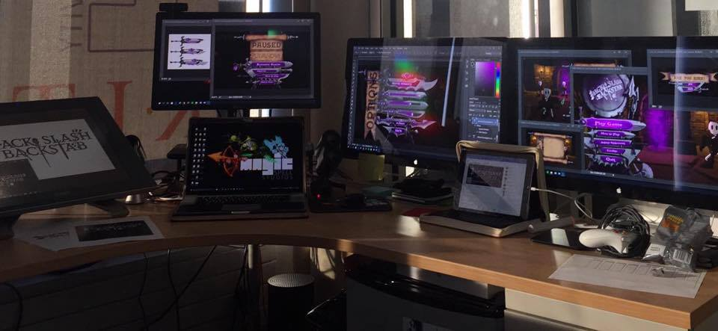
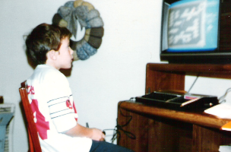
I make things.

Slide 5

RIT GAMES & INTERACTIVE MEDIA TIMELINES
2001 programming
First course in games programming
2002
Electronic Gaming Society
2003
CS/IT Concentration in Game Prog
2006
MSc Game Design & Development
2007
BSc Game Design & Development
2009
Dept. of Interactive Games & Media
2011
School of Interactive Games & Media
2012
Minor in Game Design
2013
RIT Center for Media, Arts, Games, Interaction & Creativity (MAGIC)
2013
MAGIC Spell Studios ®, LLC
2016
$30M MAGIC Spell Studios Initiative
2016
NY State Games HUB
2017
NY State Games Challenge

Slide 6
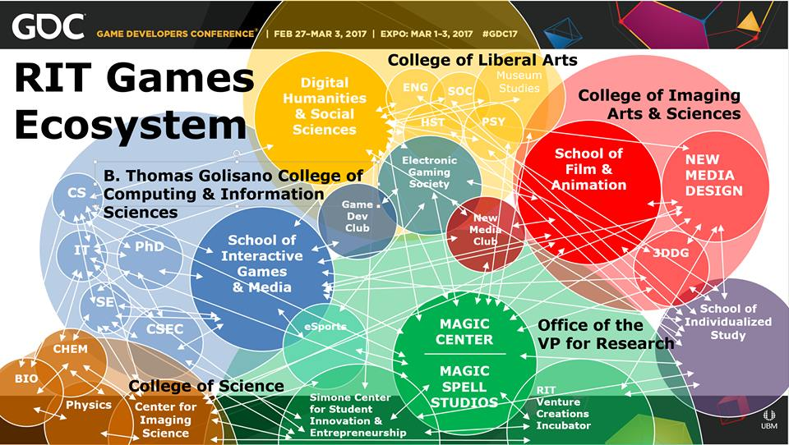

Slide 7
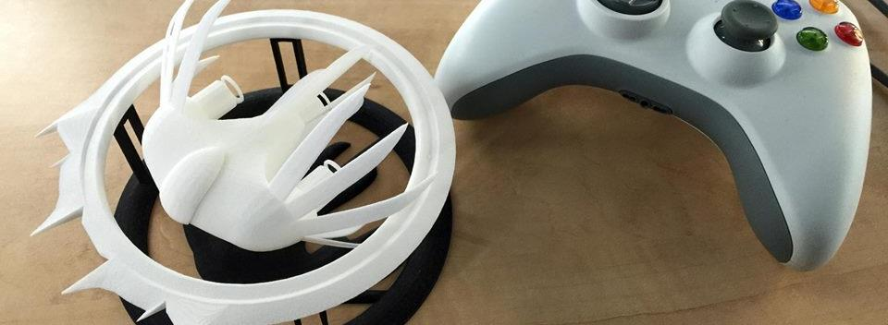
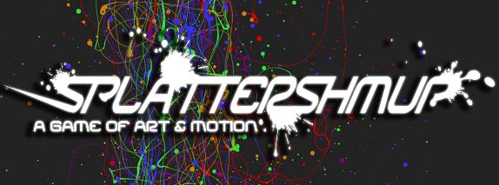
A Strange Game for Strange Reasons
This game taught us (the campus) about making things, production, and scale
This game allowed us to explore using typical game forms for telling a unique story to a very targeted audience
Finalist at GLS Education Arcade, accepted to DiGRA Blank Arcade, and IndieArcade at the Smithsonian American Museum of Art
SPLATTERSHMUP.RIT.EDU – PLAY TODAY! MAKE ART!

Slide 8
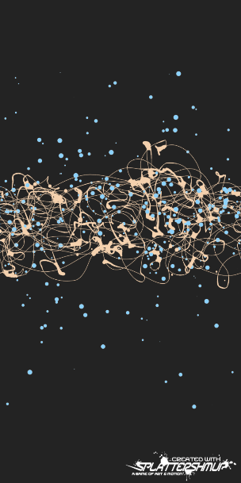
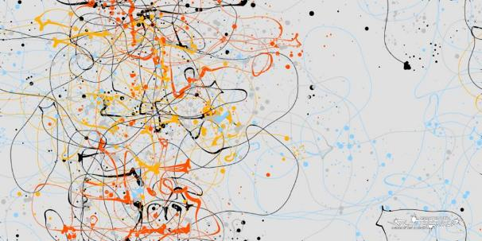
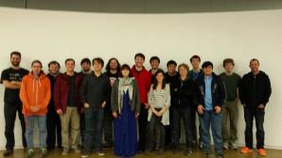
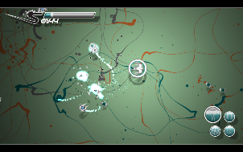
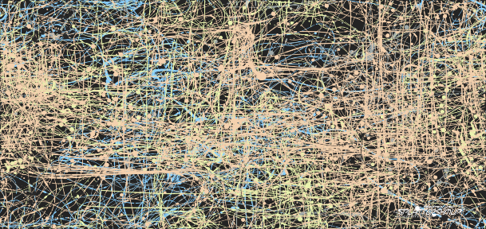
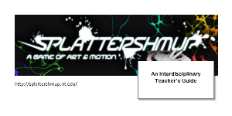



Slide 9
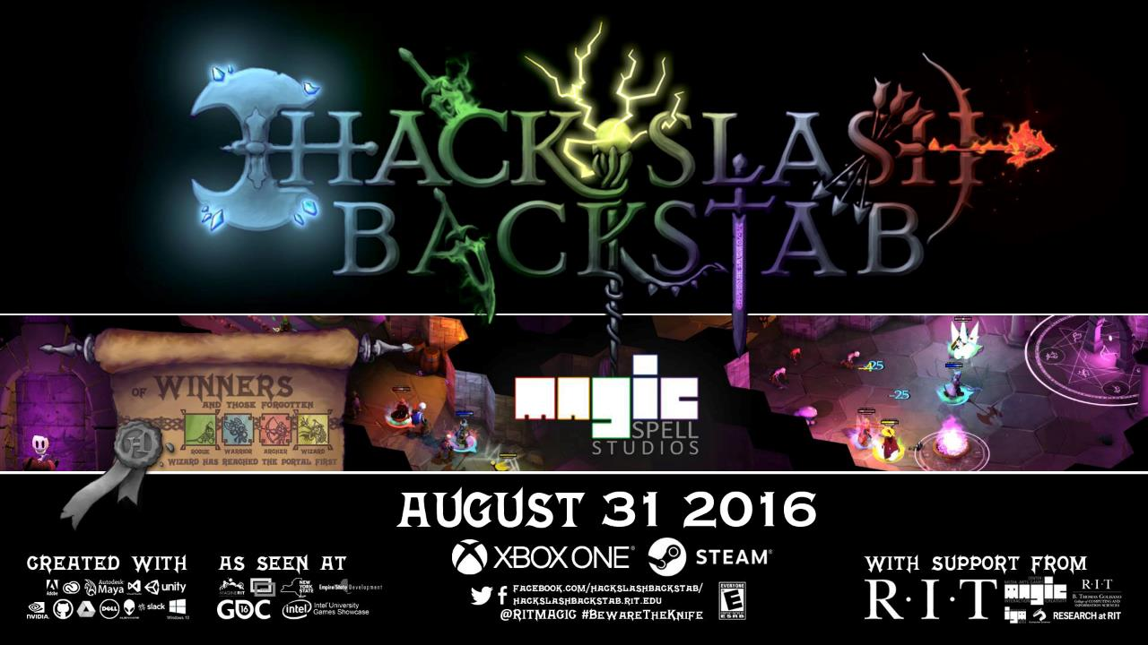

Slide 10
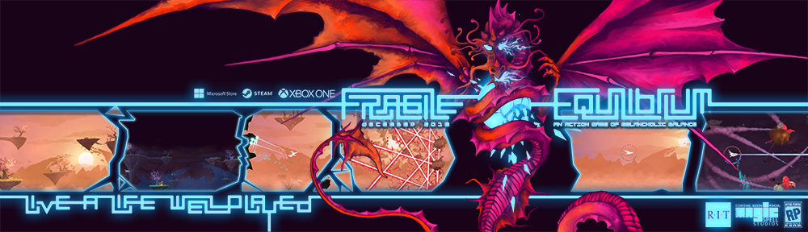
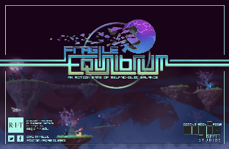
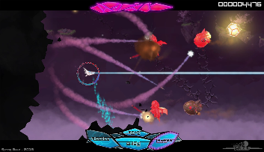
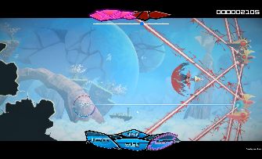
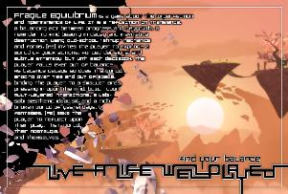

Slide 11







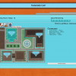
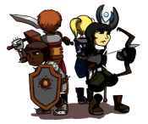








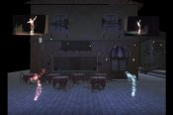
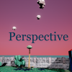








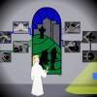



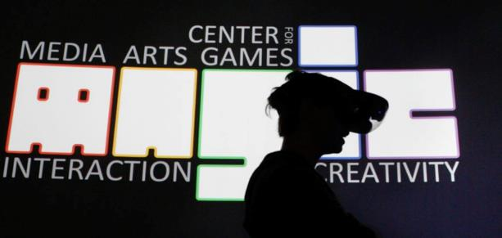




20 YEARS OF LEARNING THROUGH MAKING. 20 YEARS OF PROJECTS & MEDIA.
Notes:
So I highlight those 3 because of the things we learned and as data points of growth, but the thing is we did a LOT of stuff from a LOT of work for a LOT of people! It’s a lot bigger a community than people even think about. It’s easy when you are working on ‘your thing’ to not realize the scope and scale of everything else that’s happening and going on.

Slide 12
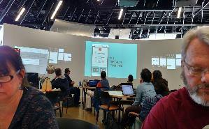
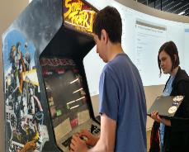
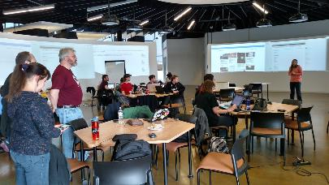
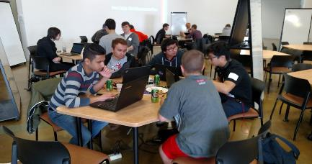
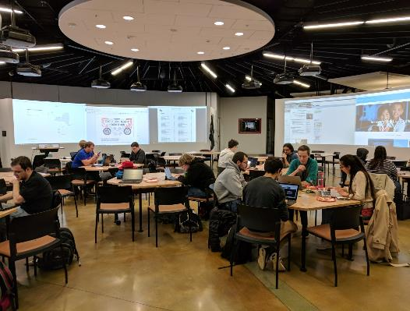
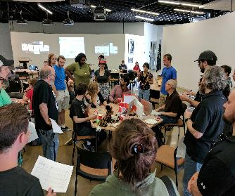
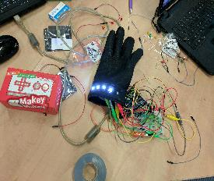
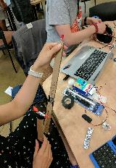
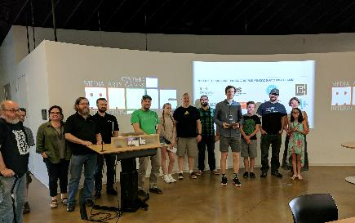
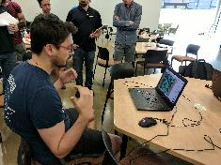
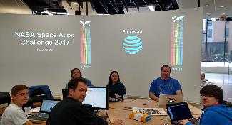


Slide 13
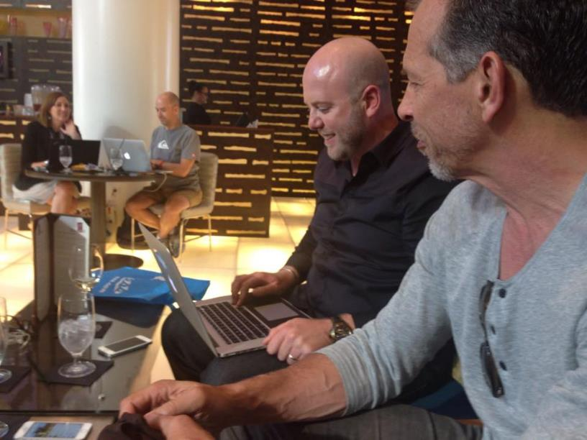
RETHINKING APPRENTICESHIP ?

Slide 14

NICE SHEEP
Game industry studies
  Co-creativity (John Banks)
  Game talk (Casey O’Donnell)
Live streaming gameplay
  Broadcasting play (TL Taylor)
  Hamilton W. A., Garretson O., & Kerne A. (2014, April 26–May 1). Streaming on Twitch: Fostering Participatory Communities of Play within Live Mixed Media. In Proceedings of the SIGCHI Conference on Human Factors in Computing Systems (CHI ’14). New York, NY, USA.

Slide 15
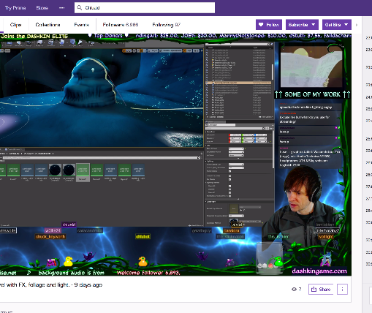
A tale of two Adams
Adam (programmer making Bot Land)
Chluaid (artist on BrackenSack: A Dashkin Game) (and also named Adam IRL)

Slide 16
A Tale Of Two Adams
“coder adam”
Talk aloud protocol
Careful attention to chat
Lots of questions & advice to/from other developers
Streams as a commitment to practice
Small community, not about audience per se
“artist adam”
A kind of ‘visual stepwise process’
Specifically wanted less feedback
Streams as a commitment to practice
Small community, not about audience per se
Cultivation of community for visibility / connections

Slide 17

DEVELOPMENT Streaming…
A commitment to practice and function?
Less about audience, more about community (maybe?)
A scalable platform for observation, practice and critique?
A form of bi-directional apprenticeship?
A dialog platform for learning communities?
A potentially scaffolded environment?
A quest for authenticity and role models?

Slide 18
A first use of developer streams is for the instructor to use the technology to stream themselves performing various tasks and activities.
Second, there may be significant value in having students stream their own creations either as a form of ‘well played’ exercise, or simply as a walkthrough and talk-aloud critique of the project they have delivered.
Third, along with streaming final games and prototypes, having students stream their own development work to then examine and reflect on it could be incredibly valuable.
Fourth, having students stream their own work and development process can surface such work across an entire student body.
Fifth, development streaming has the potential to engage students in a wider community that extends substantially beyond the campus.
Finally, it may be useful to explore having students essentially “cross the streams” to help acclimatize students in a given role with their counterparts in other majors or areas of a curriculum.

Slide 19
Potential problems
Stressing out over streaming / status / practice / etc.
Diversity and inclusion, harassment and cultural failings online
Student privacy and compliance with relevant edu statutes
Large technical infrastructure and expertise

Slide 20
Consalvo, M., & Phelps, A. (2019). Performing game development live on Twitch. Presented at the Hawaii International Conference on Systems Science, Maui, HI. Preliminary work presented at AOIR 2018.
Phelps, A., & Consalvo, M. (2018) “Live streaming game design & development: A glimpse behind the mystic curtain with pedagogical possibilities” at The InterPLAY of Game Studies and Game Design, 2018 NCA Preconference, University of Utah. S Orme, University of Suffolk. National Communication Association 104th Annual Conference, Salt Lake City, Utah.
Phelps, A., Consalvo, M., and Egerct, C. (2018) Development Streaming as a Pedagogical and Community
Strategy for Games Education. Workshop on New Research Perspectives on Game Design & Development Education. CHI PLAY 2018, October 28, 2018, Melbourne, Australia.
Decker, A., Egert. C, and Phelps, A. (2018) "Learning to Create or Creating to Learn" International Academic Conference on Meaningful Play, October 11, 2018 East Lansing, Michigan.
Phelps, A., C. Egert and A. Decker. (2018) "Splattershmup: A Game of Art & Motion". Learning in Games Book 3. Ed. K. Schrier. ETC Press, Carnegie Mellon University. (in press, forthcoming)
Decker, A. C. Egert, A. Phelps, (2017) “Trial by a Many-Colored Flame: A Multi-disciplinary, Community-Centric
Approach to Digital Media and Computing Education”, in New Directions for Computing Education
(S. Fee, et al, ed.), pp. 237-257. Springer International Publishing, Cham, Switzerland. 2017.

Slide 21
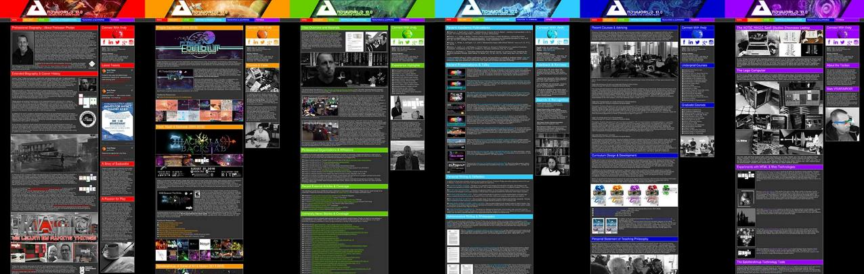
ANDYWORLD.IO | PROFESSORANDREWPHELPS.NET | @RITIGM1 | ANDY@MAIL.RIT.EDU

Slide 22
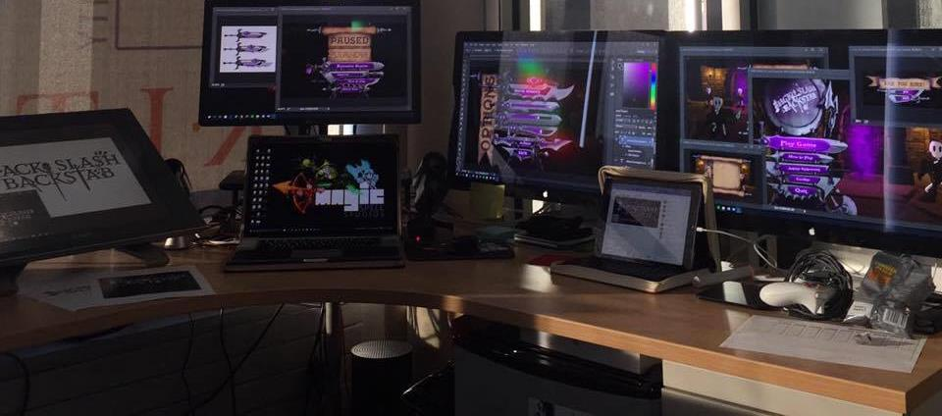
Thanks & Questions
andy@mail.rit.edu | andyworld.io| @ritigm1

