Slide 1
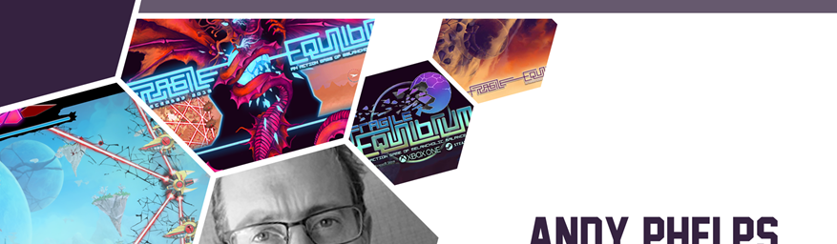


:
Experiential Games: What You Play is What You Learn
Christchurch Game Developers Meet-Up | EPIC | Christchurch, New Zealand
Andrew M. Phelps
Professor of Human Interface Technology, College of Engineering, University of Canterbury, NZ
Professor, Film & Media Arts, School of Communication, American University, USA
Director, AU Game Lab & American University Game Initiative
President, Higher Education Video Game Alliance
Co-Founder, Applied Immersive Gaming Initiative

Slide 2

Today’s Talk
Intro in 2 minutes
Overview of Fragile Equilibrium: An Action Game of Melancholic Balance
Overview of Splattershmup: A Game of Art & Motion
Overview of Hack, Slash & Backstab
The idea of Experiential Games for Learning
New Projects and CHCH Initiatives

Slide 3
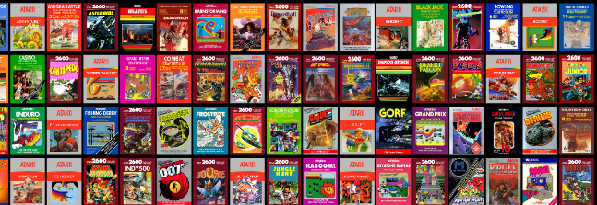

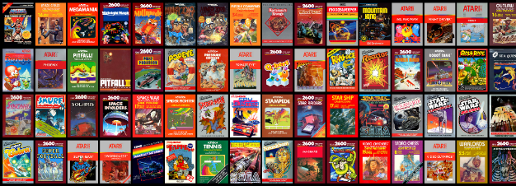
HI, I’m ANDY

Slide 4
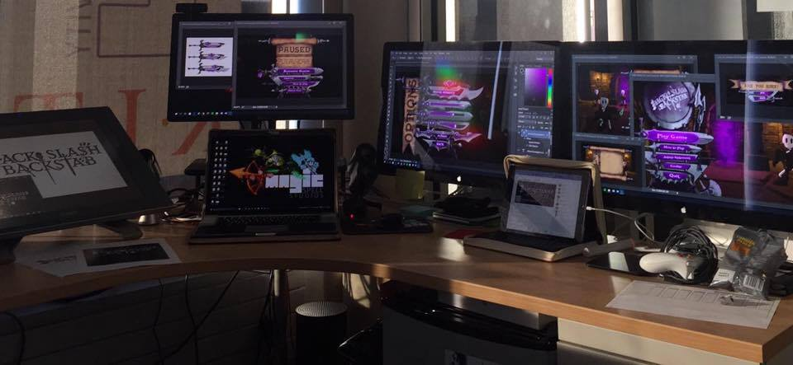

I make things.

Slide 5

A HISTORY OF GAMES & INTERACTIVE MEDIA
1999-2020
2001 programming
First course in games programming
2002
Electronic Gaming Society
2003
CS/IT Concentration in Game Prog
2006
MSc Game Design & Development
2007
BSc Game Design & Development
2009
Dept. of Interactive Games & Media
2011
School of Interactive Games & Media
2012
Minor in Game Design
2013
RIT Center for Media, Arts, Games, Interaction & Creativity (MAGIC)
2013
MAGIC Spell Studios ®, LLC
2016
$30M MAGIC Spell Studios Initiative
2016
NY State Games HUB
2017
NY State Games Challenge
2019
American University Game Lab
2020
HIT Lab NZ + AIGI

Slide 6

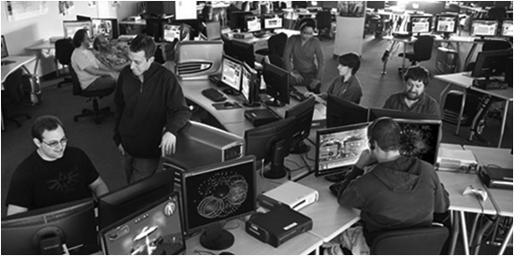



School of Interactive Games & Media

Slide 7

CENTER for MAGIC, ARTS, GAMES, INTERACTION & CREATIVITY (MAGIC)
MAGIC SPELL STUDIOS

Slide 8





INCREDIBLEY AWESOME ALUMNI
ALEX CUTTING
Senior Assoc. Producer HALO
Microsoft / 343
CLAUDE JEROME
Gameplay Designer DESTINY
Bungie
DUSTIN KOCHENSPARGER
Line Producer DLC
DESTINY
Bungie
SELA DAVIS
Platform Engineer
XBOX / XBOX Live
Microsoft
VReal
ANNA SWEET
Director of 3rd Party Development
STEAM
Valve
Oculus
Caffeine.ty
Microsoft XBOX

Slide 9
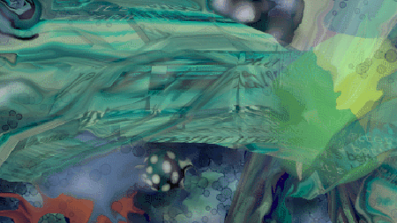



Art|dev|EDU|art|ADMIN|dev|art

Slide 10
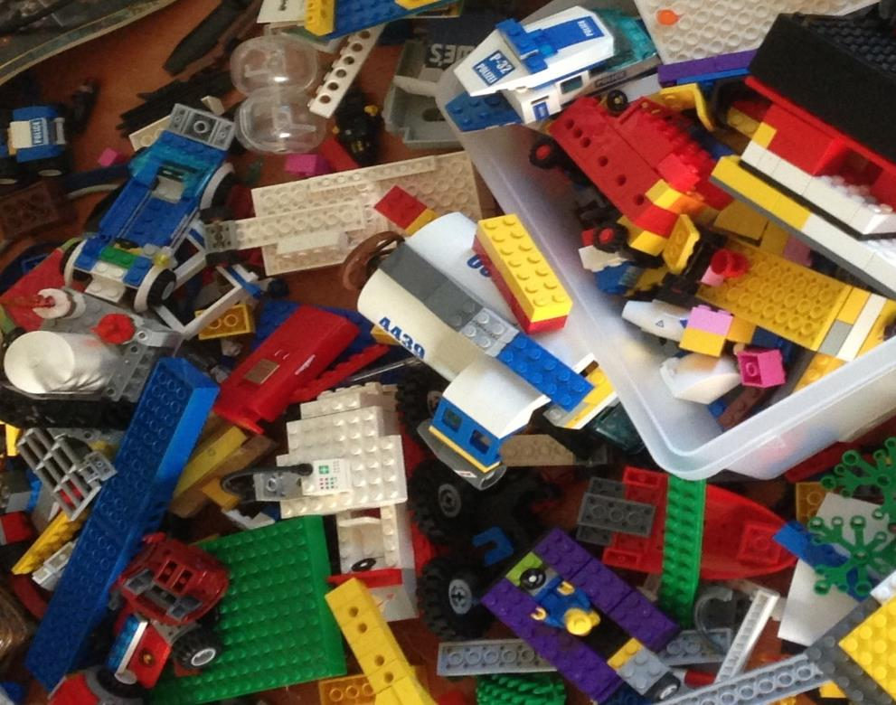
'protecting “making as a
mode of inquiry”’
-Ian Horswill, Northwestern
Notes:
This quote is from Ian Horswill, who said it, I think the first time? sitting on the floor of Microsoft Research at the MSR Faculty Summit a number of years ago. It has been rolling around in the back of my brain ever since – and it was the fundamental thing upon which MAGIC was founded, that somehow design research, making prototypes to test ideas, learning by making new things and new experiences, needed to be recognized and valued. At RIT we’ve sometimes used the rhetoric of STEM and Research to de-value those activities in weird ways.

Slide 11
GAMES OF THE SOUL

Slide 12
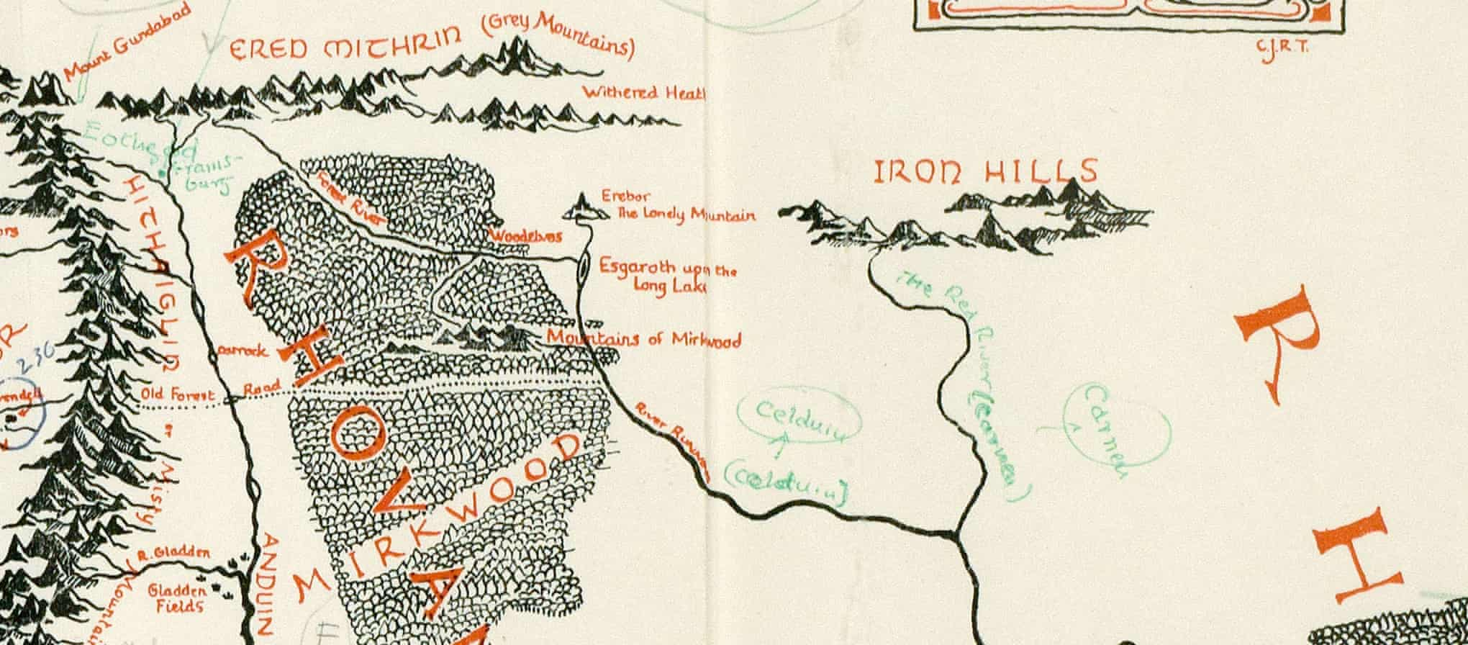
AS HUMANS, WE BRING OURSELVES TO OUR EXPERIENCES
KNOWLEDGE OF A SYSTEM IS NOT EMPATHY
AND DOES NOT PRESUPPOSE TRANSFORMATION
A large part of games’ transformative potential thus remains either unrealized or invisible (Paolo Pedercini, 2014). But how can we intentionally design for personal transformation without pre-determining the kind of change the game should ignite or seeks to impose upon its players? How can we facilitate profound, organic inner shifts through our designs that allow players to “respond to them of themselves, with recognition, uncoerced[?]” (Campbell 1991, p.3).
GAMES ARE NOT JUST COMPLEX SYSTEMS | MECHANICS

Slide 13
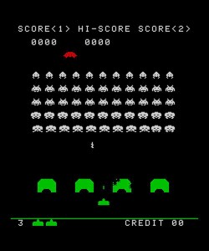
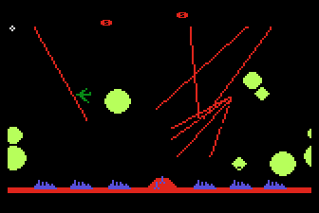
CONTEXT CAN BE EVERYTHING
Space Invaders 1978
Missile Command 1982

Slide 14


Slide 15
Video at https://youtu.be/RawagSAf-V0

Slide 16
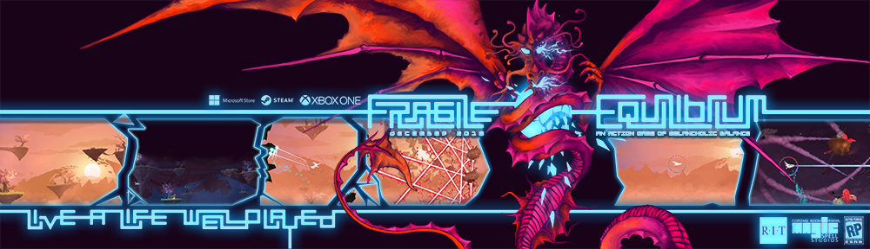
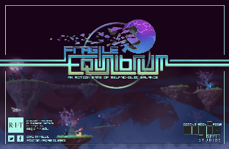
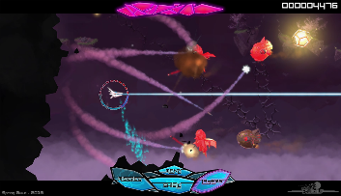
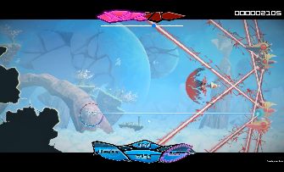
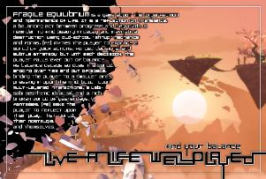

Slide 17
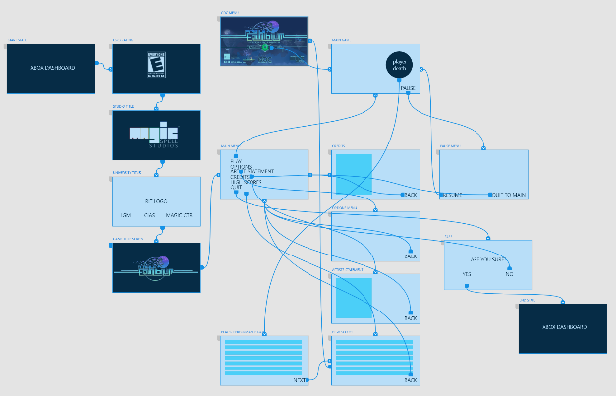
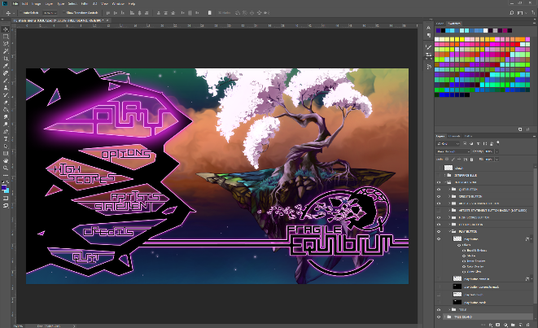





Slide 18
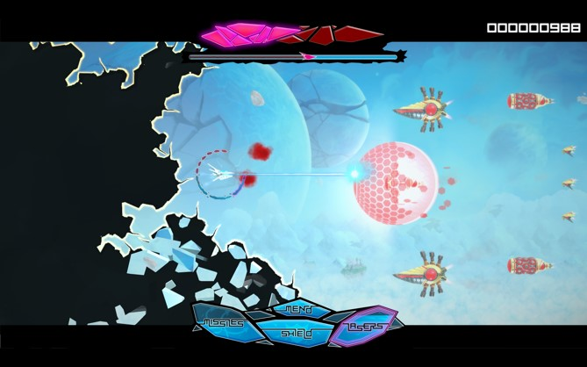
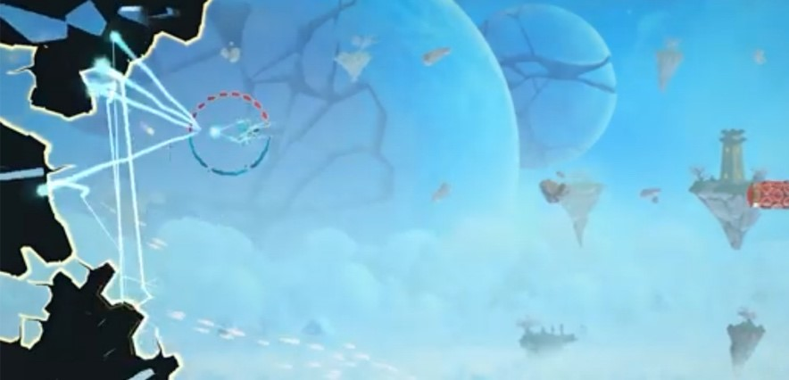
Fragile Equilibrium in both ‘shmup facing mode’ (left) and ‘repair mode’ (right).

Slide 19
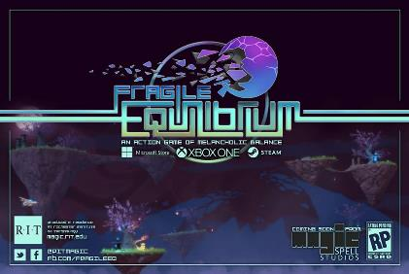
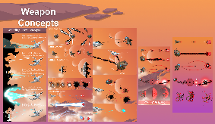
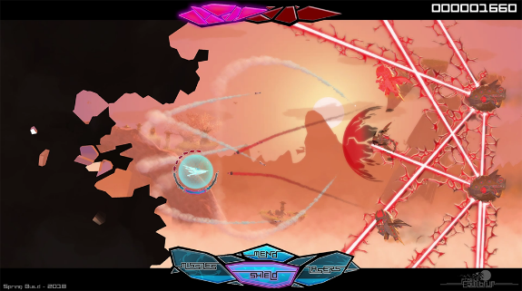
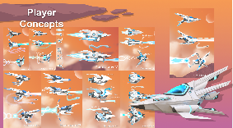
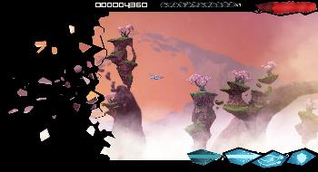
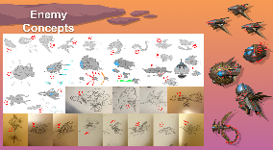
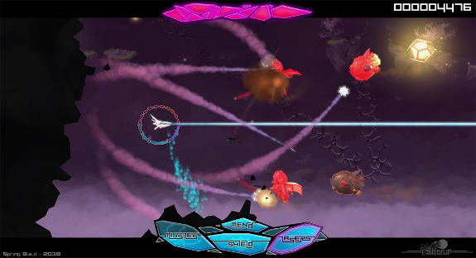


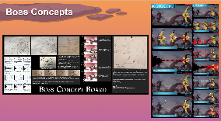

A lot went into this metaphor…

Slide 20
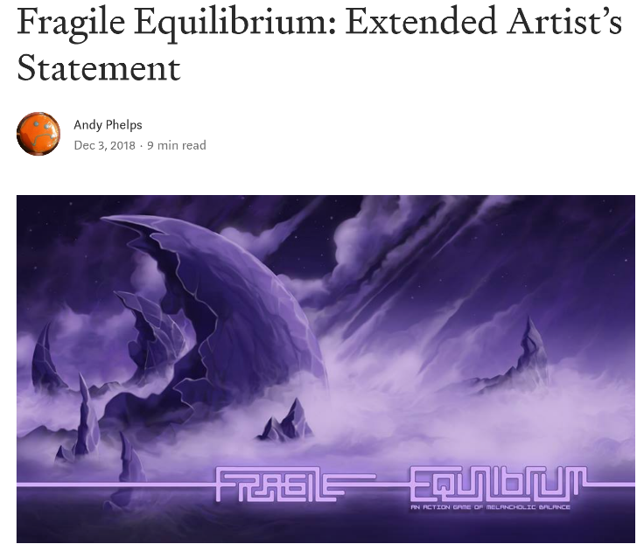
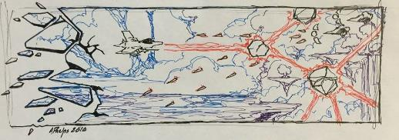
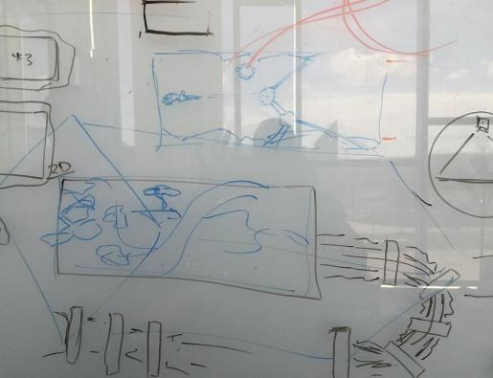

Slide 21
AN ARGUMENT FOR THE EXPERIENTIAL GAME
ACTIVE LEARNING THEORY (Kiili 2005, Cziksentmihalyi 1990)
  concrete experience
  reflective observation
  abstract conceptualization
  active experimentation
  CONSTRUCTIVIST (Phillips, 1995) and and CONSTRUCTIONIST (Papert, 1991) theory
  “the model stresses the continuous nature of learning and the appropriate feedback which provides the basis for a continuous process of goal-directed action” (Kiili, 2005). In other words, the experiential learning model promotes uninterrupted engagement with and reframing of certain concepts, cementing them through repetition and iteration within the learner’s own experience.”

Slide 22

setting of the world consists of a form of ruination and nostalgia
inspirations from Treasure’s Ikaruga, Kaihatsu’s Rai Den, and Irem’s R-Type
the artworks of Roger Dean
similar visual narratives from the late 1970s and early 1980s
In this way, the game seeks to directly employ a sense of post-apocalyptic nostalgia (Fuchs, 2017) for the era when ‘shmups’ were at their height
FE also makes a designed play on agency with regard to ruin, seeking to specifically extend a form of “‘deconstruction mode’ in which buildings or objects are turned into ruins ‘on demand’, so to speak, within the context of a game” (Lowe, 2012, chap. 3.) as the view of the world is brought to literal ruin during play
Notes:
Artwork by Roger Dean

Slide 23




VISUAL AESTHETIC

Slide 24

THE METAPHOR IN DEPTH
The designers of the game have spoken openly about the game as a metaphor for depression (Phelps, 2018), and also in the context of the Wabi Sabi aesthetic. (Koren, 2008)

Slide 25
REPETITION & LAYERS
As noted previously, this mechanic, along with other elements of the game, is meant as an experiential metaphor (as described by Rusch in Making Deep Games (2017)) for depression, mental health, and self-care. The player must at once both ‘deal with’ the normal ‘shmup world’– i.e. the external enemies and projectiles that come at them wave by wave, but also with the need to (literally) turn around and focus on their own view of the game world that is literally breaking apart. In this sense, the game invites players to reflect on external and internal conceptualizations of the world.
Ian Bogost (2007) discussed how repetition of actions or rules in video games can function to inform us about something rather than it being told to us. Phelps and Consalvo (2019) argued that “repetitive acts in gameplay can function procedurally as metaphors themselves” (p. 2).

Slide 26



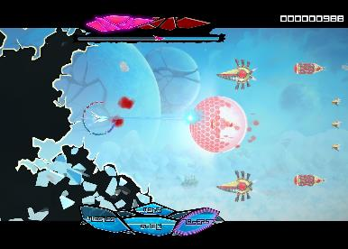
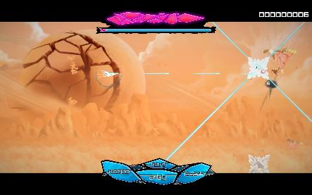
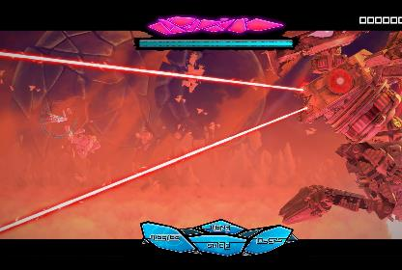

Slide 27
PLAYER ANALYSIS AND RECEPTION
“what is this? Manifestation of all the bad feels going on? Cuz often times things like depression and whatnot are shown to be like goop like that, just sticky, icky bad feelings and all that. Bogs you down…” (Mr Skysen, 2019a).
“...it’s not just recreating everything, you're just pulling it all back into place. You're not creating a new reality, you're just fixing it. You're trying to hold everything all together as best you can in this crazy world…” (Mr Skysen, 2019c).

Slide 28

ANOTHER OF (MY) EXPERIENTIAL GAMES

Slide 29
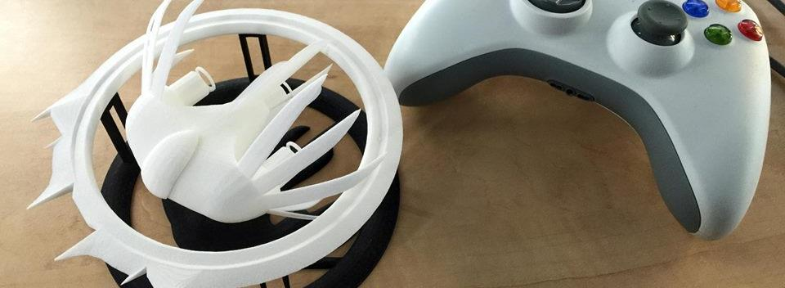
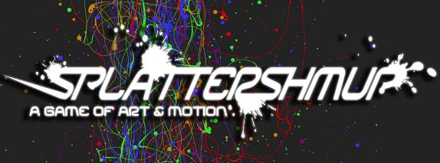
A Strange Game for Strange Reasons
This game taught us (the campus) about making things, production, and scale
This game allowed us to explore using typical game forms for telling a unique story to a very targeted audience
Finalist at GLS Education Arcade, shown at DiGRA Blank Arcade, and IndieArcade at the Smithsonian American Museum of Art
SPLATTERSHMUP.NET – PLAY TODAY! MAKE ART!

Slide 30
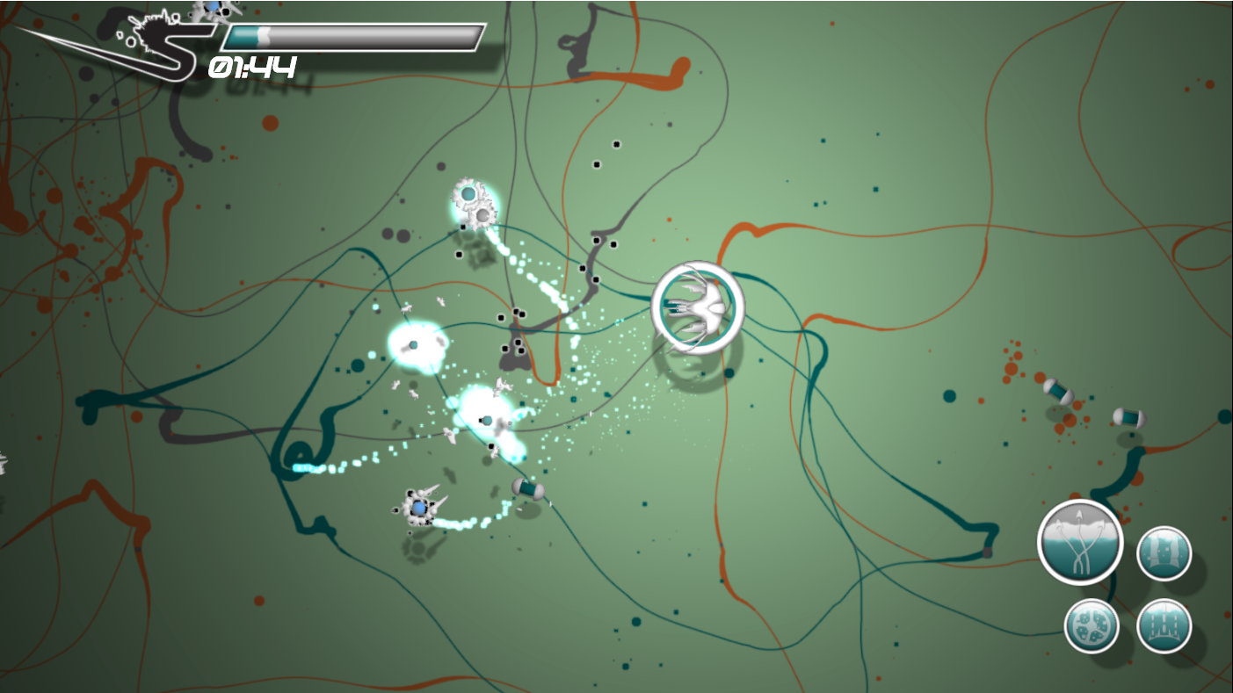

Slide 31

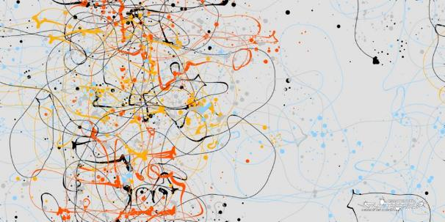

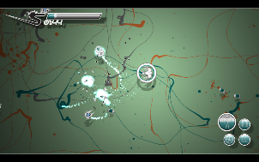
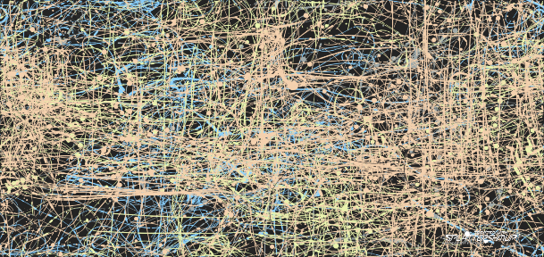




Slide 32
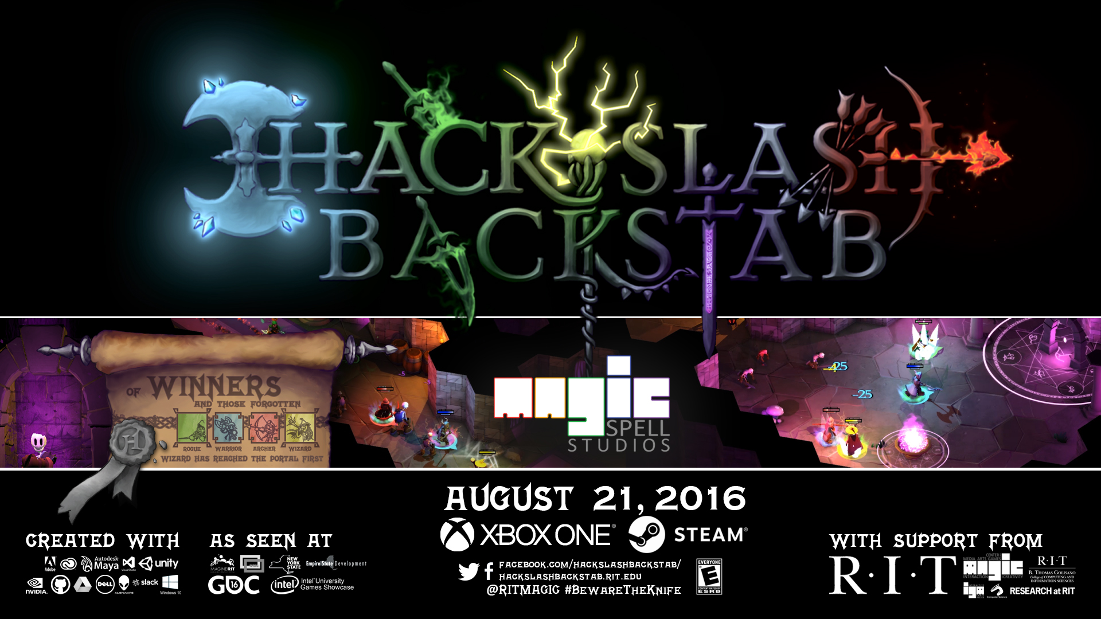
AND ANOTHER ONE…

Slide 33
VIDEO AT: https://youtu.be/9McDBSWXGzY

Slide 34

Notes:
Funded by Microsoft Research on games & learning. Three-tier development, cloud based deployment, database coupling

Slide 35

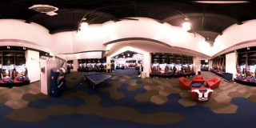


A SUMMER WITH THE
BUFFALO BILLS
Notes:
A big high-vis project that was (a) external client through the studio, (b) multi-disciplinary team, (c) primarily managed entirely by staff

Slide 36

















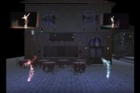
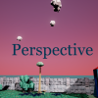












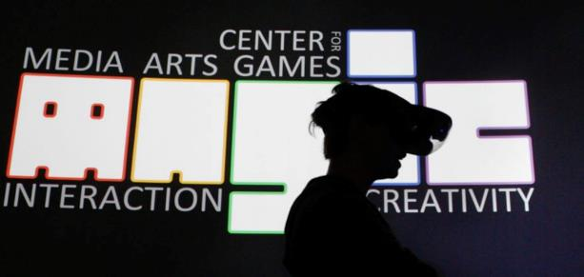




5 YEARS OF LEARNING THROUGH MAKING AT MAGIC. 5 YEARS OF PROJECTS & MEDIA.
Notes:
So I highlight those 3 because of the things we learned and as data points of growth, but the thing is we did a LOT of stuff from a LOT of work for a LOT of people! It’s a lot bigger a community than people even think about. It’s easy when you are working on ‘your thing’ to not realize the scope and scale of everything else that’s happening and going on.

Slide 37
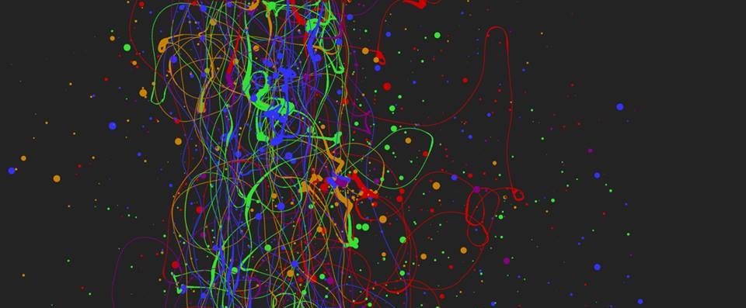
EXPERIENTIAL: “WHAT YOU PLAY IS WHAT YOU GET”
When we refer to experiential design, we mean the entire contextual experience of playing a game, and the interpretation of the experience by the player directly in the context of the experience itself. This kind of ‘what you do is what you get’ game is of increasing interest in the field, and in this manner is essentially an ‘experientially educational’ game (Phelps, Wagner, and Moger, 2020). Players can gain an understanding of, and empathy for, a given scenario or subject matter merely through the act of playing it, and specifically through the act of interacting with it. (Phelps, 2020)

Slide 38
FORTHCOMING WORK ON THIS THINKING
Phelps, A., Wagner, J. and Moger, A. (2020) "Experiential Depression and Anxiety Through Proceduralized Play: A Case Study of Fragile Equilibrium." Journal of Games, Self and Society. (2) v.1. (in press)
Rusch, Doris C. and Phelps, A. (2020) "Navigating Existential, Transformative Game Design." Digital Games Research Association (DiGRA) 2020. Center of Excellence in Game Culture Studies. Tampere, Finland. (June, 2020)
Phelps, A. (2020) “Fragile Equilibrium: An Action Game of Melancholic Balance.” The International Conference on Interactive Digital Storytelling (ICIDS) 2019 Art Show Book. Eds. R. Bown and B. Salisbury. Entertainment Technology Center (ETC) Press, Carnegie Mellon University. Pittsburg, Penn.

Slide 39
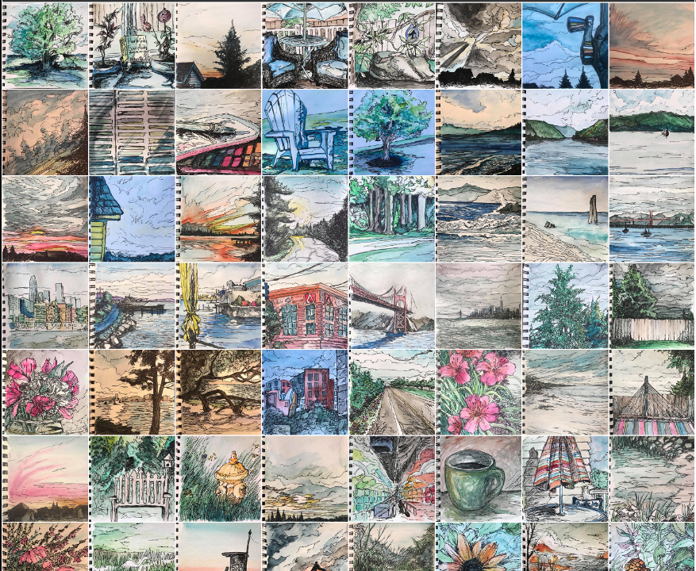

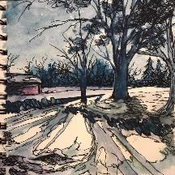
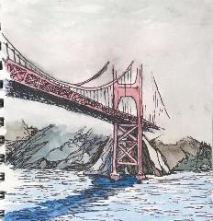

OH YEAH, AND ART ☺
WHILE ON SABBATICAL
A RECOMMITTMENT TO DAILY PROCESS
CURRENTLY EXPLORING MOVING HUNDREDS OF IMAGES INTO VR AND AR, AND WHAT THAT LOOKS LIKE IN COMPARISON TO TRADITIONAL PUBLIC GALLERY & EXHIBITION SPACES

Slide 40



Slide 41
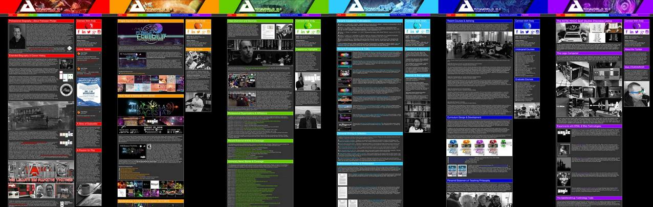
ANDYWORLD.IO | PROFESSORANDREWPHELPS.NET | @ANDYMPHELPS | ANDYMPHELPS@GMAIL.COM
Thanks & Questions

