Slide 1


:
The Role of Games in the Omnimedia Ecosystem
AMERICAN UNIVERSITY GAME LAB | WASHINGTON, DC
Andrew Phelps
Professor of Human Interface Technology, University of Canterbury, NZ
Professor, School of Communication, American University, USA
Director, AU Game Lab & American University Game Initiative
President, Higher Education Video Game Alliance

Slide 2

Today’s Talk
PART 1: GAMES, WHO PLAYS THEM, WHAT KINDS ARE THERE, AND WHO MAKES THEM
PART 2: GAMES AND LIVESTREAMING
PART 3: GAMES, STREAMING, ESPORTS AND AUDIENCE
Q & A

Slide 3
PART 1: GAMES, WHO PLAYS THEM, & WHO MAKES THEM

Slide 4
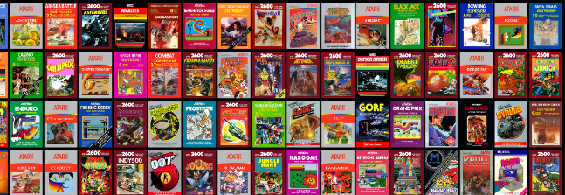
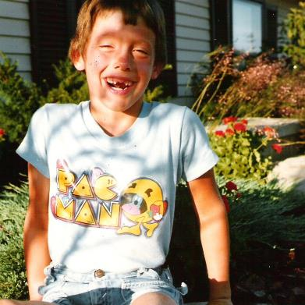
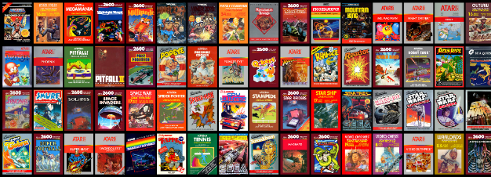
HI, I’m ANDY

Slide 5
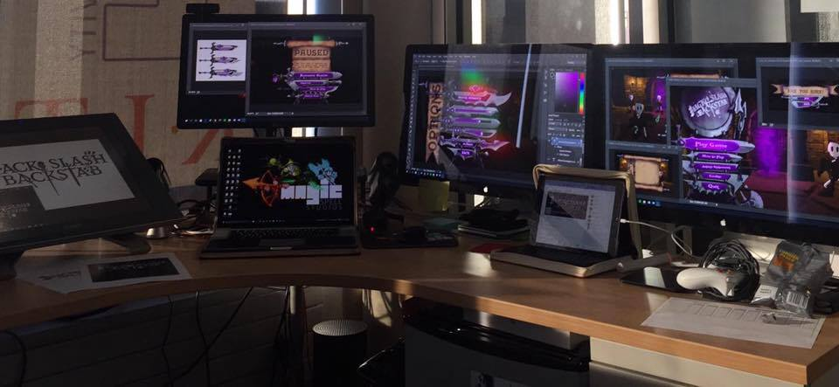
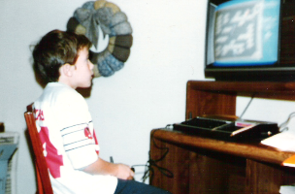
I make things.

Slide 6

A LONG CAREER OF WORKING AND PLAYING WITH GAMES
2001 programming
First course in games programming
2002
Electronic Gaming Society
2003
CS/IT Concentration in Game Prog
2006
MSc Game Design & Development
2007
BSc Game Design & Development
2009
Dept. of Interactive Games & Media
2011
School of Interactive Games & Media
2012
Minor in Game Design
2013
RIT Center for Media, Arts, Games, Interaction & Creativity (MAGIC)
2013
MAGIC Spell Studios ®, LLC
2016
$30M MAGIC Spell Studios Initiative
2016
Presidency of HEVGA
2017
NY State Games Hub CoE
2019
NY State Games Challenge
2020
AU Game Lab & School of Comm
2020
HITLab NZ and AIGI

Slide 7





INCREDIBLE ALUMNI
ALEX CUTTING
Senior Assoc. Producer HALO
Microsoft / 343
CLAUDE JEROME
Gameplay Designer DESTINY
Bungie
DUSTIN KOCHENSPARGER
Line Producer DLC
DESTINY
Bungie
SELA DAVIS
Platform Engineer
XBOX / XBOX Live
Microsoft
VReal
ANNA SWEET
Director of 3rd Party Development
STEAM
Valve
Oculus
Caffeine.ty
Microsoft XBOX

Slide 8
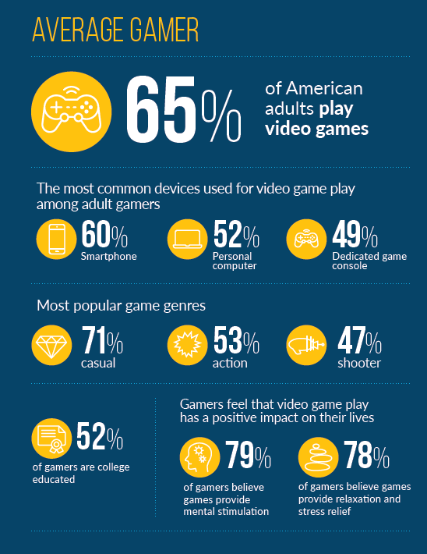
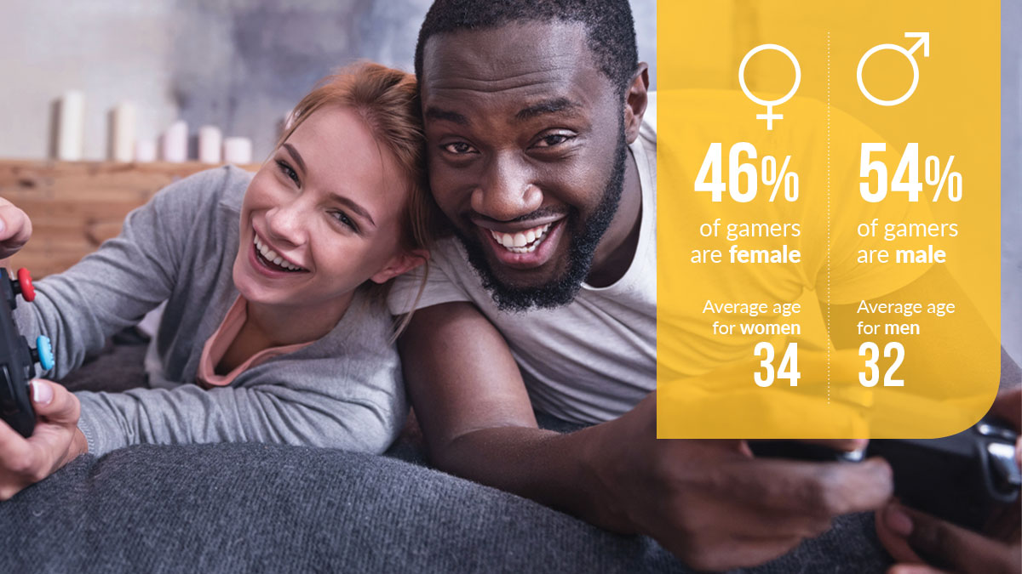
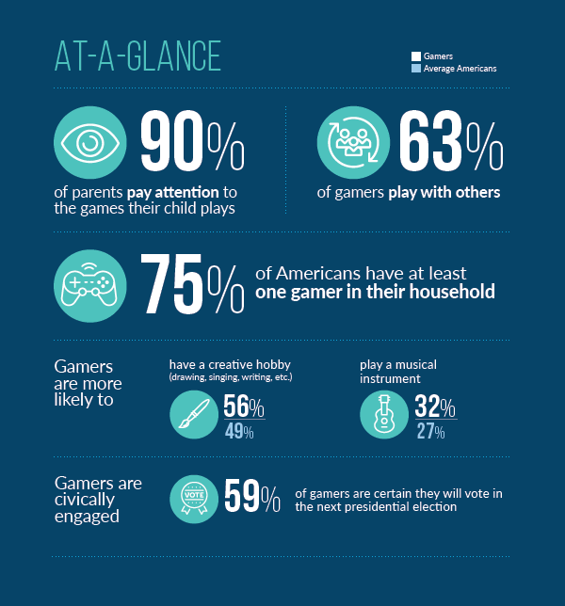
Q: WHO PLAYS THEM? A; EVERYONE.
Notes:
Essential facts about the game industry, Entertainment Software Association

Slide 9
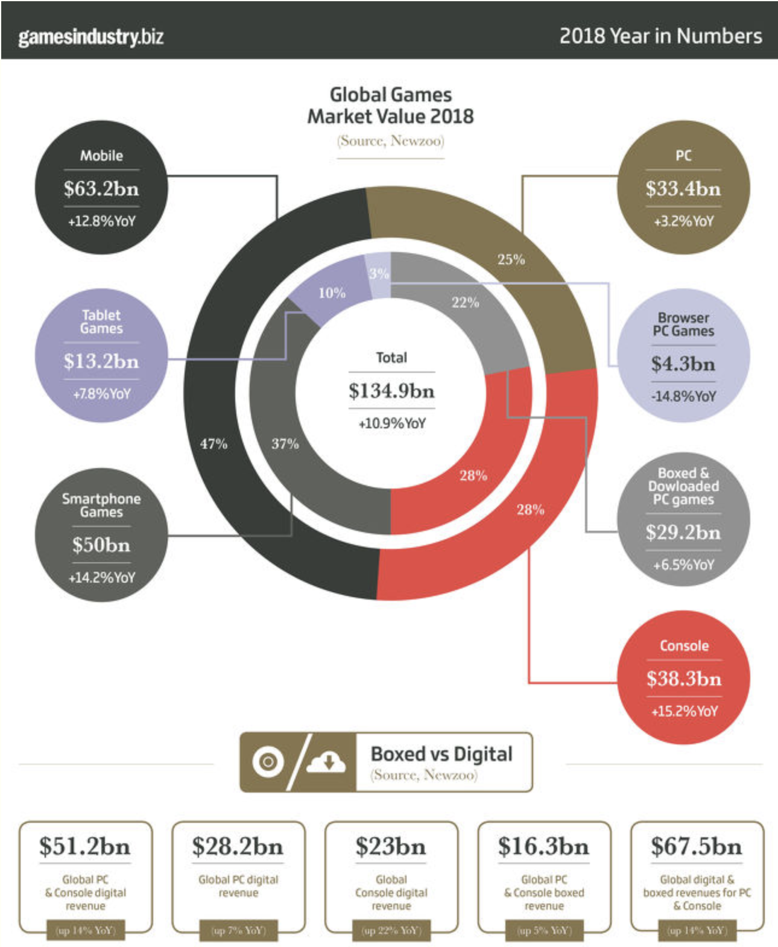
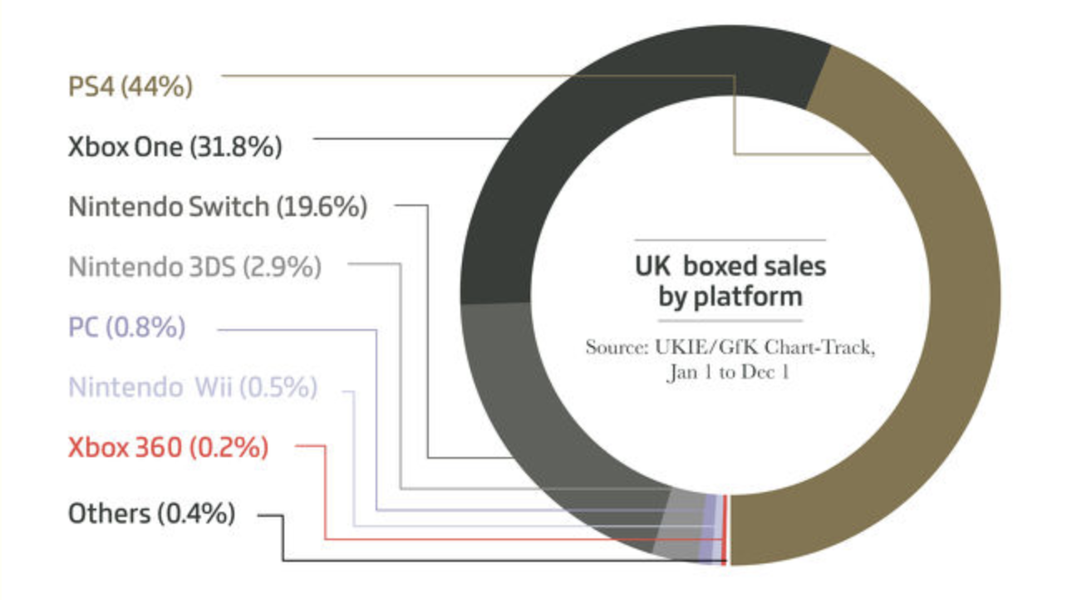
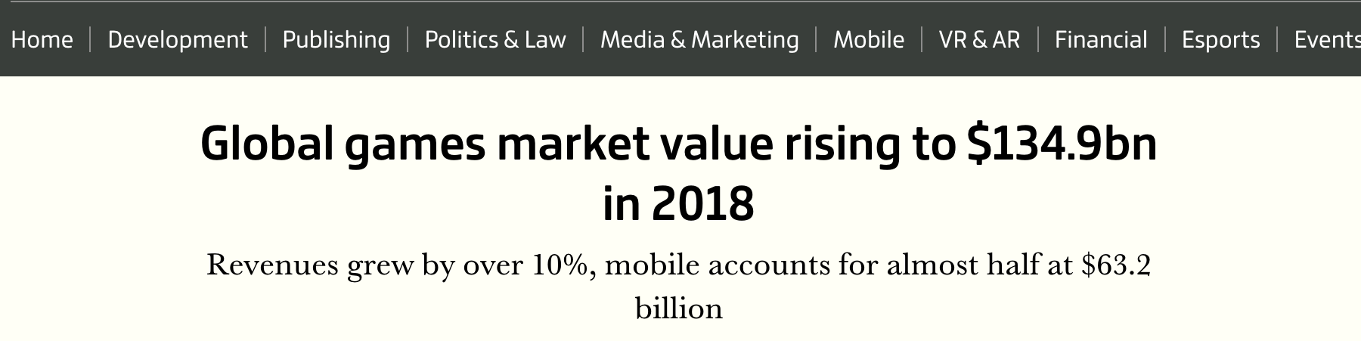
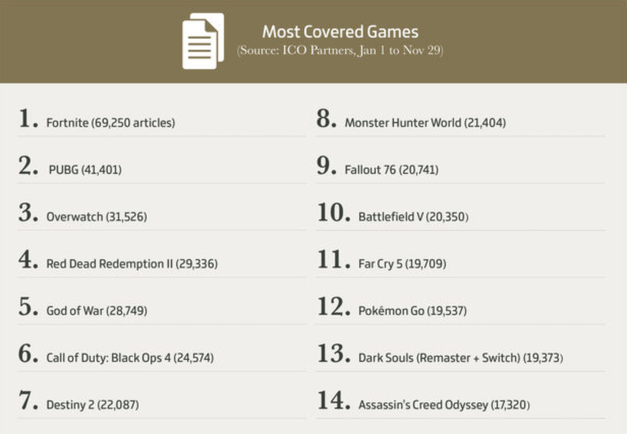

Slide 10
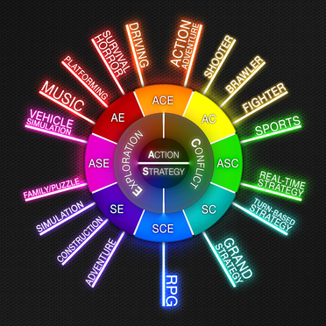
KINDS OF GAMES VARY WIDELY, AS DOES THEIR
PURPOSE
Notes:
https://v1.escapistmagazine.com/articles/view/video-games/issues/issue_283/8400-Introducing-The-Escapist-s-Genre-Wheel

Slide 11
“SERIOUS” GAMES | PLAYFUL LEARNING
Broadly defined, "a serious game or applied game is a game designed for a primary purpose other than pure entertainment. The "serious" adjective is generally prepended to refer to video games used by industries like defense, education, scientific exploration, health care, emergency management, city planning, engineering, and politics. The idea shares aspects with simulation generally, including flight simulation and medical simulation, but explicitly emphasizes the added pedagogical value of fun and competition.” – University of Michigan
Notes:
https://guides.lib.umich.edu/c.php?g=282989&p=5955091

Slide 12
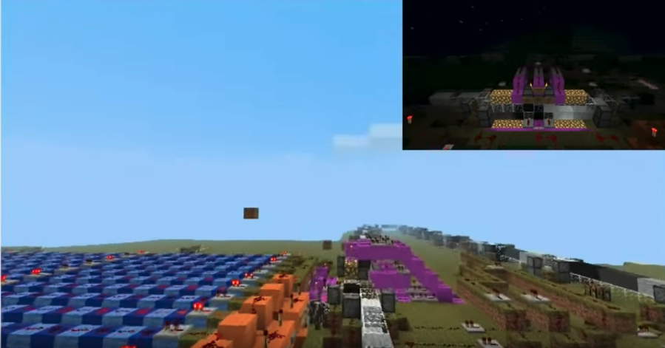
A few examples
Darfur is Dying
That Dragon Cancer
September 12th
Universal Paperclips
America’s Army
Minecraft
World Without Oil
FoldIt
Layoff!

Slide 13
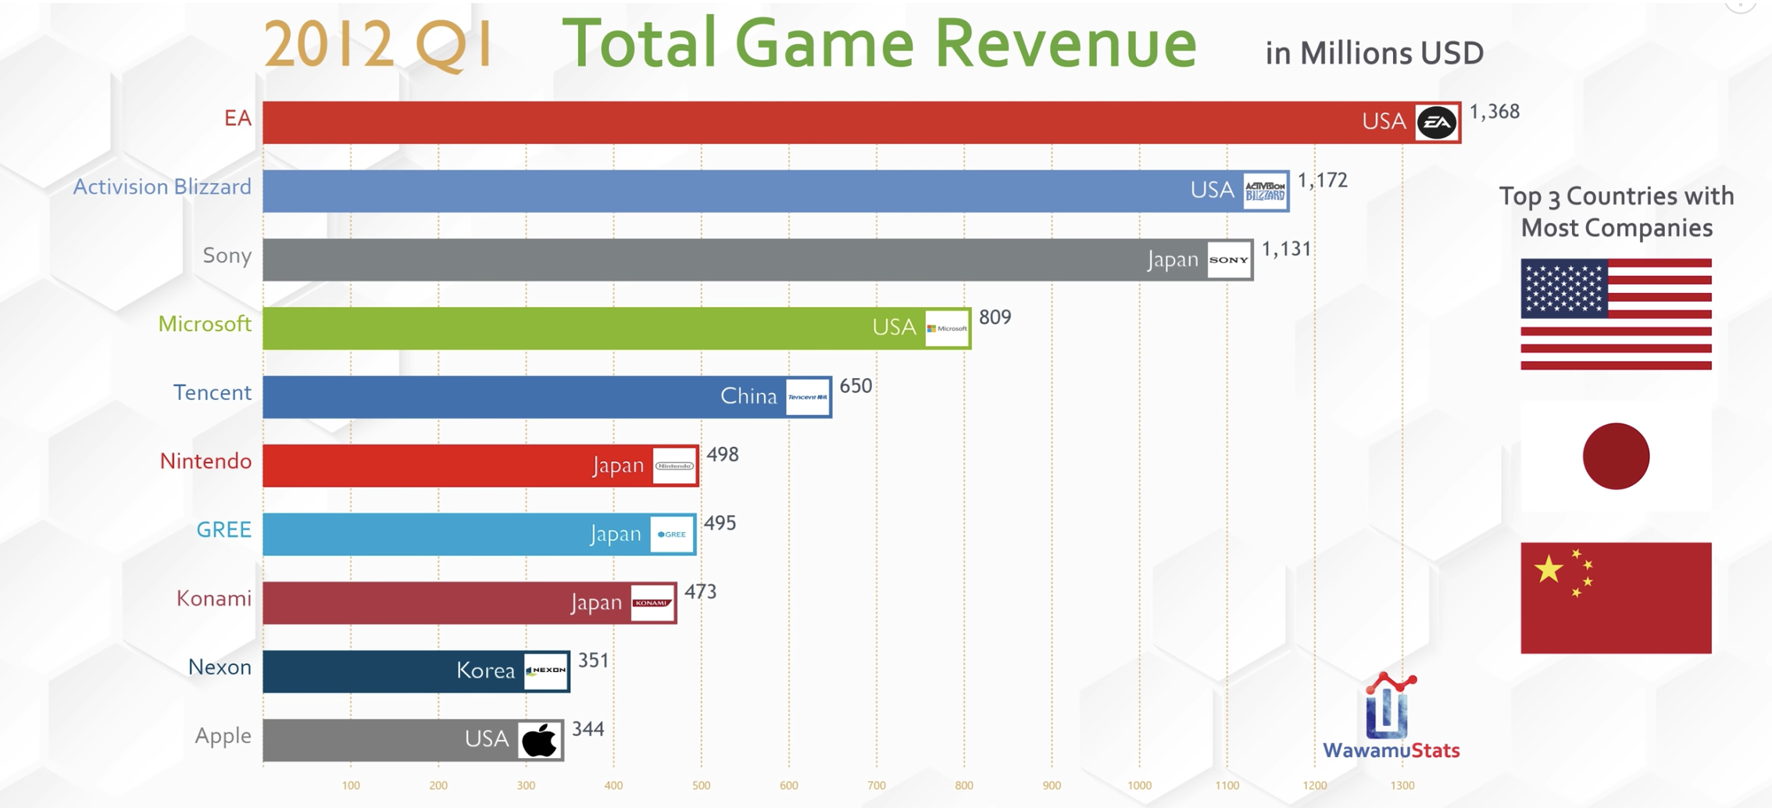
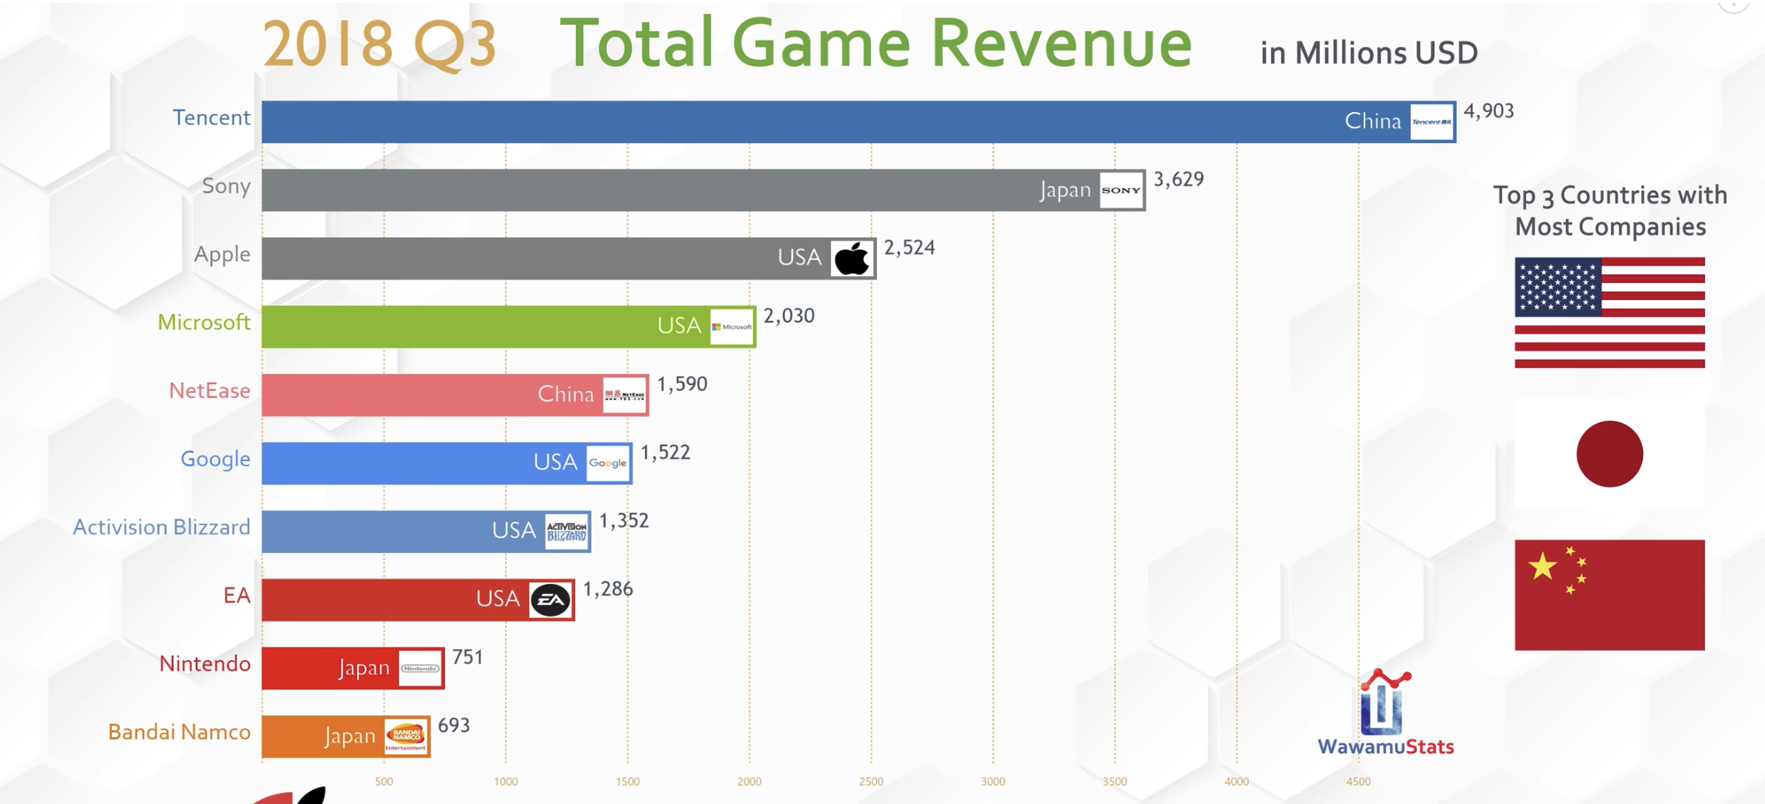
TREND: PLATFORMIZATION

Slide 14
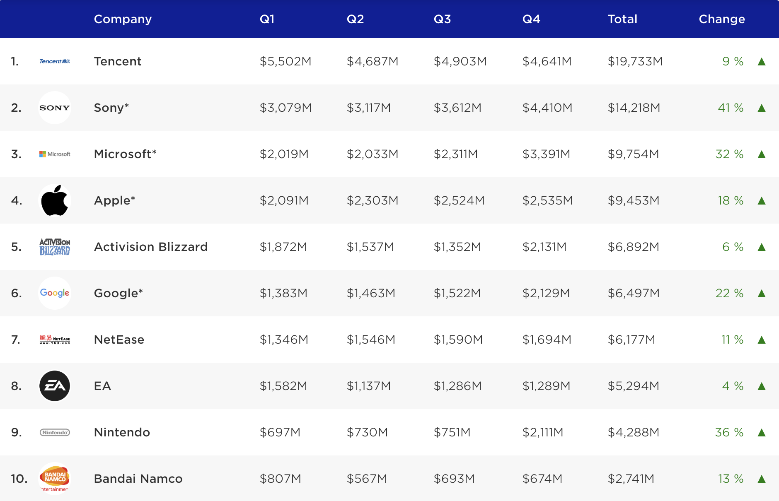
NOTE: TENCENT ALSO OWNS PIECES OF OTHER MAJOR STUDIOS…

Slide 15
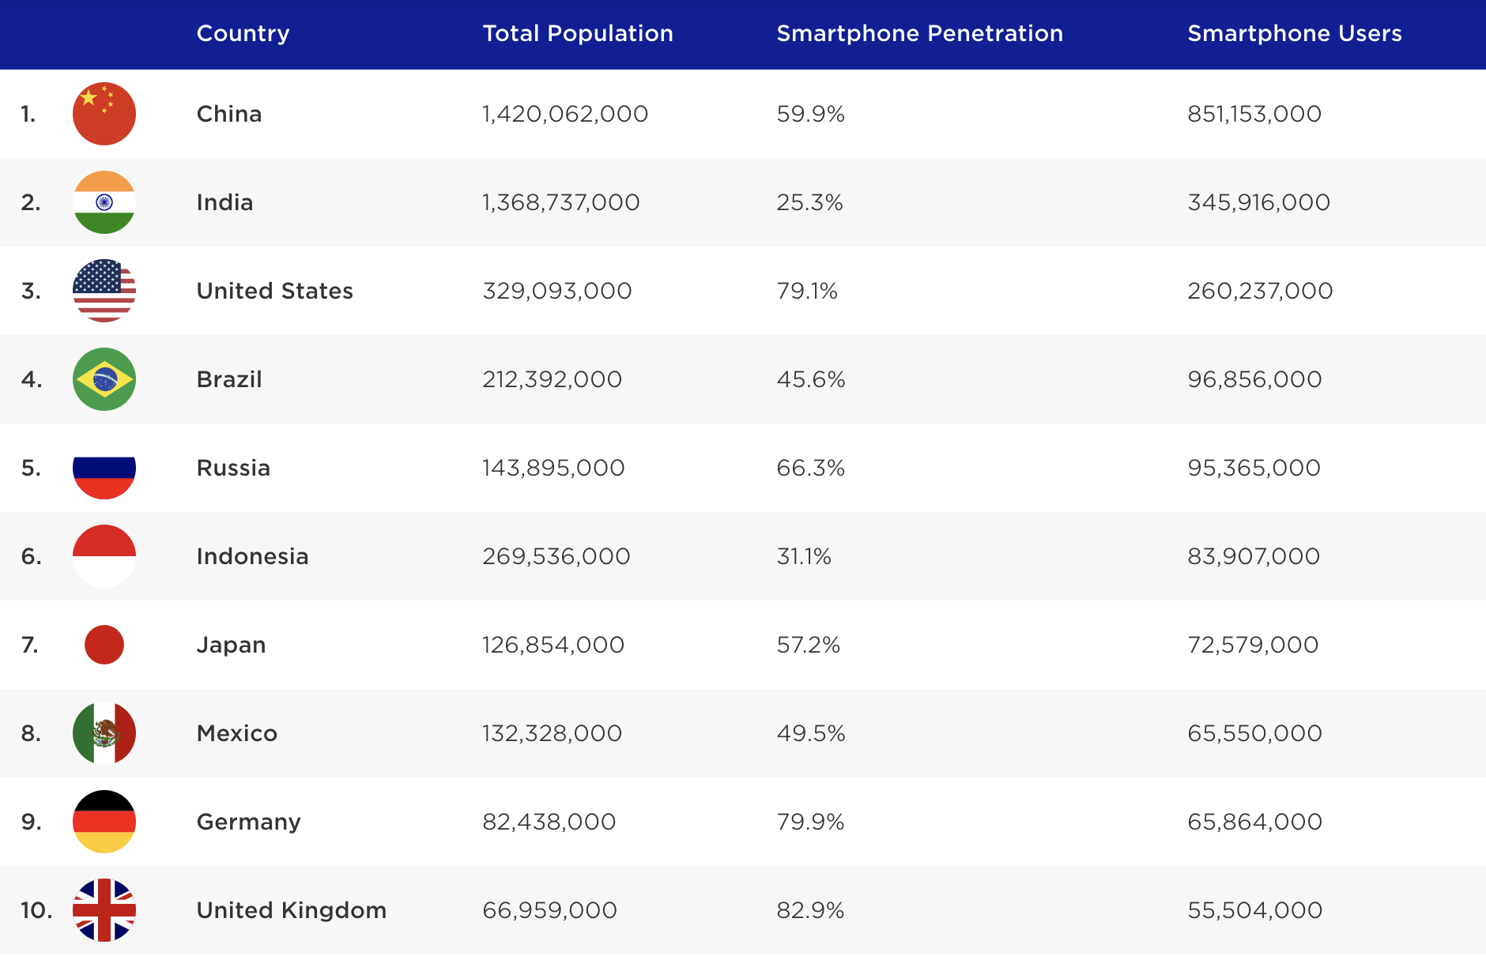
THIS IS WHERE ALL OF THE GROWTH POTENTIAL IS…

Slide 16
A little bit on the history of games in higher ed
GAME STUDIES
Circa 2001 I offered a course in ‘game programming’ that was so new the NY Times showed up to over my course. It was a weird day.
There was a mailing list of the other folks I could find that had a game development course in the states. There were 6 people on it.
Similar trajectory in games studies, game design, game art
GAME DEV
GAME DESIGN
GAME ART

Slide 17
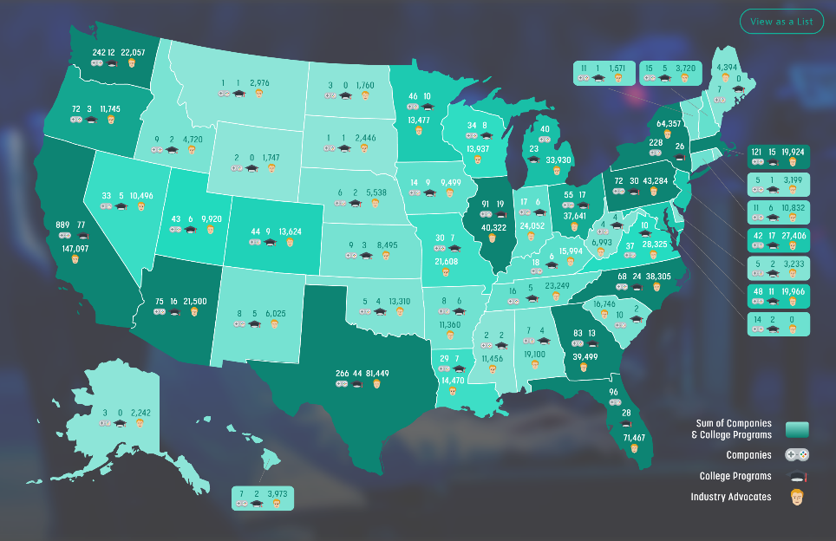
TODAY, THERE ARE 521 COLLEGE PROGRAMS IN NORTH AMERICA ALONE
THESE RANGE FROM GAME DESIGN, GAME DEVELOPMENT, GAME STUDIES, GAME ART, COMPUTING, ENGINEERING, AND MORE IN FORMAL AND INFORMAL PROGRAMS, MAJORS, MINORS, AND COURSES
Notes:
ARE WE IN YOUR STATE? Data map from Entertainment Software Association

Slide 18
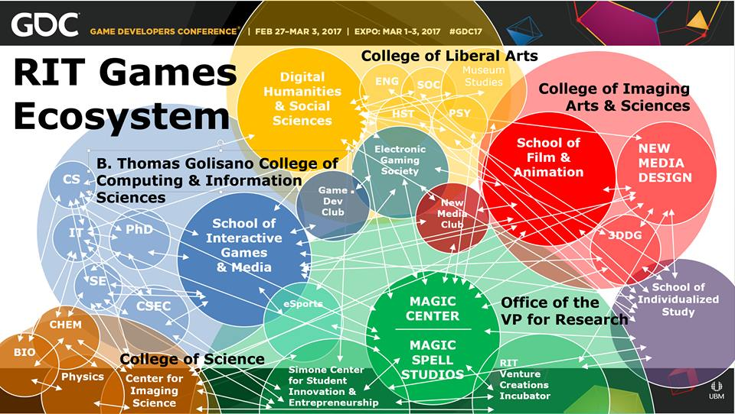
Notes:
From GDC Presentaiton

Slide 19


FIELD REPORTS & EXAMINATIONS

Slide 20

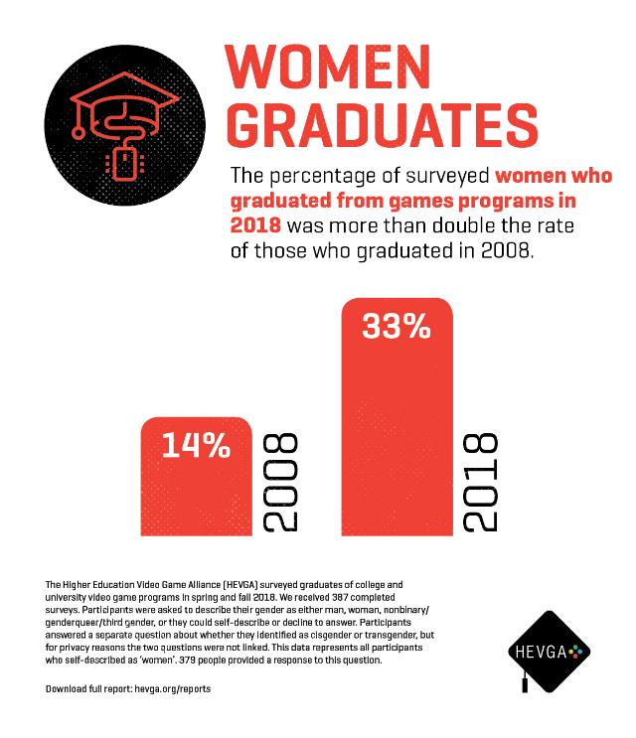

Slide 21
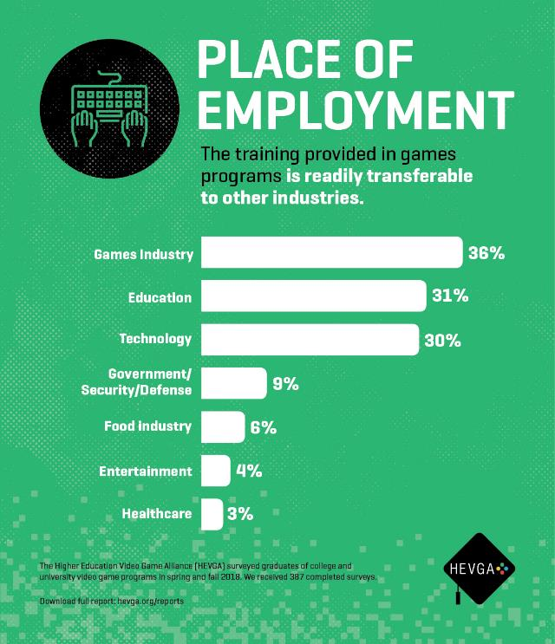


Slide 22
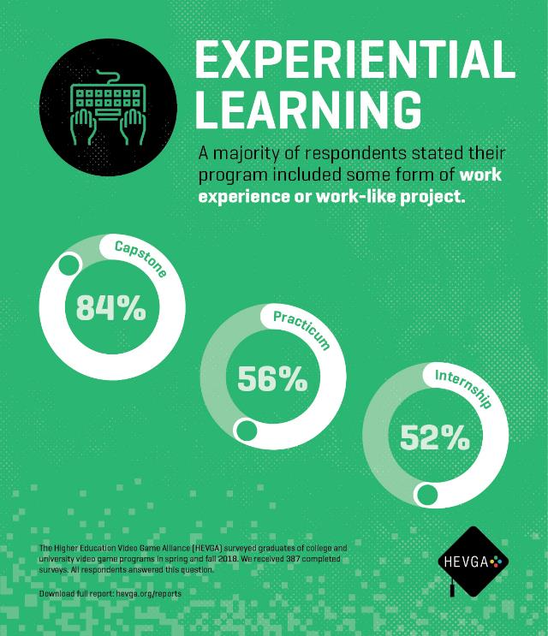


Slide 23
PART 2: GAMES and LIVESTREAMING

Slide 24
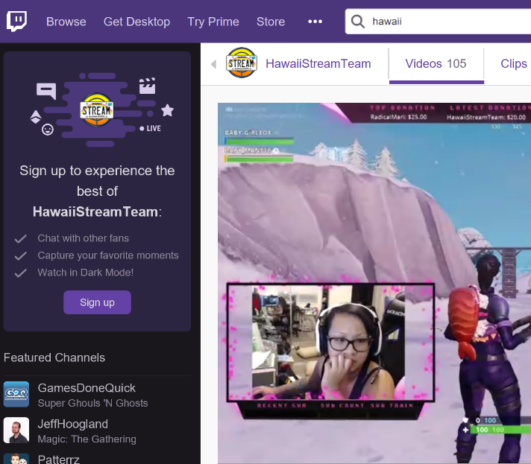
BACKGROUND ON TWITCH
Originally a spin-off of a general interest streaming platform - Justin.tv (2007)
Sold to Amazon in 2014 for $970M USD
In Feb 2014 it was the 4th largest driver of internet traffic worldwide
Twitch in turn purchased game community company Curse
As of May 2018, it had 2.2 million broadcasters monthly and 15 million daily active users, with around a million average concurrent users
Also as of May 2018, it had over 27k partner channels

Slide 25

A BIT ABOUT GAMES & STREAMING
live streaming of gameplay has become enormously popular and research about those practices has exploded. Initially most scholarly attention was on practices surrounding eSports games
research has expanded to those who engage in “variety streaming,” with the draw being a streamer’s personality. Hamilton, Garretson & Kerne argue that Twitch streams can act as “virtual third places, in which informal communities emerge, socialize, and participate”
Johnson & Woodcock point to how live streaming can push players to “building an audience”
Yet so far, work on live streaming in relation to games has focused almost exclusively on players.

Slide 26
NOTIONS OF “AUTHENTICITY”
Nearly all developers cited streaming as a way to “hear straight from players about what they think of the concept, art, gameplay and what they want to see in the game” before it’s complete.
This echoes John Banks’ findings about Auran and the ways that some developers strive to work with players to shape how their games get made.
Most developers have largely been positive, or fairly vague, on how useful such feedback can be however.

Slide 27
So that got me thinking about “ARTIST ADAM” & oTHERS
Art streaming, or ‘art development streaming’, is an underexplored area of the Twitch community that shares many facets of its operation with other hobby- or quasi-professional-based streaming communities.
At its core, art streaming is the activity of streaming the creation of art: drawing, painting, sketching, watercolor, etc. as well as digital drawing and painting in packages such as Adobe Photoshop, Adobe Illustrator, and a multitude of packages designed for anime, comic art, etc.
This has become popularized to the point that a dedicated channel has emerged on Twitch, the so-called ‘Art Channel’ which is in the ‘Creative’ section of Twitch.
Notes:
Interestingly, there is substantial consternation within this community that the deletion of ‘Twitch IRL’ and subsequent creation of specialized channels by Twitch itself within the ‘Creative’ umbrella [2] has damaged the overall general audience of viewers not engaged in art streaming themselves, as it has discouraged those outside the activity to browse the content in an integrated dashboard.

Slide 28

So I watched way to many hours of art streaming
Art Streaming Study
  Streamers selected from first 3 pages of ‘Twitch Art Channel’
  Attempt to vary presumed gender, presumed age, location, and artistic subject
  Approximately 280 observed, some repeatedly
  Vast majority <5 audience (minus me)
  Limited to 2D Drawing & Painting
  Field notes from observing both stream and chat

Slide 29
Motivations & LABOR
The vast majority of these streams are VERY SMALL.
The vast majority of these streams do not actually support their artists financially over time (despite Patreon and other linkages)
The vast majority of these streams are people essentially trying to ‘skill up’
  Informal skill levelling
  Informal → formal critique (aka ‘O’Donnell’ game talk)
  Critique as a means of ‘gamer capital’ (Consalvo)
  Commitment to DAILY PRACTICE
  MAKE BETTER ART (more on that in a bit)
Notes:
This mimics standard art education practices that often rely on daily sketching, painting, or drawing as a form of immersion and practice of technique and craft and is often assigned in introductory courses in studio disciplines. In observation,
Needless to say, this activity is obviously and foremost a form of individual labor, albeit purposefully and directly engaged in by choice as the purpose of engaging in art streaming is to engage in the creation of art.

Slide 30
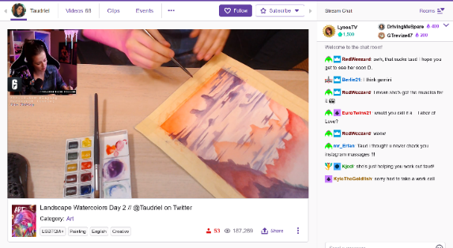
NEGOTIATED LABOR WITH THE PLATFORM ITSELSF
1) the work being created (either digital -i.e. screenshare, or physical -i.e. webcam)
2) their hands using the brush, stylus, tablet surface, or other input device during the physical act of painting or drawing
3) their face or other representation such that a live avatar was presented for narration, persona, and engagement
4) views of the software menus, palettes, and layers (if digital), and/or materials, palette, and studio space (if physical).
Streamer Taudriel engaged in watercolor work, with associated stream cam, chat, and other elements of the Twitch platform.
Notes:
It must also be noted that this activity is also a form of negotiated labor just in terms of engagement with the platform: how to best stream art creation is itself an open question, just as TL Taylor found with respect to variety streamers who were constantly tweaking and adjusting their streaming protocols
Typical reverence and mimicry of Bob Ross style stepwise “paint”through, but significant experimentation with approach and scale in certain streamers / corners
This is in addition to, or forms a layer of complexity on top of, the multiple forms of engagement required by streamers to engage technically with the platform in effective fashion, which include camera management, music, sound, the augmentation of their streams with bots, gifs, surveys, and more.

Slide 31
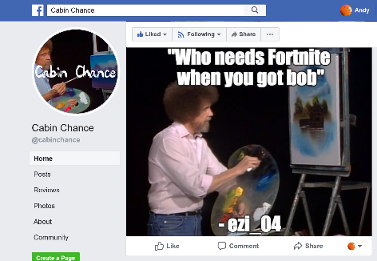
“MAKE BETTER ART”
through a combination of streaming their own practice and getting feedback,
being able to review their own process by recording their stream,
by watching the streams of others for new techniques and ideas,
and by seeking to engage in a community of practitioners that, to some extent, mimics a more traditional studio culture.
(Also, interesting mediation on what it means to “capture” process ☺)
“Cabin Chance” Facebook group, curating “the best” from the Bob Ross Weekend Marathon channel chat

Slide 32







Monetization & AUDIEINCE
(YET MORE LABOR)
Intricate system of multiple, sometimes competing, platforms and interests
Vast majority are (of course) not supporting themselves via these means
A lot less emphasis on public spectacle / fame / following
Negotiated audience participation across networks (games ←→ art, etc.)

Slide 33
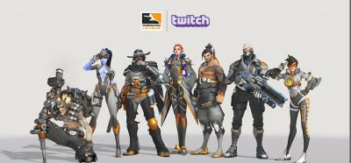
Community, Engagement, and Crossover, Oh My! (LABOR++)
More on that game ← → art thing…
And other formats / groups / crossovers (of course)

Slide 34

Toxicity (INFINITE LABOR)
forcibly engaged in the labor of mitigating or managing toxicity, mainly due to being a woman, person of color, or recognizably LGBTQ+
Sometimes though there remained a fixation on sexualized subject matter coupled with observed instances of individual streamers attempting to exert ‘expert knowledge’
often this is less about subject matter and more about the persona of the streamer
Sometimes policed moreso by the community than the individual artist, with stereotypes around the purpose of the stream (i.e. “take that $&@* to a games stream!”)

Slide 35
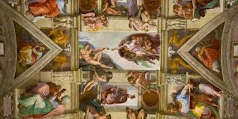
Authenticity
Own not just a commission but the process of creation
Addition of rulesets, communication norms, and functional practices surrounding feedback, time, and engagement
Twitch itself as a platform has proven largely disinterested in proactively assisting streamers in such cases, or in dealing effectively with the culture writ large (toxicity and other tools/issues)
Notes:
Reyson et al “Examination of Anime Content and Associations between Anime Consumption, Genre Preferences, and Ambivalent Sexism” as one example of the rabbit trail of literature here
https://www.polygon.com/2019/2/13/18223558/adl-anti-defamation-league-study-twitch-discord-harassment and so on

Slide 36


DEVELOPMENT Streaming… TRENDS? MICRO-TRENDS? EDU POTENTIALITIES?
A commitment to practice and function?
Less about audience, more about community (maybe?)
A scalable platform for observation, practice and critique?
A form of bi-directional apprenticeship?
A dialog platform for learning communities?
A potentially scaffolded environment?
A quest for authenticity and role models?

Slide 37

MOAR RES34CH PLZ
Notes:
Image from Filament games regarding game based learning, but what about ‘game adjacent’ learning?

Slide 38

THIS ISN’T LIMITED TO THE STATES: TOP 5 STREAMING PLATFORMS IN CHINA, 2018
Notes:
Momo 陌陌 – used to be a dating app
Huajiao 花椒 – pure play livestreaming app
YY
Yizhibo 一直播 – millennial market
Inke 映客
https://medium.com/themeetgroup/top-5-chinese-live-streaming-platforms-you-need-to-know-in-2018-d963352124c7

Slide 39

PART 3: BRINGING THIS BACK TO GAMES, eSPORTS, and AUDIENCE

Slide 40
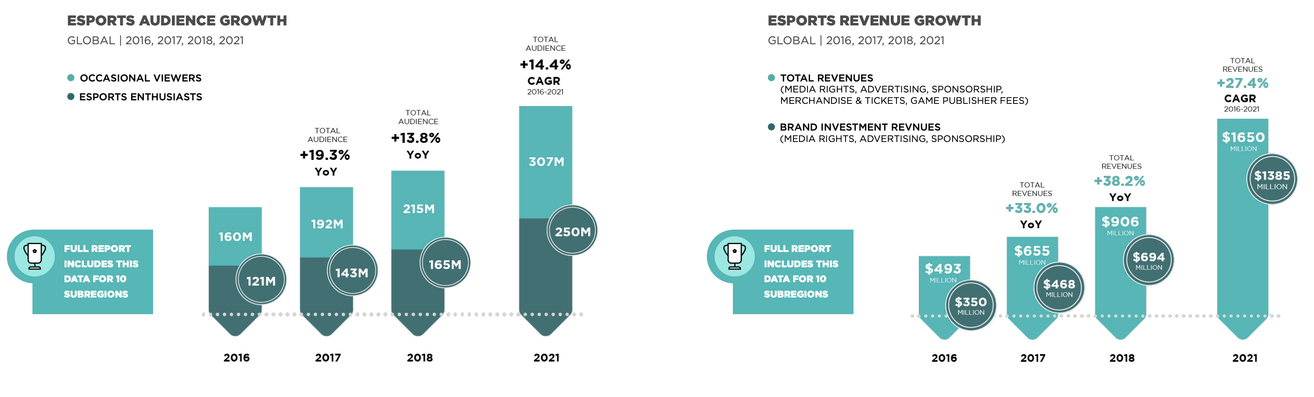
Time spent watching eSports is increasing
Revenue growth is increasing
Visible growth in tournaments
More traditional sports related coverage
Time spent watching eSports is increasing
Revenue growth is increasing
Visible growth in tournaments
More traditional sports related coverage
Notes:
https://resources.newzoo.com/hubfs/Reports/Newzoo_2018_Global_Esports_Market_Report_Excerpt.pdf?

Slide 41
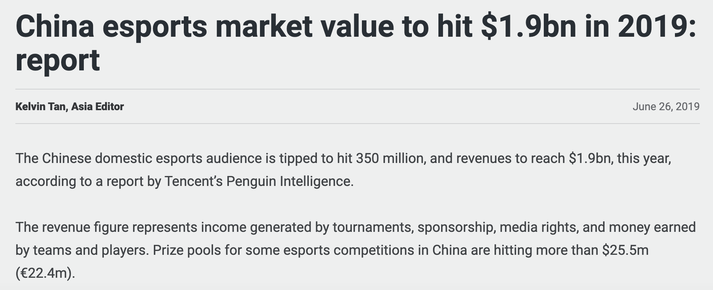
Notes:
https://www.sportbusiness.com/news/china-esports-market-value-to-hit-1-9bn-in-2019-report/

Slide 42
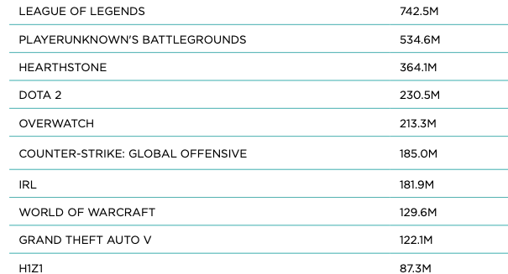
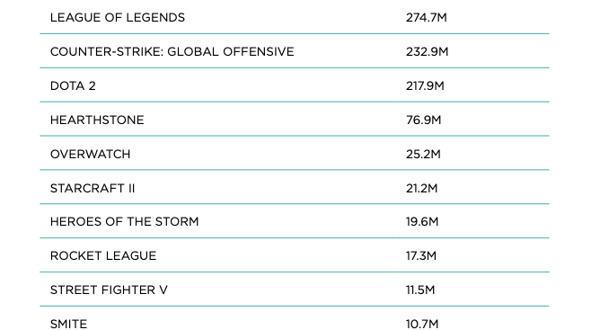
STILL, ESPORTS IS SMALLER % OF AUDIENCE
GAME HOURS VIEWED 2017 GAME HOURS VIEWED 2017
NON-ESPORTS VIEWERSHIP ESPORTS VIEWERSHIP

Slide 43

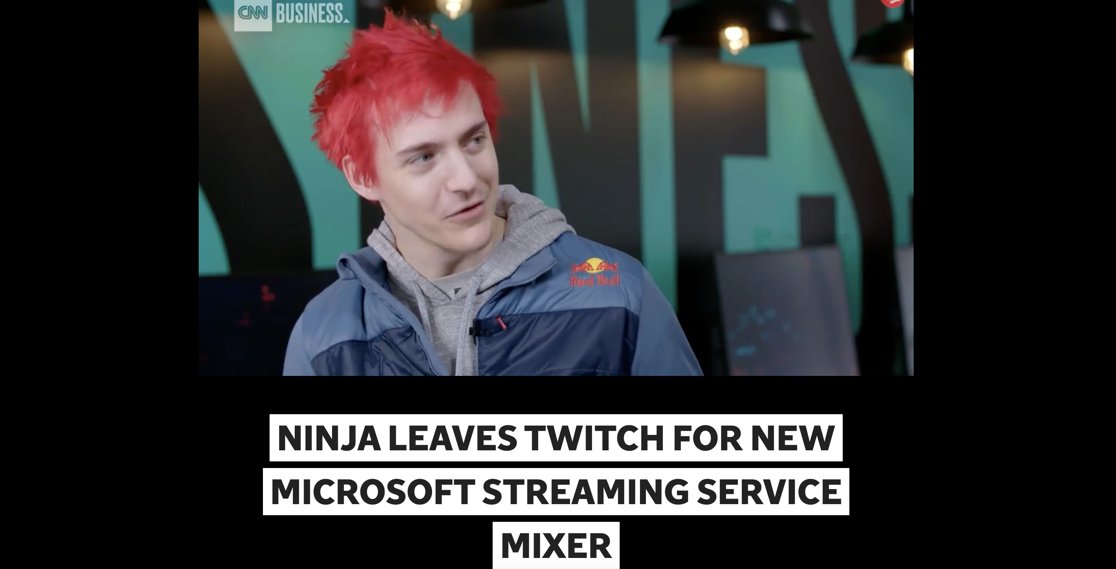

VYING FOR CELEBRITY AND VIEWERSHIP BY PLATFORM

Slide 44
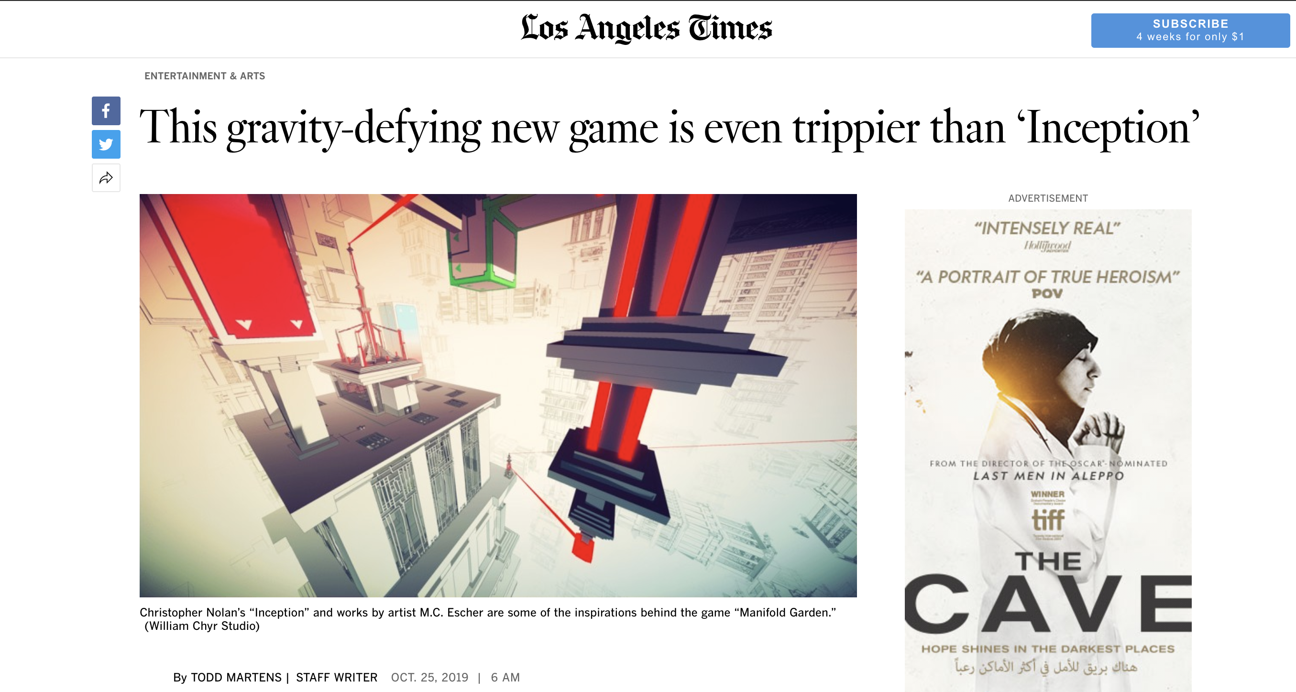
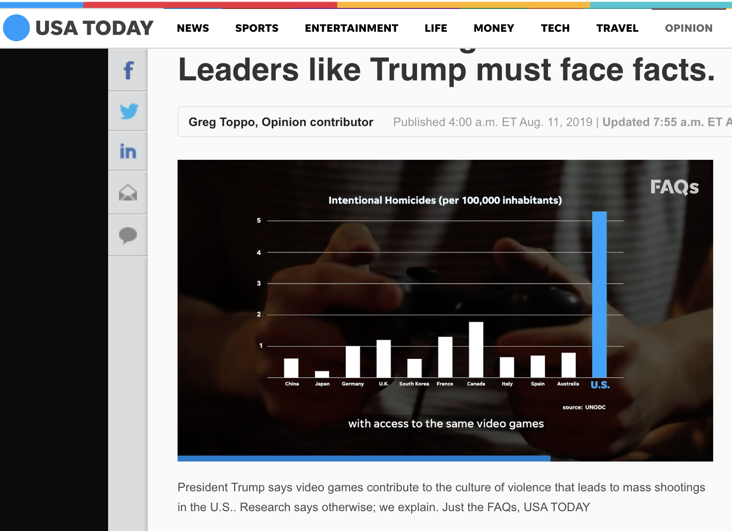
A CALL FOR BETTER COVERAGE, THAT REALLY ENGAGES WITH THE MEDIUM AND THE CULTRE
Notes:
Serious content coverage in the LA Times, real analysis and political challenge from USA Today

Slide 45

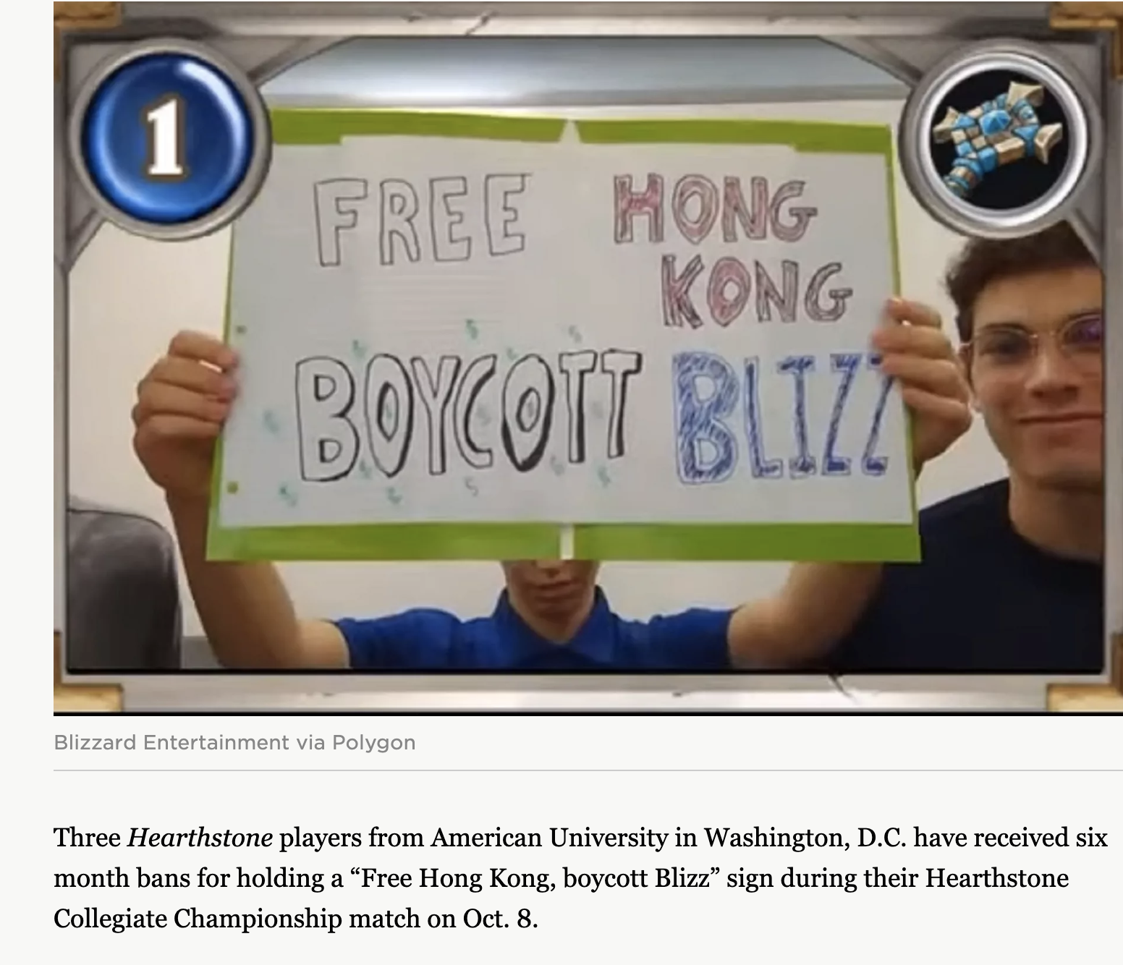

LIVESTREAMING IS LIVE, AND THAT MEANS CONTROVERSY AS AUDIENCES SCALE

Slide 46

GAMING IS GLOBAL

Slide 47
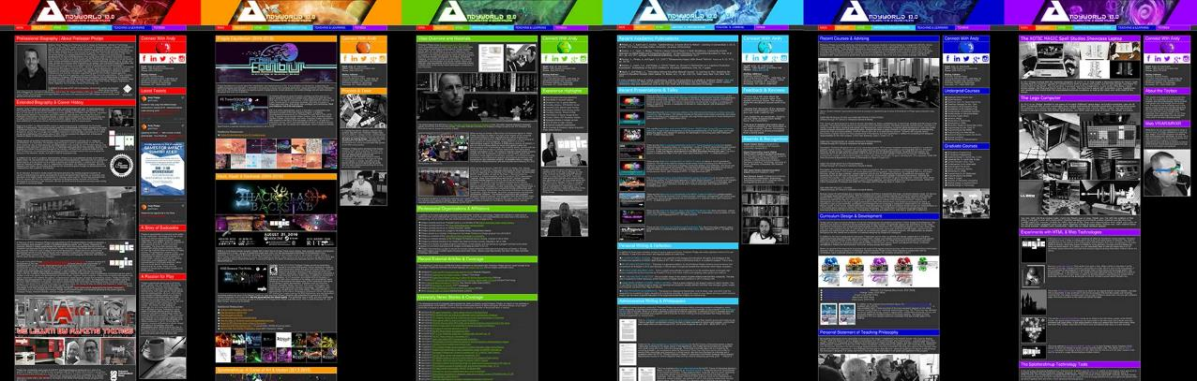
THANKS & QUESTIONS
ANDYWORLD.IO | @ANDYMPHELPS | ANDYMPHELPS@GMAIL.COM | PROFESSORANDREWPHELPS.NET

