Slide 1




A Tiny Bit More on Studios, Research, and Intersections of Play
Andrew Phelps
Professor of Art & Design, Rochester Institute of Technology
President, Higher Education Video Game Alliance
Games Scholar in Residence, American University, Spring 2019
Founder, RIT MAGIC Center & MAGIC Spell Studios
Founder, RIT School of Interactive Games & Media
Rochester Institute of Technology

Slide 2

Today’s Talk
A bit about me
A bit about games studio on academic campuses (at least mine)
A bit about some things I am investigating personally
Some ideas about how all those things connect
Q&A
Hopefully through all of that, some sense of me, my approach, my values, and motivation comes through…

Slide 3
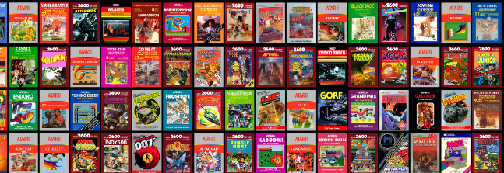

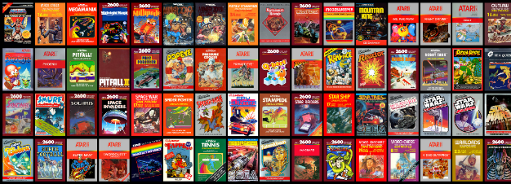
HI, I’m (STILL) ANDY

Slide 4
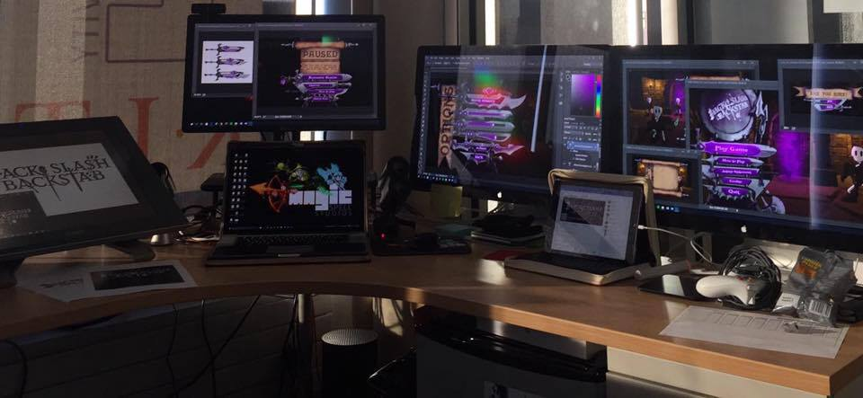
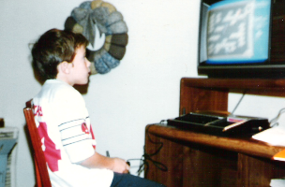
I (STILL) make things.

Slide 5

RIT GAMES & INTERACTIVE MEDIA TIMELINES
2001 programming
First course in games programming
2002
Electronic Gaming Society
2003
CS/IT Concentration in Game Prog
2006
MSc Game Design & Development
2007
BSc Game Design & Development
2009
Dept. of Interactive Games & Media
2011
School of Interactive Games & Media
2012
Minor in Game Design
2013
RIT Center for Media, Arts, Games, Interaction & Creativity (MAGIC)
2013
MAGIC Spell Studios ®, LLC
2016
$30M MAGIC Spell Studios Initiative
2016
NY State Games HUB
2017
NY State Games Challenge

Slide 6
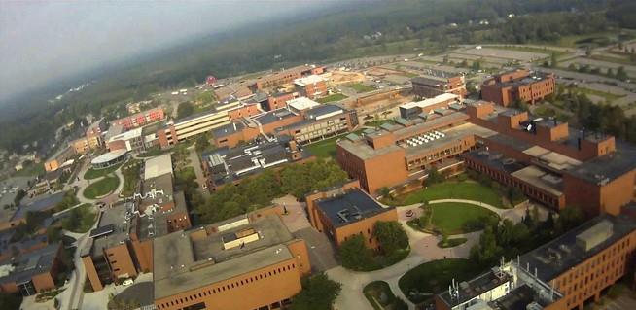
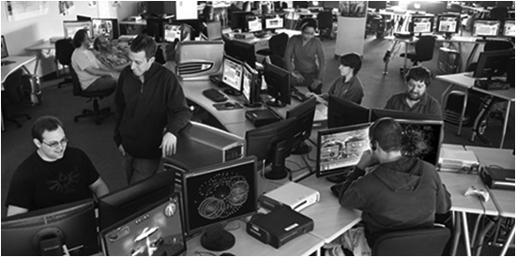



School of Interactive Games & Media

Slide 7
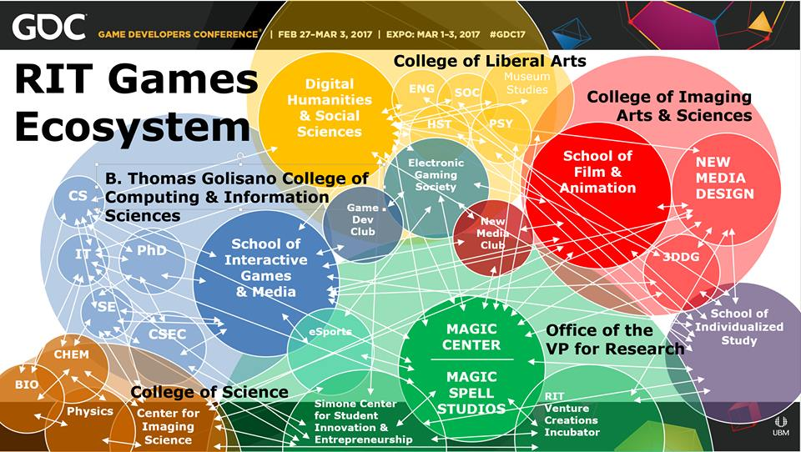

Slide 8





INCREDIBLE ALUMNI
ALEX CUTTING
Senior Assoc. Producer HALO
Microsoft / 343
CLAUDE JEROME
Gameplay Designer DESTINY
Bungie
DUSTIN KOCHENSPARGER
Line Producer DLC
DESTINY
Bungie
SELA DAVIS
Platform Engineer
XBOX / XBOX Live
Microsoft
VReal
ANNA SWEET
Director of 3rd Party Development
STEAM
Valve
Oculus
Caffeine.ty
Microsoft XBOX

Slide 9
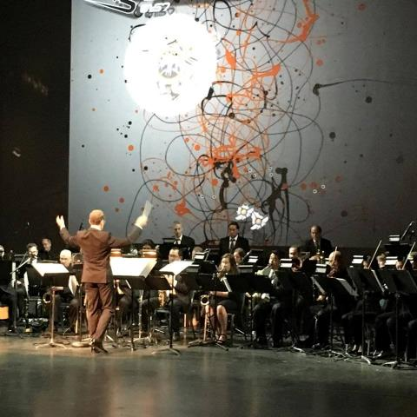
PART 1: STUDIOS
C O N V E R G E N C E
C O N V E R G E N C E
The platforms and technology for film, animation, games, media, and story are converging into new forms, new stories, new experiences, and new knowledge.
Notes:
And so we started a multi-disciplinary research center, which is basically the hardest damn thing you can do on a modern college campus. They usually fail by becoming little islands, or by becoming a kind of ‘not really there’ virtual thing, and we’ve run into both of these views as we continue to engage the campus. Nonetheless, we think there is something profound happening in the field right now that is driving the kinds of things we are doing – everything is mashing up on each other. My favorite example of this is the MARVEL extended universe, which is so many different products and experiences rolled together. But there are countless examples big and small. This picture is from the RIT West Coast board meeting where they showed one of my games set to a live orchestra composition directed by Trustee Kevin Surace. Pretty cool.

Slide 10
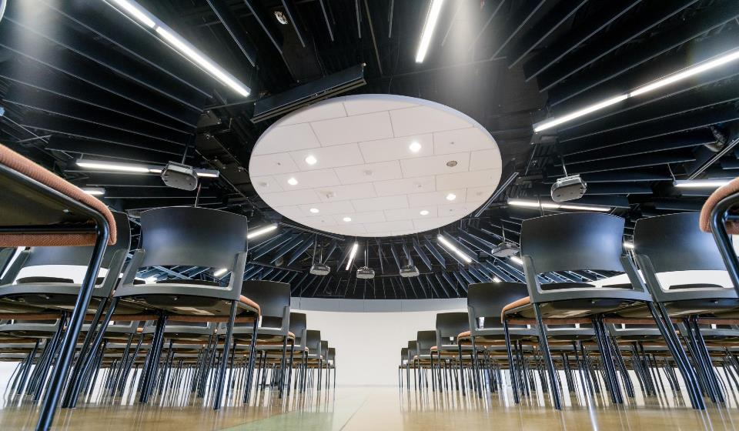


HOW IS MAGIC:
A VERY IMPORTANT DIVISION:
Notes:
Right from Bill’s ‘idea lab’ paper was the idea of an entrepreneurial effort inside the center to help publish and commercialize the things we make. We wanted to call it ‘MAGIC Studios’ at first but we were very afraid we’d get in trouble with The Mouse.

Slide 11
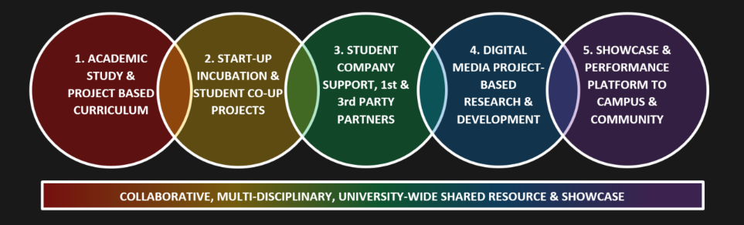
CONVERGENCE OF ANOTHER SORT
Notes:
But there’s another kind of convergence in higher ed right now that has played into MAGIC – this business of bright hard lines between teaching and research, between academic projects, commercial projects, entrepreneurship, technology transfer, etc. is another kind of mashup. The role and purpose of the university is changing in the post-industrial economy, even as it stays true to its roots in the enlightenment (if it can). This idea of little bits of fiefdom for individual programs or little research labs is breaking down because it doesn’t scale, and we’re trying to do something different and profound at MAGIC that links together our work and practice.

Slide 12
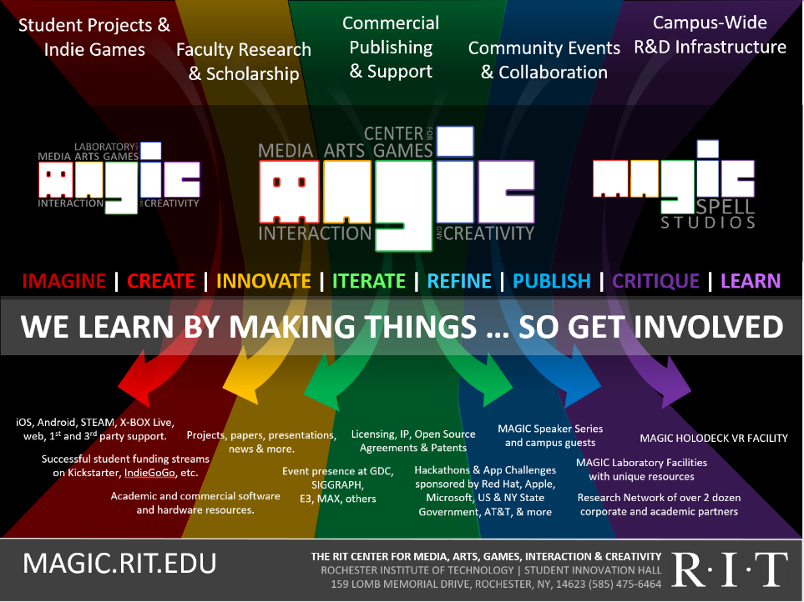




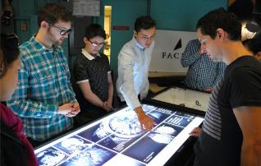

Slide 13
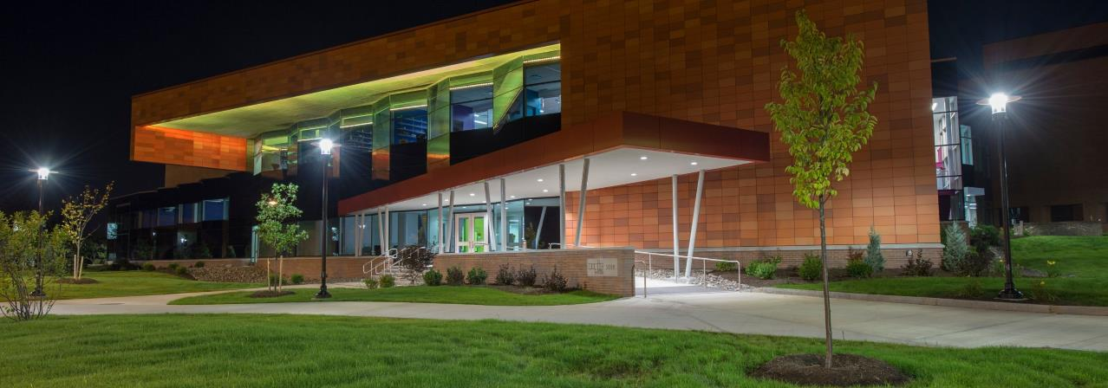
MAGIC TODAY & TOMORROW
Notes:
So let’s take a little look at where we are today, in our current home, what we’ve built, where we are going.

Slide 14

…The M is for Messy
Notes:
The M is for Messy.

Slide 15
NO REALLY, REALLY, MESSY
BUSINESS INCUBATOR & TECHNOLOGY TRANSFER OFFICE
ACADEMIC DEPARTMENTS & COLLEGES
MAGIC LAB
(RESEARCH CENTER)
MAGIC SPELL STUDIOS, LLC
PUBLICLY VISIBLE ACTIVITIES AND PRODUCTS
SPONSORED RESEARCH SERVICES
GOVERNMENT & COMMUNITY RELATIONS
DEVELOPMENT & ALUMNI RELATIONS
ENTREPRENEURSHIP CENTER

Slide 16
AND IT WAS MESSY PAYING FOR IT
START UP FINDING FROM THE UNIVERSITY
BOARD OF TRUSTEES RAISED GIFT FUNDS
RESEARCH OVERHEAD & “SPECIAL” RETURN RATE
PERCENTAGE RETURN FOR GAMES & MEDIA SALES
FUNDING FOR EVENTS & SERVICES
NSF I-CORE NODE GRANT MONEY
CORPORATE GIFTS & GIFT IN KIND SERVICES
CORPORATE R&D CONTRACTS / CLIENT WORK
PASS THROUGH FUNDING ON SBIR GRANTS
NY STATE “GAMES HUB” DESIGNATION & PROGRAM
DIFFERENT GROUPS, METHODS, POOLS, PLATFORMS, & REPORTING MECHANISMS

Slide 17
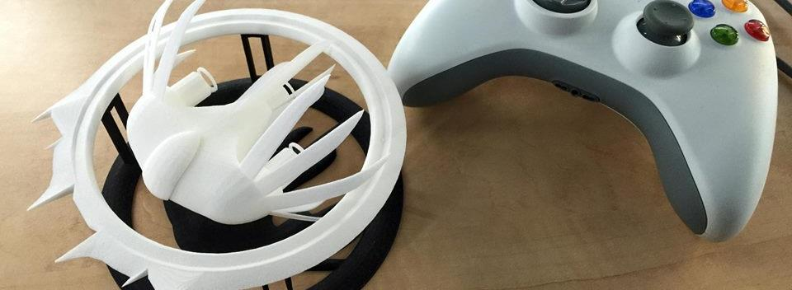

A Strange Game for Strange Reasons
This game taught us (the campus) about making things, production, and scale
This game allowed us to explore using typical game forms for telling a unique story to a very targeted audience
Finalist at GLS Education Arcade, shown at DiGRA Blank Arcade, and IndieArcade at the Smithsonian American Museum of Art
SPLATTERSHMUP.RIT.EDU – PLAY TODAY! MAKE ART!

Slide 18

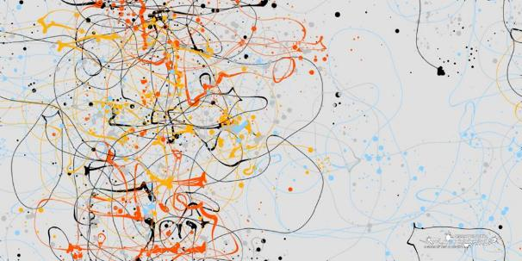
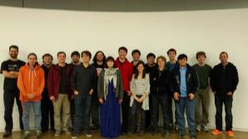
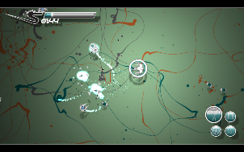
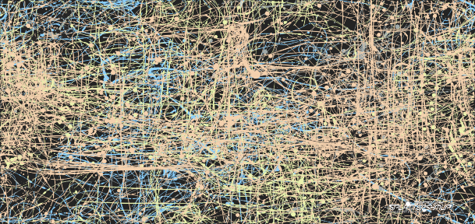




Slide 19
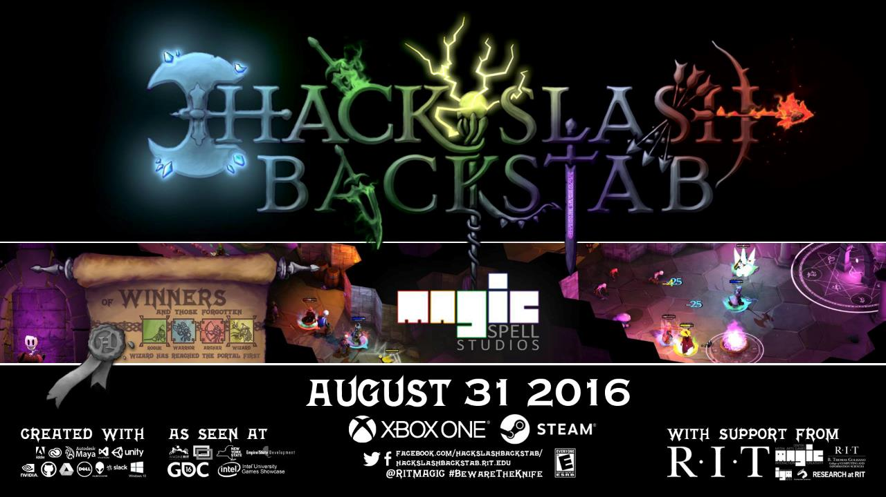

Slide 20

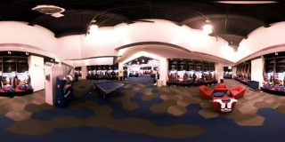


A SUMMER WITH THE
BUFFALO BILLS
Notes:
A big high-vis project that was (a) external client through the studio, (b) multi-disciplinary team, (c) primarily managed entirely by staff

Slide 21



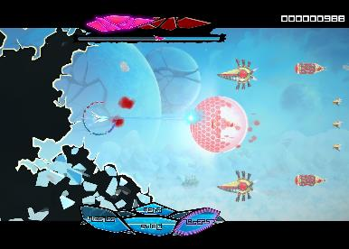
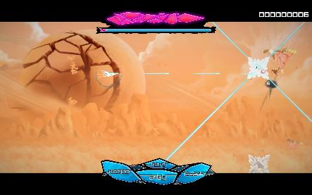
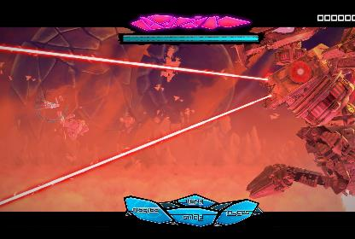

Slide 22
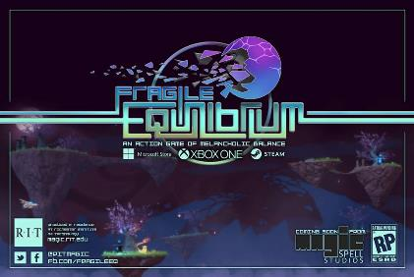
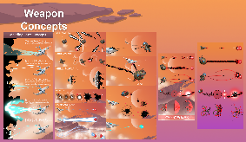
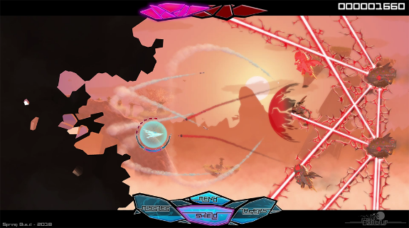
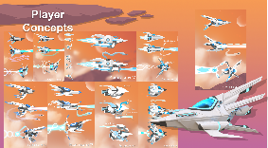
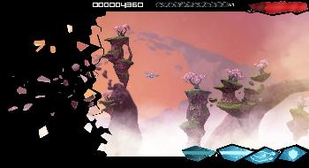
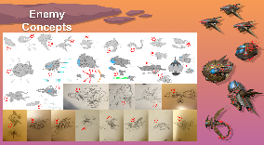
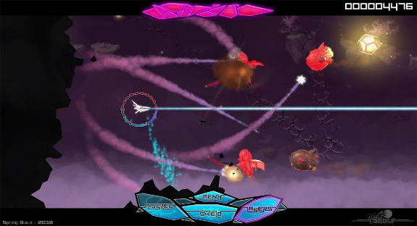

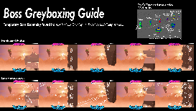
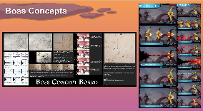

IN GAME UI, DESIGN, GAMEPLAY, ETC.

Slide 23
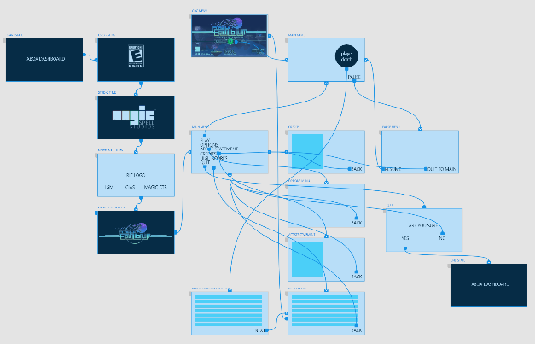
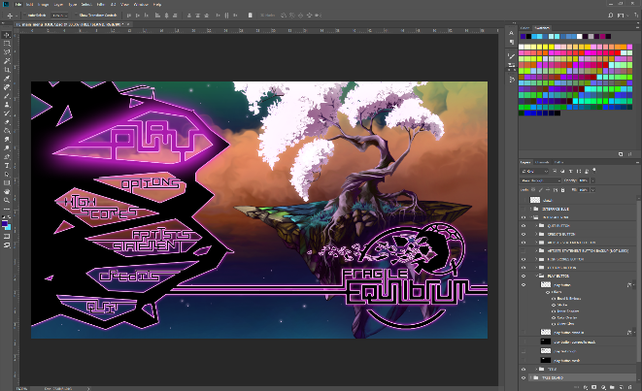




OUT OF GAME UI/UX and MENUFLOW

Slide 24
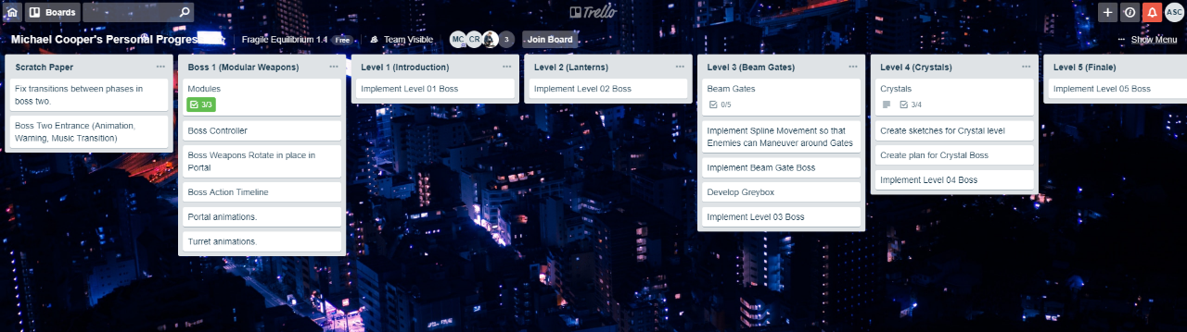

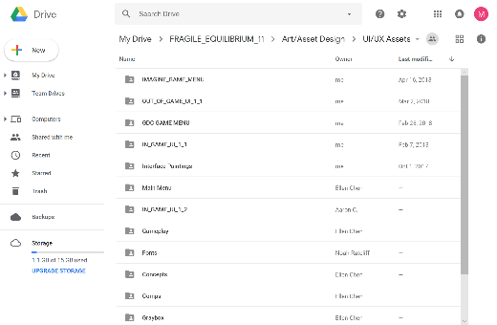
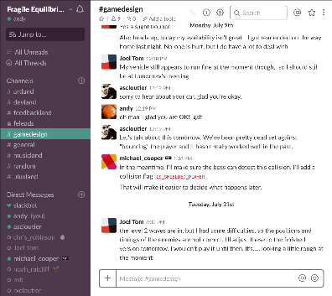

COMMUNICATIONS INFRASTRUCTURE

Slide 25







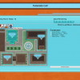
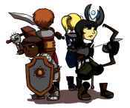







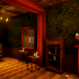
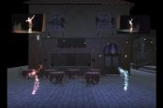
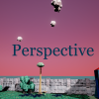








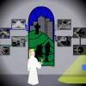



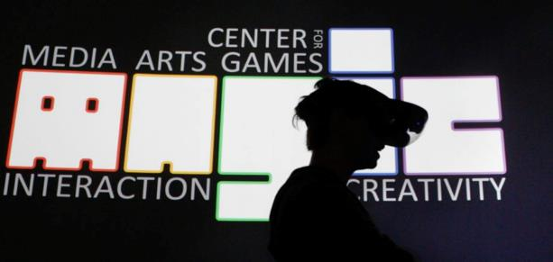




5 YEARS OF LEARNING THROUGH MAKING AT MAGIC. 5 YEARS OF PROJECTS & MEDIA.
Notes:
So I highlight those 3 because of the things we learned and as data points of growth, but the thing is we did a LOT of stuff from a LOT of work for a LOT of people! It’s a lot bigger a community than people even think about. It’s easy when you are working on ‘your thing’ to not realize the scope and scale of everything else that’s happening and going on.

Slide 26
MOST SUCCESSFUL PROJECT (measuring by ACADEMIC impact)
Funded first internally
Then by NEH
Then by NEH (again)
Then we figured out board game creation and printing
Then we figured out publishing
Then we figured out distribution
Then we figured out marketing
You’ll see it here in May, or lots of other places, and ICHENG/SMOP

Slide 27

MOST SUCCESSFUL PROJECT
(BY DOLLARS, ONE WAY)
… was an NSF award studying early computer science education that had no “product”
But we used the studio for grant support, designing logos for SIGCSE, providing logistical website support for CFP and workshop coordination, etc.
We also used the studio as a workspace for the NSF grant, and let the software and hardware licenses bleed back into academics
Dedicated staff support, marketing, and logistics

Slide 28

MOST SUCCESSFUL PROJECT
(BY DOLLARS, ANOTHER WAY)
SUPER DARYL DELUXE
First Investment by the RIT Venture Fund in a game
Support for Dan & Gary (the authors) post-graduation, in connection with studio resources
Winner best visuals INTEL Game Challenge
Winner Microsoft Imagine Cup
Released on Playstation and other platforms
Often cited in student applications (which for a tuition based university is a big deal)

Slide 29

MOST SUCCESSFUL PROJECT
(BY DOLLARS, A THIRD WAY)
In raw ROI, the NFL project was the clear winner
In institutional reputation gain, things are very mixed and largely unmeasurable ☹

Slide 30
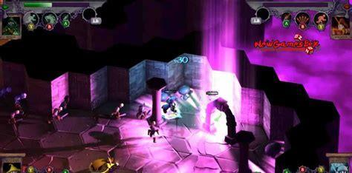
MOST SUCCESSFUL PROJECT
(BY EDUCATIONAL IMPACT)
HACK, SLASH & BACKSTAB
Most students impacted
Longest production run
Highest visibility on console market, and thereby on student portfolio tie-ins and industry reputation
Largest number of students with f/t placements afterward

Slide 31


CORE DESIGN PRINCIPLE
NO SPACE SHOULD BE USED FOR ONLY ONE THING, OR BY ONLY ONE CONSTITUENCY: OUR COMMITMENT TO MULTI-DISCIPLINARY AND CROSS-DISCIPLINARY WORK SHOULD EXTEND TO THE PHYSICAL BUILDING DESIGN, TECHNOLOGY SELECTION, ADMINISTRATION AND OPERATIONS, CULTURE & COMMUNITY.
WE WERE TRYING FOR A PARTICLE ACCELERATOR FOR THE HAPPY ACCIDENT.
(AND MODEL FOR OUR STUDENTS HOW COLLABORATION AND TEAMS FUNCTION – EXPERIENTIAL EDUCATION DELUXE)

Slide 32
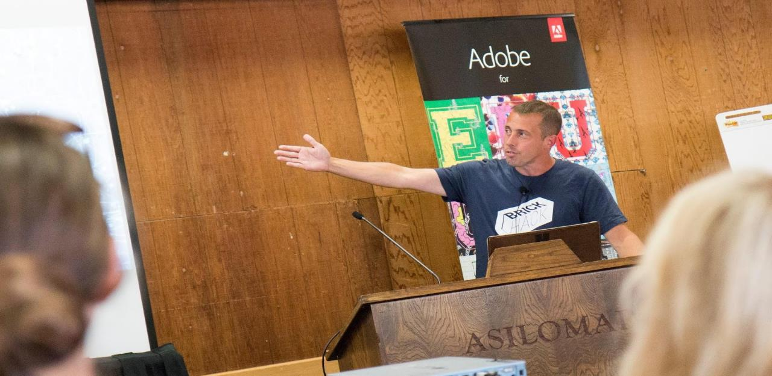
PART 2: RESEARCH and IDEAS

Slide 33
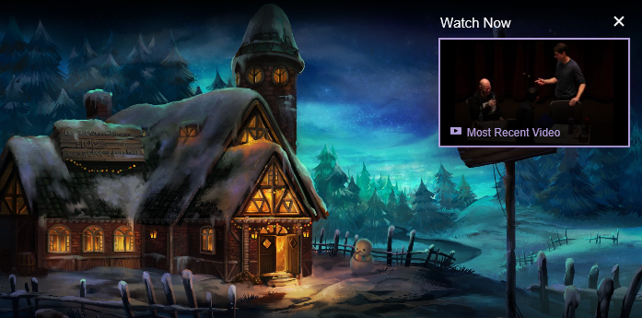
IDEA: MAYBE DEVELOPMENT STREAMING CAN HELP
PUBLIC UNDERSTANDING OF GAMEDEV?
Notes:
Of course cracks have appeared in that wall of secrecy. Smaller and independent game developers have started to share information and best practices amongst one another (Browne, 2015; Whitson, 2015).
One recent development that has significant potential to demystify the practice of game making for the non-practitioner is the recent phenomenon of “development streaming” – i.e. the livestreaming not of a game being played, but rather a game being constructed. Live streaming of games being played has received growing attention from researchers, yet on sites such as Twitch.tv, we are seeing an increase in live streaming of creative activities as well. Recognizing that growing interest, Twitch (among others) has started creating categories to help interested viewers find such content, and the platform officially launched the “Game Development” category in late 2014 (Crecente, 2014).
https://www.twitch.tv/handmade_hero – “Handmade Hero is an ongoing project to create a complete, professional-quality game accompanied by videos that explain every single line of its source code. It is intended as an educational resource for people interested in learning how game engines are developed in practice.”

Slide 34
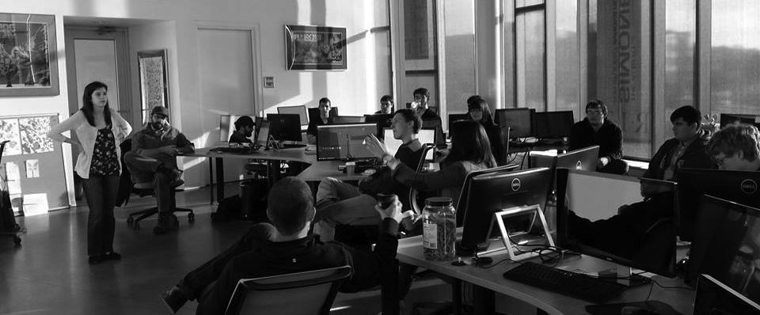
RETHINKING APPRENTICESHIP ?
Notes:
Various developers have begun to engage in such streams, from casual indie developers looking for accountability, sociality, and possibly seeking to support a portion of their work through advertisements or other funding mechanisms inherent in platforms like Twitch, YouTube, Mixer, Caffiene.tv, etc. to the occasional guest stream of a famous developer or designer discussing their process or sometimes just letting people ‘watch over their shoulder’ (Consalvo & Phelps, 2019).

Slide 35

Game industry studies
  Co-creativity (John Banks)
  Game talk (Casey O’Donnell)
Live streaming gameplay
  Broadcasting play (TL Taylor)
  Hamilton W. A., Garretson O., & Kerne A. (2014, April 26–May 1). Streaming on Twitch: Fostering Participatory Communities of Play within Live Mixed Media. In Proceedings of the SIGCHI Conference on Human Factors in Computing Systems (CHI ’14). New York, NY, USA.

Slide 36

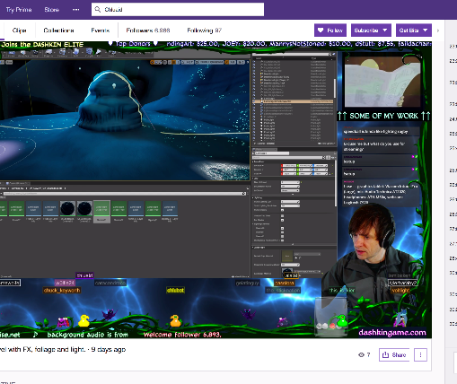
A tale of two Adams
Adam (1) (programmer making Bot Land)
Chluaid (artist on BrackenSack: A Dashkin Game) (and also named Adam (2) IRL)

Slide 37
A Tale Of Two Adams
“coder adam”
Talk aloud protocol
Careful attention to chat
Lots of questions & advice to/from other developers
Streams as a commitment to practice
Small community, not about audience per se
“artist adam”
A kind of ‘visual stepwise process’
Specifically wanted less feedback
Streams as a commitment to practice
Small community, not about audience per se
Cultivation of community for visibility / connections

Slide 38

GENERAL DISCOURSE ON LIVE STREAMING & ASSOCIATED ISSUES
Most working developers make the case for a grass roots approach that will “build up a community” around the game being created…
A second goal for developers to live stream is [daily] accountability.
Additional goal to prevent cloning of the game by other developers
One of the most remarked on outcomes for streamers is feedback and/or help: both in terms of offering instructional help to others or gaining help or feedback from viewers

Slide 39

NOTIONS OF “AUTHENTICITY”
Nearly all developers cited streaming as a way to “hear straight from players about what they think of the concept, art, gameplay and what they want to see in the game” before it’s complete.
This echoes John Banks’ findings about Auran and the ways that some developers strive to work with players to shape how their games get made.
Most developers have largely been positive, or fairly vague, on how useful such feedback can be however.
Deep well around the “this is real because it’s live” and because it’s “everyday people”
“Development Streaming and Authenticity: Cultural Connections, Participatory Democracy and Potential Practices of Engagement” in 2 weeks

Slide 40

Art streaming

Slide 41

THE BOB ROSS THING
many art streamers attempt to mimic a formulaic step-wise, talk aloud protocol as popularized most famously by Bob Ross on his television program “The Joy of Painting”, but there are numerous exceptions and experiments.
Indeed, the retro-style Ross stream is the most widely viewed in this entire sub-culture, often with a focus on merely connecting socially while satirizing the medium
occasionally to reflect upon subject, technique, and practice in ways that explore both the creation of the work itself as well as the performative act of creating work for a television program (which is related in obvious fashion to particular aspects of streaming).
CABIN CHANCE

Slide 42
methodology
Explore early observations of this activity over approximately a year.
During this period, different streams were selected several times weekly from the first three pages of the Twitch ‘Art’ channel, with an effort to vary the gender, presumed age, location, and artistic subject of the streamer.
Streams were observed for an hour or more, both watching the stream live and monitoring the chat.
During this time notes were taken in real time on the activities therein, and analyzed later to draw conclusions and recognize repeated patterns of behavior.
As such, this presentation represents early work in exploring and understanding this activity.

Slide 43
ADDITIONAL POTENTIAL CRITERION FOR EVALUATING STREAMS
1) the degree to which formal and informal design processes and principles are discussed and presented to the audience
2) the type of design vocabulary employed in the stream sessions
3) how streaming as an activity forces (or fails to enforce) a type of reflexive self-study of the role of a game designer, developer and/or artist
4) the role of the stream audience during the live session as an interactive influence on the design of the game itself
5) the potential of the stream in question to help inform novice- or non-developers about issues and paradigms in game design, development and production
Notes:
To better understand this phenomenon, the authors are engaged in several studies exploring the phenomenon of development streaming and its potential impact. For this presentation, they have observed the streams of several designers, developers, and artists engaged in game production, and report on how these streamers understand game development as well as the authors experience and observation of how these streams’ language and descriptions of their activity reflects the work they actually engage in. Particular attention is paid to several facets of these streams, including: 1) the degree to which formal and informal design processes and principles are discussed and presented to the audience, 2) the type of design vocabulary employed in the stream sessions, 3) how streaming as an activity forces (or fails to enforce) a type of reflexive self-study of the role of a game designer, developer and/or artist, 4) the role of the stream audience during the live session as an interactive influence on the design of the game itself, and 5) the potential of the stream in question to help inform novice- or non-developers about issues and paradigms in game design, development and production.

Slide 44
Why care?
Currently within the academy there is mounting pressure to deliver education via distance learning methodologies, and studio arts are often seen as problematic in that context.
Most current approaches focus on blending on-site studio practice with online reflection and critique (Bender et al 2006)
Yet in streaming, the scale and format of critique in a given online space often matures organically from a somewhat sophomoric from to discussion of both art streaming as a performative act as well as a discussion of the piece and critique of artistic process
There is also an informal system of skill levelling and knowledge acquisition as individual streamers seek to associate with others who are producing work at a similar or slightly aspirational level, in addition to pursuit of consuming celebrity streams or post-mortems of famous work.

Slide 45
Link to games & (sometimes) esports
Additionally, the practice of these streamers often involves the pre-negotiation of ‘attend my stream and I’ll attend yours’ for both individual collaboration and review, as well as the bolstering of Twitch-based metrics’
Individual streams and groups arise from common artistic practices (i.e. exploring ‘brushing technique’ or ‘experimenting with palette’ or particular forms or subjects, as well as process-oriented paradigms such as ‘sketch to paint’ or ‘polishing and print techniques’)
There is also significant anecdotal evidence that these linkages, relationships, and connection patterns are informed by, and intertwined with, other networks that surround commercial games and esports

Slide 46
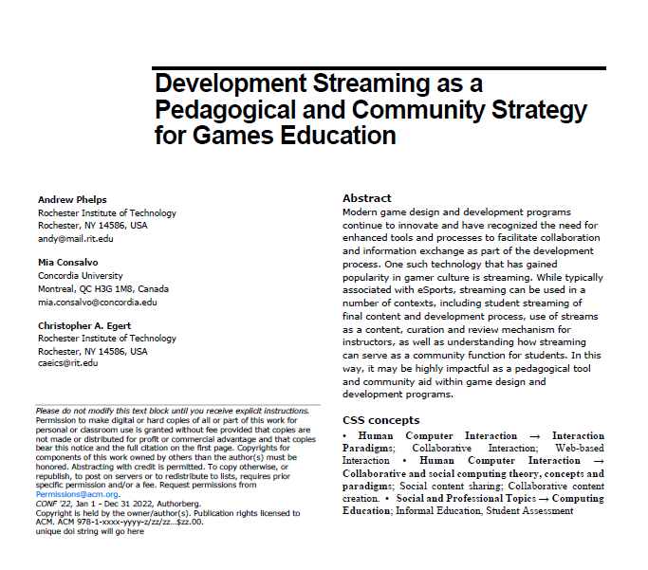
FUTURE WORK: EDUCATIONAL POTENTIALITIES
A first use of developer streams is for the instructor to use the technology to stream themselves performing various tasks and activities.
Second, there may be significant value in having students stream their own creations either as a form of ‘well played’ exercise, or simply as a walkthrough and talk-aloud critique of the project they have delivered.
Third, along with streaming final games and prototypes, having students stream their own development work to then examine and reflect on it could be incredibly valuable.
Fourth, having students stream their own work and development process can surface such work across an entire student body.
Fifth, development streaming has the potential to engage students in a wider community that extends substantially beyond the campus.
Finally, it may be useful to explore having students essentially “cross the streams” to help acclimatize students in a given role with their counterparts in other majors or areas of a curriculum.

Slide 47
CRITIQUE
it is unclear to what extent individual streamers are pre-selecting their best work for online engagement, and thus self-promotion in a very curated way, versus embracing the potential of raw potential for authenticity inherent in the streaming platform
Equally at issue is the idea of inclusion and engagement in these channels
  There remains a fixation on sexualized subject matter coupled with observed instances of individual streamers attempting to exert ‘expert knowledge’ (which is sometimes academically problematic) through either formalism (i.e. terminology) and/or raw skill (i.e. early mastery of demonstrable technique) to dominate the conversation and discourse.

Slide 48

Merge with ar/vr tech INTERESTS
(IN A STUDIO SPACE & PRACTICE)
Notes:
Coursera now valued at 1B

Slide 49

DEVELOPMENT (AND ART) Streaming…
A commitment to practice and function?
Less about audience, more about community (maybe?)
A scalable platform for observation, practice and critique?
A form of bi-directional apprenticeship?
A dialog platform for learning communities?
A potentially scaffolded environment?
A quest for authenticity and role models?

Slide 50

CONCLUSIONS
On campus studios have a variety of roles and purposes, one of which is educational impact on students in the program
On campus studios are also really complex, time intensive, and require a lot of care and feeding,
They are outside the norm of university functions, but can also serve a variety of roles and make some good things happen…
Personal streaming has some really interesting educational potential, and may bey a key to extending studio practice online, but also some key drawbacks
All of this work focuses in the end on games & media education. It may seem a bit disparate in pieces, but the core motivations haven’t shifted in 20 years and counting.

Slide 51
Phelps, A. (2019) "Happy Little Streams: Observations from the World of Art Streaming with Educational Possibilities" Venue TBD
Phelps, A. & Consalvo, M. (2019) "Development Streaming and Authenticity: Cultural Connections, Democracy and Potential Platforms of Engagement" Media in Transition 10. Boston, MA.
Phelps, A., Egert, C. & Consalvo, M. (2019) "Hack, Slash & Backstab: A Post-Mortem of University Game Development at Scale" International Journal of Designs for Learning. Special Issue (April/July, forthcoming).
Consalvo, M., & Phelps, A. (2019). Performing Game Development Live on Twitch. Proceedings of the 52nd Annual Hawaii International Conference on Systems Science, Maui, HI. p. 2438-2447. Retrived online: http://hdl.handle.net/10125/59682
Phelps, A., Consalvo, M., and Egert, C. Development Streaming as a Pedagogical and Community Strategy for Games Education. Presented at the Workshop on New Research Perspectives on Game Design & Development Education. CHI PLAY 2018, October 28, 2018, Melbourne, Australia.
Decker, A., Egert. C, and Phelps, A. "Learning to Create or Creating to Learn" International Academic Conference on Meaningful Play, October 11, 2018, East Lansing, Michigan. ETC Press (proceedings in press)
Phelps, A., C. Egert and A. Decker. (2018) "Splattershmup: A Game of Art & Motion". Learning in Games Book 3. Ed. K. Schrier. ETC Press, Carnegie Mellon University. (in press, forthcoming)
Decker, A., Phelps, A. and Egert. C.A. (2017) “Disappearing Happy Little Sheep” EdTech: Focus on K-12. 57:2, pp. 50-54.
Vullo, R., Phelps, A. and Catalfamo, M. (2016) “DIY VR: The Development of an Inexpensive Headset for Makers” Proceedings of the International Conference on Internet Computing and Internet of Things | ICOMP'16 , pp. 140-44.
Decker, A., Egert, C.A., and Phelps, A. (2016) “Splat! er, Shmup? A Postmortem on a Capstone Production Experience”, Proceedings of the 2016 Frontiers in Education Conference, Erie, PA, 9 pages.

Slide 52

ANDYWORLD.IO | PROFESSORANDREWPHELPS.NET | @RITIGM1 |ANDYMPHELPS@GMAIL.COM
Thanks & Questions

