Slide 1
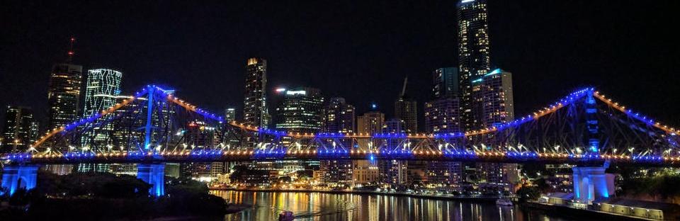

:
Co-Creative Activity in Art Streaming (on Twitch)
Queensland University of Technology | Brisbane, Australia
Andrew Phelps
Professor of Human Interface Technology, University of Canterbury, NZ
Professor, School of Communication, American University, USA
Director, AU Game Lab & American University Game Initiative
President, Higher Education Video Game Alliance
Founder, RIT MAGIC Center & MAGIC Spell Studios
Founder, RIT School of Interactive Games & Media
Notes:
Human Computer Interaction of the Science & Engineering Faculty

Slide 2

Today’s Talk
WTH is art streaming?
Some educational theory stuffs…
How is it the same as other Twitch areas? Different?
Labor and Art Streaming
Of Cabin Chance and Other Things
Why is this interesting (to me) ?
Ask a bunch of pedagogical questions…
Request for Feedback & Critique – Future Work
Apologies for some early walls of text, the slides hopefully get better as it moves along… ☺

Slide 3
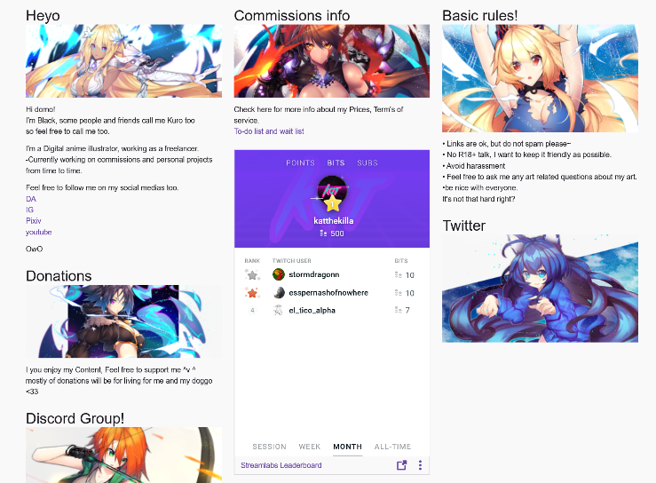
Art streaming

Slide 4
ABOUT GAME DEVELOPMENT…
How do game developers actually engage in the act of game creation? How do they experience the act of creating games? How do they talk about it, both with other developers, and within their player communities? Scholars have generated key knowledge focused on larger business trends in the game industry; the practices and attitudes of individuals at game jams and other limited term game creation events; and through the discourses and work of independent developers who are more committed to sharing knowledge with both scholars and other developers. However, much of this research still fails to examine how game developers themselves talk about the process of creating games, and how they engage with the work itself in ways that can be directly observed…

Slide 5
PUBLIC UNDERSTANDING OF GAME DEVELOPMENT
MAGIC PIXIE STUFF WITH COMPUTERS
ZOMG GAME!1!
IDEA PERSON

Slide 6
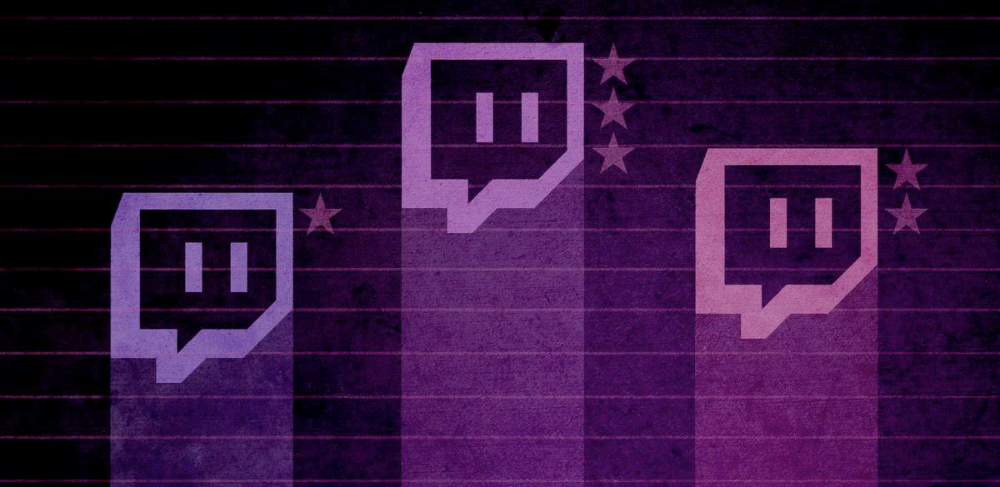
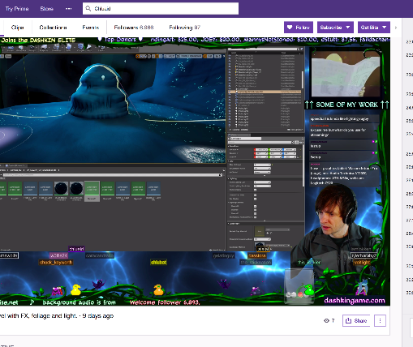
A tale of two Adams
Adam (1) (programmer making Bot Land)
Chluaid (artist on BrackenSack: A Dashkin Game) (and also named Adam (2) IRL)

Slide 7
A Tale Of Two Adams
“coder adam” (1)
Talk aloud protocol
Careful attention to chat
Lots of questions & advice to/from other developers
Streams as a commitment to practice
Small community, not about audience per se
“artist adam” (2)
A kind of ‘visual stepwise process’
Specifically wanted less feedback
Streams as a commitment to practice
Small community, not about audience per se
Cultivation of community for visibility / connections

Slide 8
So that got me thinking about “ARTIST ADAM” & others
Art streaming, or ‘art development streaming’, is an underexplored area of the Twitch community that shares many facets of its operation with other hobby- or quasi-professional-based streaming communities.
At its core, art streaming is the activity of streaming the creation of art: drawing, painting, sketching, watercolor, etc. as well as digital drawing and painting in packages such as Adobe Photoshop, Adobe Illustrator, and a multitude of packages designed for anime, comic art, etc.
This has become popularized to the point that a dedicated channel has emerged on Twitch, the so-called ‘Art Channel’ which is in the ‘Creative’ section of Twitch.
Notes:
Interestingly, there is substantial consternation within this community that the deletion of ‘Twitch IRL’ and subsequent creation of specialized channels by Twitch itself within the ‘Creative’ umbrella [2] has damaged the overall general audience of viewers not engaged in art streaming themselves, as it has discouraged those outside the activity to browse the content in an integrated dashboard.

Slide 9
perfect PRACTICE MAKES perfect
To learn to do anything well, it takes both time and practice. Findings from behavioral psychology have been popularized into the so-called ’10,000 hour rule’ which holds that in order to master a complex task at scale - playing a musical instrument, for example, mastering a sport, or learning a language fluently – it takes approximately ten thousand hours of concentrated practice to achieve expertise (Ericsson & Smith, 1991).
A more nuanced review and evaluation model is presented by North (2012) in relation to professional sports. North summarizes work from a variety of sources, including much of Ericsson’s continued work with numerous colleagues (Ericsson & Smith, 1991; Ericsson, Krampe, & Tesch-Rӧmer, 1993; Ericsson & Lehmann, 1996; Ericsson, 2006, 2007; Ericsson & Towne, 2010) that provides additional detail and complexity to the original idea of time-oriented practice: namely deliberate practice.
Notes:
A second reading of game development through the lens of creating game art and animation is similarly grounded in practice based educational concepts. Indeed, education in the traditional fine arts and their newer digital counterparts are almost wholly based in notions of practice and repetition.

Slide 10
EXPERIENTIAL LEARNING
Although the concept of experiential learning as defined by David A. Kolb (1984) has been in practice for some time, its applications to interactive video games are relatively new. Traditionally, experiential learning models utilize four steps which help to cement concepts and ideas in the minds of those using the model: concrete experience (CE), reflective observation (RO), abstract conceptualization (AC), and active experimentation (AE) (Sternberg & Zhang, 2001). According to Kiili, “the model stresses the continuous nature of learning and the appropriate feedback which provides the basis for a continuous process of goal-directed action” (2005). In other words, the experiential learning model promotes uninterrupted engagement with and reframing of certain concepts, cementing them through repetition and iteration within the learner’s own experience. It allows the learner to discover the concept on their own terms, rather than focusing on rote memorization or regurgitated theories.

Slide 11
CONSTRUCTIVISM & CONSTRUCTIONISM
The educational synergies between the observed practices of Chluaid and Adam13531 extend well beyond verbal narration, and this has deep roots in both constructivist and constructionist educational models, which the authors have explored elsewhere at length as related to more formal efforts in game development education (Decker, Phelps & Egert, 2017, p. 240; Egert & Phelps, 2011). Constructivist learning models approach the classroom such that the instructor is no longer the sole authority figure and leader of the discussion, but rather that students will explore in a self-directed fashion concepts and ideas in a manner that they see fit (Campbell, 1999; Papert, 1991; Powers & Powers, 1999; Puntambekar, 1999).
This linkage allows for the intended object to unfold as the learner creates the object, thus the learning is tied to the creator’s closeness to the object, and often proceeds in a self-directed fashion rather than a pre-established path (Papert, 1991).

Slide 12
FROM GAMES TO GAME DEVELOPMENT?
Experiential gameplay is all about problem solving and “discovery learning” (Kiili, 2005); ideas and procedures are uncovered through repeated effort. Discovery learning doesn’t just happen—in order to fully engage the player and reinforce concepts within the game, games must directly provide clear feedback, well-defined goals, and challenges that are on par with a player’s skill level at any given point (Kiili, 2005; Cziksentmihalyi, 1990), which mirrors the learning concepts as put forward in the idea of the ‘zone of proximal development’ (Vogystsky, 1978). This is further explored by Gee in the context of networks of players (2004, p. 66), and also by Squire in the context of the engaging nature of video games as a medium (2003).

Slide 13
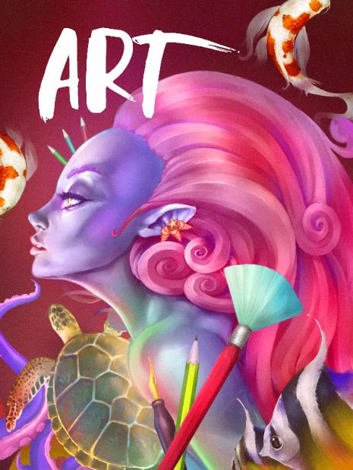
So I watched way to many hours of art streaming
Art Streaming Study
  Streamers selected from first 3 pages of ‘Twitch Art Channel’
  Attempt to vary presumed gender, presumed age, location, and artistic subject
  Approximately 280 observed, some repeatedly
  Vast majority <5 audience (minus me)
  Limited to 2D Drawing & Painting
  Field notes from observing both stream and chat

Slide 14
Motivations & LABOR
The vast majority of these streams are VERY SMALL.
The vast majority of these streams do not actually support their artists financially over time (despite Patreon and other linkages)
The vast majority of these streams are people essentially trying to ‘skill up’
  Informal skill levelling
  Informal → formal critique (aka ‘O’Donnell’ game talk)
  Critique as a means of ‘gamer capital’ (Consalvo)
  Commitment to DAILY PRACTICE
  MAKE BETTER ART (more on that in a bit)
Notes:
This mimics standard art education practices that often rely on daily sketching, painting, or drawing as a form of immersion and practice of technique and craft and is often assigned in introductory courses in studio disciplines. In observation,
Needless to say, this activity is obviously and foremost a form of individual labor, albeit purposefully and directly engaged in by choice as the purpose of engaging in art streaming is to engage in the creation of art.

Slide 15
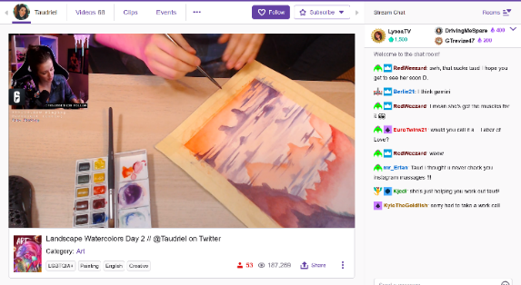
NEGOTIATED LABOR WITH THE PLATFORM ITSELSF
1) the work being created (either digital -i.e. screenshare, or physical -i.e. webcam)
2) their hands using the brush, stylus, tablet surface, or other input device during the physical act of painting or drawing
3) their face or other representation such that a live avatar was presented for narration, persona, and engagement
4) views of the software menus, palettes, and layers (if digital), and/or materials, palette, and studio space (if physical).
Streamer Taudriel engaged in watercolor work, with associated stream cam, chat, and other elements of the Twitch platform.
Notes:
It must also be noted that this activity is also a form of negotiated labor just in terms of engagement with the platform: how to best stream art creation is itself an open question, just as TL Taylor found with respect to variety streamers who were constantly tweaking and adjusting their streaming protocols
Typical reverence and mimicry of Bob Ross style stepwise “paint”through, but significant experimentation with approach and scale in certain streamers / corners
This is in addition to, or forms a layer of complexity on top of, the multiple forms of engagement required by streamers to engage technically with the platform in effective fashion, which include camera management, music, sound, the augmentation of their streams with bots, gifs, surveys, and more.

Slide 16
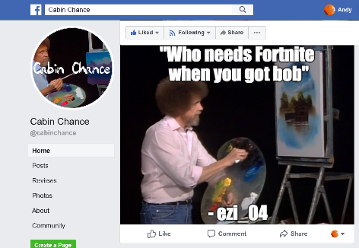
“MAKE BETTER ART”
through a combination of streaming their own practice and getting feedback,
being able to review their own process by recording their stream,
by watching the streams of others for new techniques and ideas,
and by seeking to engage in a community of practitioners that, to some extent, mimics a more traditional studio culture.
(Also, interesting mediation on what it means to “capture” process ☺)
“Cabin Chance” Facebook group, curating “the best” from the Bob Ross Weekend Marathon channel chat

Slide 17







Monetization & AUDIEINCE
(YET MORE LABOR)
Intricate system of multiple, sometimes competing, platforms and interests
Vast majority are (of course) not supporting themselves via these means
A lot less emphasis on public spectacle / fame / following
Negotiated audience participation across networks (games ←→ art, etc.)

Slide 18

Screenshot of the various galleries, websites, channels, and communications for art streamer BlackKurone
note that ‘donations will be for living for me and my doggo’
Just the beginning stages of celebrity style ‘paint alongs’

Slide 19
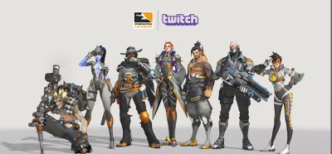
Community, Engagement, and Crossover, Oh My! (LABOR++)
More on that game ← → art thing…
And other formats / groups / crossovers (of course)

Slide 20

Toxicity (INFINITE LABOR)
forcibly engaged in the labor of mitigating or managing toxicity, mainly due to being a woman, person of color, or recognizably LGBTQ+
Sometimes though there remained a fixation on sexualized subject matter coupled with observed instances of individual streamers attempting to exert ‘expert knowledge’
often this is less about subject matter and more about the persona of the streamer
Sometimes policed more so by the community than the individual artist, with stereotypes around the purpose of the stream (i.e. “take that $&@* to a games stream!”)

Slide 21
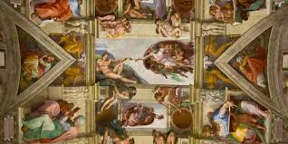
Authenticity
Own not just a commission but the process of creation
Addition of rulesets, communication norms, and functional practices surrounding feedback, time, and engagement
Twitch itself as a platform has proven largely disinterested in proactively assisting streamers in such cases, or in dealing effectively with the culture writ large (toxicity and other tools/issues)
Notes:
Reyson et al “Examination of Anime Content and Associations between Anime Consumption, Genre Preferences, and Ambivalent Sexism” as one example of the rabbit trail of literature here
https://www.polygon.com/2019/2/13/18223558/adl-anti-defamation-league-study-twitch-discord-harassment and so on

Slide 22
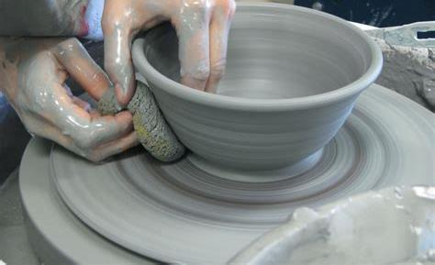
DEVELOPMENT Streaming… TRENDS? MICRO-TRENDS? EDU POTENTIALITIES?
A commitment to practice and function?
Less about audience, more about community (maybe?)
A scalable platform for observation, practice and critique?
A form of bi-directional apprenticeship?
A dialog platform for learning communities?
A potentially scaffolded environment?
A quest for authenticity and role models?

Slide 23

A first use of developer streams is for the instructor to use the technology to stream themselves performing various tasks and activities.
Second, there may be significant value in having students stream their own creations either as a form of ‘well played’ exercise, or simply as a walkthrough and talk-aloud critique of the project they have delivered.
Third, along with streaming final games and prototypes, having students stream their own development work to then examine and reflect on it could be incredibly valuable in an education context.
Fourth, having students stream their own work and development process can surface such work across an entire student body.
Fifth, development streaming has the potential to engage students in a wider community that extends substantially beyond the campus.
Finally, it may be useful to explore having students essentially “cross the streams” to help acclimatize students in a given role with their counterparts in other majors or areas of a curriculum.

Slide 24
Potential problems
Stressing out over streaming / status / practice / etc.
Diversity and inclusion, harassment and cultural failings online
Student privacy and compliance with relevant edu statutes
Large technical infrastructure and expertise
Lack of good quant / analysis / storage tools…
Notes:
https://www.polygon.com/2018/1/18/16899532/youtube-twitch-burnout-h3h3-pewdiepie-lirik
Hila (L) and Ethan Klein. YouTube/H3H3

Slide 25

MOAR RES34CH PLZ
Notes:
Image from Filament games regarding game based learning, but what about ‘game adjacent’ learning?

Slide 26
WORK TO GET HERE
Phelps, A. & Consalvo, M. (2019) "Development Streaming and Authenticity: Cultural Connections, Democracy and Potential Platforms of Engagement" Media in Transition 10. Boston, MA.
Phelps, A., Consalvo, M., and Egerct, C. Development Streaming as a Pedagogical and Community Strategy for Games Education. Presented at the Workshop on New Research Perspectives on Game Design & Development Education. CHI PLAY 2018, October 28, 2018, Melbourne, Australia.

Slide 27
FORTHCOMING PUBLICAITON IF YOU WANT MORE
Consalvo, M., & Phelps, A. (2019). Performing Game Development Live on Twitch. Proceedings of the 52nd Annual Hawaii International Conference on Systems Science, Maui, HI. p. 2438-2447. Retrieved online: http://hdl.handle.net/10125/59682
Phelps, A. & Consalvo, M. (2020) Laboring Artists: Art Streaming on the Videogame Platform Twitch. Proceedings of the 53rd Annual Hawaii International Conference on Systems Science, Maui, HI. (forthcoming)
Consalvo, M., and A. Phelps (2020) Game Development Live on Twitch: Observations of Practice and Educational Synergies. O. Sotamaa (ed) . Game Production Studies. Cultural Studies of Video Game Industries. Amsterdam University Press, Netherlands. (in review)

Slide 28
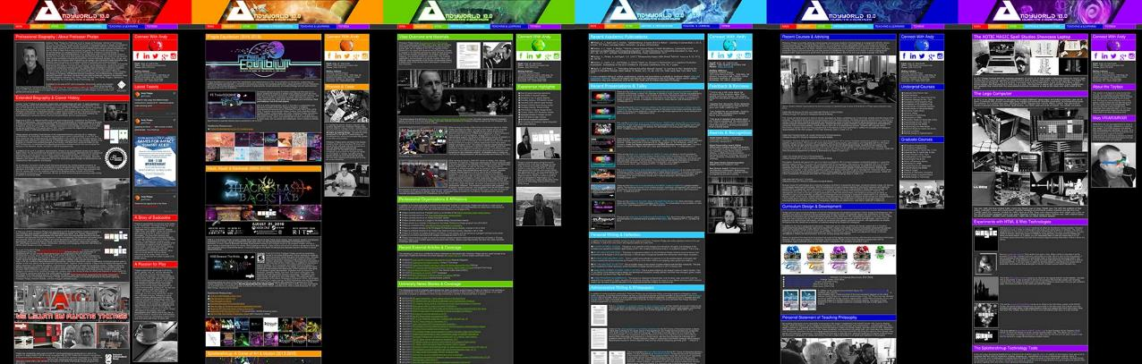
ANDYWORLD.IO | PROFESSORANDREWPHELPS.NET | @ANDYMPHELPS | ANDYMPHELPS@GMAIL.COM
Thanks & Questions

