Slide 1


:
Art Streaming on Twitch:
Some Emerging Research, Ideas & Work in Progress
DiGRA 2019 |Live Streaming & Research: New Directions| Kyoto, Japan
Andrew Phelps
Professor of Human Interface Technology, University of Canterbury, NZ
Professor, School of Communication, American University, USA
Director, AU Game Lab & American University Game Initiative
President, Higher Education Video Game Alliance
Founder, RIT MAGIC Center & MAGIC Spell Studios
Founder, RIT School of Interactive Games & Media

Slide 2
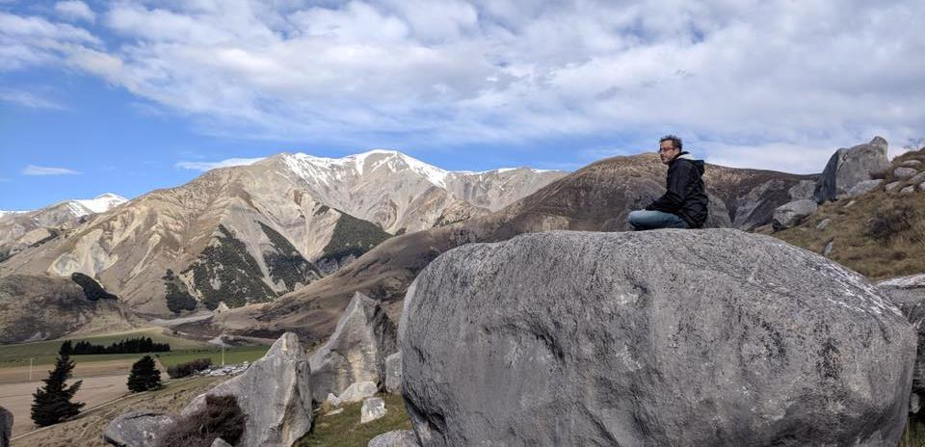
Today’s Talk
WTH is art streaming?
How is it the same as other Twitch areas? Different?
Labor and Art Streaming
Of Cabin Chance and Other Things
Why is this interesting (to me) ?
Request for Feedback & Critique – Future Work

Slide 3
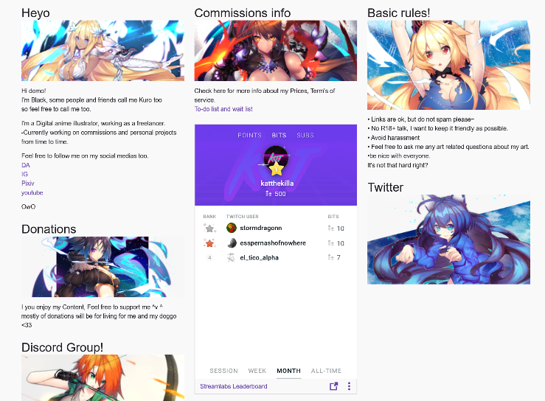
Art streaming

Slide 4
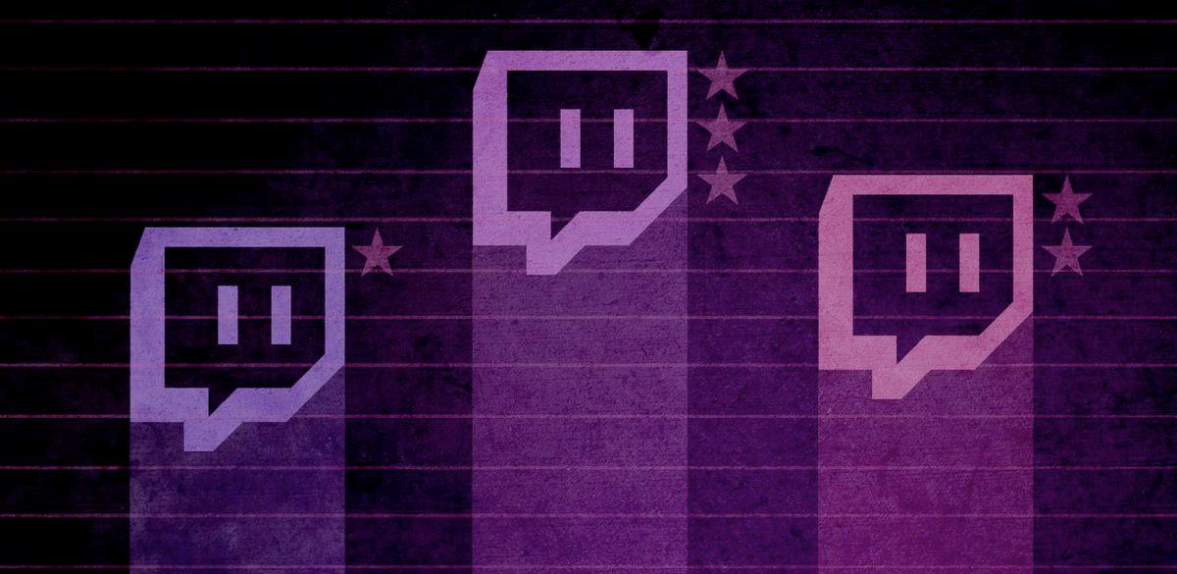
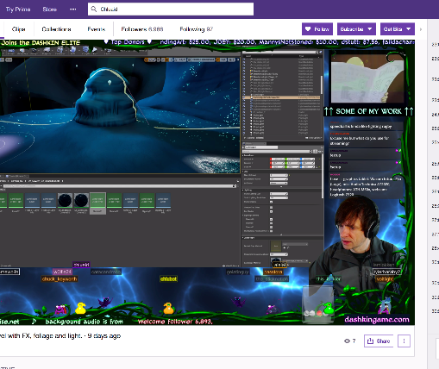
A tale of two Adams
Adam (1) (programmer making Bot Land)
Chluaid (artist on BrackenSack: A Dashkin Game) (and also named Adam (2) IRL)

Slide 5
A Tale Of Two Adams
“coder adam” (1)
Talk aloud protocol
Careful attention to chat
Lots of questions & advice to/from other developers
Streams as a commitment to practice
Small community, not about audience per se
“artist adam” (2)
A kind of ‘visual stepwise process’
Specifically wanted less feedback
Streams as a commitment to practice
Small community, not about audience per se
Cultivation of community for visibility / connections

Slide 6
So that got me thinking about “ARTIST ADAM” & oTHERS
Art streaming, or ‘art development streaming’, is an underexplored area of the Twitch community that shares many facets of its operation with other hobby- or quasi-professional-based streaming communities.
At its core, art streaming is the activity of streaming the creation of art: drawing, painting, sketching, watercolor, etc. as well as digital drawing and painting in packages such as Adobe Photoshop, Adobe Illustrator, and a multitude of packages designed for anime, comic art, etc.
This has become popularized to the point that a dedicated channel has emerged on Twitch, the so-called ‘Art Channel’ which is in the ‘Creative’ section of Twitch.
Notes:
Interestingly, there is substantial consternation within this community that the deletion of ‘Twitch IRL’ and subsequent creation of specialized channels by Twitch itself within the ‘Creative’ umbrella [2] has damaged the overall general audience of viewers not engaged in art streaming themselves, as it has discouraged those outside the activity to browse the content in an integrated dashboard.

Slide 7
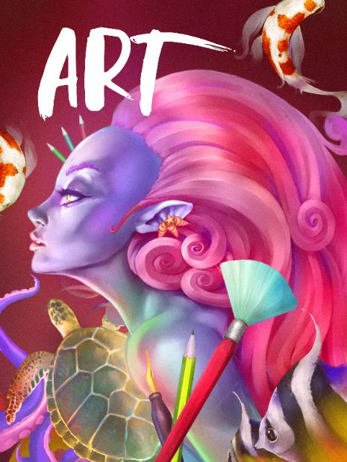
So I watched way to many hours of art streaming
Art Streaming Study
  Streamers selected from first 3 pages of ‘Twitch Art Channel’
  Attempt to vary presumed gender, presumed age, location, and artistic subject
  Approximately 280 observed, some repeatedly
  Vast majority <5 audience (minus me)
  Limited to 2D Drawing & Painting
  Field notes from observing both stream and chat

Slide 8
Motivations & LABOR
The vast majority of these streams are VERY SMALL.
The vast majority of these streams do not actually support their artists financially over time (despite Patreon and other linkages)
The vast majority of these streams are people essentially trying to ‘skill up’
  Informal skill levelling
  Informal → formal critique (aka ‘O’Donnell’ game talk)
  Critique as a means of ‘gamer capital’ (Consalvo)
  Commitment to DAILY PRACTICE
  MAKE BETTER ART (more on that in a bit)
Notes:
This mimics standard art education practices that often rely on daily sketching, painting, or drawing as a form of immersion and practice of technique and craft and is often assigned in introductory courses in studio disciplines. In observation,
Needless to say, this activity is obviously and foremost a form of individual labor, albeit purposefully and directly engaged in by choice as the purpose of engaging in art streaming is to engage in the creation of art.

Slide 9
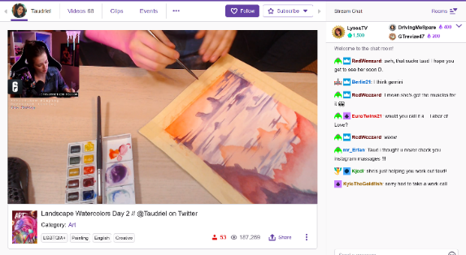
NEGOTIATED LABOR WITH THE PLATFORM ITSELSF
1) the work being created (either digital -i.e. screenshare, or physical -i.e. webcam)
2) their hands using the brush, stylus, tablet surface, or other input device during the physical act of painting or drawing
3) their face or other representation such that a live avatar was presented for narration, persona, and engagement
4) views of the software menus, palettes, and layers (if digital), and/or materials, palette, and studio space (if physical).
Streamer Taudriel engaged in watercolor work, with associated stream cam, chat, and other elements of the Twitch platform.
Notes:
It must also be noted that this activity is also a form of negotiated labor just in terms of engagement with the platform: how to best stream art creation is itself an open question, just as TL Taylor found with respect to variety streamers who were constantly tweaking and adjusting their streaming protocols
Typical reverence and mimicry of Bob Ross style stepwise “paint”through, but significant experimentation with approach and scale in certain streamers / corners
This is in addition to, or forms a layer of complexity on top of, the multiple forms of engagement required by streamers to engage technically with the platform in effective fashion, which include camera management, music, sound, the augmentation of their streams with bots, gifs, surveys, and more.

Slide 10
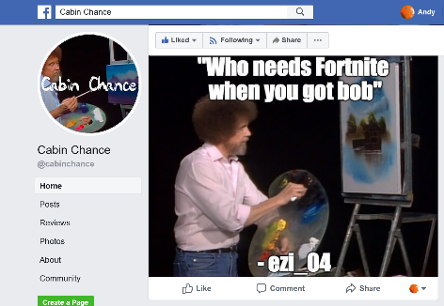
“MAKE BETTER ART”
through a combination of streaming their own practice and getting feedback,
being able to review their own process by recording their stream,
by watching the streams of others for new techniques and ideas,
and by seeking to engage in a community of practitioners that, to some extent, mimics a more traditional studio culture.
(Also, interesting mediation on what it means to “capture” process ☺)
“Cabin Chance” Facebook group, curating “the best” from the Bob Ross Weekend Marathon channel chat

Slide 11







Monetization & AUDIEINCE
(YET MORE LABOR)
Intricate system of multiple, sometimes competing, platforms and interests
Vast majority are (of course) not supporting themselves via these means
A lot less emphasis on public spectacle / fame / following
Negotiated audience participation across networks (games ←→ art, etc.)

Slide 12
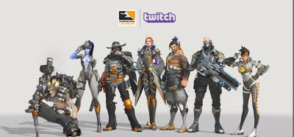
Community, Engagement, and Crossover, Oh My! (LABOR++)
More on that game ← → art thing…
And other formats / groups / crossovers (of course)

Slide 13
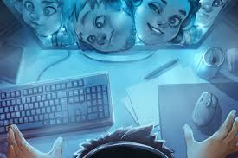
Toxicity (INFINITE LABOR)
forcibly engaged in the labor of mitigating or managing toxicity, mainly due to being a woman, person of color, or recognizably LGBTQ+
Sometimes though there remained a fixation on sexualized subject matter coupled with observed instances of individual streamers attempting to exert ‘expert knowledge’
often this is less about subject matter and more about the persona of the streamer
Sometimes policed moreso by the community than the individual artist, with stereotypes around the purpose of the stream (i.e. “take that $&@* to a games stream!”)

Slide 14
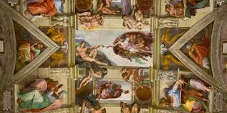
Authenticity
Own not just a commission but the process of creation
Addition of rulesets, communication norms, and functional practices surrounding feedback, time, and engagement
Twitch itself as a platform has proven largely disinterested in proactively assisting streamers in such cases, or in dealing effectively with the culture writ large (toxicity and other tools/issues)
Notes:
Reyson et al “Examination of Anime Content and Associations between Anime Consumption, Genre Preferences, and Ambivalent Sexism” as one example of the rabbit trail of literature here
https://www.polygon.com/2019/2/13/18223558/adl-anti-defamation-league-study-twitch-discord-harassment and so on

Slide 15
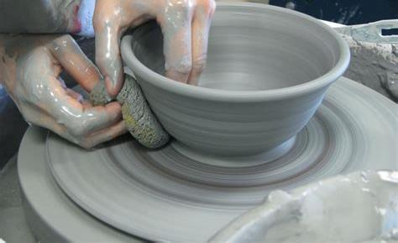
DEVELOPMENT Streaming… TRENDS? MICRO-TRENDS? EDU POTENTIALITIES?
A commitment to practice and function?
Less about audience, more about community (maybe?)
A scalable platform for observation, practice and critique?
A form of bi-directional apprenticeship?
A dialog platform for learning communities?
A potentially scaffolded environment?
A quest for authenticity and role models?

Slide 16

A first use of developer streams is for the instructor to use the technology to stream themselves performing various tasks and activities.
Second, there may be significant value in having students stream their own creations either as a form of ‘well played’ exercise, or simply as a walkthrough and talk-aloud critique of the project they have delivered.
Third, along with streaming final games and prototypes, having students stream their own development work to then examine and reflect on it could be incredibly valuable in an education context.
Fourth, having students stream their own work and development process can surface such work across an entire student body.
Fifth, development streaming has the potential to engage students in a wider community that extends substantially beyond the campus.
Finally, it may be useful to explore having students essentially “cross the streams” to help acclimatize students in a given role with their counterparts in other majors or areas of a curriculum.

Slide 17
Potential problems
Stressing out over streaming / status / practice / etc.
Diversity and inclusion, harassment and cultural failings online
Student privacy and compliance with relevant edu statutes
Large technical infrastructure and expertise
Lack of good quant / analysis / storage tools…
Notes:
https://www.polygon.com/2018/1/18/16899532/youtube-twitch-burnout-h3h3-pewdiepie-lirik
Hila (L) and Ethan Klein. YouTube/H3H3

Slide 18

MOAR RES34CH PLZ
Notes:
Image from Filament games regarding game based learning, but what about ‘game adjacent’ learning?

Slide 19
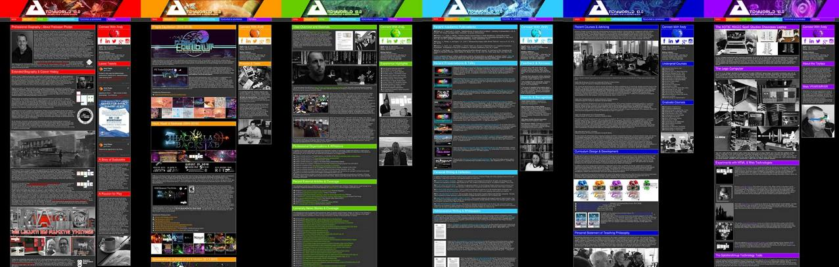
ANDYWORLD.IO | PROFESSORANDREWPHELPS.NET | @ANDYMPHELPS | ANDYMPHELPS@GMAIL.COM
Thanks & Questions

