Slide 1


Slide 2
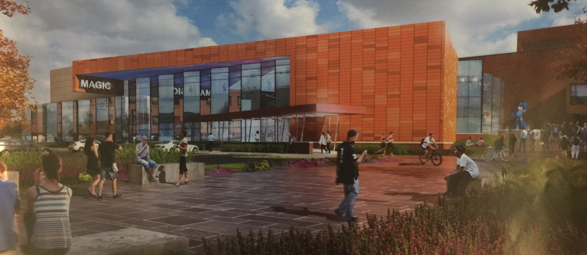
OR… A STRANGE & DETAILED WAY OF LOOKING AT
COMPUTERS, STORIES, AND INTERACTION
Andrew Phelps
Rochester Institute of Technology
Founding Director, RIT MAGIC Center
Founder & CEO, MAGIC Spell Studios, LLC
Professor & Founder, RIT School of Interactive Games & Media
Fellow, RIT School of Individualized Study
Notes:
The core of this talk is the story part. My own, the stories we’ve told as a center, and the idea of education as enabling other storytellers.

Slide 3
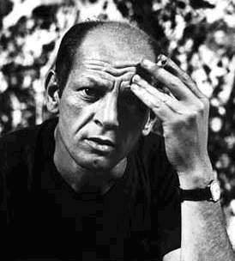
WHAT THIS TALK IS AND ISN’T
PART 0: ANCIENT HISTORY AND LEAD-IN
PART 1: WHAT DOES THE MAGIC CENTER DO?
PART 2: MOTIVATIONS
PART 3: CONCLUSIONS AND BEGINNINGS
I WILL TEACH YOU NO DISCRETE SKILLS
I WILL ONLY MENTION ADOBE PRODUCTS WHERE WE USED THEM IN PROCESS, BUT THAT ISN’T THE OVERALL POINT (AS YOU WILL SEE)
THE SLIDES (WITH NOTES) WILL BE PUBLISHED!!

Slide 4
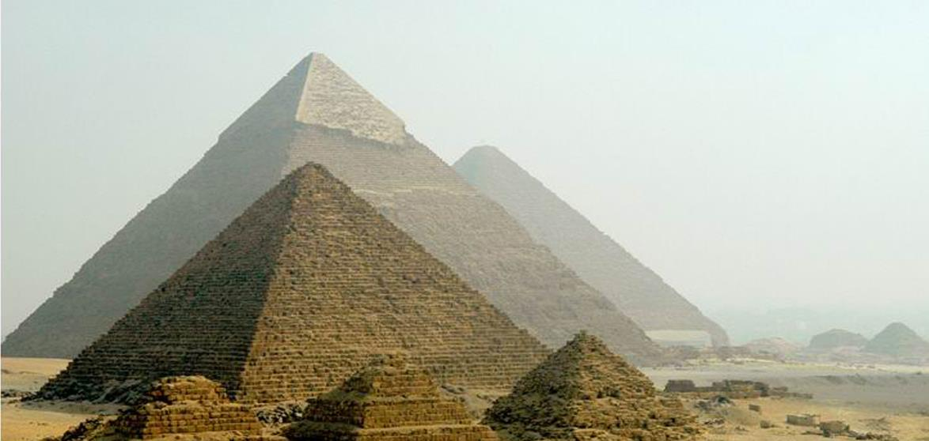
PART 0: ANCIENT HISTORY

Slide 5
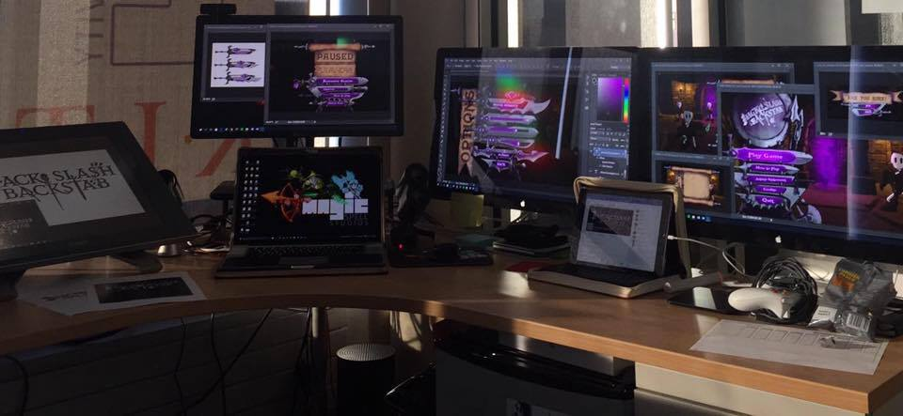
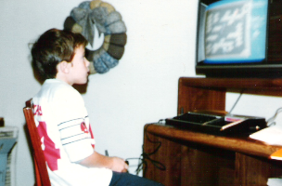
Hi, I’m andy. I make things.

Slide 6
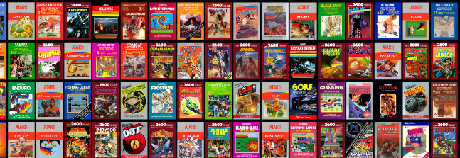
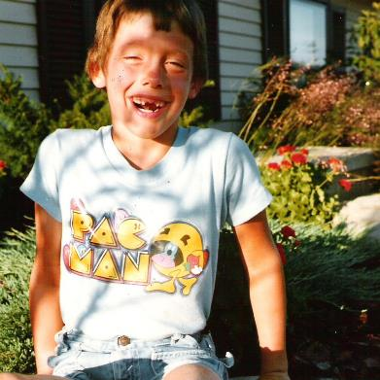
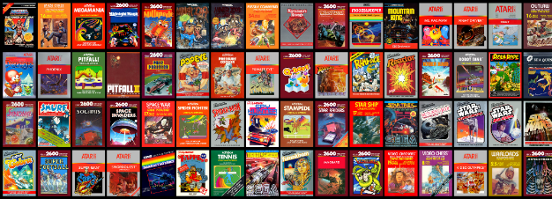
AND I GREW UP A GAMER

Slide 7
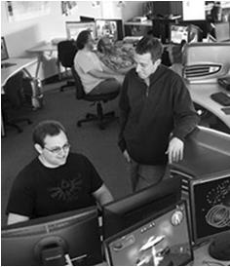
LUCKY TO HAVE MADE THINGS
FIRST graduate course in games at RIT
FIRST undergraduate course and concentration in game design and technology
FIRST degree program in the northeast in game design & development, currently ranked #2 by Princeton Review
FIRST Dept / School of Interactive Games and Media
FIRST ever of its kind public-private partnership in the MAGIC Center
FIRST university to ship on XBOX One / 1st party channel
FIRST university-wide center on digital media at RIT
Notes:
I’m a very lucky, very blessed person. I’ve had the luxury of playing around in higher education for a long time, and doing things we were mostly told ‘NO’ on the first few hundred times. We just did them anyway, and I’ve been fortunate in both my mix of colleagues, the tidal forces of politics and reality, and ability to see a forest from some trees.

Slide 8
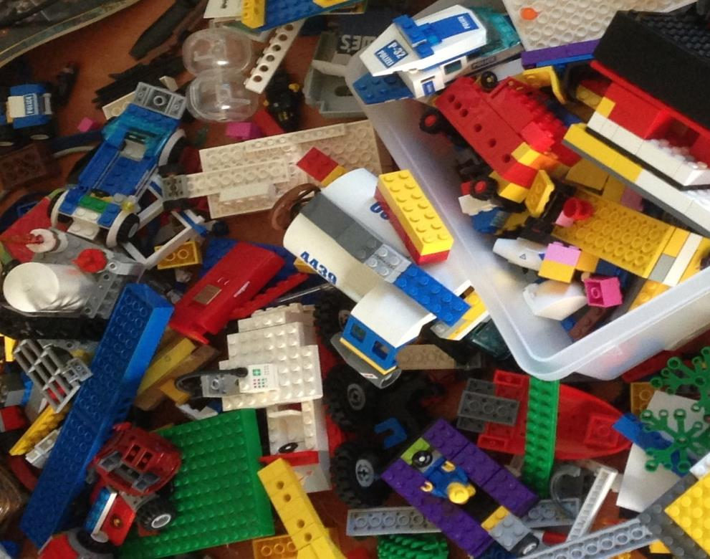
'protecting “making as a
mode of inquiry”’
-Ian Horswill, Northwestern
Notes:
Another way to paraphrase this is to say that “we hold the WORK to be self-evident’ – which seems obvious (in part) in art school, but as we move to the hard sciences and engineering that gets surprisingly twisted in higher ed – we start focusing on publication and reception of the work, and NOT THE WORK ITSELF. We focus on teaching ‘skills’ and on teaching ‘data’ and on ‘learning to code’ and we forget the REASON we are doing those things is so that someone can MAKE SOMETHING.
The only real criteria I have for an introductory programming course is that students MAKE SOMETHING THEY ARE PROUD OF….. AND IDEALLY SHARE IT.

Slide 9
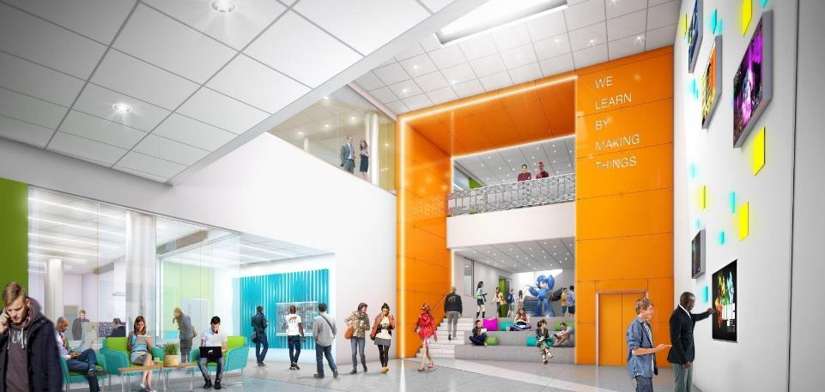
WE LEARN BY MAKING THINGS
Notes:
This is the visualization of our new building (more on that later) which inscribes our motto ‘we learn by making things’ – which was a quick encapsulation of the entire culture of RIT that I once gave to the president in a hotel lobby

Slide 10
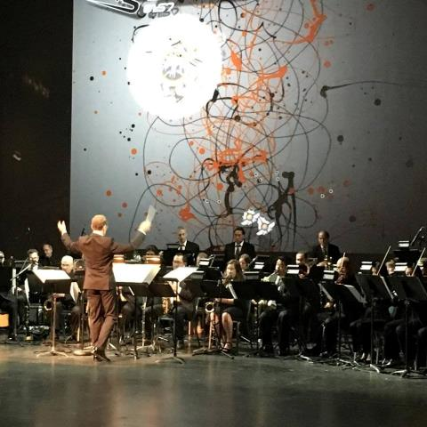
Why IS MAGIC?
C O N V E R G E N C E
C O N V E R G E N C E
The platforms and technology for film, animation, games, media, and story are converging into new forms, new stories, new experiences, and new knowledge.
Notes:
We have great academic programs in a bunch of areas: games, film, design, photography, etc. But increasingly, the technology, platforms, experiences, and products that surround these are converging – enabling new stories, new experiences and new knowledge.

Slide 11
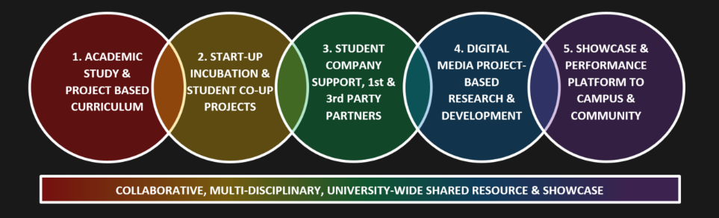
CONVERGENCE OF ANOTHER SORT
Notes:
This convergence is also wreaking havoc on traditional university structures: MAGIC is as much an answer to divisions and departments and programs and economics as it is an effort to explore a more unified intellectual questioning of the role of computational media.

Slide 12
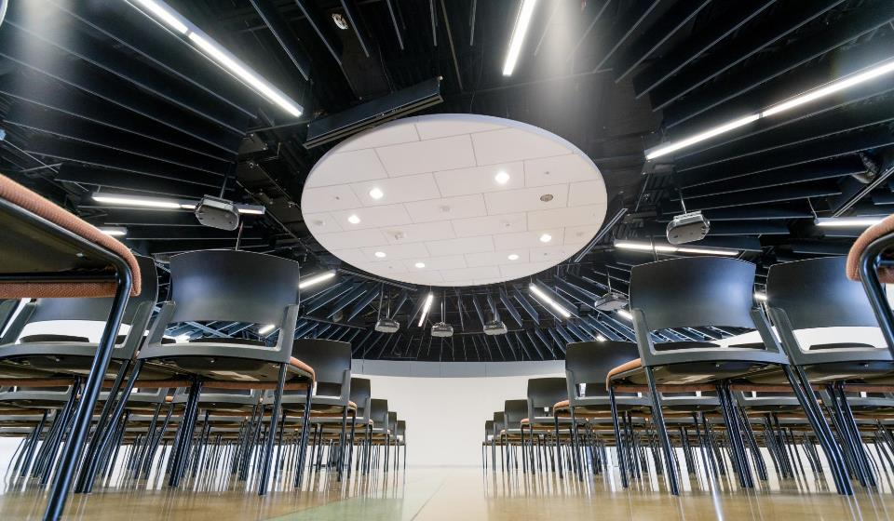


HOW IS MAGIC:
A VERY IMPORTANT DIVISION:
Notes:
The core thing we did was made a living, breathing studio along side our research center. It has resulted in pretty much all of our success.

Slide 13
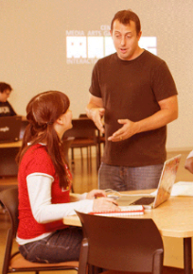
HOW IS MAGIC:
Several programs from a variety of funding sources:
  Co-UP (with Simone Center, i-Core NSF, RIT BoT, etc.)
  Industry partnership and funded research
  MAGIC academic projects (games, apps, others), and commercial projects (games, apps, others)
  Annual Speaker Series, hackathon series, cre8-a-thons
  Several “initiatives” that operate as mini-centers or labs inside MAGIC including FOSS, RC&P, Frameless labs, LSC, etc.
  Large grant designation from ESD as a ‘NY Games Center” along with RPI and NYU
  Large grant support in computing education
  26 Faculty affiliated with the center from all over campus (and counting…)
  NYS ESD Affiliated Public-Private partnership

Slide 14
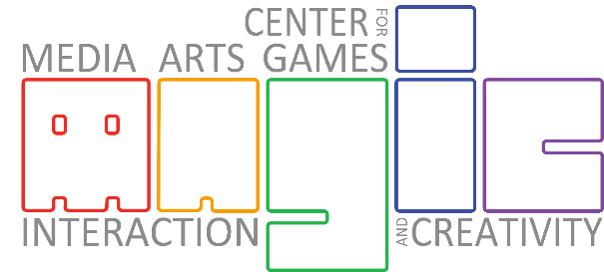
…The M is for Messy
PART I: WHAT DO WE DO?
Notes:
That said, there is no ‘one thing’ that makes this work. It is a constant mess. It is paint on the floor. It is coloring outside the lines. It is anarchy.

Slide 15
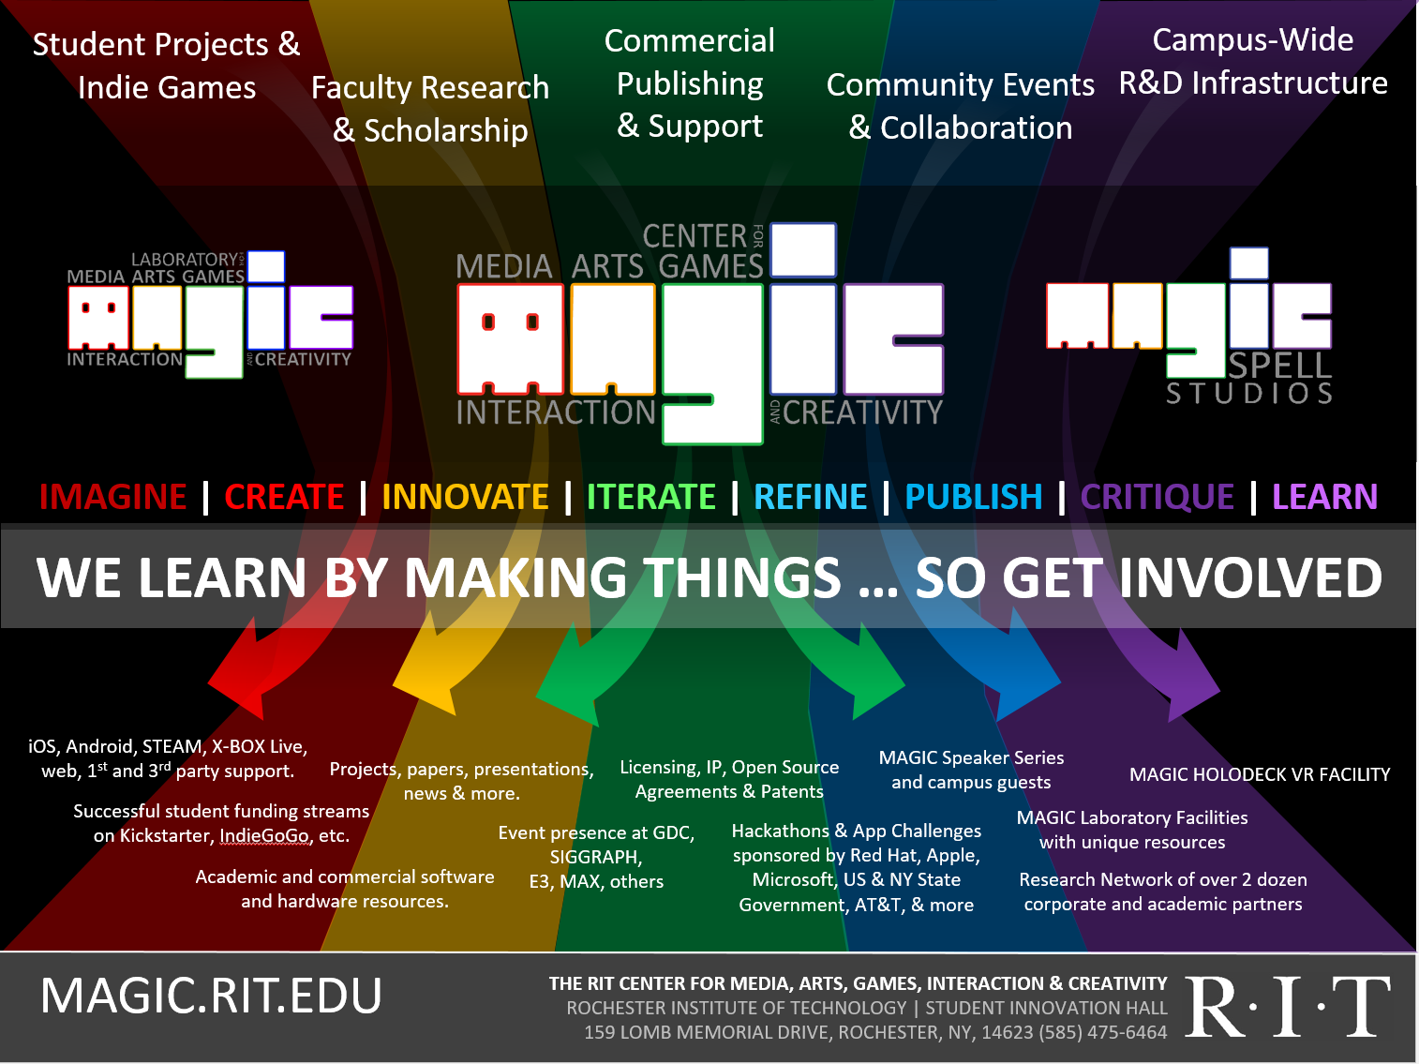


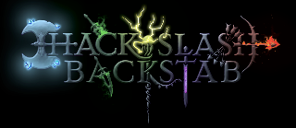
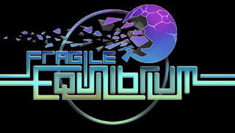
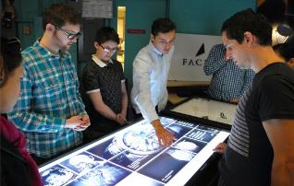
Notes:
These are the kinds of things we set out to be engaged and involved in – and 5 projects we have done over the past 5 years that illustrate some of those at different scales.
A recent summer project with the Buffalo Bills
Splattershmup: A Game of Art & Motion
Hack, Slash & Backstab
Fragile Equilibrium (newest project in development)
An R&D project with Adobe XD 2 years ago on ‘multi-screen retail experience’

Slide 16
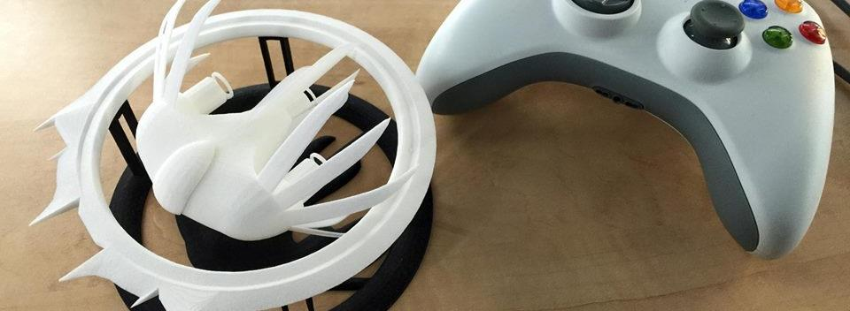

A Strange Game for Strange Reasons
This game taught us (the campus) about making things, production, and scale
This game allowed us to explore using typical game forms for telling a unique story to a very targeted audience
Finalist at GLS Education Arcade, accepted to DiGRA Blank Arcade, and IndieArcade at the Smithsonian American Museum of Art
SPLATTERSHMUP.RIT.EDU – PLAY TODAY! MAKE ART!
Notes:
If you want to know a lot more about this project, entire post-mortem is here: http://igm.rit.edu/~andy/downloads/SPLATTERSHMUP_post_mortem.pptx

Slide 17

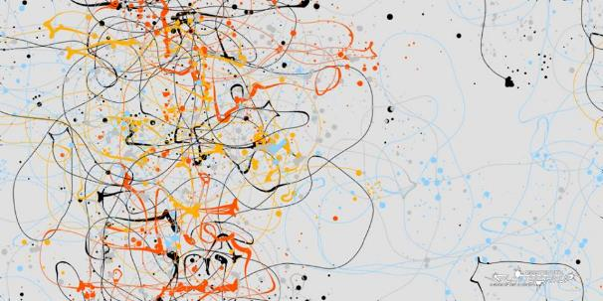
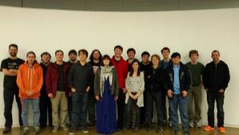
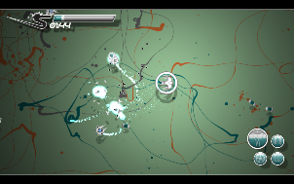
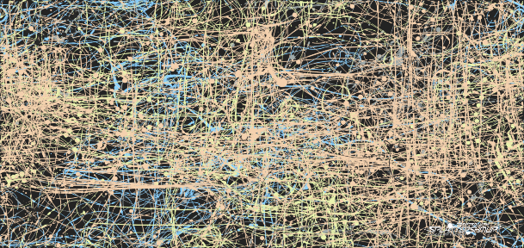
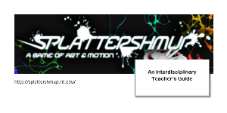


Notes:
Game written up at:
https://killscreen.com/articles/where-painting-and-videogames-collide/
Teacher’s Guide:
About the Author:
Sara M. Cometto
B.A. in Art History from SUNY Geneseo
NYS K-12 Permanent Art Education Certification from Buffalo State College
M.S. in Elementary Education Specializing in Arts for Children from SUNY Brockport
18+ years teaching Art Education, grades K-12 and special needs, at Alden Central Schools
AVAILABLE TO PLAY: SPLATTERSHMUP.RIT.EDU.

Slide 18










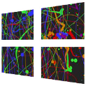




TOOLS, SOURCE & COMPILE TARGETS
+
+
+
Notes:
Tons of adobe products in the background – the game itself is a very fancy web page, bundled into app frameworks for various platforms. Write once, suffer all over the place. - make joke this would be better in Flash if only Joseph were working on it ☺

Slide 19
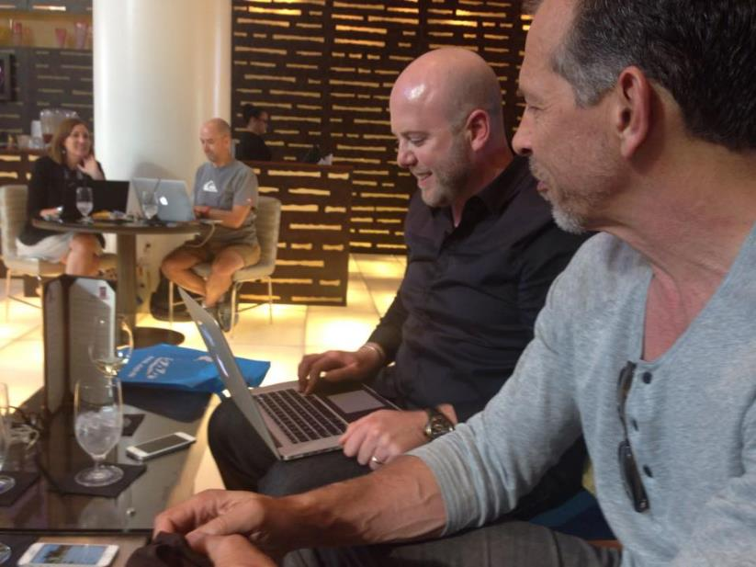
But more important than tools IS STORY
Notes:
This is Michael Gough (formerly of adobe) and a principal scientist at Adobe XD playing an alpha version of splattershmup. This is right after I was listening to Michael’s version of ‘the story of drawing’ in several contexts after the previous year. Thinking about brushes, lines, inks, paints, image, capture, process and form. Adobe talks about its tools – they don’t talk about their impact as a design agency in their own right. ☺

Slide 20

Where Did HSB Come From, and What Did We Actually Do?
Notes:
So the next project we did was HSB. Because I’d been stabbed in the back and it *!^&ing hurt. And in looking around

Slide 21
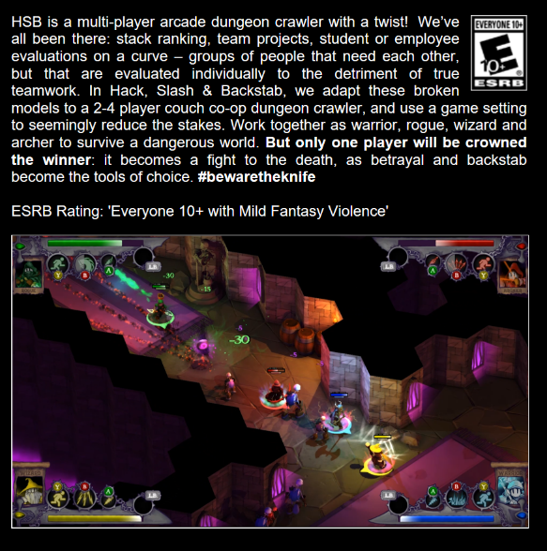
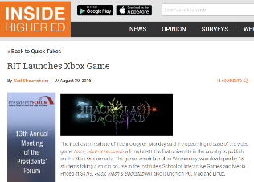
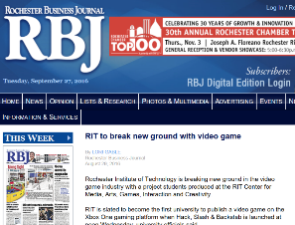
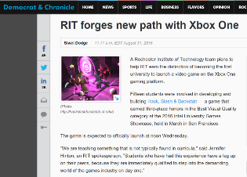
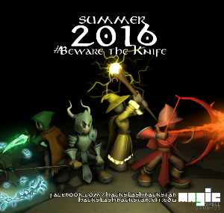
What is Hack, Slash & Backstab

Slide 22
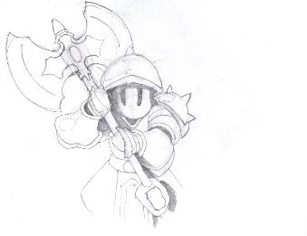
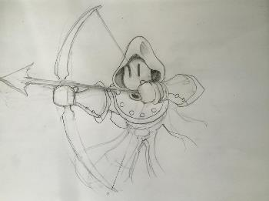
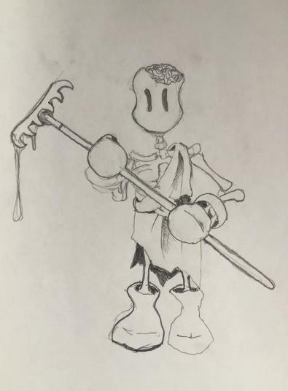
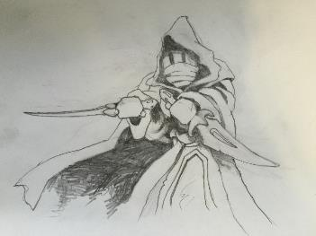
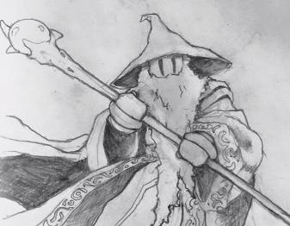
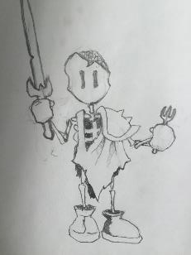
CONCEPT AND ITERATION
Notes:
What do you do when you hurt? You make art.

Slide 23
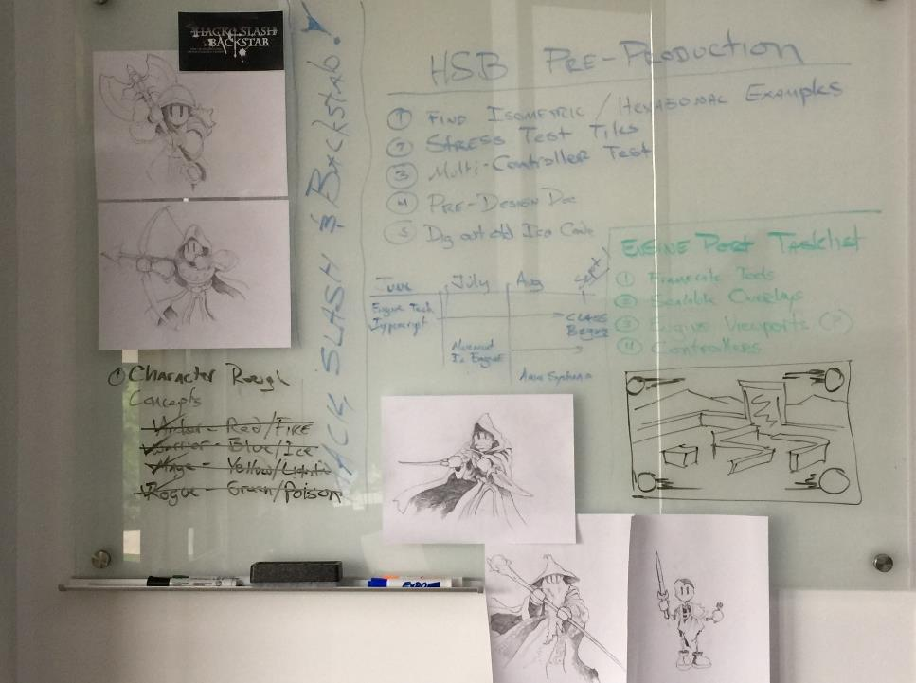
SUMMER:
Pre-Production, Thinking, Planning, Sketching,
BLOCKING,
TESTING...
PITCH DAY 1 of FALL CLASS

Slide 24
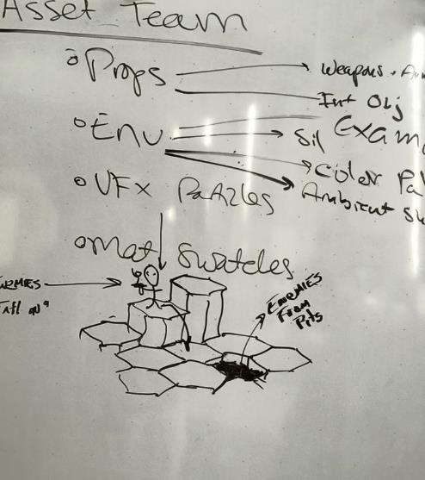
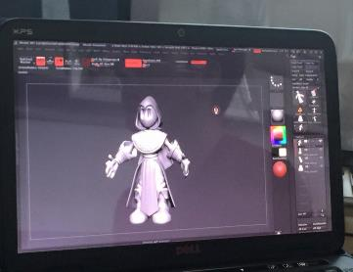
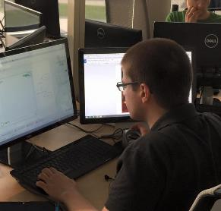
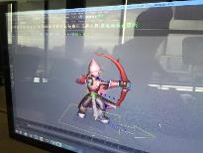
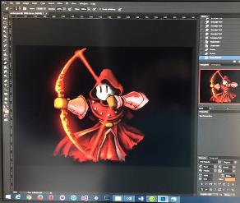

Slide 25
Structure & Schedule
ANDY
CTO
OPERATIONS MANAGER
Art schedule was fixed at about week 4, for the bulk of the semester (character and anim every 2 weeks)
Dev was more fluid, need based, iterative for specific features & systems... but still time-tasked
EVERY WEEK ELEVATOR PITCH
now we all understand it better!
CREATIVE DIRECTOR
COMMUNICATIONS
OFFICER
PROJECT MANAGER
ART TEAM
AUDIO TEAM
DEV TEAM
UI/UX TEAM

Slide 26
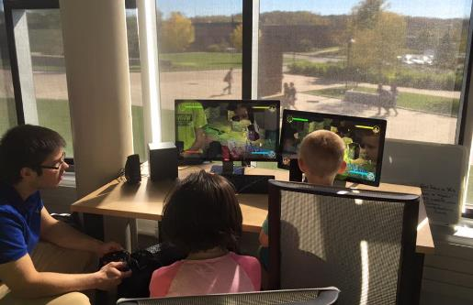
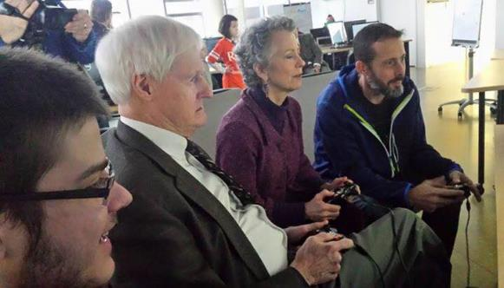
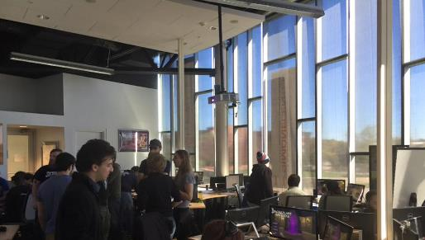
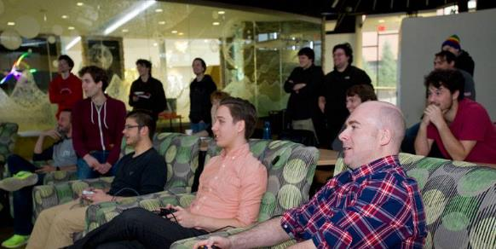
PLAYTESTING (LOTS AND STILL NOT ENOUGH)

Slide 27

AT THE END OF THE SEMESTER, WE HAD A BASIC PLAYABLE GAME.
No achievements
No platform integration or testing
No real bosses
Very few items
Very few props
Lots of UI bugs
At that point, it was reviewed for viability, and failure was no longer an option. We were going to publish it. Same bar internal & external.

Slide 28
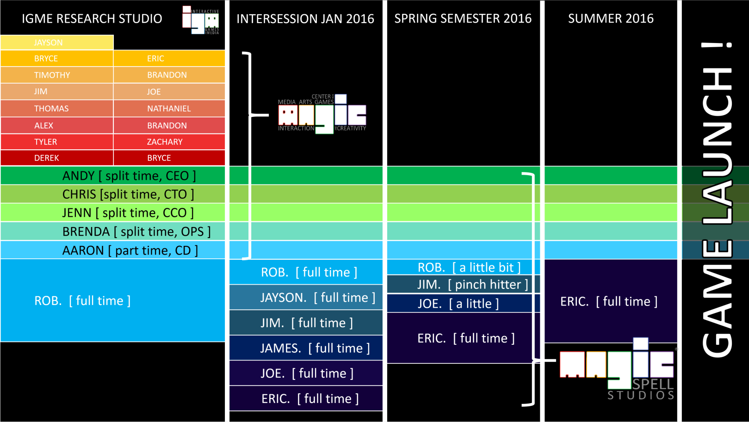

Slide 29



Slide 30

Notes:
If you want to know a lot more about this project, entire postmortem is here: http://igm.rit.edu/~andy/downloads/HSB_POST_MORTEM.pptx
The entire LIVE PRESENTAITON of the post-mortem is here: http://magic.rit.edu/studios/hsb/hsb_post_mortem_compressed.mp4

Slide 31


FIRST UNIVERSITY TO PUBLISH DIRECTLY ON XBOX ONE. BRAGGING RIGHTS++

Slide 32

FRAGILE EQUILIBRIUM: A GAME ABOUT FEELING HUMAN
is a game about the imperfection and impermanence of life. It is a reflection on transience, a balancing act between progress and regrowth, and a reminder to find beauty in decay and inevitable destruction. Using old-school shmup mechanics and form, [Fe] invites the player to explore a world of quick actions, forced decisions, and subtle strategy: as balance decays so does the world, eroding over time and out of space, compressing the player to a smaller and smaller area, pressing in upon the mind.

Slide 33








Slide 34







Notes:
It’s a game about being stuck as a the world continues to come at you, but the world is also breaking down, wrapped in the cloak of nostalgia and a false tranquility. Sound at all familiar to anyone right now?

Slide 35




A SUMMER WITH THE
BUFFALO BILLS

Slide 36

OR WE FLIP ALL THAT ON ITS HEAD AND HELP STUDENTS TELL THEIR OWN STORIES

Slide 37

Part II: Motivations
0. TO TELL A STORY THAT ISN’T STEM
1. TO HAVE IMPACT IN OUR WORK AND PRACTICE
2. TO BUILD A NEW GENERATION OF CITIZEN SCHOLARS
Notes:
So that’s “WHAT WE DO” (at least an overview – there’s a LOT more – see magic.rit.edu)
But WHY do we do it?

Slide 38

BUT FIRST, COMPUTING in 4 lenses
PATTERNS, SYSTEMS, AND SENSES
NON-DESTRUCTIVE ITERATION
SPEED AND SCALE
STORY, DATA AND NORMALIZATION
Notes:
Picture a lake, a blue lake with whitecaps and maybe some boats. Nice vacation spot, where you sit on a particular dock or beat. We could also view it from another vantage point. We could view it through thermal imaging. We could look at it as a chemical formula for lake water. We could explore it as an ecosystem. We could examine the history and lore of the region, the roles and norms of human activities in and around the lake, we could compare it to other lakes, and so on. None of these lenses is complete, and none of them is in isolation. Some of them are related to greater or lesser degree depending on our question.
4 lenses around computer literacy – these come together and ebb apart. Probably some things fall within a single one, but mostly anything we do with computers has these components in some way shape or form. These themes? These characteristics? I’m probably missing some, but these come to my mind most directly in today’s environment.
PATTERNS: repeats in the data, structures, detectable
SYSTEMS: here refers not just to computer systems but biological systems, physical systems, natural systems, anything that can be mapped and played with and someday simulated. Patterns refers not just to algorithms but to natural, behavioral, fractal, what have you.
SENSES: We attach computers to cameras that we might see with them, to microphones that we might hear, to a vast array of sensors and measurement devices that we might touch and taste and sample, to language that we might speak and communicate, to entertainment and non-entertainment media, etc.
Iteration – and in particular non-destructive iteration, opens the ability to ‘fiddle’ and ‘tinker’ and ‘go until you get it right’ and ‘start by dying on a game level and learn from there’ – but also to record and document PROCESS, and to then convey that to anyone else. It allows PLAY just as much as it allows INQUIRY, and maybe those are in some sense the same thing.
But the big one here is STORY. The big one here is STORY in COMBINATION with the rest. The big one here is the idea that we make narratives of technology EVEN WHEN NO NARRATIVE EXISTS, or EVEN WHEN THE PATTERN CONTRADICTS THE NARRATIVE.

Slide 39

PART II: NO 0: TO TELL A STORY THAT ISN’T STEM
Notes:
So a big motivation for us it to step outside of STEM and STEM rhetoric on a campus that is the 2nd largest producer of stem graduates (annually) in the country. My center in just about every way is the counter-culture, it is the pirate ship. And sure, the arts have a long history of that, but this is at a different scale in ways that challenge the university proper and its operation (which may not ultimately bode well for us :0)
Image from: https://ashleyomelia.files.wordpress.com/2014/07/bigstock-old-open-book-with-magic-light-55622912.jpg

Slide 40

STEM is the single most destructive IDEOLOGY [STORY!] in education TODAY
- zakaria in 2012, NYT OP-ED
(and probably a lot of other PEOPLE AROUND THIS TIME AS WELL)
Notes:
STEM is a STORY, it seeks to create a BUBBLE, and to define education and society on ITS TERMS
It put us at war with ourselves
It provided an excuse to use culture to attack the arts
It recontextualized education as a means to a job, not a means to humanity
This is UNIVERSAL in America – both sides of the isle, DoE on down
So what i'm trying to illustrate here is that we don't understand the themes of computing all that well, we are monkeying around with things in advance of real understanding, and yet we're REAL SURE of what value is in education. When i started with games (next slide) that was about TECHNOLOGY because it would get kids GOOD JOBS because tech. But games are really social constructs - so what happens now is all our real work is with liberal arts and fine arts as technology gets 'solved' over time. And the tech will never be solved - because innovation - but ultimately games are an entertainment medium. they are about STORY. I'm trying to illustrate the false dichotomy we put here that even adobe must pay lip service to. And just 'adding art back in' doesnt really fix it.

Slide 41

Notes:
When I started this talk I talked about having taught the first class on games at RIT and how that was an odd occurrence and a strange thing. These days EVERYONE is using games as a lens, technology as a platform, to tell stories and engage learners about their field and their passion. But are we focusing deeply on the stories we are telling? Are we thinking about them as personal narratives of learning and engagement? Or are we looking, in the most shallow sense possible, to just apply some ‘stickiness’, some ‘marketing’ some ‘pizazz’ to something unrelated? And what impact does this have? Why DO millennials have this quest for authenticity? And what is the narrative of authenticity, anyway? Learn by doing? Apprenticeship? Engagement? What do these words mean?

Slide 42

ART IS ALSO ABOUT STORY,
AND HAS ITS OWN LENSES
Notes:
I wont presume to talk about art to artists, I have some humility. But in my own work in art and design, Ive been most interested in particular forms that directly and baldly relate to an easily understood and obvious narrative: illustration, for example, or period pieces. But all forms of art have a narrative, from early cave paintings forward. They are a visual representation of story, of experience, of perception.

Slide 43

WE NEED A BETTER STORY
STEM created a story, and there is not [yet] a strong counter-narrative
We added ‘A’ for STE(A)M, some places took the plunge to ‘digital humanities’ or added ‘H’– but we never (re)addressed the core value proposition of education rooted in something other than commercial gain in a post-industrial economy
The role and form of education is currently under attack and increasingly devalued on arguments of relevancy (by applying commercialism to all value contexts)
Notes:
We want to argue relevancy for the arts and humanities but we agree to do it on terms that value only profit and earning potential, not on living a life of the mind, or creating a better world
WE LEFT THE PURPOSE OF THE ENLIGHTENMENT BEHIND
And I say that from a co-op school that advertises itself on its job placement ratings
Picture from https://i.pinimg.com/736x/b5/95/02/b59502fd683ff52fd90e1de67a179b87--magic-book-the-magic.jpg

Slide 44

Notes:
So what happens when there aren’t jobs anymore. For a whole bunch of us. What happens to the story of what it means to be a part of society, of what society is, when the production of labor isn’t the core element of being in the world?

Slide 45

VALUE TO SOCIETY, ROLE, PERSONAL HAPPINESS & WELL-BEING?
Notes:
What happens when the place that makes software engineers does so in a world that no longer needs software engineers? When AI writes the code, software looks like design and scales quite differently. Right now the thing I’m so proud of with our students is that they go on to find value and joy in making the things they want to make, and living a life supported by that endeavor. Does that break if the making of things no longer sustains them financially? Emotionally? Societally?
What does it mean when software design looks like design not engineering?

Slide 46

Strategies FOR EXTENDING THE STEM STORY
A focus on ‘learn by doing’ at all levels, from ideation to finished products with a mix of internal, external, research, and ‘big name’ clients, big money and volunteer
Embedding a ‘live production studio’ in a research university
Shared services model to support and encourage multi-disciplinary work that spans a campus, and straddles art & design & computing & more
Not just creative process: entrepreneurship, legal, IP and (most importantly) start-up and studio culture (both big and small)
Notes:
The big take away here is the idea that none of them will have a single career in anything.
The picture here was from a very old project we did called M.U.P.P.E.T.S. where you could explore object oriented programming by walking around inside of it. This user wanted to be a storm trooper. We were combining virtual worlds and gaming culture with introductory programming experiences and logical design.

Slide 47

PART II: NO 1: TO HAVE IMPACT IN OUR WORK AND PRACTICE
Notes:
If you study millennials, and post-millennials, you will find that one of the key motivations is to have impact. To solve real problems. That they are trying to step away from the marketed commercialism of the 1980’s – the artisanal movement, the small batch movement, the return to community housing, the greenspace and work/life efforts – these are all of a piece. They crave a sense of impact.

Slide 48

IMPACT THROUGH NETWORKS
Notes:
In 2011, Richard Van As and Ivan Owen teamed up to design and build prosthetic hands for growing children using low-cost 3D printing.
Later, Jon Schull recognized the need to CONNECT A COMMUNITY around these possibilities, and e-NABLE was born.
And this is heartwarming and we love it and it makes us oooh and aaah. But it also challenges notions of expertise and practice, of what is ‘right’ or ‘expected’.
And what if its not eNABLE hands? What if you could see anything you wanted on Amazon as a simulation, but then it was just MADE TO ORDER and sent to you in ways that no longer require warehousing, pre-fabrication, etc. and that are autonomously delivered? Are these things still real? What effect does that have on this thing we call ‘existence’ ? The value here is in the NETWORK and the DISTRIBUTION OF KNOWLEDGE.

Slide 49


MAGIC is a NY STATE GAMES HUB,
(TO GROW THE STATE ECONOMY)
Notes:
Working with local libraries, schools, educational programs, afterschool programs, etc.
This picture is the first ever ‘made in Rochester’ games festival – combining local studios, talent, schools, programs, entrepreneurs and the public.
We don’t get to just make things and not think about their impact – we have to think about the societal, social, and long-term effects of what we do and our processes. Which is extremely unusual in some respects for a ‘research center’ – which often stop at ‘invention’ – the Real Genius quote of ‘yeah, let the engineers figure out a use for it’

Slide 50










FREE & OPEN SOURCE SOFTWARE
DIGITAL & PHYSICAL MAKER COMMUNITIES
Notes:
If you’ve been following what we’re doing we’re making an effort to be essentially everywhere: here are some of the initiatives and efforts and partners of recent note. We’re taking that notion of working with communities and networks really seriously at local, state, national, and international levels.
The general public doesn’t understand education, doesn’t understand what we do, and is increasingly critical of higher education in specific as overpriced, overblown, and overvalued. So how do we change any of these perceptions other than by cutting costs (which we need to do as well) ?

Slide 51

STRATEGIES FOR IMPACT
Recognition and capitalization on convergence of technology, media, message, and consumption
Constantly pushing beyond cutting-edge work: if it’s been done, we don’t do it again. (this avoids squatting in a comfort zone)
Engagement with local, regional state and national networks of community
Convergence, 1952 by Jackson Pollock
Notes:
You can’t challenge beliefs doing something you know, and you can’t learn about beliefs by working in a cultural vacuum. A great example of this is the work Owen is doing at MAGIC on religion, policy and culture as informed by games and interactives. See magic.rit.edu/rcp for more

Slide 52

PART III: NO 2: TO EDUCATE A NEW GENERATION OF CITIZEN SCHOLARS
Notes:
A great deal has been written of late of the way in which we as americans get information, evaluate information, arrive at conclusions, etc. We kind of just had an election based on it, and it’s a very scary thing. But what does this look like in the present day and moving forward?

Slide 53

SOME PATTERNS AND SYSTEMS AND ITERATIONS AND SCALES
Notes:
Kevin Slavin – How Algorithms Shape Our World
https://www.ted.com/talks/kevin_slavin_how_algorithms_shape_our_world#t-303789
Referring to the Flash Crash of 2:45 or Flash Crash of 2010. 9% of the market vanished nearly instantly.
Hollowing out the buildings around the carrier hotel in NYC (where the internet plugs in)
We can’t know and understand the scale of what the hell we’re doing anymore in every context. The asylum has, to some degree, eaten the inmates.

Slide 54


Convenience and compartmentalization
(FOR COMMERCIALIZATION)
Notes:
Most people don’t know, and don’t care, what constitutes ‘their bubble’
Many of us aren’t aware there ARE bubbles.
Some of us are trying to expose these bubbles and make more people aware.
Some of us are trying to manipulate these bubbles for commercial gain.
Some of us are trying to encode these bubbles into more structures and institutions
Some of us are using these bubbles as IDENTITIES.

Slide 55

The death of privacy and unanticipated consequences
Notes:
The story of the congressional panel and the discussion of AR, and what it would mean to have everyone’s donor history and voting record and personal browsing history and trending status tattood over them in augmented reality as they walked around DC.

Slide 56


THE MYSTERIOUS CASE OF NICOLE MINSEY
Notes:
THE MYSTERIOUS CASE OF NICOLE MINSEY
Trump’s number one twitter fan – until he retweeted her. Then was she a bot? Turns out wasn’t a bot – but nothing about her is real…
http://www.thedailybeast.com/i-found-trump-fan-nicole-mincey-and-shes-not-a-bot
Who is this woman and does she even exist?! And in some sense, she is real despite her lack of existence? Because her narrative is real, she is a form of real, even as a stock photo.
To what extent is what we see on social a cultivated refracted “non real” view of ourselves – but to what extent to marketplaces and maker movements and hobbyist good represent a kind of cultural longing for authenticity?
What started with kids hacking communications structures ‘FOR THE LOLZ’ has become not so simple, and not so funny – it’s impact is rather huge.

Slide 57

DEEP ANALYTICS + SERVICES
+ HUMAN KNOWLEDGE & CREATIVITY
Notes:
https://www.buzzfeed.com/peteraldhous/hidden-spy-planes?utm_term=.buGkW9dpL#.lceZYB9J4
This is an example of ‘journalism’ in today’s world – tasking/training an AI and pattern matching algorithm against a sea of data logs and flight details to find the ‘hidden’ things that are happening. Spy planes over domestic soil.
“A secret spy plane operated by the US Marshals hunted drug cartel kingpins in Mexico. A military contractor that tracks terrorists in Africa is also flying surveillance aircraft over US cities. In two stories published last week, BuzzFeed News revealed the activities of aircraft that their operators didn’t want to discuss.”
IS THIS “COMPUTING” or “INVESTIGATIVE REPORTING”? It means knowing something about patterns and AI and recognition and datamining. But it also means thinking about STORY through a lens of computing.

Slide 58

Notes:
I was just at this conference on games and games education and I had that very surreal experience of someone quoting me as a part of their paper presentation, while I was there. And that always a little strange. This also happened the same day you may have heard the President of the United States gave a little press conference in which he failed to condemn white supremacists and said there were ‘good people on both sides’ of the issue, and that made it a lot more strange.
But what’s strangest to me is that this is excerpted from a larger piece where I was making the argument that the game development community, and the educational community that explores games and games research, is implicit in the things we make, in the STORIES we use TECHNOLOGY to LEGITIMIZE and NORMALIZE. That we have obligation beyond capitalism, that our work has ramification beyond “fun”. And a connection I would draw is that when computing is divorced from the liberal arts, it FACILITATES this siloed, safe-space, irresponsible approach. It enables techbro Silicon Valley culture, disruption without thought or cause or effect.
Facebook can’t say it isn’t responsible for content when it is the medium of stories. It CAN. NOT.

Slide 59

ELECTION NIGHT HACKATHON
MAGIC & PUBLIC POLICY DEPT

Slide 60

Strategies FOR SOCIETAL REFLECTION
A focus on ‘data driven design’ in our work, coupled with human-knowledge and expertise through an open critique process.
Again with the CONVERGENCE thing…
Projects that require an emotional component and a conveyance of message. Projects that facilitate a human experience, that don’t stop at invention, that TELL STORIES.
Projects that are public and require a direct interaction with their presentation, performance, reception and impact
Notes:
The first thing we do in all our work is we directly gather data on everything we do and try to make decisions from it. But we couple that at every stage with artistic studio critique and decision making – we reserve the right to say something ‘doesn’t feel right’ or ‘isn’t working’ or ‘needs X’ – but only in ways that are OPENLY DISCUSSED. This drives students from engineering and computing insane.
Everything we do is DONE ON STAGE. You can’t hide from your work, you can’t put your work out there and walk away from it – work has impact. And our students are required to participate in that impact, to engage with the public, to not just present the work but to SEE and FEEL it’s reaction, it’s impact, it’s lifespan.
Picture: These are the ridiculous homemade trophies for the projects at the ArTech Cre8-A-Th0n event we held at MAGIC this fall. Artech.magic.rit.edu

Slide 61

PART III: CONCLUSIONS AND BEGINNINGS
We’re going to spend the next 3 days exploring new features and tools that help us tell stories better – and we’re going to be inspired by the speakers that have told some great, complex stories in many varieties and mediums.
But when we all go home, what is the story of our students, and what stories will we enable them to tell? And what will we say to them about their stories? What are we really teaching them and why?
Usually when we meet, a lot of discussion goes into democratizing access: tools, platforms, internet, etc…
Notes:
At MAGIC, we’re using technology to tell stories, we’re educating by immersion. The students that works best for have a lot to say.
Everyone in this room has access to amazing tools for enabling students to tell stories, and to create and share their own stories. Not everyone has these tools, and Adobe is always looking for ways to get them into the hands of more people (they are a company after all – but also an education group).
The first step is to democratize access to tools that help people understand the way stories are created, shared, and propagated in our culture. It’s the old media literacy argument, but with some very new and disturbing undertones. See Danah Boyd’s talk from DML 2017 if you haven’t.
Usually when we meet, a lot of discussion goes into democratizing access: tools, platforms, internet, etc… and we’re doing a lot of that right now at RIT

Slide 62

DEMOCRATIZING CAPABILITIES & POSSIBILITIES
(~$25M NYS ESD PUBLIC/
PRIVATE PARTNERSHIP)
Movie & Gallery Theatre
Sound Stage (7k sq. ft.)
Social gathering lobby and atrium
Sound-Mix Facility
Color-Correction Room
Computer Game & Media Dev Labs
VR/AR Laboratory
Demo Lounge
Animation Classroom & Studio
Collaborative Partner Suite
MAGIC Spell Studios Innovation Suite
Media Research Computing &
  Control Room Facility
Notes:
At MAGIC, I’m a lot less interested in

Slide 63





Slide 64

FLOOR 1
ANIMATION
CLASS
LAB
INFRA
GAME AND MEDIA DEV LABS
DEMO
SOUND STAGE
SOUND
MIX
COLOR
CORRECT
THEATRE
FOLEY
RECORDING
COLLAB
PARTNER
SUITE

Slide 65

FLOOR 2
MEDIA &
ANIMATION
CLASS -
LAB
VR
AR
STOP
MOTION
GAME &
MEDIA
CLASSLAB
MAGIC
SUITE &
INNOVATION
LABORATORY

Slide 66

Democratizing access isn’t enough – working with students to tell stories is of paramount importance, enabling storytelling and working with them on content, generation to generation, mind to mind.
‘Job readiness’ isn’t a path for impact by itself – movements like CS4All, Code.org, etc. stop short of providing a contextual, expressive relationship between computing and the arts, between the machine and the human. They don’t contextualize STEM in a flyover state, a gentrified city, or a world at war.
Notes:
“In the coming years, we should build on that progress, by … offering every student the hands-on computer science and math classes that make them job-ready on day one.”
President Obama in his 2016 State of the Union Address
https://obamawhitehouse.archives.gov/blog/2016/01/30/computer-science-all

Slide 67

ULTIMATE MOTIVATION
TO BREAK THE UNIVERSITY, OUT OF LOVE
Notes:
Ultimately my “group” is a change agent – it’s looking to break down the structures that keep pulling apart technology and the arts and the humanities. It’s intended purpose is to educationally, structurally, and politically challenge the status quo: when we do our job well it asks uncomfortable questions, it encourages a certain form of anarchy. We were set up as a challenge to a list of wicked problems, and our goal is to use what we know about networks, patterns, scale, and most importantly story to challenge our thinking – out of a love of humanity and a desire for evolution.

Slide 68

Computing is not about computers anymore. It is about living.
~Nicholas Negroponte, Being Digital, 1995
Notes:
Anyway, Raph Koster closed a recent talk I was at with the notion that we in the games industry, but more broadly the media industry, the technology industry, the computing industry, need to consider the notion of DESIGN WITH INTENT. That these systems are so important to our culture that the responsibility falls to us as designers and developers to consider the impact and intent of these patterns and interactions.
And while this is true it is also equally true that perhaps we must re-examine and re-contextualize what it is to LIVE WITH INTENT in the digital age. That roles such as ‘citizen’ or ‘neighbor’ or ‘friend’ or ‘human’ carry with them both opportunity and obligation, that our lives are what we make of them, and our digital lives are included. And wasn’t the role of the university, really, the cultivation of knowledge towards the betterment of the human? We have grown beyond our bodies, but we must each of us consider the patterns and scales of our expanding digital minds.
We must consider the story of what it is to be human, we must consider the stories we tell ourselves about ourselves. We must consider the stories we tell our young, and the effect those stories have on our condition. And if we don’t like where we are, we must change the stories and how we tell them.

Slide 69






Thank you TO THE AEL PROGRAM
AND SOME VERY SPECIAL PEOPLE
Notes:
Michael, Kelly, Tacy, Johan, Nancy, Kevin

Slide 70

Thanks & Questions
andy@magic.rit.edu | magic.rit.edu | @ritmagic
@ritigm1 | facebook.com/andy.m.phelps

