Slide 1
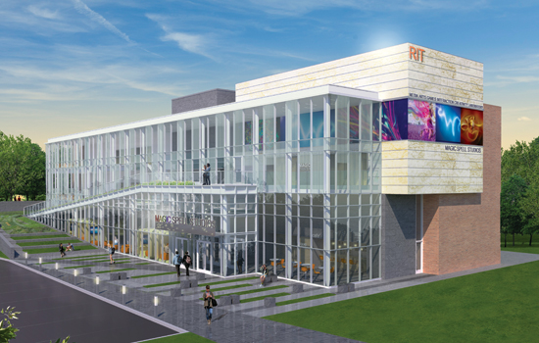

A FEW THOUGHTS ABOUT INNOVATION, STRUCTURE, PRACTICE, & MAKER CULTURE
MAGIC WELCOMES BUTLER/TILL
Andrew Phelps
Founding Director, RIT Center for Media, Arts, Games, Interaction & Creativity
Professor & Founder, School of Interactive Games & Media
CEO, MAGIC Spell Studios, LLC
Rochester Institute of Technology
andy@magic.rit.edu | @RITMAGIC | facebook.com/magicrit

Slide 2
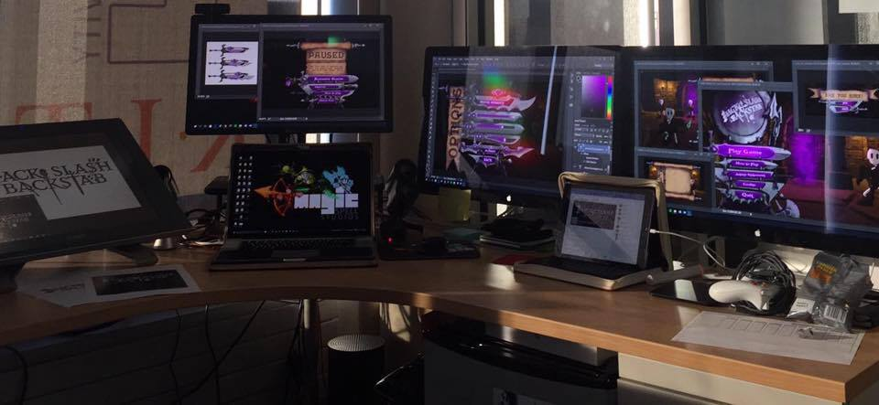
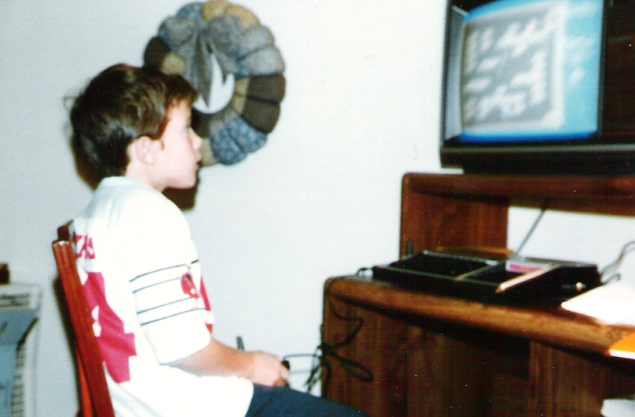
Hi, I’m andy. I make things.

Slide 3
WELCOME TO MAGIC. IT IS.

Slide 4
What Does MAGIC Do?
Mentors students and teams on leadership and production
Helps foster entrepreneurial efforts and incubates additional start-ups
Works with faculty/staff/students to refine ideas and seek funding
Co-Ops and Internships
Enables outlets for volunteer efforts and community service
Showcase (on campus, locally and national / international shows)
Serves as a 1st and 3rd party publisher to RIT students and faculty
[…and the list goes on]

Slide 5
What Does MAGIC Do?
Grant and Project Support
Research Infrastructure
Hiring students and staff
Basic supervision, account maintenance
Financial management
Corporate & Gov. Relations
Brainstorming and Market Analysis
Project Related Purchasing & Travel
Materials & Supplies
Branding & Press (aka “storytelling”)
Pilot Projects & Proposal Development
In-House Skunkworks and Ideation
[…and the list goes on]

Slide 6
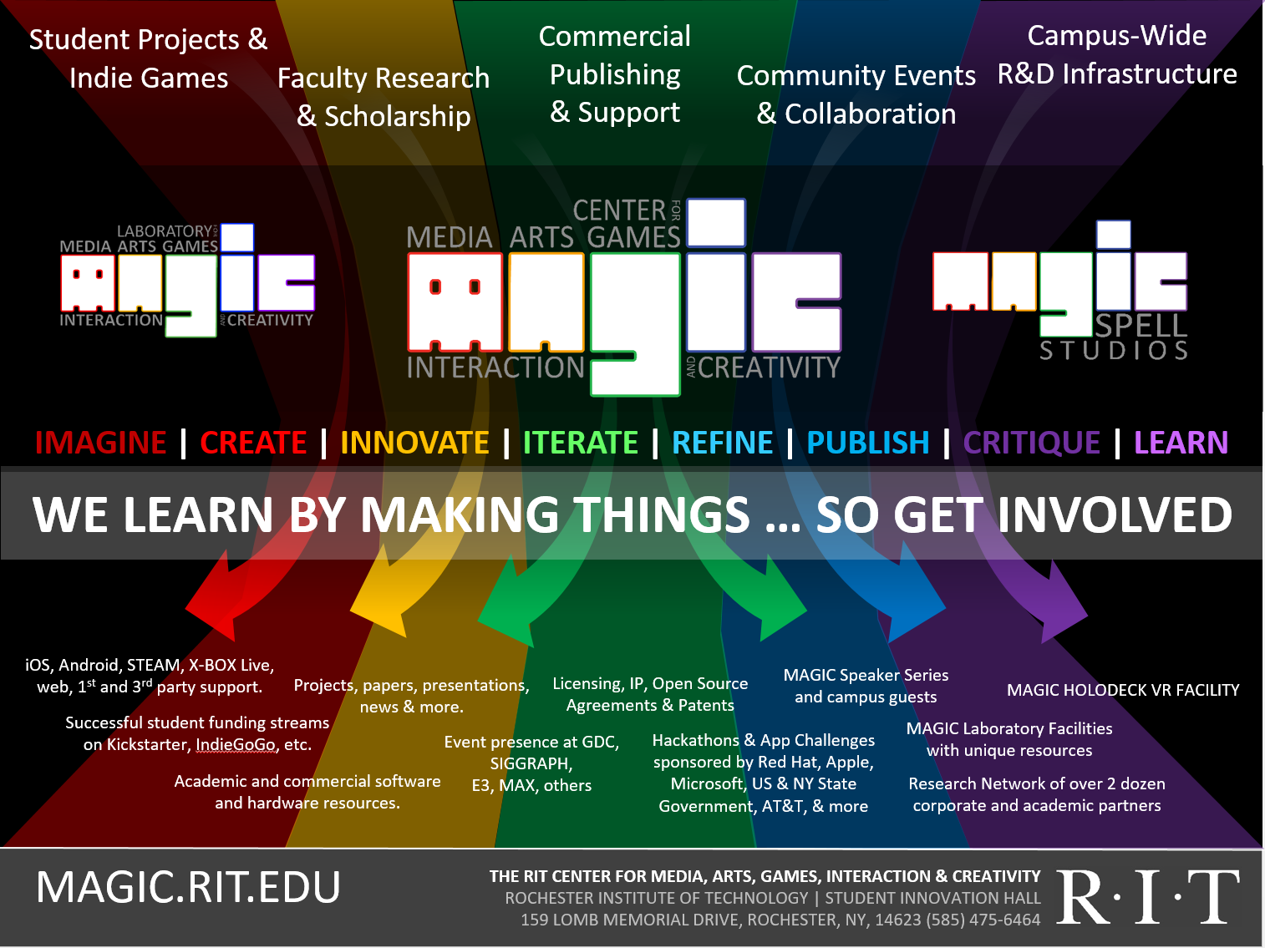

Slide 7
Which all boils down to:
MAKE STUFF.

Slide 8
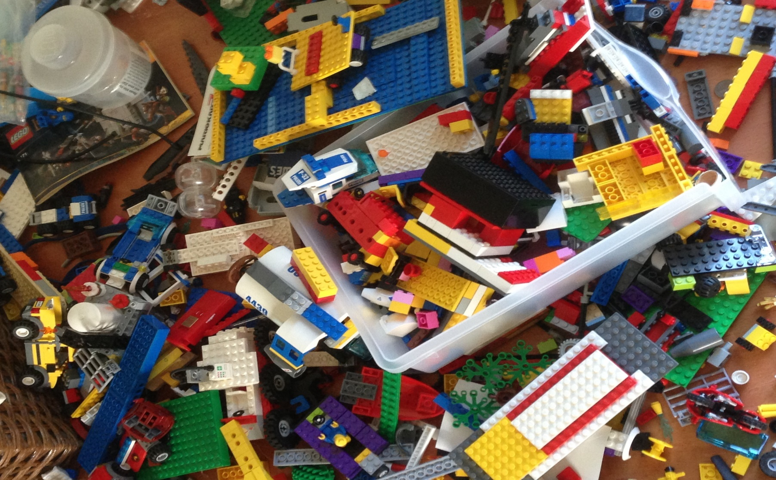
WE LEARN BY MAKING THINGS
'protecting “making as a mode of inquiry”’
-Ian Horswill, Northwestern

Slide 9
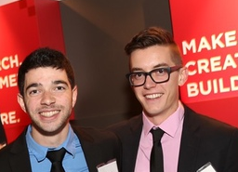
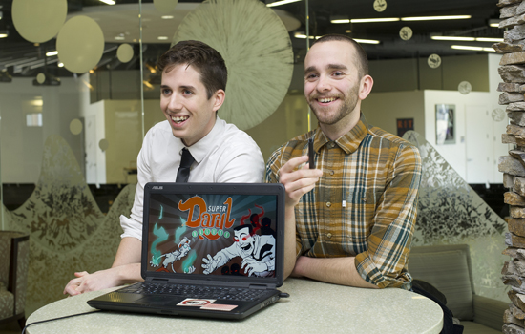
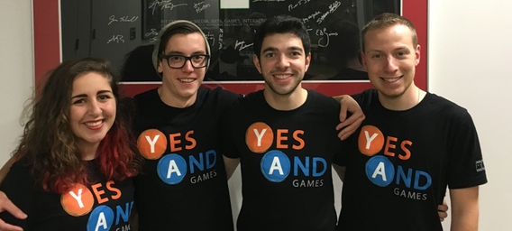
Helping students make things
Help students & faculty create things, get excited, and start businesses that make things.
They already WANT to do this.

Slide 10
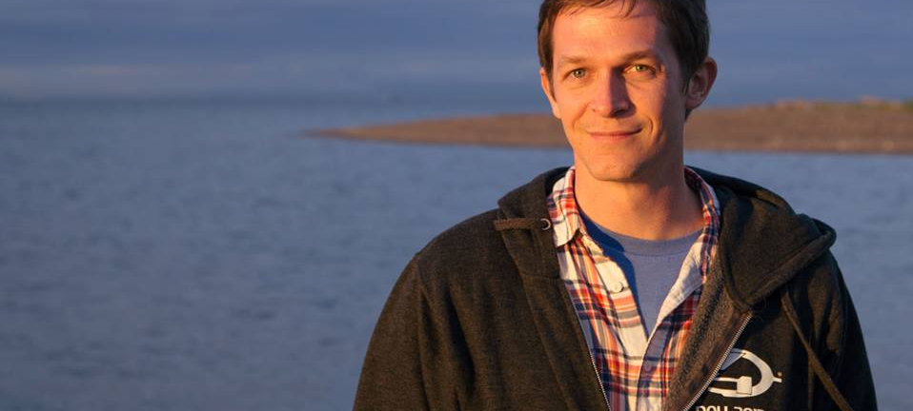


Alex makes Halo.
Alex makes one of the best selling and iconic games of all time.

Slide 11


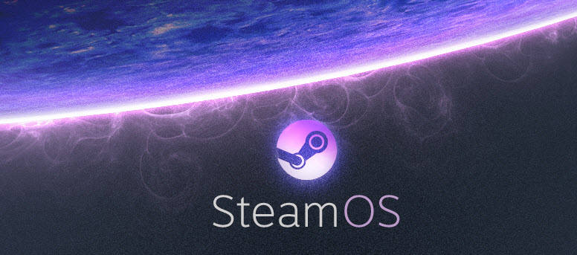

Anna: helps people make VR

Slide 12

Making our own things, to illustrate and learn

Slide 13


Slide 14
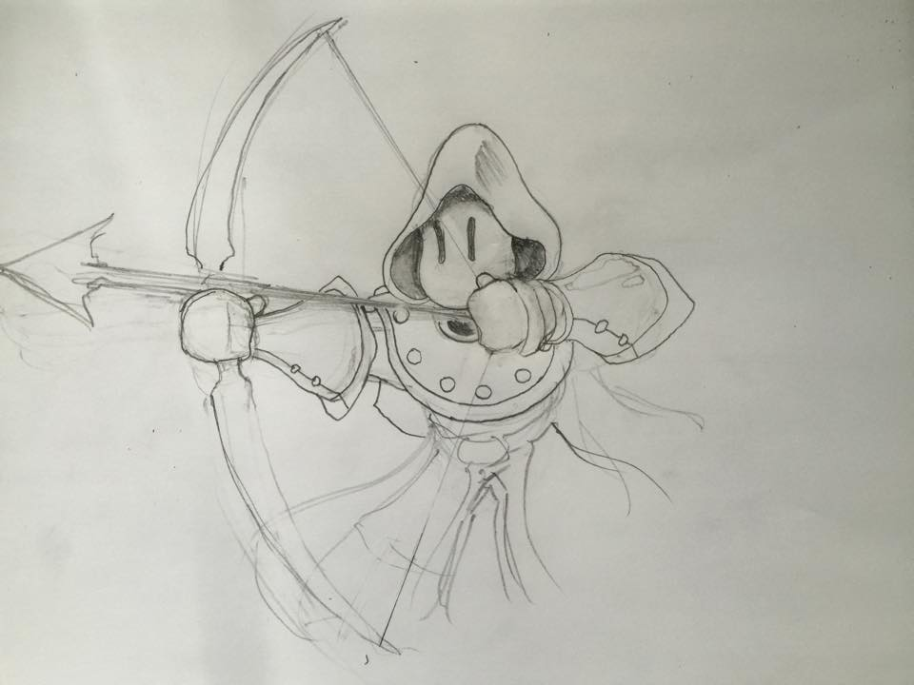
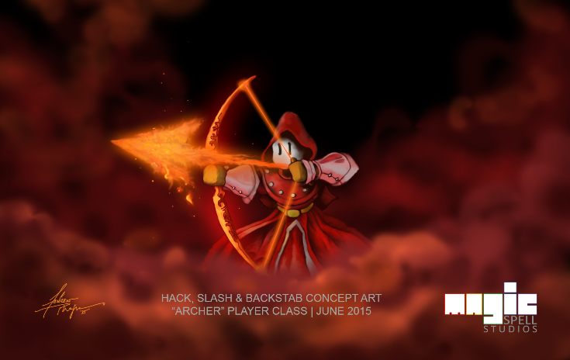
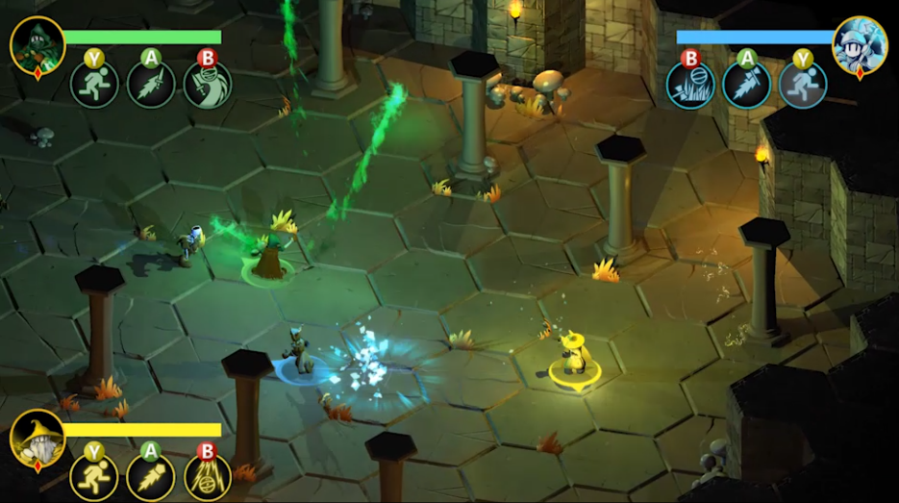
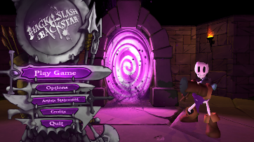
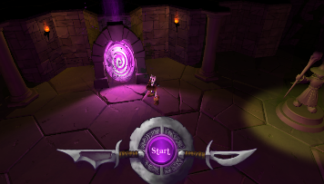
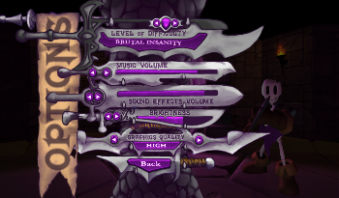
EXPERIENTIAL, PROCESS DRIVEN, CONSTRUCTIONIST
Everything is focused on work produced.
Nothing is taught as a “skills course” – everything is presented as “skills mastery”
Everything is team-based & multidisciplinary
This makes everything hard!

Slide 15
And it is very, VERY difficult
It’s expensive. (we’re helping in a variety of ways, but how to scale? And how do WE scale? How do we stay sane?)
It’s demanding. (it’s the 90/10 design rule, and we’re focused on the 10 as well as the 90)
It’s exhausting. (nothing works for a very long time, the ‘dark’ periods of development don’t fit a lot of current models for education or review)
It isn’t ‘how we do things’ (media is different and RIT is an engineering-centric campus, and this is a long, long game)
BUT IT IS FUN ☺

Slide 16
HOW ARE WE SET UP TO DO THIS, AND WHY?

Slide 17
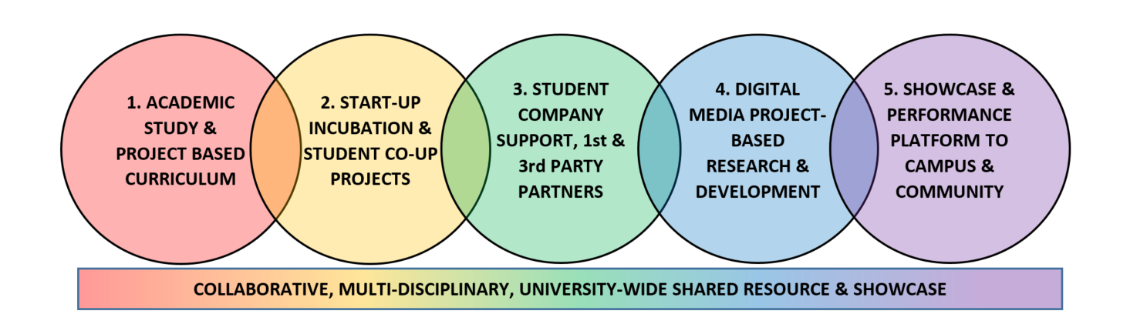
C O N V E R G E N CE

Slide 18
MAGIC IS:
a university-wide research center of excellence
a physical and virtual laboratory environment for creating and exploring digital media of all varieties
a commercial entity for publishing apps, games, software, and digital creations of all kinds
a brand that speaks to quality and commitment in supporting its constituents & partners
deeply aligned with new RIT strategic plan

Slide 19
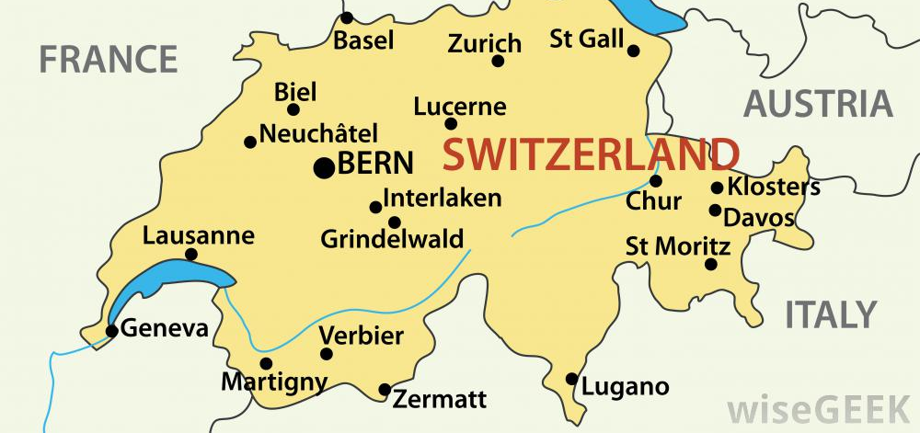
Magic is:
A free standing unit of the university that is outside of the colleges or institutes – no courses, no degrees, no curriculum.
A neutral ground for collaboration and partnership
A “research” organization: it falls within the office of the Vice President for Research, and was established by the President

Slide 20


A “NEW” KIND OF UNIVERSITY RESEARCH CENTER, LIKE NO OTHER ANYWHERE…
University
RESEARCH
Commercial
PRODUCTION

Slide 21
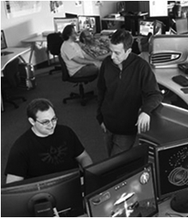
Lots of public success
FIRST graduate course in games at RIT
FIRST undergraduate course and concentration in game technology
FIRST degree program in the northeast in game design & development
FIRST School of Interactive Games and Media
FIRST ever of its kind public-private partnership in the MAGIC Center
FIRST university to ship on XBOX One / 1st party channel
Lots of other firsts wrapped up in there.
HUGE outsized effect on university brand and public engagement

Slide 22

Lots of private failure
We do things differently and that creates friction
We pride ourselves on different values and criteria than other portions of the organization - sometimes
What we think is important is often under-valued and unrecognized or under-appreciated
What we think is not important is often over-valued and incentivized in ways that break morale and engagement
We do not see our work as work. If we do, then we’ve failed. And this sometimes happens.
We are often afraid, often feel alone, often feel unsupported, and often feel adrift.
Angry birds is the 52nd game by that group. Fifty. Second. MAGIC is on its third reincarnation.

Slide 23
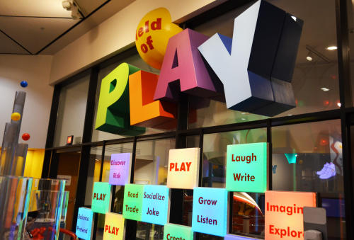
The importance of PLAY

Slide 24
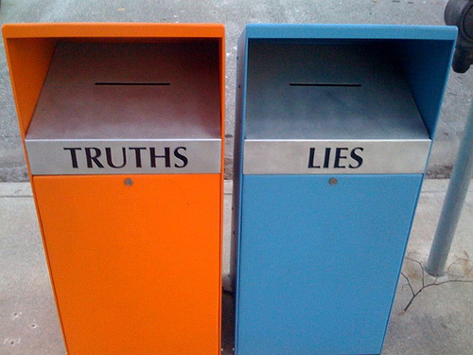
TODAY: 4 themes and a lie

Slide 25
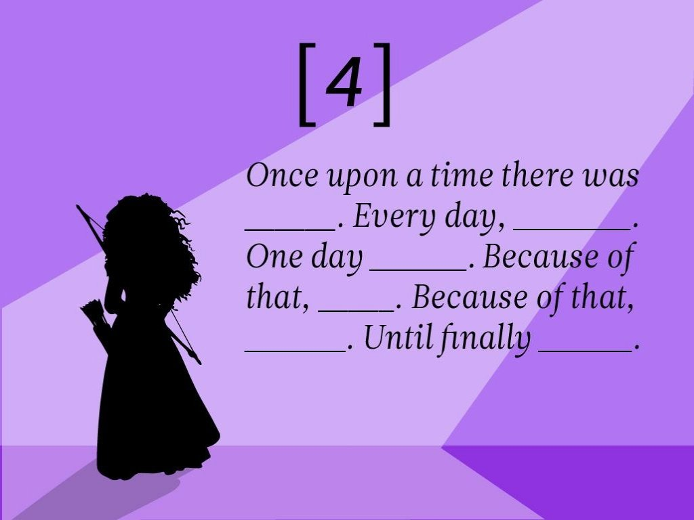

THEME 1: Belief, Identity, and Story

Slide 26

We got where we are by deciding what our story was, and then telling it over and over, internally and externally, before it was true.
We said it until it became true.
  “We are the best games program. We are excellent at this.”
  “What World Will You Create?”
  “We Learn by Making Things”
  “MAGIC is a unique part of the university, we learn by production and public engagement.”
  “Greatness through difference.”

Slide 27
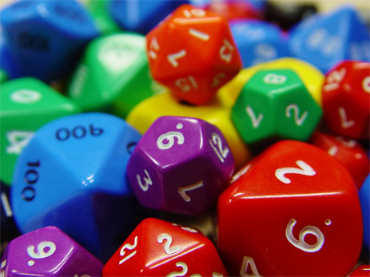
THEME 2: Expectation, Accountability, Respect, Risk, and Motivation

Slide 28
OPPORTUNITIES
Step outside the box, change the value proposition of the university
Take better advantage of existing resources
Incentivize collaboration and teamwork
Create economy of scale around specific target area (digital media)
Create distance from university brand proper (MAGIC Spell Studios), while engaging in risky or non-traditional activity
Explore new frontiers and projects not yet engaged in
Serve as role model for innovative efforts in other verticals

Slide 29

CHALLENGES
Challenge to existing structure / authority
Unknown (unknowable?) to entities outside creative unit
Threat to ‘what we do, here’ – where to fit on the board
Seen as consumer of limited resource
Seen as distraction from existing production
Seen as challenge to traditionalism
Doesn’t ‘play by the rules’ – so why should we?

Slide 30
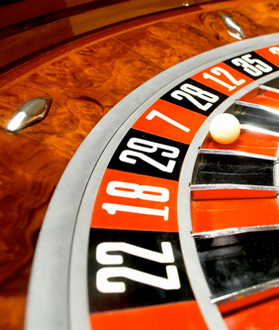
Games and the Assumption of Risk
Games of Skill, Games of Chance
Uncomfortable notion of random
Random Reward
Luck, Fortune and Fate
Notes:
Kevin Slavin and all his stuff and references

Slide 31

The M is for Messy

Slide 32
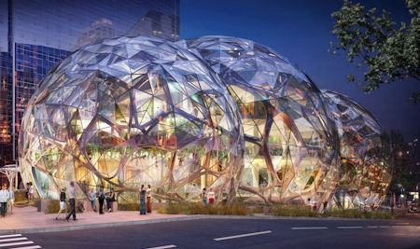
THEME 3: Intent, Purpose, and Structure

Slide 33
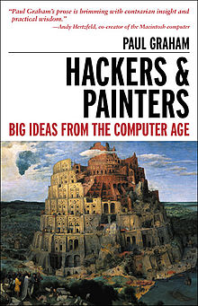
How to go about “doing innovation” structurally
Divide and conquer approach
Time slice approach
Constant integration approach
Timed collaboration approach
Swapped collaboration approach
Odd bedfellows approach
Fill the gaps approach

Slide 34
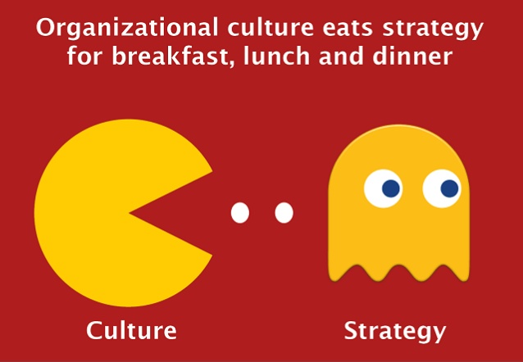
Tools and Techniques
Studio culture and open critique
Additional or competing or overlapping metrics and scales
Post-mortem dissection
No sacred cows, pets, or crosses
Communication & Culture

Slide 35

Requirements
Leadership must be about leading from every point and direction – not just top down, and not just bottom up. With the team.
Mission and vision must be clear and everyone in org knows it and is invested in it
Behaviors, including meetings and discussions and dialogs need to have working agreements and norms that are understood
Failing forward is an accepted norm of operation (that allows for leap-taking)
Accountability and responsibility with authority and capability in equal measure.
EMPATHY.

Slide 36
THEME 4: Rewards & Recognition
Gold. Star.

Slide 37

What is a ‘reward’
Intrinsic and extrinsic reward, motivation breakdown, and the myth of chocolate covered broccoli
Teamwork and usual its fallacies
The “story” of annual reviews
What if everyone actually did a great job? What if everyone utterly failed? What constitutes “success”?
What are the real metrics of value to the organization and why?
On what timescale are rewards recognized and achieved, and is that in line with organizational planning?

Slide 38

The differences of regulations, rules, rituals, traditions, and practices

Slide 39

THE LIE: “The Innovation University”

Slide 40
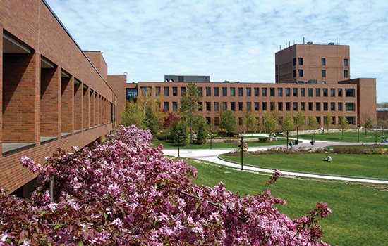
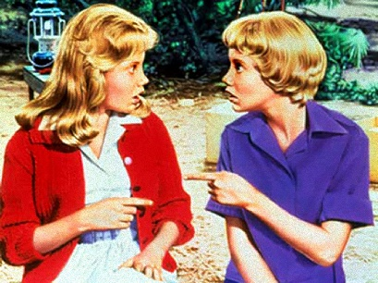
I mean, let’s be honest…
Universities are not particularly innovative – little bits of them are. Sometimes. Maybe. Even research models are failing.
In fact, a lot is being written right now about how un-innovative we are. We are in many ways failing the public trust.
And ‘where’ do we need to innovate. What does it look like? What is progressive? What role does traditionalism play as a normalizing factor?
What problem are we trying to solve?!?
(HALEY MILLS & THE ASSESSMENT TRAP)

Slide 41
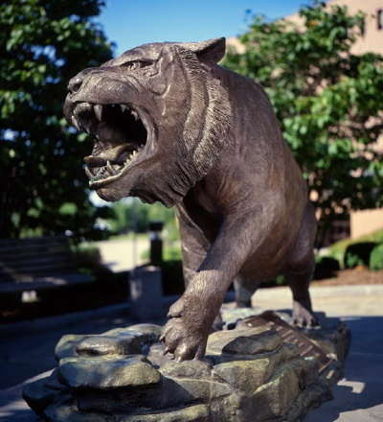
And yet
This university continues to better itself, in ways that are uniquely different from the status quo
In large part, our largest and most visible successes are in areas that are considered ‘unique’
MAGIC continues to grow and scale, with a focus that is continually dialed on things we’ve never done before (with trails of institutionalization)

Slide 42
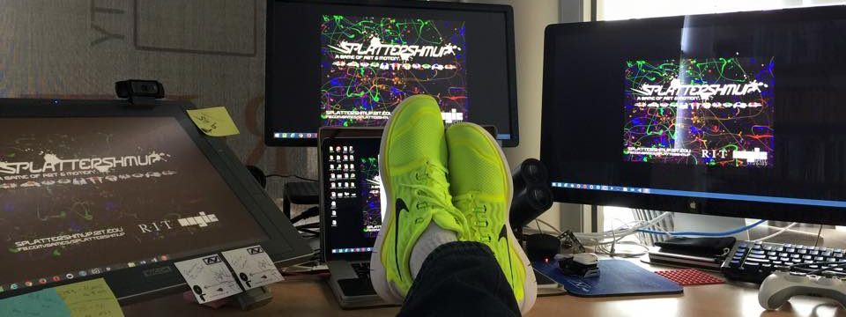
Thanks & Questions
andy@magic.rit.edu | magic.rit.edu | @ritmagic

Slide 43
Theme: Structures & Roles
Questions: Think about your current role and work tasks, how can you incorporate innovative thinking into your work?
Theme: expectations and risk
Questions: How comfortable are you with risk, specifically at work? What does a risk feel like for you? What are you afraid of/what is holding you back? How do you define success? Failure?
Theme: belief, identity, story
Questions: why do you think that Butler/Till has prioritized “building a culture of innovation”? How do you (can you) contribute to this culture?
Theme: rewards & recognition
Questions: If innovation was celebrated, what would it look like? What would it feel like? How do you want to be rewarded? How do you want to reward others?

