Slide 1





Whose vibe is it anyway?
Negotiating Definitions of Cozy Games
Big Island, Hawaii, USA | January 2025 | HICSS 58
Hawaiian International Conference on Systems Science

Slide 2




Kelly Boudreau
Associate Professor of Interactive Media Theory & Design
Harrisburg University of Science & Technology, Harrisburg, PA, USA
Mia Consalvo
Professor of Communication Studies
Canada Research Chair for Games Studies & Design
Director, Technoculture, Art & Games (TAG)
Concordia University, Montreal, Quebec, CAN
Andrew Phelps
Professor of Film & Media Arts, American University, Washington, DC, USA
Visiting Professor, Uppsala University, Gotland, Sweden
Director, American University Game Center
President, Higher Education Video Game Alliance

Slide 3
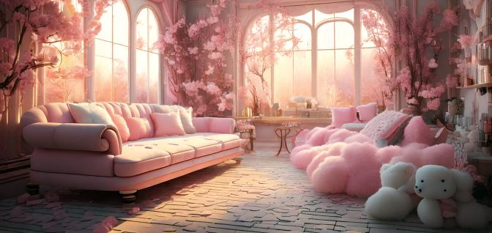
What is a cozy game …

Slide 4

… and who gets to decide?

Slide 5
Untangling conflicting discourses between:
1) Game designers and developers (+ some input from games academics)
2) Games/Mainstream Media
3) Players

Slide 6
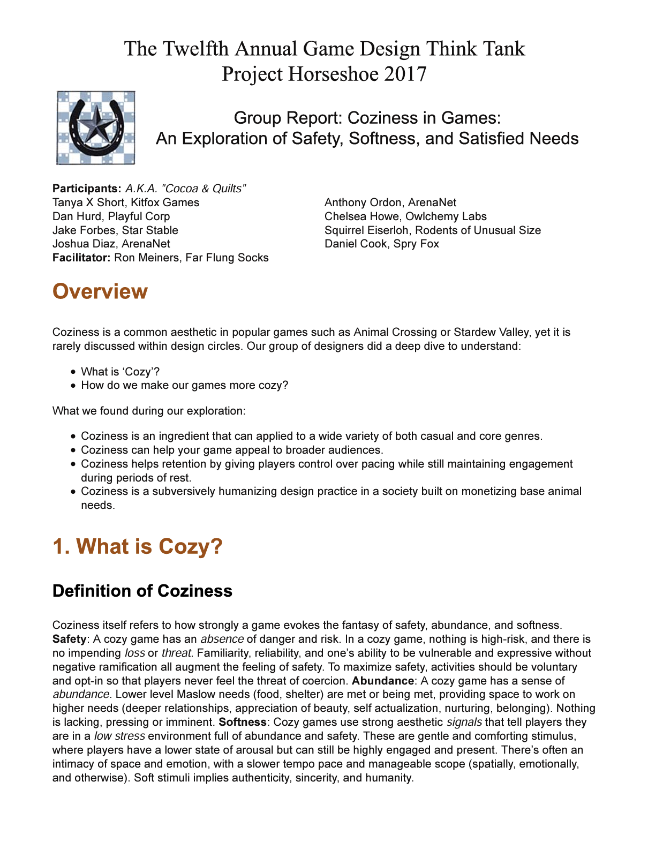
Three areas for examination
1) Game developers and academics’ working definitions of what constitutes a cozy game
  Primarily through the genre-defining Project Horseshoe Whitepaper
2) Media discussions of cozy games in 16 outlets including Polygon, Games Radar, PC Gamer, Washington Post & Rolling Stone
3) High profile TikTok content creators who post about #cozygames

Slide 7
Designing and Developing Cozy Games

Slide 8
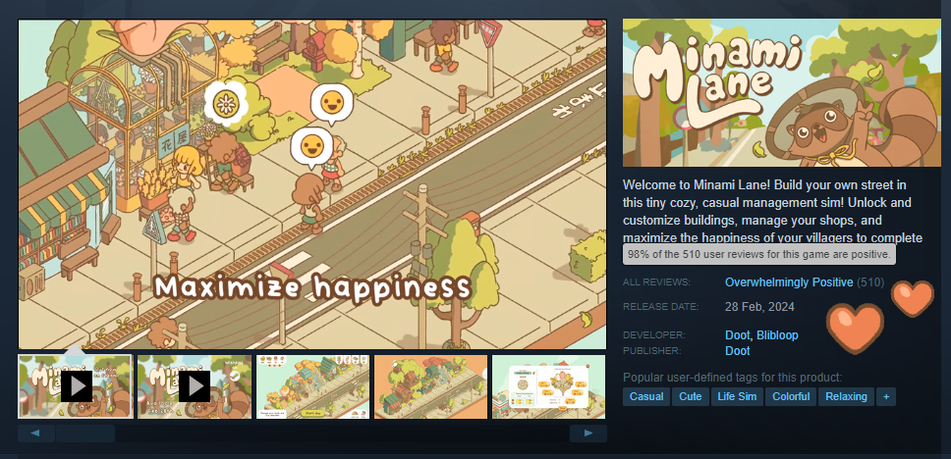
Features of cozy games: 1) aesthetics
Soft in color, tone and textures
  Mostly lighter colors, with some dark tones now appearing
Audio
  Continuous, soft, non-intrusive
  Ambient and gentle
  Create a sense of intimacy with game environment

Slide 9
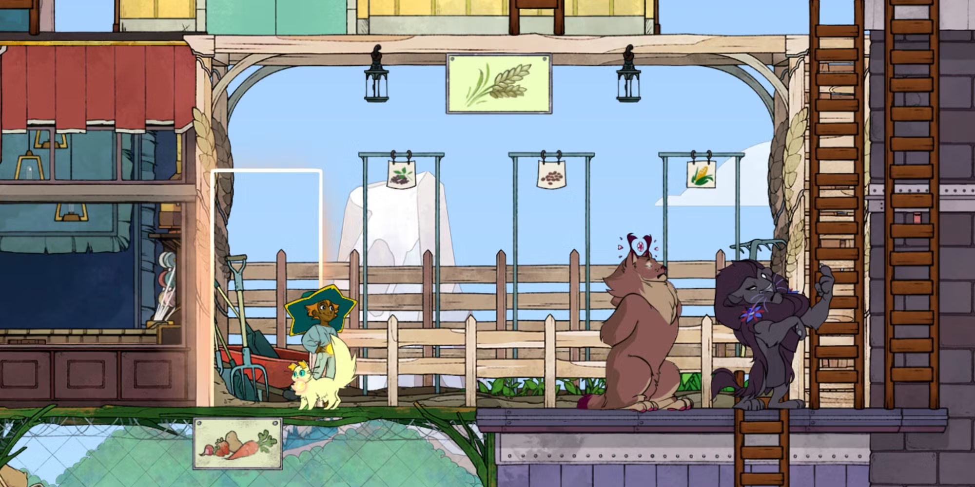
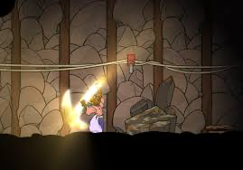
Features of cozy games: 2) safety
Low-risk, possibly low-demand, tasks
  Failure is either not an option or has few if any consequences
Abundance
  Resources are not in short supply, can be gained without exceptional effort required

Slide 10
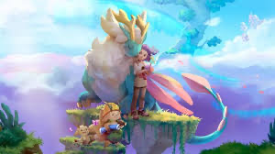
Features of cozy games: 3) connectedness
Social connectedness
  Aiding in-game characters in a variety of ways
World connectedness
  The player can build, expand, tend the land and creatures
Creates a sense of ownership and belonging
Grow, Song of the Evertree

Slide 11

Features of cozy games 4) energy requirements
Relating to safety, tasks should be low stress or stress-free

Slide 12
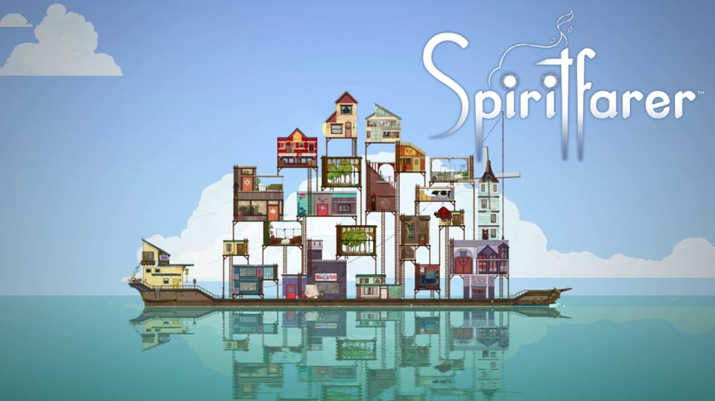

Features of cozy games 5) pacing
Often deliberately slow to allow for player contemplation, consideration, reflection

Slide 13
Games and Mainstream Media’s Construction of Cozy Games

Slide 14
A definitional/relational bridge to the wider public
(Remember how they talked about social games like Farmville?)

Slide 15
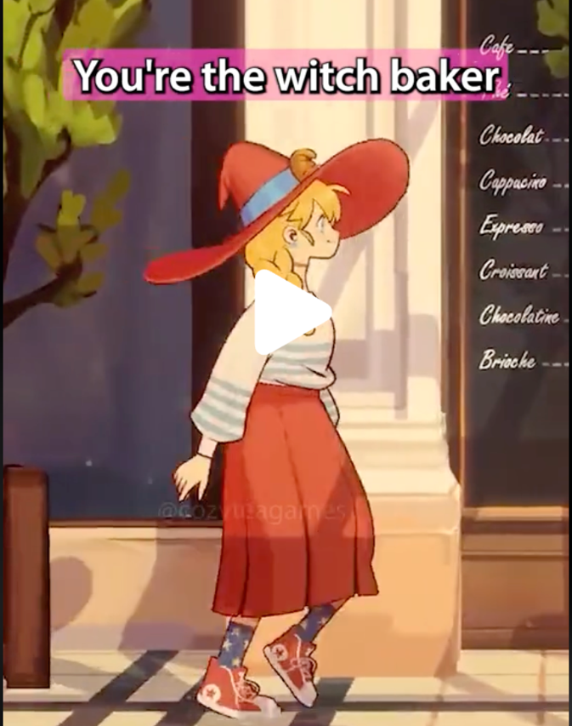
Most common element found: “stress free”
Debunking idea that all games are violent and/or competitive
Correlates with core design element of “low stakes/risk”
Offer a respite from daily (stressed!) life
  They “provide players with the perfect escape and replication of life”
Figure 2. Screenshot of gameplay from A Witch’s Bakery, cozyteagames’ video. Taken by authors, June 14, 2024.

Slide 16
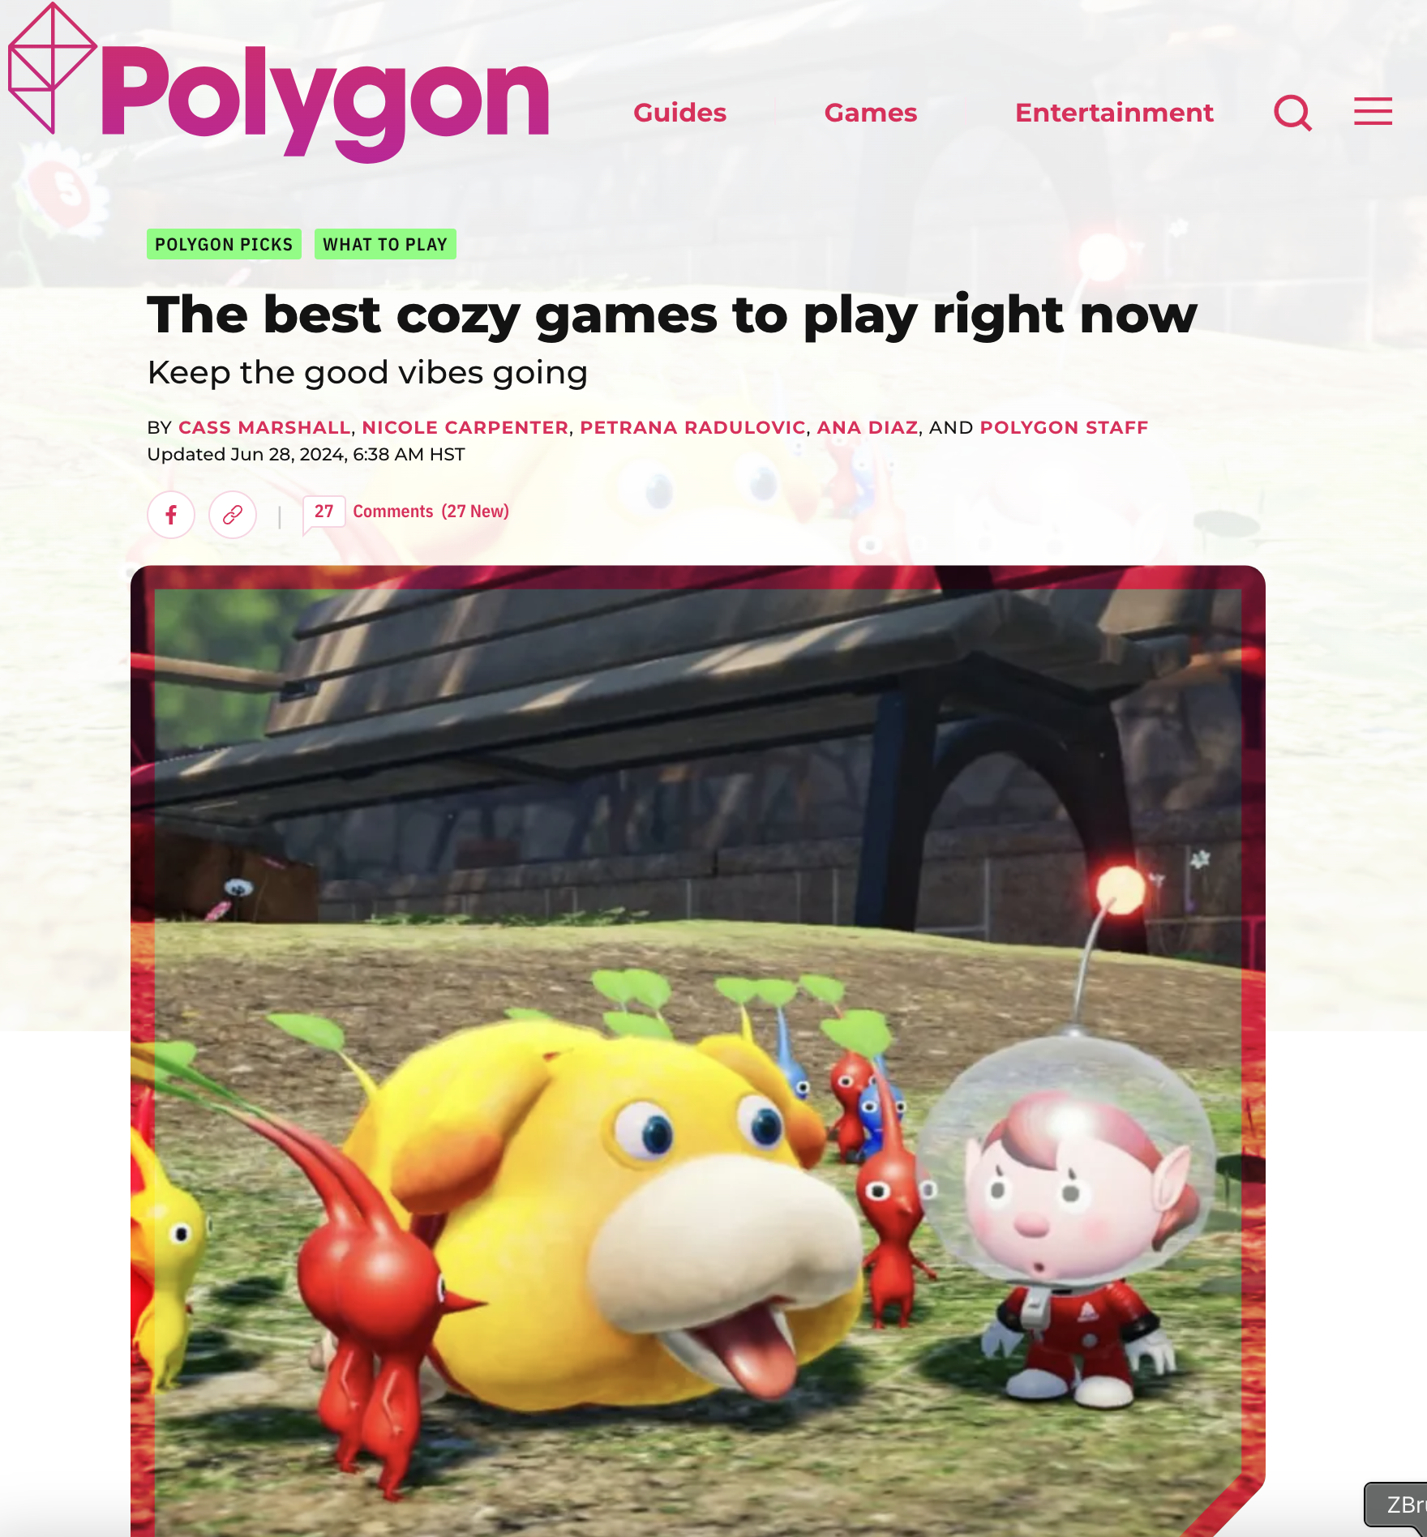
Beyond the definition: they are worth your time
Helping your mental health
Provide space for comfort and self-reflection
Require emotional engagement (not of the adrenaline type)
And, importantly, “playing cozy games doesn’t make you less of a gamer”

Slide 17
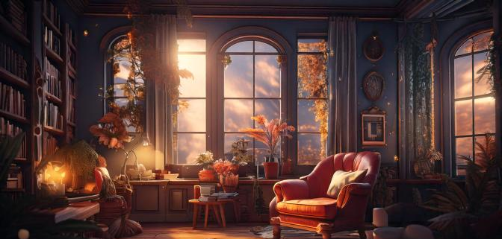
Reminder alert! Cozy is a vibe!

Slide 18
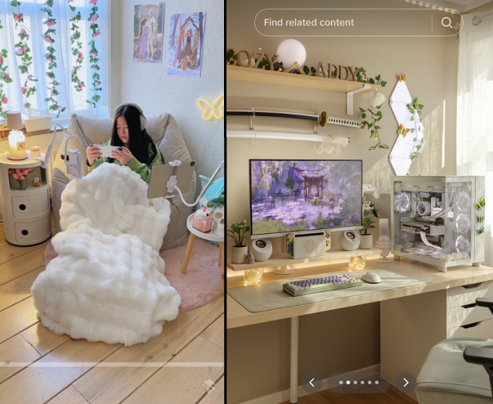
TikTok + #cozygames
Ultra high-end PC Gaming rig, but in clear, pink, purple, & white!
Figure 4. On the left, XiXi_playing in her cozy nook. On the right, a gaming setup belonging to cozyaddy_. Screenshots by authors.

Slide 19
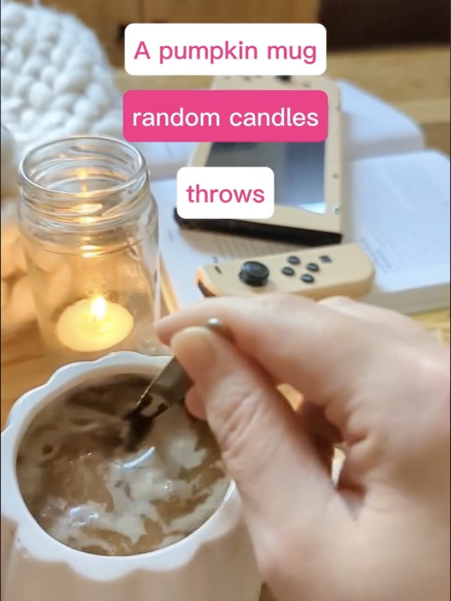
Would you like some tea with your cozy game?
Figure 3: Shot from hercozygaming video showing stereotypical items cozy gamers have in their home. Author screenshot.

Slide 20
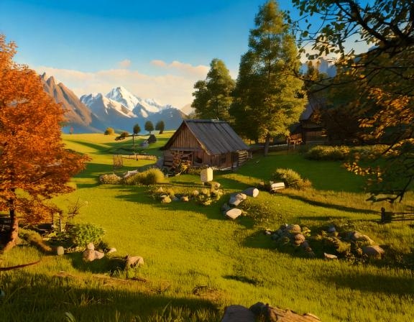
Majority in alignment with designer elements of cozy games
1) Wholesome, lighthearted, carefree, rejuvenating (hercozygaming)
2) No combat, just crafting and building (gemzape)
3) Comfort, relaxation and warmth (gamergirlgale)

Slide 21
Yet…

Slide 22
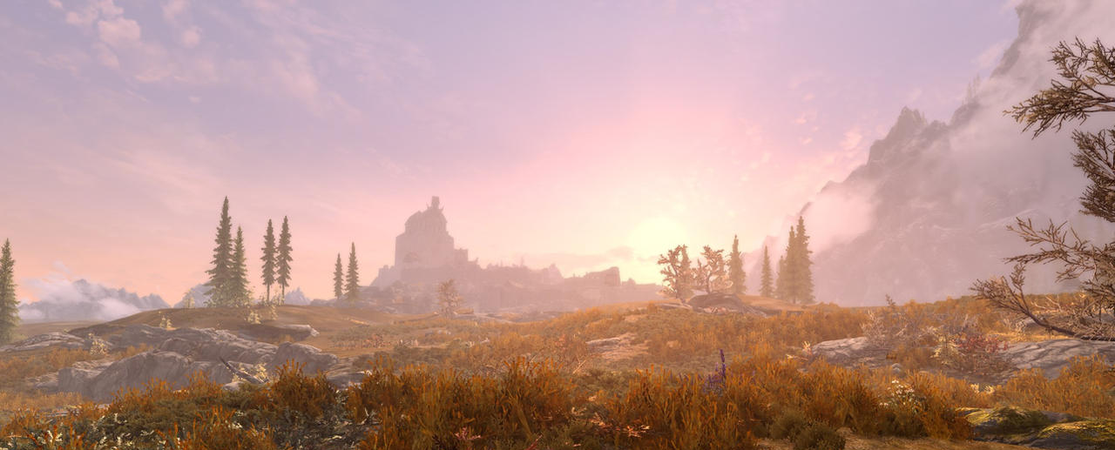
“skyrim is the og cozy game”
Screen capture from DeviantArt user “forestvoid24”
https://www.deviantart.com/forestvoid24/art/Skyrim-screenshot-2-905665911

Slide 23
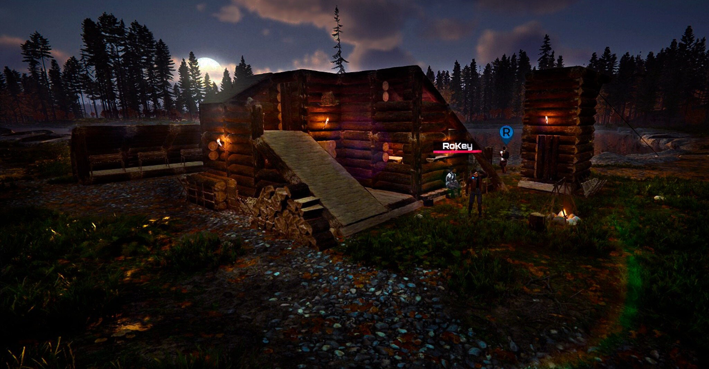
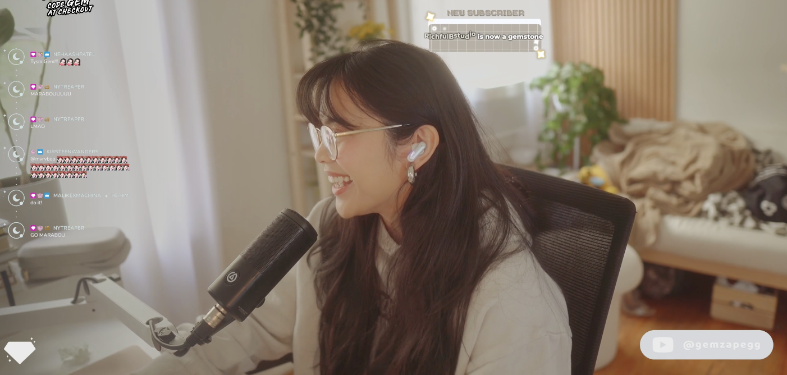
Survival horror game Sons of the Forest is ‘morbid and horrific’ but a favorite cozy game of gemzape.

Slide 24
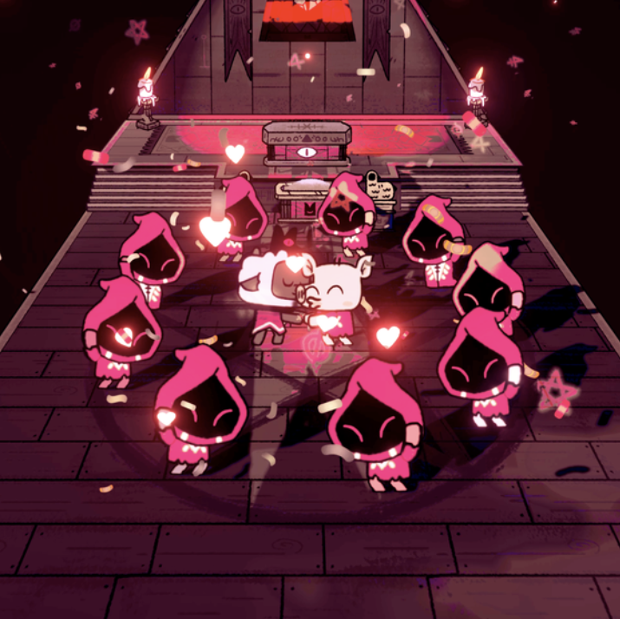
Return of the vibe

Slide 25
As per Wasziewicz and Bakun (2020) coziness may be ‘situational’ where it is “a singular sequence rather than the entire game”

Slide 26
+ cozy content (outside gameplay itself)
Room décor
Self-presentation

Slide 27

Room decor
Plants
Pumpkin mug
Candles
Throw pillows, blankets
Tea or other warm beverage

Slide 28
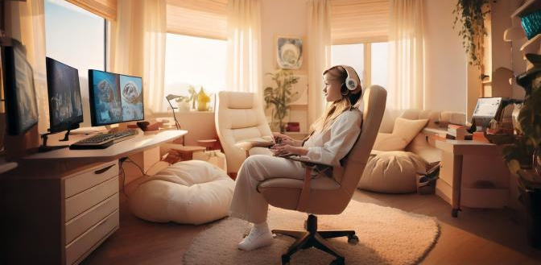
Room décor x2
Specific color palettes
  White, cream, beige, taupe, other neutrals in the majority of spaces
  Highly curated and organized
  Little clutter
  Warm lighting
  Soft furniture
    Bean bags
    Chaise
  Clacky keyboard

Slide 29

Self-presentation
Cozy clothes
  Oversized sweats, sweaters
  Big socks
  Robe
  Soft fabrics
Feminine self
  Makeup
  Manicured nails
  Curled up under blanket, resting

Slide 30
Design Principles | Design Elements
Aesthetics | Visually Soft (warm colors, soft shapes)
 | Comforting
 | Relaxing (soothing, calm audio – ambient and diegetic)
 | Familiar
Safety | Low risk situations
 | Absence of fight or flight moments / Stress-Free
Abundance | Resources
 | Time
Low stakes | Consequences are not detrimental to progress
Connectedness | Social (in/out of game)
 | With the gameworld
Growth | Expansion of space,
 | Tending to /caring for things (animals, friends, crops, etc.),
Access | Low-barrier to entry regarding player-skill/required knowledge
 | Access to space, zones, etc., do not require significant effort
Progression | Player-centric/driven
 | Lack of pressure
 | Intrinsically Rewarding
Pacing | Deliberate slowness
 | Space for reflection / contemplation
 | Opportunities for immersion through repetition of tasks

Slide 31
Conclusion
Much overlap in definitions, but important divergences
  Why Skyrim, BG3?
  Cozy horror?
  Overlap with cozy books, cozy clothes, rooms
Is the “vibe” overtaking “genre” as a way to understand gameplay?
How will cozy gaming continue to evolve?
  In how developers create such games
  In how the media talks about those games
  In how players situate those games

Slide 32

THANKS & QUESTIONS
KELLY BOUDREAU kboudreau@harrisburg.edu
MIA CONSALVO mia.consalvo@concordia.ca
ANDY PHELPS andymphelps@gmail.com
(all AI generated images “from” Adobe® Firefly)

