Slide 1


Fame! I wanna stream forever:
Analysis and critique of successful streamers’ advice to the next generation
Maui, Hawaii, USA | January 2023 | HICSS 56
Hawaii International Conference on Systems Science

Slide 2


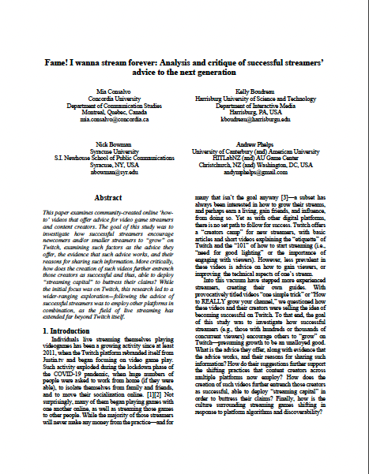
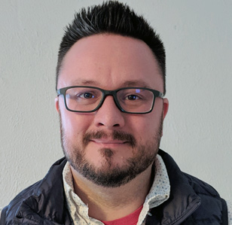

Mia Consalvo
Professor of Communication Studies
Canada Research Chair for Games Studies & Design
Concordia University, Montreal, Quebec, CAN
Kelly Boudreau
Associate Professor of Interactive Media Theory & Design
Harrisburg University of Science & Technology, Harrisburg, PA, USA
Nick Bowman
Associate Professor of Communication
Syracuse University, Syracuse, NY, USA
Andrew Phelps
Professor of Human Interface Technology, University of Canterbury, Christchurch, NZ
Professor of Film & Media Arts, Professor of Computer Science, American University, Washington, DC, USA
Visiting Professor, Uppsala University, Gotland, Sweden
Director, American University Game Center
President, Higher Education Video Game Alliance

Slide 3

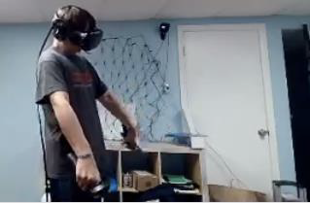
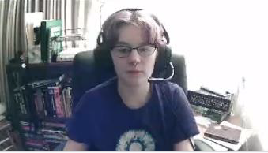
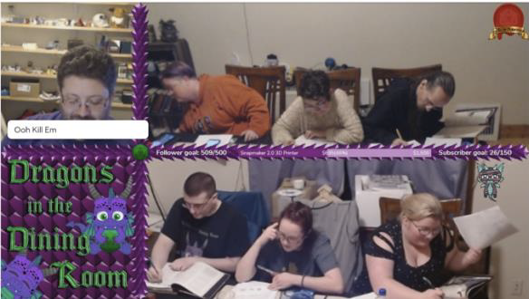
Last year (not “at”) at HICSS…
We presented on some streaming research in a small study that looked at ‘microstreamers’ entitled “Shared Spaces as Authenticity: Exploring the Connectedness of the Physical Environments of Microstreamers and their Audience.”
This got us interested in how small streamers think about success, and then what BIG streamers think small streamers need to do to be ‘successful’...

Slide 4
Research Questions

Slide 5
Research Questions
RQ1: What advice do top-ranked videos offer for streamers on how to be “more successful” on Twitch?
  How does that advice differ from Twitch’s official advice for how to be successful on the platform?
RQ2: What streamer capital, if any, do successful streamers deploy in order to convince others to take their advice?
  How did the rhetoric of authenticity fit this framework?

Slide 6
Methods
What did we do to try and answer these questions?

Slide 7
Methods: What did we do?
On YouTube, we searched for tutorial videos using relevant key phrases like ‘how to be a bigger streamer’ or ‘how to gain followers on witch’ (we did NOT focus on live streaming of other content)
Given the streaming explosion during the pandemic, we focused on more recent videos, but also wanted to see if advice changed pre-post 2020, so we limited searches to videos 2019-2022
Allowed the YouTube algorithm to aid in selection process
Excluded videos with less than 20k views
Examined videos that were specifically aimed at ‘smaller streamers’ or ‘new streamers’

Slide 8
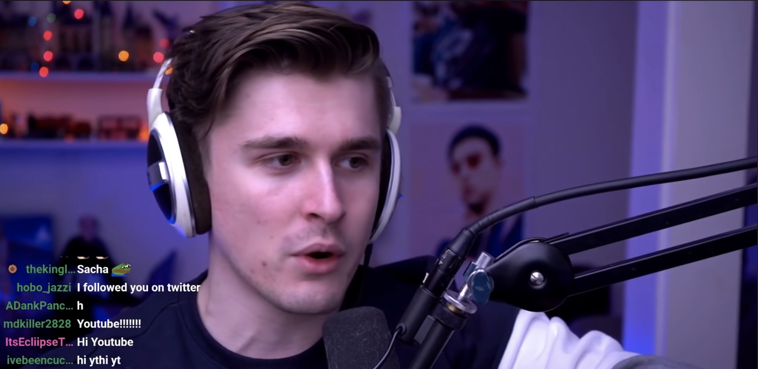
Methods: So, we watched a lot of videos…

Slide 9
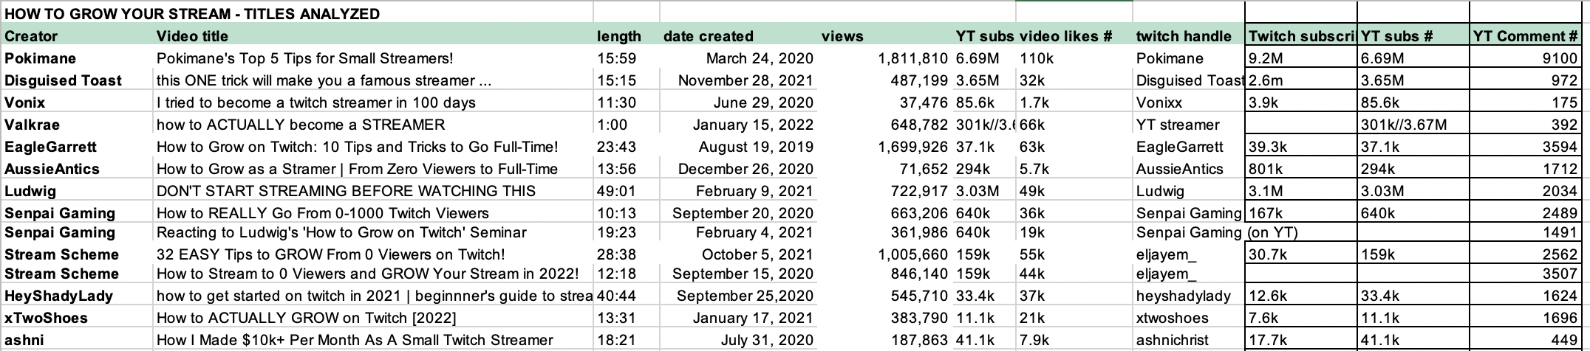
Methods: and we examined their similarities & differences…

Slide 10
Methods: and we examined their similarities & differences…
Ultimately, we selected 14 videos for deeper analysis by 12 different content creators
Of those 12, four presented as women and eight as men, representing both the breakdown of Twitch streamers generally as well as who are the most popular/lucrative streamers.
All videos were made between August 19, 2019 and January 15, 2022, however, the majority were either released in 2020 (7) or 2021 (5).
Videos were limited to examples that featured English-speaking streamers. Additional demographics such as LGBTQ+ status, race, and geographic or cultural background of the streamer were not explored, although this is a compelling area for further study.

Slide 11
Methods: and we examined their similarities & differences…
What advice is being offered?
  What evidence (if any) is given to justify the advice?
  What means of persuasion/rhetorical devices are used?
What justification is offered for making the video?
How are viewers / viewing community / chat discussed?
  How is the social aspect of streaming conceptualized?
Who is the presumed audience for the video?

Slide 12
Data Analysis & Results

Slide 13
Why Make These Tutorial Videos Anyway?
What are these mega streamers hoping to accomplish?

Slide 14
Why do streamers make these videos?
Viewers (streamers) ask them for advice
They see bad or dated advice out there
It’s good business for them to offer advice
These all tie to notions of authenticity and “streamer capital”

Slide 15
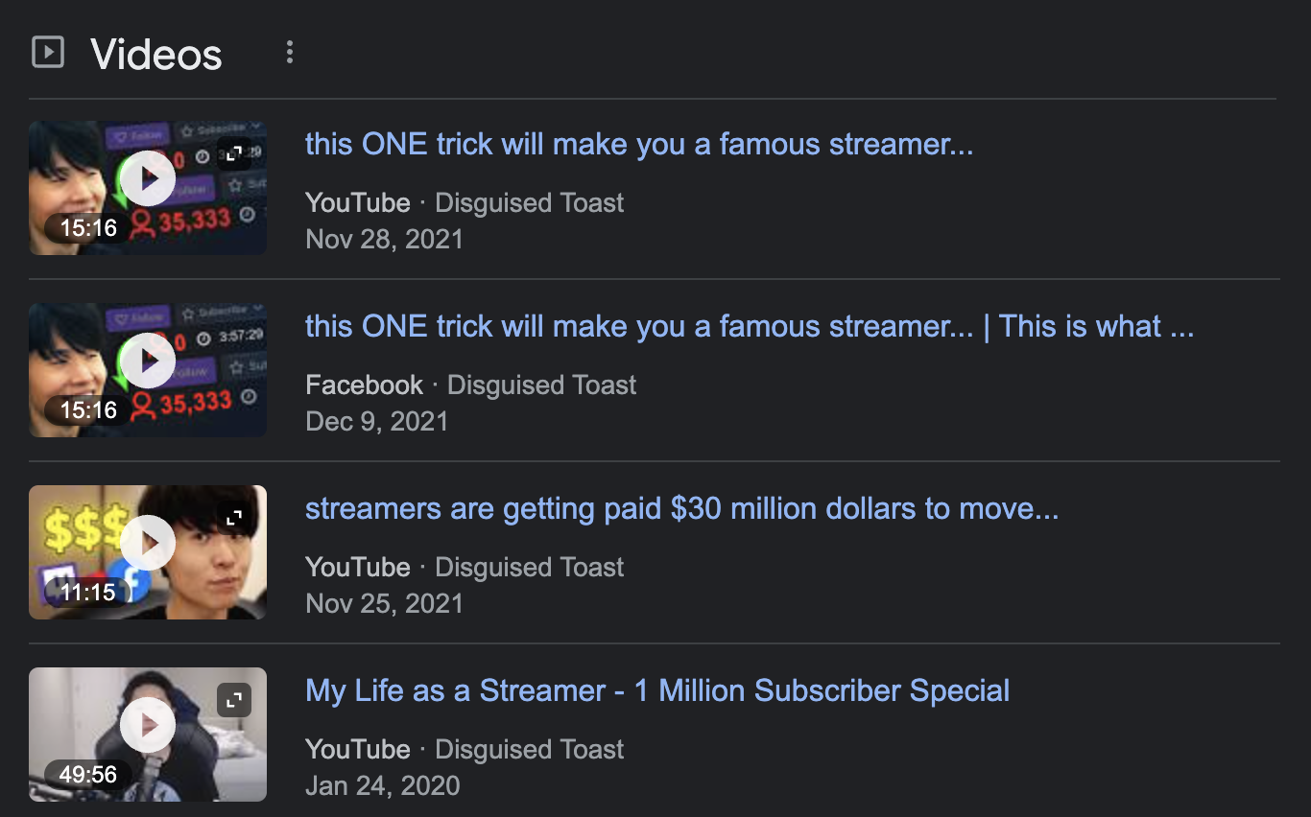
Example: Disguised Toast
He claims that he’s “seen a lot of videos and guides and threads” for how to do this, but there is one problem with them: “they are all written by very irrelevant individuals.”
Disguised Toast has 2.6 million followers on Twitch, suggesting that his advice would therefore be more relevant than anyone else’s.

Slide 16
How to be a More Successful Streamer
What do they actually tell you to do?

Slide 17
How to be more more successful
Category 1: Nuts & Bolts Issues
  Combatting lag
  Microphone and technical/software setup
  Naming and tagging strategies
  Avoiding crass self-promotion tactics
  Setting a schedule and sticking to it consistently

Slide 18
How to be more more successful
Category 2: Sociality as the Key to Success
  Often begins with friends and family or other social networks
  Audiences tend to support smaller streamers more generously (note the irony here)
  Bifurcation between ‘followers as friends’ and ‘followers as financial gain’
  Exacerbated by growth as a topic
  People become products that add value to one’s stream
  NOTE: Less consistent advice here amongst the videos, but this was a consistent topic even if strategy varied

Slide 19
How to be more successful
Category 3: The New Twitch Meta
  Cross-platform work
  Increasing collapse between marketing, content creation
  It’s hard work, takes years, but MY advice will work

Slide 20
Streamer Capital
How do we know these are the right people to listen to?

Slide 21
Markers of Streamer Capital
Subscriber count, views, and likes
Audience Response
Frequency & Longevity
(and $$$, of course)

Slide 22
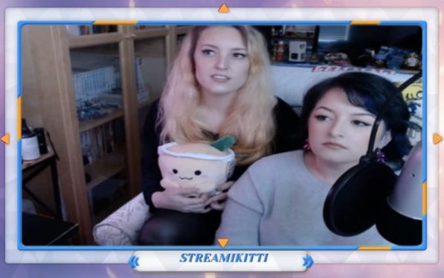

And Yet, Microstreamers…
Disguised Toast (and others) describe microstreamers through a rhetoric of failure – focusing on discoverability and boring content
Yet our prior work would indicate they are very satisfied and ‘happy’ with some of these smaller streaming communities
Twitch itself recently removed the ability to search the ‘Just Chatting’ area, and seems uninterested in this long-tail of smaller streamers
This is all in contrast to the notions of perpetual growth, content aggregation, and the idea that ”streams with large viewer counts have better content” (a quote from Disguised Toast)

Slide 23
Conclusions
The field that comprises live streaming of games has expanded from platforms such as Twitch or YouTube Live to encompass Twitter, Instagram, YouTube and Discord servers—the role of social media has become essential
We witness large/successful streamers strategizing how to maintain their position—with one way being acceding to viewer requests to explain their success, boiled down to a formula.
This also results in the collapse of content and marketing, ensuring all content is marketing material, and all marketing is entertaining content.
Video creators trade in streaming capital as part of their work, both demonstrating it and gaining it

Slide 24
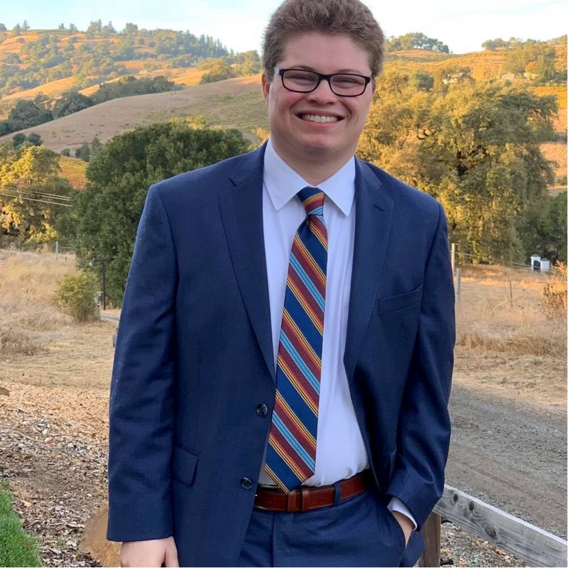
Acknowledgements
The authors would like to thank Samuel Smyth, graduate assistant at the AU Game Center, for his aid with data collection and preliminary analysis.

Slide 25

THANKS & QUESTIONS
MIA CONSALVO @miaC | mia.consalvo@concordia.ca
KELLY BOUDREAU @velixious | kboudreau@harrisburg.edu
NICK BOWMAN @bowmanspartan | nbowman@syr.edu
ANDY PHELPS @andymphelps | andymphelps@gmail.com

