Slide 1




GAMES of the SOUL
EXPLORING A DESIGN FRAMEWORK FOR CREATING EXISTENTIAL, TRANSFORMATIVE GAMES
FUTURE and REALITY of GAMING [FR0G] VIENNA | KEYNOTE PRESENTATION 2020
Doris C. Rusch, Ph.D.
Associate Professor/Senior Lecturer of Game Design, Uppsala University
Deputy Head of Department of Game Design
Uppsala University, Gotland, Sweden
Andrew M. Phelps
Professor of Human Interface Technology, College of Engineering, University of Canterbury, NZ
Professor of Media Arts & Sciences, School of Communication, American University, USA
Professor of Computer Science, College of Arts & Sciences, American University, USA
Director, American University Game Lab
President, Higher Education Video Game Alliance

Slide 2
Today’s Talk
Part 0: Background, history, and framing: How did we arrive at this work?
Part 1: Existential Theming
Part 2: Myth and Ritual
Part 3: Experiential Play
DESIGN SPACE MAP
Conclusions & Questions

Slide 3
PART 0
Background, history, and framing: How did we arrive at this work?

Slide 4


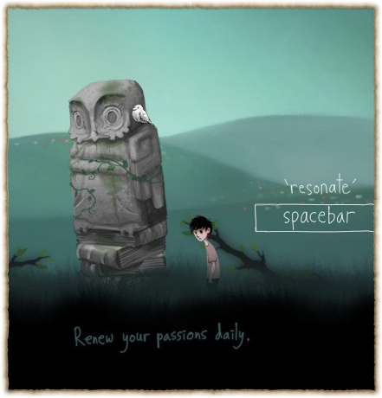
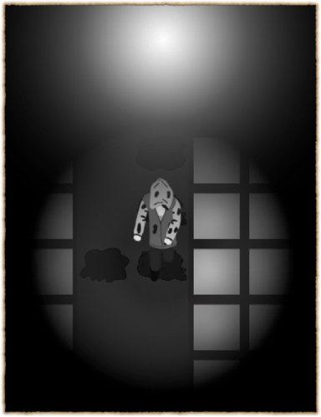

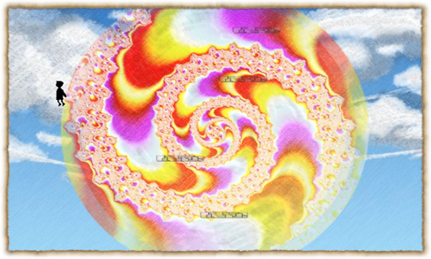
http://fortherecords.org

Slide 5





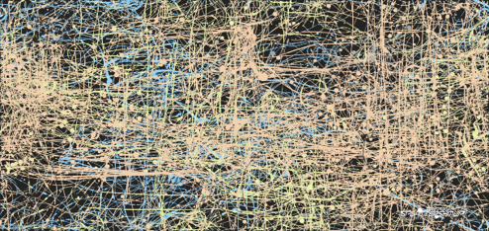

Slide 6


Notes:
this landed me in the games 4 health and games 4 change space. That seemed to work out well for a while, because there was so much interest for games that could promote some kind of growth - but what disturbed me was the idea that games could be a cure. That they could be therapy. And by requiring them to be therapy, they needed to prove they “worked”. Which is a really reductionist view on the human experience and personal transformation.
I had an identity crisis, struggling with the demands of what I had come to view as my disciplinary home and what I felt I wanted to do with games and where their potential lay and that it couldn’t and shouldn’t be reduced to metric and measurable change.

Slide 7
The Transformational Framework
(Sabrina Culyba, 2018)
intention is to change the player
in particular ways
change transfers to real life and lasts
Notes:
this implies change is measurable.

Slide 8
“the kinds of change we can clearly measure are not all that interesting.”
–Paolo Pedercini, Games 4 Change keynote, 2014

Slide 9

games can contribute to a meaningful life
Notes:
Beyond measurable change…

Slide 10
PART 1
Existential Theming

Slide 11
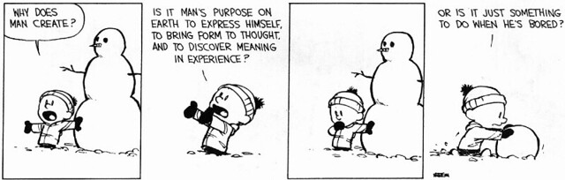
The Existential Givens
life is finite;
there is no external meaning
we must make choices
we are ultimately alone

Slide 12
existential humanistic psychotherapy
rejects ideas of “mental illness” and focuses on creating a sense of true self, deep connection, purpose
client vs. patient
client is met where they are at, not with assumptions about who they are supposed to be

Slide 13
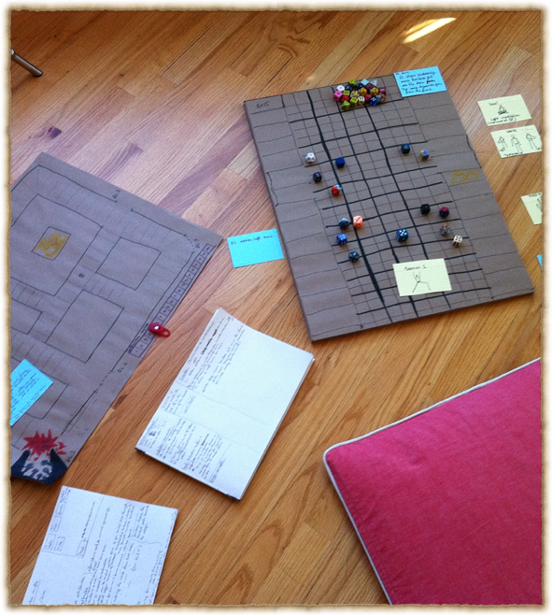
application to game design
transformational design approach that doesn’t try to change player
player is not assumed to need fixing
game aims to provide possibility space to explore and contemplate the game’s existential themes and see what resonates with players out of their own accord.

Slide 14
existential humanistic psychotherapy goals
making clients sensitive to their existence
calling attention to clients’ unique traits
helping clients improve encounters with others
assisting clients in establishing a will to meaning
encouraging clients to make decisions about present and future directions in life.

Slide 15

goal: improving encounters with others
deeper issue: “we are all lonely ships in a dark sea”
understanding limits of intimacy
Fromm (1956): “the ability to be alone is the condition for the ability to love"

Slide 16
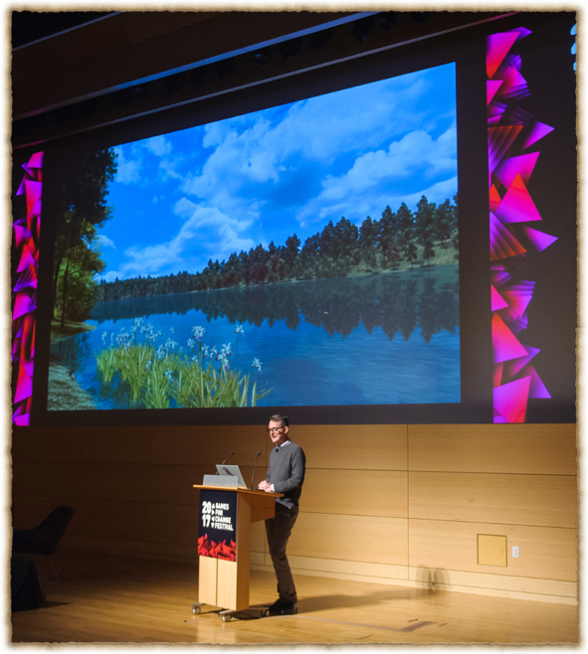
application to game design
e.g. Walden, a game (GameInnovationLab, USC)
exploring solitude, connection to nature, transcendence
conversation with self as basis for conversation with others
“inspiration” as game resource

Slide 17
James Bugental (1992)
“viewed from an existential perspective, the good life is an authentic life, a life in which we are as fully in harmony as we can be. Inauthenticity is illness, is our living in distorted relationship with our true being.” (p.246)

Slide 18
how can games contribute to authenticity and inner balance?

Slide 19

Authenticity and the Unconscious

Slide 20
PART 2
Myth and Ritual

Slide 21

Enter the Unknown Forest
“A myth is a way of making sense in a senseless world.
Myths are narrative patterns that give significance to our existence.” (Rollo May, 1991)
Notes:
key figures of existential psych. turned to myth to deal with the baffling question of meaninglessness. Rollo May: “The Cry for Myth”. When science fails, we turn to art.

Slide 22

Not just „stories“
“Mythic narratives are based on a model of the human psyche“ (Bonnett, 2006)
„Their true meaning is understood as internal processes“ (Kirmayer, 1999)
Myth speaks the language of the Unconscious through symbolism and imagery
Notes:
key figures of existential psych. turned to myth to deal with the baffling question of meaninglessness. Rollo May: “The Cry for Myth”. When science fails, we turn to art.

Slide 23


myths work through resonance
Jung: “the auditor experiences some of the sensations but is not transformed. Their imaginations are stimulated: they go home and through personal fantasies begin the process of transformation for themselves. (Bonnett, 2006)
Notes:
myths are more than just stories. They “spring from powerful and mysterious inner processes.” (Bonnett, 2006, p.4)
they transform us by way of resonance, not coercion.

Slide 24

Robert A. Johnson: Inner Work
into the depths of one’s innermost world:
dream work and active imagination
Notes:
How to create new myths?

Slide 25

Goodwyn: The Number One Dream Hack:
“the meaning of this dream is that you are living your life as if X.”

Slide 26

Active Imagination:
hold balance between dreaming and waking to let unconscious material bubble to the surface.
Notes:
start by asking a question and let the answer emerge. Follow where the inner voice leads you - allows unconscious material to bubble to the surface. Hold balance between dreaming and waking.

Slide 27
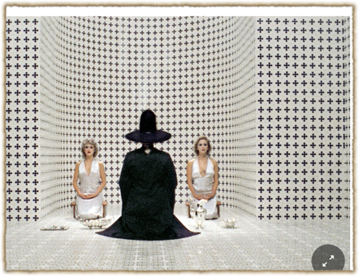
Ritual as Enacted Myth
Transformative potential of symbolic action
Getting a handle on “inner processes” through performance of symbolic actions
Jodorowski: “psychomagic, poetic acts”
Game Mechanics as symbolic enactments of inner processes

Slide 28
Part 3
Experiential Play

Slide 29
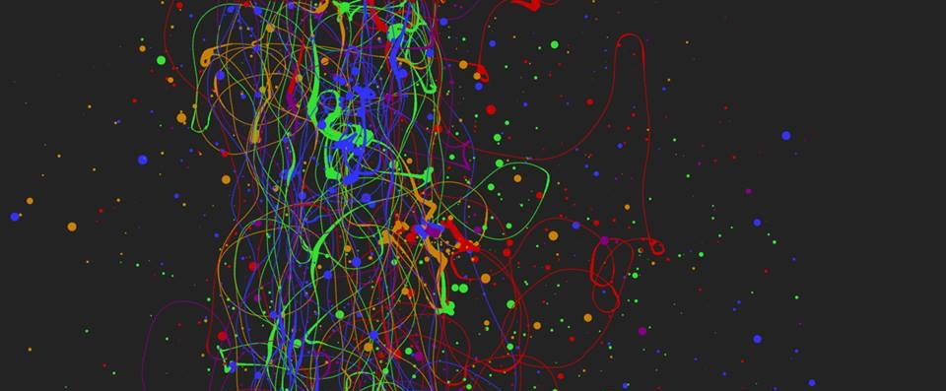
3: EXPERIENTIAL – “WHAT YOU PLAY IS WHAT YOU GET”
When we refer to experiential design, we mean the entire contextual experience of playing a game, and the interpretation of the experience by the player directly in the context of the experience itself. This kind of ‘what you do is what you get’ game is of increasing interest in the field, and in this manner is essentially an ‘experientially educational’ game (Phelps, Wagner, and Moger, 2020).
Players can gain an understanding of, and empathy for, a given scenario or subject matter merely through the act of playing it, and specifically through the act of interacting with it. (Phelps, 2020)

Slide 30

AS HUMANS, WE BRING OURSELVES TO OUR EXPERIENCES
KNOWLEDGE OF A SYSTEM IS NOT EMPATHY
AND DOES NOT PRESUPPOSE TRANSFORMATION
A large part of games’ transformative potential thus remains either unrealized or invisible (Paolo Pedercini, 2014). But how can we intentionally design for personal transformation without pre-determining the kind of change the game should ignite or seeks to impose upon its players? How can we facilitate profound, organic inner shifts through our designs that allow players to “respond to them of themselves, with recognition, uncoerced[?]” (Campbell 1991).
GAMES ARE NOT JUST COMPLEX SYSTEMS | MECHANICS

Slide 31


Slide 32

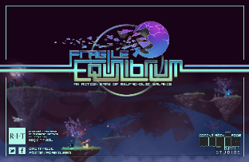


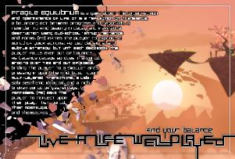

Slide 33
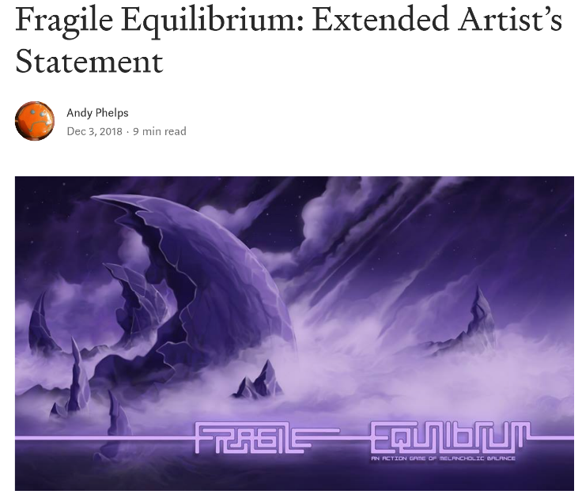
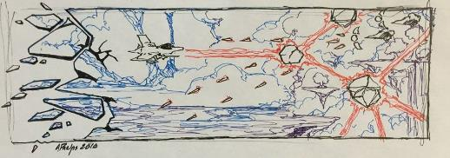
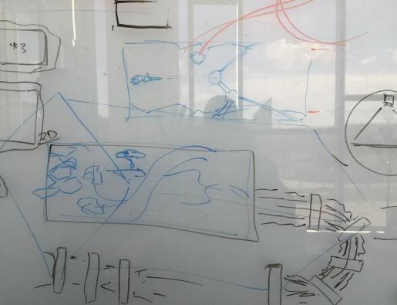

Slide 34

So what is this really all about?
This whole game is a metaphor for living and coping with depression and anxiety
It is intended not as an educational game, but as an experiential game.
The idea is to simply convey a feeling – the idea of compression, of balance, of a constant need to evaluate and course correct in the midst of other action and experience
Notes:
Reference to Lost in Translation for obvious reasons (i.e. that this is an experiential game in part the way that movie tried to convey the cultural dissonance)

Slide 35
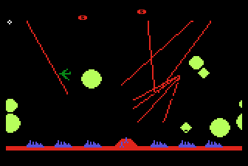
CONTEXT CAN BE EVERYTHING
Missile Command 1982

Slide 36
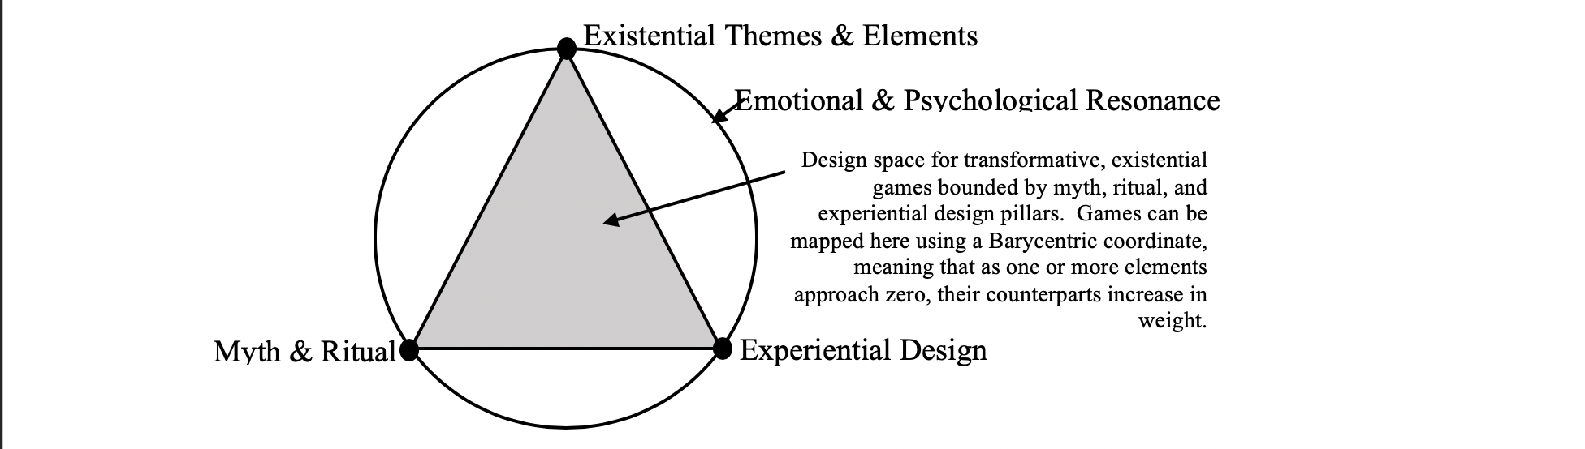
DESIGN SPACE MAP
Mapping a design space for games of the soul
(Rusch & Phelps, DiGRA 2020)

Slide 37

CONCLUSION(ISH): WE NEED MORE AND BETTER KINDS OF ’MEANINGFUL’ GAMES
Experiential games have a unique place in the design space
By focusing less on procedural rhetoric and more on abstract expression via interaction to trigger transformation, we open different doors in the interaction of humans and technology
Utilizing these different lenses examines UX not through functionality or optimization, but through intuition and interpretation
Measuring differently to allow for different design spaces and methodologies is critical if we want to aspire to different results

Slide 38


Slide 39
Rusch, D. and Phelps, A. Games of the Soul: Creating Transformative Experiences Through Experiential Existential Design. Taylor & Francis, Spring 2022(ish).

Slide 40
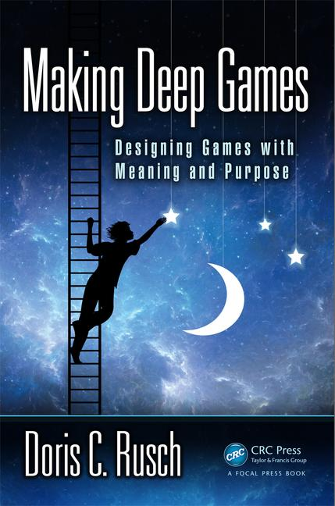
Phelps, A., Wagner, J. and Moger, A. "Experiential Depression and Anxiety Through Proceduralized Play: A Case Study of Fragile Equilibrium." (2020) Journal of Games, Self, & Society, vol. 2, no. 1. Eds. Rivers, S. E., & Dunlap, K. https://doi.org/10.1184/R1/12215417
Rusch, D. ”Existential, Transformative Game Design." (2020) Journal of Games, Self, & Society, vol. 2, no. 1. Eds. Rivers, S. E., & Dunlap, K. https://doi.org/10.1184/R1/12215417
Rusch, D. and Phelps, A. “Existential Transformational Game Design: Harnessing the "Psychomagic" of Symbolic Enactment” Frontiers in Psychology. Special Issue on Digital Games and Mental Health. doi: 10.3389/fpsyg.2020.571522 (in press)
Phelps, A., and Rusch, D. C. (2020) "Navigating Existential, Transformative Game Design." Proceedings of the Digital Games Research Association (DiGRA) 2020 Conference: Play Anywhere. Tampere, Finland. http://www.digra.org/wp-content/uploads/digital-library/DiGRA_2020_paper_21.pdf

Slide 41
Thanks and Questions
@D_Carmen @andymphelps

