Slide 1
Beyond the BA: Navigating Status as a Department, Center or Program, While Working with Industry Partners
Andy Phelps
Director, RIT MAGIC Center
Professor & Founder, RIT School of Interactive Games & Media
Rochester Institute of Technology

Slide 2
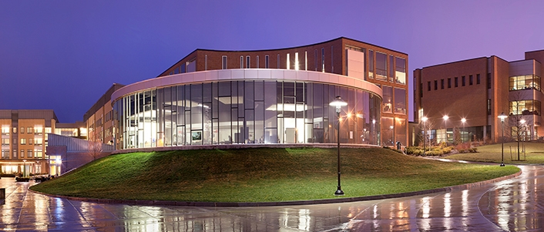
Rochester Institute of Technology
Private university of ~18,600, est. 1829
~4000 computing students
Engineering centric culture
Long history of technology + arts
Alumni & partners worldwide
Nowhere remotely near NYC

Slide 3
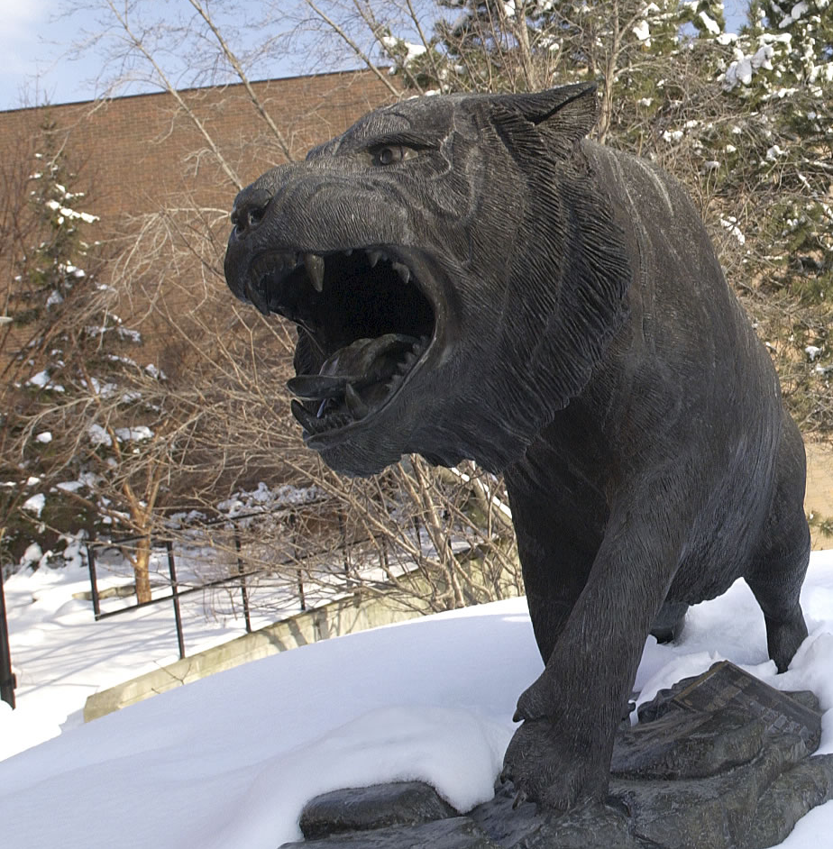
RIT GAMES TIMELINES
2001 programming
First course in games programming
2002
Electronic Gaming Society
2003
CS/IT Concentration in Game Prog
2006
MSc Game Design & Development
2007
BSc Game Design & Development
2009
Dept. of Interactive Games & Media
2011
School of Interactive Games & Media
2012
Minor in Game Design
2013
RIT Center for Media, Arts, Games, Interaction & Creativity (MAGIC)
2013
MAGIC Spell Studios ®, LLC
2016
$30M MAGIC Spell Studios Initiative
2016
NY State Games HUB
2017
NY State Games Challenge

Slide 4
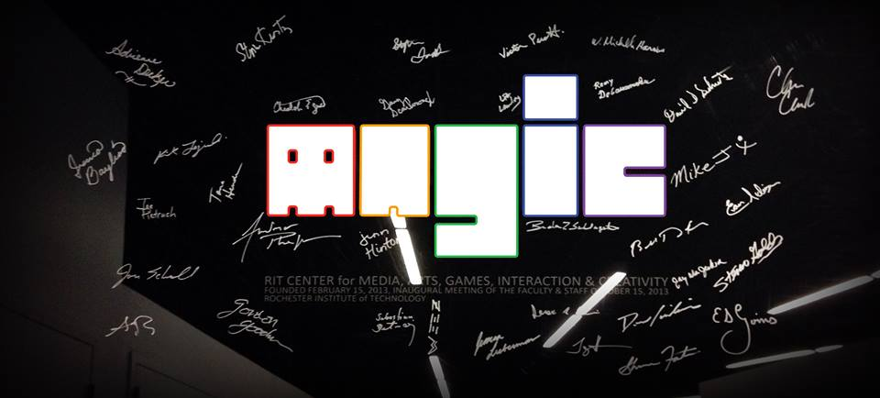
RIT MAGIC Center
Established by RIT President Dr. William Destler
Designed to bridge gap between research & production
Reports directly to OVPR – not an academic unit
Multi-disciplinary disruption as a mission statement

Slide 5
RIT Games
Ecosystem
College of Liberal Arts
Digital Humanities & Social
Sciences
Museum Studies
ENG
SOC
College of Imaging
Arts & Sciences
HST
PSY
School of
Film &
Animation
Electronic Gaming Society
NEW MEDIA DESIGN
B. Thomas Golisano College of Computing & Information Sciences
CS
Game Dev Club
New Media
Club
School of Interactive Games
& Media
IT
PhD
3DDG
SE
MAGIC CENTER
MAGIC SPELL STUDIOS
CSEC
eSports
Office of the
VP for Research
Simone Center for Student Innovation & Entrepreneurship
Venture Creations
Incubator

Slide 6
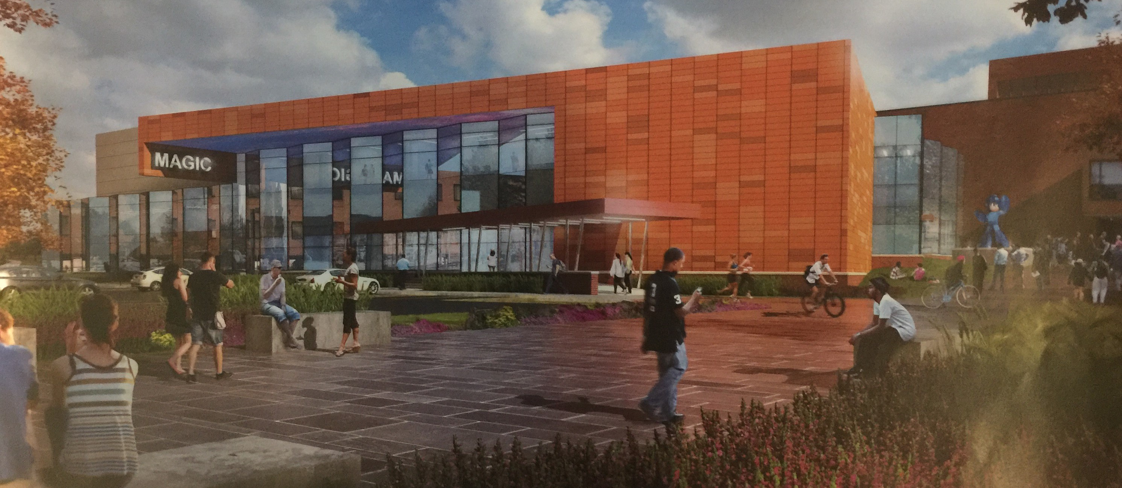
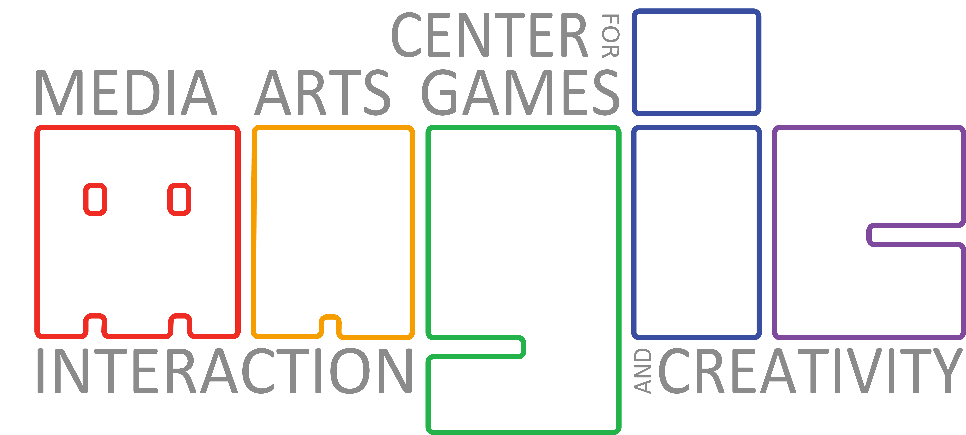

A New Kind of University Research Center

Slide 7





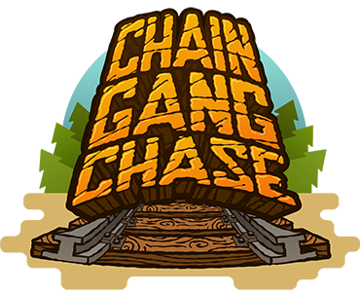

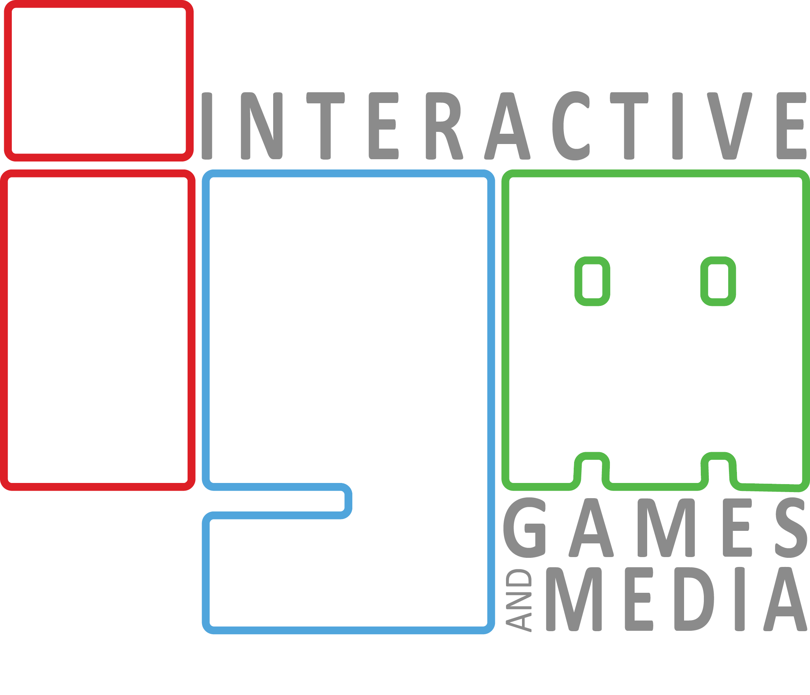


Slide 8
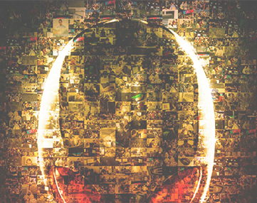
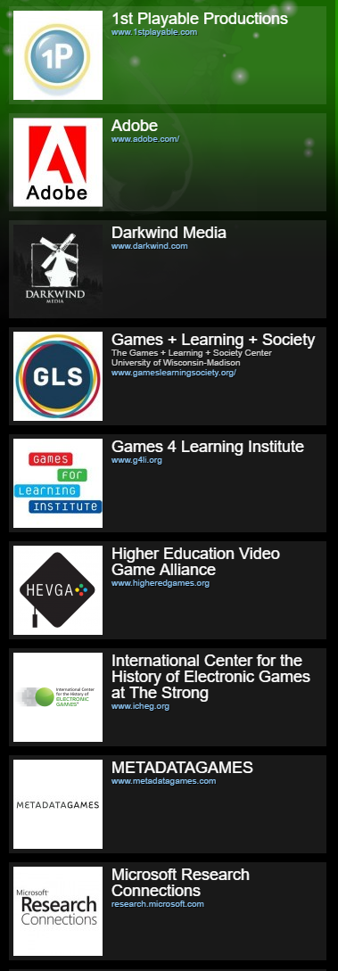
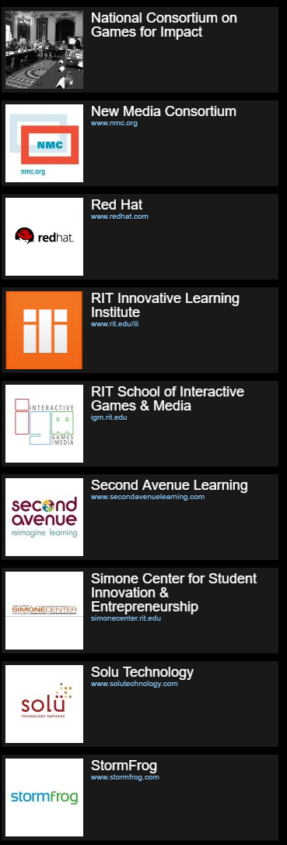
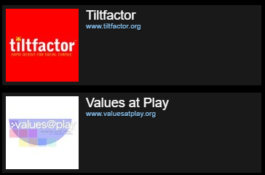
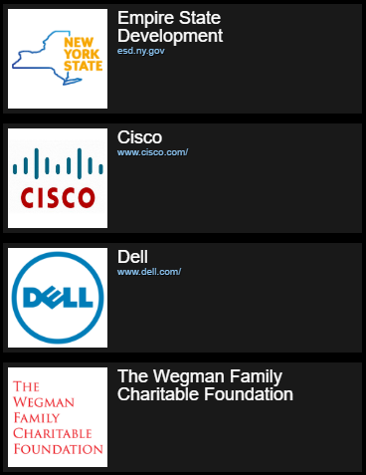




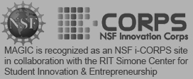


MAGIC Motto: Define relationships as partnership, and
maker community.
Collaboration is
bi-directional.

Slide 9
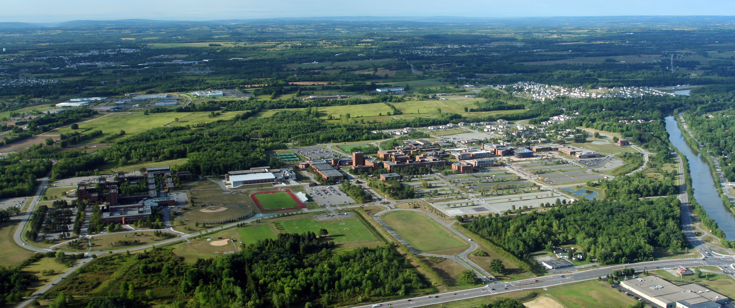
Problems with:
INSIDE
PARTNERS
Faculty & Staff
Dept/Colleges
Service Orgs
Clubs & S-Life
Finance
OUTSIDE
PARTNERS
Corporate
Government
Colleges & Univ.
Foundations
Alumni
K-12
and more…
Community vs. departmental culture
Budgets & expectation
Autonomy & responsibility
Multi-disciplinary collaboration
Traditionalism vs. disruption
Advances in:
IP and contracts
Fundraising and support
Sponsored research
Technology transfer
STUDENTS
By offering
no curriculum,
anyone & everyone can
participate
Multi-university collaboration
Publishing & distribution
Media marketing and press
and more…

Slide 10
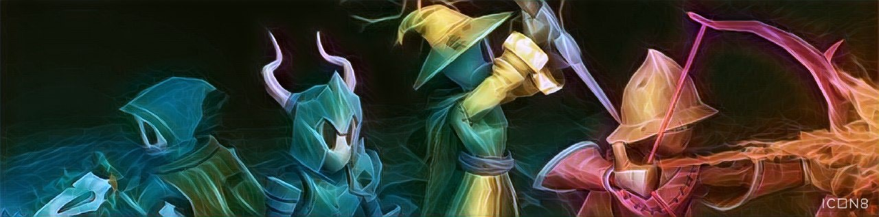

facebook.com/ritmagic
@RITMAGIC
andy@magic.rit.edu
magic.rit.edu

