Slide 1
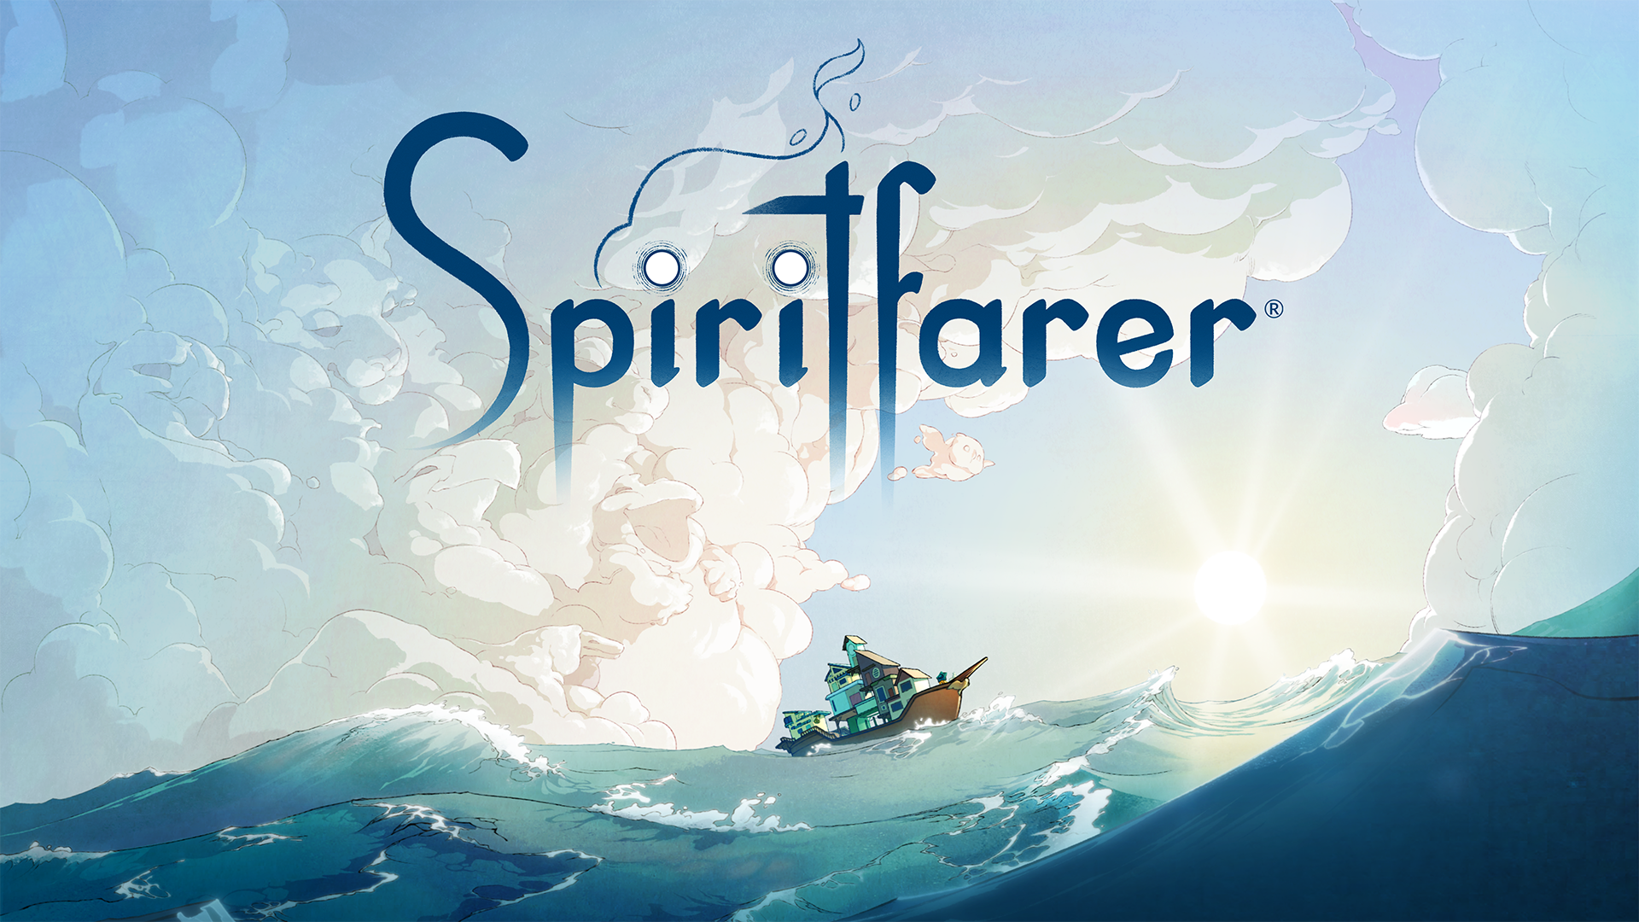
Well-Played:
Age, Death, Peace, and a Pandemic
Notes:
Andy

Slide 2




Jocelyn Wagner
They/Them
Drew
Moger
He/Him
Mia
Consalvo
She/Her
Andy
Phelps
He/Him
American University
American University
Concordia University
American University
University of Canterbury
Notes:
Andy

Slide 3
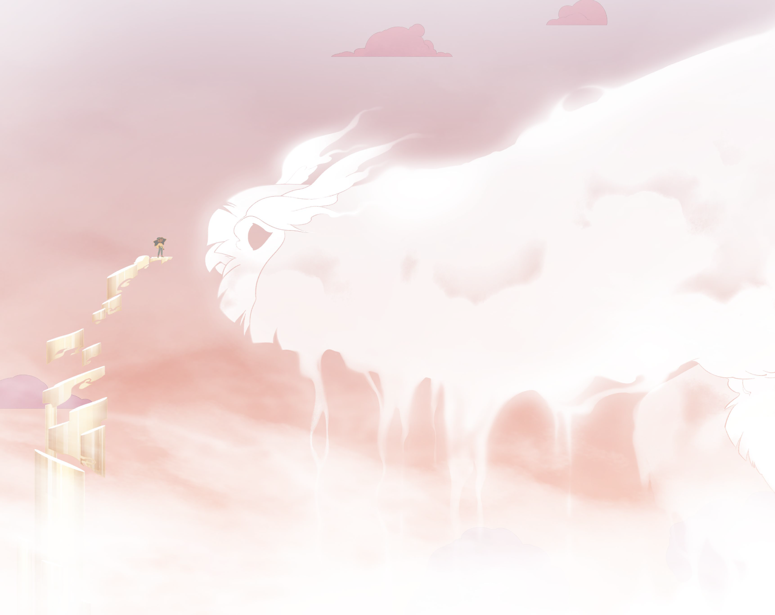
Spiritfarer:
A Cozy Management Game About Death
Notes:
Drew
Based on Greek Myth
Map

Slide 4
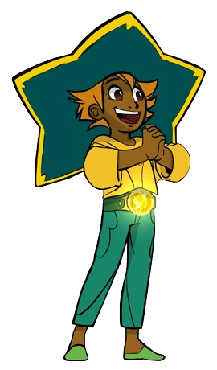
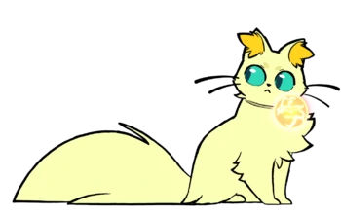
Stella and Daffodil
Notes:
Drew
Introduce Stella and her role

Slide 5

Notes:
Drew
Talk about management

Slide 6

Notes:
Drew
Talk about ship construction as part of management and travel

Slide 7
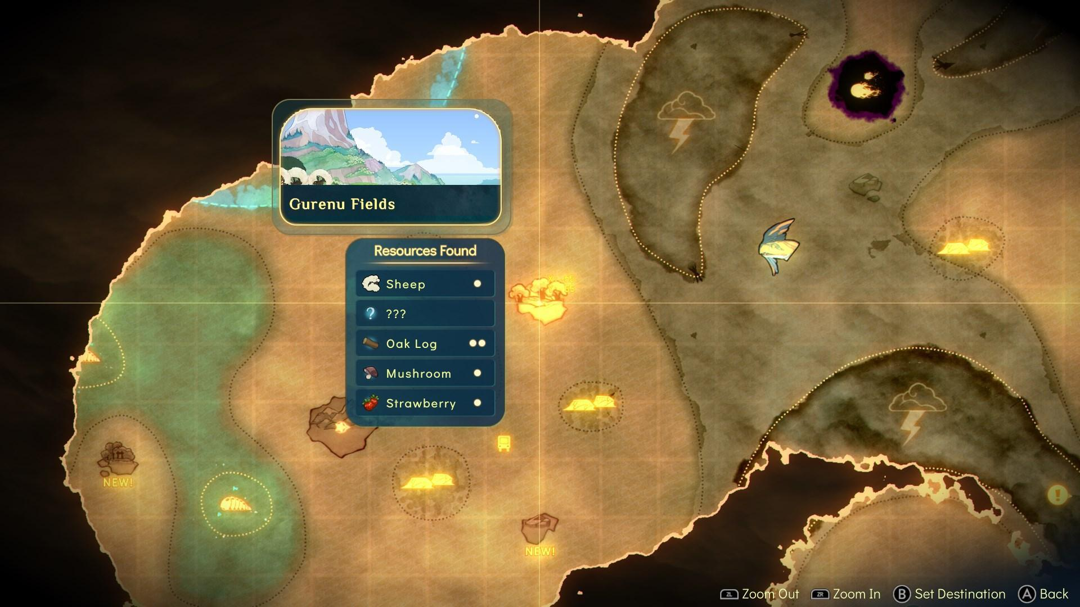
Notes:
Drew
Talk about travel

Slide 8

Why is Spiritfarer Unique?
Notes:
Accepting death, dealing with end of life issues in a positive way, not grimly depicting death and aging, etc. Talk about the game in general, segue into older adults - Jocelyn

Slide 9
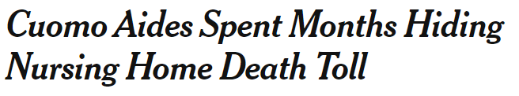
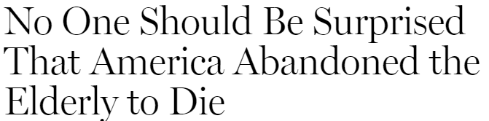
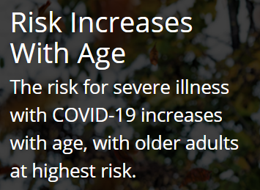
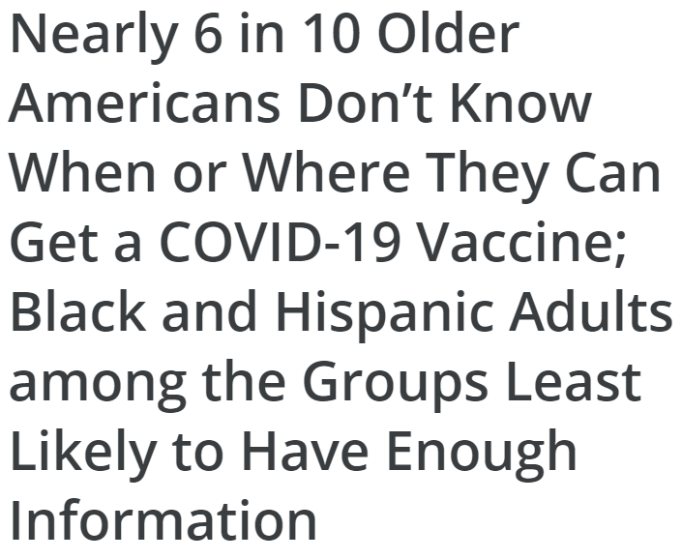
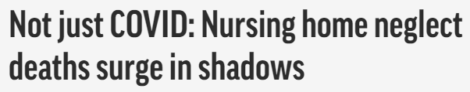
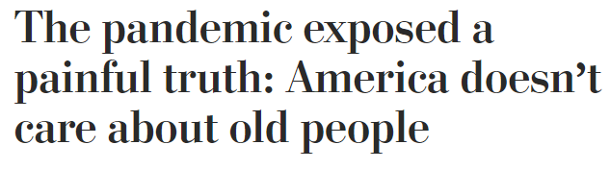

Ageism in The US and Canada
Notes:
Mia

Slide 10


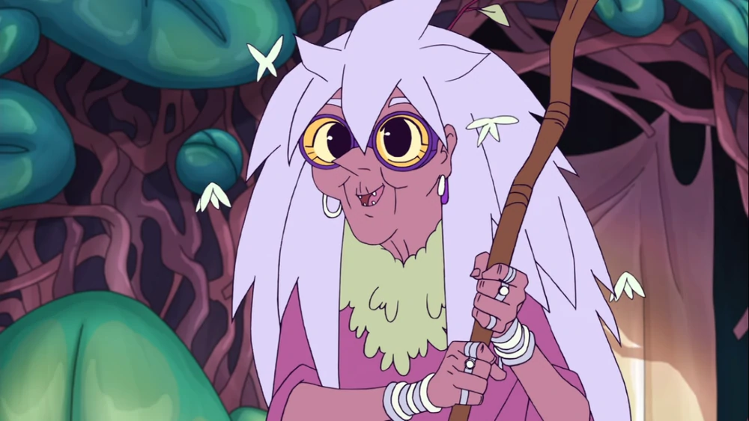

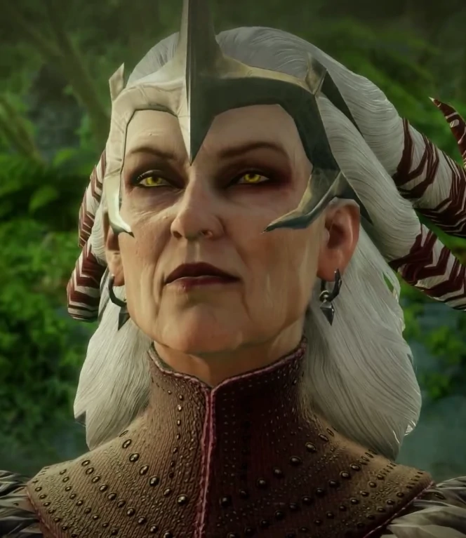

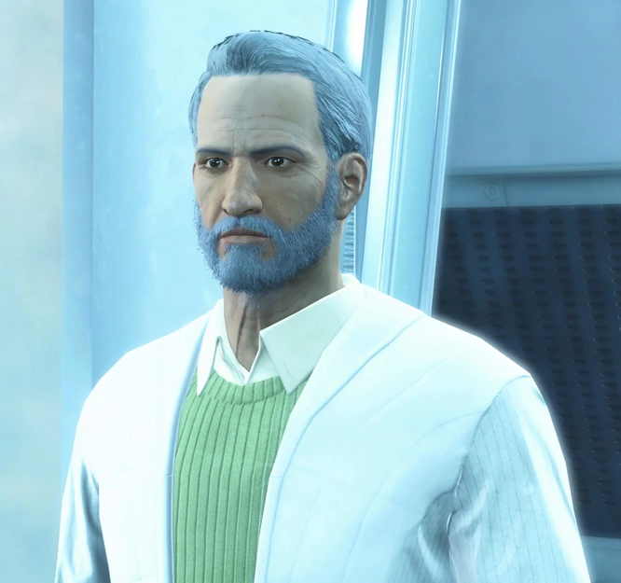
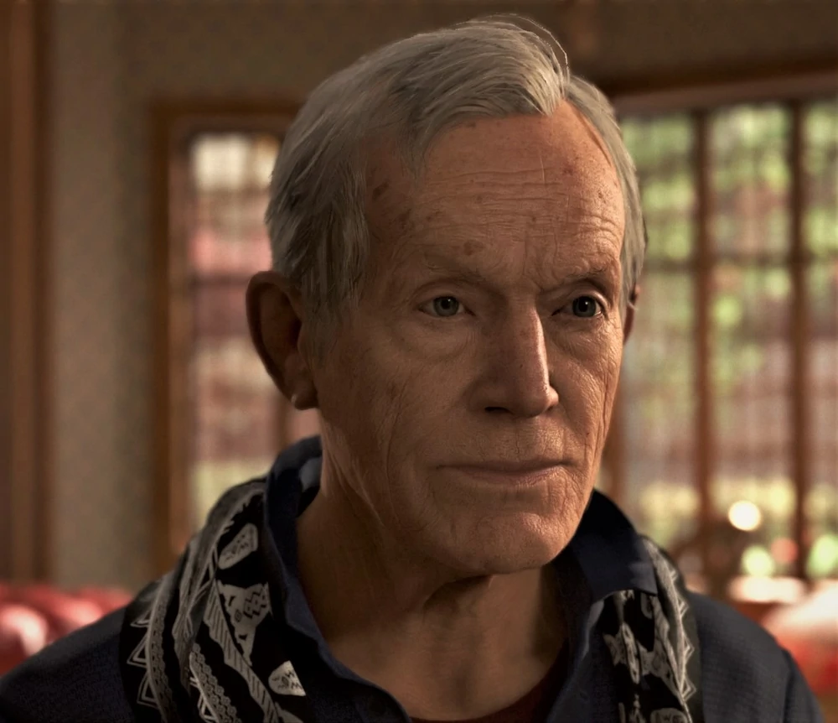
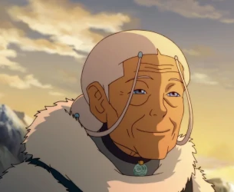
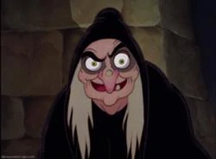
Ageism in Games & Other Media
The good
The bad
Image from BioShock Wiki
The ugly
Image from SeaWolf Press
Image from Dragon Age Wiki
Image from She-Ra and the
Princesses of Power Wiki
Image from aminoapps.com
Image from Avatar Wiki
Image from Detroit Become
Human Wiki
Image from Fallout Wiki
Image from Disney Wiki
Notes:
Good = good representation
Bad = bad representation
Ugly = bad representation + ugly old person stereotype
All - each take a character or two
Outer worlds - win the retirement lottery! (and die)

Slide 11

Spiritfarer’s Depiction of Older Adults
Notes:
Title slide (Andy)

Slide 12
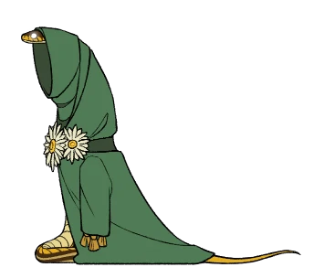
Summer
“A true child of the earth”
Embraces spirituality, meditation, and crystal healing
Found love later in life (married Stella’s aunt)
Has regrets related to prior career and damaging the Earth
Battles and succumbs to cancer caused by the heavy chemicals of previous career
Notes:
Jocelyn (plus all)

Slide 13
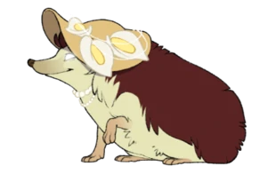
Alice
“Soft spoken and unobtrusive”
Loves romance novels and crafting
Introduces an orchard to the ship
Reminisces about her daughter and her late husband
Gradually succumbs to dementia
Notes:
Andy (plus all)

Slide 14

Astrid
“[A]n extravagant, assertive woman”
Advocate for workers’ rights and unions
Hid Jewish children during WWII
Constantly disappointed and betrayed by the love of her life
Notes:
Drew (plus all)

Slide 15
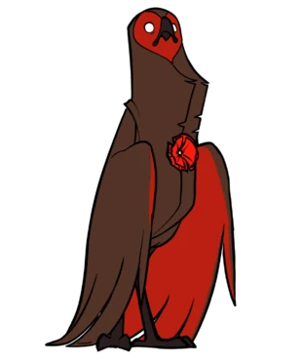
Gustav
“[A] peculiar character”
An art curator and musician with a penchant for travel
Challenges the notion that usefulness is the basis of meaning and purpose in life
Controversy surrounding the initial ableist depiction of this character
Notes:
Mia (plus all)

Slide 16

Death, Fear, and Authenticity
Notes:
Reflect on societal fears a la the paper (go through each character and maybe touch on other experiences as well) (ALL)

Slide 17

Other Reactions and Play Experiences
Notes:
(ALL)
Atul exemplifies the pandemic and the lack of saying goodbye
Talk about other play experiences: timed elements, annoying platforming, etc. Constructive criticism and also things we liked. Also timeliness of release during pandemic and the content of the game.

Slide 18
“Helping Grandma Home: Spiritfarer’s Progressive Treatment of Older Adults During COVID-19”
Based on our forthcoming paper:
Coming soon in Well-Played from ETC Press!
Notes:
Andy

Slide 19

Questions?

Slide 20

Credits
Presentation template by SlidesCarnival
Paper backgrounds by SubtlePatterns
Character images from Spiritfarer Wiki
Unless otherwise noted, images are from the Thunder Lotus media pack and Spiritfarer: the artbook

Slide 21
references
CDC. (2020, February 11). COVID-19 and Your Health. Centers for Disease Control and Prevention. https://www.cdc.gov/coronavirus/2019-ncov/need-extra-precautions/older-adults.html
Goodman, J. D., McKinley, J., & Hakim, D. (2021, April 28). Cuomo Aides Spent Months Hiding Nursing Home Death Toll. The New York Times. https://www.nytimes.com/2021/04/28/nyregion/cuomo-aides-nursing-home-deaths.html
Jones, S. (n.d.). America Is Sacrificing the Elderly to Coronavirus. Retrieved July 12, 2021, from https://nymag.com/intelligencer/2020/07/america-is-sacrificing-the-elderly-to-coronavirus.html
Khimm, S. (n.d.). The hidden Covid-19 health crisis: Elderly people are dying from isolation. Retrieved July 12, 2021, from https://www.nbcnews.com/news/us-news/hidden-covid-19-health-crisis-elderly-people-are-dying-isolation-n1244853
Kohn, N. A. (n.d.). Perspective | The pandemic exposed a painful truth: America doesn’t care about old people. Washington Post. Retrieved July 12, 2021, from https://www.washingtonpost.com/outlook/nursing-home-coronavirus-discrimination-elderly-deaths/2020/05/07/751fc464-8fb7-11ea-9e23-6914ee410a5f_story.html
Nearly 6 in 10 Older Americans Don’t Know When or Where They Can Get a COVID-19 Vaccine; Black and Hispanic Adults among the Groups Least Likely to Have Enough Information. (2021, January 22). Kaiser Family Foundation. https://www.kff.org/coronavirus-covid-19/press-release/nearly-6-in-10-older-americans-dont-know-when-or-where-they-can-get-a-covid-19-vaccine-black-and-hispanic-adults-among-the-groups-least-likely-to-have-enough-information/
Sedensky, M., & Condon, B. (2020, November 18). Not just COVID: Nursing home neglect deaths surge in shadows. Associated Press. https://apnews.com/article/nursing-homes-neglect-death-surge-3b74a2202140c5a6b5cf05cdf0ea4f32

Slide 22
Contact info
Twitter: @kuriouswhims
Email: w5233a@student.american.edu
Twitter: @drews_clues28
Email:
am2289b@student.american.edu
Twitter:
@miaC
Email: mia.consalvo@concordia.ca
Twitter: @andymphelps
Email: andymphelps@gmail.com

