Slide 1



Dr Mia Consalvo
Professor, Communication Studies
Concordia University, Canada
Dr Kelly Boudreau
Associate Professor, Game Studies & Design
Harrisburg University, USA
Dr Andy Phelps
Professor, Film & Media Arts
American University
USA

Slide 2
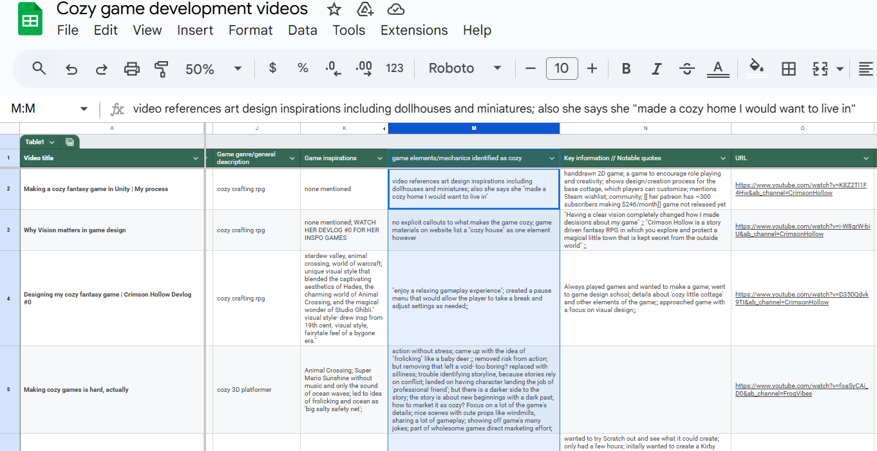
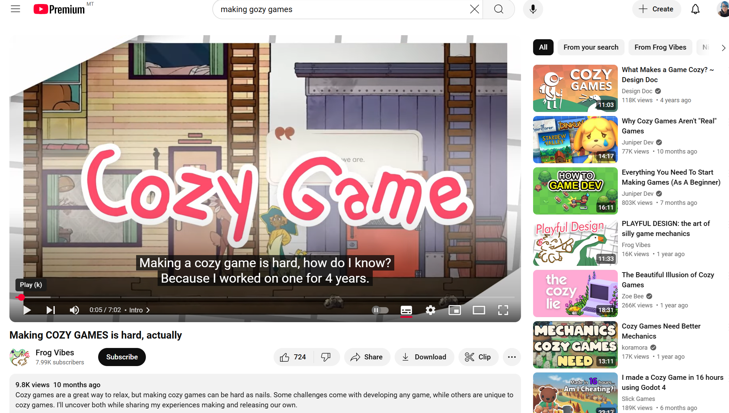
What did we do?
21 YouTube videos
  Amateur & Professional Developers
Search parameters
  Combination of Key words:
    cozy game, developer, development, how to make
  Min. 5 minutes +
  2022-20225
Analysis parameters
  Inspirations
  Elements/mechanics identified as cozy
  Commentary on cozy (or not) aspects of the design process

Slide 3
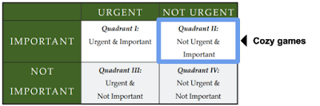
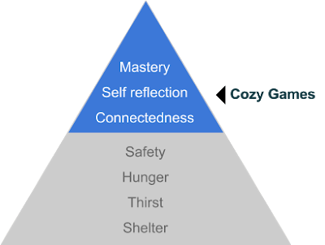
What did we want to know?
How does the wider community of game developers define cozy games
Is there agreement with the conclusions of the 2017 Project Horseshoe whitepaper outlining conceptual and technical elements of cozy games?
Are developers
  broadening the genre
  augmenting it with their own ideas of what cozy games could/should be

Slide 4
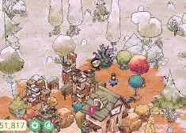

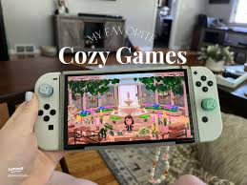
Why does it matter?
Notes:
A brief rationale of the work – why do we care if devs define cozy different;y?

Slide 5
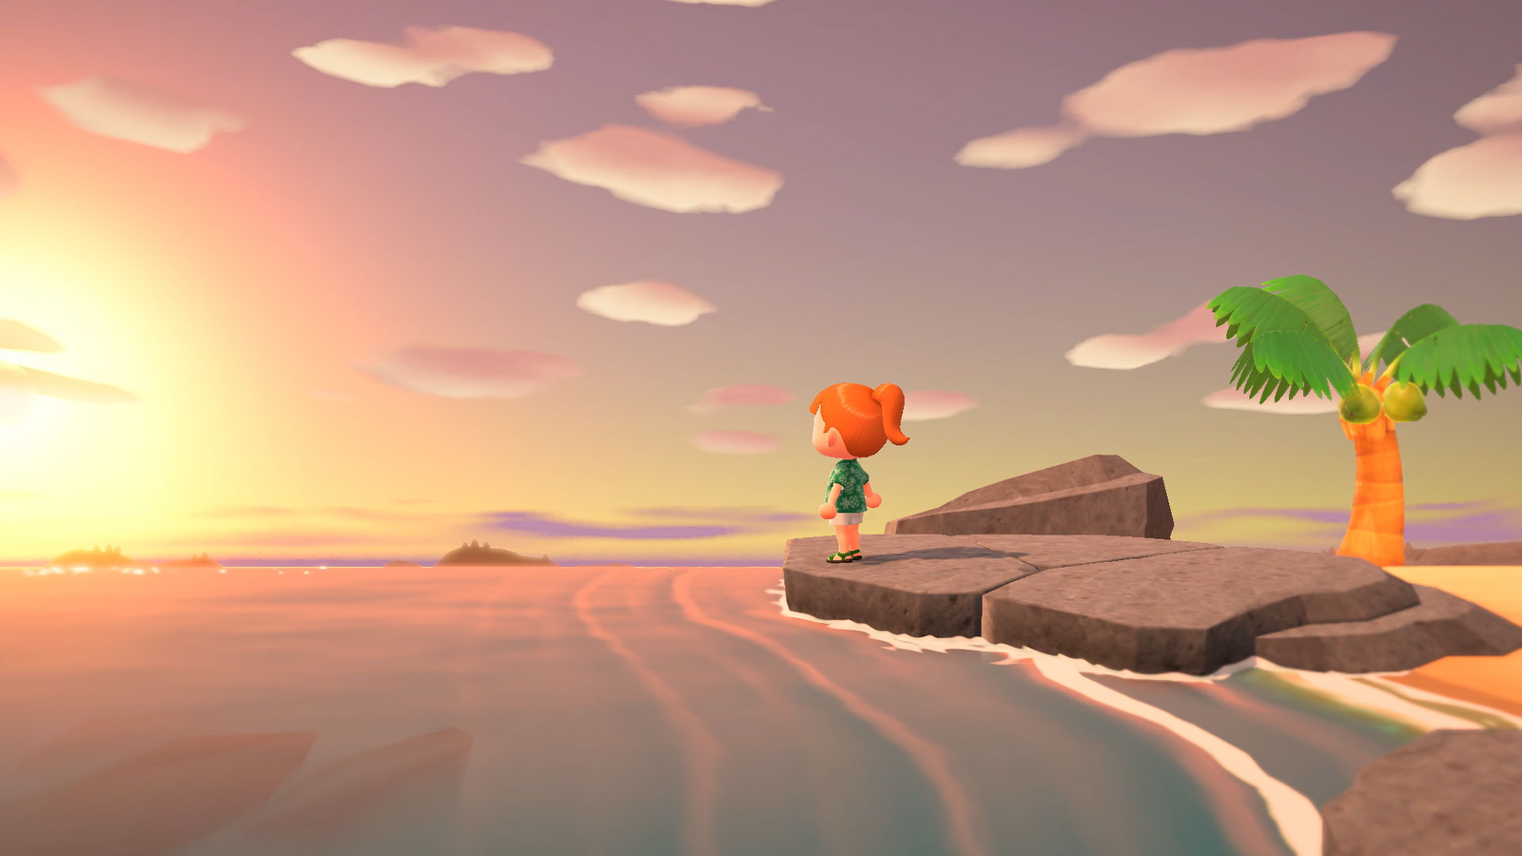
But first, a briefest of descriptions
Coziness itself refers to how strongly a game evokes the fantasy of safety, abundance, and softness”. (Project Horseshoe, 2017)
Safety:
  risk and danger (physical, emotional, social) are minimized.
Abundance:
  lower-level needs are met, and nothing is lacking or pressing.
Softness:
  stimuli are gentle and comforting, reducing stress.
Notes:
Based on the Project Horseshoe Report – reviewer 1 wanted an “overview” of basic cozy

Slide 6
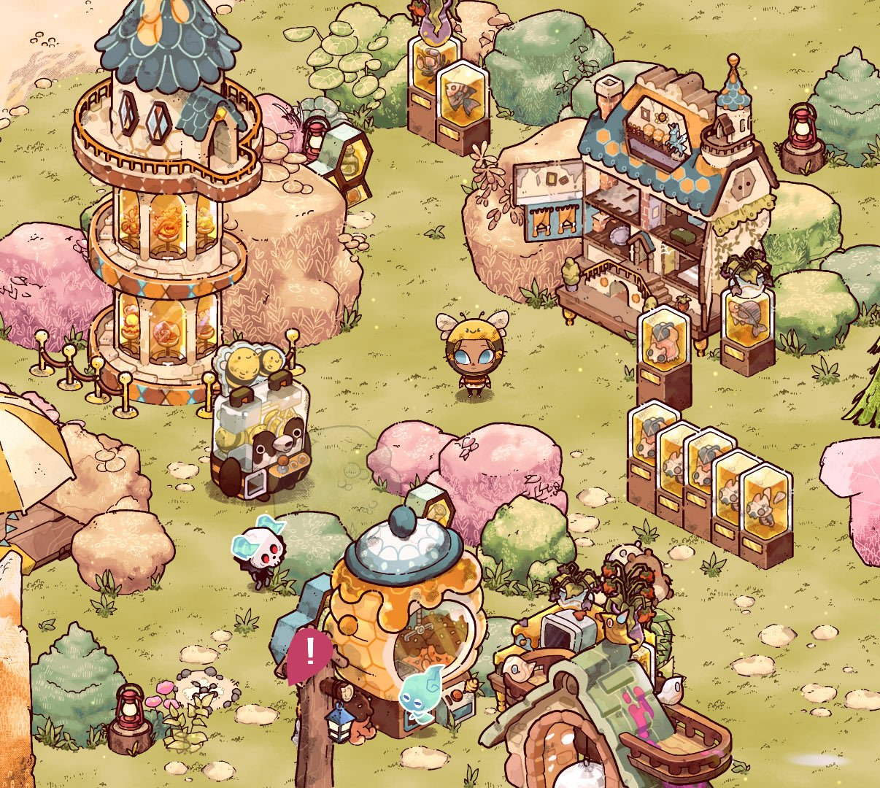

Of course, it’s more than that…
Mechanics
  Tidying, organizing, fishing, collecting, etc.
Aesthetics
  may include warmer, low-contrast colors and lighting, natural and familiar building materials, enclosed intimate spaces, and occasional windows into the external, non-cozy space taken refuge from.
Audio
  ideally diegetic
  Ambient or human-created music and audial reminders of safety, abundance, and reinforce comfort
Narrative / Contexts
  Cozy narratives and themes center around homes and family, or practicality,

Slide 7
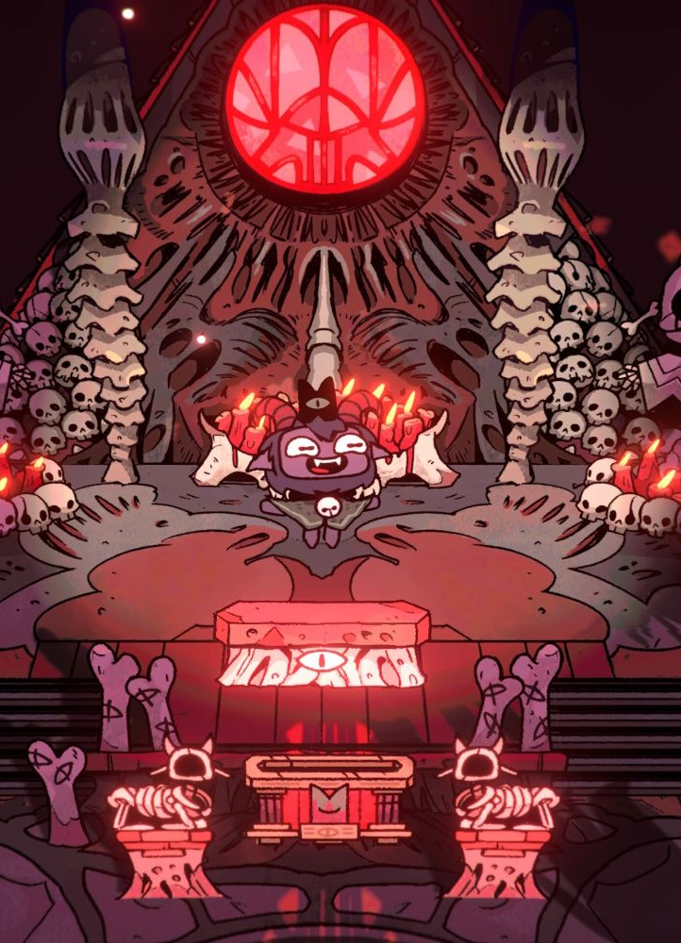
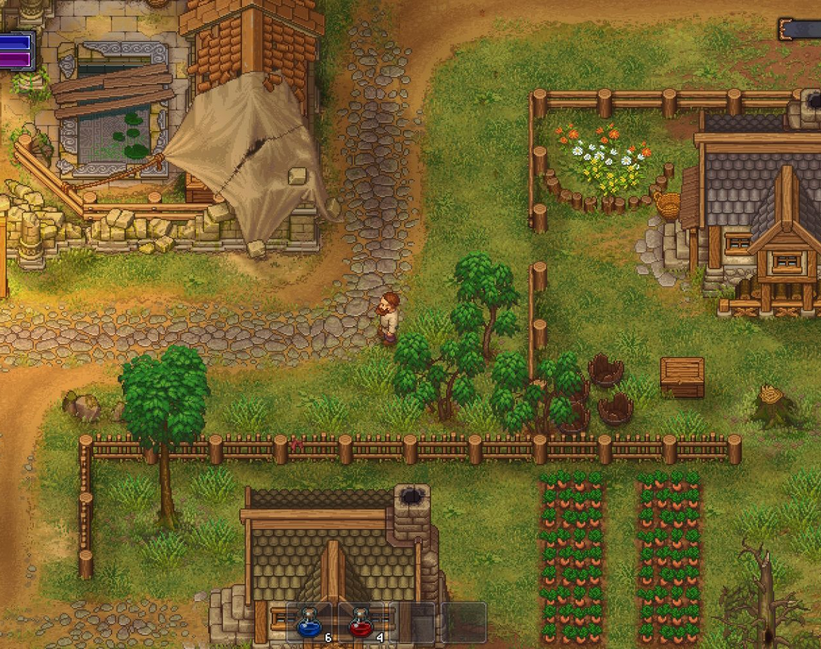
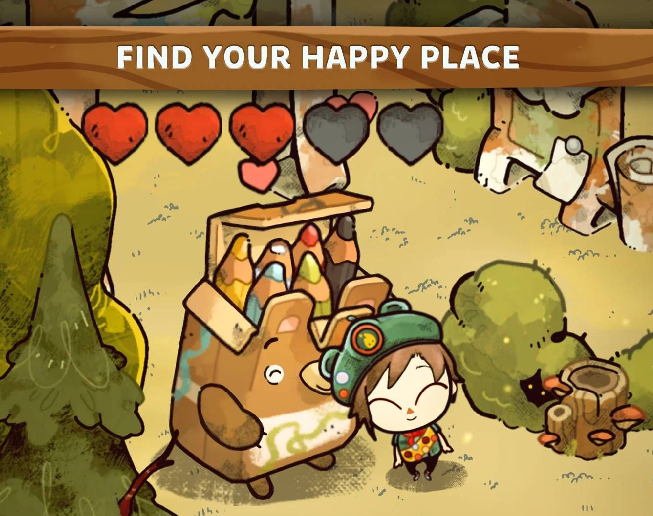
What we found (key take-aways)
Many novice developers worked within the existing definitions of cozy as inspired by major/popular cozy games
Developers of all levels have different understandings of what makes a game cozy based on inspiration games and personal experience
Developers aimed to push the genre in terms of mechanics, themes, and aesthetics

Slide 8

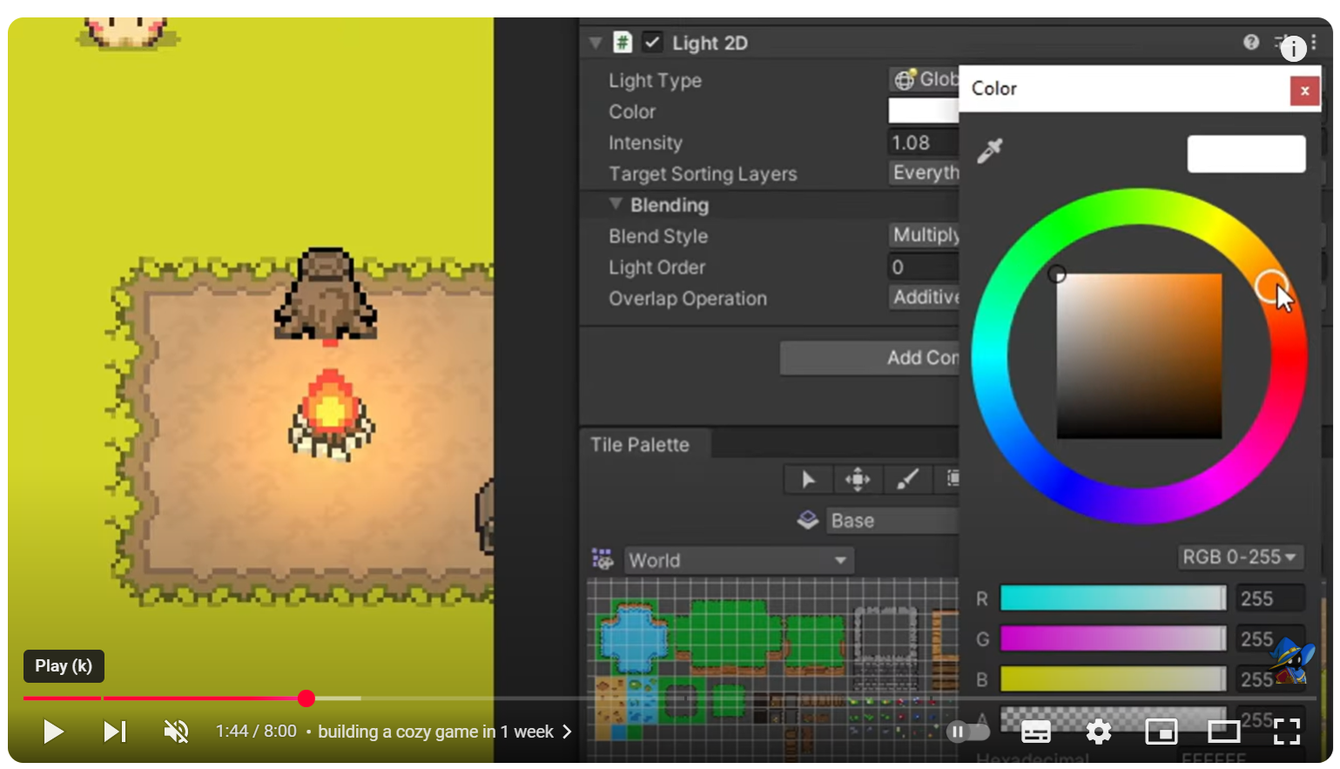
Explicit Cozy Design Choices
Set out to make a game using Project Horseshoe’s white paper’s design principles
Focused on SENSE OF SECURITY as key to cozy games
  nothing threatening in the game or that can kill you.
  very little sense of challenge but more about just mindlessly exploring forest world.
  Making a cozy game from Scratch…
  by Byte of Michael

Slide 9

Explicit Cozy Design Choices
Began design without knowledge or understanding of cozy, but had implemented mechanics and gameplay elements that were cited as “cozy”
Researched cozy games – implemented more ‘cozy’ features
How to (accidentally) make a cozy game- advancenine
Notes:
Once he found out that his mechanics were cozy, made an explicit effort to research cozy game design, implement cozy elements and playtest / get feedback
the only youtuber who talks about getting feedback during the design process -

Slide 10

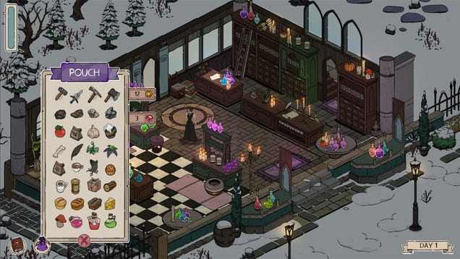
Implicit Cozy Design
Many creators discussed their game design choices, but didn’t explain what elements were considered cozy or why – instead, focusing on technical process
Focuses included
  Pacing
  Cooking, but without the stress
  Repetition in play as meditative
  Sense of serenity
  Visual elements
Notes:
Pacing – accomplishing tasks that are often thought of as fast paced – cooking / serving – fast paced (cooking mama, diner dash)- but without the stress (I quit my job to make a cozy game – here’s what happened (part 1)
Repetitive gameplay as creating a ‘meditative’ vibe – but not necessarily adheres to any specific design principle as repletion is not an OG criterion of cozy game design, but can be considered cozy at the player level

Slide 11
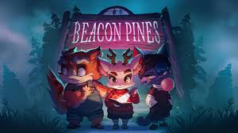

Mechanics, Aesthetics & Vibes:
The Growing Nature of Cozy
As you approach cozy design, remember that coziness is an aesthetic goal, a flavor that can be applied to any underlying type of game
- Project Horseshoe, 2017

Slide 12

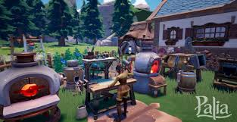
Pushing the definition
(& gameplay experience) of Cozy Games
Cozy Platformer
  Inherent risk
  Challenge / difficulty
  Failure – but less/non-punishing
  Cozy aesthetics
Social Cozy Games
  Collective play
  Perceptions of cozy as individual ‘vibe’ creates design challenge
Notes:
Can mention cozy horror here even if we did not have any in our pool
address what the games the videos talked about and how they are different from the standard “animal crossing esque’ games

Slide 13



As Cozy Games Grow,
Developer Definitions Are in Evolving
Notes:
Conclusion = overview of the elements that our videos stated were cozy, but also, others talked about games that are not typically considered ‘cozy’ such as platformers, due to the nature of risk and failure etc. --- riff here

Slide 14

Thank You!

