Slide 1
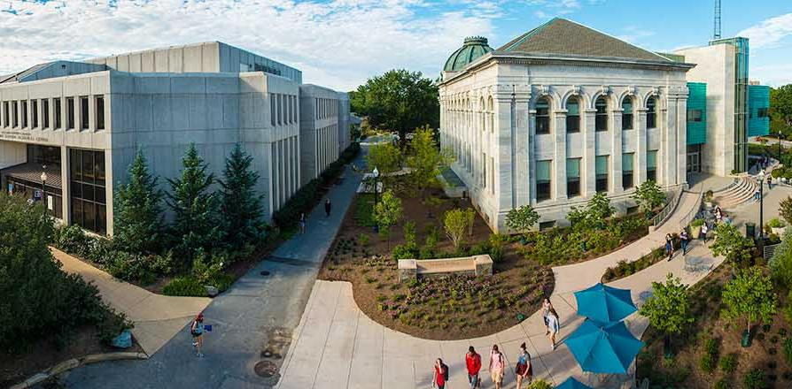
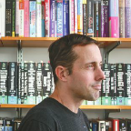




A bit on MAGIC Spell Studios,
and University Game Studios Generally
Games + Communication Ante-Conference
A conference preceding the International Communication Association (ICA) annual conference
American University Game Lab, Washington, DC 2019
Andrew Phelps
Professor of Art & Design, Rochester Institute of Technology (RIT)
Professor of Human Interface Technology, University of Canterbury, NZ
President, Higher Education Video Game Alliance
Games Scholar in Residence, American University, Spring 2019
Founder, RIT MAGIC Center & MAGIC Spell Studios
Founder, RIT School of Interactive Games & Media

Slide 2
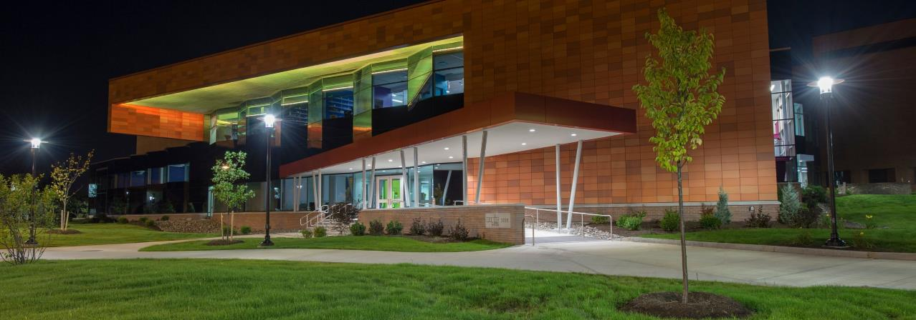
MAGIC TODAY & TOMORROW
Notes:
So let’s take a little look at where we are today, in our current home, what we’ve built, where we are going.

Slide 3
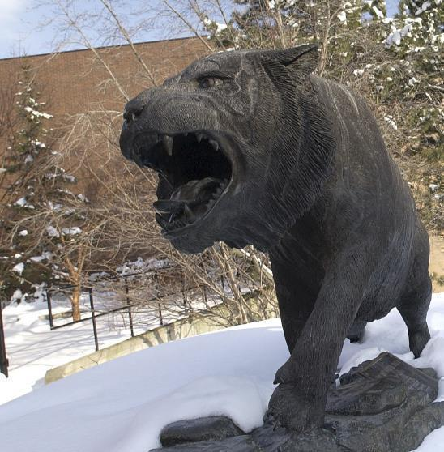
RIT GAMES & INTERACTIVE MEDIA TIMELINES
2001 programming
First course in games programming
2002
Electronic Gaming Society
2003
CS/IT Concentration in Game Prog
2006
MSc Game Design & Development
2007
BSc Game Design & Development
2009
Dept. of Interactive Games & Media
2011
School of Interactive Games & Media
2012
Minor in Game Design
2013
RIT Center for Media, Arts, Games, Interaction & Creativity (MAGIC)
2013
MAGIC Spell Studios ®, LLC
2016
$30M MAGIC Spell Studios Initiative
2016
NY State Games HUB
2017
NY State Games Challenge

Slide 4
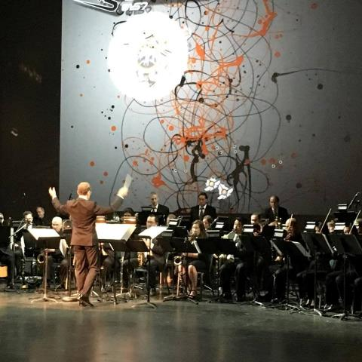
CAMPUS STUDIOS
C O N V E R G E N C E
C O N V E R G E N C E
The platforms and technology for film, animation, games, media, and story are converging into new forms, new stories, new experiences, and new knowledge.
Notes:
And so we started a multi-disciplinary research center, which is basically the hardest damn thing you can do on a modern college campus. They usually fail by becoming little islands, or by becoming a kind of ‘not really there’ virtual thing, and we’ve run into both of these views as we continue to engage the campus. Nonetheless, we think there is something profound happening in the field right now that is driving the kinds of things we are doing – everything is mashing up on each other. My favorite example of this is the MARVEL extended universe, which is so many different products and experiences rolled together. But there are countless examples big and small. This picture is from the RIT West Coast board meeting where they showed one of my games set to a live orchestra composition directed by Trustee Kevin Surace. Pretty cool.

Slide 5
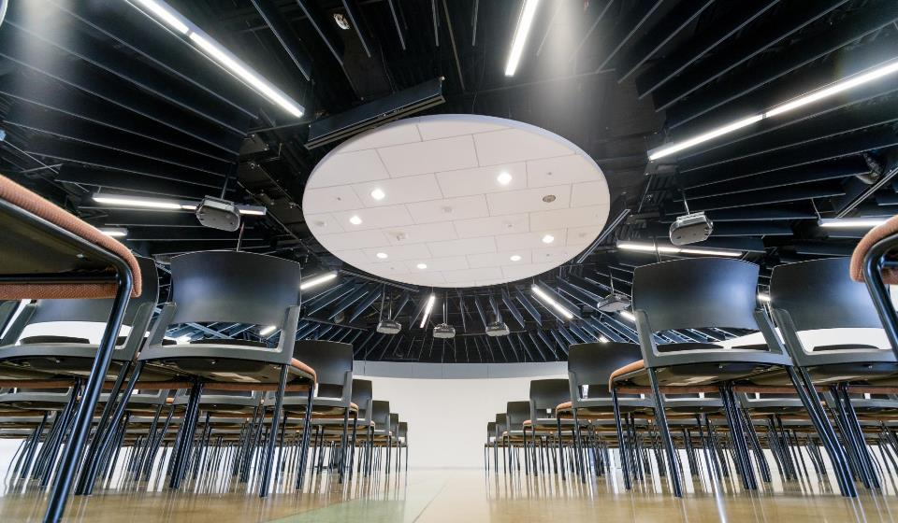
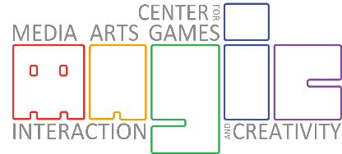
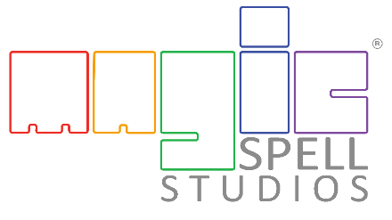
HOW IS MAGIC:
A VERY IMPORTANT DIVISION:
Notes:
Right from Bill’s ‘idea lab’ paper was the idea of an entrepreneurial effort inside the center to help publish and commercialize the things we make. We wanted to call it ‘MAGIC Studios’ at first but we were very afraid we’d get in trouble with The Mouse.

Slide 6
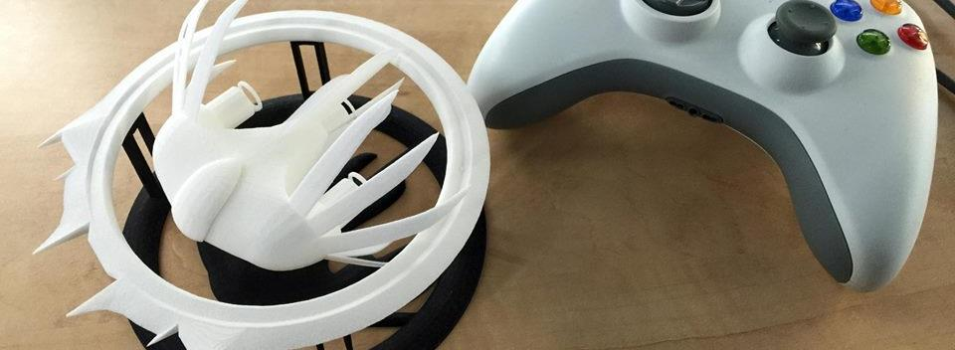
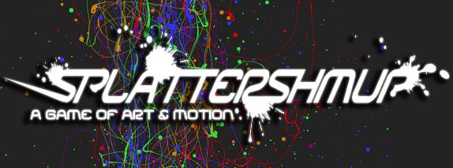
A Strange Game for Strange Reasons
This game taught us (the campus) about making things, production, and scale
This game allowed us to explore using typical game forms for telling a unique story to a very targeted audience
Finalist at GLS Education Arcade, shown at DiGRA Blank Arcade, and IndieArcade at the Smithsonian American Museum of Art
SPLATTERSHMUP.RIT.EDU – PLAY TODAY! MAKE ART!

Slide 7

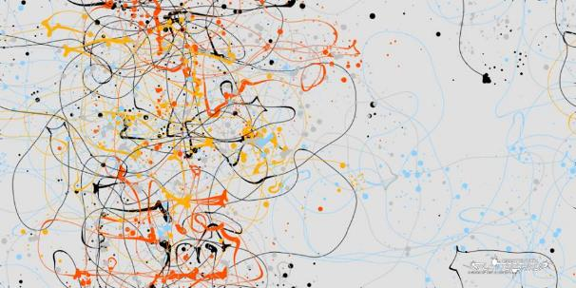
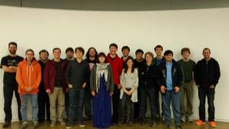
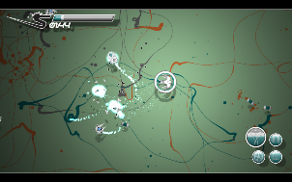
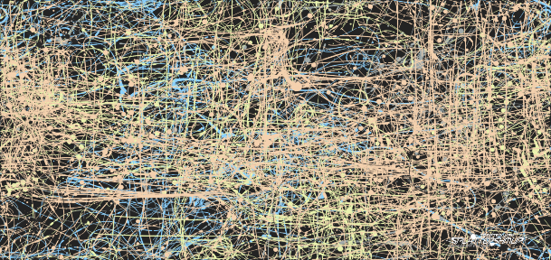
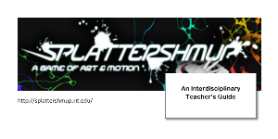



Slide 8
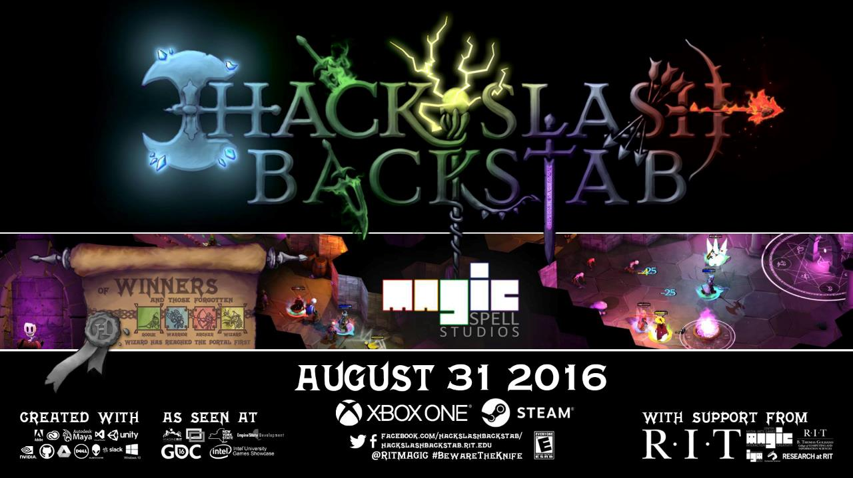

Slide 9

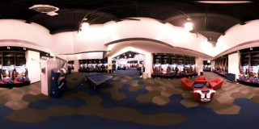

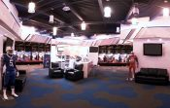
A SUMMER WITH THE
BUFFALO BILLS
Notes:
A big high-vis project that was (a) external client through the studio, (b) multi-disciplinary team, (c) primarily managed entirely by staff

Slide 10



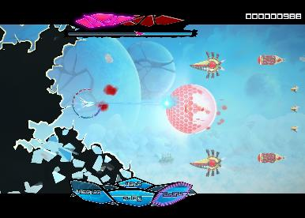
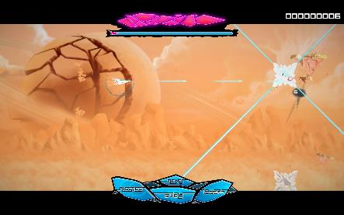
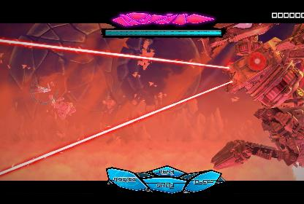

Slide 11
NO REALLY, REALLY, MESSY
BUSINESS INCUBATOR & TECHNOLOGY TRANSFER OFFICE
ACADEMIC DEPARTMENTS & COLLEGES
MAGIC LAB
(RESEARCH CENTER)
MAGIC SPELL STUDIOS, LLC
PUBLICLY VISIBLE ACTIVITIES AND PRODUCTS
SPONSORED RESEARCH SERVICES
GOVERNMENT & COMMUNITY RELATIONS
DEVELOPMENT & ALUMNI RELATIONS
ENTREPRENEURSHIP CENTER

Slide 12
AND IT WAS MESSY PAYING FOR IT
START UP FINDING FROM THE UNIVERSITY
BOARD OF TRUSTEES RAISED GIFT FUNDS
RESEARCH OVERHEAD & “SPECIAL” RETURN RATE
PERCENTAGE RETURN FOR GAMES & MEDIA SALES
FUNDING FOR EVENTS & SERVICES
NSF I-CORE NODE GRANT MONEY
CORPORATE GIFTS & GIFT IN KIND SERVICES
CORPORATE R&D CONTRACTS / CLIENT WORK
PASS THROUGH FUNDING ON SBIR GRANTS
NY STATE “GAMES HUB” DESIGNATION & PROGRAM
DIFFERENT GROUPS, METHODS, POOLS, PLATFORMS, & REPORTING MECHANISMS

Slide 13







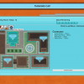
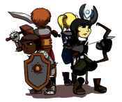







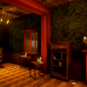
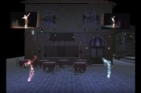
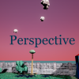
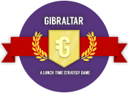







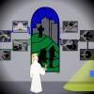



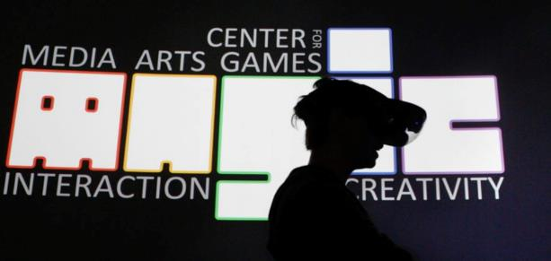
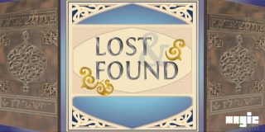
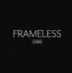


5 YEARS OF LEARNING THROUGH MAKING AT MAGIC. 5 YEARS OF PROJECTS & MEDIA.
Notes:
So I highlight those 3 because of the things we learned and as data points of growth, but the thing is we did a LOT of stuff from a LOT of work for a LOT of people! It’s a lot bigger a community than people even think about. It’s easy when you are working on ‘your thing’ to not realize the scope and scale of everything else that’s happening and going on.

Slide 14
MOST SUCCESSFUL PROJECT (measuring by ACADEMIC impact)
Funded first internally
Then by NEH
Then by NEH (again)
Then we figured out board game creation and printing
Then we figured out publishing
Then we figured out distribution
Then we figured out marketing
You’ll see it here in May, or lots of other places, and ICHENG/SMOP

Slide 15

MOST SUCCESSFUL PROJECT
(BY DOLLARS, ONE WAY)
… was an NSF award studying early computer science education that had no “product”
But we used the studio for grant support, designing logos for SIGCSE, providing logistical website support for CFP and workshop coordination, etc.
We also used the studio as a workspace for the NSF grant, and let the software and hardware licenses bleed back into academics
Dedicated staff support, marketing, and logistics

Slide 16

MOST SUCCESSFUL PROJECT
(BY DOLLARS, ANOTHER WAY)
SUPER DARYL DELUXE
First Investment by the RIT Venture Fund in a game
Support for Dan & Gary (the authors) post-graduation, in connection with studio resources
Winner best visuals INTEL Game Challenge
Winner Microsoft Imagine Cup
Released on Playstation and other platforms
Often cited in student applications (which for a tuition based university is a big deal)

Slide 17

MOST SUCCESSFUL PROJECT
(BY DOLLARS, A THIRD WAY)
In raw ROI, the NFL project was the clear winner
In institutional reputation gain, things are very mixed and largely unmeasurable ☹

Slide 18
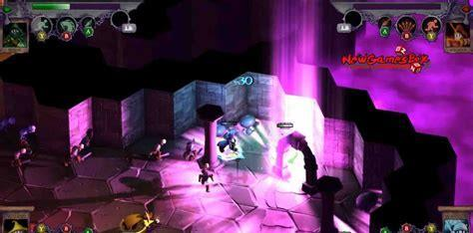
MOST SUCCESSFUL PROJECT
(BY EDUCATIONAL IMPACT)
HACK, SLASH & BACKSTAB
Most students impacted
Longest production run
Highest visibility on console market, and thereby on student portfolio tie-ins and industry reputation
Largest number of students with f/t placements afterward

Slide 19
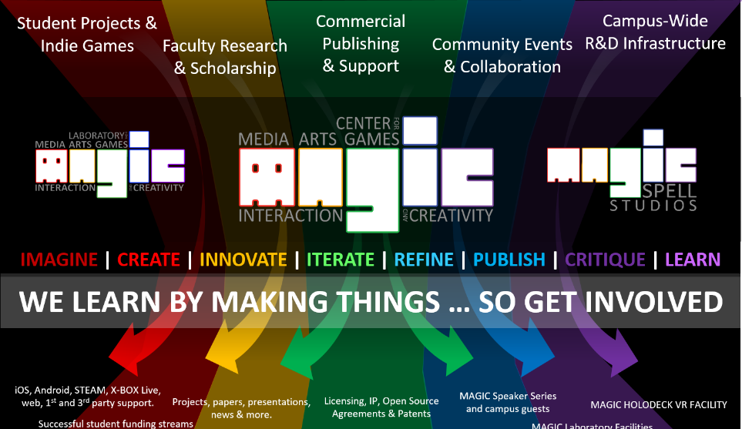
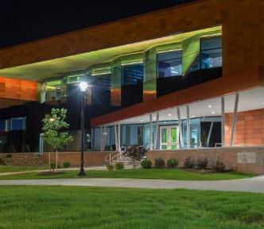
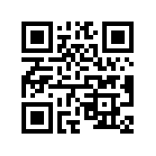
VISIT MAGIC.RIT.EDU to learn more about MAGIC Spell Studios

