Slide 1

A POST-MORTEM...
Andrew Phelps
Director, RIT MAGIC CENTER
Professor & Founder, School of Interactive Games & Media

Slide 2
A TALE FOR TWO AUDIENCES
IGM FACULTY & MAGIC AFFILIATIES
PROFESSIONAL PARTNERS
(This isn’t intended for students, although they are welcome.)

Slide 3
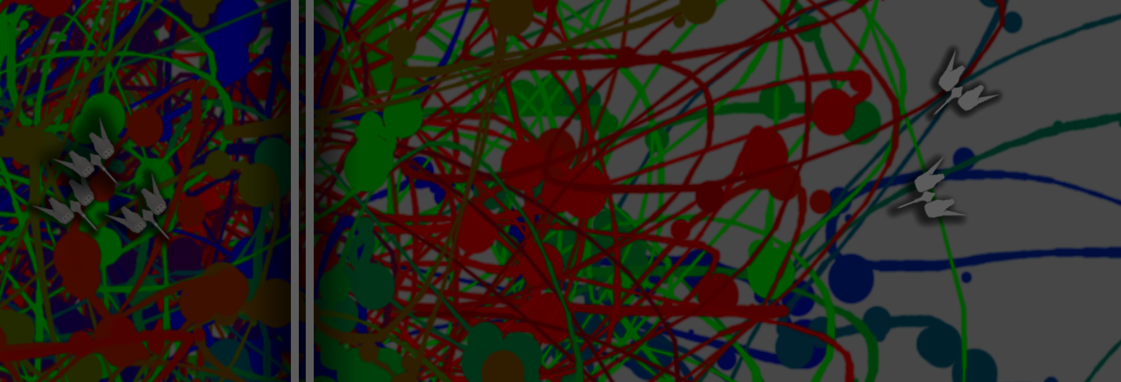
PART I: THE GOALS & THE STORY
“Let’s make a game where you make a painting by playing it, that gets you to think about painting differently…”
(general confusion ensues)

Slide 4
A PRODUCTION STUDIO…
If we really wanted to teach production, and we agree that we learn by doing, then what we were after was to “DO” production.
So I planned. A lot. And hired a production expert (Aaron Cloutier), and a media relations person (Jenn), and a producer (me).

Slide 5


…TO MAKE A GAME

Slide 6
Oh, and also
WE MAKE STUDENTS, BUT FOR SOME REASON WE DON’T MAKE A LOT OF POLISHED CONTENT. AND THAT’S INCREASINGLY AN ISSUE, SO LETS FIX THAT.
Had buy in from Provost and OVPR.
Was initially unclear on IGM, but worked out OK.
Crafted an agreement that we all (students and faculty) gave our work to the studio, to do with it what it wanted (hopefully ship it)

Slide 7
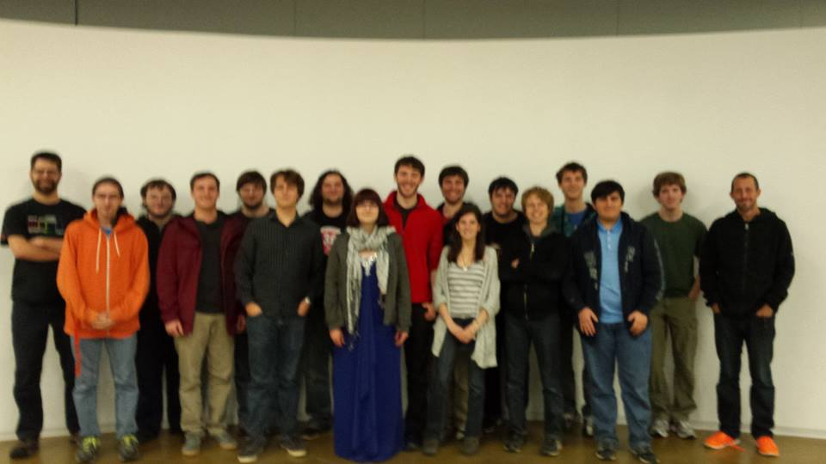

Slide 8
WE THOUGHT
STUDENTS WOULD BE READY & EXCITED (Course filled in ~4 minutes!!!)
STUDENTS WOULD STRUGGLE WITH A BIG, MULTI-DISCIPLINARY TEAM
STUDENTS WOULD KNOW THE TECH COMING IN (UNITY)
STUDENTS WOULD BE ENGAGED IN THE EXPERIENCE BASED ON THE OPPORTUNITY

Slide 9



WE ORGANIZED A PROCESS
Tried to walk a line between my vision for the game, Aaron’s input as a design consultant, and giving the students agency.
Also tried to establish a workflow based on a SCRUM model, code reviews, crits, and an aggressive plan to finish the game in several parts given a series of major milestones.

Slide 10
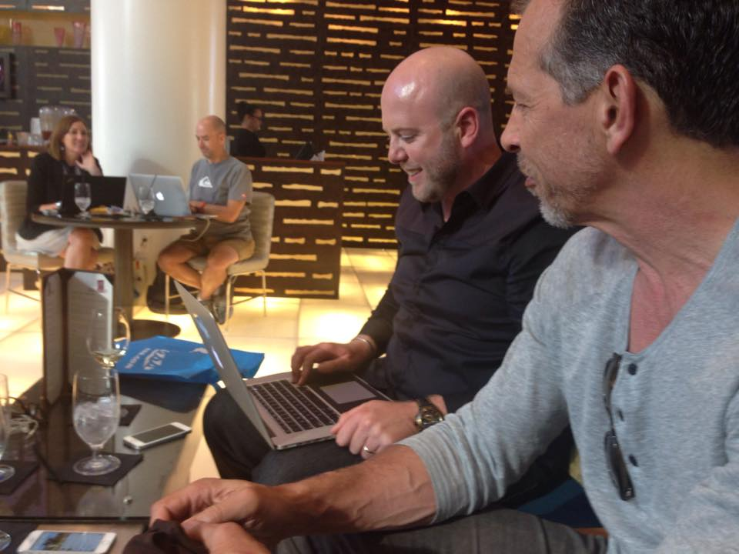

CELEBRITY CHALLENGES & PUBLISHING OPPORTUNITIES

Slide 11
WHAT WE FOUND
STUDENTS WEREN’T READY (Which I guess we should have known), and some were younger than they were on paper
STUDENTS DID STRUGGLE WITH A BIG, MULTI-DISCIPLINARY TEAM
STUDENTS SORT OF KNEW THE TECH, BUT NOT IN A PRODUCTION-READY WAY
SOME STUDENTS WERE ENGAGED IN THE EXPERIENCE BASED ON THE OPPORTUNITY, A LOT TREATED IT LIKE ANY OTHER COURSE
SOME STRUGGLED WITH NOT HAVING COMPLETE CREATIVE CONTROL AND DESIGN FOCUS
VERY LITTLE FOCUS ON POLISH, TESTING, UI, USABILITY, ETC. BUT A LOT OF FOCUS ON EXTRANEOUS FEATURES / NON-CORE ITEMS

Slide 12
ACTUAL PRODUCTION Vs. EXPECTATION & RESULT

Slide 13
Splattershmup Inspiration
10 games
Small teams, limited development time. Indie channels. Shmups.

Slide 14
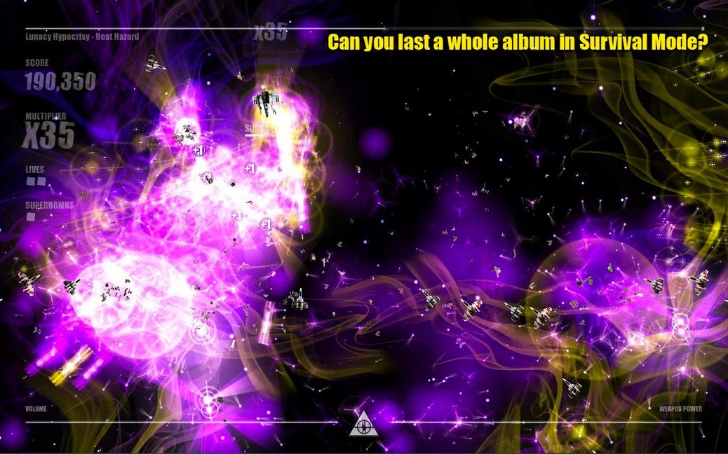

Slide 15
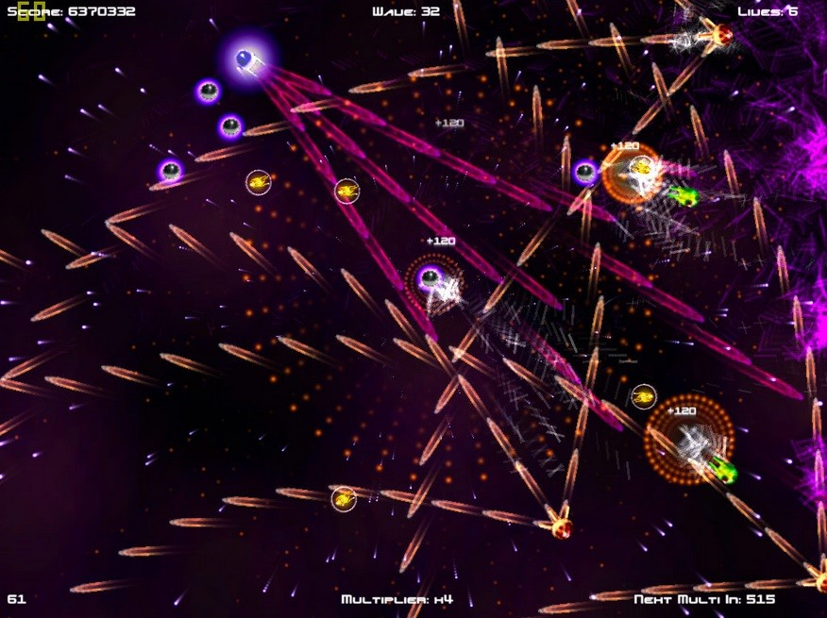

Slide 16
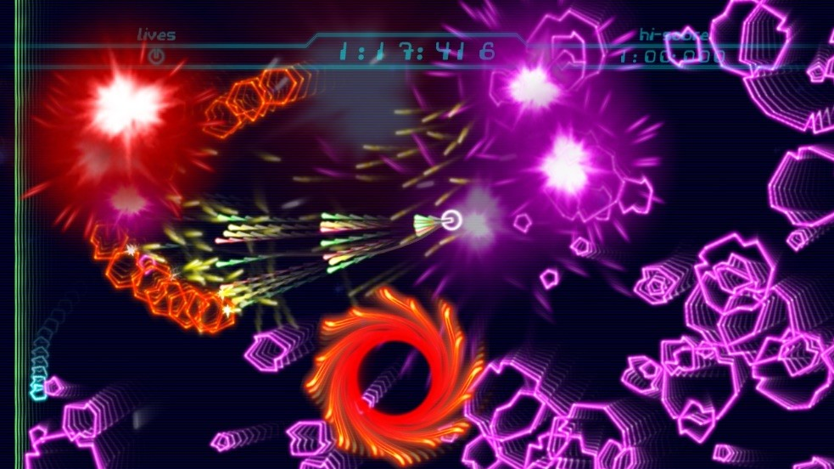

Slide 17
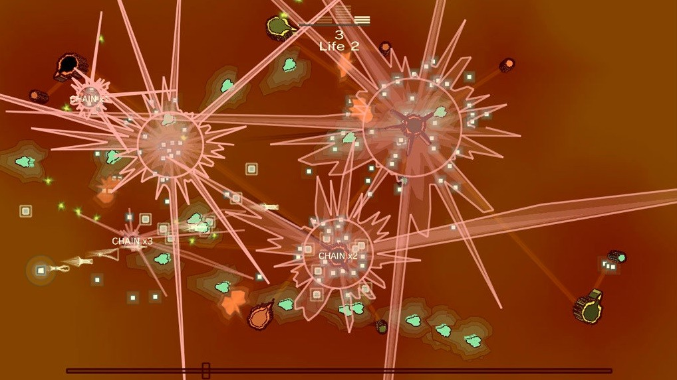

Slide 18
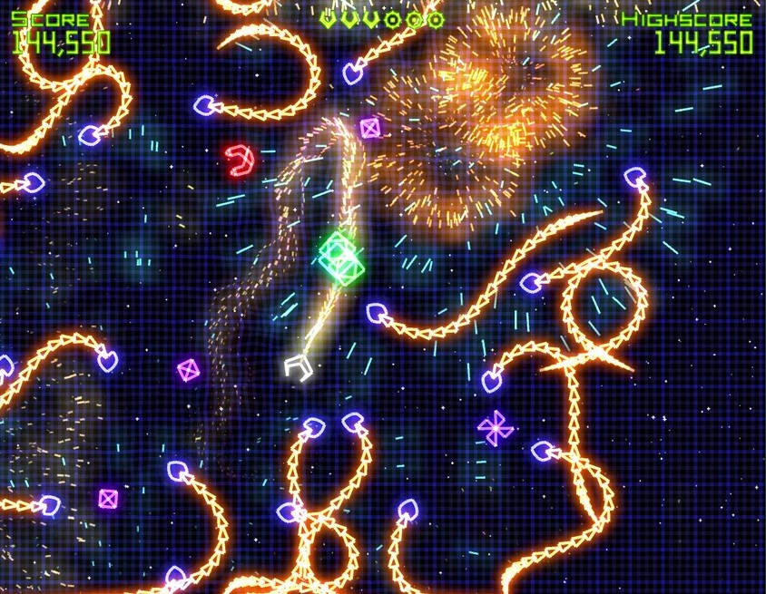

Slide 19
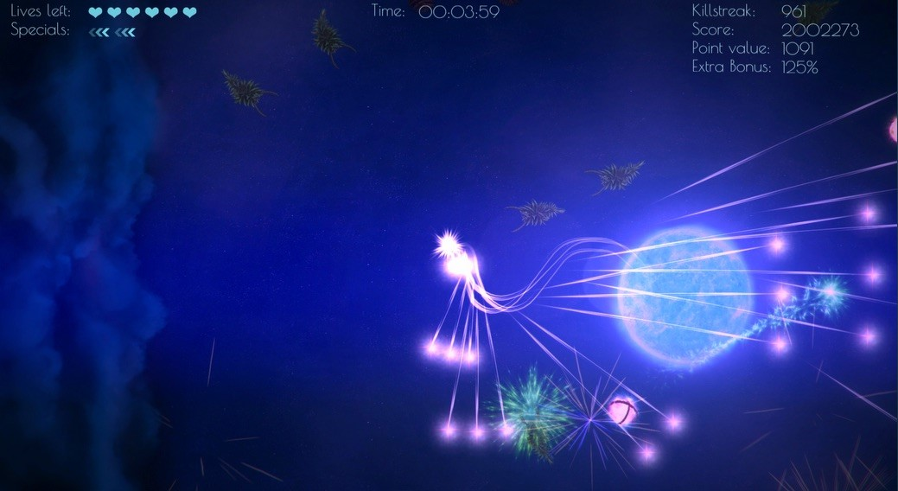

Slide 20
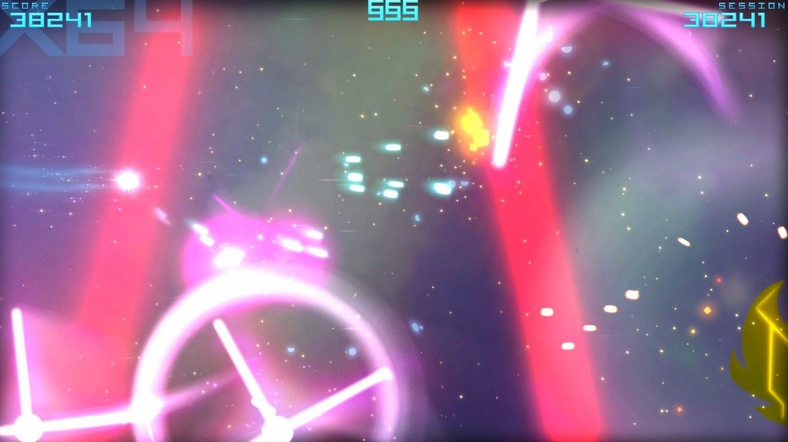

Slide 21
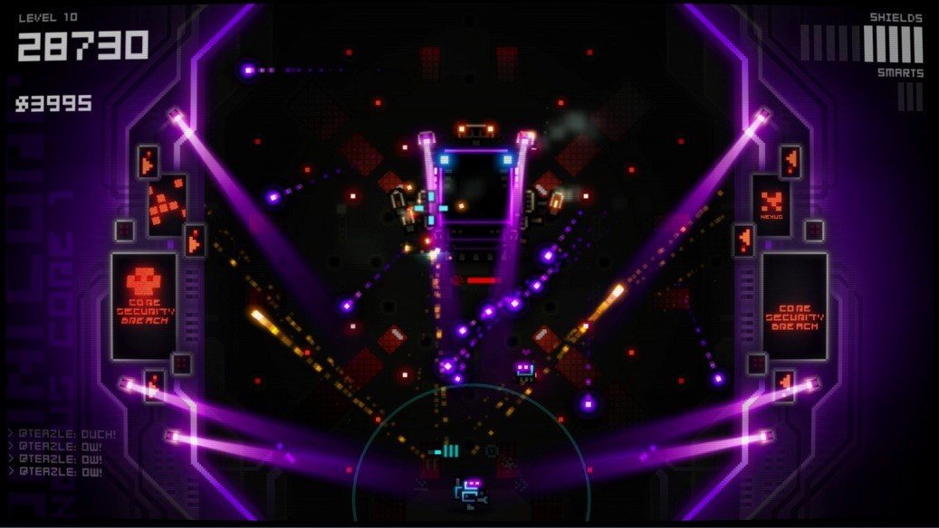

Slide 22
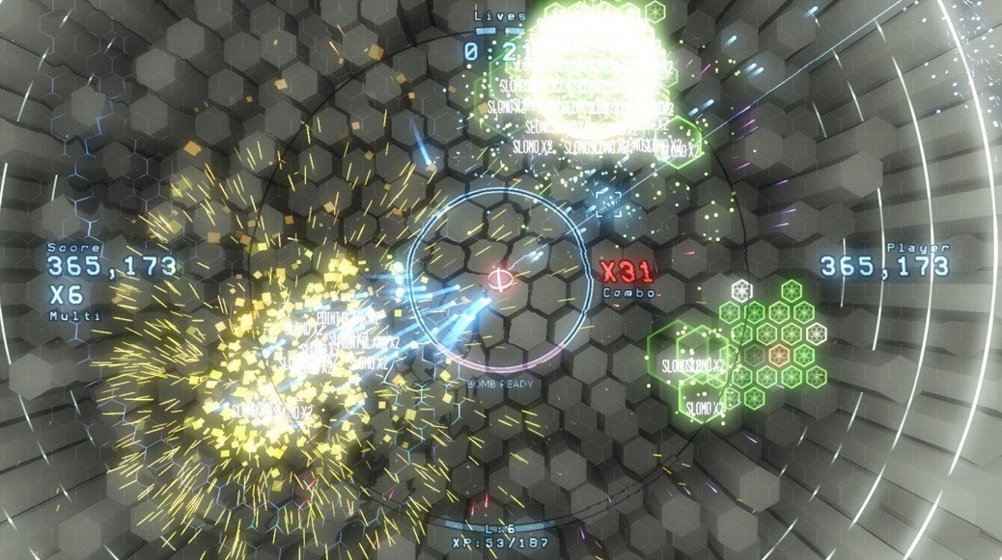

Slide 23
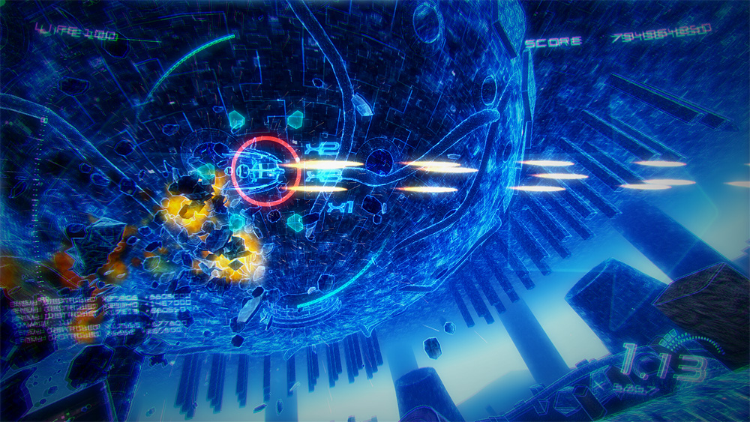

Slide 24
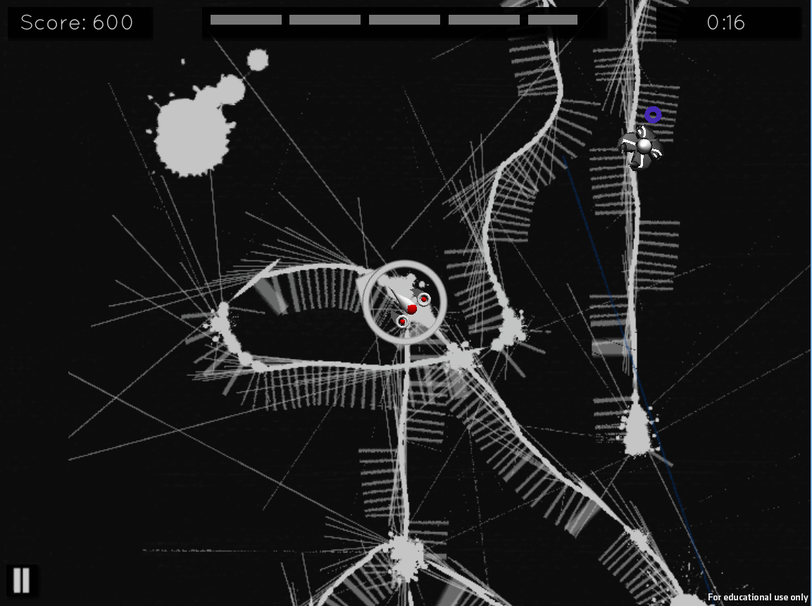
AND THIS WAS US. →

Slide 25
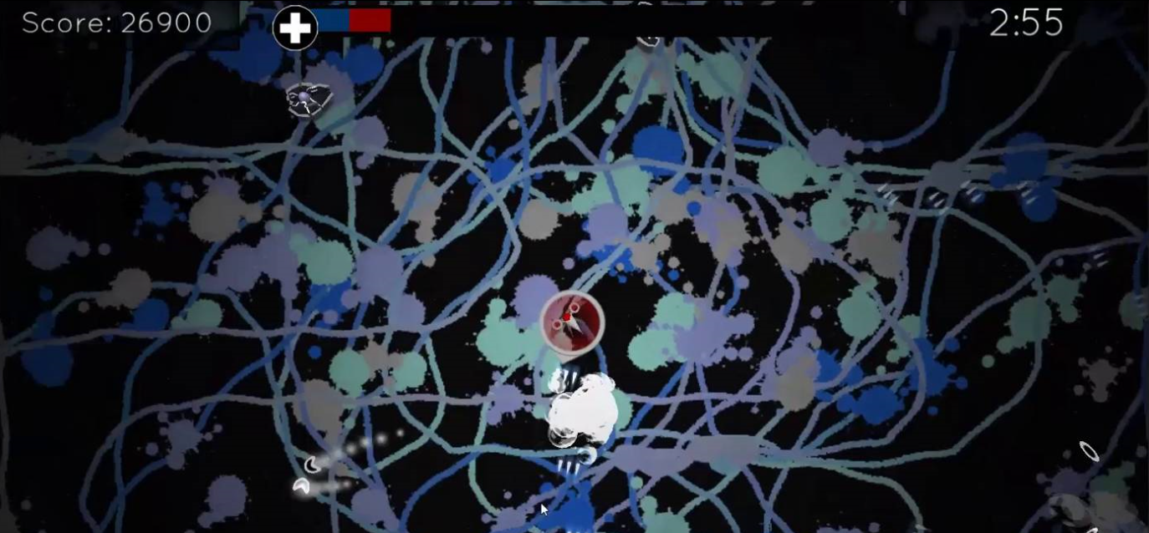
A Student FINAL PROJECT alpha
http://player.vimeo.com/video/112358715

Slide 26
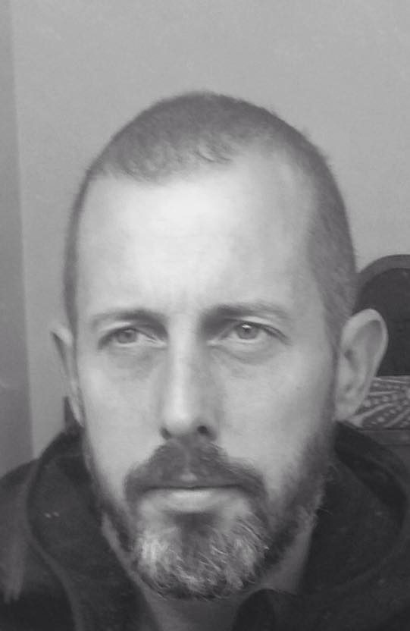
NOT HAPPY, BOB. NOT… HAPPY...
“IF I HEAR THE WORDS ‘GOOD ENOUGH’ ONE MORE TIME, I AM GOING TO THROW A SHOE.” - JENNIFER HINTON, 2014

Slide 27
Emergent roles
Andy became a weird amalgamation of GM, Producer, and Tech
Aaron became an art director
Jenn became a crisis councilor and communications mentor
“I was surprised how I was utilized often, and the “soft” skills that they were lacking and needed coaching through. I spent a lot more time doing this than I did what I thought I was going to do (and was credited for): marketing/pr/brand. If we were to do it again, I would advocate for addressing this in a more meaningful way at the outset and ongoing, collecting feedback in a more ongoing and deliberate way” – JH

Slide 28
8 year olds, dude
Our playtests weren’t formal enough, or “blind” enough
Awesome opportunities from high-profile events, but that skewed perceptions and interactions among the team
Confusion around my role as lead dev vs. magic director vs. course instructor vs. industry liaison
A lot of assumptions about what we would be doing / accepting / promoting / offering

Slide 29

PART II: THE REVISED STORY
“Hey Aaron, Let’s clean this up and make it a product, because it’s a cool idea and we need stuff to get out the door.”
(general confusion ensues)

Slide 30
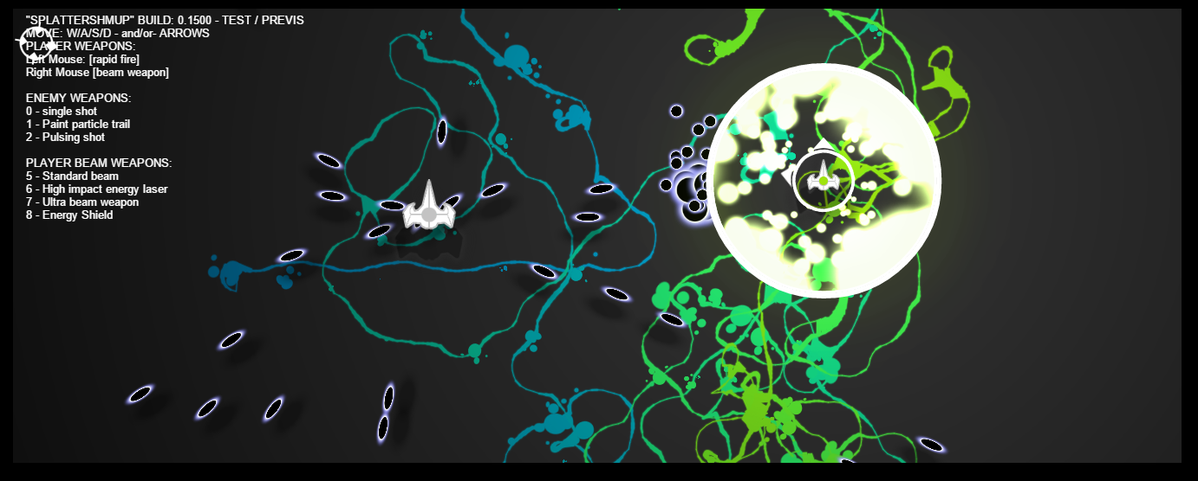
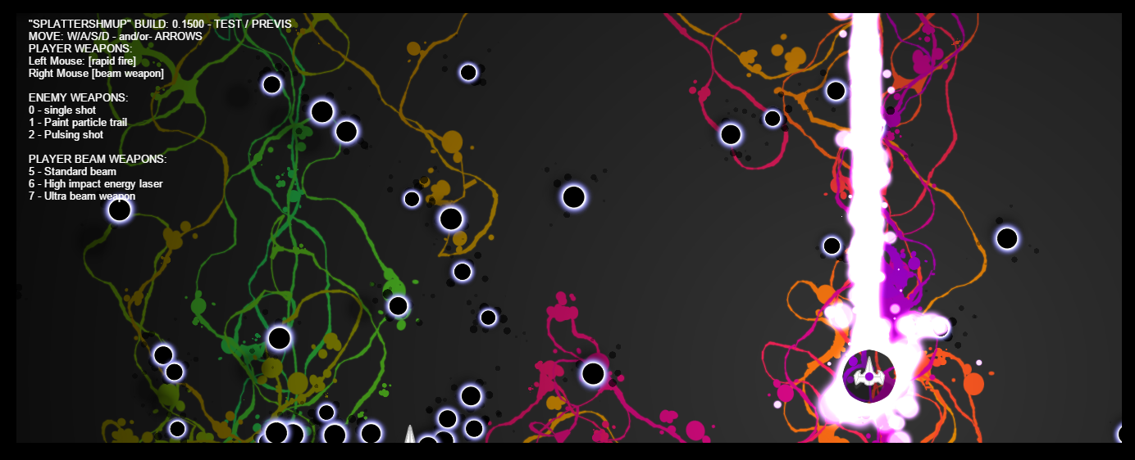
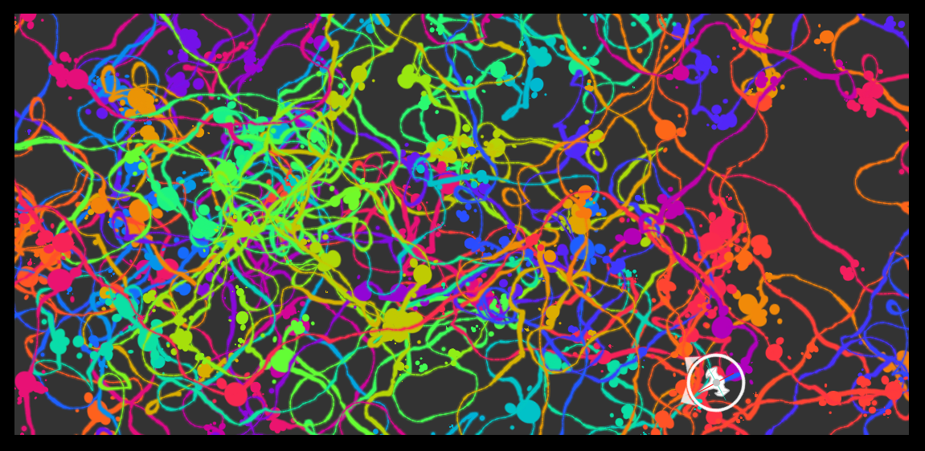
SIMULTANEOUS TECH-TESTS & PRE-VIS

Slide 31
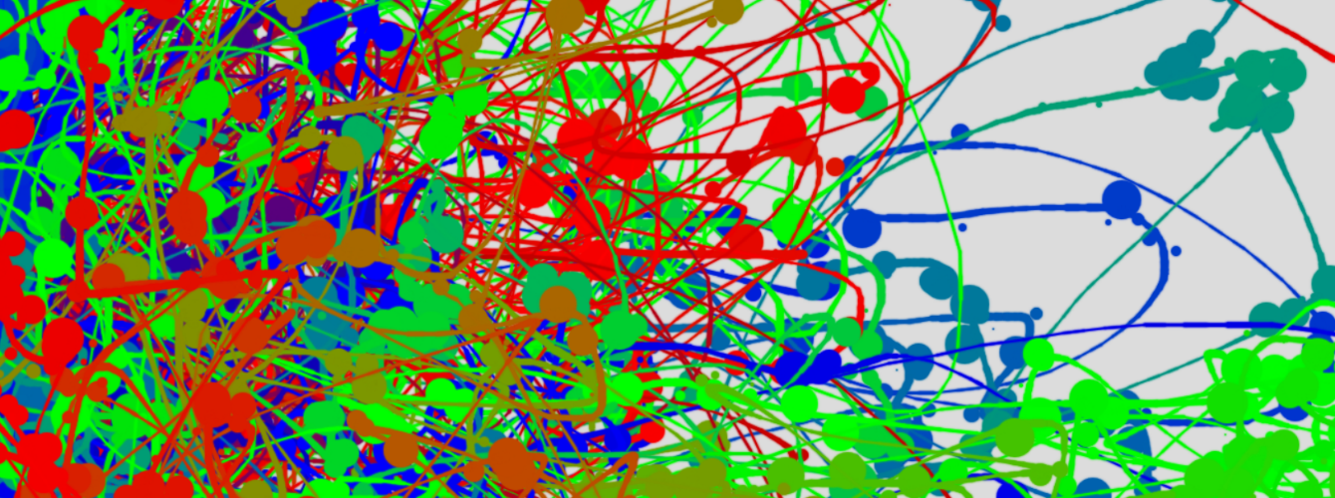
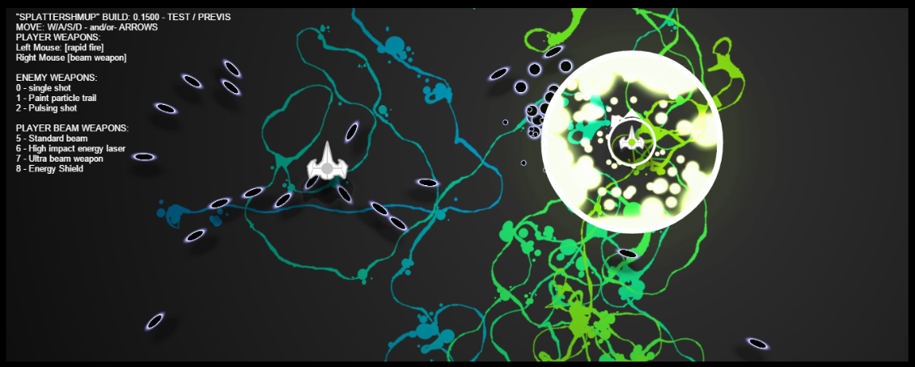
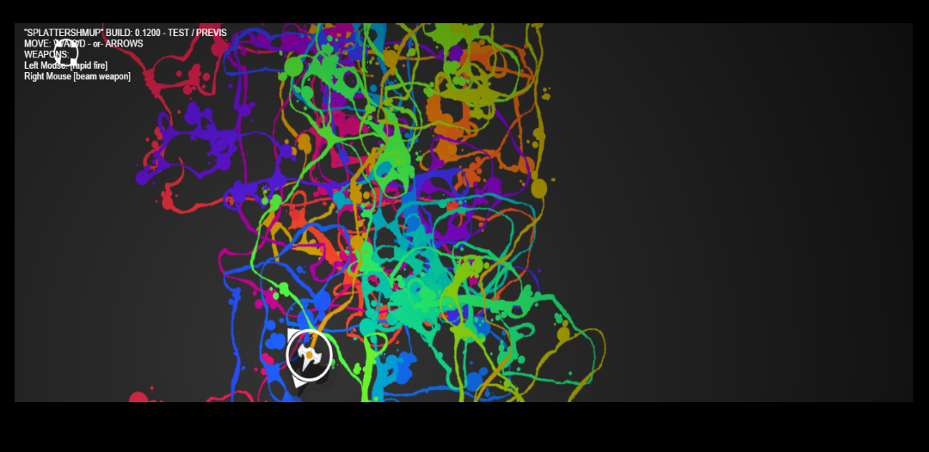
TECH TESTS
Started as a way to test game ideas and feasibility, became a way to communicate expectations and designs
http://igm.rit.edu/~andy/paintr/

Slide 32

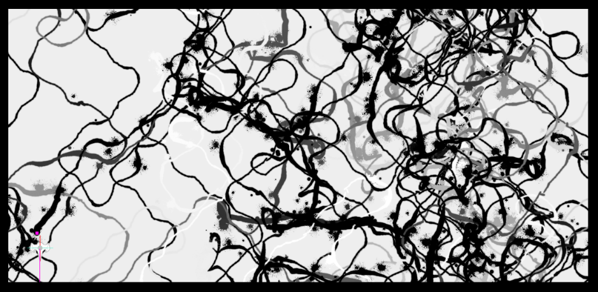
The tech tests became the basis for re-implementation in web tech
made ‘ok’ paintings
color scheme maybe?

Slide 33
Hired some co-ops, BUT MOSTLY OURSELVES
REALLY LIMITED SCOPE
NO ACCESS TO INTERNAL CODE-BASE
INTEGRATE-TEST FOR EVERYTHING THEY MADE
SMALL, DISCRETE TASKS, UNIT TESTS ONLY
  RESULTED IN CORE CODE FOR SHARING (THAT HAD TO BE REWORKED)
  RESULTED IN MIXED SUCCESS ON OTHER TOPICS (‘TOO OPEN ENDED’)

Slide 34
MEANWHILE ANDY & AARON
GRIND! BUILD! ARGGH!
Trading code ON AVERAGE every 90 minutes, sometimes as often as 30 seconds, sometimes as long as 2 days.

Slide 35
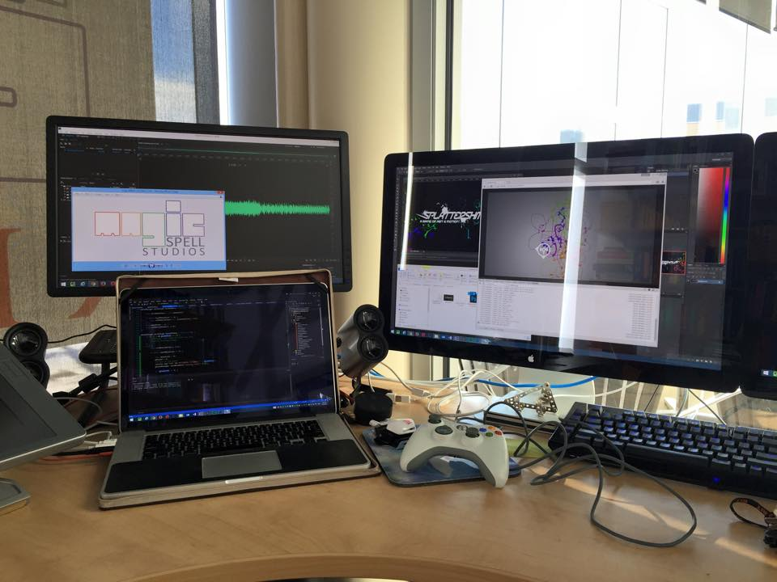
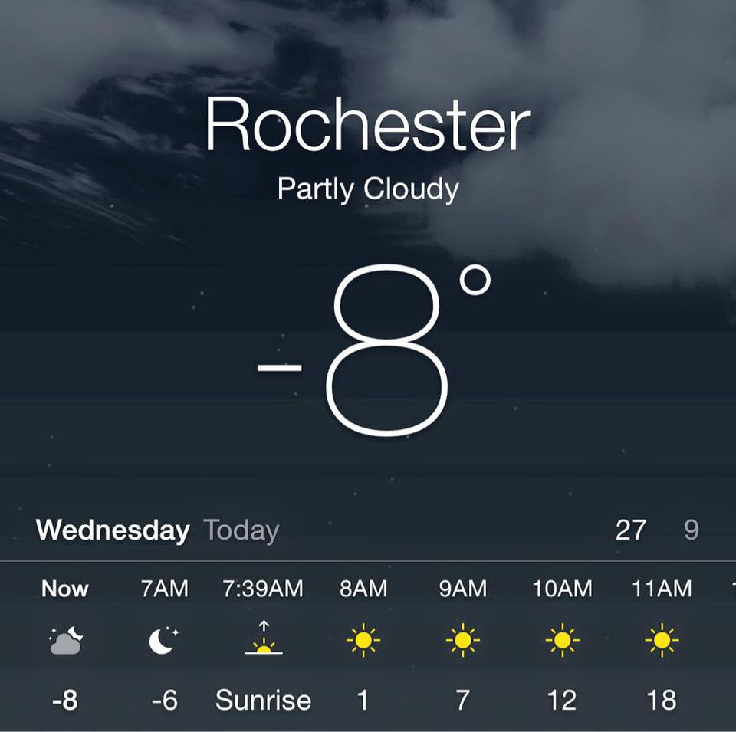
TIRED. GRUMPY.
Every day was work all day, code during lunch. Go home, eat dinner, get kids to bed and work till 3am. Be at work by 7:30. Rinse. Repeat. For the entire dev cycle. +Weekends all code++

Slide 36
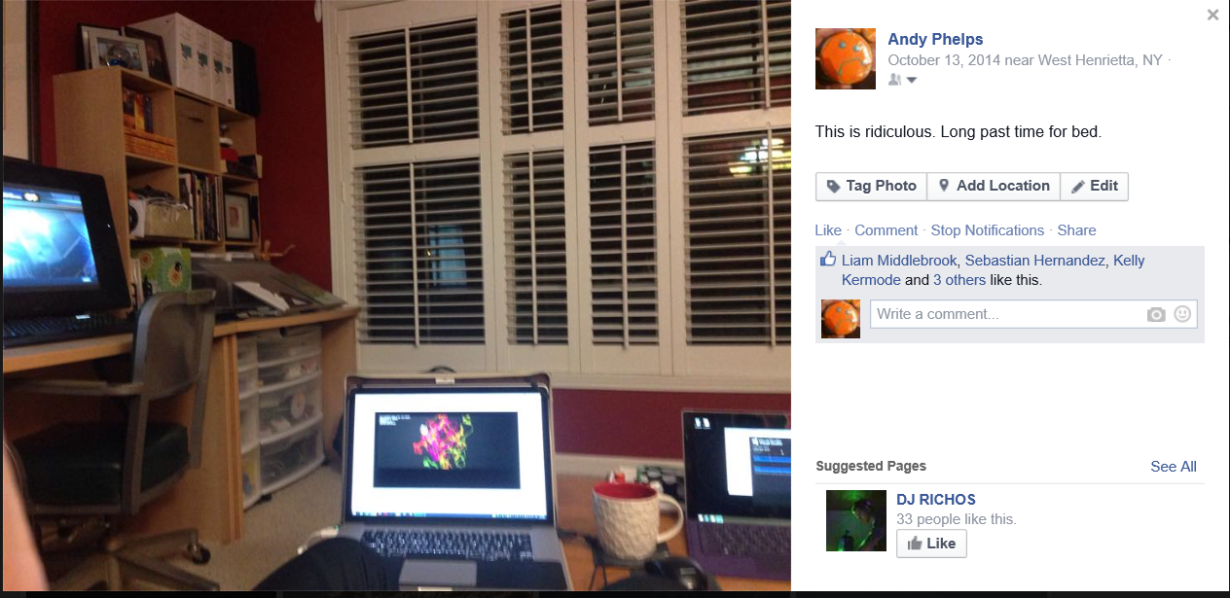

Slide 37
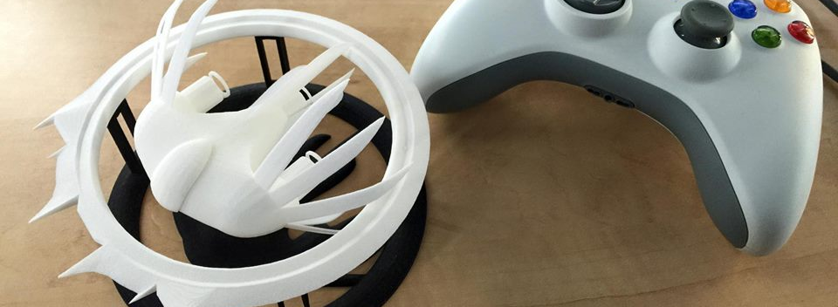
BUT MARCH WAS AWESOME
In the end it felt really good to really MAKE SOMETHING of our own again.
Better late than never. ☺
“This really meant a lot to me, more, even, than I thought it might.” – Aaron Cloutier, sometime in March.

Slide 38
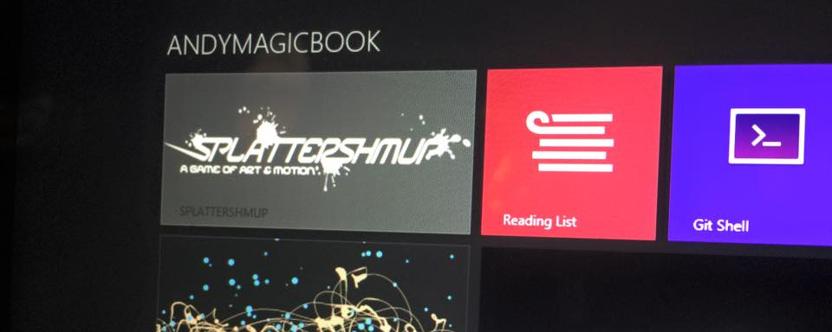
PART III: TECH
We set off to use a “web tech” approach because the promising samples were already written in it, and it seemed like it could cut dev time. Plus, sharing was an important feature.
(general confusion ensues)

Slide 39
JANUARY/FEBRUARY
19,000+ LINES OF JAVASCRIPT, 180+ assets, icons, 1000s of tests
ALL NEW MODELS, TEXTURES, UI, INPUT, ICONS
ALL NEW COLLISION SYSTEM, MISSILE SYSTEM, RENDERING SYSTEM, PAINT SYSTEM, ENEMY AI
MENUS AND CORE UI WAS CHRISTMAS BREAK / INTERSESSION
SHARING & SAVING WAS ONGOING NIGHTMARE
BUT WE KEPT THE MUSIC AND REALLY TRIED TO HONOR THE CORE GAMEPLAY IDEAS FROM THE CLASS

Slide 40
Libraries and Add-ons
THREE.js
  copyShader
  FXAA
  (customshaders galore for masking, blending and clipping)
    EffectComposer !!!!
    MaskPass | Renderpass | ShaderPass | TexturePass
    A ton of custom shaders for various overlays, masks, and effects
Sound.js
Preload.js
CanvasToBlob.js (polyfill)
Gamepad.js (deprecated and unused, but started with)

Slide 41



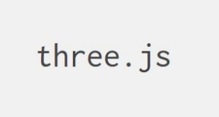

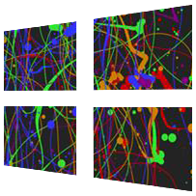




SOURCE & COMPILE TARGETS
+
+
+

Slide 42
SURPRISES
WEB GL PERFORMANCE ON FIREFOX IS POOR. LIKE IMPOSSIBLE.
ANY PERFORMANCE ON SAFARI IS POOR (but better on mobile???!?!? What in the @#)($*)(??).
So we built some tech that runs on the ‘higher end’ of JS/GL implementations, but would not yet be a good candidate for mobile. Which seems pretty typical of this space right now.
BUT – we were going for a high end feel with a very particular effect (that couldn’t be pre-created / cached)

Slide 43
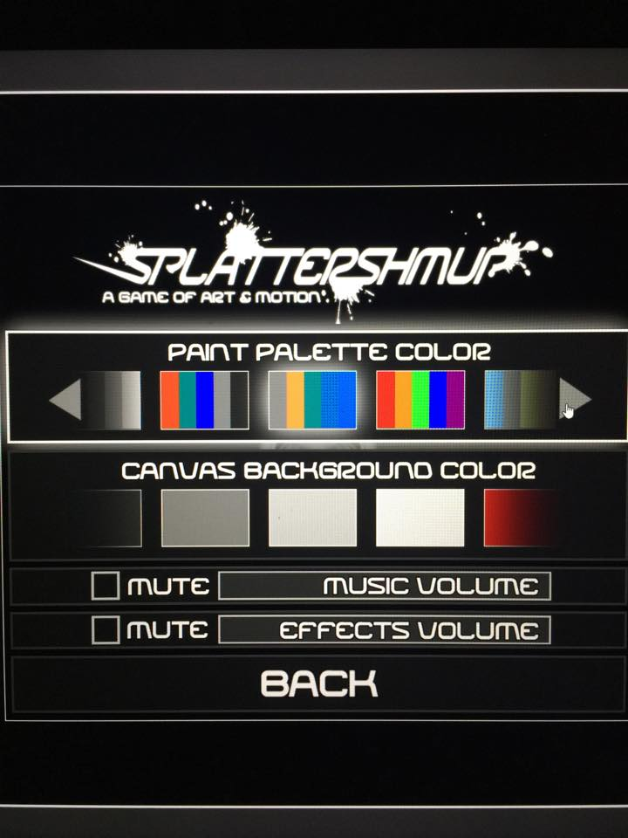
MAJOR PLATFORM INCONSISTENCIES
COORDINATE SYSTEMS AAAAARGH!
Build & Packaging Process, different everywhere
CSS/JS Does Not Like Game Interfaces, !draggable, !ada, !touch
Dealing with local files, sandboxing, and shenanigans
Dealing with images as streams or blobs or binary, UNDOCUMENTED SIZE LIMITS in toDataURL()
Dealing with @#)$() FACEBOOK

Slide 44
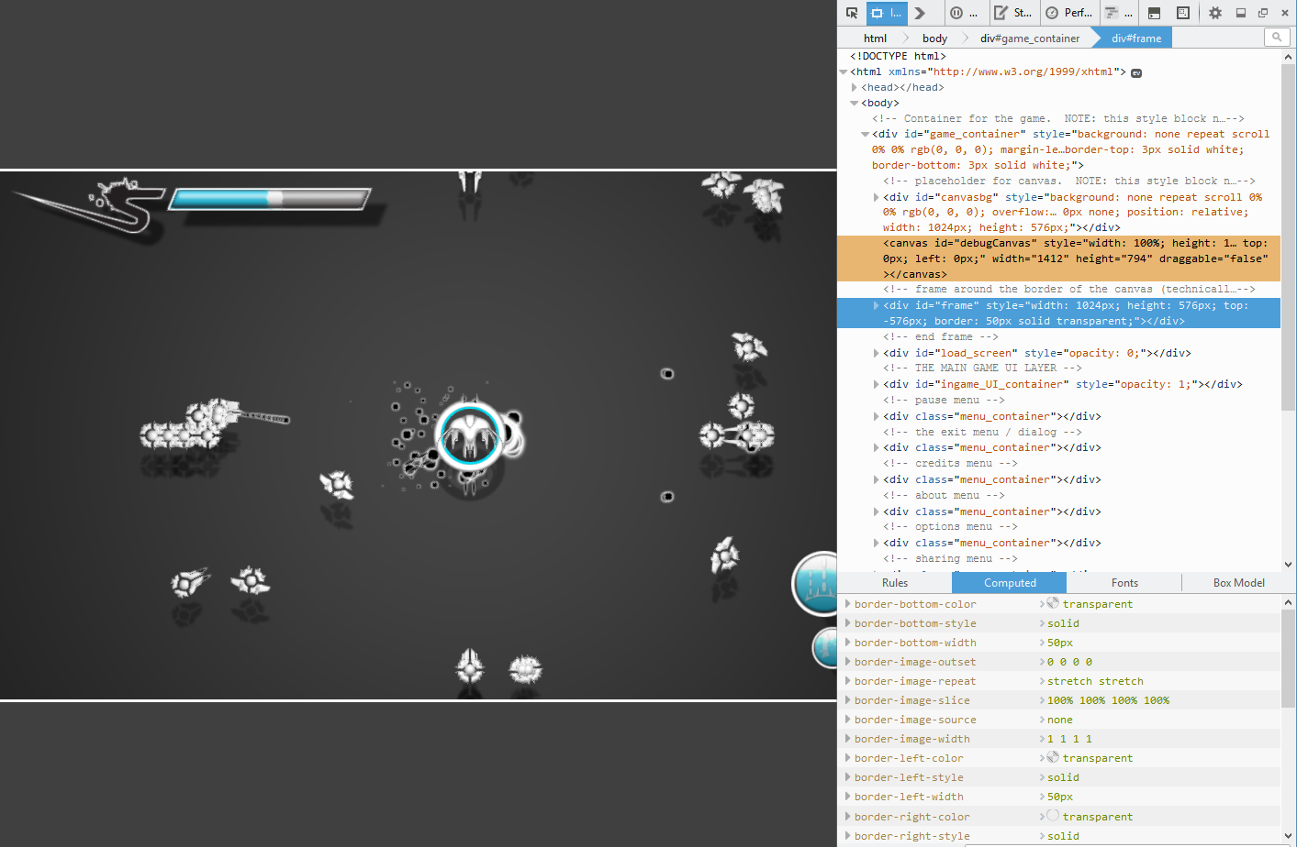
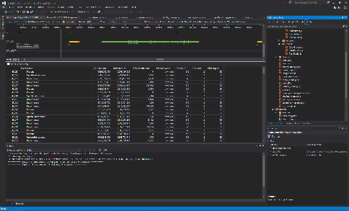
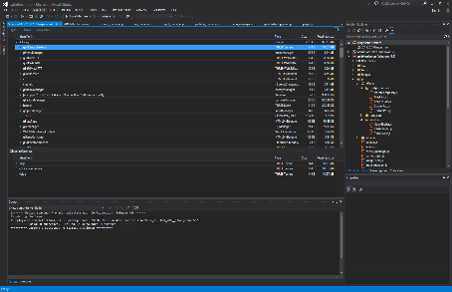
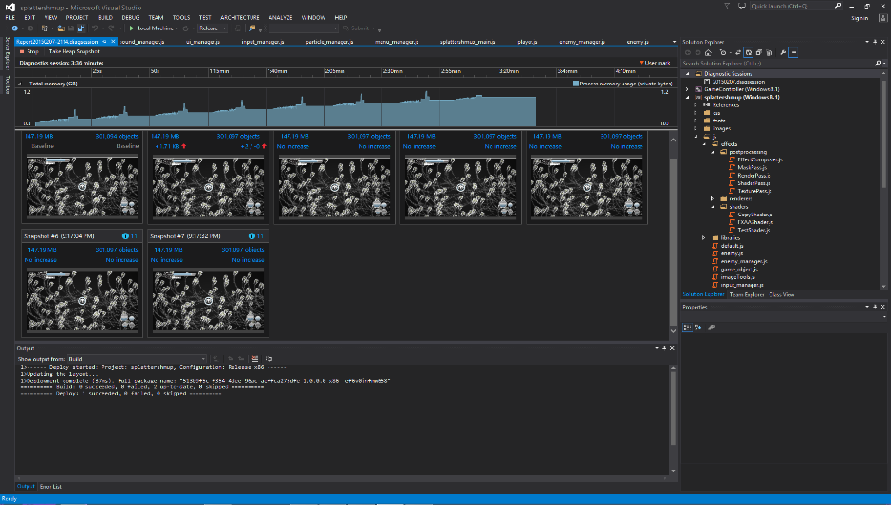
WRITE ONCE, DEBUG *EVERYWHERE* (JUST LIKE 2002! YAY!)

Slide 45
JAVASCRIPT
Is a really, REALLY stupid language to make a game in. There, I said it. And Aaron agrees.
  Typeless
  Artless
  Relatively easy to screw up
  Relatively easy to screw up in such a way you can’t easily debug
  “string centric” ish ( YOU CAN Concatenate Anything! Yay! Oh.)
But it is quick to develop, debug and deploy!

Slide 46
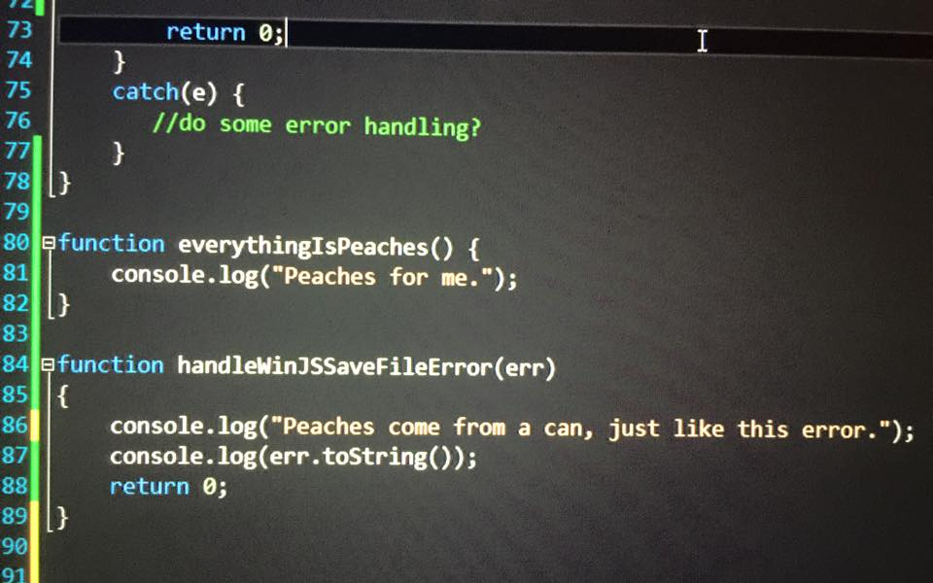

Slide 47
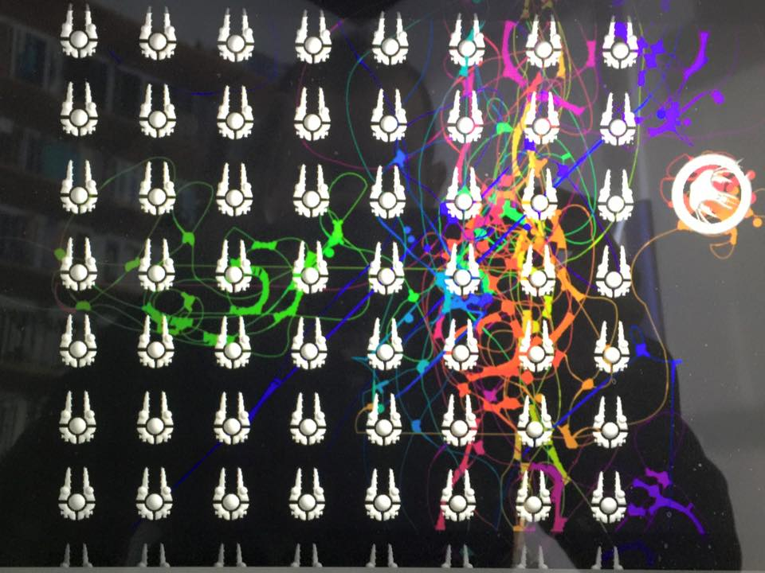
PERFORMANCE CONCERNS

Slide 48
We “squeezed” this, but DIDN’T really SQUEEZE hard
We optimized on particle drawing in a single call, in a single loop
  And that really junked up other parts of the engine (bad)
  But it made the one part we used a lot really fast (good)
We optimized our models WAY down, and then cut them in half.
Biggest current bottleneck is “painting” but… well… er…
Collisions were another annoyance, in the future would use an asm library or pre-compiled solution. We thought converting to screen space would be cheaper, but it wasn’t.

Slide 49
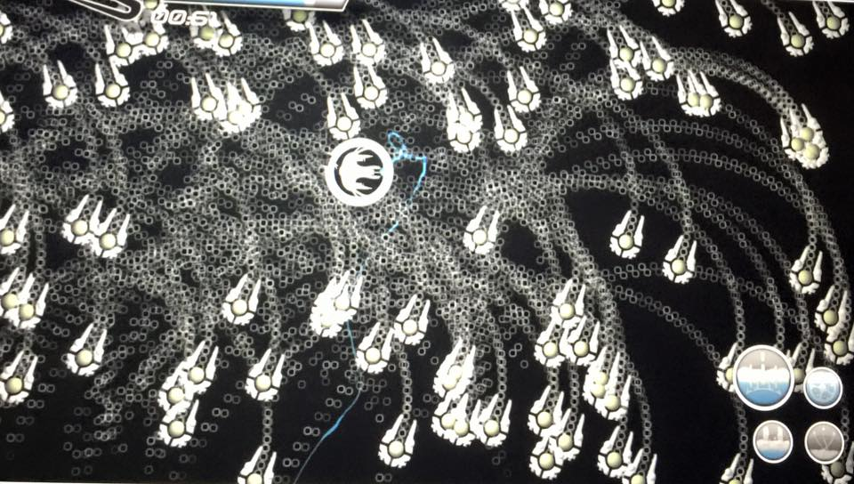
PRE-COLLISION, ☺ POST COLLISION ☹

Slide 50
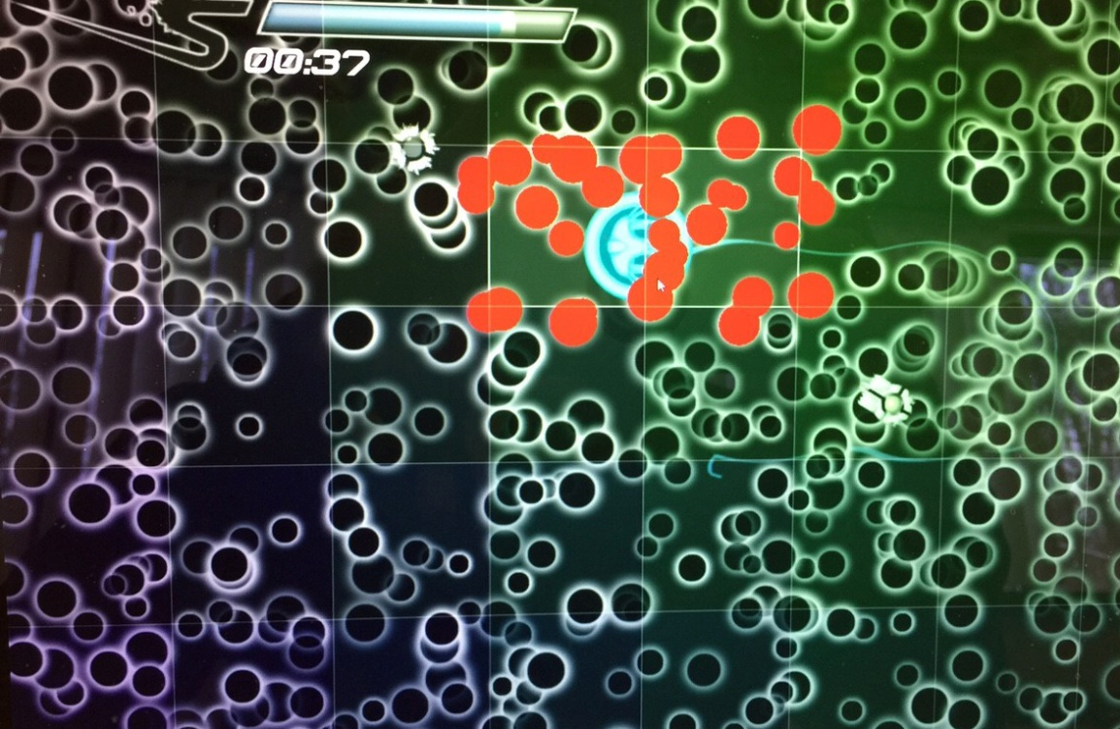
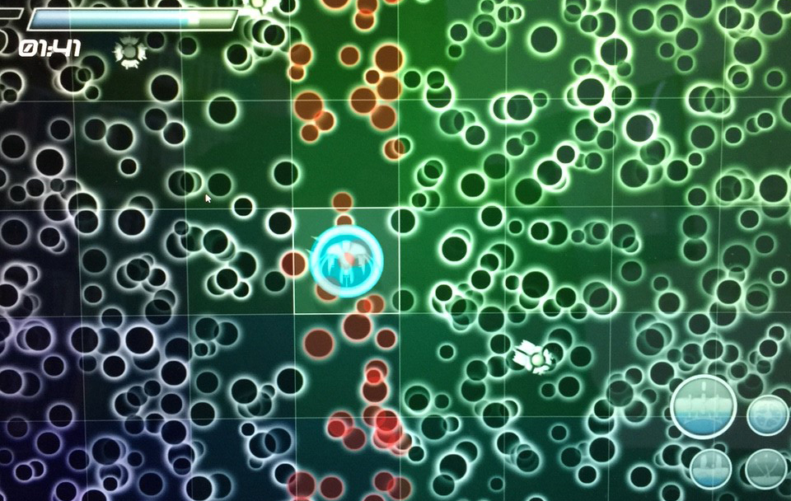
“OOF” GOES THE MATH LIBRARY

Slide 51
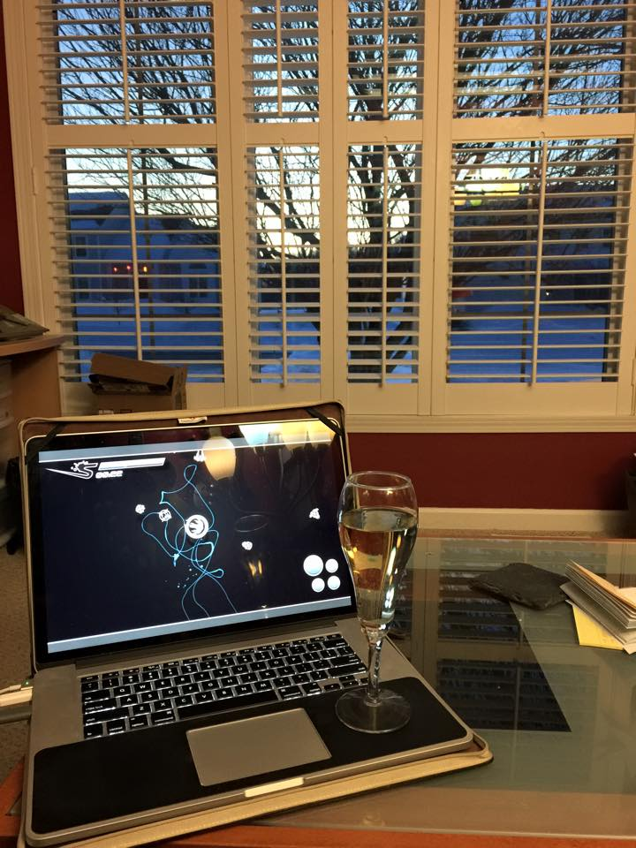
PART IV: SUCCESS
(and YET MORE general confusion)

Slide 52

TEN MINUTES

Slide 53
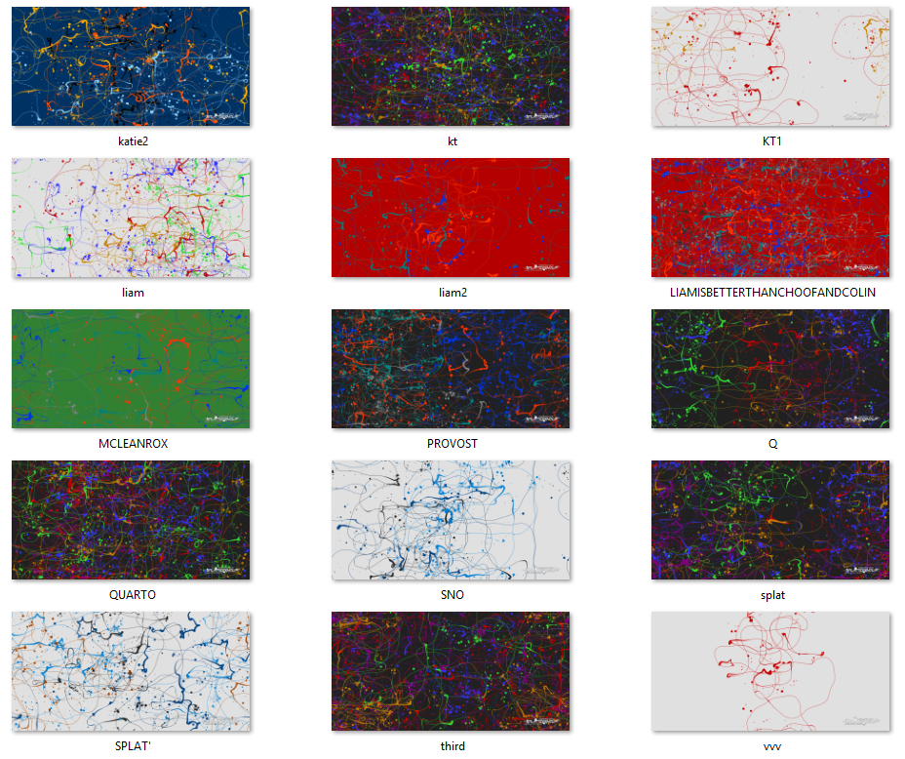
AND SOME REALLY GREAT PIECES

Slide 54

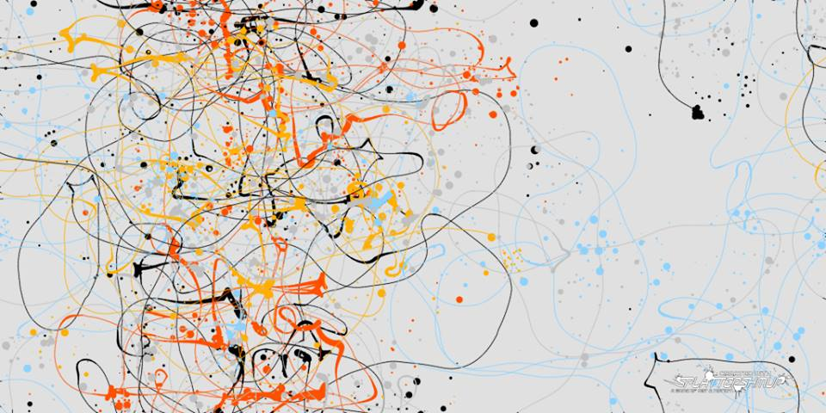
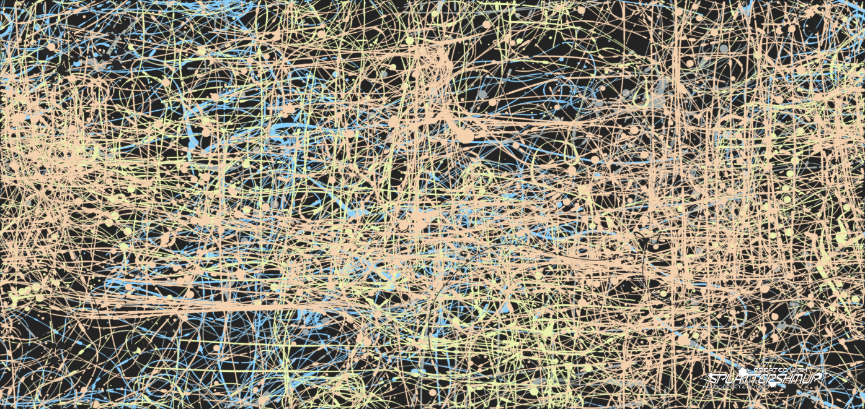

Slide 55
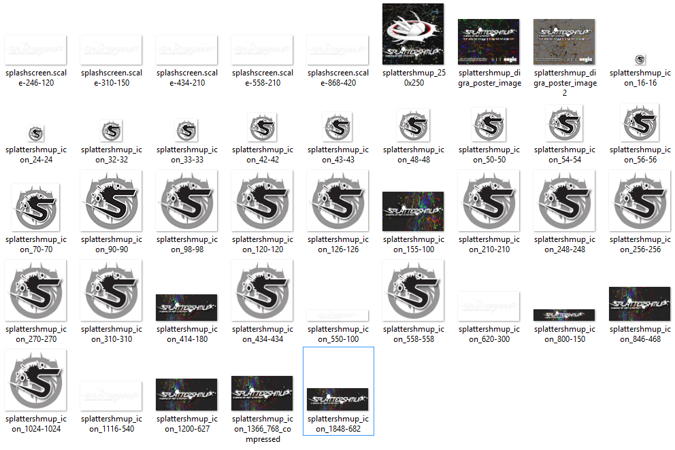
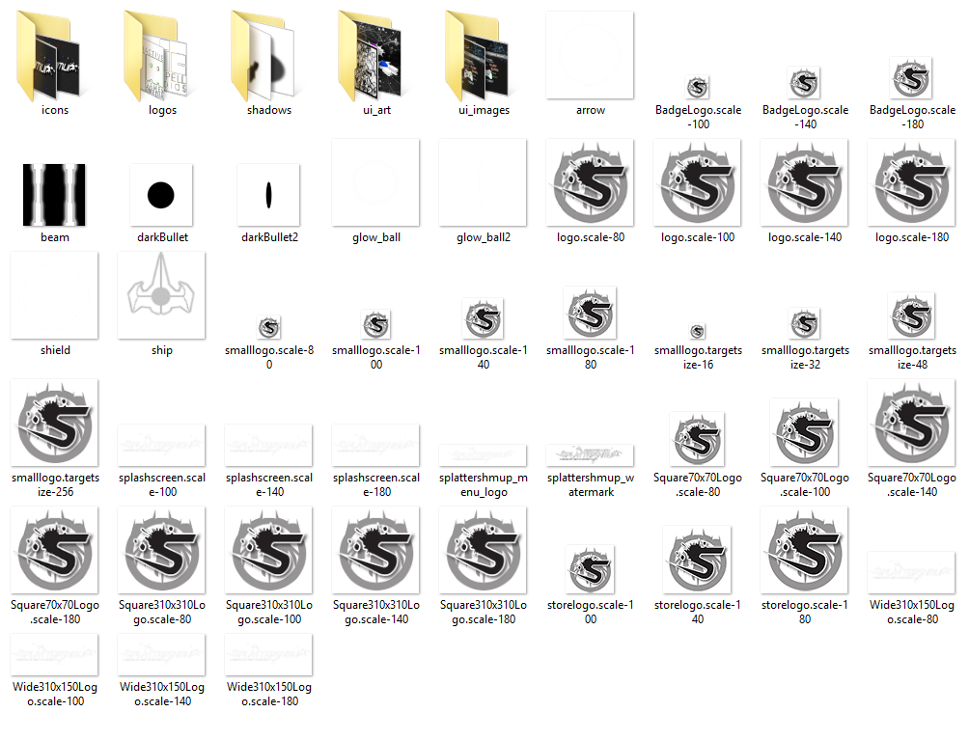
We really “DID” production
And students learned from it, even if some of it was after the fact
Everyone on the team has approached me with the “I get it now” speech
Even at the VALVE party ☺
And MAGIC Spell Studios also learned…

Slide 56
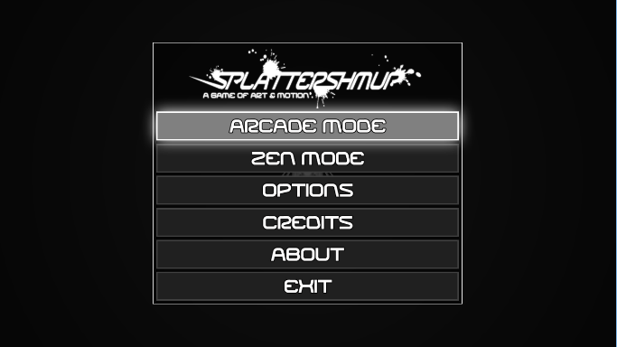
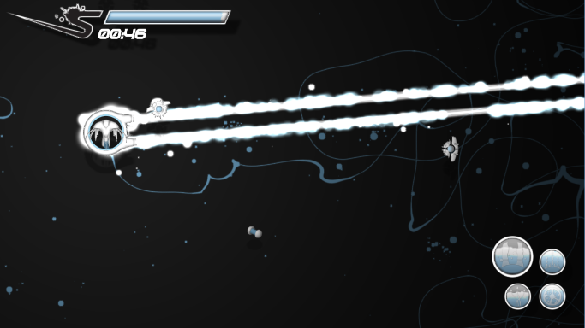
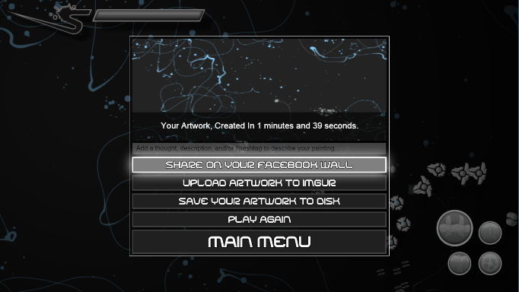
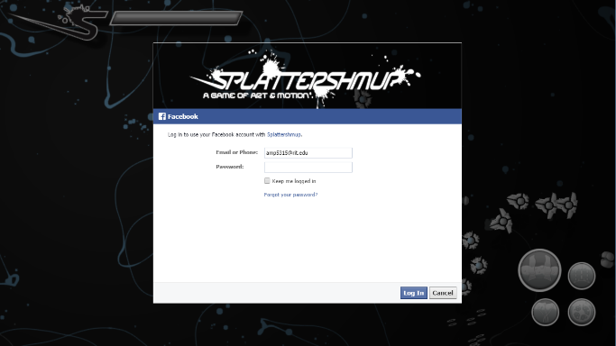


PRODUCTION A LA FACEBOOK

Slide 57




PRODUCTION A LA MICROSOFT

Slide 58


PRODUCTION A LA MAGIC SPELL STUDIOS

Slide 59

UNS, ACCOUNTING, LEGAL, SRS, ETC. ARE ALL CONFUSED, BUT (FINALLY) EXCITED

Slide 60

PART V: LESSONS LEARNED
(WITH LIKELY FURTHER confusion)

Slide 61
STUDENTS NEED MORE AND VARIED PRODUCTION EXPERIENCE
Need to stop separating “their work” from “industry work” or “professional work” and see themselves as developing into professionals from the minute they start every project.
Need to incorporate more design into our development activities – not just separate out on mechanics but integrate in *active video games* and the messy details.
Need to think of EVERYTHING as public, portfolio driven activity
Need to establish a culture where they can building things *with us* not *for us* in all cases.

Slide 62
WEB TECH IS INTERESTING
Web GL is a massively reduced feature set, but still functional for the right kind of experiences
Most of the libraries are still emerging and not really optimized for games (yet)
Most of what is out there now are demos and little toys, and there aren’t great tools to build big content (yet)
The graphics tools (WEB GL, Canvas) far outpace the sound and streaming libraries (and this is a problem)
The web is ‘growing into’ a core gaming platform
Lots of success building and packaging native apps

Slide 63
MAGIC SPELL STUDIOS
Is an interesting experiment for the university
Was successful in all 3 cases thus far of helping students, students and faculty, and faculty create and ship interactive media commercially.
Could really benefit from some R&D relationships with our partners in the area as things are changing REALLY FAST
Need to figure out how to make this sustainable, (if we feel it isn’t already.)

Slide 64

DO IT ALL AGAIN
[project x] coming spring 2016…

Slide 65




Thanks & Questions

